Slide 1
What all NGIs need to do: Helpdesk / User Support
Torsten Antoni
KIT - Karlsruhe Institute of Technology
antoni@kit.edu

Slide 2
Regional Support with central coordination
NGIs
ROC C
RC A
ROC B
VO Support
C
RC A
ROC N
VO Support
B
RC A
VO Support
A
RC B
RC B
RC B
RC C
RC C
RC C
NGIs
VO TPM C
ROC C
ROC B
ROC N
VO TPM B
VO TPM A
CIC
Portal
GGUS
Central
System
COD
Deployment
support
Middleware
support
Deployment
support
Network Support
TPM
Network Support
ENOC/OPN
Middleware
support
Middleware
support
Middleware
support
Other Grids
Other Grids
Other Grids
Middleware
support
Middleware
support
Other Grids
Middleware
support
Other Grids
Other Grids

Slide 3
General workflow
First Line
Support
MW Support
Operations
Support
Community and
Applications
Support
Second & Third
Level Support

Slide 4
Workflow for global VOs
GGUS
Auto-
mation
Direct
assignment
Left-overs
Central
First Line
Support
Regional
First Line
Support
Interfaces
Second &
Third Level
Support

Slide 5
Workflow for regional VOs
GGUS
Regional
First Line
Support
Central
First Line
Support
Interfaces
Second &
Third Level
Support
Regional
Second & Third
Level Support

Slide 6
User Support in EGI
TSA1.6 - Helpdesk
The EGI Helpdesk is a distributed infrastructure consisting of a central helpdesk interconnected with a collection of local NGI/EIRO Helpdesks. This provides a regional support system with central coordination undertaken by EGI.eu. The evolution of this service is under the responsibility of the User Services Advisory Group (USAG).
The central instance provides access to a ticketing system that allows for the bi-directional exchange of tickets with the remote NGI Helpdesks to ensure that tickets opened centrally are handled by the appropriate support team. For example, those opened locally can be passed to the central instance or other areas, while user and operational problem tickets can be opened centrally and subsequently routed to the NGI local support infrastructures.

Slide 7
What all NGIs need to do
Helpdesk
Provide NGI helpdesk
Interface NGI helpdesk to GGUS
Via Web Services
Via Messaging
Documentation on interfaces is available at
https://gus.fzk.de/pages/docu.php
The NGI integration process will also be discussed at the OTAG meeting on Wednesday
A document describing the process will be available soon

Slide 8
What all NGIs need to do
Regionalised GGUS
Alternative to running NGI helpdesk
Simplified GGUS instance
Maintained at KIT with desired URL
Synchronisation with GGUS for non-regional problems
Integrated news module for announcement of maintenances, events etc.
Javascript enabling is mandatory
Development covered by TJRA1.2.2
Resources for customisation and operation come from NGI part of TSA1.6

Slide 9
What all NGIs need to do
Regionalised GGUS
NGI has to provide
list of regional support units with email addresses (mailing lists)
list of problem types (default list given)
1st line support
Hostname
Website banner 940x100-130 px
User/support staff administration via integrated user admin tool
Support unit list administration via integrated tool
Problem type list administration via integrated tool
Start date of prototype NGI-DE: May 1st.

Slide 10
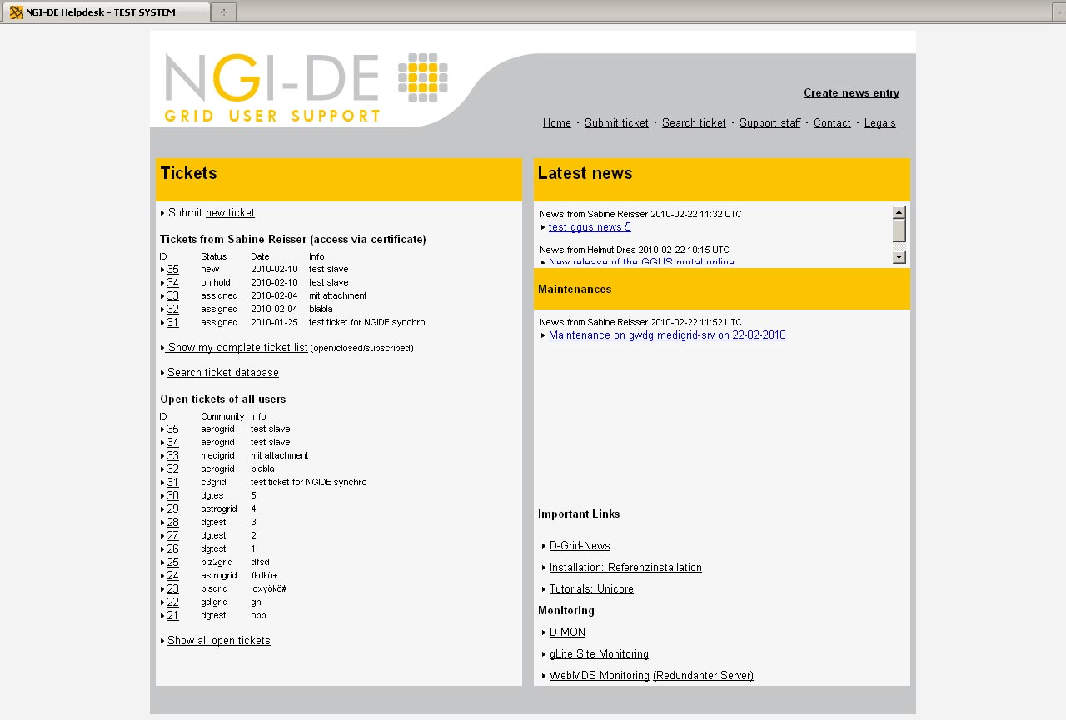
Example of regionalised GGUS
Transition to EGI, OTAG meeting Amsterdam, 3rd of March 2010
10
Notes:
10

Slide 11
User Support in EGI
TSA1.7 – Support Teams
This task supports the Ticket Triage teams within EGI.eu and the teams carrying out the user support work within the NGI. The Ticket Triage team (or Ticket Processing Management – TPM) is responsible for the monitoring and routing of all active tickets in the Grid user support system to the appropriate second-line specialized support units. These support units will be in the operational tasks, in other activities, or other projects like the VRCs. In the NGIs, the teams support their local users of international VOs.

Slide 12
User Support in EGI
TSA1.7 – Support Teams
At the core of the Operational Support Teams‘ work is the monitoring and support of the sites through a ticketing system which will contain issues raised as a result of the monitoring system, VOs, users and system administrators. This ensures that the International VOs get the services agreed through EGI. The practical work includes:
Monitoring and help desk shifts
Triage of incoming problems, assignment of tickets to the 2nd line support units, ticket escalation, ticket follow-up, suspension of sites if needed, etc.
Certification of the sites entering the NGI Grid and thus in the EGI Grid, with the rules agreed with EGI, according to the site category and SLD.
The interface with the NREN is specifically required for troubleshooting of connectivity problems, test for advancement in technologies etc.
Maintenance of web pages for FAQ, best practices etc.
Operation of a ticketing system integrated with the EGI Helpdesk
The bulk of the work is done by NGIs using their own monitoring infrastructure for their own sites and users but there is a central role in coordination so that the international VOs receive the same level of service and cross-border issues are resolved.

Slide 13
What all NGIs need to do
Support Teams
Provide national first line support
React to user tickets assigned through GGUS
React to operations tickets assigned through GGUS
Project-wide SLAs apply
National support units covering all relevant areas
Sites
Tools / Services
…
Strong links to:
GOCDB
Monitoring
Operations Dashboard

