Slide 1
Open Science Grid Operational (Interoperational) Tools Rob Quick OSG Operations Area Coordinator Manager High Throughput Computing Indiana University

Slide 2
Agenda
OSG Operations Services
OSG Shared Topology DB (OIM)
RSV Monitoring and SAM
The Original Ticket Exchange
MyOSG
Evolution of OSG/WLCG/EGI Interoperations

Slide 3
Open Science Grid
“The Open Science Grid (OSG) advances science through open distributed computing. The OSG is a multi-disciplinary partnership
to federate local, regional, community and national Cyberinfrastructures to meet the needs of research and academic communities at all scales.”

Slide 4
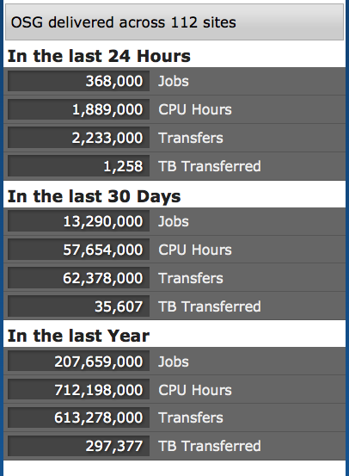
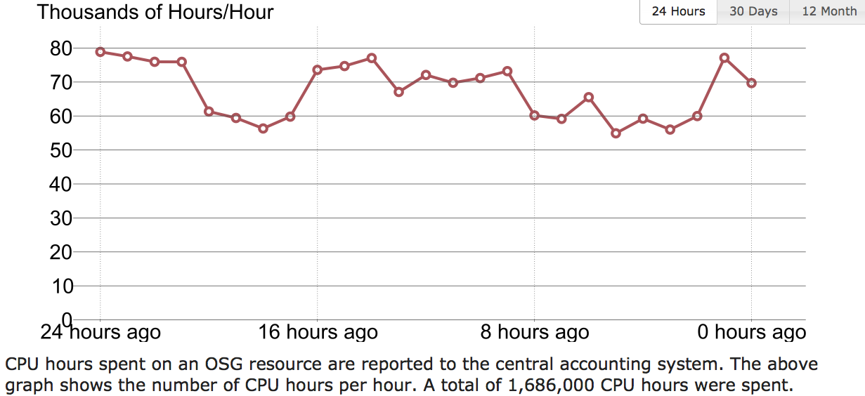
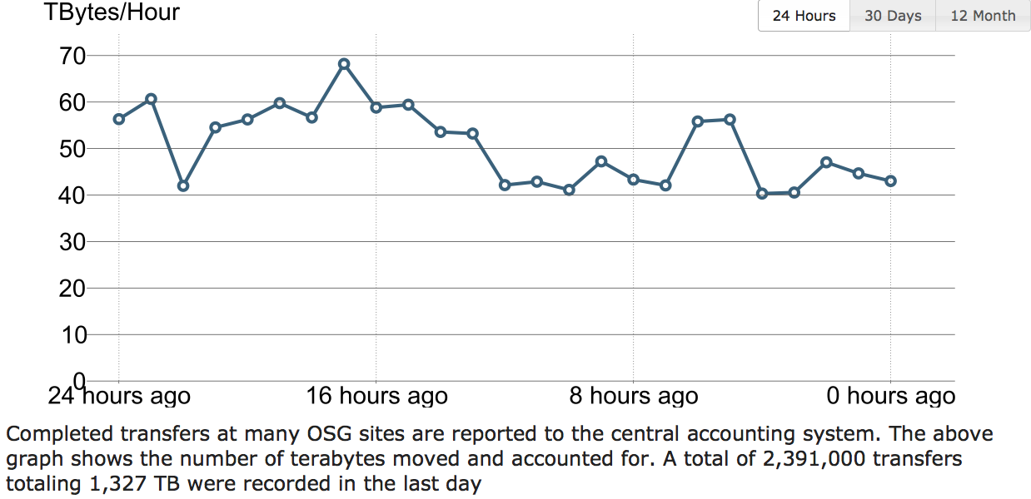
Aug 29, 2012

Slide 5
OSG Operations Tools
Includes all OSG infrastructure services
OIM Topology and Contact DB
Glide-In WMS Factories
BDII Information Service
RSV Monitoring
Gratia Accounting
OSG Ticket
MyOSG Presentation
Operational Notification Environment
TWiki, Software Cache, DocDB, ReSS, etc.
24x7 Support Desk

Slide 6
OIM Topology DB
Registration of People, VOs, Resources, Support Centers, Downtime
Feeds topology to all other services including
Monitoring, Information Systems, Accounting, Ticketing, TWiki, Glide-In Factories
Resource Downtime Entry
Static Accounting Data
New functionality
PKI User Front End
Ties credentials with user registration
New functionality
PKI Administrative Tools
Ties credential requests and approvals to OSG ticketing system

Slide 7
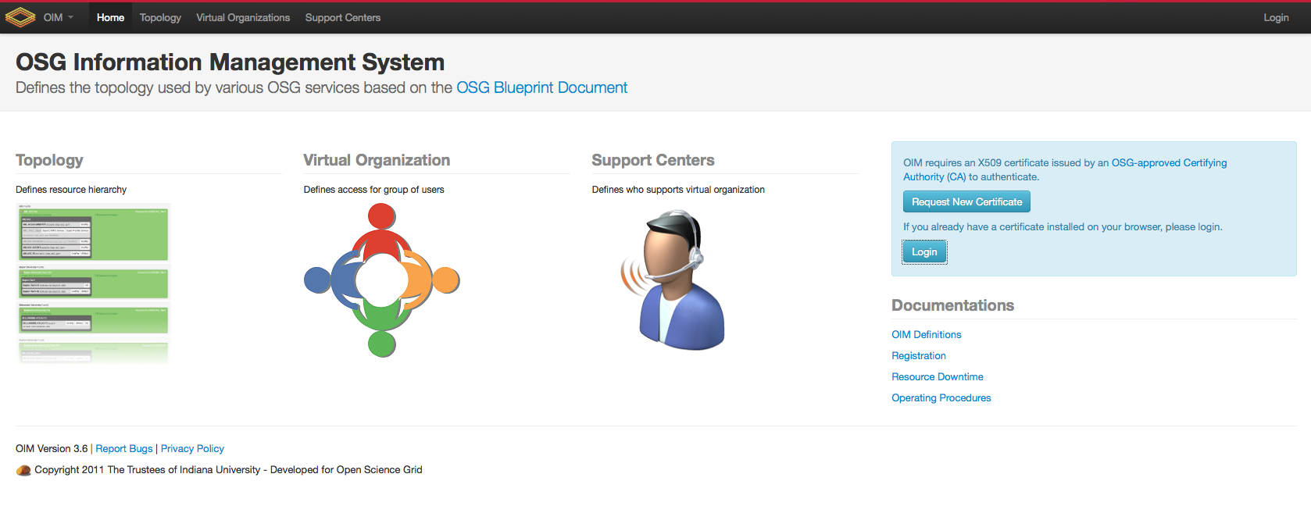
OIM

Slide 8
Monitoring with RSV
All probes run locally and report up to the RSV Collector
Includes resources and operational services
Sent to SAM via messaging
This has been functioning very well
Occasional recalculation requests
No recent changes or updates
Some housekeeping done after the last EGI Technical Forum
Comparison reports will be deprecated soon
Continue to work closely with David Collados and SAM Team

Slide 9
Ticket Exchange
GGUS Ticket Exchange Working Well
Soichi and Guenter are in regular contact
We’ve worked out solid change management procedures
Added FermiGrid Service Now to OSG Exchange
CMS Savannah Problems
Agreement to move to GGUS in the near future
Ticket Exchange with XSEDE is under discussion
EGI Security Ticketing
Should we keep mail procedures or work out a separate exchange with Security RT?

Slide 10
MyOSG
Consolidated Presentation Environment
OIM, RSV, Gratia, BDII
New functionality
Operational Notification Environment
Realtime Event Ticker
RSV Monitoring
Ticket Creation and Updates
Registration of New OIM Entity or Downtime
Certificate Requests and Actions

Slide 11
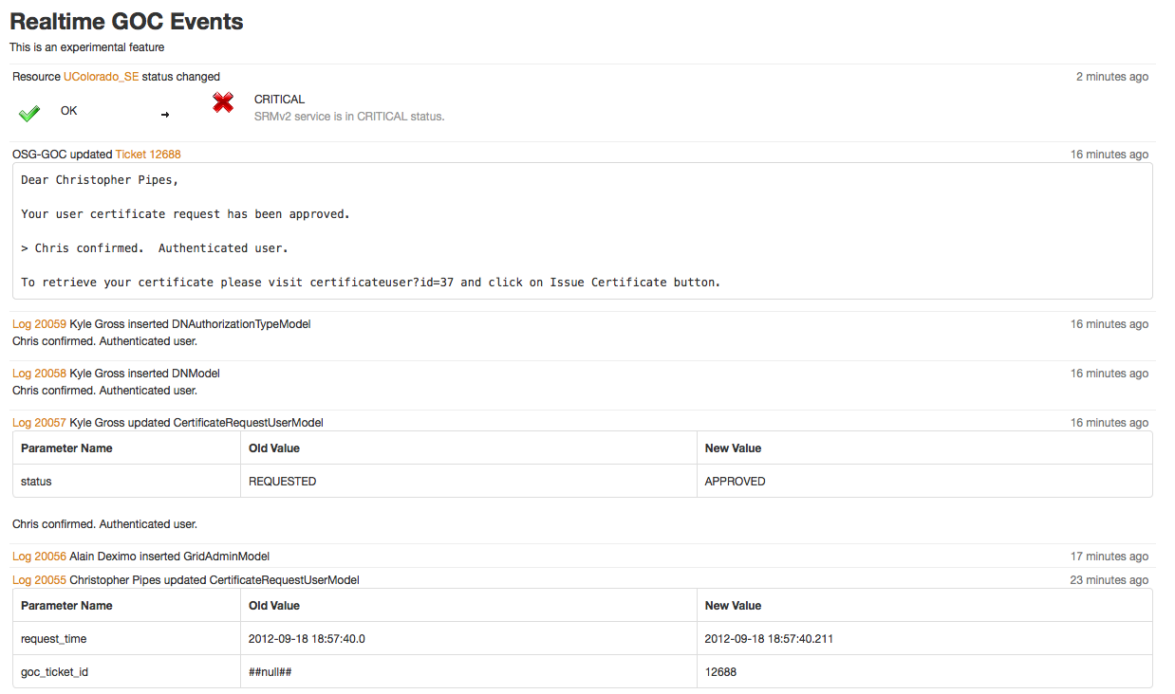
MyOSG Realtime Event Ticker

Slide 12
Maturity of Collaboration
Ticketing
Topology & Monitoring
Information System
Accounting
Security
Are there others?

Slide 13
Questions

