Slide 1




Training Marketplace
Claire Devereux
STFC
claire.devereux@stfc.ac.uk

Slide 2
Where do you go to find training?
Colleagues
Research funders
Commercial providers
National facility
National training courses
Projects
Google
Institution
Online tutorials

Slide 3
Online courses and materials
Training Marketplace
Training events
Resources and infrastructures
Educational courses (PhD, MSc etc)
http://www.egi.eu/services/support/training_marketplace

Slide 4
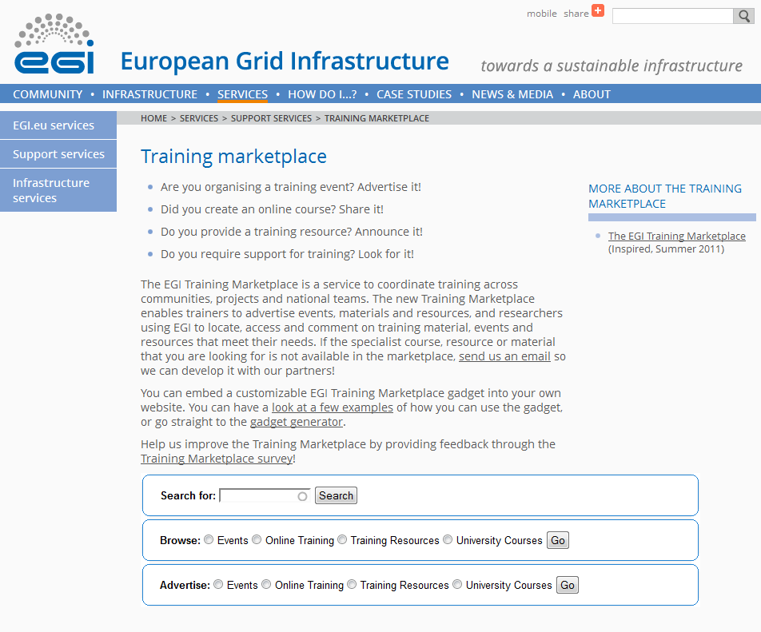
http://www.egi.eu/services/support/training_marketplace

Slide 5
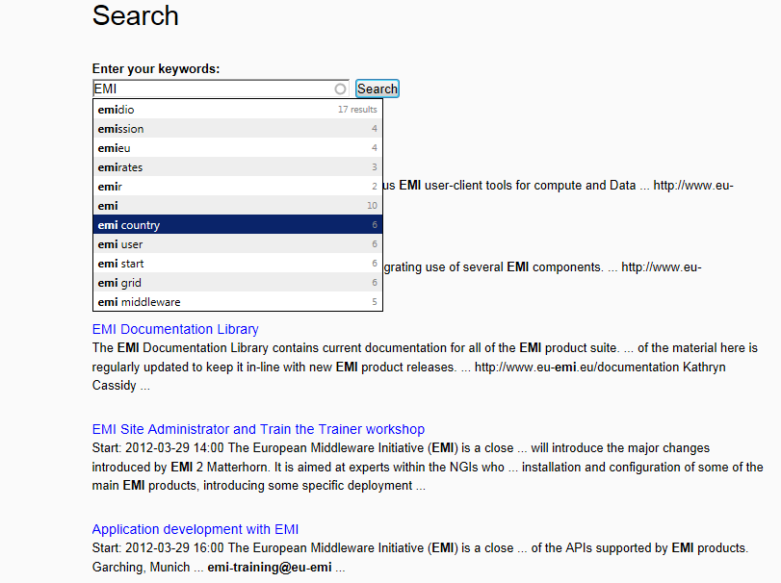
Search
Auto-predicts
Ranks

Slide 6
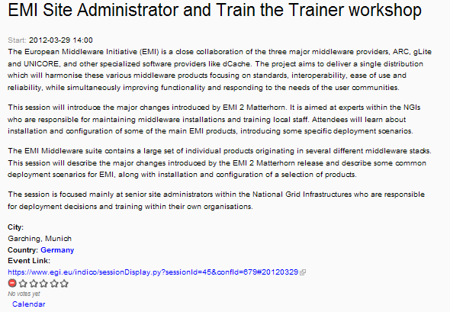
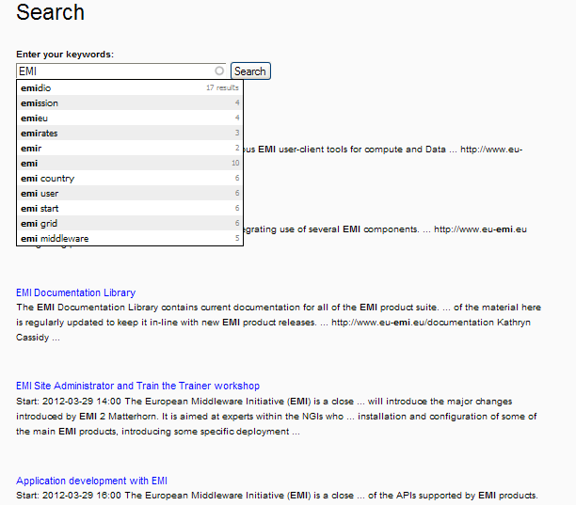
Search

Slide 7
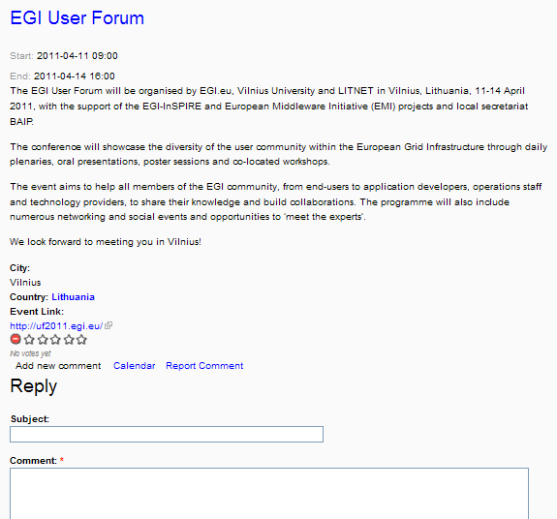
Search
Rate it
Report comment
Comment
Add to calendar

Slide 8
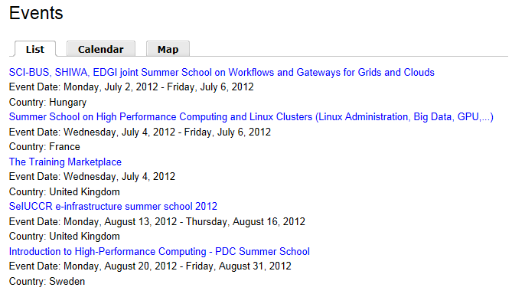
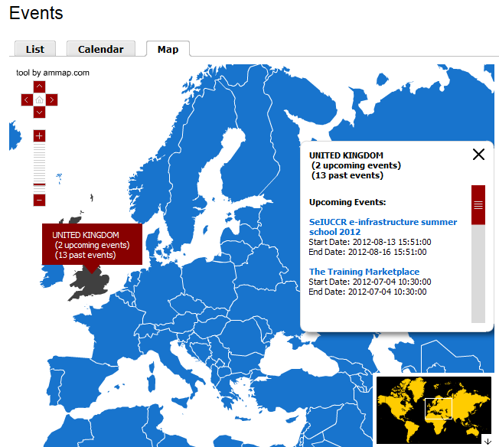
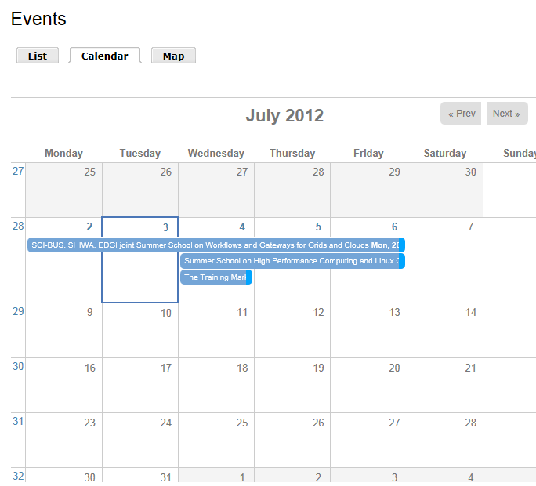
Browse

Slide 9
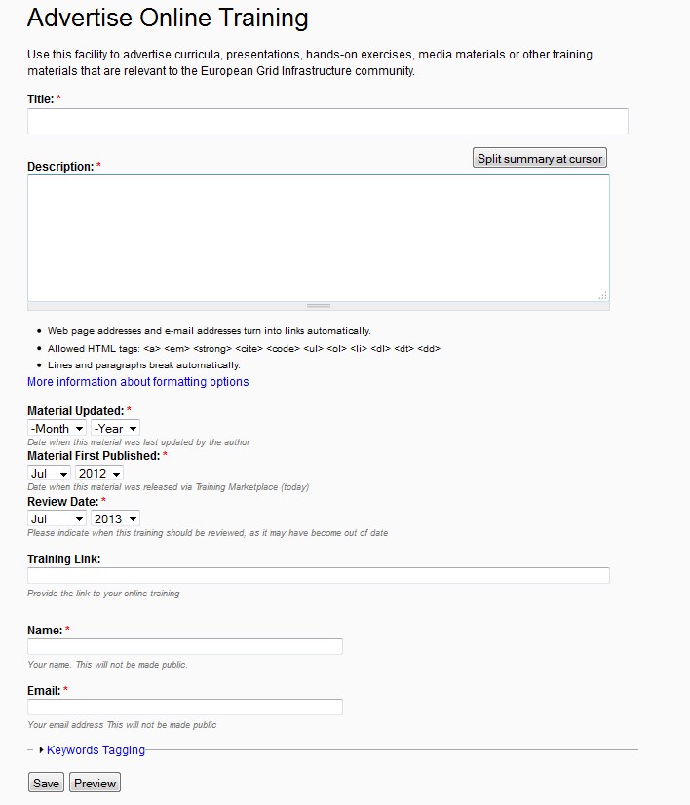
Advertise
Fill in and submit form
Checked (EGI)
Review keeps it current
Published

Slide 10
Products
Central portal:
EGI website
Central database
(STFC)
All
Filters
Project websites
National websites
Gadget
Commercial websites

Slide 11
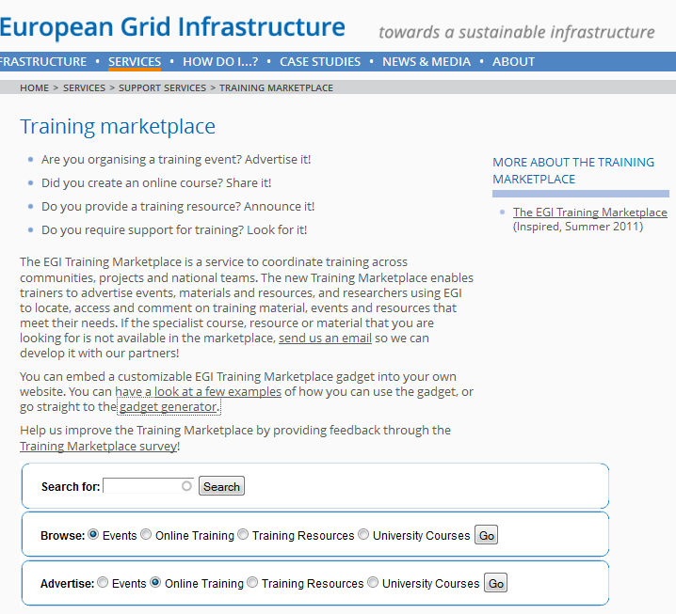
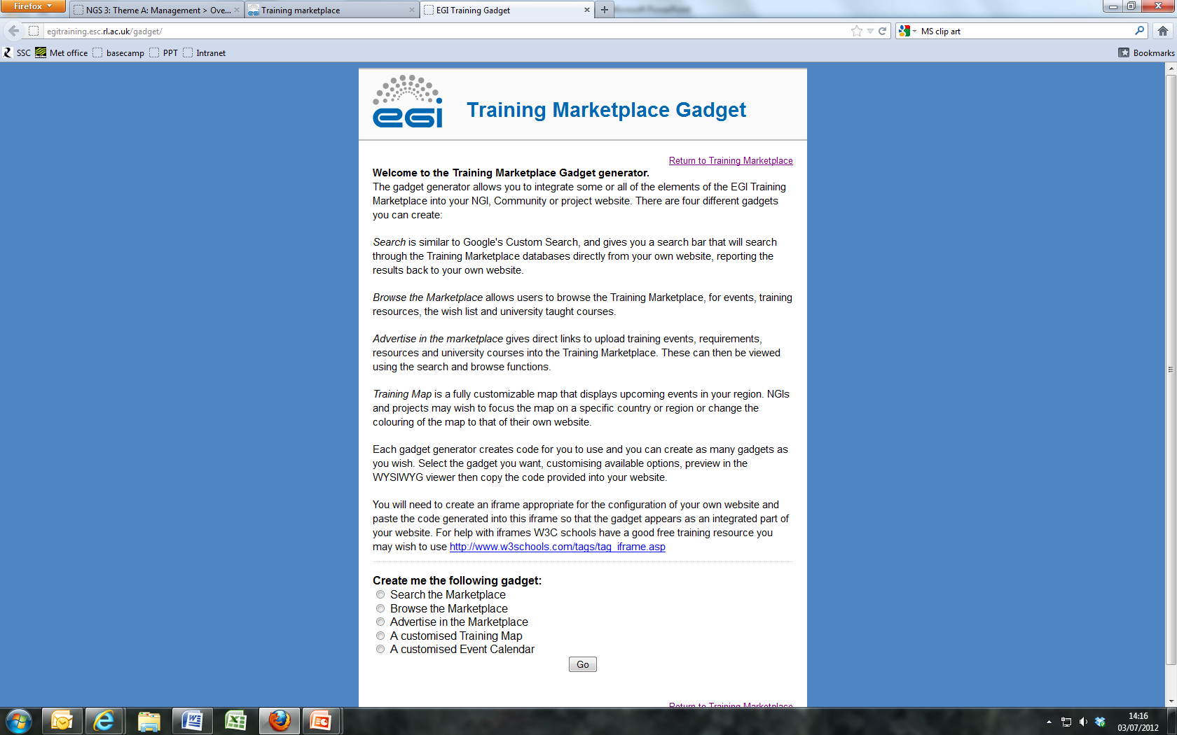
Gadget

Slide 12
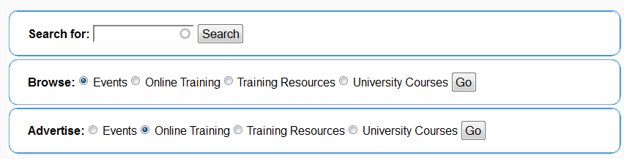
Gadget

Slide 13

Gadget

Slide 14
Future plans
Increased customisation in the gadget
  Filter by project, or company, or something else
  Improved look and feel
Increased promotion and uptake
  Increased traffic = increased promotion
What do you want?

Slide 15
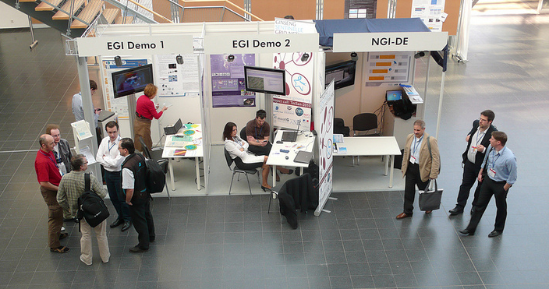
Demo tomorrow!
Wednesday, EGI demo booths

Slide 16
Gadget
Questions?
claire.devereux@stfc.ac.uk
http://www.egi.eu/services/support/training_marketplace
Thanks to Ahmed Sajid, Matt Heeks and Tom Morrison

