Slide 1
Helix Nebula Workshop
On Interoperability among Public
And Community Clouds
Session 2: Networking Connectivity
Convener: Carmela ASERO, EGI.eu 19 September 2012, Prague
Carmela.Asero@egi.eu

Slide 2

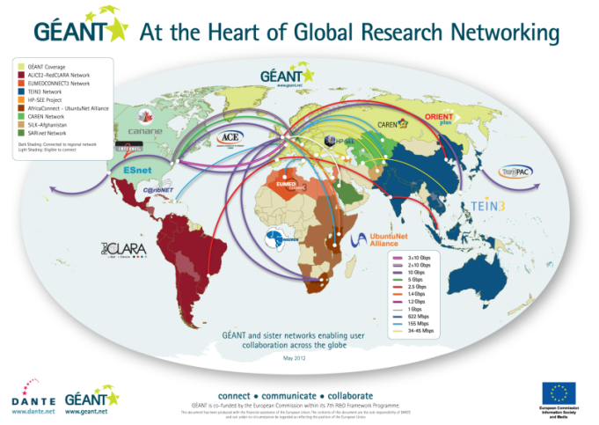
40 million researchers in over 8,000 institutions across 40 European countries
Federated services (eg. eduroam® eduGAIN, perfSONAR, eduPKI)
Trials toward 2Tbps capacity across the core network
Next Géant phase approaching!

Slide 3
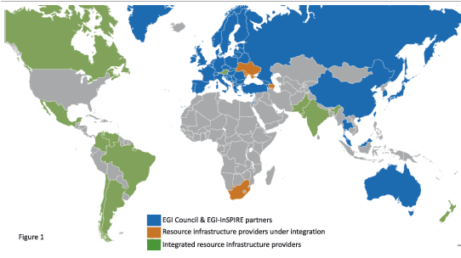

27 national and 9 federated operations centres encompassing multiple NGIs in Europe, Asia Pacific and Latin American regions
EGI comprises resources provided by 56 countries plus CERN
In the last year two new partner infrastructures: South African Grid Initiative and Ukrainian National Grid

Slide 4
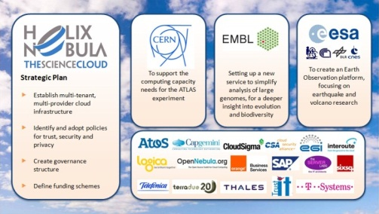

Helix Nebula
Goal #1 Establish a Cloud Computing Infrastructure for the European Research Area (ERA) serving as a platform for innovation and evolution of the overall infrastructure
Preliminary step towards a European cloud-based scientific e-infrastructure: HELIX NEBULA – the Science Cloud
Two years’ pilot-phase to investigate procurement processes and governance issues for a PPP framework of
Three initial flagship use cases from HEP, molecular biology and earth observation

Slide 5
Opportunities
Interoperability of large e-Infrastructures (GEANT, EGI and PRACE) is vital to allow the research community to migrate their data and combine them thus achieving higher efficiency
Cost-effective and high performance network access to the science cloud across the ERA will be an important aspect of its deployment.
GEANT could provide high-performance network connectivity to HELIX NEBULA – the Science Cloud. Terena and the NRENs could play an important role in this initiative by facilitating the connection to the data centres of commercial cloud service providers.

Slide 6
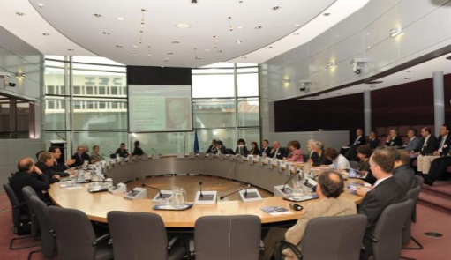
Operating in a common policy environment
“Europe’s ambitions for research and innovation can only be met by ensuring European researchers have access to the best possible e-infrastructure services. Ultra-high speed, high capacity network services are an indispensable element of these e-infrastructure services, and in fact the foundation on which the whole edifice rests.”
Knowledge without Borders
Report of the GÉANT Expert Group (October 2011)

Slide 7
Operating in a common policy environment
Implement and promote the uptake of electronic identity and digital research services
Ensure optimal interaction and linkages and strategic partnering between academia and industry and define joint collaborative research agendas to maximize the use of research results
Preventing “unnecessary duplication of national research and infrastructure investment”
EC Communication “A Reinforced European Research
Area Partnership for Excellence and Growth”

Slide 8
Objectives of this session
Identify requirements/constraints at the policy level to connect publicly-funded network with commercial providers
Enhanced coordination with GEANT and the NRENs to ensure network connectivity and policy compliance for the data-intensive use cases and agreement on connectivity scenarios for the selected commercial providers
To fine-tune EGI and HN activities with the agenda of GEANT/NRENs in terms of next steps for collaboration on activities related to cloud services

Slide 9
Thank You!

