Slide 1


WS-VLAM workflow management System
Adam Belloum
Institute of Informatics
University of Amsterdam
a.s.z.belloum@uva.nl
EGI Technical Forum, 17-21 September 2012 Prague , 2012
Notes:
Conference of the High Performance Computers' User
the annual scientific meeting concerning the computations being performed in the Centre by use of the high performance computers, computing clusters and installed software. http://www.cyfronet.pl/kdm11/index-en.html

Slide 2
Outline
Introduction
Life cycle of e-Science Workflow
Different approaches to workflow scheduling
  Workflow Process Modeling & Management In Grid/Cloud
  Workflow and Web services (intrusive/non intrusive)
Provenance

Slide 3
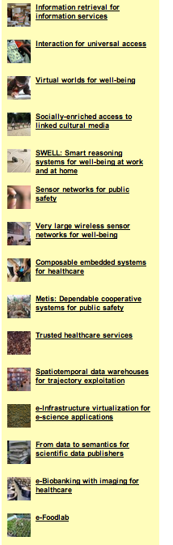
The project: COMMIT
COMMIT is a public-private research community solving grand challenges in information and communication science shaping tomorrow’s society.
COMMIT has 15 projects and 200 people in 80 organisations such as universities, TNO, Thales, Logica, Philips, AMC, and SME’s like DevLab, Hyves, Waag.
COMMIT delivers science, disseminates its results, measures its impact, generates synergy.
www.Commit-nl.nl
Notes:
COMMIT’s revenue is €110 million, of which the government contributes €50 million and the remaining €60 million is paid for by knowledge institutes, companies and non-profit organizations.

Slide 4
Complex Scientific experiments model
Problem
investigation:
Look for relevant problems
Browse available tools
Define the goal
Decompose into steps
(2) Experiment
Prototyping:
Design experiment workflows
Develop necessary components
Shared
repositories
(4) Results
Publication:
Annotate data
Publish data
(3) Experiment
Execution:
Execute experiment processes
Control the execution
Collect and analysis data
Collaborative e-Science experiments: from scientific workflow to knowledge sharing A.S.Z. Belloum, Vladimir Korkhov, Spiros Koulouzis, Marcia A Inda, and Marian Bubak JULY/AUGUST, IEEE Internet Computing, 2011
Notes:
And used different terminology to say basically the same things.

Slide 5
Outline
Introduction
Lifecycle of an e-science workflow
Different approach to workflow scheduling
  Workflow Process Modeling & Management In Grid/Cloud
  Workflow and Web services Workflow and Web services (intrusive/non intrusive)
Provenance
(1)
Problem
investigation:
(2) Experiment
Prototyping
Shared
repositories
(4)
Results
Publication:
(3) Experiment
Execution:

Slide 6
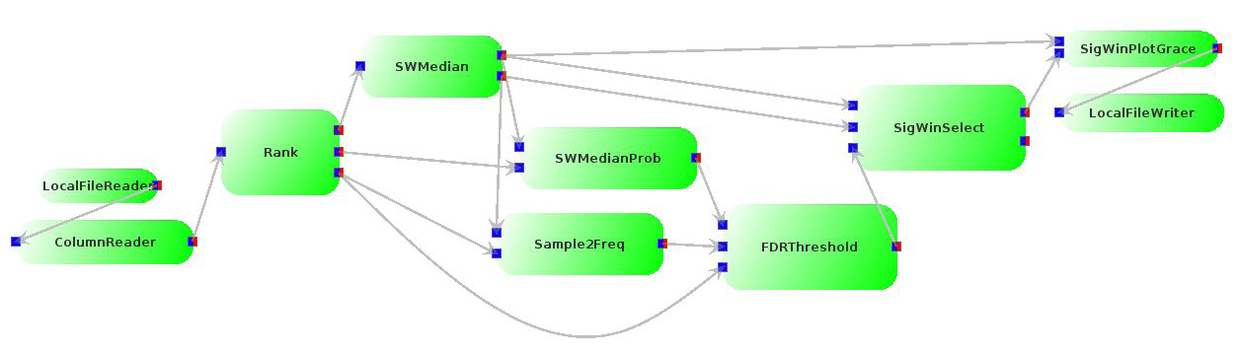
Model of computation
WS-VLAM Engine: architecture
(1st generation)
Targeted stream-based Applications.
  Engine co-allocates all workflows.
  Components waste time idling.
  Co-allocation difficult.
Communication: time coupled
  Assumes components are running
  Simultaneously
  Synchronized p2p
SigWin-Detector workflow has been developed in the VL-e project to detect ridges in for instance a Gene Expression sequence or Human transcriptome map, BMC Research Notes 2008, 1:63 doi:10.1186/1756-0500-1-63.
Notes:
modeling of applications in the domain of video, audio, and graphics applications, we notice that they exhibit a high degree of task
parallelism and operate on streams of data. Models that we can use to specify such stream-based applications on a high level of abstraction are
the dataflow models
process network models
“Modeling Stream-Based Applications using the SBF model of computation”
Bart Kienhuis and Ed F. Deprettere IEEE Workshop on Signal Processing Systems (SIPS 2001), Antwerp, Belgium, September 26-28, 2001

Slide 7
WS-VLAM Features
Provide streaming facilities between applications executed on resource geographically distributed.
Support the composition and the execution of hierarchical workflows.
Support for remote graphical output.
Provides the detach/attach capability for long running workflows.
Provides a monitoring facilities based on the WS-notification.
Provides workflow farming possibilities.
etc.
More features: http://staff.science.uva.nl/~gvlam/wsvlam/demos/wsvlam-about.html

Slide 8
WS-VLAM Engine: architecture
(1st generation)
Service host(s) compute element(s)
GT4 Java Container
Job functions
GRAM
services
RTSM
Factory
pre-ws-GRAM
Client
RTSM
Instance
Worker
nodes
Delegate
Delegation
service
Workflow
components
V. Korkhov et al. WS-VLAM: Interactive data driven workflow engine for Grid-enabled resources, Scientific Programming 15 (2007) 173–188 173 IOS Press

Slide 9

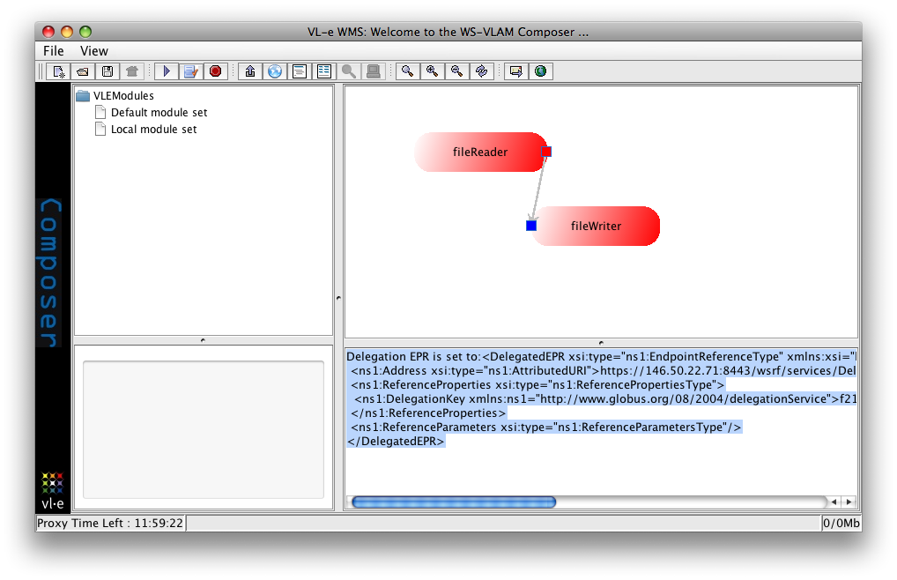
deployment
WSRF Services
- WS-VLAM engine
- workflow component repository
VLe Studio
WS-VLAM composer
VBrowser
Semantic tools
SAW: Semantic Annotation for Workflow
CLAMP: Connecting LAnguage for Modules & Programs
HAMMER: Hybrid-bAsed MatchMaker for e-Science
Resources
Sara: National super
computing center
Production Grid
Storage
Server host
Experimental
Environment
The user interface of the WS-VLAM a workflow management system developed in the VL-e project to execute application workflow on geographically distributed computing resources

Slide 10
List of applications developed using WS-VLAM
  sigWin detector
  Affymetrix Permutation
  Omnimatch
wave propagation
Blast
gut microbiota
Smart Infrastructure
Dynamic network control
GridSFEA,
More applications www.science.uva.nl/~gvlam/wsvlam/Applications
[Micro-Array Dept-UvA]
[Micro-Array Dept-UvA]
[UU/Leiden]
[TUE ]
[AMC ]
[CWI]
[SNE-UvA]
[SNE-UvA]
[TU Munchen]

Slide 11
WS-VLAM Engine: architecture
(2nd generation)
Target loosely couple applications data
  components scheduled depending on data
  components only activated when data is available
  no need for co-allocation
Communication: time decouples
  messaging communication system.
  components not synchronized

Slide 12
Additional features-Farming
Task farming: task replication.
Implements 3 types of farming:
  Auto Farming: The engine decides on farm size depending on port load.
  One-to-One Farming: A task replicated for every message received.
  Fixed Farming: Statically defined.
Allows parameter sweep studies.
A task becomes a parameter engine

Slide 13
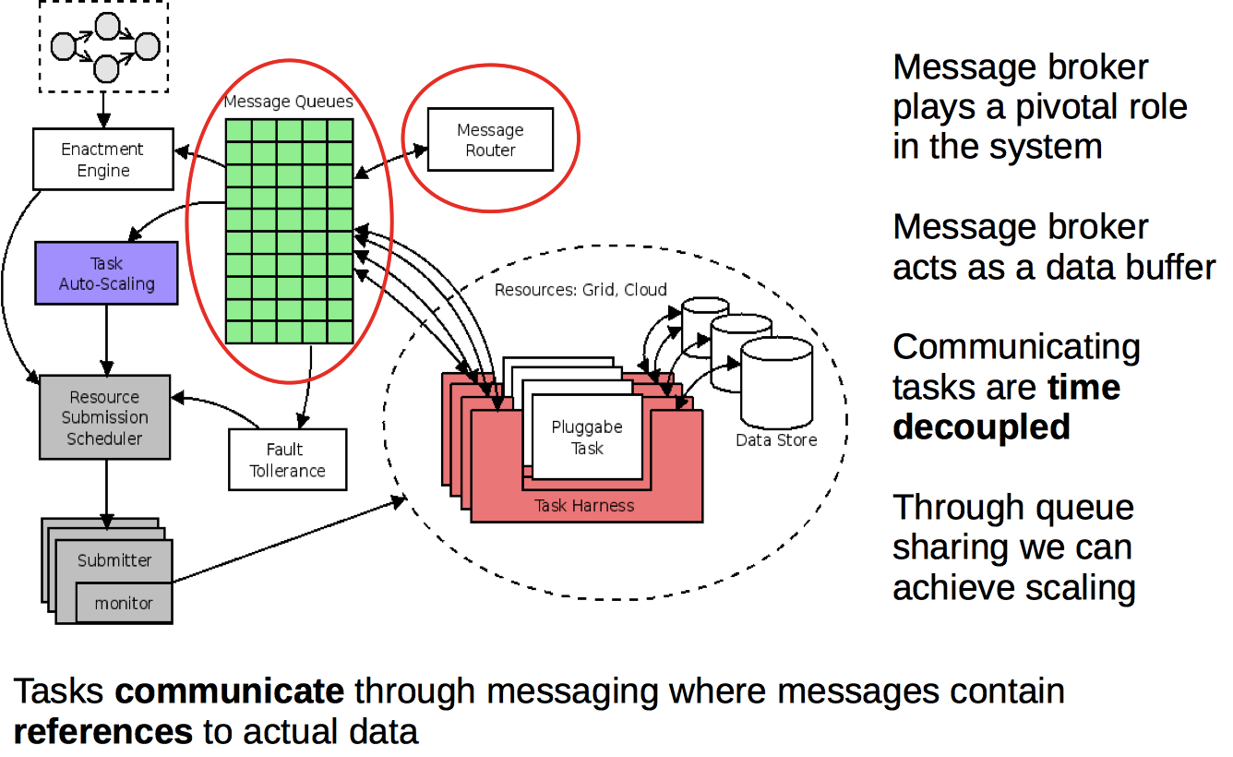
Message Broker
Reginald Cushing, Spiros Koulouzis, Adam S. Z. Belloum, Marian Bubak, Prediction-based Auto-scaling of Scientific Workflows, MGC’2011, December 12th, 2011, Lisbon, Portugal
Notes:
The message queues play a pivotal role in the whole architecture. Most importantly message queues allows intertask communication over computing infrastructure domains which, most often, have restricted Internet access.
Intermediate messages allow tasks to exploit the concurrency between dependent tasks. As with message streams, the granularity of concurrency depends on the task logic and how often messages are produced and consumed
Task harness is a late binding, pilot job mechanism, a harness is submitted
it will pull the actual job,
It also stage in/out the actual data and update the references in the message queue
The system has two level of scehduling
The Enactment engine deels with tasks at an abstract level (it is a modification of the Freefluo used in Taverna
Model the workfow as a dataflow graph (verticies = tasks, and edges = data depnedencies)
The module of computation a task is schduled only if all required data is available
The submission system is composed of a set of submitters corresponsing to various middleware including Cloud submitters
Task Farming when set to auto-scalling will based on two inputs:
Queued data and mean data processing time → will replace the task

Slide 14
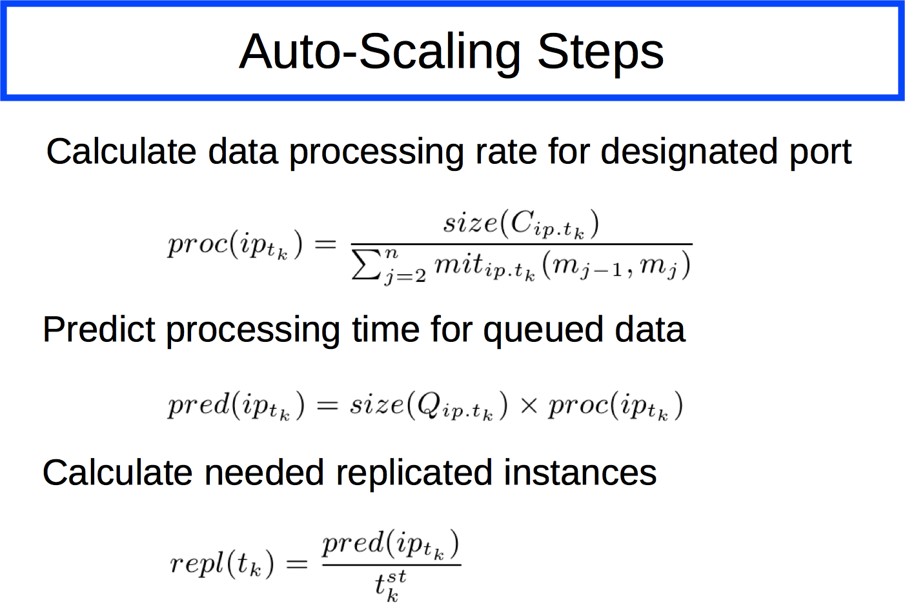
Auto-scaling Steps
Reginald Cushing, Spiros Koulouzis, Adam S. Z. Belloum, Marian Bubak, Prediction-based Auto-scaling of Scientific Workflows, MGC’2011, December 12th, 2011, Lisbon, Portugal

Slide 15
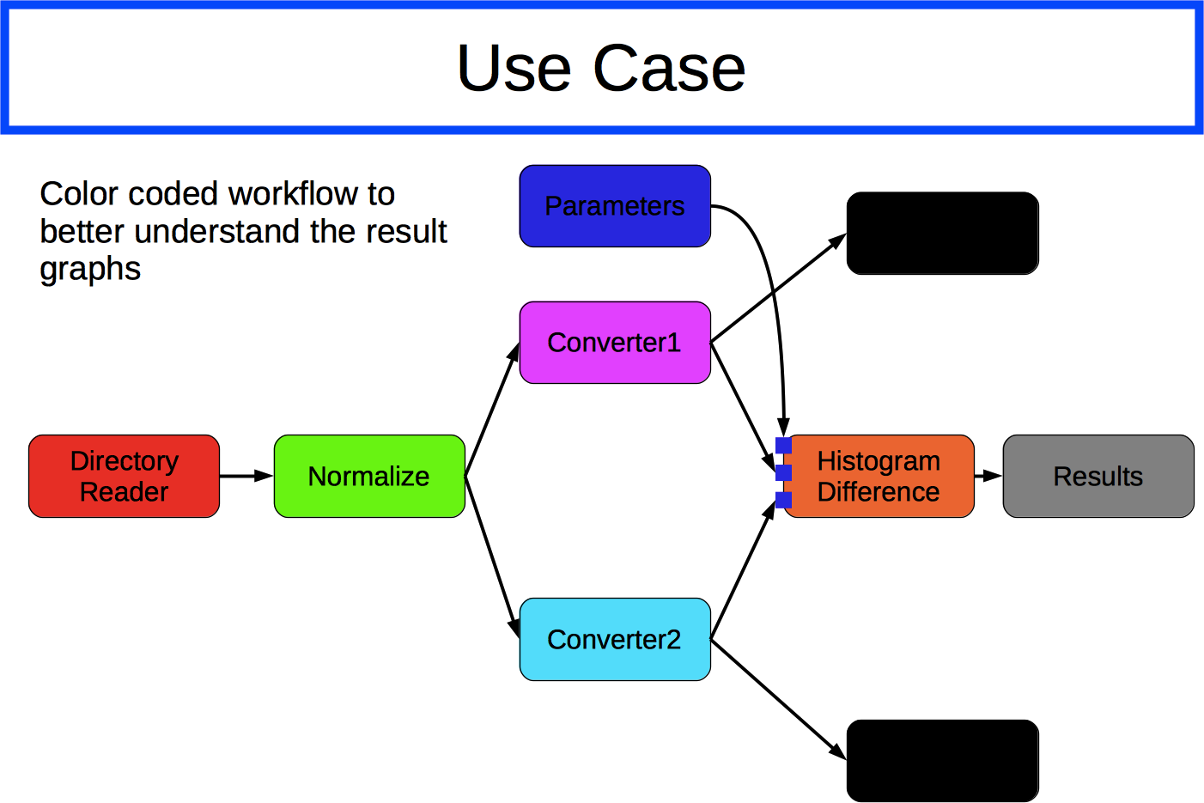
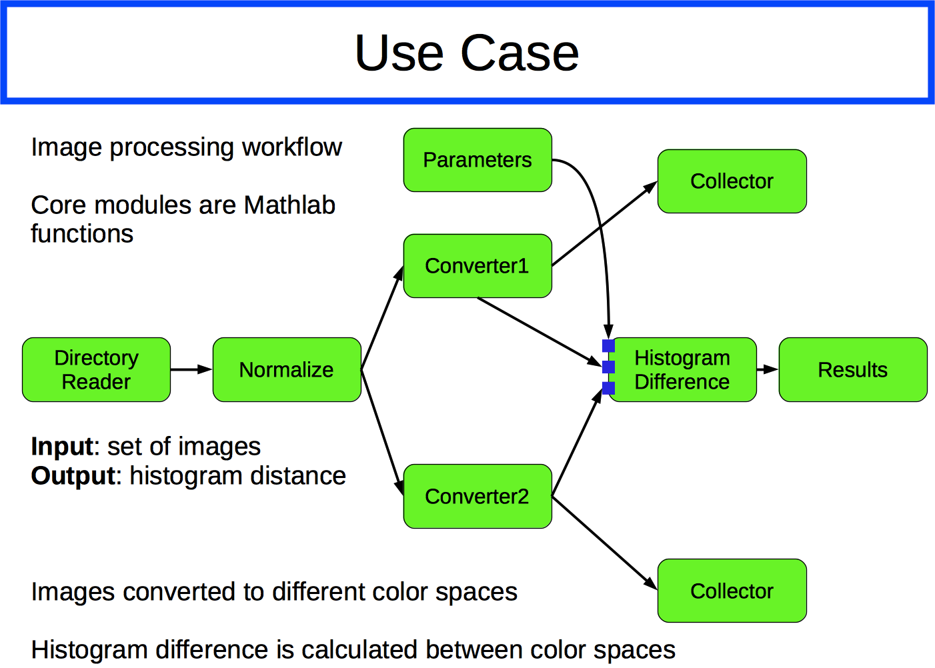
Use case
Matlab

Slide 16
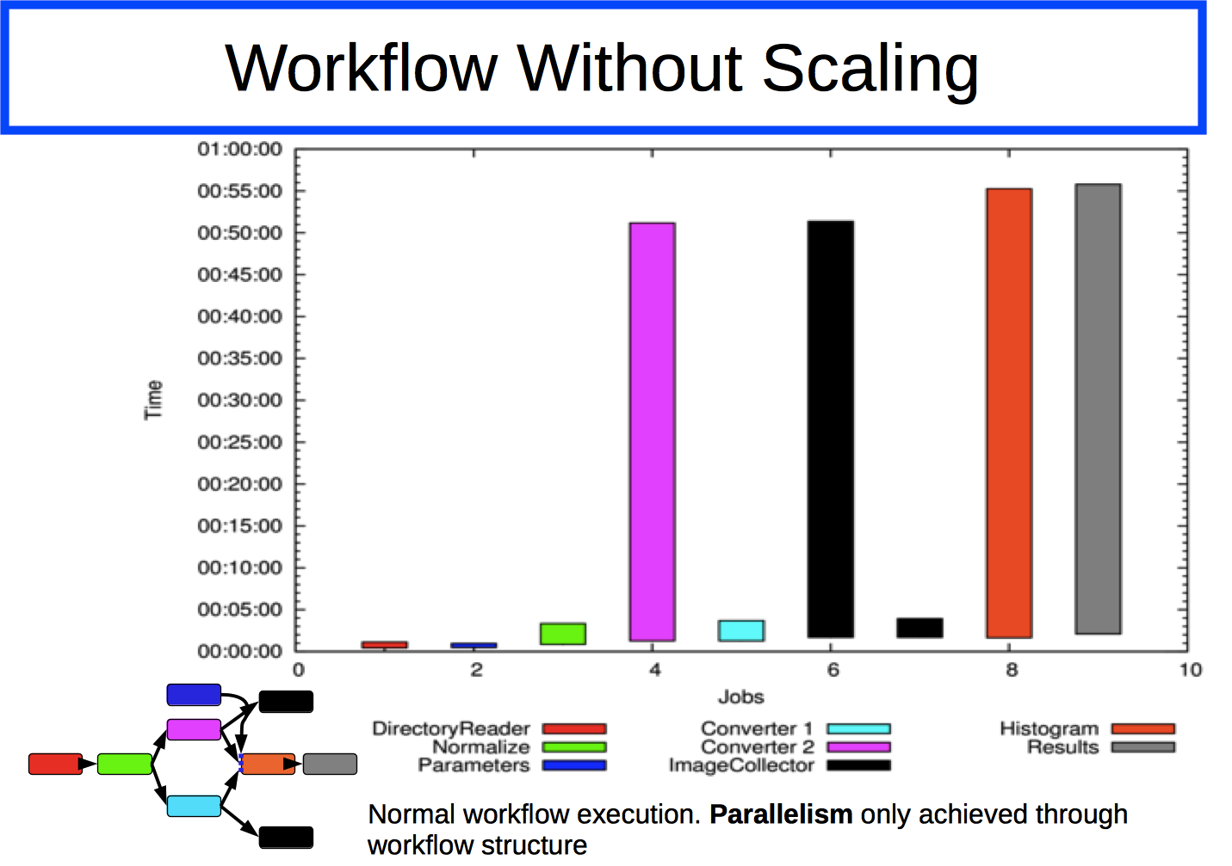
Workflow Without Scaling

Slide 17
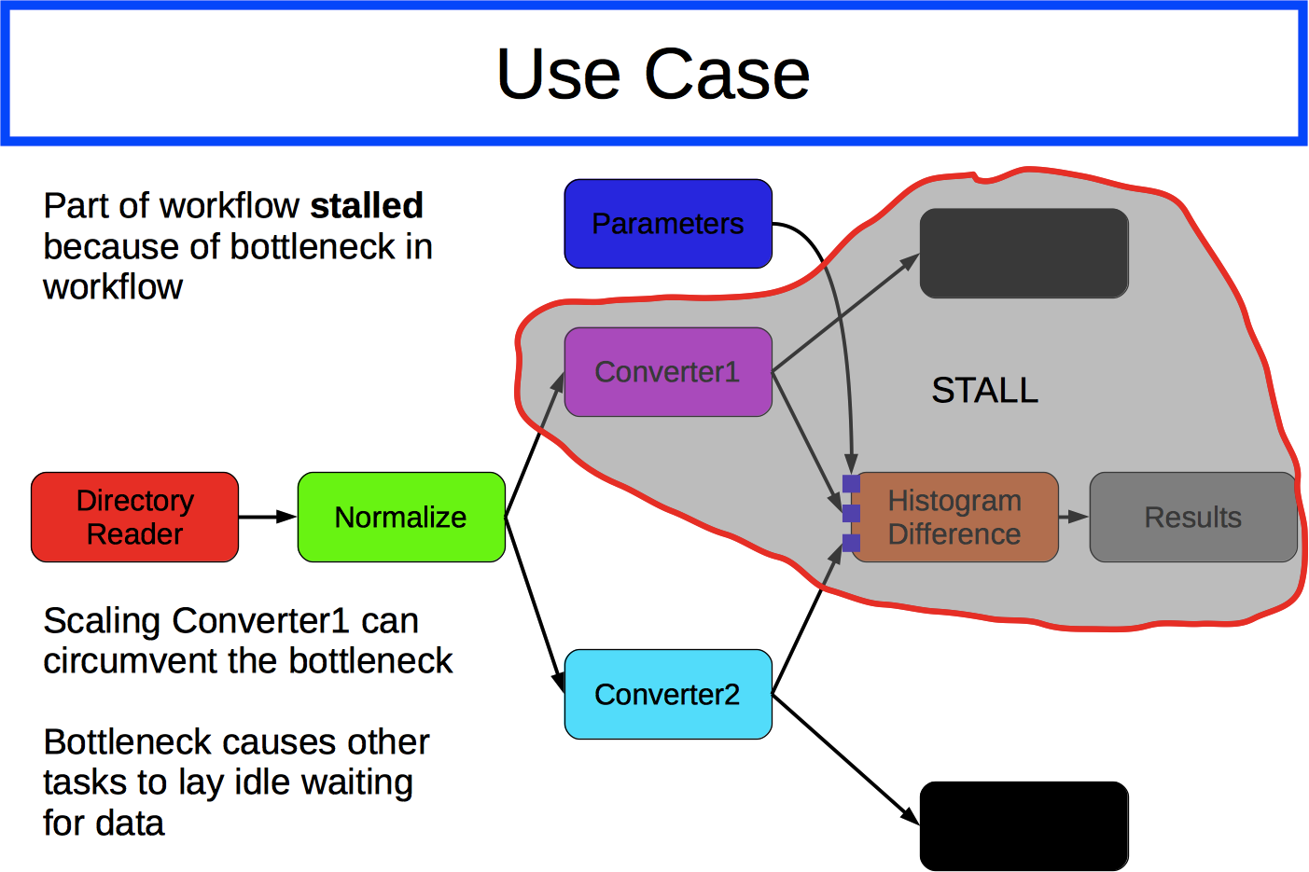
Use Case

Slide 18
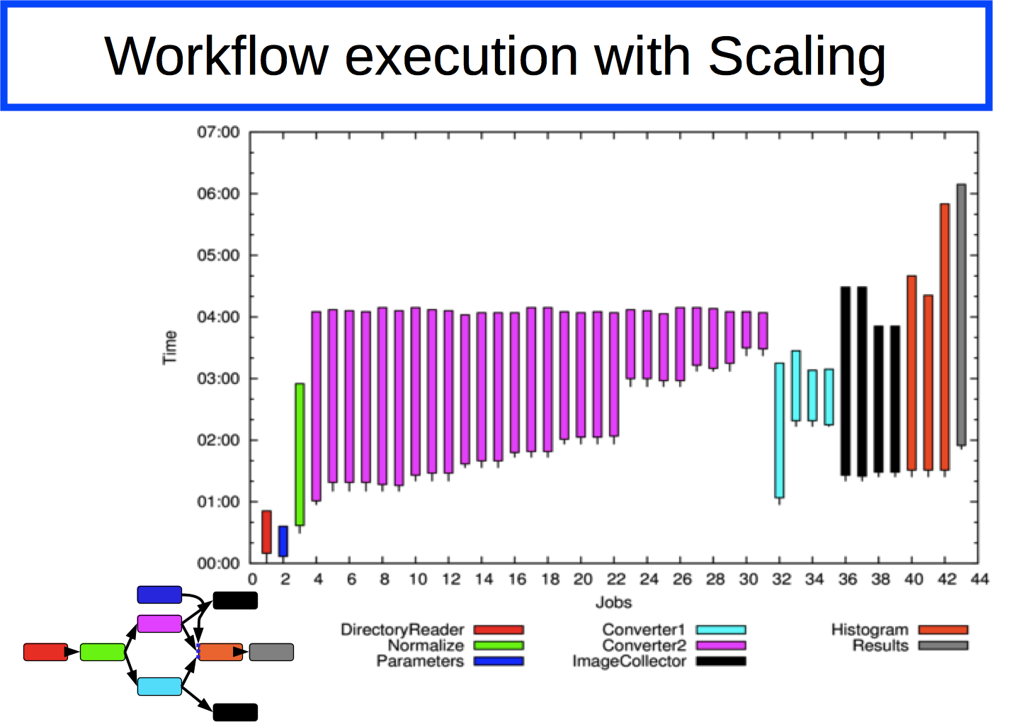
Workflow execution with Scaling

Slide 19
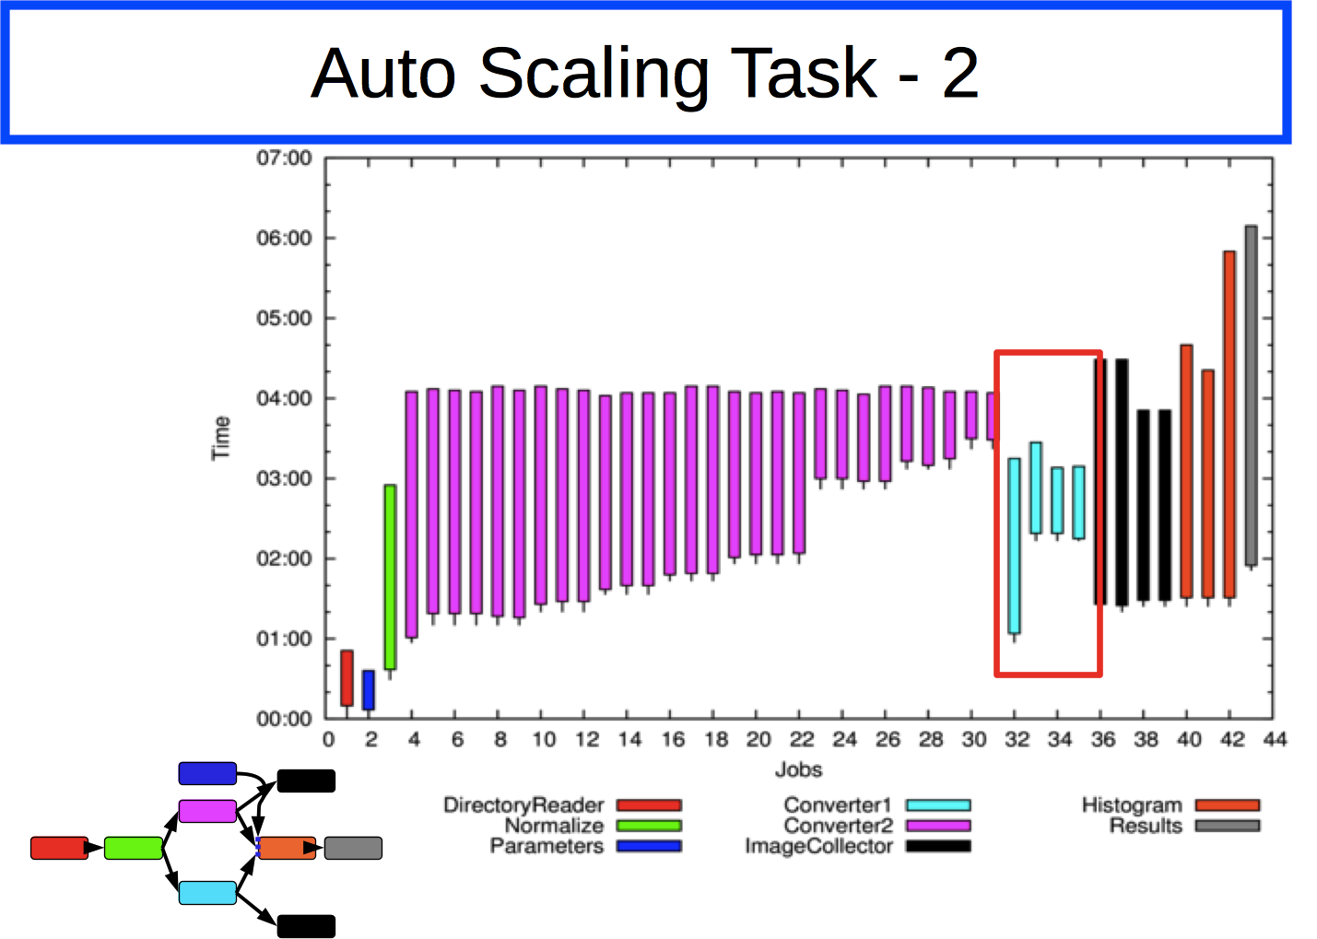
Auto Scaling Task -2

Slide 20
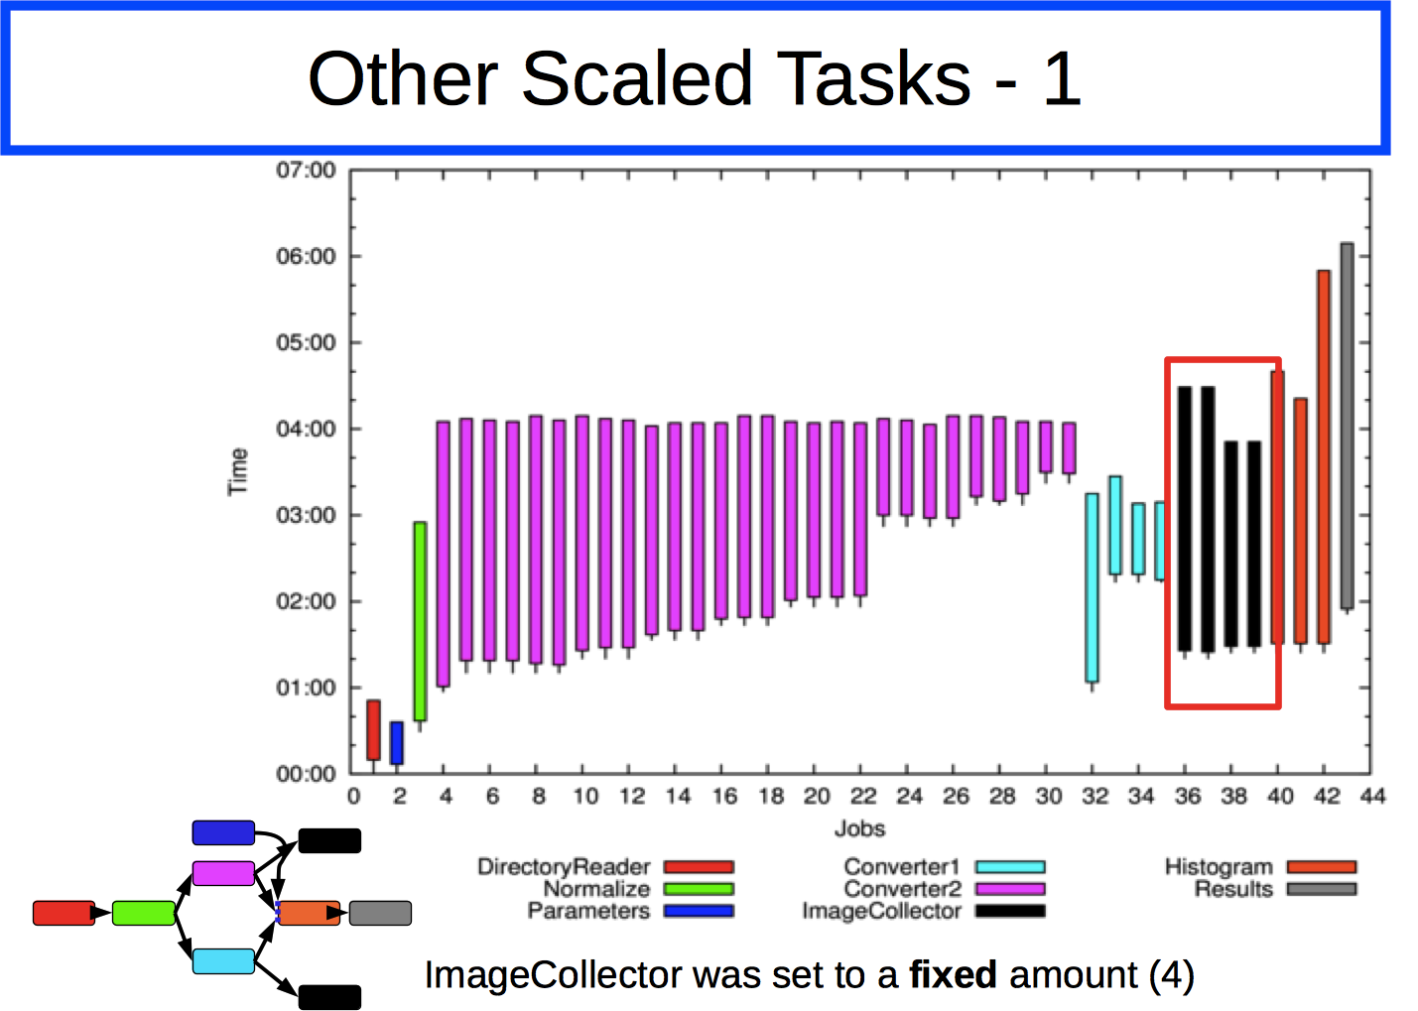
Other Scaled Task -1

Slide 21
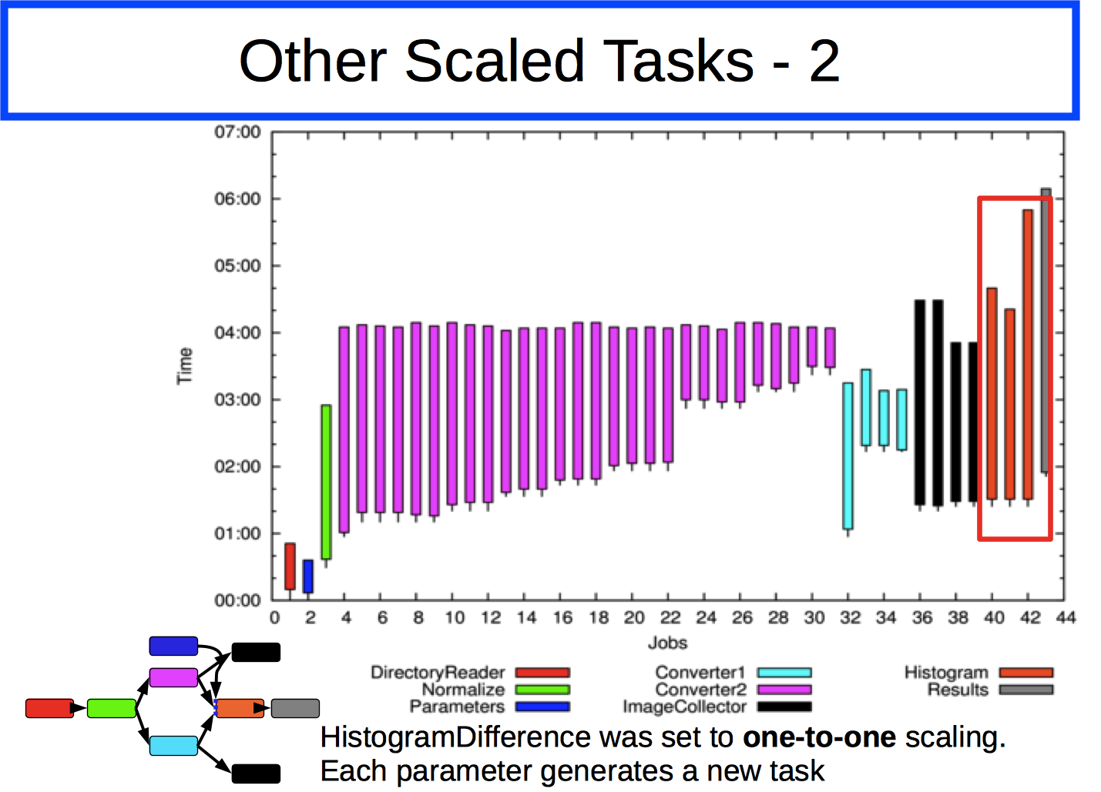
Auto Scaling Task -2

Slide 22
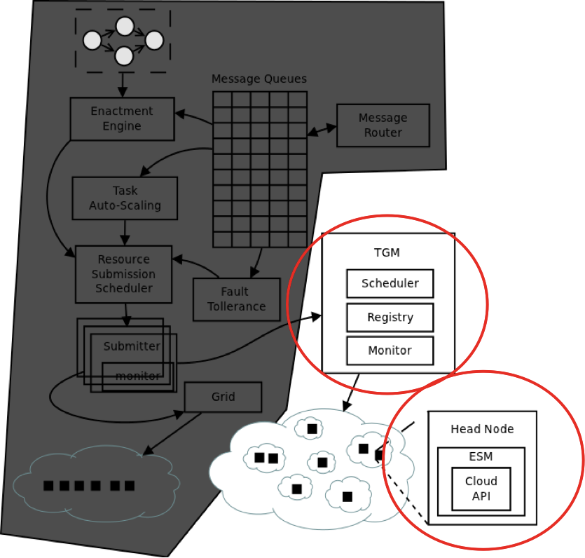
Extension to support Cloud resources
Managing creation and deletion of clusters within multiple clouds
Manages scheduling Vms to ideal cloud e.g. cost
CAdapters abstract various cloud APIs
TGM supports dynamic cloud addition and removal of clouds
Each cluster head node is prepped with a controller program ESM and manages local Vms
Resource on-demand using multiple cloud providers, Super-computing 2010, and SCALE 2012

Slide 23
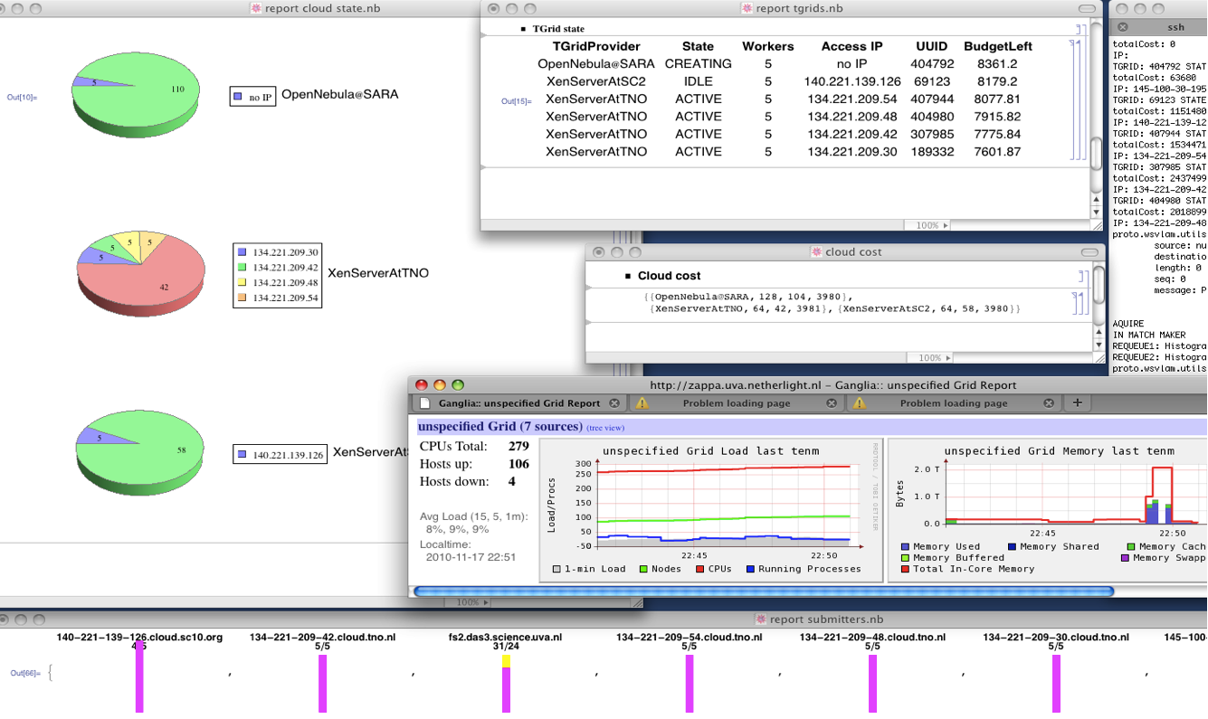
Extension to support Cloud resources
Resource on-demand using multiple cloud providers, Super-computing 2010, and SCALE 2012

Slide 24
Outline
Introduction
Lifecycle of an e-science workflow
Different approach to workflow scheduling
  Workflow Process Modeling & Management In Grid/Cloud
  Workflow and Web services (Workflow and Web services (intrusive/non intrusive)
Provenance
(1)
Problem
investigation:
(2) Experiment
Prototyping
Shared
repositories
(4)
Results
Publication:
(3) Experiment
Execution:

Slide 25
Usage of Web Services in e-science
WS offer interoperability and flexibility in a large scale distributed environment.
WS can be combined in a workflow so that more complex operations may be achieved,
but any workflow implementation is potentially faced with a data transport problem
Notes:
In service orchestration, all data is passed to the workflow engine before delivered to a consuming WS
Data transfers are made through SOAP, which is unfit for large data transfers
Third party file transfer results in unnecessary intermediate transfers that slow down workflow execution and place excessive demand o storage resources

Slide 26
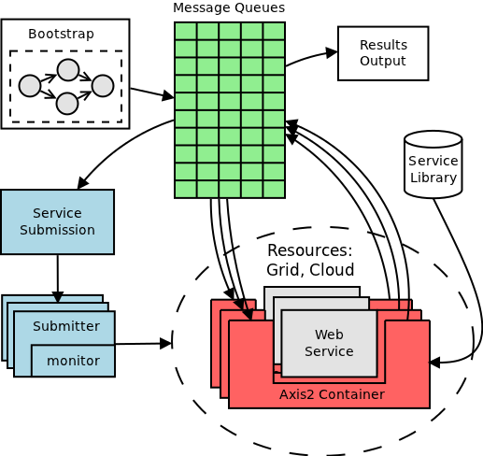
Service Submission
Tasks/Jobs can be queued on the runqueue by any entity. The service submission listens on the runqueue and picks up new tasks to submit
Resources such as Grid or Cloud are abstracted using submitters plugins
Enabling a new resource is a matter of writing its submitter
Service Submission performs matchmaking between services and resources to run on
Reginald Cushing, Spiros Koulouzis, Adam S. Z. Belloum, Marian Bubak, Dynamic Handling for Cooperating Scientific Web Services, 7th IEEE International Conference on e-Science, December 2011, Stockholm, Sweden

Slide 27
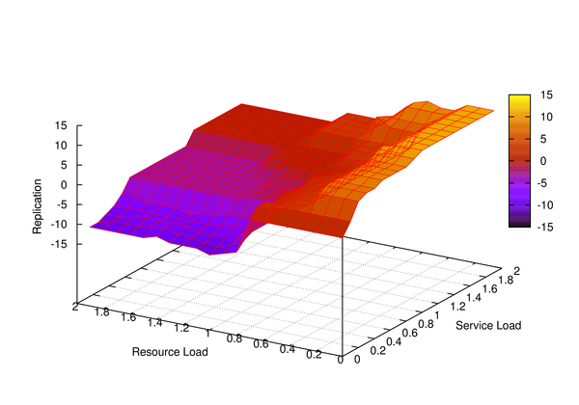
Fuzzy Rule Map
Service load is based on the amount of data being queued on the service and the time quantum for the service to run
The service container continuously monitors the data processing rate and estimates the computation time needed to process all the queued data within a time frame of the data and the processing time are directly proportionate. This might not be the case for all problems.
The estimated processing time and the time quantum given by the resource for executing the service are used to derive the service load. Thus a service load of 2 means that it will take twice as much time as the allocated quantum to process the data.
Reginald Cushing, Spiros Koulouzis, Adam S. Z. Belloum, Marian Bubak, Dynamic Handling for Cooperating Scientific Web Services, 7th IEEE International Conference on e-Science, December 2011, Stockholm, Sweden
Notes:
Dataprocessing rate and time quantum = prediction of computation
Data and computation directly proportionate

Slide 28
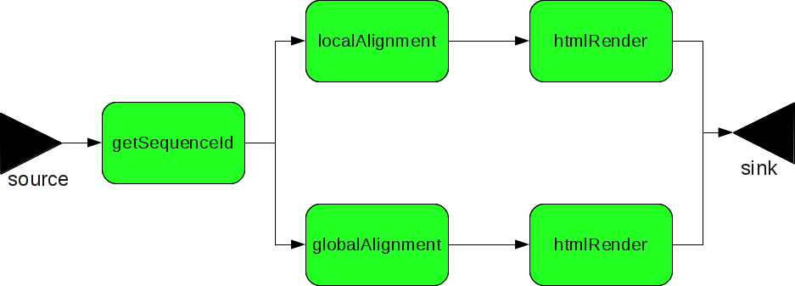
Use Case
Workflow with 2 pipelines. The pipelines perform sequence alignments using data from UniProtKB
Each pipeline performs 22500 alignments i.e. 45100 total alignments in all
All modules are standard web services which are hosted in the modified Axis2 container
The alignments where performed using BioJava api
Source and sink are part of the bootstrapping sequence. Source submits the getSequenceId service while sink waits for output from the htmlRenderer
The Distributed ASCI Computer 3 (DAS3) was used as the resource pool.
www.uniprot.org
Notes:
getSequenceIds web service reads a list of sequence ids and returns the actual sequence data for the ids.
localAlignment performs a local alignment on the passed sequences while globalAlignment performs a
global alignment. Both alignment web services use the BioJava API [4] for processing the biological data. htmlRender
transforms the results into HTML tags which are then made accessible through a web browser. The sink concatenates the
results into HTML pages

Slide 29
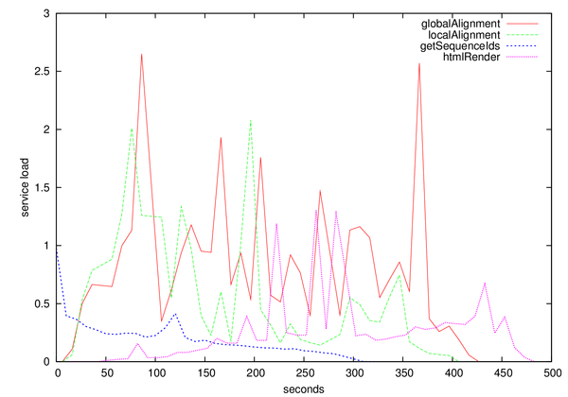
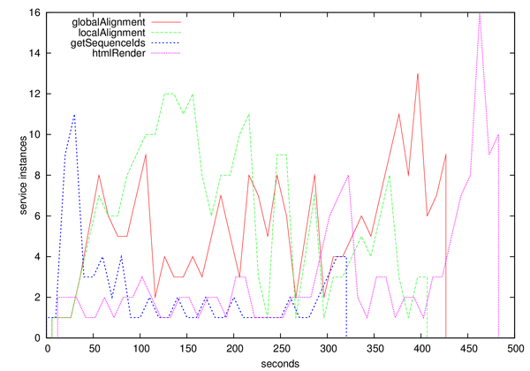
Evaluating Auto-Scaling
Service Load
Running Service instances

Slide 30
Scale up web services
Peaks in load(left) will result in peaks in instances(right). The fuzzy controllers scale up the web services to meet the demands

Slide 31
Scale up web services
Notes:
Peaks in load(left) will result in peaks in instances(right). The fuzzy controllers scale up the web services to meet the demands

Slide 32
Greedy Scale up
Notes:
Greedy resource usage when no one else is using the resources

Slide 33
Outline
Introduction
Lifecycle of an e-science workflow
Different approach to workflow scheduling
  Workflow Process Modeling & Management In Grid/Cloud
  Workflow and Web services (intrusive/non-intrusive)
provenance
(1)
Problem
investigation:
(2) Experiment
Prototyping
Shared
repositories
(4)
Results
Publication:
(3) Experiment
Execution:

Slide 34
Provenance/ reproducibility
“A complete provenance record for a data object allows the possibility to reproduce the result and reproducibility is a critical component of the scientific method”
Provenance: The recording of metadata and provenance information during the various stages of the workflow lifecycle
Workflows and e-Science: An overview of workflow system features
and capabilities Ewa Deelmana, Dennis Gannonb, Matthew Shields c, Ian Taylor, Future Generation Computer Systems 25 (2009) 528540

Slide 35
History-tracing XML (FH Aachen)
provides data/process provenance following an approach that
  maps the workflow graph to a layered structure of an XML document.
  This allows an intuitive and easy processable representation of the workflow execution path,
  which can be, eventually, electronically signed.
<patternMatch>
<events>
<PortResolved> provenance data</PortResolved>
<ConDone>provenance data
</ConDone>
...
</events>
<fileReader2>
<events> ... </events>
<sign-fileReader2> ...
</signfileReader2>
</fileReader2>
<sffToFasta>
Reference
</sffToFasta>
<sign-patternMatch> ...
</sign-patternMatch>
</patternMatch>
M. Gerards, Adam S. Z. Belloum, F. Berritz, V. Snder, S. Skorupa, A History-tracing XML-base Provenance Framework for workflows, WORKS 2010, New Orleans, USA, November 2010
<patternMatch>
<events>
<PortResolved> provenance data</PortResolved>
<ConDone> provenance data </ConDone>
...
</events>
<fileReader2>
<events> ... </events>
<sign-fileReader2> ... </sign-fileReader2>
</fileReader2>
<sffToFasta>
Reference
</sffToFasta>
<sign-patternMatch> ... </sign-patternMatch>
</patternMatch>
<patternMatch>
<events>
<PortResolved> provenance data</PortResolved>
<ConDone> provenance data </ConDone>
...
</events>
<fileReader2>
<events> ... </events>
<sign-fileReader2> ... </sign-fileReader2>
</fileReader2>
<sffToFasta>
Reference
</sffToFasta>
<sign-patternMatch> ... </sign-patternMatch>
</patternMatch>
<patternMatch>
<events>
<PortResolved> provenance data</PortResolved>
<ConDone> provenance data </ConDone>
...
</events>
<fileReader2>
<events> ... </events>
<sign-fileReader2> ... </sign-fileReader2>
</fileReader2>
<sffToFasta>
Reference
</sffToFasta>
<sign-patternMatch> ... </sign-patternMatch>
</patternMatch>
<patternMatch>
<events>
<PortResolved> provenance data</PortResolved>
<ConDone> provenance data </ConDone>
...
</events>
<fileReader2>
<events> ... </events>
<sign-fileReader2> ... </sign-fileReader2>
</fileReader2>
<sffToFasta>
Reference
</sffToFasta>
<sign-patternMatch> ... </sign-patternMatch>
</patternMatch>
Notes:
Direct map of workflow graph to provenance trace
> Intuitive representation: 1 task = 1 layer
> Interleaving of embedded XML signatures without complex XPath expressions enables liable counter-signing and actor identification

Slide 36
OPM 1.1
Plier (UvA/BigGrid)
PLIER is an implementation of the OPM 1.1 specifications.
PLIER API
  provides a set of functions to build, store, and share workflow experiments as graphs.
  implements a relational database as back-end storage that captures the concepts of the OPM model, using the Java Persistence API (JPA 2.0) and Hibernate.
  provides specific interfaces, using JDO 3.1, to transform, or serialize, the provenance data into specific formats (e.g. RDF, XML, and DOT).
Id_368139581_input_result_fasta
resultPatternMatch
tagMichel20080707.txt
Ribosomal_Human.gz
parameter
Id 1587433265 input patternFile
input_file
Input sffinfo Component.tar
input_file
parameter
sffTo
Fasta
input_file
input_file
blast
all
Pattern
Match
TrigeredBy
TrigeredBy
Completed
Completed
output_file
output_file
Completed
output_file
output_file
Id 81081428 output sffOutput
Id_1587433265_output_result_fasta
Id_1587433265_output_result_txt
Id_368139581_output_out_blast_tar
M. Gerhards, V. Sander, A. Belloum, D. Vasunin & A. Benabdelkader (). HisT/PLIER: A two-fold Provenance Approach for Grid-enabled Scientific Workflows using WS-VLAM. In Proceedings of the 2011 IEEE/ACM 12th International Conference on Grid Computing (pp. 224-225).
Notes:
Inter-operability, Standardization and Data Sharing: due to the compliance of PLIER with OPM specifications
> Graphical representation: data in the graph is encoded as visual properties
> Statistical information and data summaries: built-in components based complex queries formulated against the back-end database

Slide 37
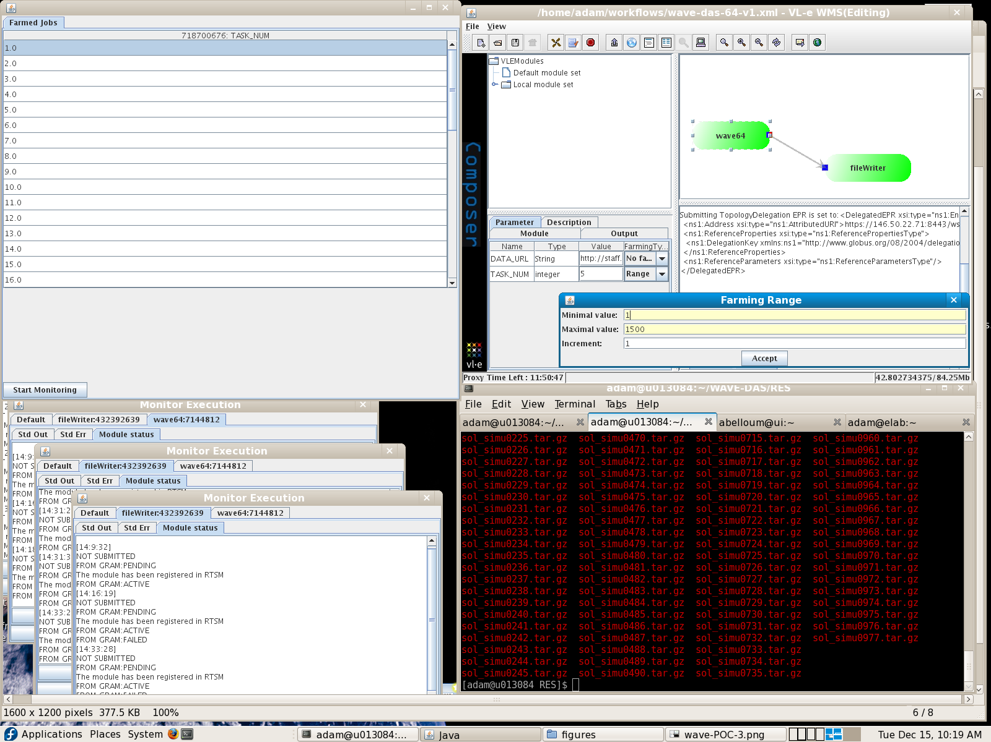
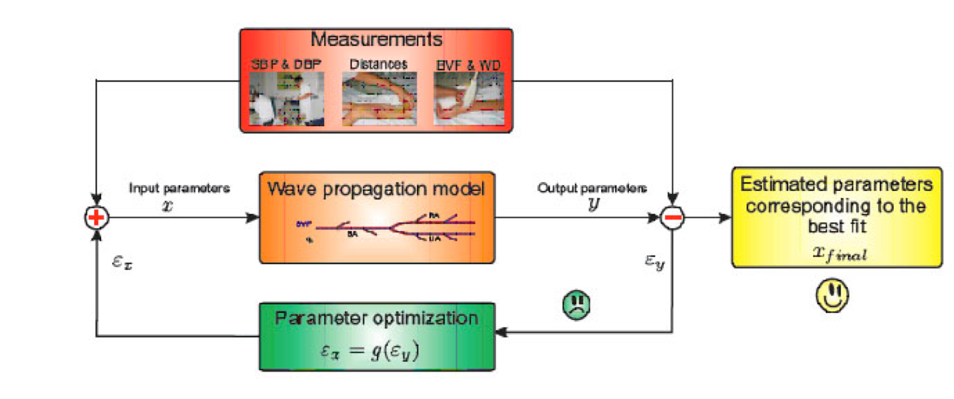
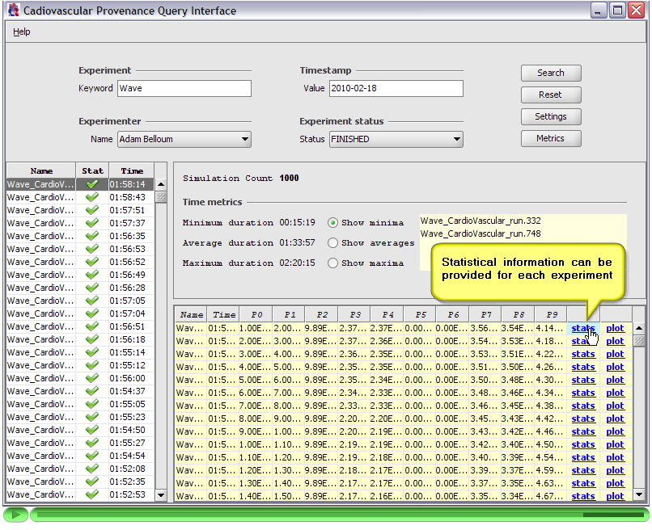
wave propagation model applications
User Interface to compose workflow (top right), monitor the execution of the farmed workflows (top left), and monitor each run separately (bottom left) data
[Biomedical engineering Cardiovascular biomechanics group TUE])
wave propagation model of blood flow in large vessels using an approximate velocity profile function:
a biomedical study for which 3000 runs were required to perform a global sensitivity analysis of a blood pressure wave propagation in arteries
Query interface for the provenance data collected from 3000 simulations of the “wave propagation model of blood flow in large vessels using an approximate velocity profile function”
BigGrid project 2009, presented EGI/BigGrid technical forum 2010

Slide 38
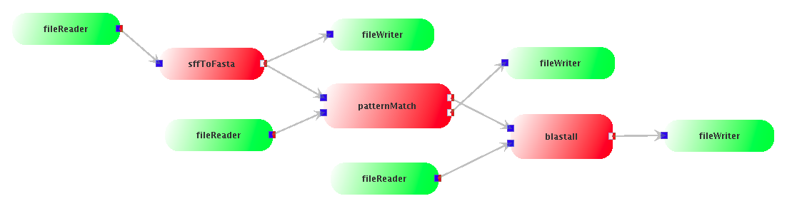
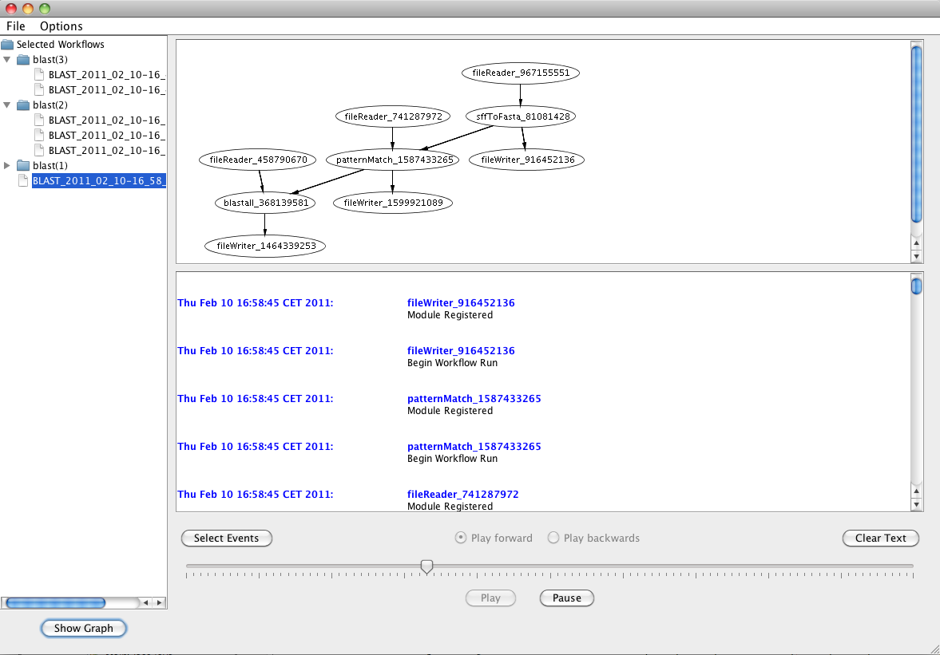
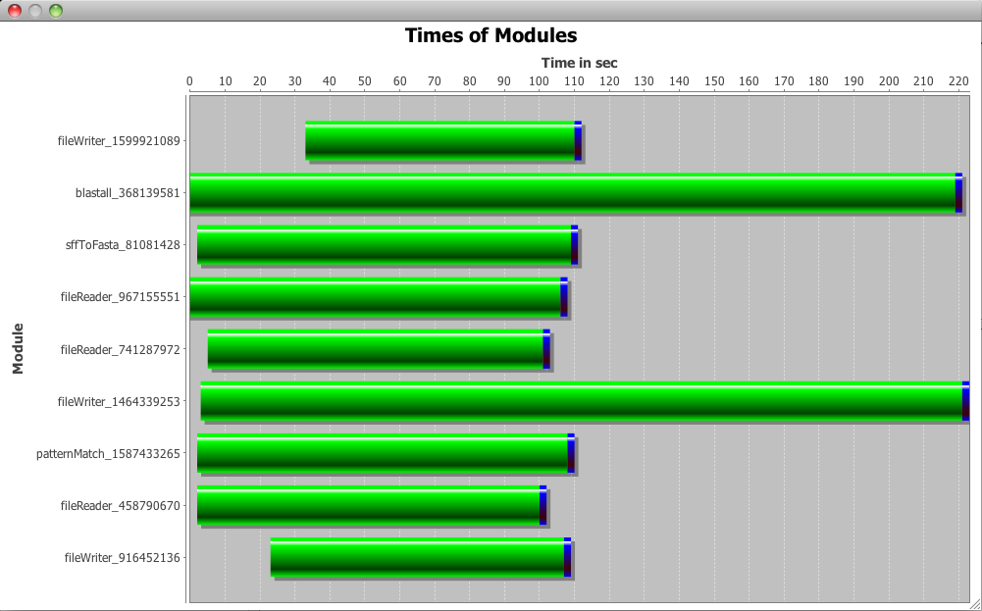
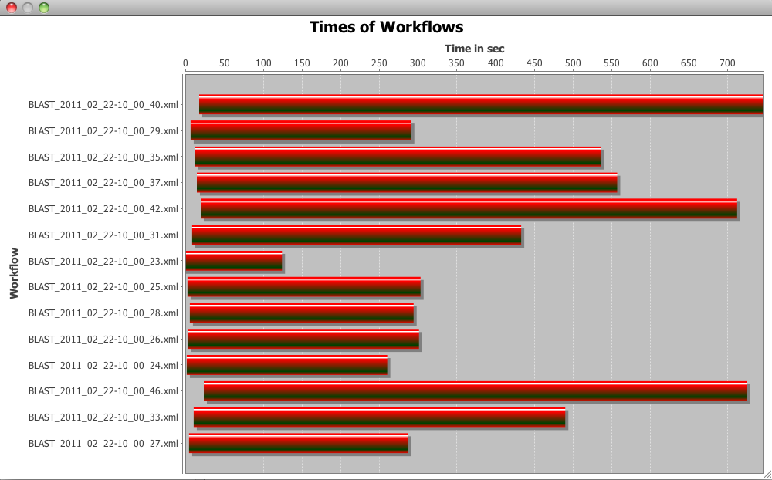
Blast Application
[Department of Clinical Epidemiology, Biostatistics and Bioinformatics (KEBB), AMC ]
The aim of the application is the alignment of DNA sequence data with a given reference database. A workflow approach is currently followed to run this application on distributed computing resources.
For Each workflow run
The provenance data is collected an stored following the XML-tracing system
User interface allows to reproduce events that occurred at runtime (replay mode)
User Interface can be customized (User can select the events to track)
User Interface show resource usage
on-going work UvA-AMC-fh-aachen

Slide 39
http://www.commit-nl.nl/
http://www.science.n/~gvlam/wsvlam/
http://www.vle.nl/

Slide 40
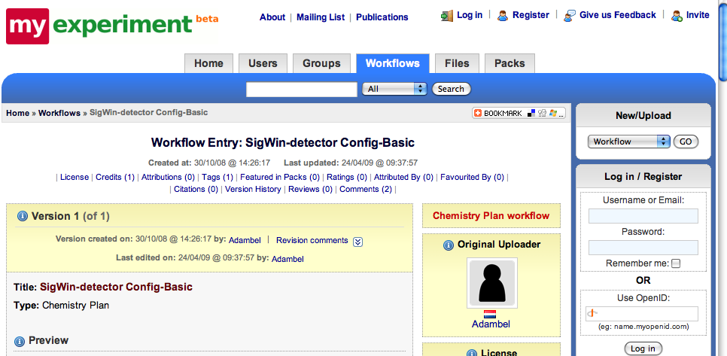
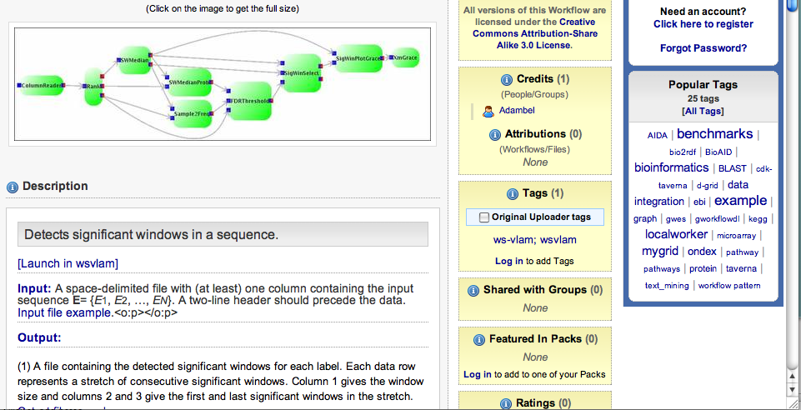
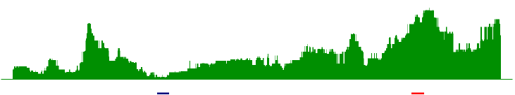
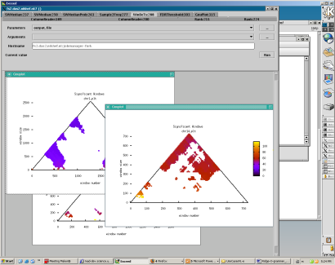
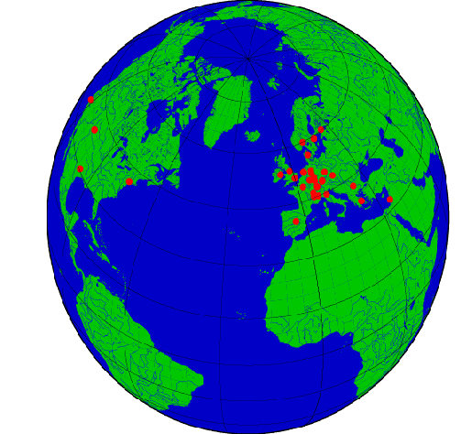




(4) Results Publication
Workflow can be invoked form other systems
Workflow can be made available to entire community (using Web 2.0 approach)
WS-VLAM composer
Human transcriptome map
DNA curvature of the Escherichia Coli chromosome
Marcia A Inda, Marinus F van Batenburg, Marco Roos, Adam SZ Belloum, Dmitry Vasunin, Adianto Wibisono, Antoine HC van Kampen and Timo M Breit SigWin-detector: a Grid-enabled workflow for discovering enriched windows of genomic features related to DNA sequences, BMC Research Notes 2008,

