Slide 1
Cloud Based Services for Science
Steve Tuecke
Computation Institute
University of Chicago and Argonne National Laboratory
Notes:
While cloud based services have made a big impact in commercial and consumer markets, their impact on science has so far been modest. Software as a Service (SaaS) can deliver advanced capabilities to a large set of users in a manner than can be more easily and cost-effectively adopted both by individual researchers and the research community as a whole. In this keynote Steven Tuecke will describe how SaaS approaches are being successfully applied to research tasks, explore ways to further empower researchers with new capabilities, examine the economics and processes around SaaS, and discuss challenges and opportunities presented by the SaaS approach.

Slide 2


Computation Institute (CI)
Apply
to challenging problems
Computation as
discovery paradigm
Accelerate
by building the research cloud
Promulgate
via new educational methods

Slide 3
Cloud Layers
Software-as-a-Service (SaaS)
Platform-as-a-Service (PaaS)
Infrastructure-as-a-Service (IaaS)

Slide 4
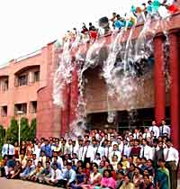
The data deluge

Slide 5
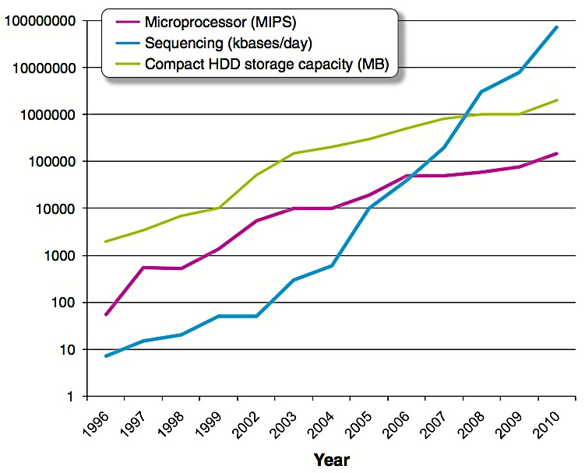
The data deluge in biology
x10 in 6 years
x10⁵ in 6 years
Notes:
Gap of >1000 – AND many more systems as people jump on bandwagon
Meanwhile, other resources [money, people] stay flat
Crisis
10^5 in 6 years
10 in 6 years

Slide 6
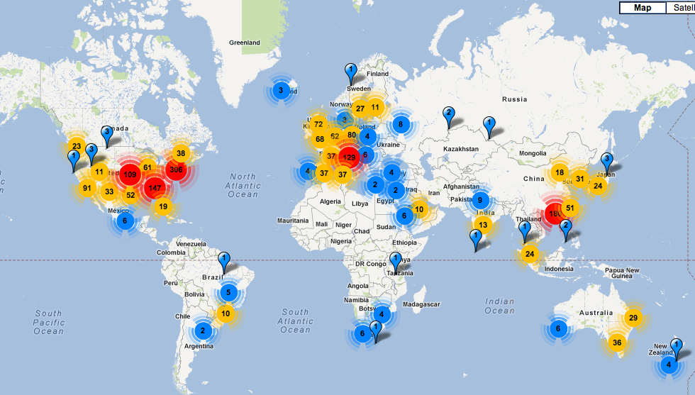
Number of sequencing machines
http://omicsmaps.com/
Notes:
http://omicsmaps.com/

Slide 7
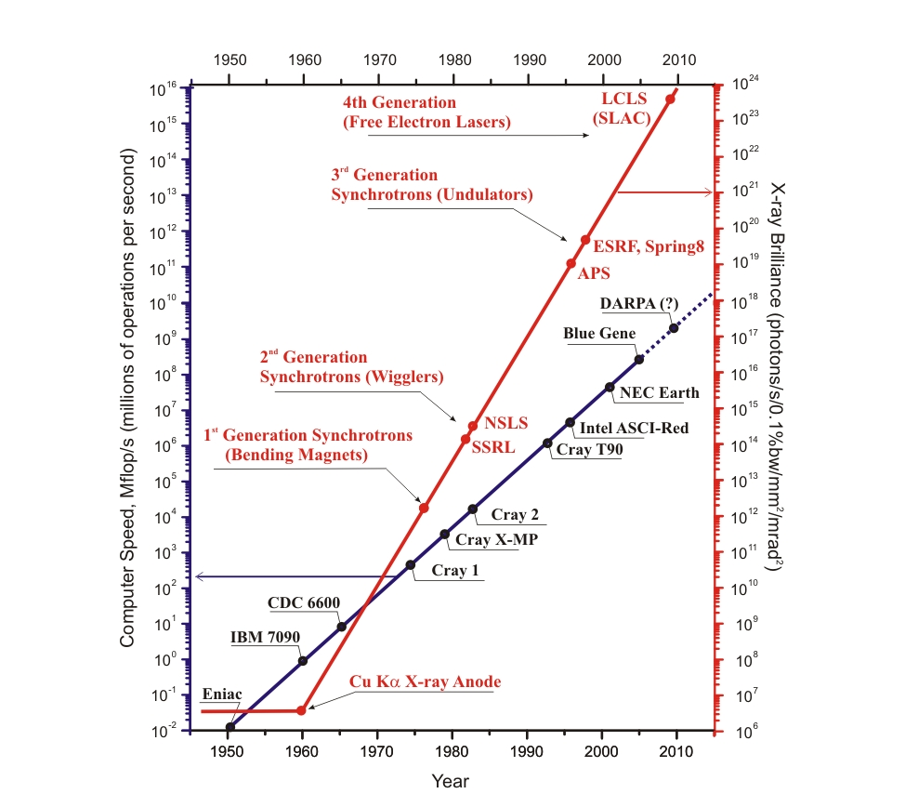
Moore’s Law for X-ray sources
18 orders
of magnitude
in 5 decades!
12 orders of
magnitude
in 6 decades
Credit: Linda Young
Notes:
Many important aspects of batteries cannot be studied in model systems, e.g., failure due to thermal runaway can only be reproduced and understood in fully encased cells where gas and heat are contained. High-energy x-ray methods allow study on actual cells, revealing nanoscale physical and chemical structures.
Nanostructured electrodes combine higher charge storage and diffusivity, which are key to the energy storage needs for transportation and renewable energy. Li-air batteries offer the ultimate in energy storage density but face major roadblocks; for example, the difficult problem of developing metal catalysts to break Li-O bonds at the air electrode

Slide 8
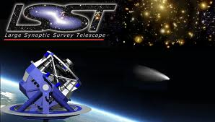
Exploding data volumes in astronomy
MACHO et al.: 1 TB
Palomar: 3 TB
2MASS: 10 TB
GALEX: 30 TB
Sloan: 40 TB
100,000 TB
Pan-STARRS:
40,000 TB

Slide 9
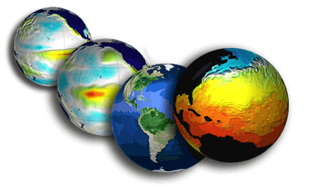
Exploding data volumes in climate science
2004: 36 TB
2012: 2,300 TB
Climate
model intercomparison
project (CMIP) of the IPCC

Slide 10
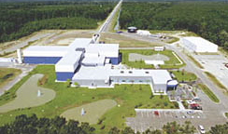
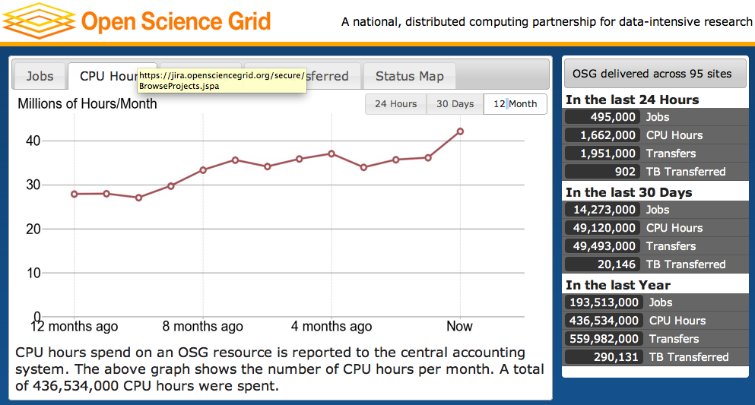

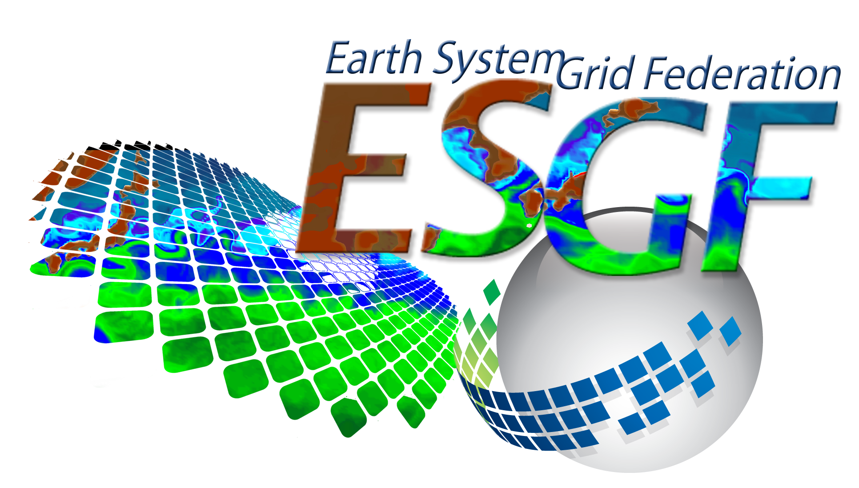
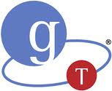
Big science has been successful
OSG: 1.4M CPU-hours/day, >90 sites, >3000 users,
>260 pubs in 2010
LIGO: 1 PB data in last science run, distributed to 800 scientists worldwide
Substantial teams
Sustained effort
Leverage common technology
Application-specific solutions
Production focus
ESG: 1.2 PB climate data
delivered to 23,000 users; 600+ pubs
All build on Globus Toolkit software

Slide 11
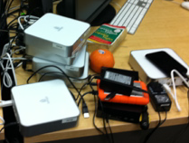
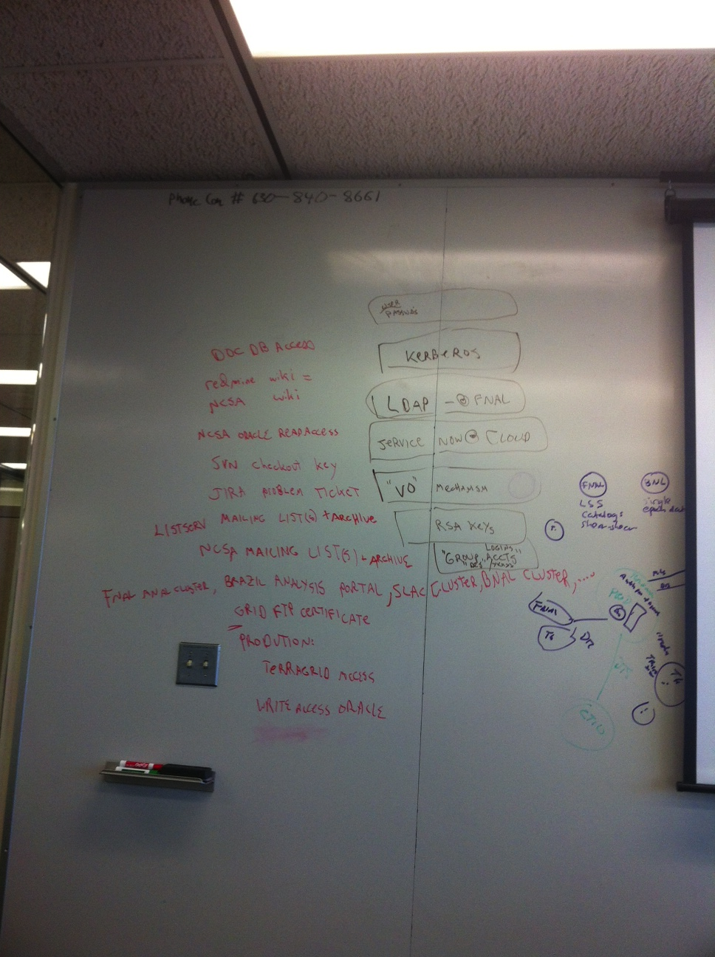
But small and medium science is suffering
Data deluge
Ad-hoc solutions
Inadequate software,
hardware & IT staff

Slide 12
Dark data in the long tail of science
NSF grant awards, 2007 (Bryan Heidorn)
Notes:
80% of awards and 50% of grant $$ are < $350K

Slide 13
A crisis that demands new approaches
We have exceptional infrastructure for the 1% (e.g., supercomputers, Large Hadron Collider, …)
But not for the 99% (e.g., the vast majority of the 1.8M publicly funded researchers in the EU)
We need new approaches to providing research cyberinfrastructure, that:
— Provide advanced functionality
— Reduce barriers to entry
— Are cheaper
— Are sustainable
Notes:
The answer cannot simply be more money
We lack both $$ and the people to spend $$ on

Slide 14
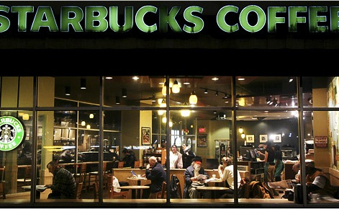
Run a research project from a coffee shop?
Notes:
Small and medium businesses deal with these challenges by outsourcing many business functions to third-party “cloud” providers.
Last year we introduced the seemingly farfetched notion that one could run a research project from a coffee shop…

Slide 15
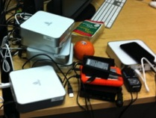
Rethinking how we provide research IT
Accelerate discovery and innovation worldwide by providing research IT as a service
Leverage the cloud to
provide millions of researchers with unprecedented access to powerful tools;
enable a massive shortening of cycle times in
time-consuming research processes; and
reduce research IT costs dramatically via economies of scale
Notes:
Not (particularly) computing as a service
But the IT functions that researchers need to function
Include collaboration as a service

Slide 16
Time-consuming Tasks in Research
Run experiments
Collect data
Manage data
Move data
Acquire computers
Analyze data
Run simulations
Compare experiment
with simulation
Search the literature
Communicate with colleagues
Publish papers
Find, configure, install relevant software
Find, access, analyze relevant data
Order supplies
Write proposals
Write reports
…
“Civilization advances by extending the number
of important operations which we can
perform without thinking of them”
—Alfred North Whitehead , 1911
Notes:
So let’s look at that list again.
I and my colleagues started an effort a little while ago aimed at applying SaaS to one of these tasks …

Slide 17
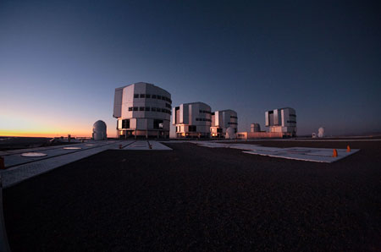
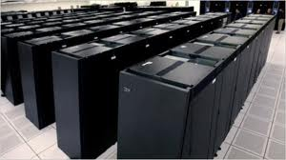

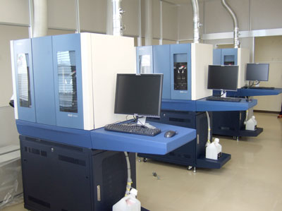
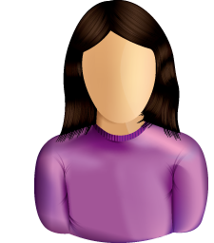
Addressing the big data challenge
Telescope
In millions of labs worldwide, researchers struggle with massive data, advanced software, complex protocols, burdensome reporting
Simulation
Staging
Ingest
Registry
Community Repository
Analysis
Next-gen genome
sequencer
Archive
Mirror
Accelerate discovery and innovation by outsourcing difficult tasks

Slide 18
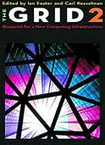


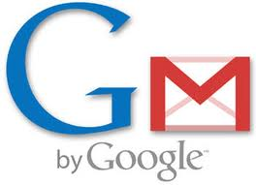


Grid meets Cloud
Millions of researchers worldwide need advanced IT to tackle important and urgent problems
The Research Cloud
Notes:
Leverage the cloud to
provide millions of researchers with unprecedented access to powerful tools;
enable massive shortening of cycle times in
time-consuming research processes; and
reduce research IT costs dramatically via economies of scale

Slide 19
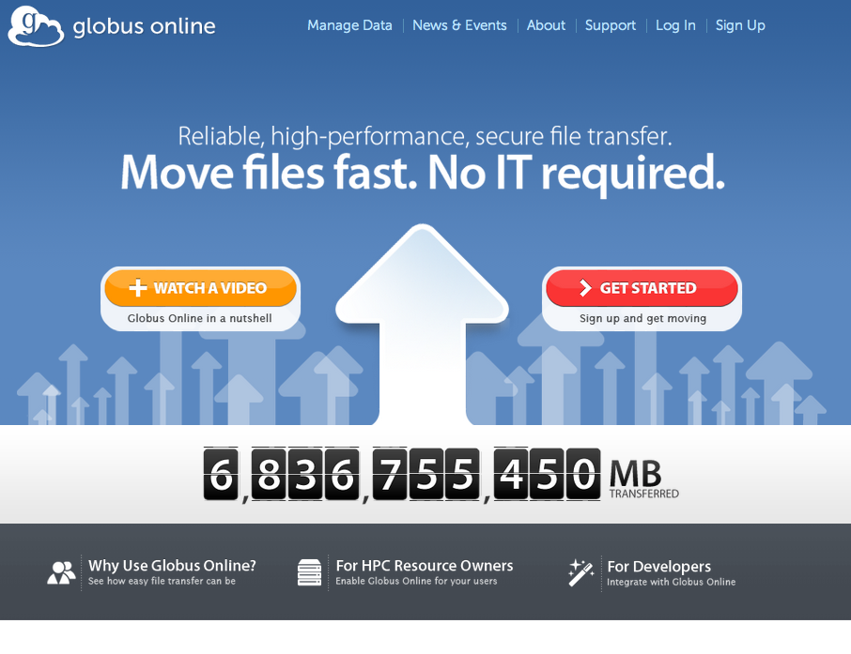

Slide 20
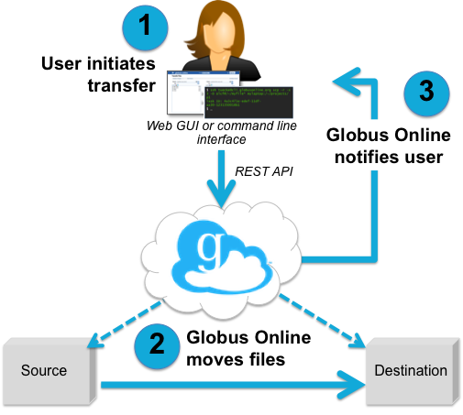
What is Globus Online?
Transfer and synchronize files
  Easy “fire-and-forget” transfers
  Automatic fault recovery
  High performance
  Across multiple security domains
Minimize IT costs
  Software as a Service (SaaS)
    No client software installation
    New features automatically available
  Consolidated support & troubleshooting
  Simple endpoint installation with Globus Connect and GridFTP
Recommended by XSEDE, Blue Water, NERSC, ALCF, ESnet, many Universities

Slide 21

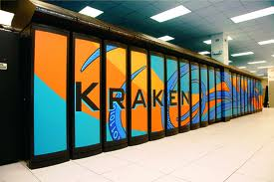

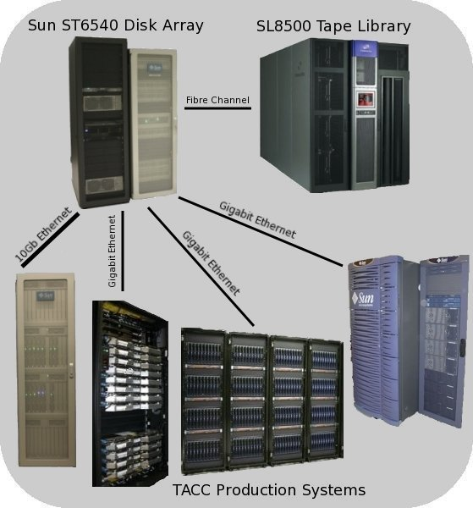
Case Study: Lattice QCD
Fast: Reduced transfer times
Easy: Fire-and-forget transfers
  Automated retry
  No file pre-staging
  No complex infrastructure
  Convenient CLI and GUI interfaces
Indiana University researcher moved
~6 TB from Tennessee to Texas in 2 days
“Globus Online frees up my time to do more creative work than typing scp commands or devising scripts to initiate and monitor progress to move many files.”
“I moved 100 7.3 GB files tonight in about 1.5 hours. I am very impressed. I also like the new commands and help system.”

Slide 22

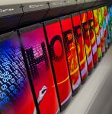
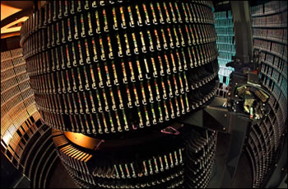
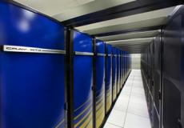
Case Study: Enabling Users @ NERSC
Challenge
  “We need to provide web-based ways to accomplish computing tasks – it’s what our scientists expect. And it will make them more productive.”
Solution
  Globus Online endpoints maintained by NERSC
  Globus = recommended transfer method
Benefits for NERSC users
  Drag and drop archiving
  Easy to use
  Users can focus on their research (not on IT)
Benefits for NERSC
  Operations and support outsourced to Globus
  Fast and easy to make endpoints available
  Automated authentication
  Reliable performance and support
“Fantastic! I have already started using Globus Connect to transfer data, and it only took me 5 minutes to set up. Thank you!” – NERSC user
Hopper, Franklin and HPSS are among the NERSC resources leveraged by Globus Online.
Notes:
Point out the Globus Online picture with endpoints

Slide 23
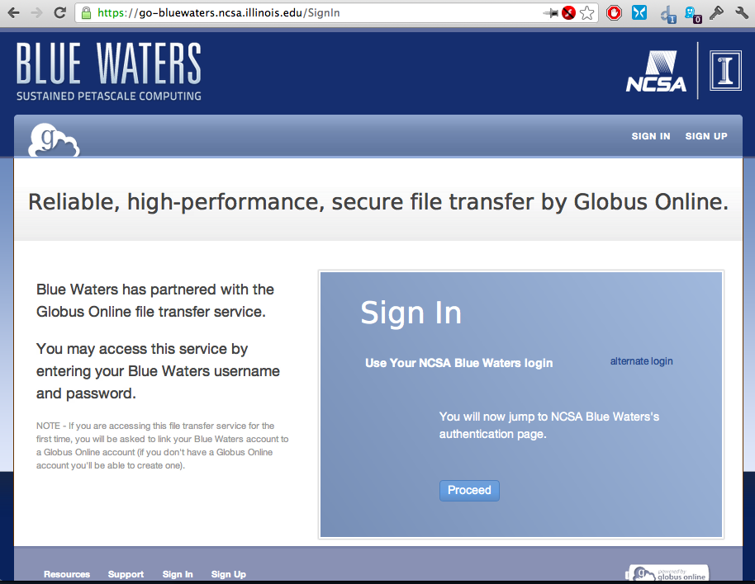

Slide 24
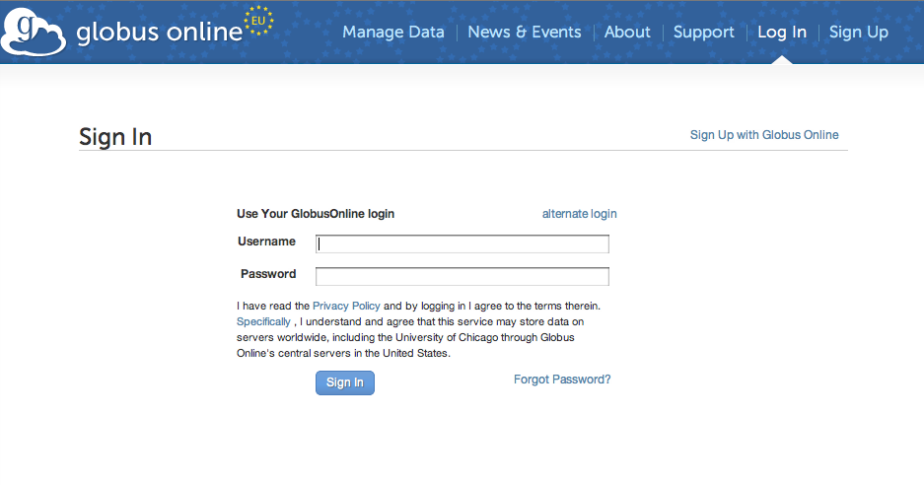


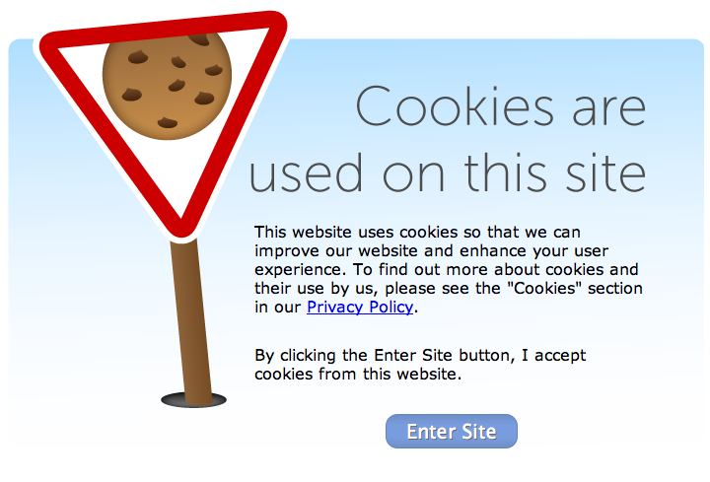
globusonline.eu (coming soon)
Partners
EU-friendly identity providers
EU relevant endpoints
Integrated support with EGI & IGE
EU Cookie Law compliant
Consent to store log data in US

Slide 25
Why SaaS?
Software-as-a-Service (SaaS)
Platform-as-a-Service (PaaS)
Infrastructure-as-a-Service (IaaS)
Deliver advanced functionality that:
  Requires no user software installation or operation
    Minimal IT proficiency required
  Can be cheaply and incrementally adopted
    Usage-based subscription pricing; no big up-front costs
  Consolidates troubleshooting and support
    An expert group can proactively detect and correct problems
  Utilizes an efficient software delivery lifecycle
    Updates developed, tested and deployed quickly
Dominates commercial & consumer markets
  What about the research market?

Slide 26
Software as a Service (SaaS) vs Traditional software delivery
SaaS changes assumptions and approach throughout the software lifecycle
  Architecture and design
    Designed for specific environment (e.g., AWS)
  Software development
    No porting or cross platform testing. Focus on functionality.
  Operations
    Continuous update cycle. Nobody else will operate.
    Focus on availability, automation, monitoring
  Support
    Tightly integrated with operations
We are delivering a service, not software

Slide 27
Potential economies of scale
Small laboratories
  PI, postdoc, technician, grad students
  Estimate 10,000 across US research community
  Average ill-spent/unmet need of 0.5 FTE/lab?
+ Medium-scale projects
  Multiple PIs, a few software engineers
  Estimate 1,000 across US research community
  Average ill-spent/unmet need of 3 FTE/project?
= Total 8,000 FTE: at ~$100K/FTE => $800M/yr
(If we could even find 8,000 skilled people)
Plus computers, storage, opportunity costs, …

Slide 28
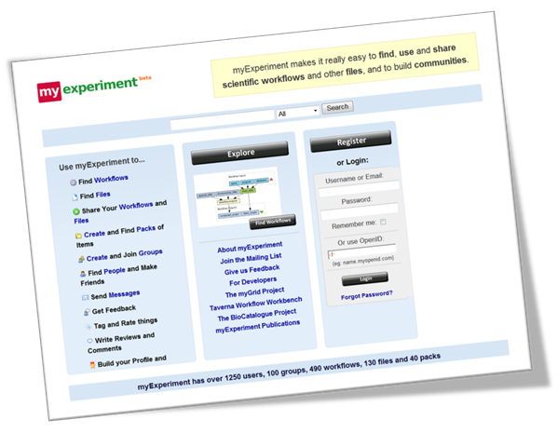
Other innovative science SaaS projects

Slide 29
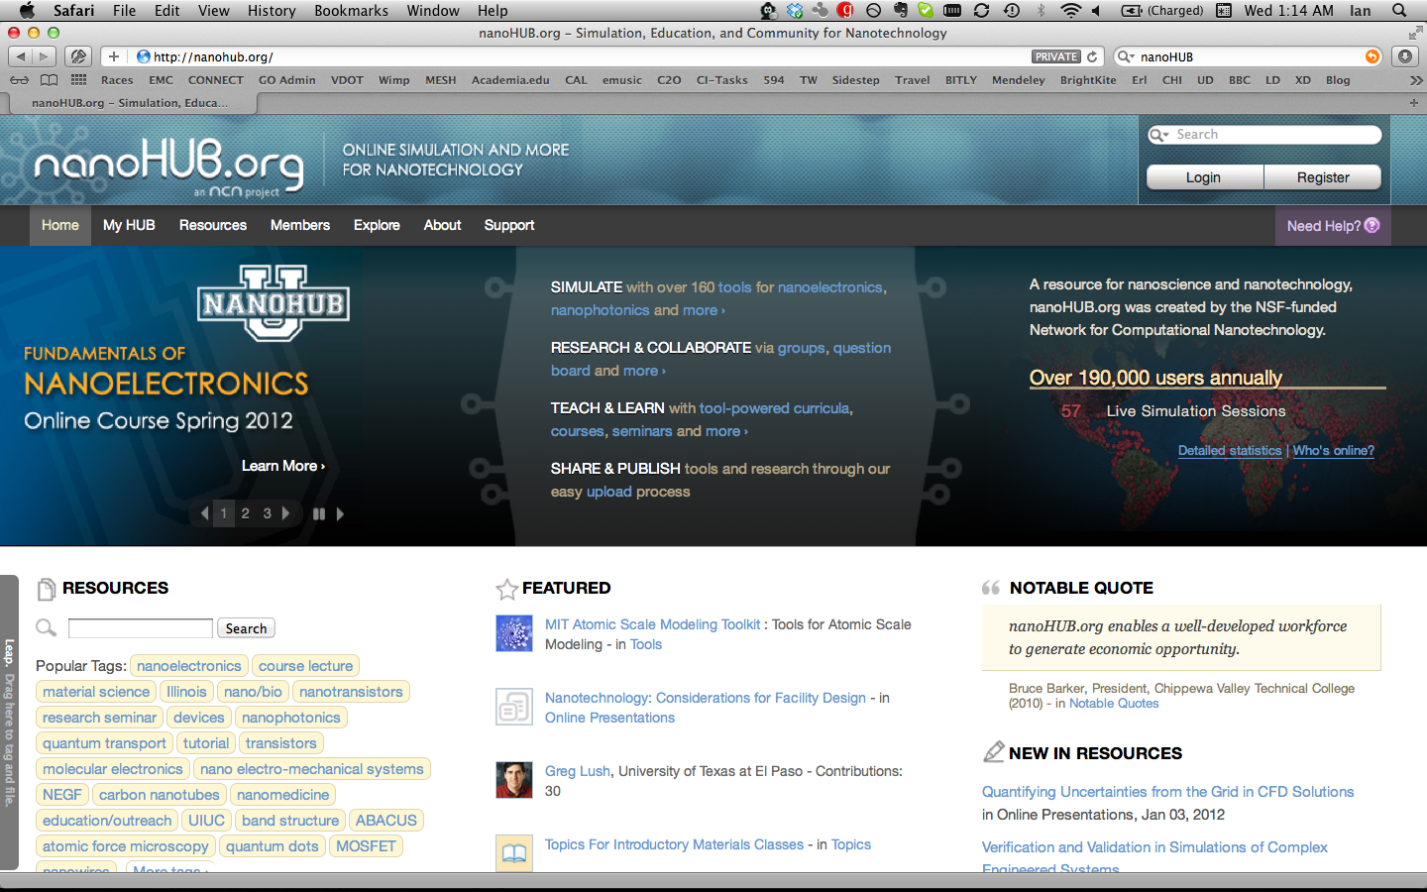
Other innovative science SaaS projects

Slide 30
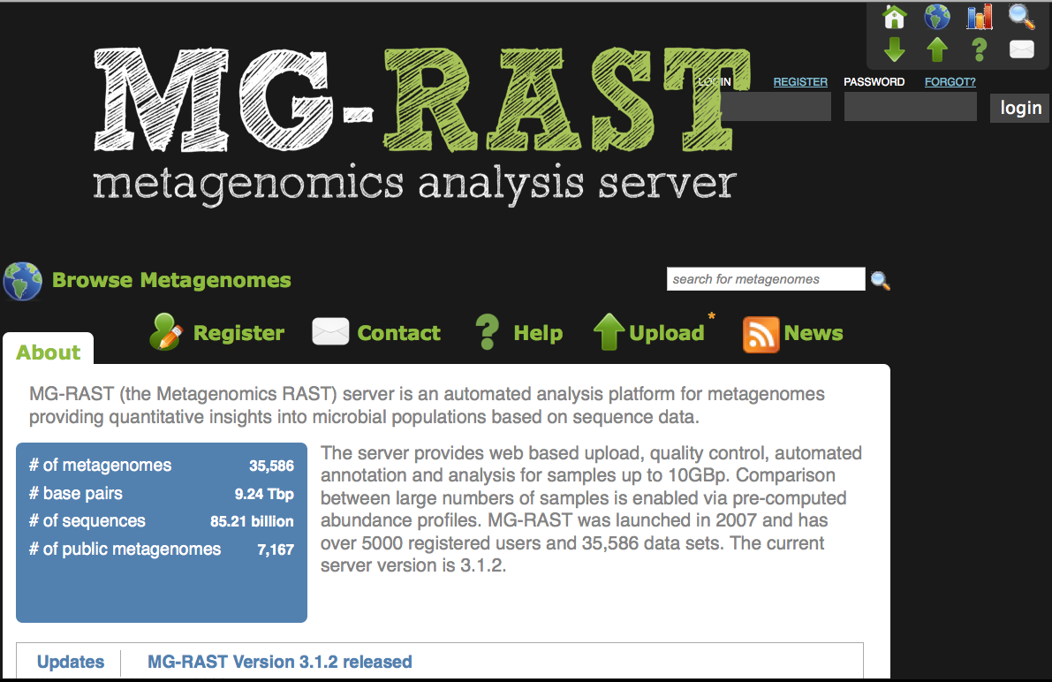
Other innovative science SaaS projects

Slide 31
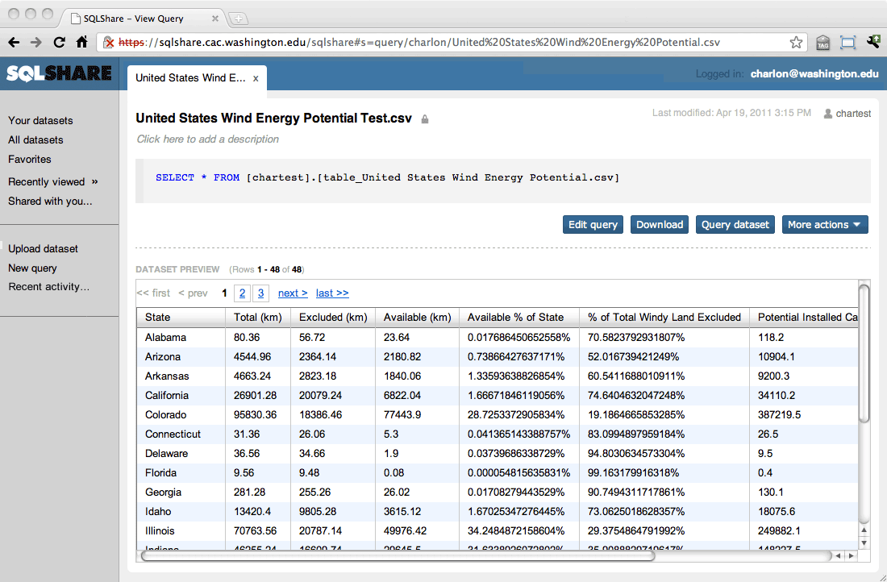
Other innovative science SaaS projects

Slide 32
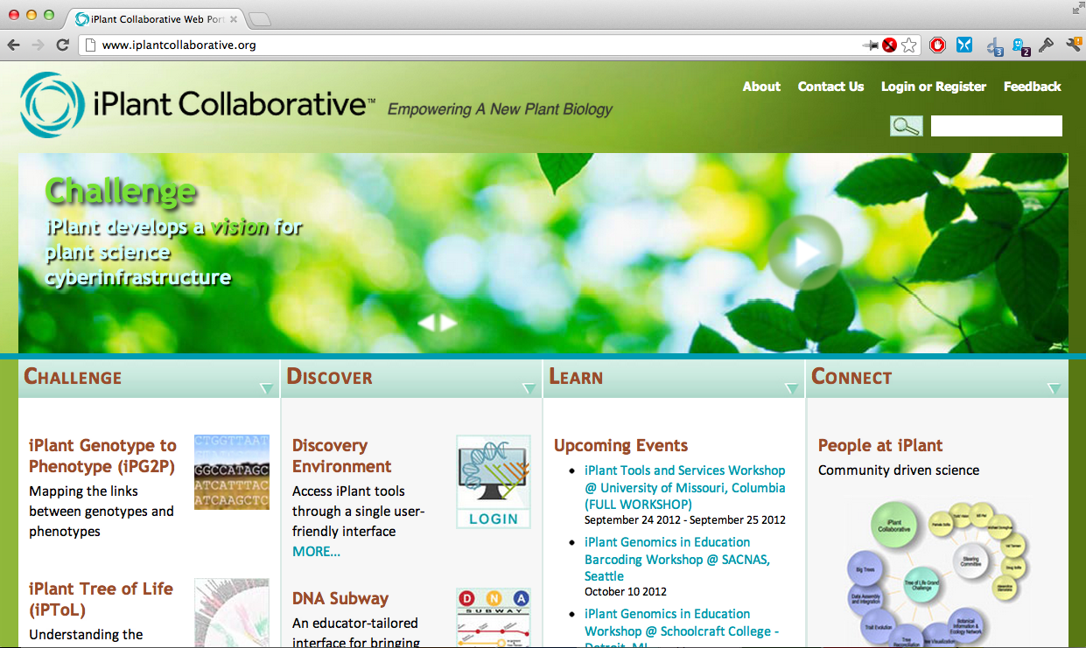
Other innovative science SaaS projects

Slide 33

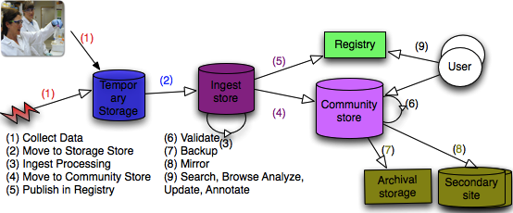
Towards “research IT as a service”
Research Data Management-as-a-Service
Globus Transfer
Globus Storage
Globus Catalog
Globus Collaborate
…SaaS
Globus Integrate
…PaaS
Notes:
Put the new services in context…

Slide 34
PaaS for Research
Software-as-a-Service (SaaS)
Platform-as-a-Service (PaaS)
Infrastructure-as-a-Service (IaaS)
No one SaaS provider can deliver it all
Must create ecosystem that:
  Allows any SaaS provider to easily participate
  Dramatically reduces the cost of creating and operating services within the ecosystem
  Provides seamless user experience across services
  Agnostic to / works across any cloud IaaS provider
Ecosystem requires Platform as a Service
  Target the unique needs of the research community

Slide 35
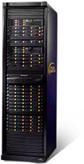
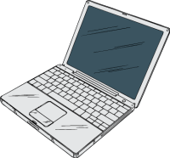
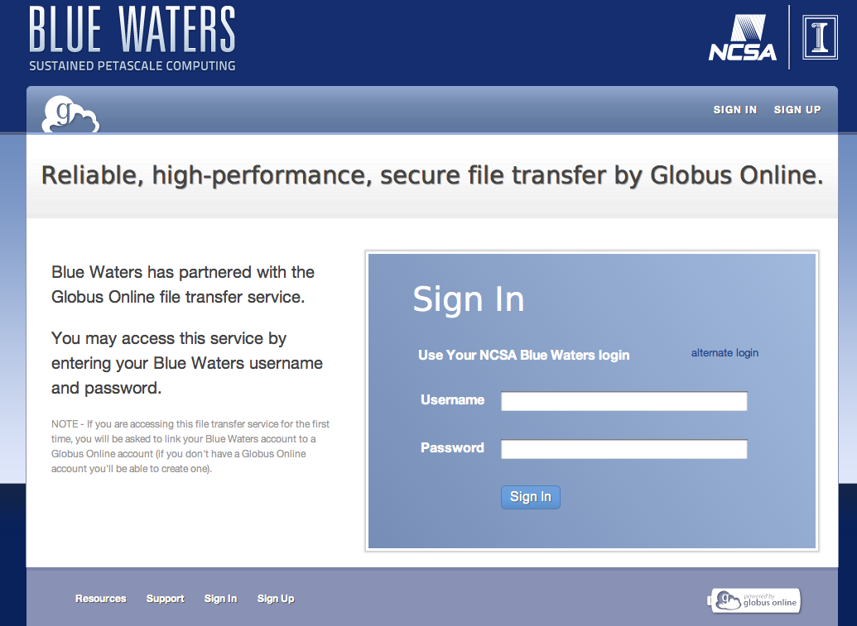
Globus Integrate: For when you want to…
Integrate with the Globus research cloud ecosystem
Write programs that leverage:
  (federated) user identities, profiles, groups
  data, compute and collaboration
… via REST APIs and command line programs
Globus Transfer
Globus Storage
Globus Catalog
Globus Collaborate
Globus Integrate
Globus Connect Multi User
Globus Connect
Globus Toolkit
Globus Nexus
Notes:
Introduce the Globus Nexus here…

Slide 36
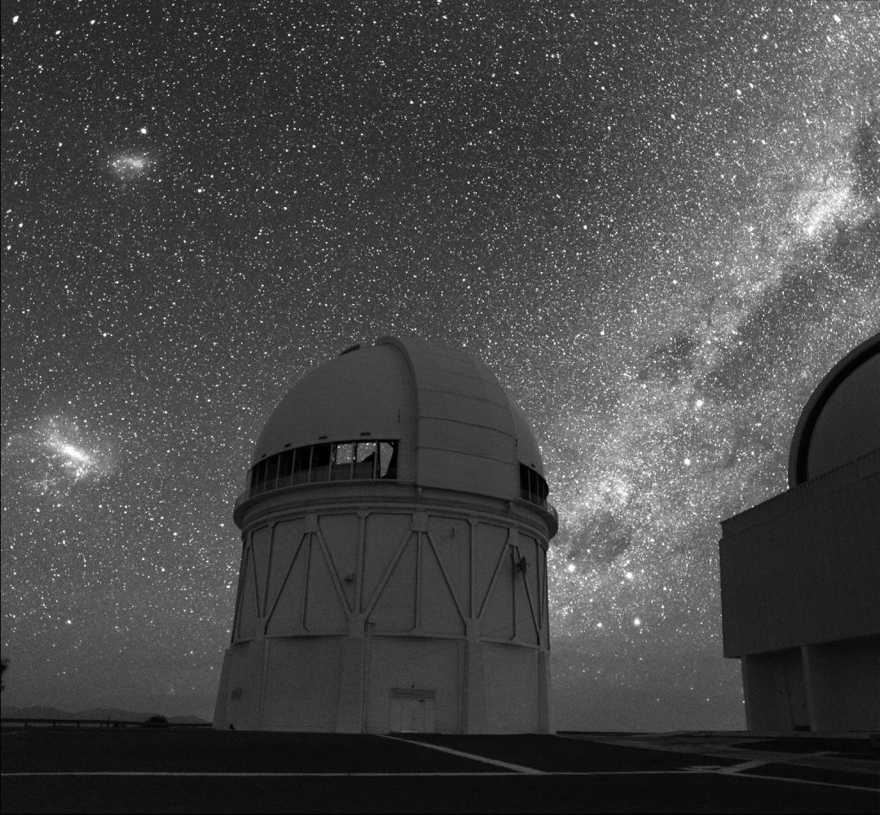
Dark Energy Survey – Leveraging transfer
Blanco 4m on Cerro Tololo
Every night, they receive 100,000 files in Illinois
They transmit files to Texas for analysis …
then move results back to Illinois …
and make them available to users
Process must be reliable, routine, and efficient
The cyberinfrastructure team is not large!
Image credit: Roger Smith/NOAO/AURA/NSF
Notes:
Not just small labs—medium science too.
E.g., Dark Energy Survey.

Slide 37
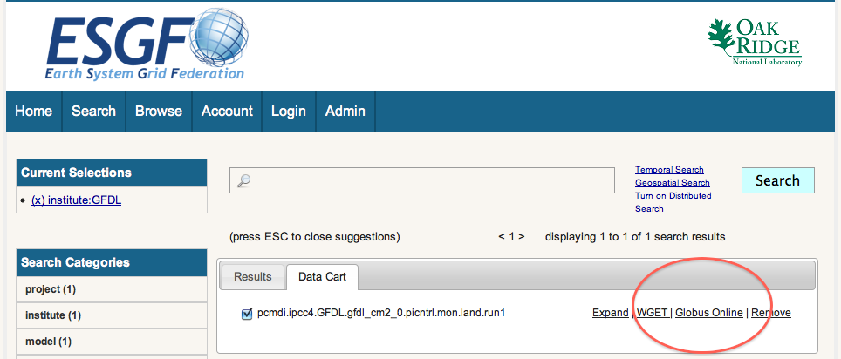
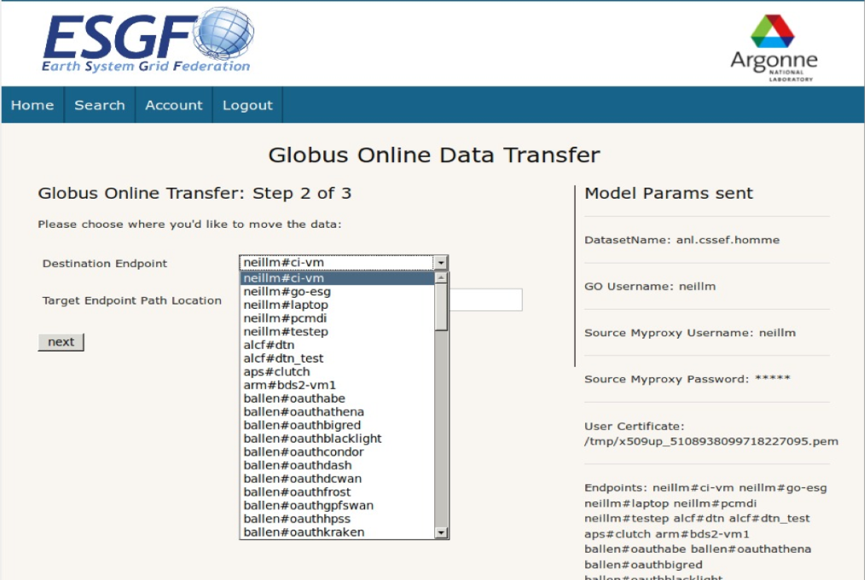
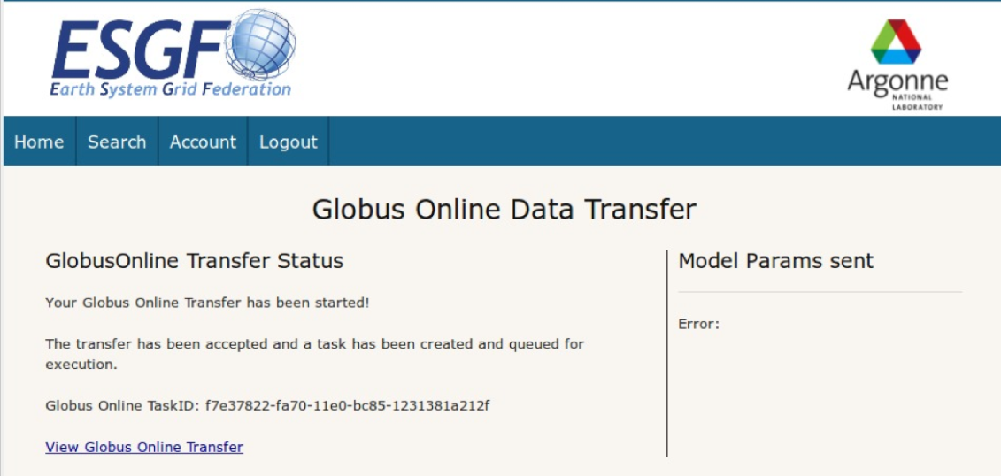
Earth System Grid – Portal integration
Outsource data transfer to Globus
  Data download to user machine from search
  Data transfer to another server by user
  Replication of data between sites by administrator
No ESGF client software needed
Notes:
Highlight portal integration (identity and such is managed else where, just integration of capability needed thus far

Slide 38
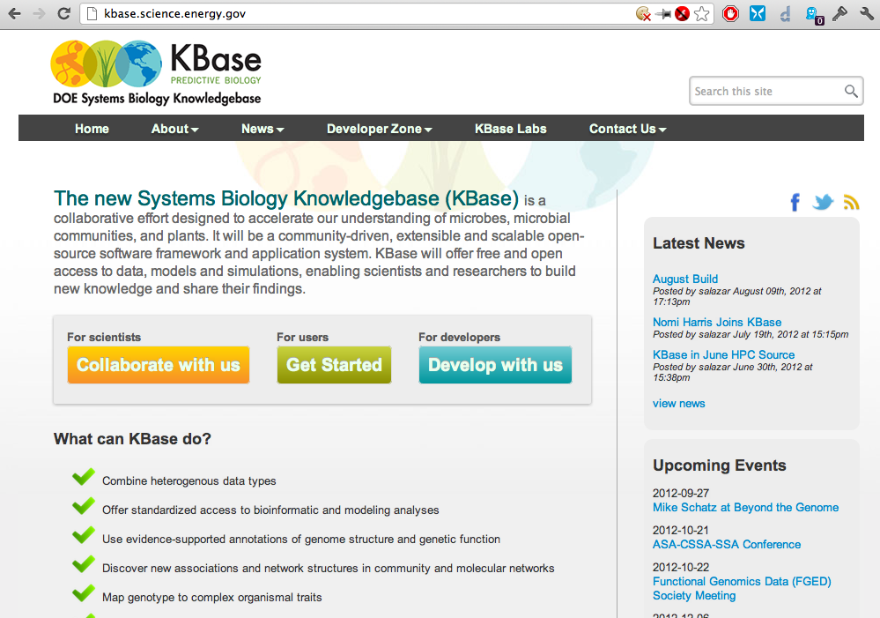
KBase – Leveraging the full platform

Slide 39


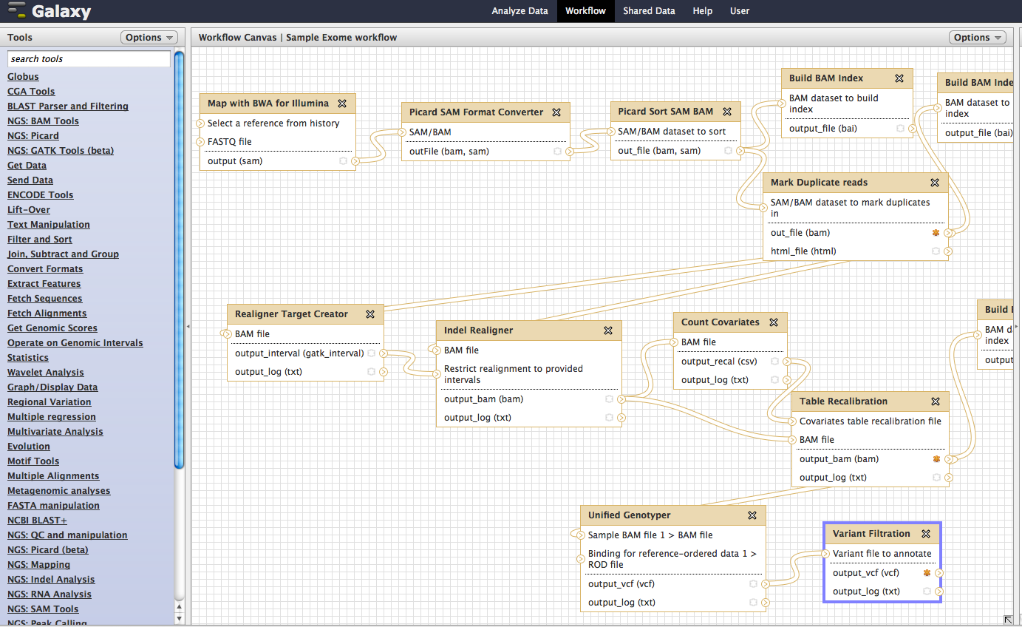
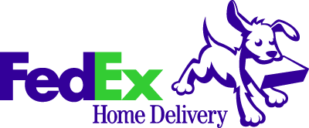
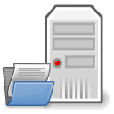
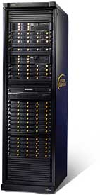
Genomics Analysis using
Globus Online and Galaxy
Globus Online
Galaxy Based Workflow Management System
Public
Data
Globus Online Integrated within Galaxy
Web-based UI
Drag-Drop workflow creations
Easily modify Workflows with new tools
FTP, SCP, others
Globus Endpoints
Fastq
Ref Genome
FTP, SCP, HTTP
Galaxy
Data Libraries
Sequencing Centers
Sequencing Centers
Globus Online Provides a
High-performance
Fault-tolerant
Secure
file transfer Service between all data-endpoints
Picard
Storage
FTP, SCP
SCP
Research Lab
Alignment
Seq Center
Local Cluster/
Cloud
Analytical tools are automatically run on the scalable compute resources when possible
GATK
Variant Calling
Galaxy in Cloud
Data Management
Data Analysis

Slide 40
Thank you!

