Slide 1

How to integrate EGI portals with
Identity Federations
Roberto Barbera (roberto.barbera@ct.infn.it)
Univ. of Catania and INFN
EGI Technical Forum – Prague, 20 September 2012

Slide 2
Outline
The Catania Science Gateway framework
Considerations driving current activities:
  The CHAIN Worldwide Interoperability Demo
  «Social» and mobile access to Science Gateways
The Science Gateway market place
Summary and conclusions

Slide 3







The Catania Science Gateway model
Embedded Applications
Administrator
Power User
Basic User
.......
App. 1
App. 2
App. N
Science
Gateway
Standard-based (SAGA) middleware-independent
Grid Engine
Users from different organisations having different roles and privileges

Slide 4
Summary of standards adopted
Catania Science Gateway framework builds on consolidated and widely adopted standards:
  The JSR 168 and JSR 286 standards (also known as "portlet 1.0" and "portlet 2.0" standards)
  The OASIS Security Assertion Markup Language (SAML) standard and its Shibboleth and SimpleSAMLphp implementations
  The Lightweight Direct Access Protocol, and its OpenLDAP implementation
  The Cryptographic Token Interface Standard (PKCS#11) standard and its Cryptoki implementation
  The Open Grid Forum (OGF) Simple API for Grid Applications (SAGA) standard and its JSAGA implementation

Slide 5











AuthN & AuthZ Schema
Science Gateway
Authorisation
Authentication
1. Register to a Service
GrIDP
(“catch-all”)
IDPCT
(“catch-all”)
Social Networks’ Bridge IdP
IDP_y
2. Sign in
LDAP
.........

Slide 6


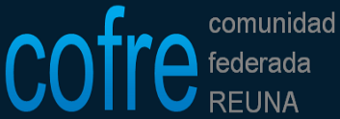
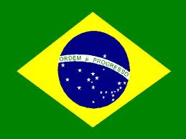








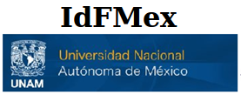

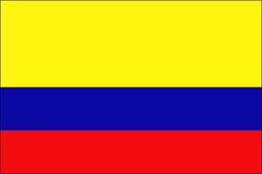



Official Identity Federations currently supported by Catania Science Gateways
To be created
soon

Slide 7
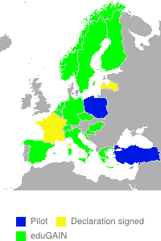
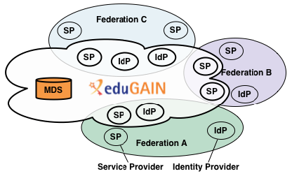
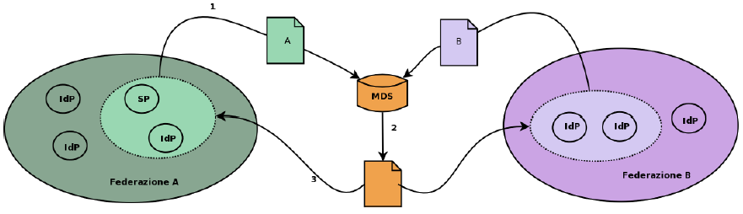
eduGAIN
(www.edugain.org)
Catania Science Gateways are also
registered as Service Providers of eduGAIN

Slide 8
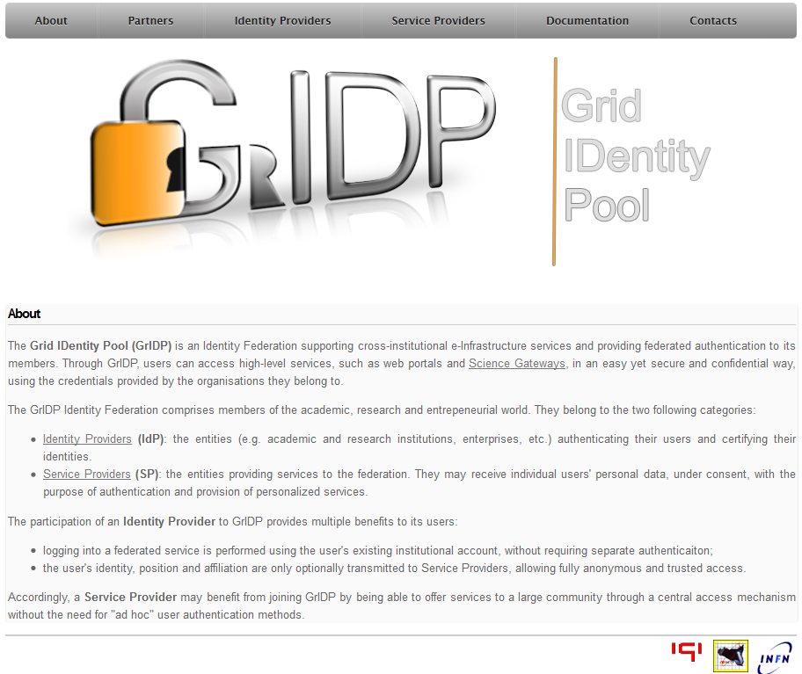
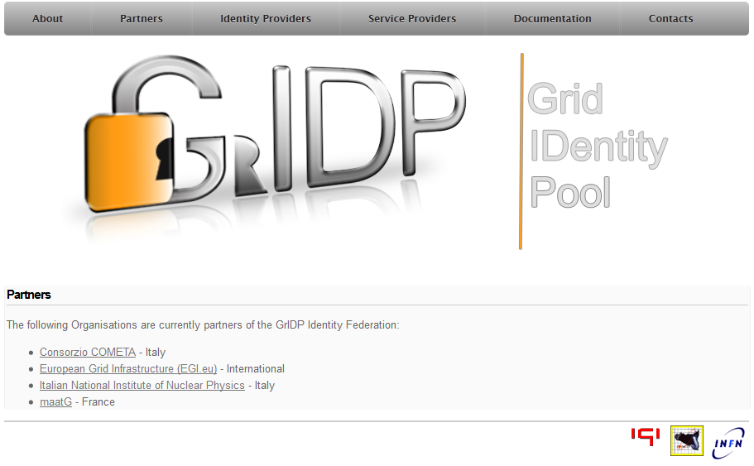
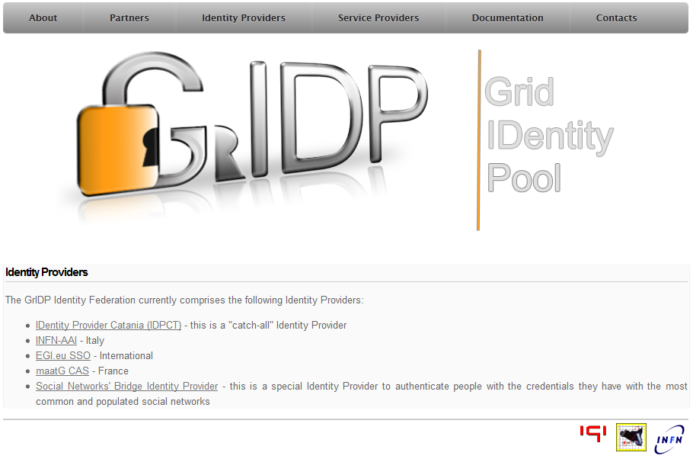
The Grid IDentity Pool (GrIDP)
(http://gridp.ct.infn.it)
This is an “open” Identity Federation

Slide 9
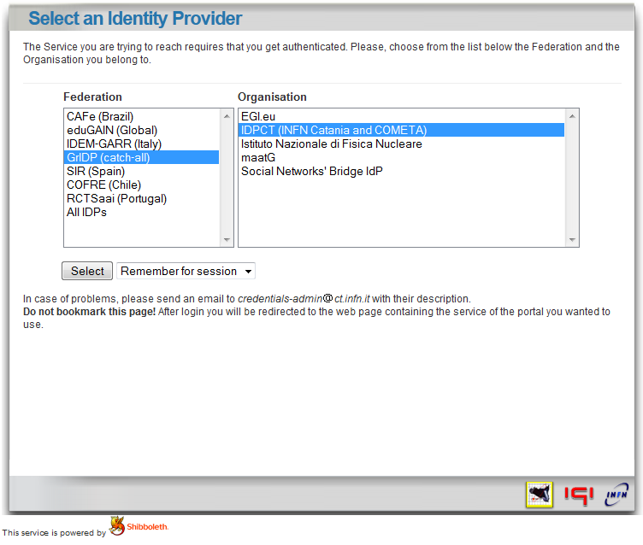
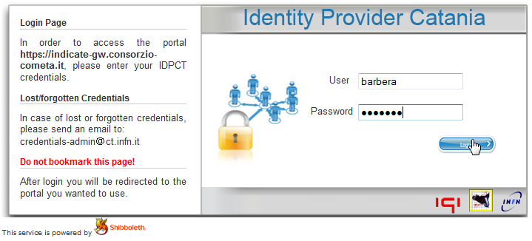
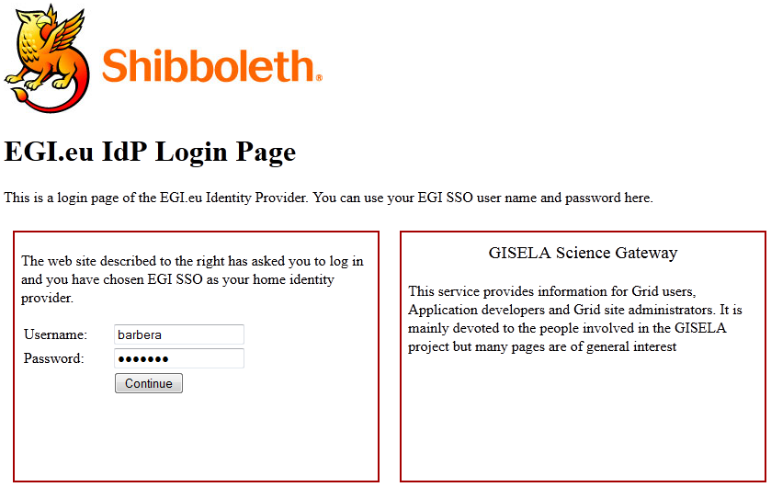
The normal Authentication Procedure
Identity Federations’ discovery service
«Open» Identity Provider
http://idp.ct.infn.it

Slide 10
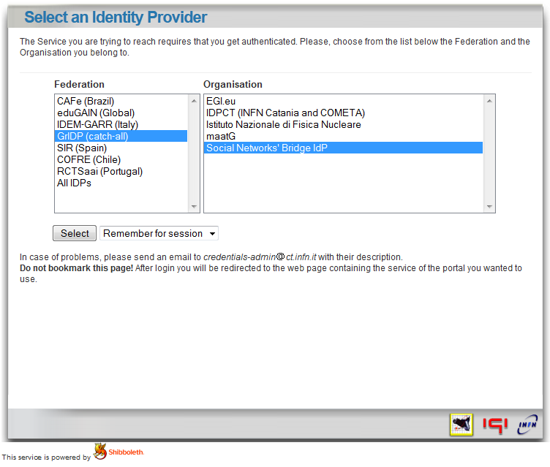
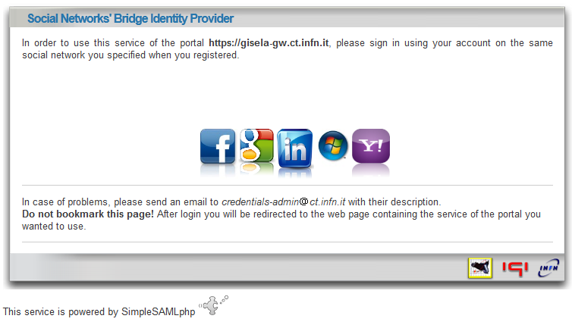
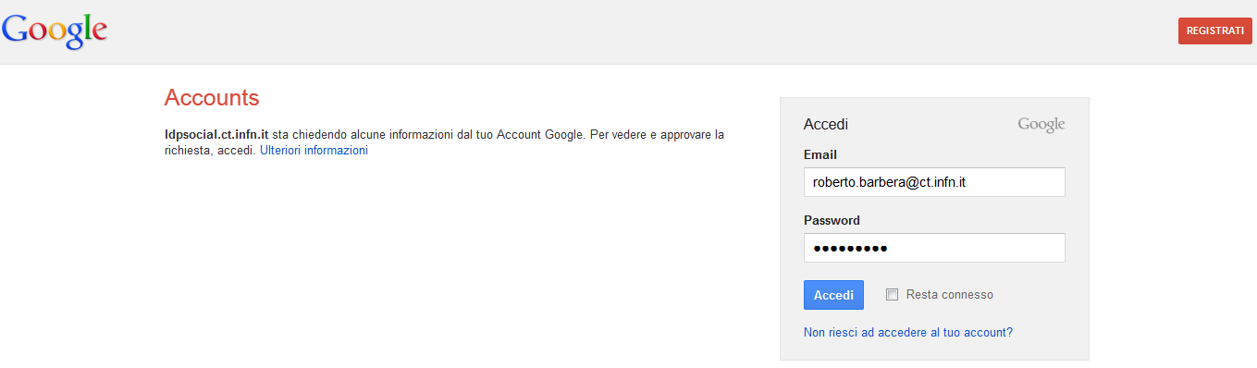
The “social” Authentication Procedure
Identity Federations’ discovery service
For more information watch
www.youtube.com/watch?v=w6wfuGUwVVU
https://idpsocial.ct.infn.it

Slide 11
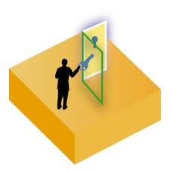

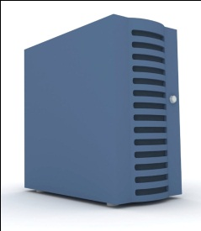




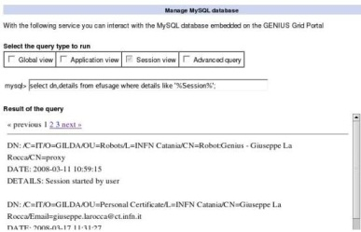

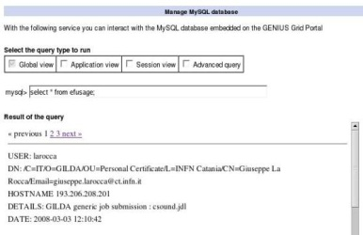
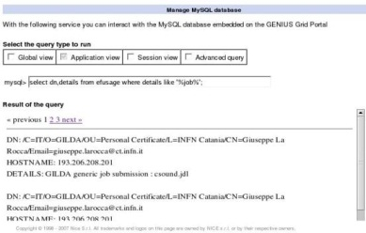
Catania Science Gateways access workflow
User Registry
eToken server
2’. authN
2”. authZ
3. create a proxy from an eToken
server with robot certificates
Identity Provider
1. sign in
6. get the results
4. execute action
The Grid
User
5. get output
Admin
3’/4’. track
user
Compliant with the EGI.eu Portal and Traceability Policies

Slide 12
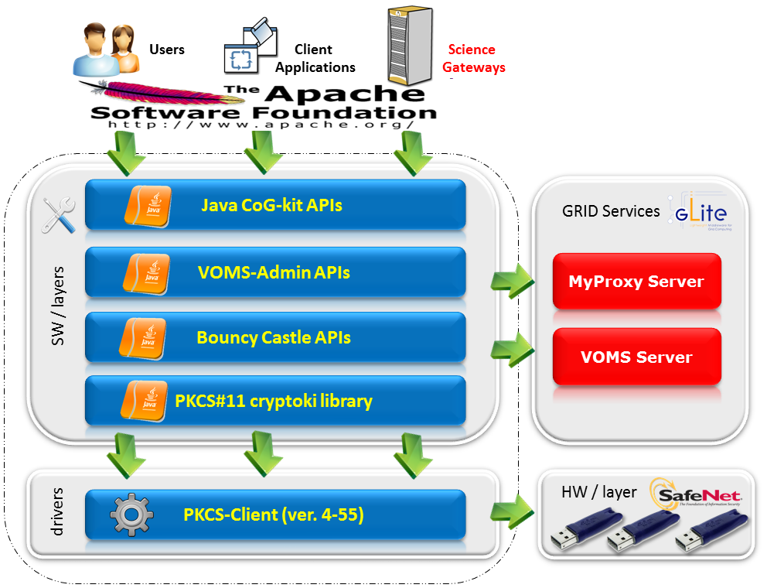
The «lightweight» crypto-library

Slide 13

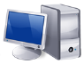
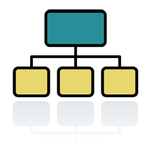




The eToken server working scenario
^{(*)} SSL encryption
ask for
a service
list/create
request
^{(*)}
eTokenServer
retrieve
serials/proxy
get
results
^{(*)}
execute
a service
get the
results back
store
long proxy
ask/get
VOMS AC attributes
VOMS Server
MyProxy Server

Slide 14
The Catania Grid Engine
Liferay Portlets
Science
GW 1
Science
GW 2
Science
GW 3
Grid Engine
eToken
Server
Science GW Interface
Data Engine
Job Engine
Users
Track &
Monit.
Users
Tracking
DB
SAGA/JSAGA API
Grid MWs
Modified
New
New
Modified

Slide 15
First set of considerations - Interoperability
Interoperability is a property referring to the ability of diverse systems and organizations to work together (inter-operate). The term is often used in a technical systems engineering sense, or alternatively in a broad sense, taking into account social, political, and organizational factors that impact system to system performance;
According to ISO/IEC 2382-01 (Information Technology Vocabulary, Fundamental Terms), interoperability is "The capability to communicate, execute programs, or transfer data among various functional units in a manner that requires the user to have little or no knowledge of the unique characteristics of those units".

Slide 16
The CHAIN Worldwide Interoperability Demo
(http://science-gateway.chain-project.eu)
To demonstrate that:
  e-Infrastructures can be made interoperable to each other at user application level using standards
    with the meaning of interoperability given in the previous slide;
  VRC-specific applications can be submitted from anywhere and run everywhere

Slide 17
The CHAIN Worldwide Interoperability Demo - Requirements
The user interface must be only web based
Users must be transparently authenticated & authorised on all e-Infrastructures without any additional human/machine intervention
There must be the smallest possible interaction with both site managers and e-Infrastructure operators
No modification whatsoever of the various middleware should be required to their developers (missing JSAGA adaptors should be created)

Slide 18
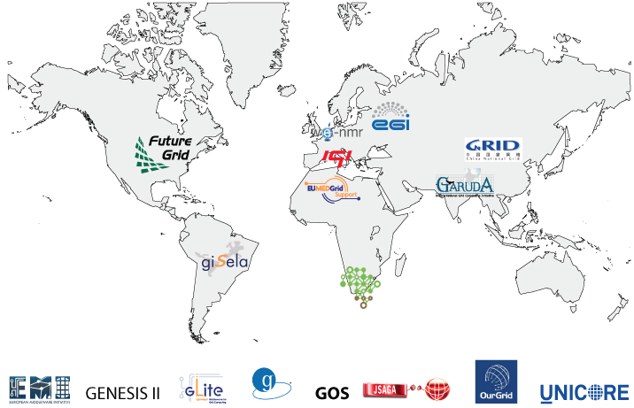



CHAIN Demo Contributors

Slide 19
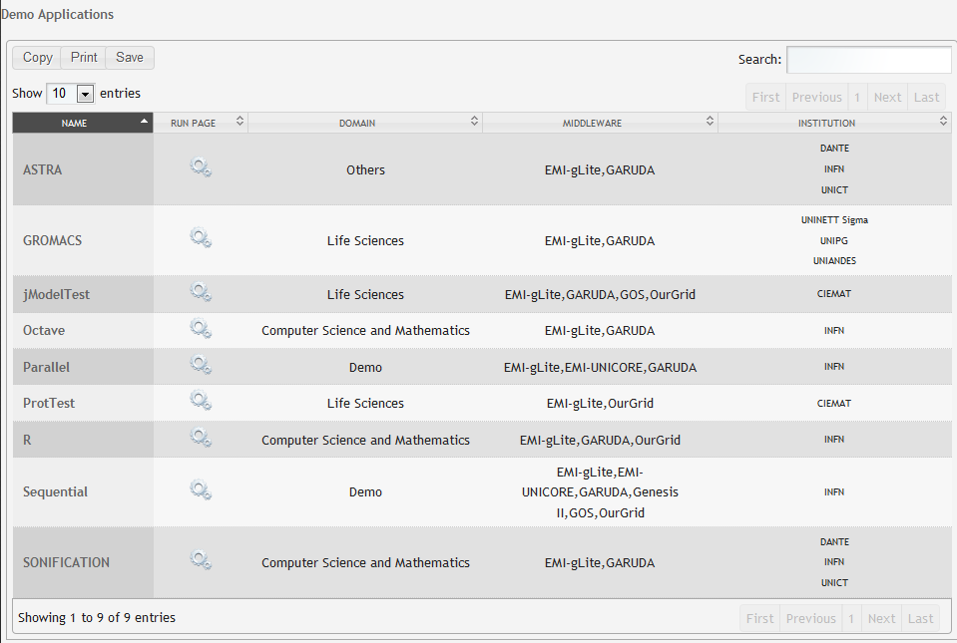
CHAIN Demo Applications
(http://science-gateway.chain-project.eu/general-overview)
general purpose applications

Slide 20
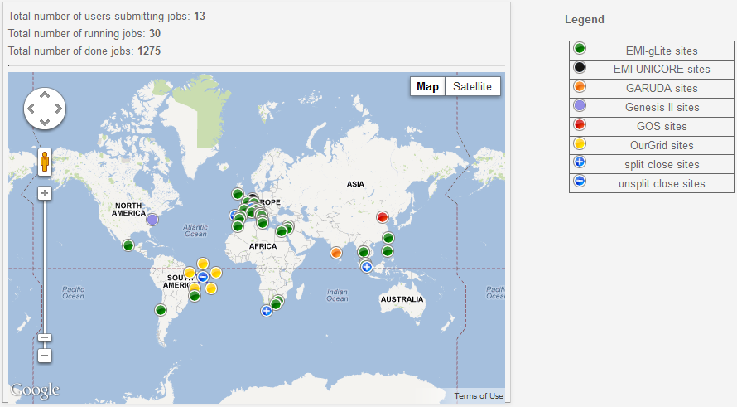
CHAIN Demo Status
(http://science-gateway.chain-project.eu/demo-status)
See the demo in action at the CHAIN booth (no. 7 in the
exhibition area) and learn how to run it yourself !

Slide 21
Second set of considerations – Social Networks
About 1 billion people have accounts on the existing Social Networks (many of the researchers we are targeting with e-Infrastructures are among them)
Web-based social networking accounts for more than 10-15% of the total time spent online in the whole world
Social Networks’ are by far the most used (liked) virtual environments in the world

Slide 22

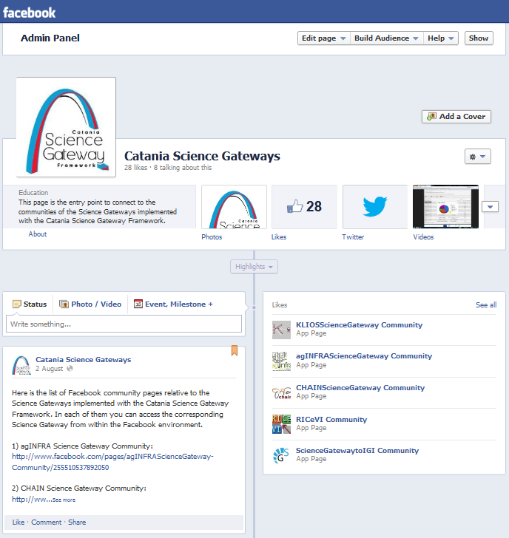
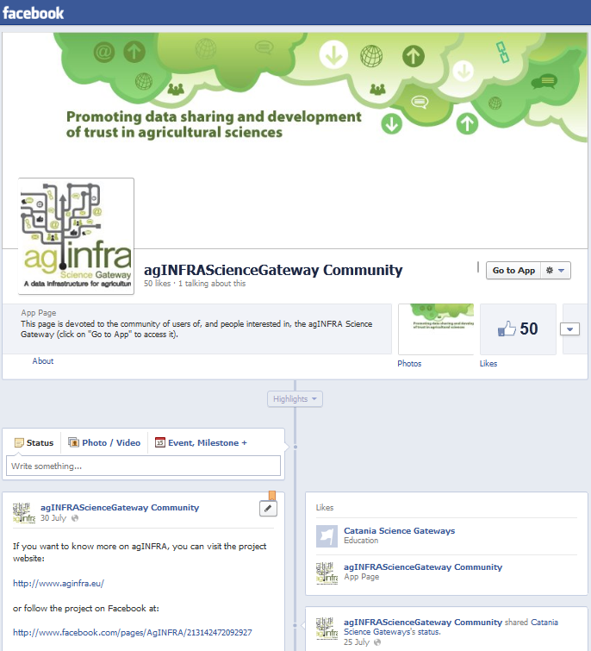
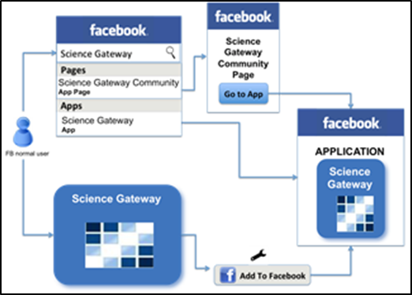
Catania “social” Science Gateways
(http://www.facebook.com/pages/Catania-Science-Gateways/220075701389624)

Slide 23
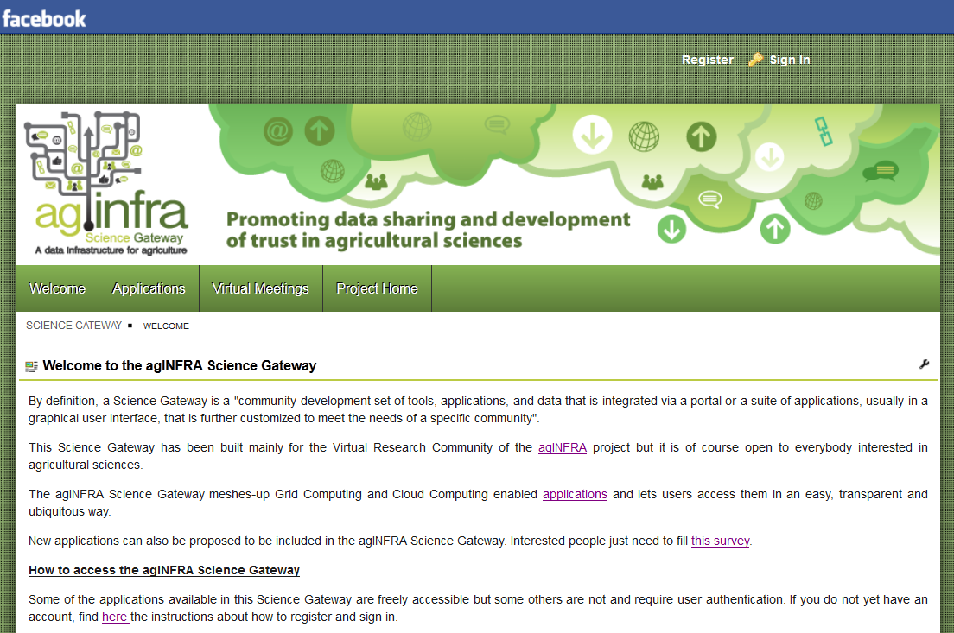
Catania “social” Science Gateways
(agINFRA Science Gateway as Facebook app)
SSO possible through the Social Networks’ Bridge IdP

Slide 24
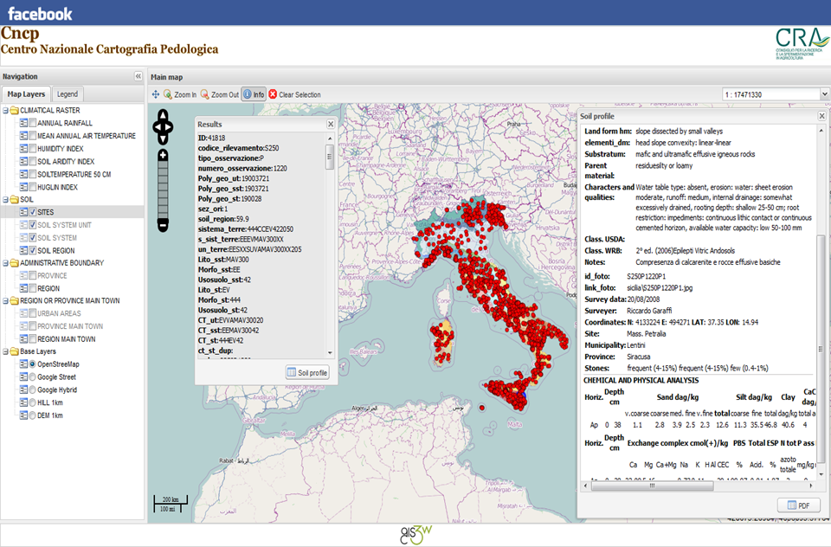
Catania “social” Science Gateways
(Italian Soil Information System – WebGIS-based and Cloud-enabled)

Slide 25
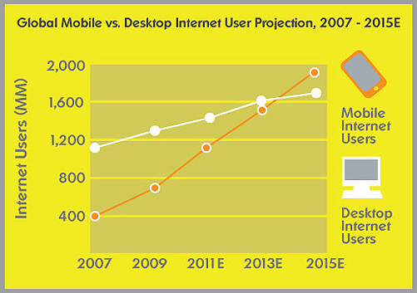
Third set of considerations – Mobile Access
More than 25% of mobile phones in the world are smartphones and the number of people connected through mobile appliances increases every year
Social networking amounts to 91% of mobile internet access, compared to 79% on desktops, and it is expected that by 2014 mobile internet should take over desktop internet usage^{(*)}
So, mobile access to “everything” is not any more an option; it is a must and e-Infrastructures shouldn’t/won’t be an exception
^{(*)} http://www.biztechday.com/mobile-stats-2011-91-use-mobile-phones-to-socialize

Slide 26
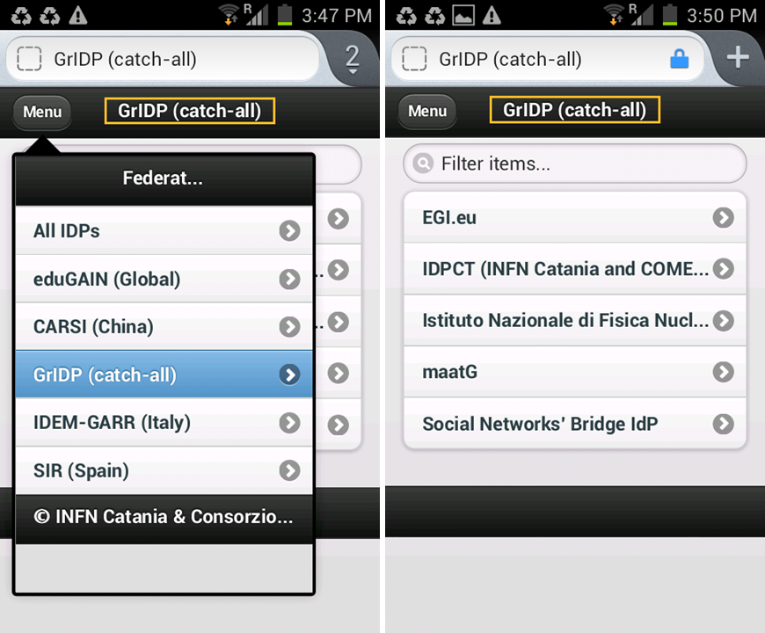

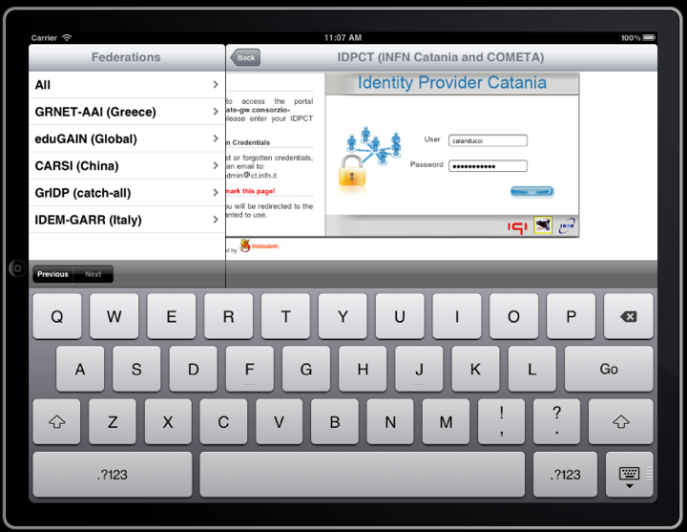
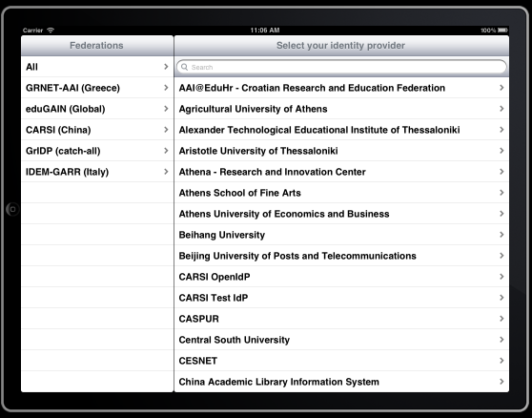
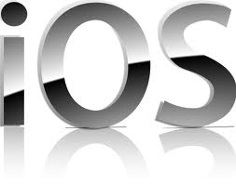
The “mobile” Authentication Procedure
(REST API independent of the Science Gateway)

Slide 27
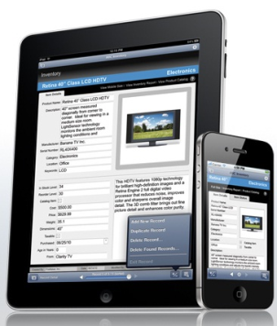



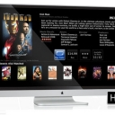
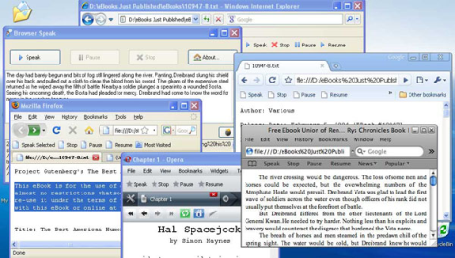




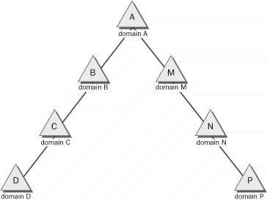
Example #1: the new gLibrary architecture
Science Gateways
gLibrary REST API
Repo 1
Repo 2
Repo 3
Discovery Service
Rest API
Metadata Services
Storage Services
Grid Auth Service
AuthN/AuthZ Services
eToken Service
Databases
Storages
Identity Federations
e-infrastructure resources

Slide 28
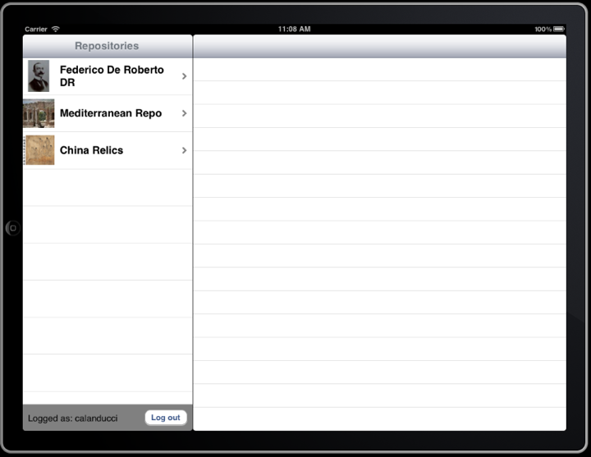
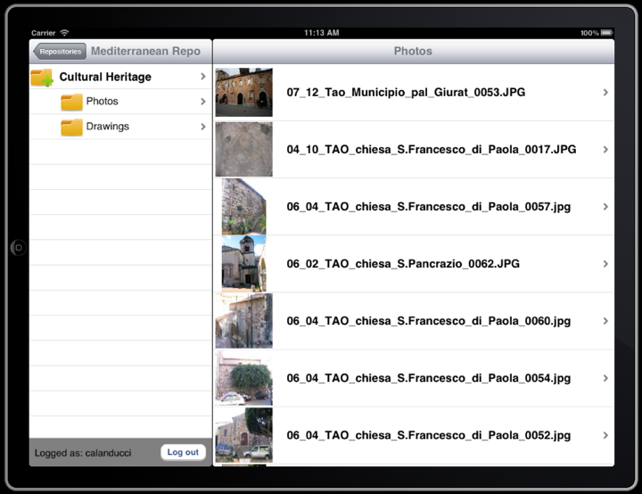
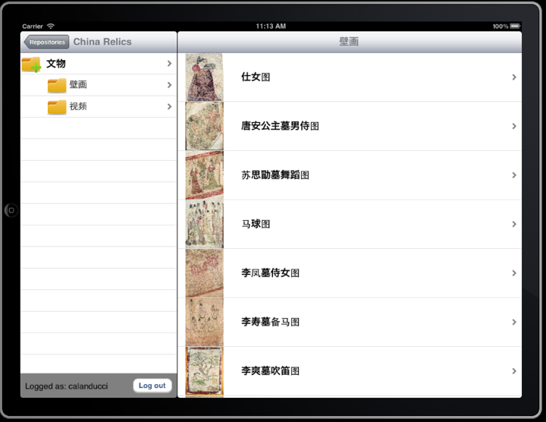
The mobile version of the INDICATE
e-Culture Science Gateway – Browse contents

Slide 29
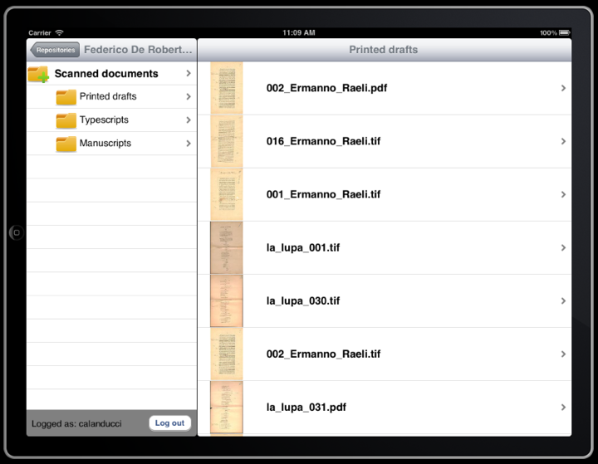
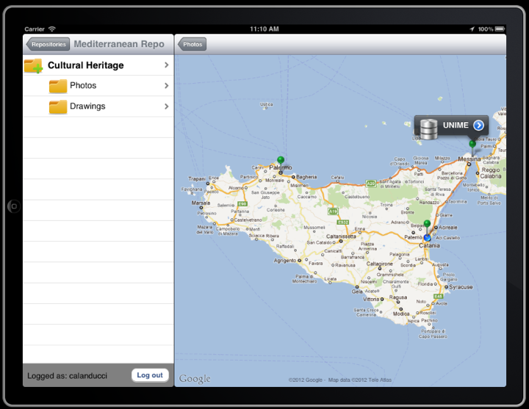
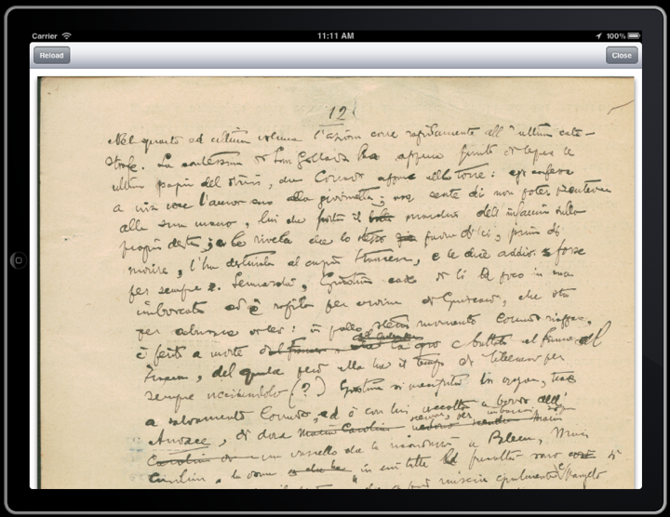
The mobile version of the INDICATE
e-Culture Science Gateway – Download contents

Slide 30
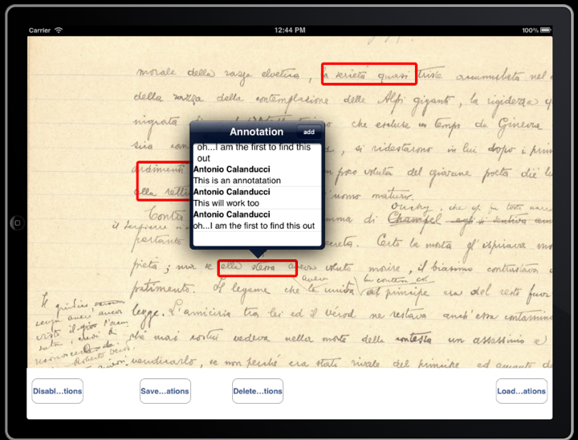
The mobile version of the INDICATE
e-Culture Science Gateway – Annotate contents
First prototype

Slide 31
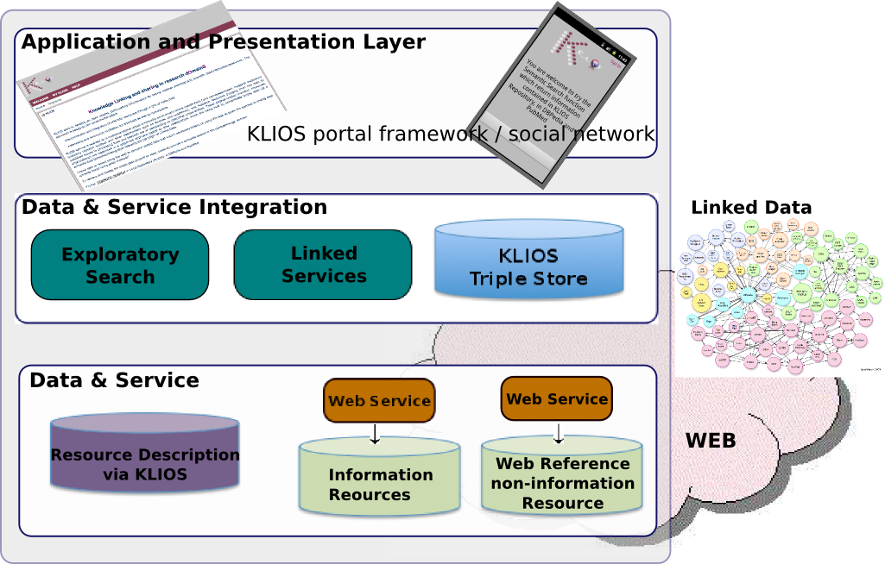
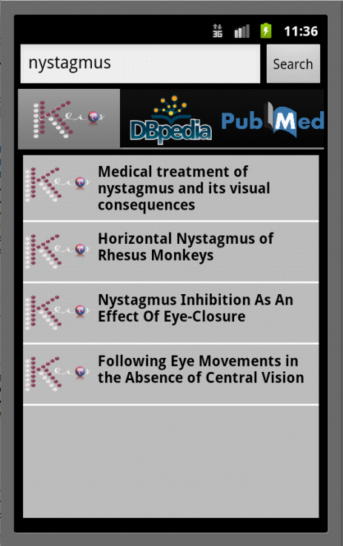


Example #2: KLIOS mobile
(klios.ct.infn.it)
Knowledge Linking and sharIng in research dOmainS

Slide 32
Big challenges are in front of us…
Now that many users can potentially access and use Catania Science Gateways, a new training and communication strategy is needed as well as a portfolio of appealing applications to attract them

Slide 33













The Science Gateway market place
SG Dev.
Users/VRCs
2.
1.
3.
4.
5.
Science Gateway

Slide 34

Survey for VRCs to propose applications
(http://applications.epikh.eu/survey4sciencegateways)

Slide 35


Training for Science Gateway developers
New training material:
New training tools:
New training events:
  http://agenda.ct.infn.it/conferenceDisplay.py?confId=608
  http://agenda.ct.infn.it/conferenceDisplay.py?confId=784

Slide 36
Catania Science Gateway application developers task force
Argentina: 1
Brazil: 1
China: 1
Colombia: 9
Ecuador: 2
Italy: ~10
Mexico: 6
South Africa: 1
Spain: 2
Uruguay: 1
Venezuela: 7

Slide 37

Uptake of Catania Science Gateways
Users from 184 Organisations in 43 Countries

Slide 38
Summary and conclusions
e-Infrastructures can be very beneficial platforms for many users, provided they are really «easy to use»
Catania Science Gateways, with support for Identity Federations, Social Networks and mobile access, are changing the way Grid infrastructures are used, hugely widening their potential user base, especially non-IT experts and the “citizen scientist”, yet keeping the required security
The adoption of standards (JSR 286, SAGA, SAML, etc.) represents a concrete investment towards sustainability and allows worldwide interoperability at user application level
By design, the components of Catania Science Gateways have maximum re-usability and, indeed, they have been already adopted in/by several projects (agINFRA, DECIDE, EarthServer, EUMEDGRID-Support, GISELA, INDICATE, etc.)
If you want to join the Science Gateway market place, please contact me at sg-licence@ct.infn.it

Slide 39
Thank you !

