Slide 1

Network Connectivity for Science Clouds -
Developing Network-as-a-Service.
Jurry de la Mar, EGI Technical Forum, September 2012

Slide 2
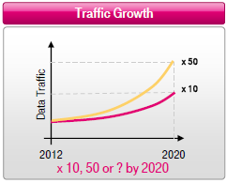

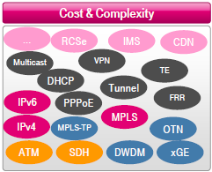
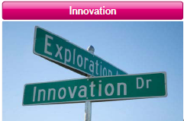
Carrier challenges

Slide 3
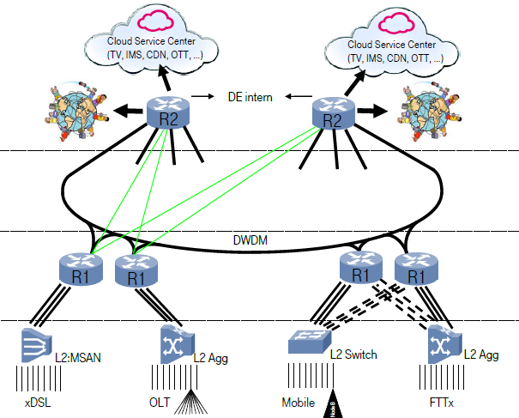
New Architectures

Slide 4















Current Internet
Roadblocks to Innovation
Current Mode of Operation:
High complexity and cost,
Coarse traffic management,
not easy to innovate on top
Closed
Service
Service
Service
Operating
System
Specialized Packet Forwarding Hardware
Service
Service
Service
Operating
System
Service
Service
Service
Specialized Packet Forwarding Hardware
Operating
System
Service
Service
Service
Specialized Packet Forwarding Hardware
Operating
System
Specialized Packet Forwarding Hardware
Service
Service
Service
Operating
System
Specialized Packet Forwarding Hardware

Slide 5















“Software Defined Networking” Approach To Open It
LB service
FW service
IP routing service
Network Operating System
Service
Service
Service
Operating
System
Specialized Packet Forwarding Hardware
Service
Service
Service
Operating
System
Service
Service
Service
Specialized Packet Forwarding Hardware
Operating
System
Service
Service
Service
Specialized Packet Forwarding Hardware
Operating
System
Specialized Packet Forwarding Hardware
Service
Service
Service
Operating
System
Specialized Packet Forwarding Hardware

Slide 6
The “Software-defined Network”
Future Mode of Operation:
Lower complexity and cost,
Granular traffic management,
Dynamic and Automated
North-bound
interface API
Unchanged mgmt API
LB service
FW service
IP routing service
Network Operating System
OpenFlow API
Simple Packet Forwarding Hardware
Simple Packet Forwarding Hardware
Simple Packet Forwarding Hardware
Simple Packet Forwarding Hardware
Simple Packet Forwarding Hardware
Notes:
SDN Defines a new model for high performance, and cost effective network infrastructure:
Network control is decoupled from forwarding and is directly programmable.
Enables the underlying infrastructure to be abstracted and thereby virtualized

Slide 7





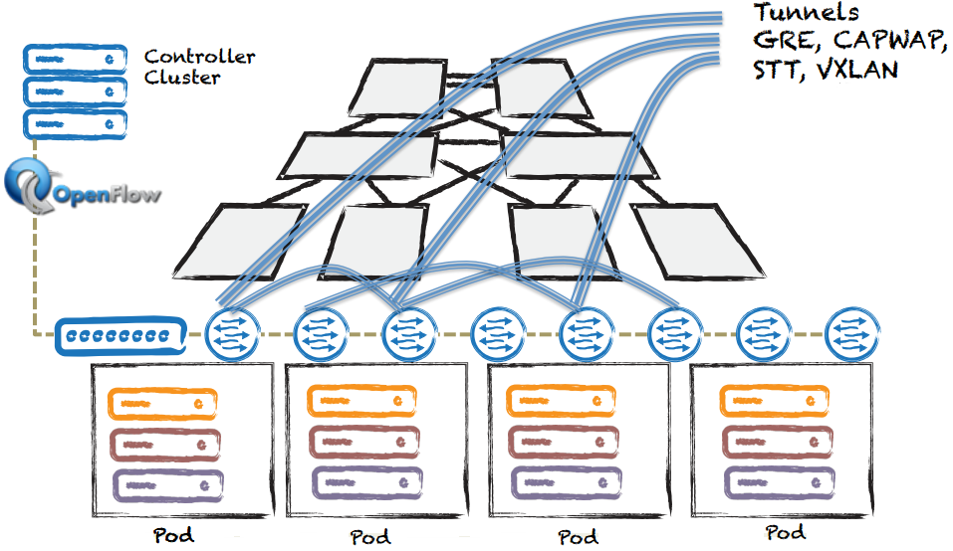
Two Modes of SDN Deployment
In-network: Existing or green-field network fabrics upgraded to support OpenFlow
2. Overlay: WITHOUT changing fabric, the intelligence is added to
edge-devices,
  as an additional appliance (e.g., gateways managed by controller)
  as enhanced server kernel bridge (e.g., OpenVSwitch in x86 hypervisors)
Hardware
switch
Control Path
OpenFlow
Data path (Hardware)

Slide 8
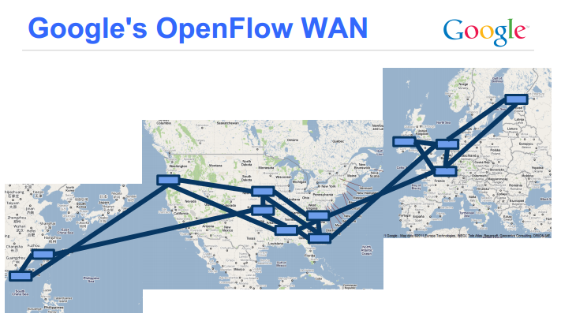
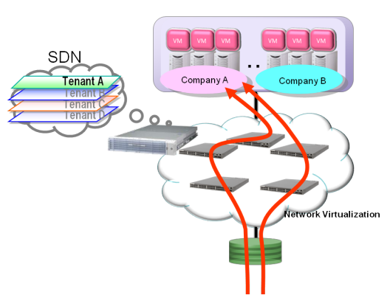
Publicly Announced SDN Production Deployments
Google (Mode #1):
  Uses OpenFlow controllers and enabled switches to interconnect their data centers
AT&T, eBay, Fidelity Investments, NTT and Rackspace (Mode #2):
  Using OpenStack Quantum and Nicira NVP controller to manage the virtual networks within cloud environment
Genesis hosting (Hybrid Mode #1 + Mode #2)
  Uses NEC controller in intra-data-center scenario in production setting

Slide 9
Summary – The “Software Defined Network”
Define networks for (cloud) applications
Increase Service flexibility (SaaS, PaaS, …)
Reduce Costs
Global and widely supported emerging standard
A pragmatic approach for European Science …..?

Slide 10
References
OpenFlow:
www.openflow.org
Open Network Foundation:
www.opennetworking.org
Deutsche Telekom activities:
Revolutionizing Carrier Service Delivery,
Axel Cauberg, VP IP Architecture and Design
http://opennetsummit.org/talks/ONS2012/clauberg-wed-carrier.pdf

