Slide 1
Science Gateway session introduction
Robert Lovas
MTA SZTAKI / NGI_HU NIL
[robert.lovas@sztaki.mta.hu]
EGI Technical Forum 2012, Prague
http://tf2012.egi.eu

Slide 2
SGP-VT Project
General project info
Start : 16 May 2012
End : 15 Nov 2012
Wiki : http://go.egi.eu/sgp-vt
What is a Science Gateway?
EGI science gateway is a community-specific set of tools, applications, and data collections that are integrated together via a web portal or a desktop application, providing access to resources and services from EGI.
Motivation
How to identify the right set of technologies to build a science domain specific gateway? Dedicated webpages to present basic information about ready to use SGs and about SG enabling technologies are in place.
This VT aims to help gateway developers and provide an 'EGI gateway primer', a manual that collects useful and up to date information from the EGI community about science gateway development.

Slide 3
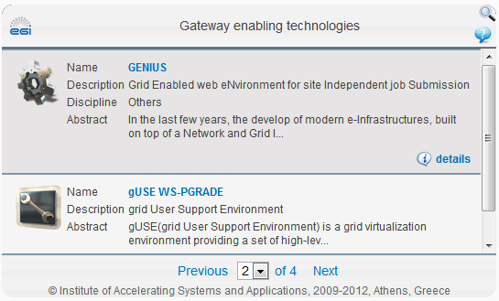
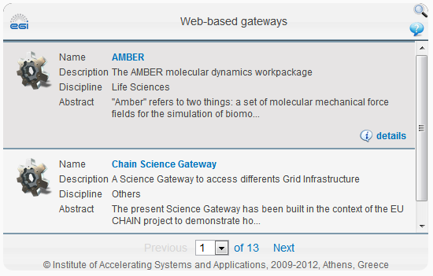
EGI AppDB

Slide 4
Project and members
Goals?
Provide a comprehensive document, an 'EGI science gateway primer‘, that collects information about technologies, policies, solutions that exist from the EGI community for gateway developers,
Up to date and complete information in the EGI Application Database about EGI science gateways and science gateway enabling technologies,
Recommendations on how to improve the data structure of the EGI Application Database and the EGI website to better support science gateway developers.
Who?
34 individuals (including 5 NILs) from Armenia, France, Greece, Hungary, Ireland, Italy, Netherlands, Poland, Serbia, Malaysia, Spain, Switzerland, Taiwan, UK, and Ukraine

Slide 5
Progress and plans
Achievements | Status
Wiki site, regular WebEx meetings, etc. | DONE
Learning from the others, e.g. XSEDE | DONE
Focus on the Primer ToC | READY
Draft of Primer with several chapters | AVAILABLE for the VT members
Organize and advertise a double session at the EGI.TF.2012 | DONE
Next steps | When
Presentations and discussion on SG double session @ EGI.TF.2012 | 20th Sep.
More contributions based on the presentations and discussions | Mid Oct.
EGI AppDB / EGI website improvements | Last month

Slide 6
SG Primer – current status
1 INTRODUCTION
2 DEFINITIONS
2.1 Distinction Between "Enabling Technology", "SG Framework", and "SG Instance"
2.2 Front-end, Back-end
2.3 Roles: Gateway User (Community), Developer, and Operator; Middleware Operators and Developers
3 SG FUNCTIONAL FEATURES/FUNCTIONALITIES (e.g. Data management)
4 SG LIST AND COMPARISON
5 SG QUALITIES (from different points of view)
5.1 SG Developers
5.2 SG Operators
5.3 Application Developers
5.4 End-users

Slide 7
SG Primer – current status
6 FOR SG (FRAMEWORK) DEVELOPERS AND OPERATORS
6.1 What is their Role?
6.2 What is Expected from Them?
6.3 Who are these Players in Europe?
7 FOR SG (INSTANCE) DEVELOPERS AND OPERATORS
8 STEPS OF BUILDING YOUR SG
8.1 Create an Exact List of Requirements your SG Should Meet
8.2 Choose Technologies based on Resources and Time
8.3 Building Portals from Reusable Components
8.4 Select a Development Team with User Interface (UI) Experience
8.5 Plan for the Long Term
8.6 Develop in Stages
9 INTEGRATION WITH EGI INFRASTRUCTURE → next slide

Slide 8
INTEGRATION WITH EGI INFRASTRUCTURE
EGI.eu policies (VO Portal, Service Operations Security, Traceability and Logging, Security Incident Response Policy)
How to keep track of user identities and activities inside the portal and on the grid
How to integrate EGI portals with identity federations
How to integrate portals with EGI monitoring system
How to integrate portals with EGI accounting system
How to integrate portals & enabling technologies with EGI Applications Database
The future of science gateway and EGI support

Slide 9
Thank you!
Science Gateway Primer – Virtual Team
http://go.egi.eu/sgp-vt

