Slide 1
EGI delves into the sea depths: the collaboration with EMSO begins
D.Cesini (INFN/IGI)
(on behalf of the EMSO/IGI collaboration)
Authors: P. Favali (INGV), G. Riccobene (INFN), L. Badiali (INGV), D. Cesini (INFN), G. Giovanetti, (INGV), E. Giorgio(INFN), L. Gaido (INFN), G. Marinaro (INGV), D. Embriaco (INGV), F. Zanolin (INGV).

Slide 2
Outline
The EMSO project
The IGI-EMSO collaboration
The EMSO computing model
The Grid pilot activity: building a T0
Conclusion

Slide 3
EMSO
EMSO, a Research Infrastructure of the ESFRI Roadmap, is the European network of fixed seafloor and water column observatories constituting a distributed infrastructure for long-term monitoring of environmental processes
EMSO is a Marine Research Infrastructure: permanent, large-scale, deep-sea laboratory to observe and study
Marine Ecosystems
Climate Change
Geo-Hazards
A large European users community has been gathered around ESONET-NoE (2007-2011, www.esonet-emso.org/) which has been providing many inputs to the shaping of EMSO

Slide 4
EMSO
EMSO is in the Preparatory Phase (2008-2012; 12 Countries involved) with the aim to establish the legal entity EMSO-ERIC (European Research Infrastructure Consortium) in charge of coordinating the infrastructure
The EMSO-ERIC statutes were distributed to and amended by the Funding Agencies to arrive to the final acceptance & signature (within 2012)
Full Members: Italy, France, Germany, UK, Spain, Greece
Observers: Ireland, Norway, Turkey
New Full Member candidate: Romania
Arctic
Iberian
margin
…RDs…
EMSO-ERIC will be composed by:
Central coordination
(statutory seat with central management)
Regional Team (in charge of the EMSO nodes)
Secretariat
(Italy)
Ligurian
Sea
Marmara
Sea
W. Ionian
Sea
Hellenic
Arc
4

Slide 5
EMSO Timeline
2010
2011
2012
2013-2015
2016-2020
`
Obtain Commitment
Establish EMSO ERIC
Obtain Finance
Upgrade and jointly manage initial sites
Operate First Sites
Expand ERIC membership
Build additional sites
Fully Operational EMSO Infrastructure

Slide 6
EMSO e-infrastructure
EMSO is going to exploit the power of the European GRID Infrastructure to create a data infrastructure to serve the wide communities of scientists studying marine mammals’ underwater noise, oceanography, geophysics, astro-particle physics, and ecology.
A special objective is to also provide open access and shared tools for collaborative studies with state-of-the-art analysis algorithms.
The distributed computing paradigm of the EU e-infrastructure will be used to provide large CPU and storage capacity.

Slide 7
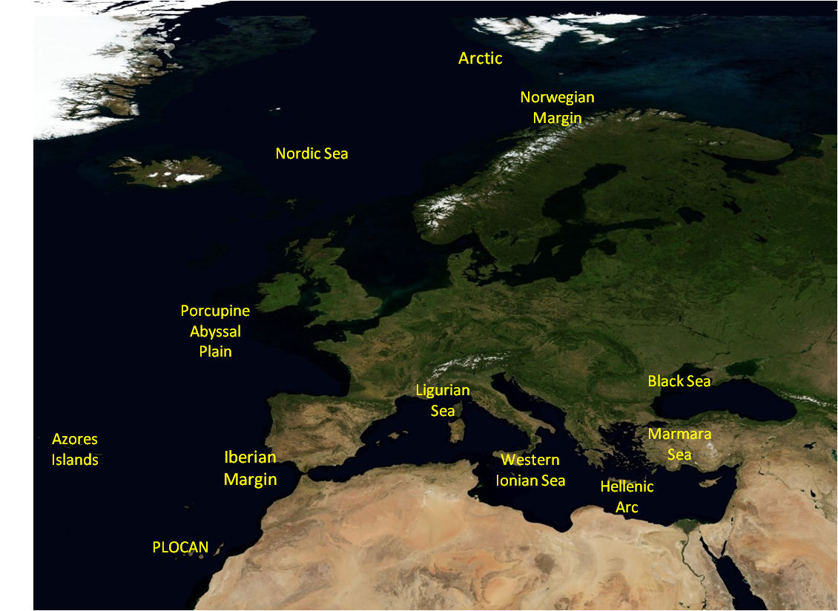
EMSO sites

Slide 8
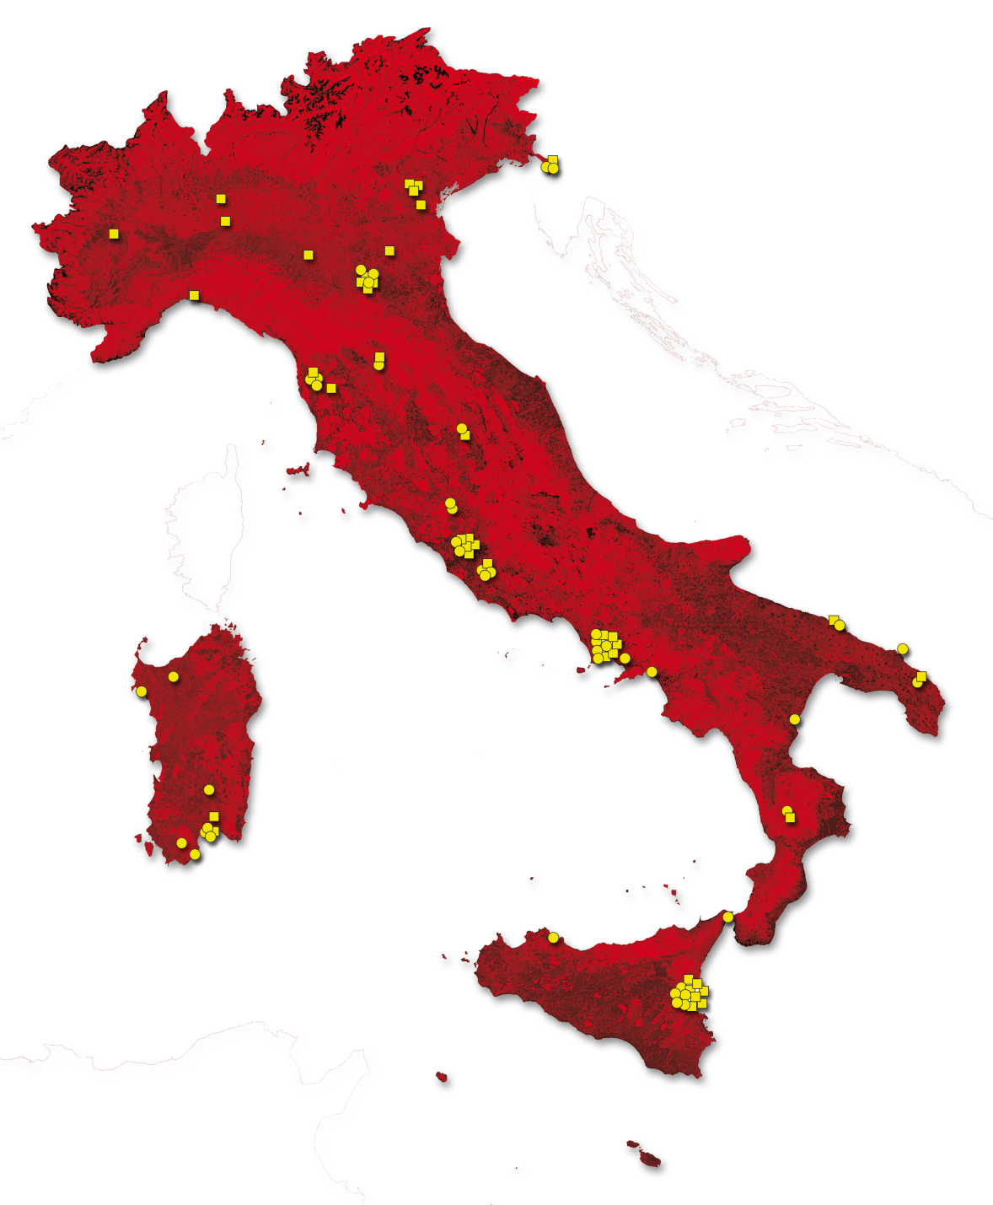
EMSO & GRID - Pilot Activity
This activity aims at deploying a Grid-based solution for the data repository and for the basic tools needed to manage data acquired at the Western Ionian Sea node near Catania.
Collaboration between NGI_IT (IGI) and EMSO representatives
IGI N NUMBERS
55 Sites
33000 Cores
17 PB Disk Storage
10 PB Tape Storage
8000 CPUs
1100 Users
50 VOs
30M jobs/year
10 Application Domains
Notes:
Membership service

Slide 9
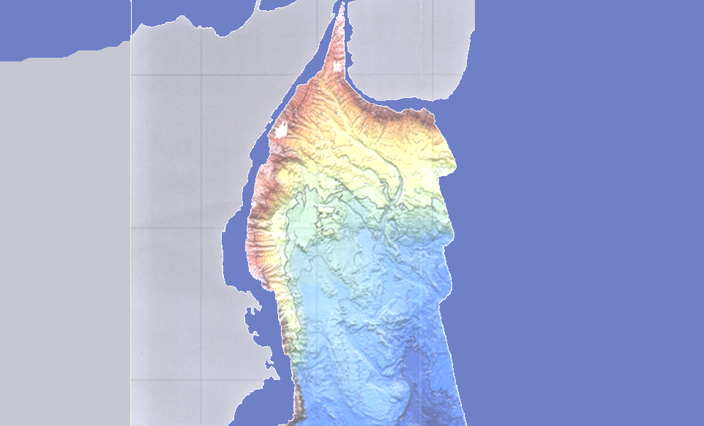
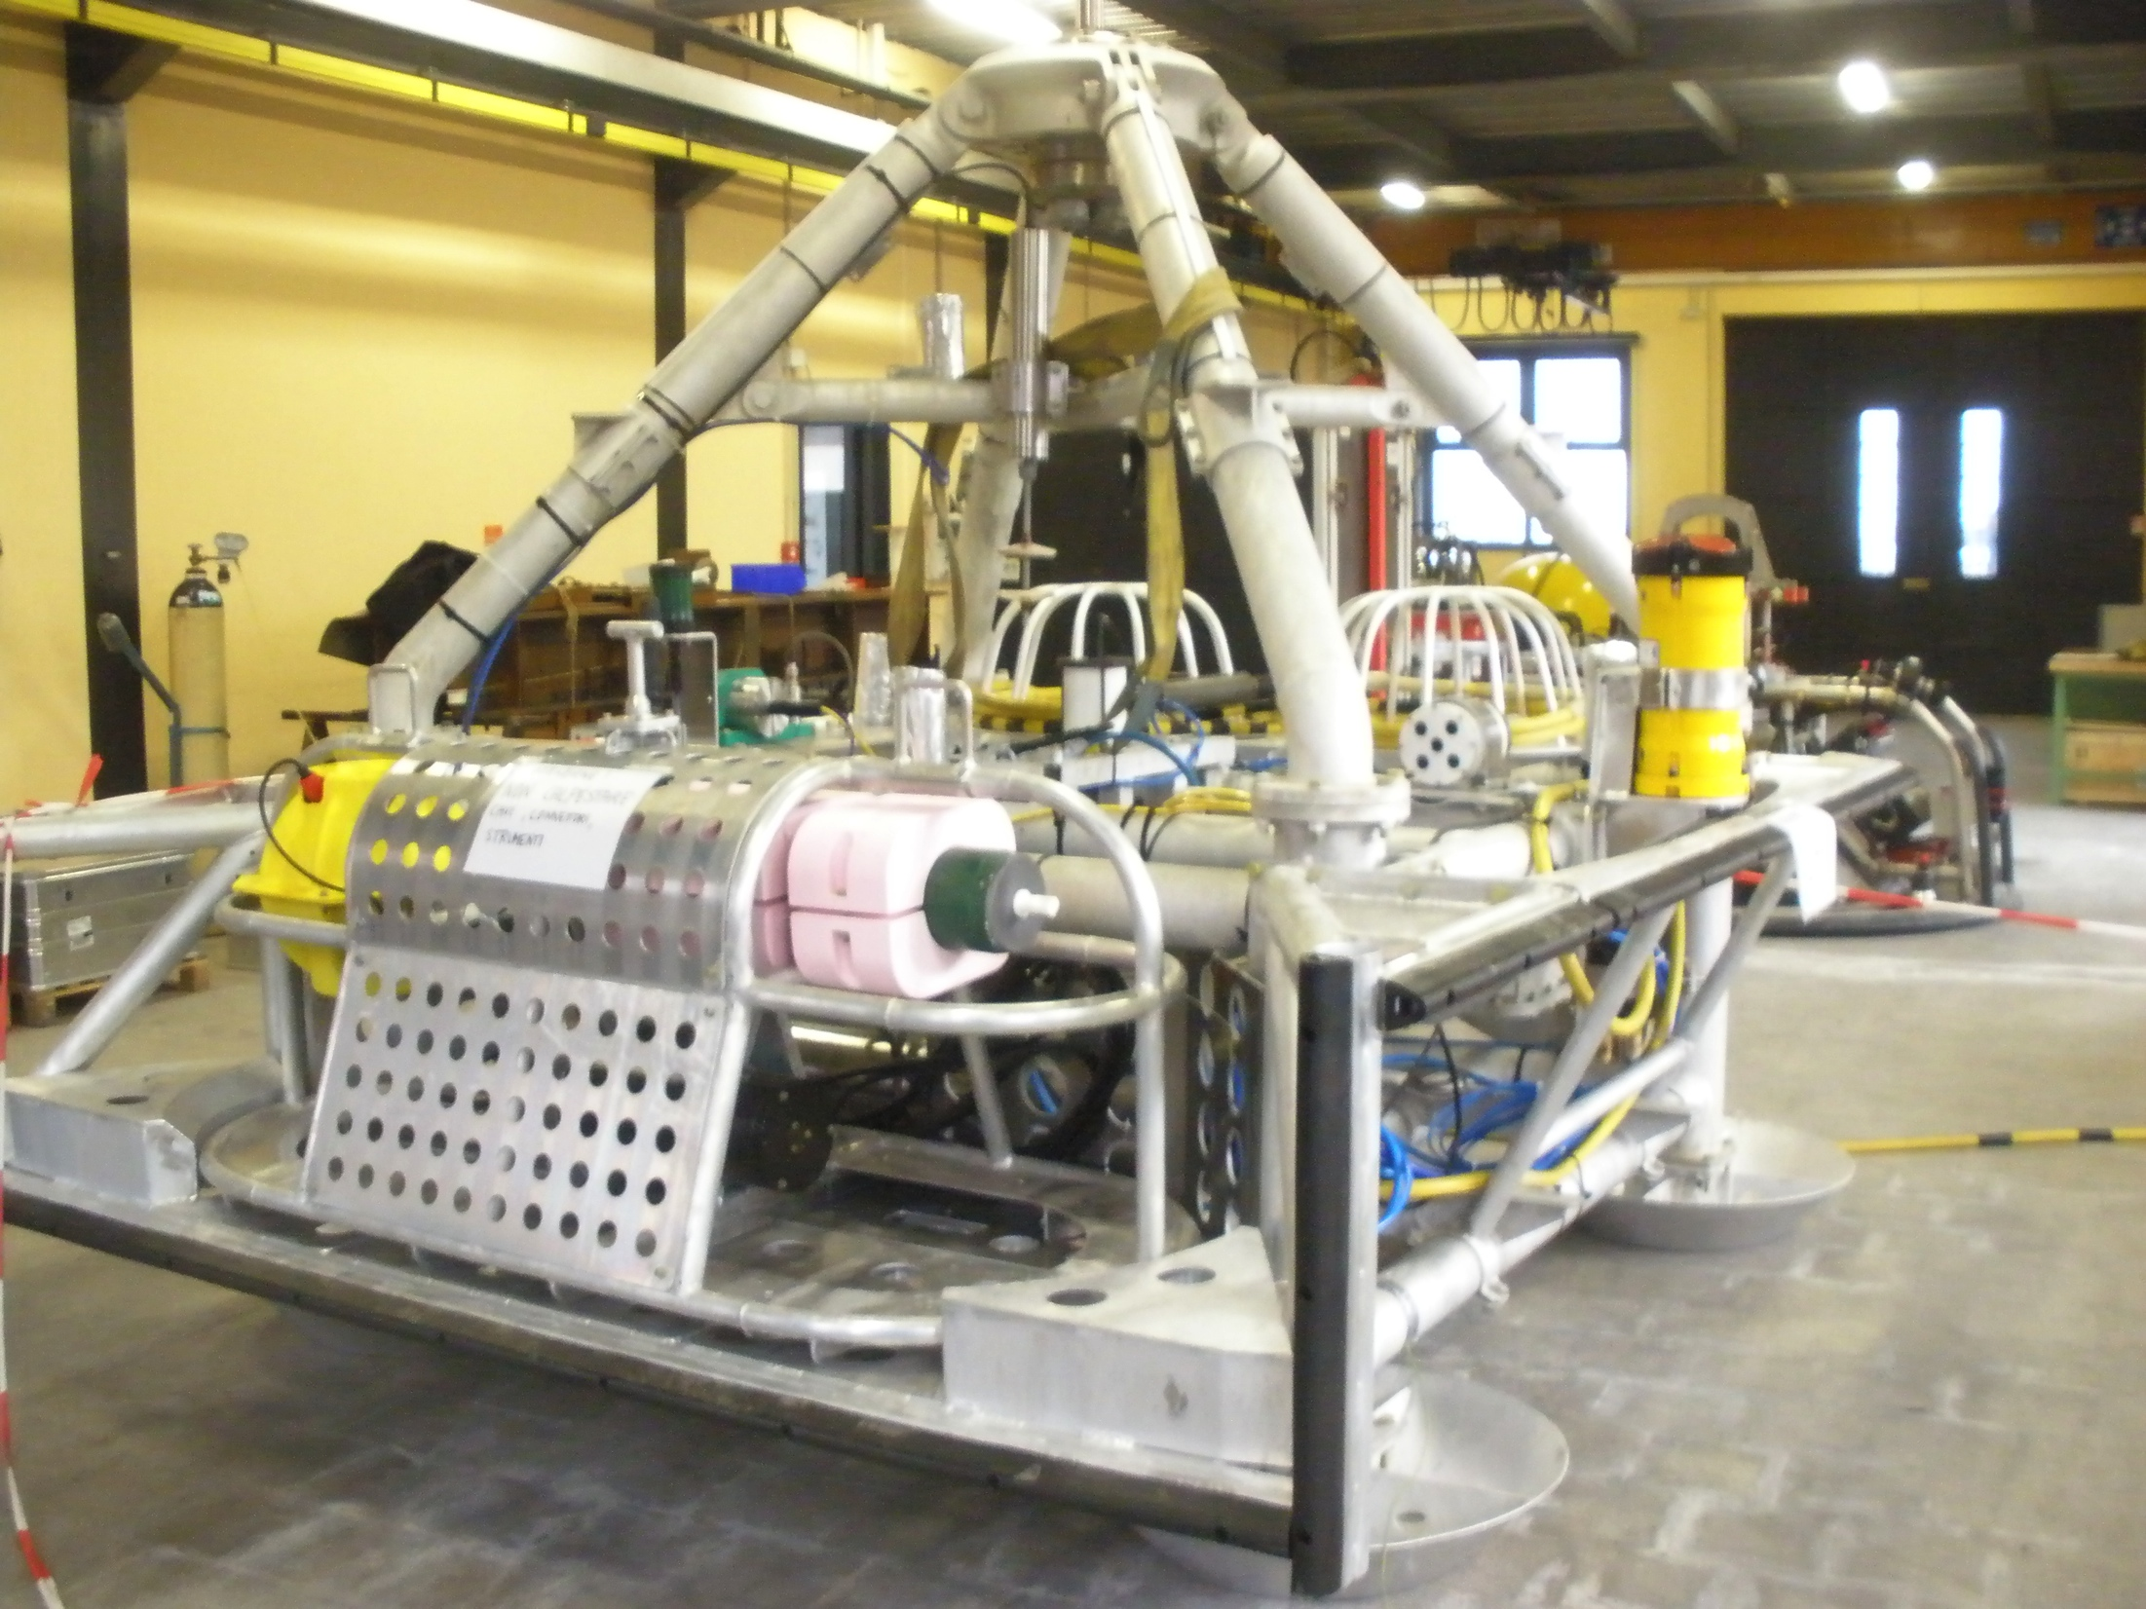
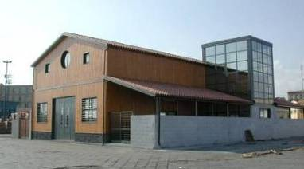
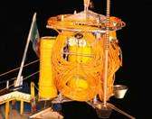
Western Ionian Sea
(offshore Catania)
@ 2000 m depth
North Site - SN1
Geo-hazard and bio-acoustic module
5 km
Shore Station
Catania harbour
20 km
6 e.c.
10 fibers
5 km
Bio-acoustic module
South Site
NEMO Junction Box
Synergy between the 2 ESFRI infrastructures: KM3NeT & EMSO

Slide 10
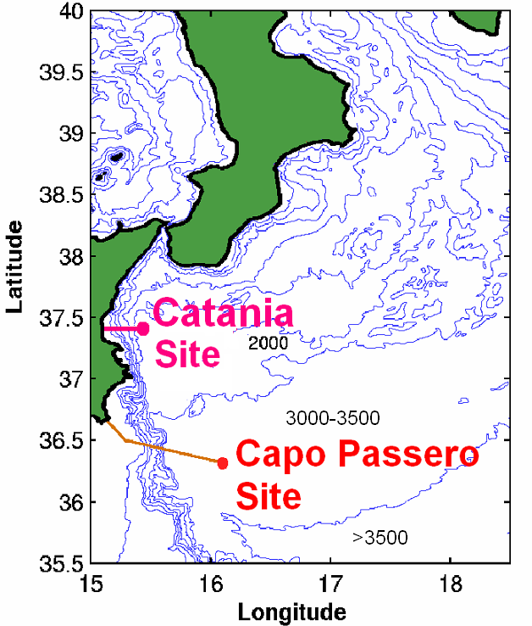
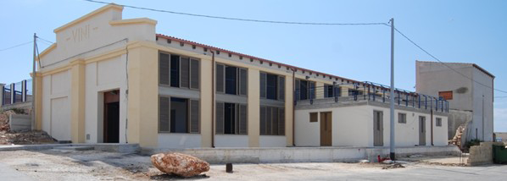
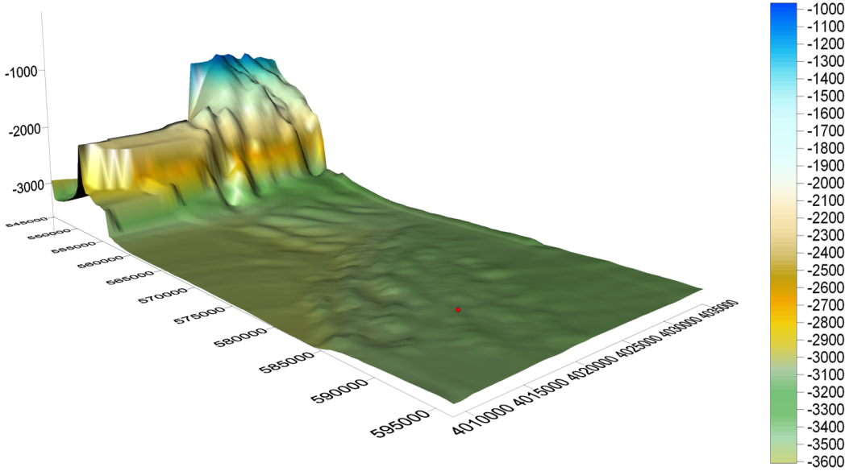
Western Ionian Sea
(offshore Capo Passero)
85 km South East offshore Capo Passero, 3500-m depth
(cable deployed 2007, junction box deployed 2009)
Shore Station in Porto Palo Harbour
INFN NEMO (Neutrino Mediterranean Observatory) KM3 experiment site
CP Site
@ 3500 m depth
The Capo Passero Site lies at 3500 m water depth on a flat and wide plateau

Slide 11
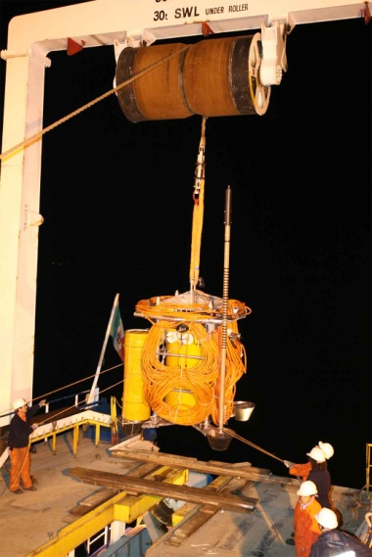
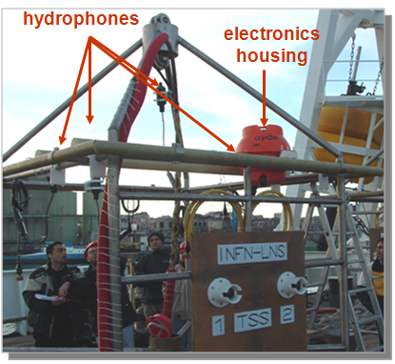
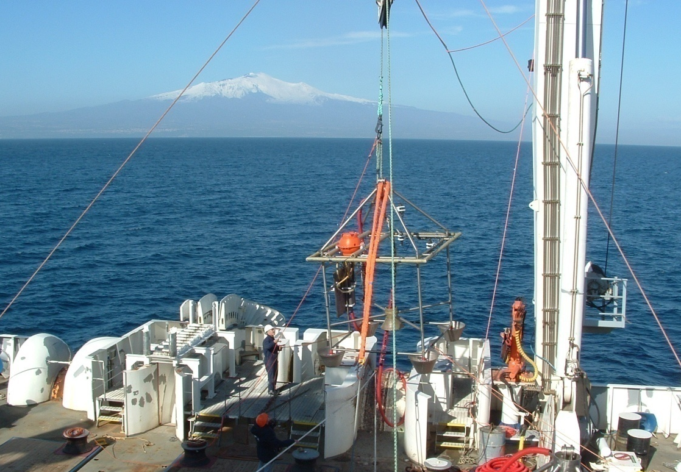
Western Ionian Sea
Deployment at the Catania Test Site
@ 2000 m depth

Slide 12
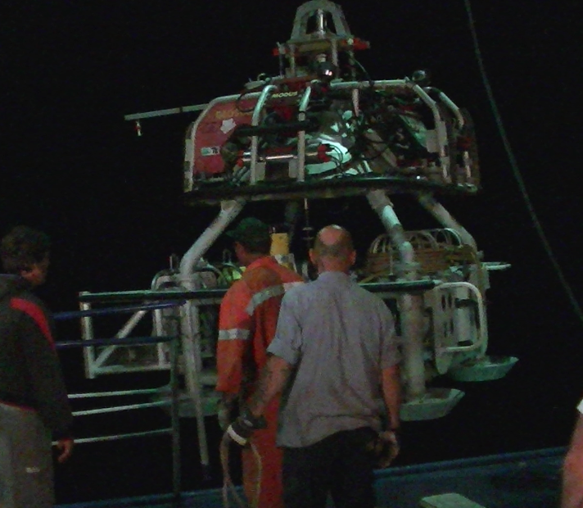
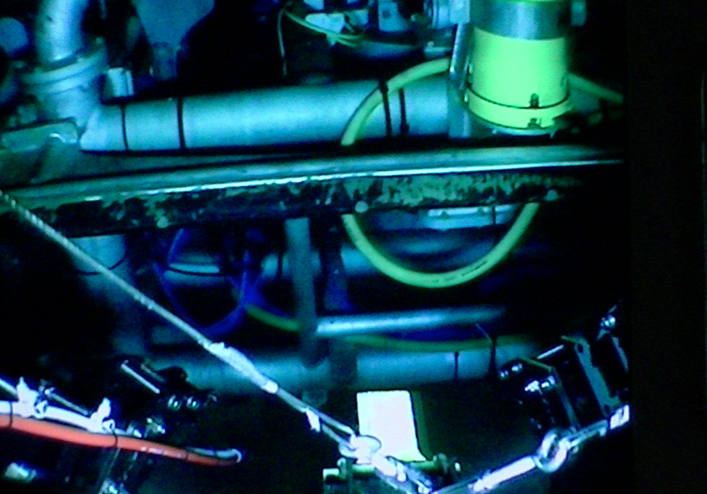
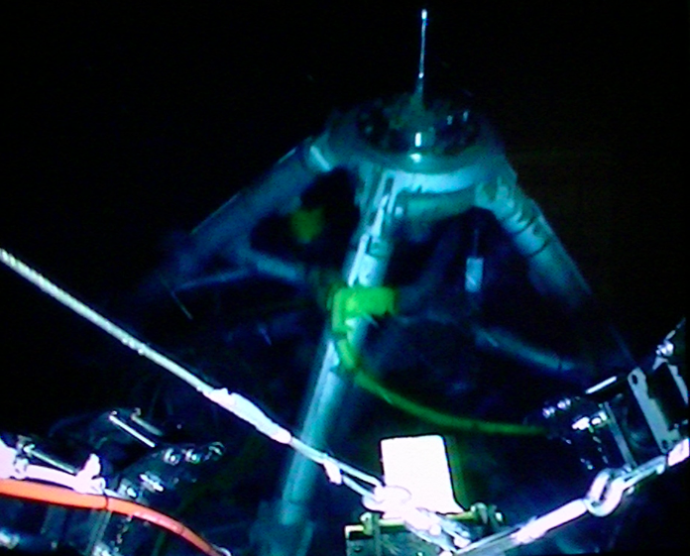
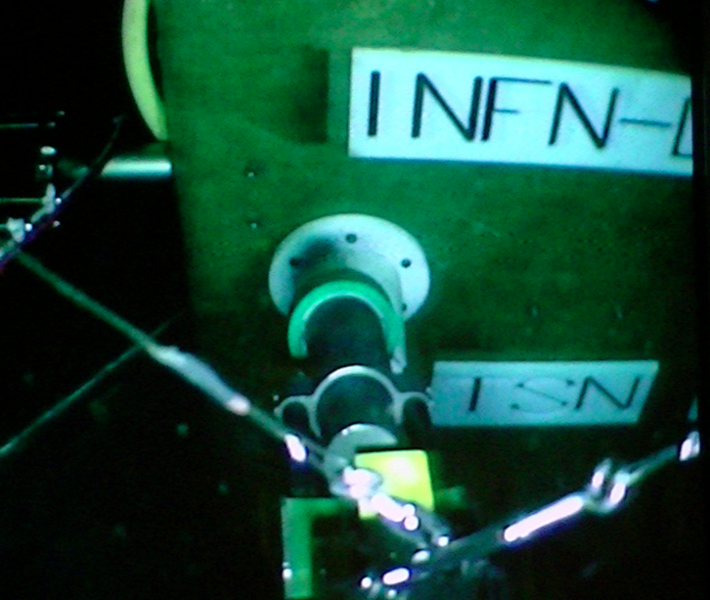
SN1 (TSN) installation and connection (8 June 2012)
MODUS Shuttle power failure.
SN1 released 250 above seabed (1850 m).
SN1 fallen upside down on the seabed
SN1 deployed with the MODUS Shuttle (INGV standard operation)
ROV and Certamen C/L Vessel joint operation: SN1 hooked and turned correctly above the seabed
SN1 connected to the TSN cable termination. Switch on.
Notes:
LBW = large bandwidth
LF= low frequency

Slide 13
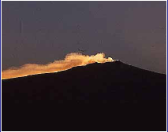
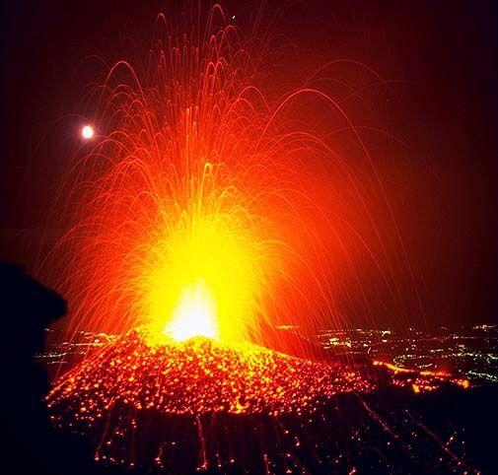
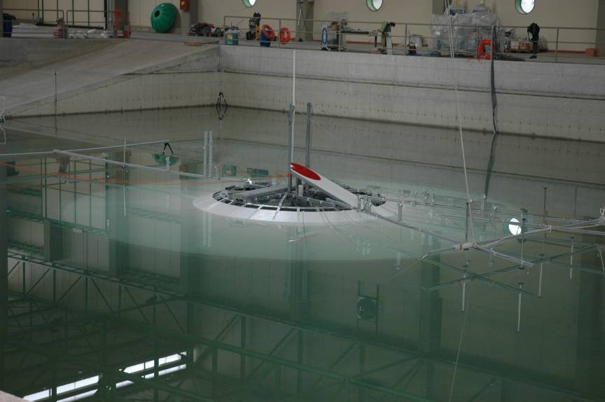
Western Ionian Sea
Geo-hazard: towards tsunami early warning systems
Monitoring of volcanic and seismic activity in Sicily
-Development of Tsunami early warning systems
Multiparameteric observatories are necessary for early detection of tsunamigenic events:
- Seismic waves
- Magnetic field change
- Low f sound waves
Laboratory test for tsunami modelling (Roma 3)

Slide 14
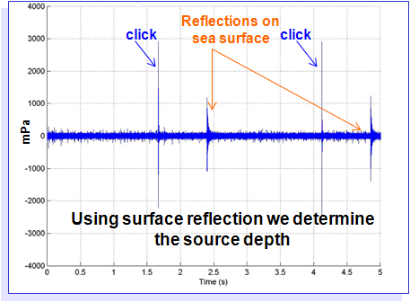
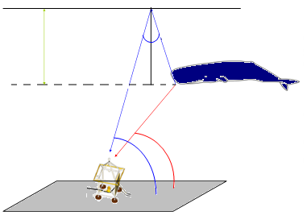
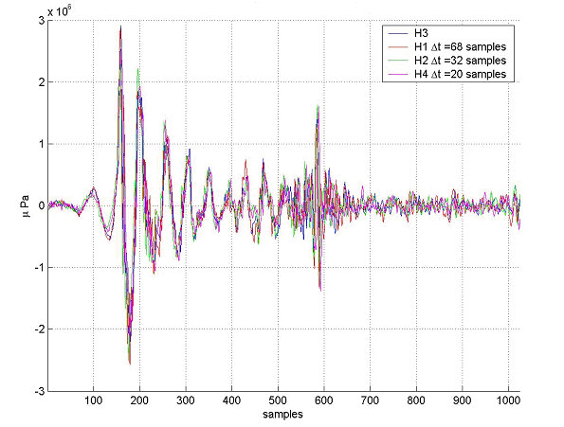
Western Ionian Sea
Sperm-whales’ tracking
Wave direction reconstruction through 4 hydrophones → source tracking
Surface reflection permits determination of source position.
Sperm-whales’ click analysis: size of the animals
Measurement of Inter-Pulse-Interval permits to determine the size of individual whales and to assess the population size and structure
P1
P2
IPI = head(m) * c_{s} / 2
Head = 3.41 ± 0.05 m → Total length = 9.72÷10.50 m - Young male or female

Slide 15
Western Ionian Sea
Data rate produced daily or monthly by
NEMO-SN1 observatory
INSTRUMENT | byte/day | byte/month
Oceanographic sensors | 13 M | 390 M
Gravity meter | 5 M | 150 M
Magnetometers | 2.5 M | 75 M
Seismic sensors | 933 M | 28 G
DACS monitor | 11 M | 330 M
Bio-acoustic Hydrophones* | 372 G | 11 T
Station monitoring | 163 M | 5 G
Lossless data compression algorithms (e.g. FLAC) may reduce file-size to 30% of the original size.

Slide 16
The EMSO data
The scientific data measured by the EMSO seafloor observatories are mainly composed by hydrophones.
4 hydrophones with sampling rate of 96kHz are located in the CATANIA NORTH site ~ 3 Mb/s for each hydrophone;
4 hydrophones with doubled sampling rate (192kHz) are located in the CATANIA SOUTH site with the rate doubled accordingly.
So 4 x 3 Mb/s from the north plus 4 x 6 Mb/s from the south ~36 Mb/s = 4,5 MB/s ~ 11 TB/month
This raw data has to be shared and freely accessed by all the EMSO members

Slide 17
The EMSO Computing Infrastructure
The computing model and data distribution infrastructure designed for EMSO will be based on layered structure
Similar to the one already adopted for the LHC community;
Tier0s will be close to the experimental sites;
Will contain all the experiment data
Tier1s will host replicas for experimental analysis.

Slide 18
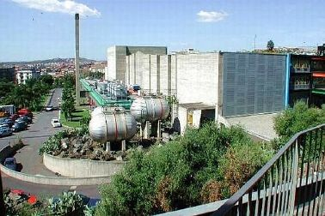
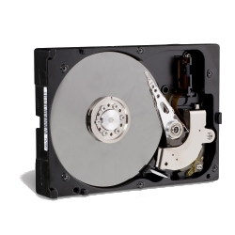
Building the Western Ionian Tier0 Site
Shore Station
Catania harbor
Shore Station
Porto Palo (Syracuse) harbor
Internet Radio Link @ 100 Mbps
Local Storage @ LNS-INFN Catania
(40+120 TB)
LNS-INFN Catania

Slide 19
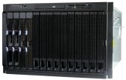
Building the Western Ionian Tier0 Site
A grid storage has been installed @ LNS-INFN Catania, mounting the RAW data from the local storage
Grid Storage @ LNS-INFN Catania
The lcg_util and lfc plugins have been installed to use lcg-* and lfc-* client commands directly from the storage;
To make available the RAW data from the LNS-INFN Catania local storage to the Grid one a small application, run as a cron was developed

Slide 20
Building the Western Ionian Tier0 Site
The cron job:
downloads a robot certificate is downloaded from the eTokenServer using a REST call. This certificate will be used to secure the grid operation;
reads recursively the RAW data from the local storage and create the SURL/LFN for each “new” entry to be registered in the LFC File Catalog;
The entries to be registered are stored on a sqlite database;
registers SURLs on the LFC File Catalog;
replicates SURLs on Tiers1 (*);
adds the metadata (SURL) into a dedicated DB (MOISTdb) (*).
(*) working in progress – T1s need to be identified
The Italian catch-all GRIDIT VO is currently used
eTokenServer
Grid Storage @ LNS-INFN Catania
EMSO Tiers1
MOISTdb

Slide 21
Conclusion and next steps
Accomplishment
The collaboration with EMSO started
A layered WLCG-like architecture has been chosen as e-infrastructure
A prototypical Grid Tier0 was created for the Western Ionian site
Next steps
Create an EMSO dedicated VO (name under discussion)
Replicate data at least in one T1
Support EMSO in the applications porting activity
Create high level interfaces to access the data
Wait for EMSO to evaluate the services offered by EGI/IGI

