Slide 1
G-NEMO: a Grid empowered version of the state-of-the-art European modelling framework for oceanographic research
Alessandro COSTANTINI¹, Marco BENCIVENNI¹, Diego MICHELOTTO¹, Daniele CESINI¹, Emidio GIORGIO¹, Luciano GAIDO¹, Vania BOCCIA¹, Roberto ALFIERI², Paolo ODDO³, Massimiliano DRUDI³, Mario ADANI³
¹ INFN/IGI, Bologna (IT)
² INFN-Parma (IT)
³INGV Bologna (IT)
alessandro.costantini@cnaf.infn.it

Slide 2
Summary
The Italian NGI
The User Community: INGV
The computational problem
Code Porting: NEMO
A smart solution: IGI web portal
MPI Performances
Conclusions

Slide 3
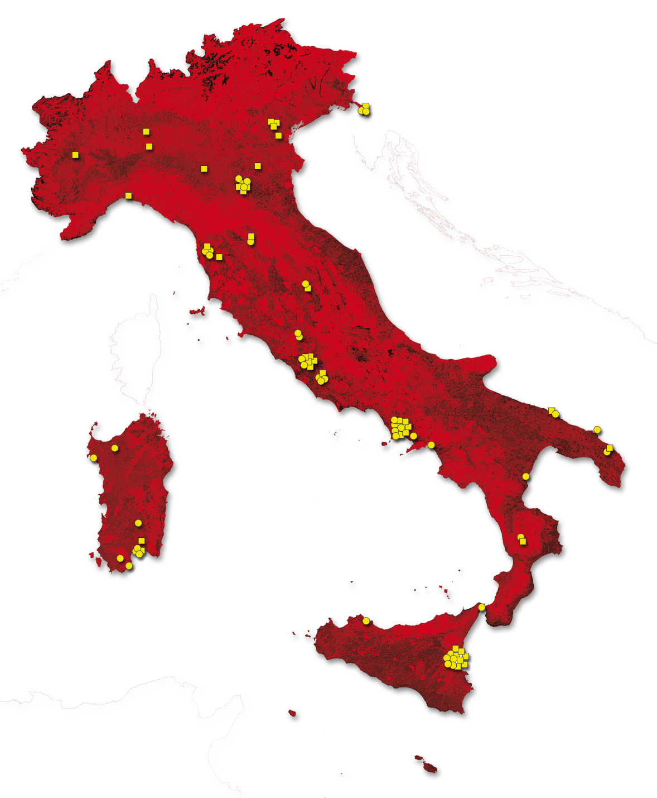
Work-plan for application porting
Seek, identify, and closely support new communities to deploy their applications and create the computing model
The NGI_IT
User Support and
Training (FUS in Italian) team
Disseminate the work done to find new applications for long term sustainability
Train users to use the new execution procedure

Slide 4
Collaborations
National Institute of Geophysics and Vulcanology (INGV, Bologna division)
produces short-term forecasts for the Mediterranean and Adriatic system
produces seasonal forecasts carried out with coupled ocean-atmosphere models
MPI multicore group of IGI & Distributed Unified Computing for Knowledge (DUCK)
setting up of a HPC testbed for “not high-end” HPC applications, based on IGI Grid technologies

Slide 5
MPI Multicores group
Participating sites have been selected among the ones running HPC clusters in the IGI Grid environment.
These sites contributed with their specific HPC experience and their available infrastructure
including special HPC components such as high speed networks, high performance shared file systems, libraries and tools
EMI middleware, with the SMP Granularity support
Collaborated within the activities of the EGI MPI-VT
Demo scheduled at 17:30

Slide 6
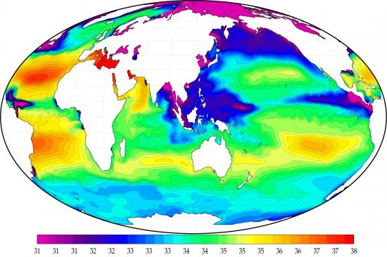
The scientific problem
Multiscale modeling of oceanographic simulations
Target: oceanographic simulations for provisioning purposes
Software used: Nucleus for European Modelling of the Ocean (NEMO) simulation framework

Slide 7
NEMO simulation framework
NEMO is an ocean modelling framework which is composed of "engines" nested in an "environment".
The "engines" provide numerical solutions
ocean, sea-ice, biochemistry equations, related physics.
The "environment" consists of the pre- and post-processing tools
NEMO is developed by a European Consortium established between CNRS (F), Mercator-Ocean (F), NERC (UK), UKMO (UK), CMCC (I) and INGV (I).

Slide 8
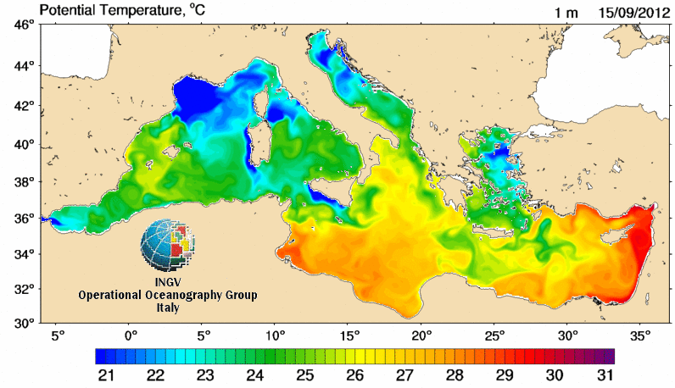
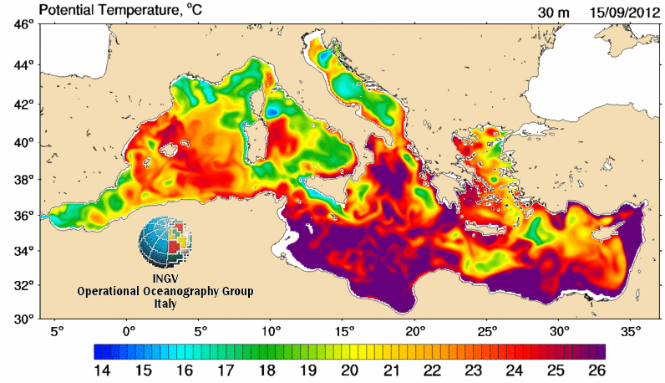
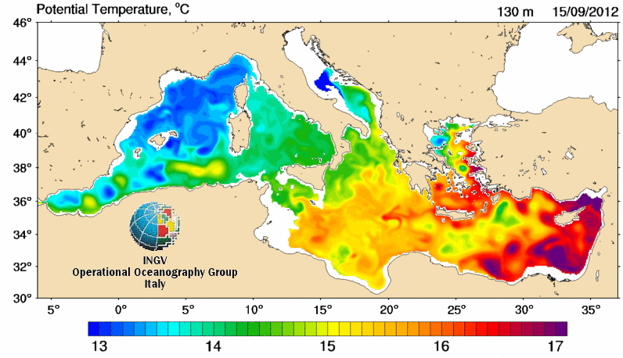
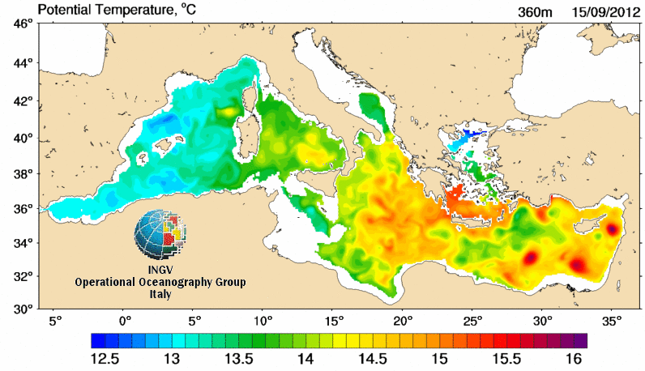
NEMO calculation
Mediterranean forecasting
Notes:
18/09/12
8

Slide 9
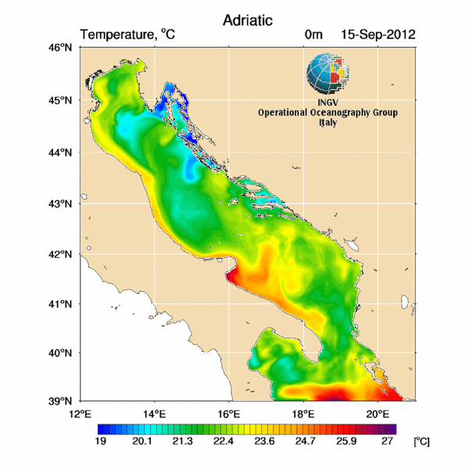
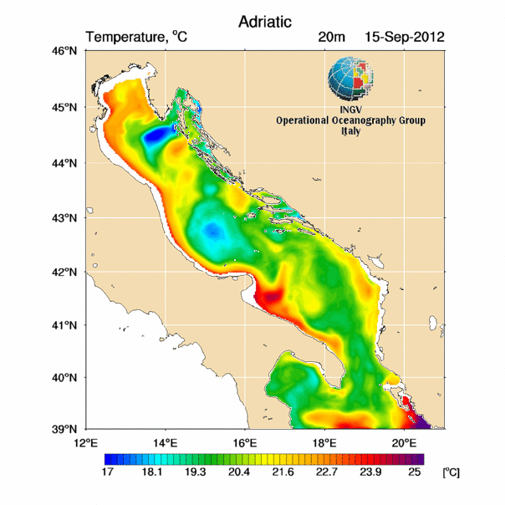
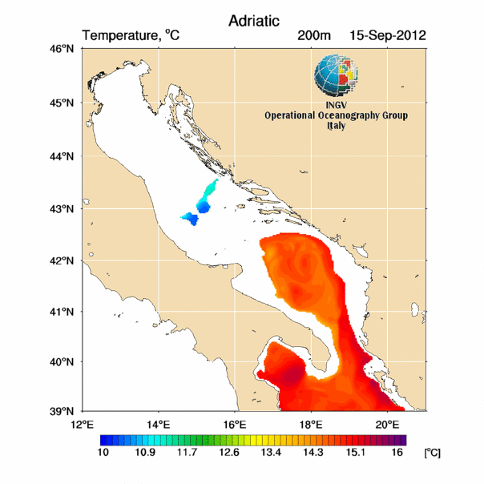
NEMO calculation
Adriatic forecasting
Notes:
18/09/12
9

Slide 10
The computational problem
NEMO calculations performed by INGV can be treated as a series of independent computations
Model evaluation purposes
They require:
A set of multiprocessors (or multicore) resources for parallel calculations
From hours to days of CPU time per computation
Storage area to save the results coming from the computations (from few to hundred GB/calculation)

Slide 11
Application porting
NEMO has been compiled in a UI machine that belongs to the IGI domain and tested in a site located at CNAF
The build-up of the executable has been carried out
Under Scientific Linux 5.7 O.S. (EMI 1)
gfortan 44
Netcdf 1.0.1 User Requirements
openmpi 1.4.3
Statically linked

Slide 12
The IGI Portal facility
IGI Portal is a powerful and easy to use gateway to access distributed computing and storage resources
Based on the WS-PGRADE application
The generic application structure is a workflow
Interface can be customized to support different user communities needs (GRIDIT, THEOPHYS, COMPCHEM, …)
A web GUI has been provided through a dedicated portlet
To access the standard functionalities of the Grid
To minimize the skills needed by the user to use the Infrastructure
IGI PORTAL Presentation
Booth no. 1

Slide 13
The typical usecase
User provides the initial input files and executable and waits for the results until the calculation is terminated
Netdcf formatted input files
Executable implementing the different models to test
Needs
Resources for parallel calculations
Store GB of data for each computation

Slide 14
The NEMO portlet

Slide 15
The NEMO Requirements
The validation runs were performed on the resources made available by the IGI Infrastructure (MPI Multicores)
Simulation of one day of a Mediterranean sea benchmark using an increasing number of cores
Unfortunately, due to its implemented parallel strategy, NEMO requires
shared memory multiprocessor architecture
distributed memory multicomputer architecture with clustered file system

Slide 16
Performance
Performance very close to the ideal value up to 8 cores
Increase in communications between the computational processes due to a reduction of the domain-specific dataset

Slide 17
Conclusion
NEMO was successfully ported to Grid services in strong partnership with the INGV community in order to address their requirements and with the MPI Multicores group of IGI
The adoption of a “web based ad-hoc solution” allows also inexperienced users to execute NEMO on the Grid
The implemented case study demonstrates the validity of this approach that can adopted in other research fields
Work in progress to build a solid platform, offered to users as a service, for assembling accurate multi scale realistic simulations.

