Slide 1
Authorisation in Grids using an eID card
Anton Frank, Wolfgang Hommel, Stefan Metzger, Tom Weber
Leibniz Supercomputing Centre, Germany
EGI-TF 2012, Prague, 19/09/2012
19/09/2012
Prague
Notes:
1

Slide 2
Motivation
Identification Procedures
are essential for resource and service providers
are considered a nuisance by the users
Username/password
Users are accustomed to it
are not fulfilling today’s security requirements
Recommendation to change password regularly
Users storing passwords in browser (or on paper)
… (add your own experiences with users)
Alternative
PKI infrastructures with X.509 certificates
Is it really an alternative?
Notes:
The talk is split on two parts. First we would briefly talk about Grid Computing in general following by three demos.
2

Slide 3
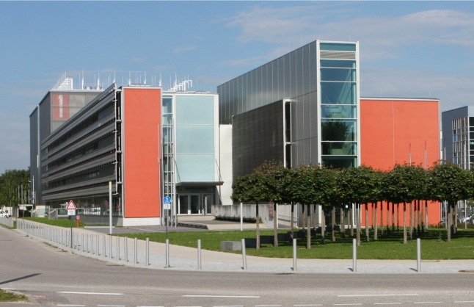
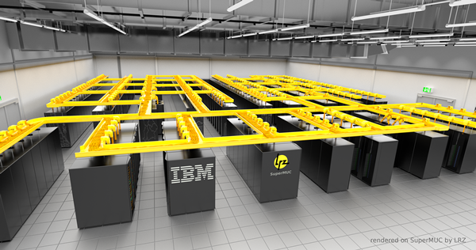
Federated Identity Management at LRZ
Serving over 120.000 users with various services
Mail/Web, Network, HPC, Grid/Cloud, Backup/Archive, Visualisation, etc.
Grid Computing since 2001; involved in D-Grid/NGI.DE, DEISA/PRACE, EGI, WLCG, GÉANT
Operating Grid-RA (CA: DFN) for
University Munich (LMU)
University of Technology Munich (TUM)
University of Armed Forces Munich
Bavarian Academy of Sciences and Humanities
Federated Identity Management system spanning LMU, TUM, LRZ
Shibboleth, EduGain, etc.
SuperMUC: Fastest Supercomputer in Europe
155,000 cores, 300 TB memory, 3 Petaflop/s, 85 M€
Notes:
The talk is split on two parts. First we would briefly talk about Grid Computing in general following by three demos.
3

Slide 4
Certificate-based PKI for FIM:
Building a Mutual Trust Relationship
Mainly driven by the NRENs an international PKI is in operation
Many certification and hundreds of registration authorities
IGTF (EUGridPMA, TAGPMA, APGridPMA)
Is all of this really necessary to build a trust relationship?
yes, till today, since there was no alternative. But in the future?
Security?
Certificate stored on various computers, shared file systems
Certificate can easily be passed on (only limited by policy)
Trustworthyness of ID providers?
no widespread uptake in commercial world
Privacy?
DN contains name, institution, country
needed only to make administrators feel more comfortable
User convenience??
Notes:
The talk is split on two parts. First we would briefly talk about Grid Computing in general following by three demos.
4

Slide 5
Identity Provisioning Elsewhere
Commercial providers trust:
Full name, address, and bank account
Credit card number
PostIdent, Ident.Brief, Gelbe Identifikation, …
based on ID card, passport
Usual way of identification used by public authorities:
ID card, passport, driving license
Trusted third party is governmental institution
Online Identification with electronic ID card
Notes:
The talk is split on two parts. First we would briefly talk about Grid Computing in general following by three demos.
5

Slide 6
German Electronic ID card
Introduced 1st Nov, 2011
Machine readable travel document (MRTD) according to ICAO specification (International Civil Aviation Organization)
Integrated RFID chip for contactless data transfer
data container
integrated cryptographic processor based on ECC / AES
cryptographicly strong random number generator
ePass application
Biometric data, fingerprints
only accessible by public authorities
eID application
Personal data (Name, date of birth, etc.)
Verifikation of age and residence
Restricted identification (Pseudonym)
eSign application
eSignature key, X.509 certificate
Notes:
The talk is split on two parts. First we would briefly talk about Grid Computing in general following by three demos.
6

Slide 7
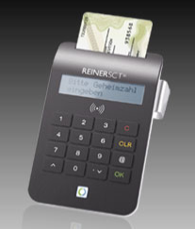
Technological issues
Secure communication between Service provider and eID server
specified in „Technische Richtlinie eID-Server” (BSI-03130)
exchange of SOAP
encryption on transport layer using SSL/TLS.
or SAML messages using HTTPS
according to„Web Browser SSO Profile“ (OASIS)
XML-Encryption and XMLDSIG based on X.509 certs
SAML answer encrypted as well
Secure communication between eID server and eID card API
complex
application provided by eID service provider
detailed knowledge not required
Notes:
The talk is split on two parts. First we would briefly talk about Grid Computing in general following by three demos.
7

Slide 8
Research on German Electronic ID card
FhG-SIT (Institute for Secure Information Technology)
Leading expert for IT Security
Competence Center new eID Card
Cooperation with public authorities
Consulting about eID Card integration
Security Testing
DFN (German NREN)
tests for remote identification
development of web application
can be used for creation of X.509 certificates
2-factor authentication
https://www.pki.dfn.de/fileadmin/ PKI/DFN-PKI_Offener_ Anwendungstest_eID.pdf (in German)
LRZ
Student project to set up basic web service
Notes:
The talk is split on two parts. First we would briefly talk about Grid Computing in general following by three demos.
8

Slide 9
A Small Application for Reading eID Data
Used to learn in detail about the technologies and experience obstacles on the way of adopting such a service
Developed a Java-based web application to read eID data
Chose eID-Service „Governikus Autent“ of the BOS GmbH & Co. KG (Bremen, http://www.bos-bremen.de) for testing
Chose Web Service according to TR-03130 of the BSI for connecting.
BOS provided the necessary test authorization certificates of the BVA as well as test ID cards.
Technology quite simple to apply
Administrative hurdles are HIGH
Notes:
The talk is split on two parts. First we would briefly talk about Grid Computing in general following by three demos.
9

Slide 10
Negotiation process
BOS AutentApp
BOS eID server
(6) Verifikation
of the eID
Authentifizierung nPA (5)
Data Request (8)
UseID
Request (2)
(3) UseID
Response
(7) Redirect back
LRZ-Server (de.lrz.srv.npaonlrz)
Browser
of user
ManagerServlet
de.lrz.srv.npaonlrz.auth
(1) POST-Request
AutentUseIdParams
(4) Redirect
to AutentApp
1
*
AutentClient
(9) Data Provisioning
AutentConfig
Notes:
The talk is split on two parts. First we would briefly talk about Grid Computing in general following by three demos.
10

Slide 11
Discussion
Security
2 factor authoriztion, encrypted communication
intensively tested – high public attention – security problems identified
additional psychological barrier
Users will not pass on ID card to colleague for HPC access
Privacy
German government very restrictive with providing permission to service providers to retrieve data from eID card
If no further justification is given, eID function is restricted to age/residence verification or identification via pseudonym
Pseudonym is sufficient
aren’t we talking about trust after all?
User Convenience
In Germany very citizen is required to have it (soon)
Will become a standard method for identification
Notes:
The talk is split on two parts. First we would briefly talk about Grid Computing in general following by three demos.
11

Slide 12
Issues hindering a widespread adoption
Still lacking a widespread adoption by users
users need a card reader (additional device, costs)
depending on multiple commercial services become available
eID information is not sufficient
eID only provides identification of a person
Necessary to combine with additional attributes
Verification of institution
Information about VO
Information about role
Necessary? What about citizen scientists, schools?
Autorisation process for Service Providers is still very complicated
Notes:
The talk is split on two parts. First we would briefly talk about Grid Computing in general following by three demos.
12

Slide 13
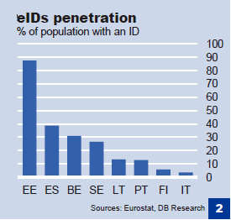
eID situation in Europe
eID cards
available in: Austria, Belgium, Estonia, Finland, Germany, Iceland, Italy, Latvia, Lithuania, Netherlands, Poland, Portugal, Spain, Sweden
planned: France, Hungary, Malta, Romania, Slovakia, Slovenia
not planned: Denmark, Switzerland, UK
European perspective
National solutions incompatible
EU projects
ISA: Legal amendments
SPOCS: harmonize administration
STORK: eID interoperability
Specification of European Citizen Card
Deutsche Bank Research, 2010
Notes:
The talk is split on two parts. First we would briefly talk about Grid Computing in general following by three demos.
13

Slide 14
Summary/Outlook
eID cards are interesting way for ID management
eID for authorization, eSign for acceptance of AUPs, etc.
will become a standard within the next 5-10 years
FIM activities should strongly investigate how to adopt it
In our analysis we made a first step
Only student-based research
We started from German eID card and processes
What about other European countries?
Anybody already intensively investigating this?
Anybody aware of research projects?
We would be interested in collaborating
Notes:
The talk is split on two parts. First we would briefly talk about Grid Computing in general following by three demos.
14

Slide 15
Thank you!
Notes:
The talk is split on two parts. First we would briefly talk about Grid Computing in general following by three demos.
15

