Slide 1
EGI support services Science gateway developers
Nuno Ferreira
User Community Support Team
EGI.eu, Amsterdam
nuno.ferreira@egi.eu

Slide 2
Overview
Science Gateway dedicated webpage
Applications Data Base
Training Marketplace
Requirements Tracker
Common Glossary
Policies

Slide 3
EGI and Science Gateways
EGI Technical Forum 2011, Lyon
Session: Portal technologies for EGI communities
Expected outcome: best practices, latest developments, requirements, services and reusable software from the field
Action plan: to increase the visibility and comparability of portal technologies within EGI
EGI Community Forum 2012, Garching
Session: Portals and Gateways
Intro: Science gateways overview
Do you want to read more?
Users
Developers
http://go.egi.eu/sciencegateways

Slide 4
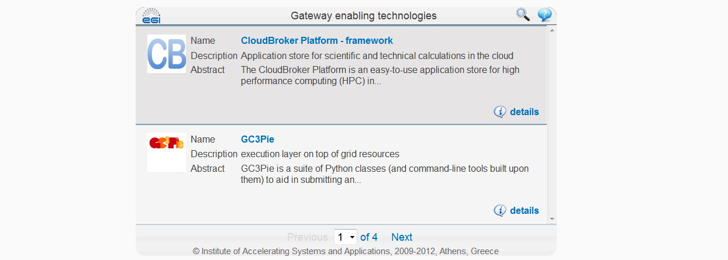
Dedicated webpage

Slide 5
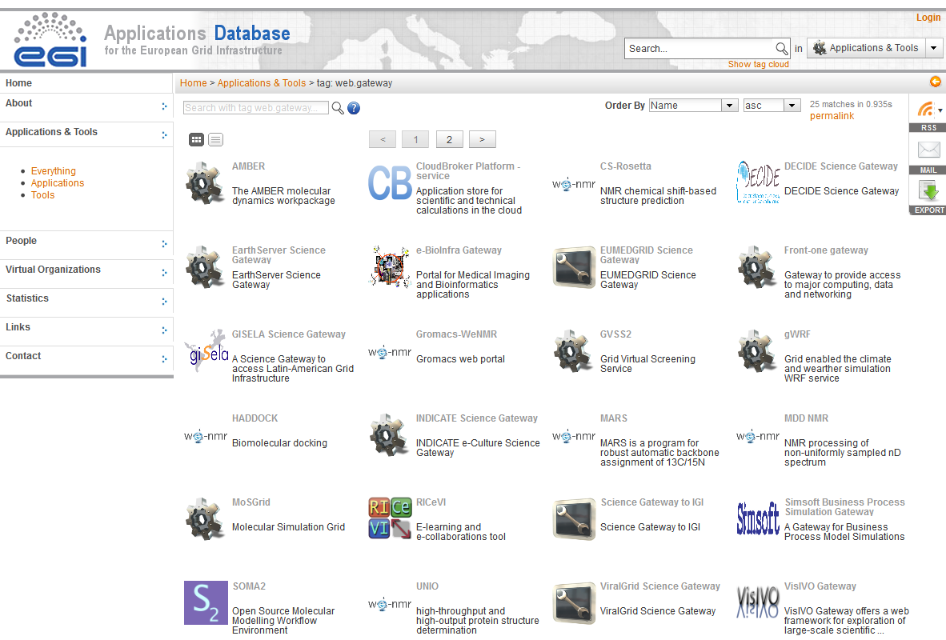
Applications Data Base
In a nutshell:
Stores science applications / tools & …
… categories feature (new feature)
Target audience: researchers and developers
Rich set of features:
Filtering and search capabilities
Dissemination (feeds, emails)
Tagging
Ranking & commenting
Problem reporting, …
Access through:
web page
web gadget
API (r+w)
http://appdb.egi.eu

Slide 6
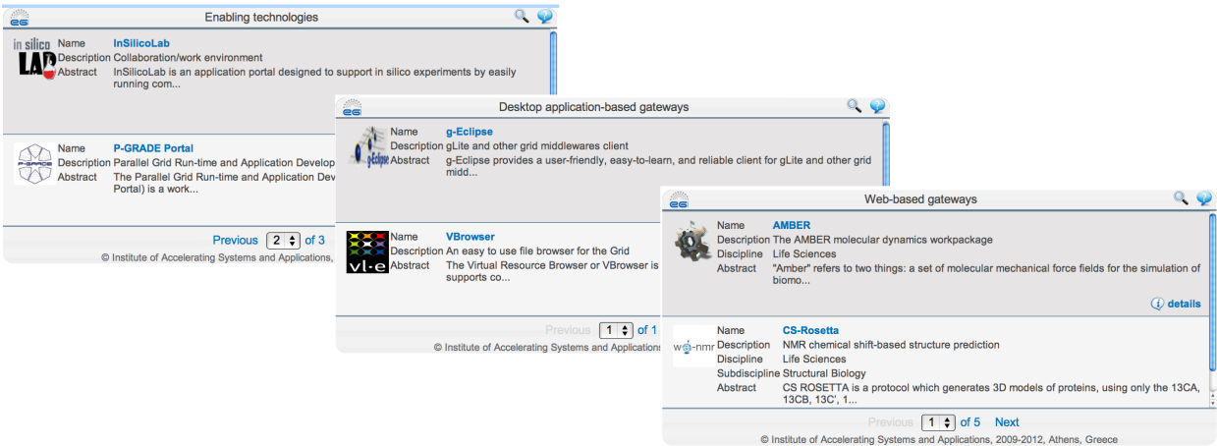
Register a SG to EGI AppDB
Science gateways and enabling technologies are registered in AppDB
Key information stored, such as SG description, access and download links
AppDB gadget can be used to display customized SG lists in your homepage
Step by step instructions?
http://go.egi.eu/SG.register

Slide 7
Requirements tracker
User Support Team of EGI.eu
Operational requirements
Technology providers
EGI Requirements Tracker
Techn. Coord. Board
VOs
User Comm- unity Board
VRCs
Proj.
User & community requirements
NGIs
Events
Tool to record community feature requests
Customizable dashboards
Public access
Gadgets available:
List requirements
Submit requirements
http://go.egi.eu/requirements

Slide 8
Training Marketplace

Slide 9
Training Marketplace
Gadget also available
Read more about this service here:
http://go.egi.eu/Training_Marketplace

Slide 10
Glossary
Why a common glossary?
EGI community is composed by heterogeneous actors
EGI actors contribute to provide and/or consume services for e-Science
Actors expressed the need to identify a common set of terms which definition is agreed and shared so to improve the understanding and consistency of documents
The EGI glossary addresses this need
Who maintains the glossary?
EGI Glossary Coordination Group
Want to know more?
EGI Glossary - latest version: http://wiki.egi.eu/wiki/Glossary

Slide 11
Glossary & Science Gateways
Glossary of Terms v.1
(approved by GCG June 1, 2012)

Slide 12
Policies & Procedures
Title
VO portal policy Policy statement: this Policy applies to all Portals operated by Virtual Organisations that participate in the Grid
Policy on Grid Multi-User Pilot Jobs Policy statement: security policy for operation of multi-user pilot jobs.
Grid Security Traceability and Logging Policy Policy statement: this policy defines the minimum requirements for traceability of actions on Grid Resources and Services as well as the production and retention of security related logging in the Grid.
Service Operations Security Policy Policy statement: this security policy presents the conditions that apply to anyone running a Service on the Infrastructure, or to anyone providing a Service that is part of the Infrastructure.
http://go.egi.eu/policies_procedures

Slide 13
What’s in all this for me?
Service
EGI SG webpage | Single point of access
AppDB | Register SG’s and their enabling technologies
RT | The way to feed SG community requirements
TM | Promote SG related events and training material
Glossary | Shared set of terms across all the functional areas of EGI
Policies | Establish the playground
Social Media | Dissemination channels open
Science Gateway Primer Virtual Team can make use of these services …
… and ‘tweak’ them if there’s the need of.

Slide 14
EGI support services Science gateway developers
Thank you.

