Slide 1


A Workflow Manager for NMR :
objectives, design, and implementation
Notes:
1

Slide 2
Introduction
  CCPN and WeNMR
  NMR data and software
WMS Workflow Management System
  Goals
  Implementation
Status

Slide 3
CCPN
Collaborative Computing Project for NMR
(Nuclear Magnetic Resonance)
Funded by BBSRC since 1999
WeNMR project partner
Goals:
  Unifying platform for NMR software
  Community-based, open-source
  software development
  Outreach: meetings and courses
Notes:
3

Slide 4

CCPN Credits
University of Cambridge
  John Ionides (WMS lead)
  Rasmus Fogh (WMS)
  Wayne Boucher
  Tim Stevens
  Magnus Helgstrand
  Prof. Ernest Laue
University of Leicester
  Prof. Geerten Vuister
EBI (PDBe), Hinxton
  Pieter Hendrickx
  Aleksandras Gutmanas
  Gerard Kleywegt
Funding:
  EU FP7 (WeNMR partner)
  BBSRC (CCPN grant)
  AstraZeneca, Genentech, Janssen Pharmaceutical, Lead Pharma, Medivir, Novartis, NovoNordisk, Syngenta, Vernalis
Notes:
4

Slide 5
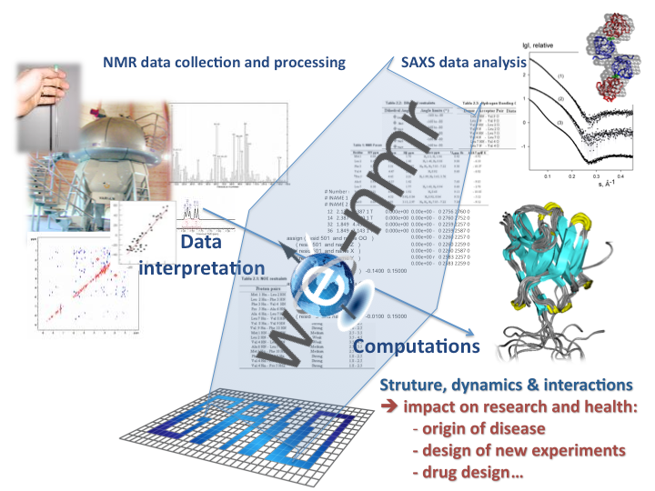
WeNMR
NMR Calculation
web portals
Notes:
5

Slide 6
Introduction
  CCPN and WeNMR
  NMR data and software
WMS Workflow Management System
  Goals
  Implementation
Status

Slide 7
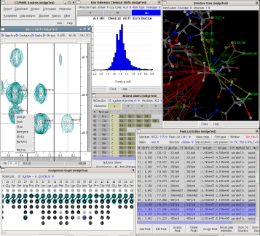

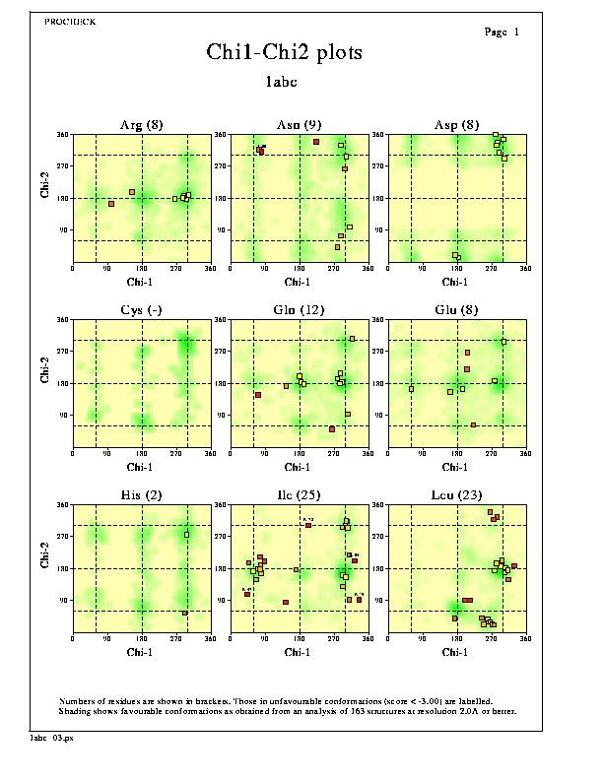
Macromolecular NMR pipeline
Structure
generation,
Dynamics,
Interactions
Analysis
Assignment
NMR processing
Validation
NMR experiments give atomic-level, qualitatively diverse information
No direct mathematical relationship between final model and original measurements
Peak-atom mapping (‘assignment’) is ‘puzzle solving’
  Redone for each sample group, semi-ambiguous
Data heterogenous and extremely complex
Workflow often branched or recursive

Slide 8
NMR software
Many programs - limited resources
Programs often done by single person,
  who has since left or become professor
  and is thus unavailable for maintenance
Each program allows different subset of possible data
Different data formats, with different dialects
Different atom naming systems, with local variants

Slide 9
Native Disorganisation
Task1
Task2
Convert
Task1
Task1
Convert
Convert
Task2
Convert
Convert
Task3
Task3
Task3

Slide 10
CCPN Data Standard
Task1
Task1
Task2
Convert
Convert
Data
Standard
Task1
Task2
Convert
Convert
Task3
Task3
Task3

Slide 11
CCPN data standard
Program-independent data storage and exchange
Final and intermediate data for all relevant programs
  Keyword-value for program-specific parameters
Precise, detailed, comprehensive, coherent
Object-oriented, normalized, for changing data
UML model as source for automatic code generation
Data access libraries for Python, Java, C;
XML and SQL storage. 800 000 lines/implementation
BIG!
  531 classes, 135 data type definitions,
  2044 attributes, 1790 roles

Slide 12
Molecule and NMR data (20% of classes)
+dataDim
ccp.molecule.ChemComp.NonStdChemComp
ccp.molecule.Molecule.MolResidue
ccp.molecule.MolSystem.MolSystem
+code1Letter: Word
+serial: Int
ccp.molecule.Molecule.Molecule
+code: Word
+stdChemCompCode: LongWord
+seqCode: Int
+name: Line
+name: Text
+getCode1Letter()
+seqInsertCode: Line =
+longName: Text
+numChains: Int
+molType: MolType
+isFinalised: Boolean = False
+hasChemExchange: Boolean
+ccpCode: LongWord
+molType: MolType
+commonNames: Text
ccp.molecule.ChemComp.StdChemComp
+linking: ChemCompLinking
+commonNames: Line
+keywords: Line
1
ccp.molecule.MolSystem.StructureGroup
+code1Letter: Word
+descriptor: Line
+keywords: Line
*
+functions: Line
+serial: Int
ccp.molecule.ChemComp.ChemComp
+stdChemCompCode: LongWord
+getMolType()
+functions: Line
ccp.molecule.MolSystem.MolSystemSysName
+isParamagnetic: Boolean
+name: Line
+molType: MolType
+getCcpCode()
1
+seqLength: Int
+namingSystem: Word
1
+molecularMass: Float
*
+detail: Text
+ccpCode: LongWord
+getCode1Letter()
+getChemCompVar()
*
+calcIsoelectricPoint: Float
+name: Line
+details: Text
+name: Text
+setChemCompVar()
+empiricalFormula: Line
+getNumChains()
+code3Letter: ThreeLetterCode
+molecularMass: Float
+getIsParamagnetic()
*
+code1Letter: Word
ccp.molecule.ChemComp.ChemCompVar
+limitResidues
1
+formalCharge: Int
+getMolecularMass()
+baseGlycoCtCode: String
2
+isAromatic: Boolean
1
1
+commonNames: Text
1
+linking: ChemCompLinking
+isParamagnetic: Boolean
1
1
1
+stdChemCompCode: LongWord
+descriptor: Line
1
+smiles: String
+keywords: Line
+isDefaultVar: Boolean = False
+smilesType: SmilesType
+merckCode: Word
+name: Text
ccp.molecule.Molecule.MolSeqFragment
+details: String
*
+sigmaAldrichCode: Word
1
+varName: Text
+organismName: Line
*
+seqDetails: Text
+beilsteinCode: Word
+glycoCtCode: String
+organismSciName: Line
+fragmentDetails: Text
ccp.molecule.MolSystem.MolSystemLink
+casRegCode: Word
+formula: Line
+getOrganismName()
+mutationDetails: Text
+details: Text
+formalCharge: Int
1
+getOrganismSciName()
1
+seqString: String
1
+dihedralAngle: LinkDihedralAngle
+hasStdChirality: Boolean
+molecularMass: Float
+stdSeqString: String
ccp.nmr.Nmr.ExternalShiftReference
+isLinearPolymer: Boolean
1
+nonStereoSmiles: String
+hasNonStdChemComp: Boolean
*
+sampleGeometry: Line
+getCode1Letter()
1
*
+stereoSmiles: String
1
+hasNonStdChirality: Boolean
ccp.molecule.MolSystem.ChainFragment
+location: Line
+getStdChemComp()
+isParamagnetic: Boolean
+isStdLinear: Boolean
+axis: Line
+getIsLinearPolymer()
+isAromatic: Boolean
+isStdCyclic: Boolean
ccp.molecule.MolSystem.Chain
+serial: Int
1
+getLinkEnds()
+getMolType()
+code: Line
+molType: Word
*
+pdbOneLetterCode: Line =
+isLinearPolymer: Boolean
1
+getFormula()
1
ccp.molecule.Molecule.Alignment
*
+getSeqLength()
+role: Line
1
+getMolecularMass()
+getEmpiricalFormula()
1
1
1
+getChemBonds()
+serial: Int
+getMolecularMass()
+magnEquivalenceCode: Line
*
+getChemAngles()
+homologyRatio: FloatRatio
+getFormalCharge()
+physicalState: Line
1
+getChemTorsions()
+dbRefAlignBegin: Int
+getIsAromatic()
*
+conformationalIsomer: Line
+getChemAtomSets()
+dbRefAlignEnd: Int
+getIsParamagnetic()
+chemExchangeState: Line
+nIdentical: Int
1
*
*
+getChemCompSysNames()
+nPositive: Int
+getIsStdCyclic()
+empiricalFormula: Line
2
+getName()
+alignLength: Int
+getIsStdLinear()
+molecularMass: Float
ccp.molecule.ChemComp.ChemBond
+setName()
*
+alignmentScore: Float
+getHasNonStdChemComp()
+formalCharge: Int
*
+alignmentProgram: Text
+getHasNonStdChirality()
2
+details: Text
ccp.molecule.MolSystem.ChainInteraction
+bondType: BondType = single
*
+details: String
+getSeqString()
+getEmpiricalFormula()
1
*
+interactionType: Line
+stereochem: BondStereochemistry
*
+getStdSeqString()
ccp.molecule.MolSystem.MolSystemLinkEnd
+getMolecularMass()
+linkCode: Word
+getFormalCharge()
*
ccp.molecule.Molecule.MolResLinkEnd
1
+getLinkEnd()
+createChainFragments()
ccp.nmr.Nmr.ChainStateSet
+linkCode: Word
*
+serial: Int
1
+getLinkEnd()
*
+stateSetType: ChainStateSetType
ccp.nmr.Nmr.ChainState
*
2
*
+details: Text
+serial: Int
ccp.nmr.Nmr.DataList
*
*
*
+name: Line
+name: Line
ccp.molecule.ChemComp.ChemAngle
*
{ordered}
*
+details: Text
+unit: Word
*
+stereochemistries
ccp.molecule.Molecule.MolResLink
*
+definition: String
ccp.molecule.ChemComp.Stereochemistry
*
+dihedralAngle: LinkDihedralAngle
ccp.molecule.MolSystem.NonCovalentBond
+sf: Float
+isStdLinear: Boolean
2
+serial: Int
ccp.molecule.MolSystem.Atom
*
ccp.molecule.MolSystem.Residue
ccp.molecule.Molecule.MolResLink
+getIsStdLinear()
+name: Word
1..*
+seqId: Int
+stereoClass: Word
{ordered}
*
*
*
+seqCode: Int
{ordered}
+chemAtoms
+value: Word
*
*
3
+dihedralAngle: LinkDihedralAngle
+getChemAtom()
*
*
*
+chemAtoms
{ordered}
+isStdLinear: Boolean
+seqInsertCode: Line =
+chemAtoms
+getRefStereochemistry()
+coreAtoms
2
+chemAtoms
+chemAtoms
+molType: MolType
+setRefStereochemistry()
+coreStereochemistries
ccp.molecule.ChemComp.AbstractChemAtom
+getIsStdLinear()
1
+ccpCode: LongWord
ccp.nmr.Nmr.AtomSet
+stereochemistries
+name: Word
+linking: ChemCompLinking
*
*
+subType: Int = 1
1
+descriptor: Line
+serial: Int
+chemAtoms
ccp.molecule.MolStructure.Residue
+details: Text
+name: Line
{ordered}
ccp.molecule.MolStructure.Chain
+seqId: Int
+getMolResidue()
4
1
+seqCode: Int
+getMolType()
1
1
+code: Line
+seqInsertCode: Line =
+getCcpCode()
ccp.molecule.ChemComp.LinkAtom
*
+getChain()
*
+getResidue()
+getChemCompVar()
ccp.molecule.ChemComp.LinkEnd
ccp.molecule.MolStructure.Atom
+remoteLinkEnd
*
+boundLinkEnd
*
+elementSymbol: Word
1
+linkCode: Word
+name: Word
*
1
+boundLinkEnds
*
*
+getElementSymbol()
+remoteLinkEnds
+getChemCompVars()
+altLocationCode: Line =
+coordChains
+boundLinkAtom
+remoteLinkAtom
+index: Int
*
ccp.molecule.ChemComp.ChemTorsion
*
+elementSymbol: Word
+name: Word
ccp.molecule.ChemComp.ChemAtom
1
*
+coordinates: Float
1
ccp.molecule.MolStructure.Coord
+chirality: AtomChirality
1
+bFactors: Float
ccp.molecule.MolStructure.StructureEnsemble
+altLocationCode: Line =
+nuclGroupType: Word
1
+occupancies: Float
*
+ensembleId: Int
+x: Float = 0.0
1
+elementSymbol: Word
+boundChemAtom
+getAtom()
+atomNamingSystem: Line
+y: Float = 0.0
+shortVegaType: Line
+remoteChemAtom
+getElementSymbol()
*
+resNamingSystem: Line
+z: Float = 0.0
*
+sysNames
+waterExchangeable: Boolean = False
*
*
*
+getChemAtom()
1
+nAtoms: Int = 0
+bFactor: Float = 0.0
+getChemElement()
ccp.molecule.ChemComp.ChemAtomSet
+getCoords()
+softwareName: Word
+occupancy: Float = 1.0
ccp.molecule.ChemComp.ChemTorsionSysName
+getCoordinates()
+orderedAtoms
+details: Text
+getAltLocationCode()
+sysName: Word
+name: Word
+getBFactors()
{ordered}
+getEnsembleValidations()
+setAltLocationCode()
*
+subType: Int = 1
+getOccupancies()
*
+purge()
*
+getX()
*
+isEquivalent: Boolean
+getSubmatrixData(name)
+getNAtoms()
+setX()
+isProchiral: Boolean
+setSubmatrixData(name, values)
*
+getY()
+distCorr: Float = 0.0
+setCoordinate(index, values)
ccp.molecule.MolStructure.Model
1
+setY()
*
*
+elementSymbol: Word
*
+setBFactor(index, value)
+serial: Int
+getZ()
ccp.molecule.ChemComp.NamingSystem
+getElementSymbol()
+setOccupancy(index, vaue)
+name: Line
*
+setZ()
ccp.molecule.ChemComp.AtomSysName
1
+setSubmatrixValues(name, index, values)
+index: Int
+getBFactor()
1
+atomName: Word
*
+name: Word
*
+newCoord()
+details: Text
1
+setBFactor()
+atomSubType: Int = 1
+getMainChemCompSysName()
+coordinates: Float
+getOccupancy()
+sysName: Line
1
+atomSetReference
+bFactors: Float
+setOccupancy()
+altSysNames: Line
+atomSetVariantSystems
+atomVariantSystems
+occupancies: Float
+atomReference
*
+getCoords()
Â«DataTypeÂ»
+getCoordinates()
ccp.molecule.MolStructure.EnsembleDataNames
+getBFactors()
+getOccupancies()
+getSubmatrixData(name)
+inputMeasurements
ccp.nmr.Nmr.AbstractMeasurement
+setSubmatrixData(name, values)
ccp.nmr.Nmr.AbstractMeasurementList
2
ccp.nmr.Nmr.DataDimRef
*
ccp.nmr.Nmr.HExchProtection
+value: Float
*
+serial: Int
+refPoint: Float = 0.0
ccp.nmr.Nmr.ExpTransfer
+error: Float = 0.0
+parentList
+name: Line
+refValue: Float = 0.0
+mixingTime: Float
+measurements
+figOfMerit: FloatRatio = 1.0
+unit: Word
+valuePerPoint: Float
+transferType: ExpTransferType
+dataDerivations
+details: Text
+measurements
1
+details: String
+localValuePerPoint: Float
*
+transferSubType: ExpTransferSubType
*
+isSimulated: Boolean = False
+spectralWidth: Float
+isDirect: Boolean = True
1
*
+spectralWidthOrig: Float
+parentList
*
+getSpectralWidth()
ccp.nmr.Nmr.HExchProtectionList
+getSpectralWidthOrig()
+unit: Word = ratio
ccp.nmr.Nmr.AbstractDataDerivation
+getValuePerPoint()
+protectionType: HExchProtectionType
+serial: Int
+pointToValue(point)
+details: Text
ccp.nmr.Nmr.DataDerivation
*
+parentList
ccp.nmr.Nmr.DataList
*
+valueToPoint(value)
1
*
ccp.nmr.Nmr.AbstractPeakDimContrib
+derivations
+name: Line
ccp.nmr.Nmr.FreqDataDim
+serial: Int
+unit: Word
+numPointsOrig: Int
+dim: Int
1
+definition: String
+pointOffset: Int = 0
+getDim()
+sf: Float
ccp.nmr.Nmr.AbstractDataDim
+phase0: Float
+dim: PositiveInt
+phase1: Float
+numPoints: NonNegativeInt
+valuePerPoint: Float
+fileDim: NonNegativeInt
+spectralWidth: Float
+isComplex: Boolean
+spectralWidthOrig: Float
+unit: Word
+getSpectralWidth()
+shapeSerial: PositiveInt
+getSpectralWidthOrig()
ccp.nmr.Nmr.HExchRate
+dataDims
*
ccp.nmr.Nmr.FidDataDim
1
+firstValue: Float = 0.0
+valuePerPoint: Float
ccp.nmr.Nmr.DataSource
+maxValue: Float
+serial: Int
+numPointsValid: NonNegativeInt
+name: Line
+pointOffset: Int = 0
+numDim: Int
+phase0: Float
ccp.nmr.Nmr.DataSourceImage
+scale: Float = 1.0
+phase1: Float
+noiseLevel: NonNegativeFloat
+spectralWidth: Float
+signalLevel: NonNegativeFloat
+oversamplingInfo: Text
+snRatio: NonNegativeFloat
+alternateSign: Boolean = False
+details: String
+negateImaginary: Boolean = False
+isNormalStorage: Boolean = True
+getMaxValue()
+storageDetails: String
+getSpectralWidth()
+dataType: DataSourceDataType
+isSimulated: Boolean = False
+recordNumber: Int = 0
+numShapes: NonNegativeInt = 0
+numSparsePoints: NonNegativeInt = 0
*
+getSnRatio()
+processedFrom
+processedTo

Slide 13
Data Interoperability
CCPN has standard representation (our first task!)
Writing is straightforward
Reading requires disambiguation
  User interaction
  Heuristics
  Known starting point (WMS)
Not all programs can deal with all problems
Programs are generally large(ish) loosely coupled batch jobs

Slide 14
Introduction
  CCPN and WeNMR
  NMR data and software
WMS Workflow Management System
  Goals
  Implementation
Status

Slide 15
Workflow Management Goals
Standardized interface to WeNMR portals
  Application-independent data selection
  Standardized task submission and result gathering
  Submit to multiple programs from single task
  High-quality modern interface
  Easy to modify and customize calculation protocols
Seamless, invisible data flow
  Automatic conversion to/from program-specific formats
  Start and end on precisely defined CCPN data
Combine tasks into workflows

Slide 16
Data Management Goals
Central data store, with access control
Track jobs and data flow
  NMR analysis is rarely linear
  Alternative jobs from single starting point
  Run – modify – re-run
Identified as desirable also for management of non-Grid data
  Group/department data store

Slide 17
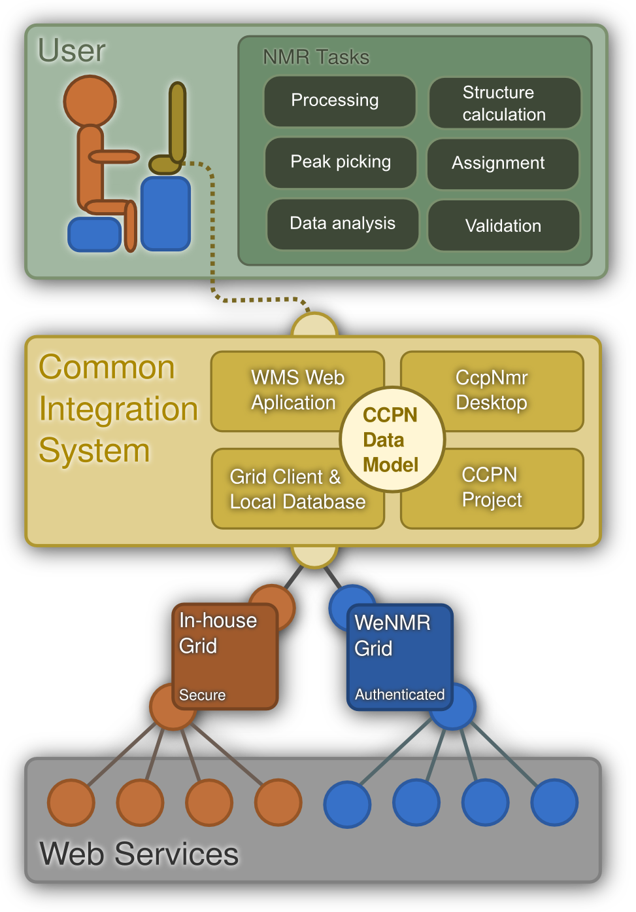
WMS – End User Local Platform
  WMS is a web-based end
  user platform for accessing
  web-based services and executing workflows
  Development of the
  Extend-NMR project
  Accesses services through adaptor modules
  Also direct access from desktop CcpNmr Analysis

Slide 18
Introduction
  CCPN and WeNMR
  NMR data and software
WMS Workflow Management System
  Goals
  Implementation
Status

Slide 19
WMS – Architecture
Web Client
Standardised interface
(Java / GWT)
Bioinformatics web services
WeNMR web portals
Local installation
Web Service Wrapper (Java / CGI)
Program files
CCPN data
Taverna
Remote Execution
Server
Server
(Java /Hibernate)
Data Adapter
(Python)
Database
(Postgres)
WSDL
CcpNmr Analysis
Desktop (Python )

Slide 20
Data handling
Data sets are large (XML 100’s of Mb)
Thin summary sent to client for selection
Data kept on server
  Standard CCPN data storage
  Task data in separate package (NmrCalc)
Transferred as tarred, zipped CCPN data sets
  Hidden ports.
  Transfer one zipped data bundle, one JSON parameter file

Slide 21
Data Flow
Generation
Data Flow
Protocol specification
UI generator
User Interface
Specification
Client
UI
Parameter definitions
NmrCalc : Program
map
Data selection
Input
Converter
NmrCalc
Parameters
Data
Generated
from selection
GRID /
LOCAL
calculation
Launch
TASK
Output
Converter

Slide 22
Protocol and interface specification
Multiple interfaces, different programs and protocols
  Group and user specific
User and program interfaces abstracted out
  Driven by specification file
  Custom-made widget for each data type
    structures, peak lists, shift lists …
Layout specification as part of protocol specification
Layout editor planned
  Scaled back due to developer illness

Slide 23
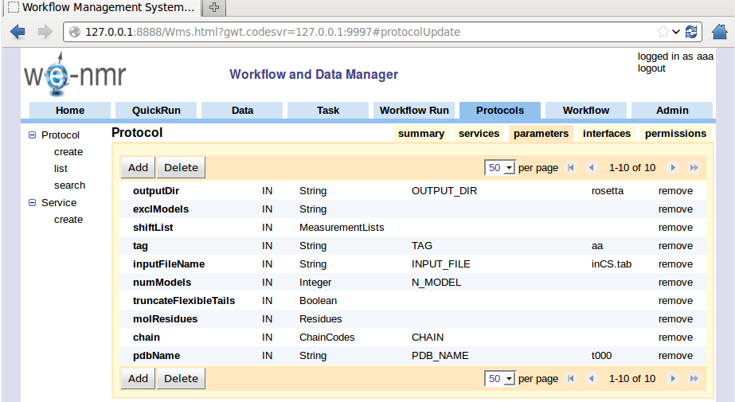
WMS Protocol Edit
View / edit protocol specification

Slide 24
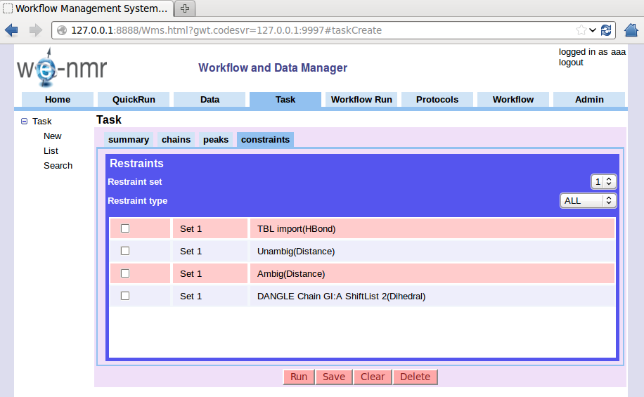
WMS Constraints select

Slide 25
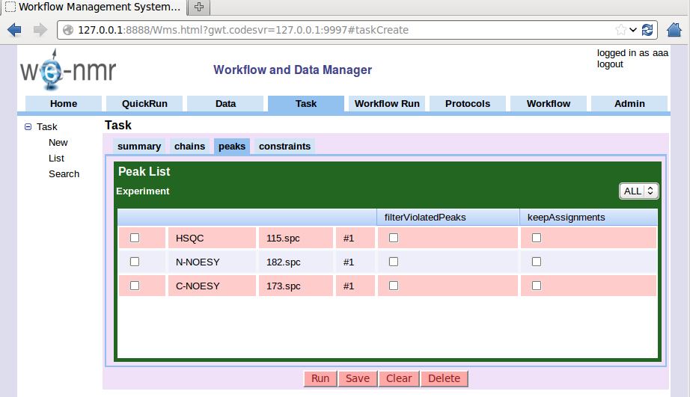
WMS Peaklist Select

Slide 26
Interface Implementation
Requirements analysis emphasized modern toolset, drag-and-drop, …
Hence choice of GWT
Fast, customizable interface generation
proved more important
Browser interface is a single, complex HTML page with varying content.
GWT less useful in practice
Simpler system might have been preferable

Slide 27
Taverna
Intention was full integration with Taverna
  Generate workflow specifications with SCUFL2 API
  But SCUFL2 API not ready and available in practice
Handbuilt workflow manager user for normal tasks
Taverna used for workflows
  Workflows written as t2flow files using Taverna Workbench
Problems passing complex objects and large binary blocks in Taverna protocol
  Keep data bundles on server and pass only handle

Slide 28
Introduction
  CCPN and WeNMR
  NMR data and software
WMS Workflow Management System
  Goals
  Implementation
Status

Slide 29
Status
Prototype for alpha testing
  End October project deliverable
Submit four different structure generation tasks to WeNMR portals from a single input selection
Validation task
Separate facility for Taverna Workflows
Lost most of a man-year (out of three)
due to lead developer illness.

Slide 30
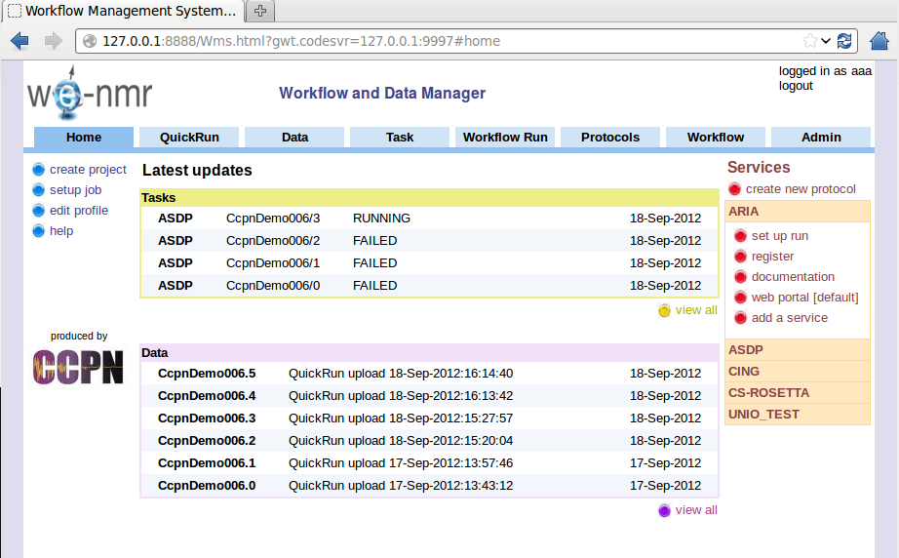
WMS Home page

Slide 31
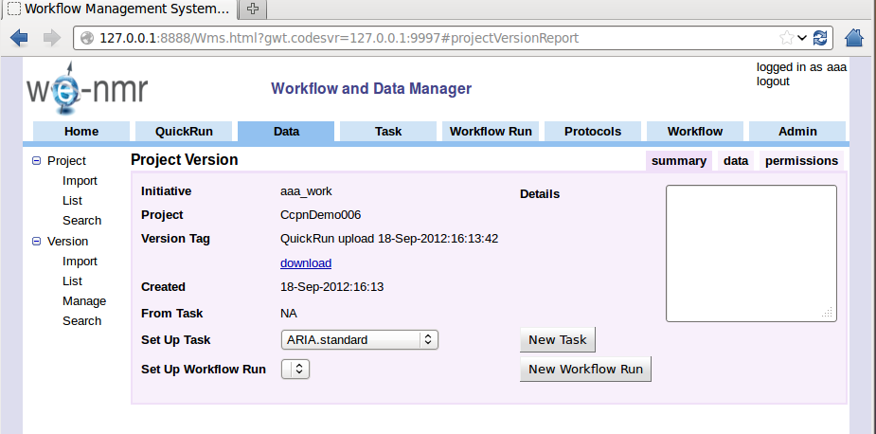
WMS Submit page
Submit task or workflow for project snapshot

Slide 32
END

Slide 33
NmrCalc
ccp.general.Template.MultiTypeValue
RunIo
+textValue: String
+name: Line
NmrCalcStore
+intValue: Int
+code: Word
+floatValue: Float
+ioRole: IoRole = input
1
+booleanValue: Boolean
+data
1
*
*
1
*
RunParameter
Data
*
Run
+serial: Int
*
+serial: Int
+inputs
ParameterGroup
+details: Text
*
+outputs
*
ccp.nmr.Nmr.AbstractMeasurementList
ccp.molecule.MolStructure.StructureEnsemble
+serial: Int
1
+name: Line
*
+unit: Word
+measurementList
ccp.molecule.MolStructure.Model
+details: String
+isSimulated: Boolean = False
*
{ordered}
+parentList
1
MeasurementListData
StructureEnsembleData
*
+measurements
+measurementListSerial: Int
+molSystemCode: Word
+getMeasurementList()
+ensembleId: Int
ccp.nmr.Nmr.AbstractMeasurement
+setMeasurementList()
+modelSerials: Int
+value: Float
+getStructureEnsemble()
+error: Float = 0.0
+setStructureEnsemble()
+figOfMerit: FloatRatio = 1.0
+getModels()
+details: Text
+setModels()
Notes:
33

