Slide 1
SA1 and JRA1 Operations and Operational Tools
EGI-InSPIRE PY2 Review
27-28 June 2012
T. Ferrari, Chief Operations Officer/EGI.eu

Slide 2
Contents
Introduction to SA1 and JRA1
Resource infrastructure
Service infrastructure
Analysis

Slide 3
PART I
Introduction to SA1 and JRA1
resources
partners
objectives
Resource infrastructure
Service infrastructure
Analysis

Slide 4
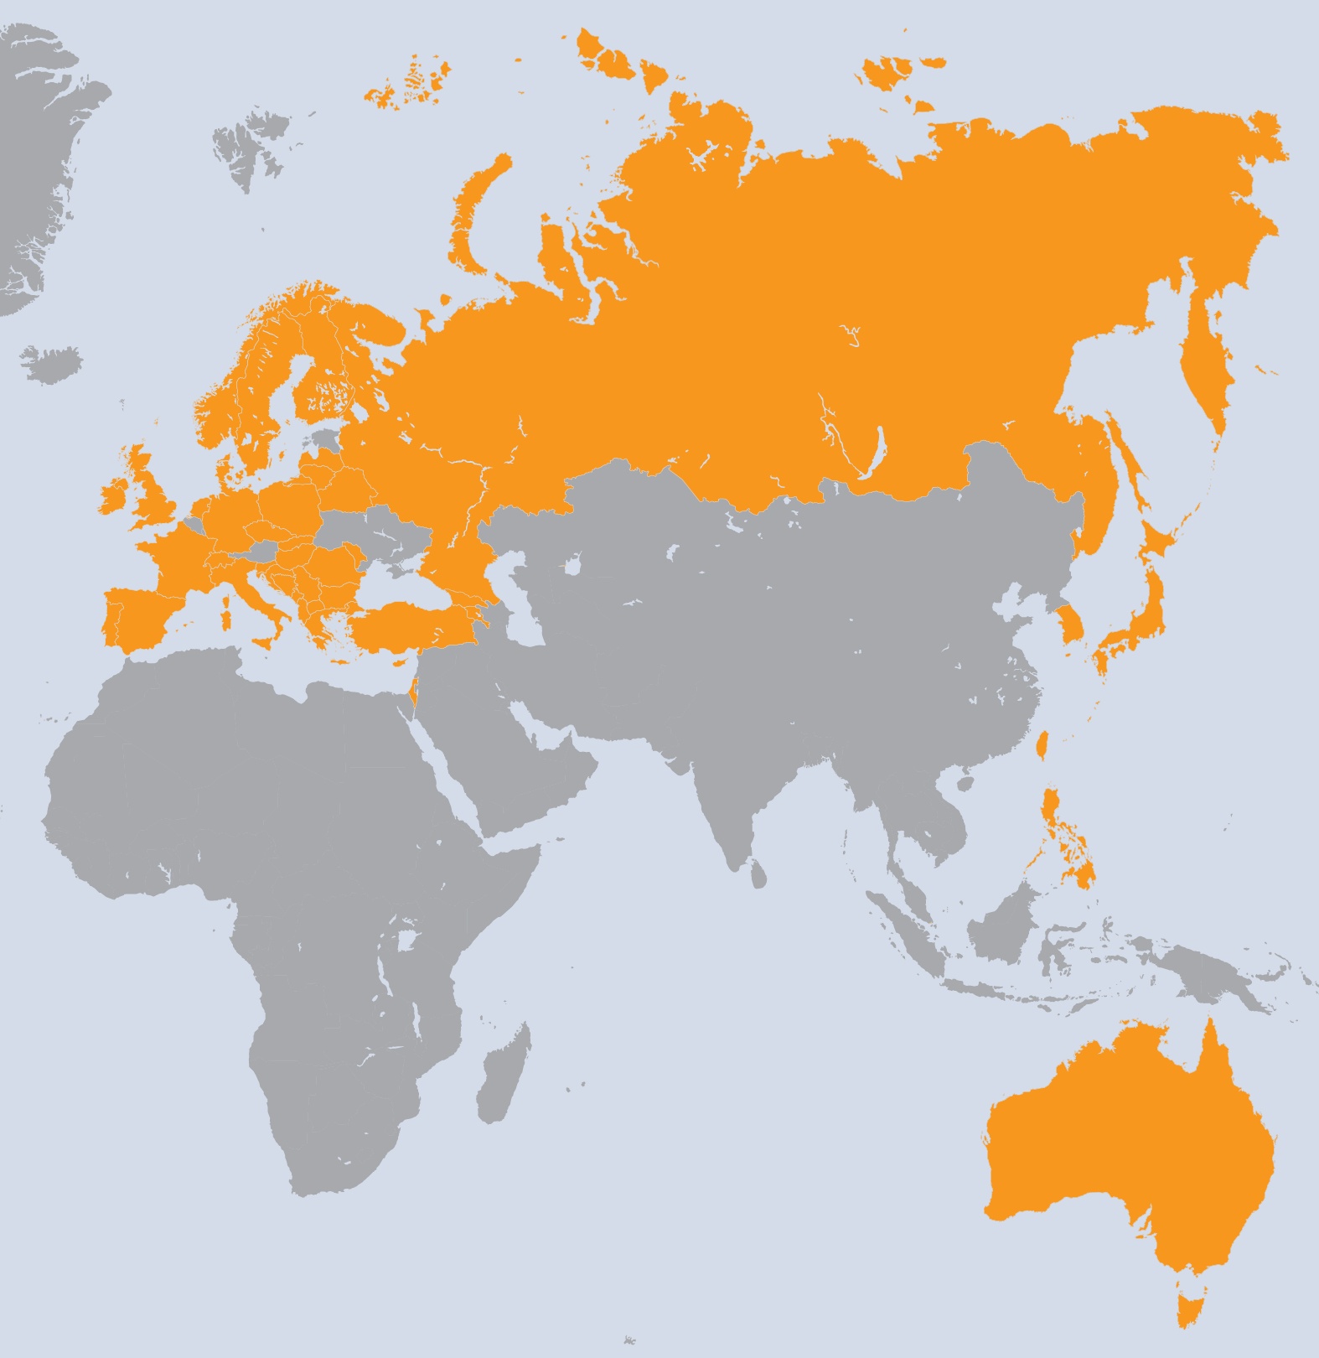
SA1 Overview
I. Introduction
France
Finland
Spain
Poland
Greece
Italy
Germany
Portugal
Netherlands
Croatia
UK
Sweden
Slovenia
Czech Republic
Russia
Georgia
Romania
Bulgaria
Armenia
Latvia
Serbia
Israel
Hungary
Moldova
Norway
Switzerland
Ireland
Turkey
Denmark
Cyprus
Slovakia
Belarus
FYR Macedonia
Bosnia & Herzegovina
Montenegro
Albania
Lithuania
Taiwan
Philippines
Japan
Korea
Australia
Singapore
WP | Beneficiary | Total PM
WP4-E | EGI.eu | 55
WP4-E | CERN | 59
WP4-E | CNRS | 12
WP4-E | CSC | 23
WP4-E | CSIC | 29
WP4-E | CYFRONET | 23
WP4-E | FOM | 35
WP4-E | GRNET | 70
WP4-E | INFN | 48
WP4-E | VR-SNIC | 11
WP4-E | KIT-G | 70
WP4-E | LIP | 17
WP4-E | SRCE | 39
WP4-E | STFC | 67
WP4-N | ARNES | 94
WP4-N | CESNET | 124
WP4-N | CNRS | 312
WP4-N | CSC | 63
WP4-N | CSIC | 364
WP4-N | CYFRONET | 152
WP4-N | E-ARENA | 71
WP4-N | FOM | 155
WP4-N | GRENA | 19
WP4-N | GRNET | 176
WP4-N | ICI | 54
WP4-N | IICT-BAS | 124
WP4-N | IIAP NAS RA | 19
WP4-N | IMCS-UL | 48
WP4-N | INFN | 374
WP | Beneficiary | Total PM
WP4-N | IPB | 114
WP4-N | IUCC | 25
WP4-N | KIT-G | 274
WP4-N | VR-SNIC | 80
WP4-N | LIP | 103
WP4-N | MTA KFKI | 108
WP4-N | RENAM | 16
WP4-N | SIGMA | 78
WP4-N | SRCE | 72
WP4-N | STFC | 273
WP4-N | SWITCH | 83
WP4-N | TCD | 90
WP4-N | TUBITAK | 126
WP4-N | UCPH | 81
WP4-N | UCY | 48
WP4-N | UI SAV | 92
WP4-N | UIIP NASB | 26
WP4-N | UKIM | 71
WP4-N | UOBL ETF | 71
WP4-N | UOM | 71
WP4-N | UPT | 28
WP4-N | VU | 22
WP4-N | ASGC | 193
WP4-N | ASTI | 156
WP4-N | KEK | 1
WP4-N | KISTI | 92
WP4-N | UNIMELB | 36
WP4-N | NUS | 14
43 Countries
45 Beneficiaries
5151 PMs
107,3 FTEs
SA1 Effort

Slide 5
JRA1 Overview
I. Introduction
7 Countries
8 Beneficiaries
315 PMs
8.67 FTE
Italy
Germany
Spain
Greece
Croatia
CERN
France
UK
WP | Task | Beneficiary | Total PMs
WP7-E | TJRA1.1 | INFN | 24
WP7-E | TJRA1.2 | KIT-G | 47
WP7-E | TJRA1.2 | CSIC | 12
WP7-E | TJRA1.2 | CNRS | 12
WP7-E | TJRA1.2 | GRNET | 12
WP7-E | TJRA1.2 | SRCE | 12
WP7-E | TJRA1.2 | STFC | 24
WP7-E | TJRA1.2 | CERN | 12
WP7-G | TJRA1.3 | CSIC | 3
WP7-G | TJRA1.3 | CNRS | 3
WP7-G | TJRA1.3 | SRCE | 3
WP7-G | TJRA1.3 | STFC | 3
WP7-G | TJRA1.3 | CERN | 6
WP7-G | TJRA1.4 | KIT-G | 18
WP7-G | TJRA1.4 | CSIC | 18
WP7-G | TJRA1.4 | INFN | 26
WP7-G | TJRA1.4 | STFC | 27
WP7-G | TJRA1.5 | CNRS | 53
JRA1 Effort

Slide 6
SA1 tasks and resource distribution
I. Introduction
 | Task | Leader/Partner | Task effort distribution
TSA1.1 | Activity Management | T. Ferrari/EGI.eu | 1%
TSA1.2 | Secure Infrastructure | M. Ma/STFC | 9%
TSA1.3 | Service Deployment Validation | M. David/LIP | 11%
TSA1.4 | Infrastructure for Grid Management | E. Imamagic/ SRCE | 21%
TSA1.5 | Accounting | J. Gordon/STFC | 6%
TSA1.6 | Helpdesk Infrastructure | T. Antoni/KIT | 9%
TSA1.7 | Support Teams | R. Trompert/SARA | 28%
TSA1.8 | Providing a Reliable Grid Infrastructure and core services | C. Kanellopoulos/AUTH | 15%

Slide 7
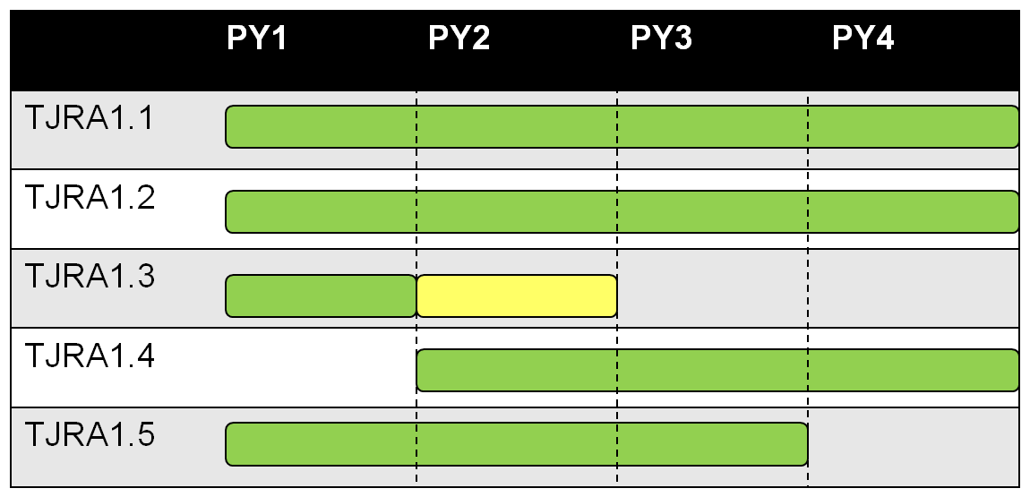
JRA1 tasks and resource distribution
I. Introduction
 | Task and Effort Distribution | Leader
TJRA1.1 | Activity Management (7%) | D. Cesini/INFN
TJRA1.2 | Maintenance and development of the deployed operational tools (42%) | T. Antoni/KIT
TJRA1.3 | Supporting National Deployment Models (6%) | P. Solagna/EGI.eu
TJRA1.4 | Accounting for usage of different resource types (28%) Cloud, HPC, Desktop Grid, Storage/Data Usage Application Usage Billing system | J. Gordon/SFTC
TJRA1.5 | Integrated Operations Portal (17%) Service Oriented model Porting to Symfony New DCI integration Support of mobile devices | C. L’Orphelin/CNRS

Slide 8
Objectives
I. Introduction
Operate a secure, reliable European-wide federated production grid infrastructure that is integrated and interoperates with other grids worldwide
 | Tasks | Task Objectives
O1 | TSA1.2 | Maintain a secure infrastructure
O2 | TSA1.3 | Validate new technology releases (tools and middleware)
O3 | TSA1.7 | Support end-users and Resource Centre administrators
O4 | TSA1.8 | Service Level Management, grid oversight, documentation and procedures
O5 | TSA1.4 TSA1.5 TSA1.6 | Operate tools, the accounting infrastructure and the EGI Helpdesk
O6 | JRA1.2 JRA1.3 JRA1.4 JRA1.5 | Evolve the operational tools used by the production infrastructure Maintenance, development and support of national deployment Accounting for the use of new resources (desktop, virtualisation, storage, data, application and billing)

Slide 9
PART II
Introduction to SA1 and JRA1
Resource infrastructure
Resource Centres
Operations Centres
Usage

Slide 10
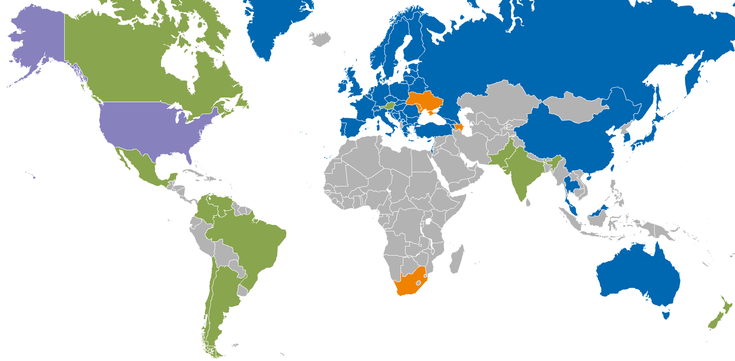
Resource infrastructure Providers (RPs)
II. Resource infrastructure
Metrics (April 2012) |  | Value (yearly increase)
Resource Centres (RCs) | EGI-InSPIRE and Council Participants | 326 (+3%)
 | Including integrated infrastructures | 352
 | Supporting MPI | 90 (+20%)
Countries | EGI-InSPIRE and Council members | 42
 | Including integrated RPs | 54
Operations Centres | Total (National, Federated, EIRO) | 37 (27, 9, 1)
 | New | NGI_FI, NGI_IE, NGI_UK
Integrated EGI-InSPIRE Partners and EGI Council Members
Internal/External RPs being integrated
External RP
Peer RP

Slide 11
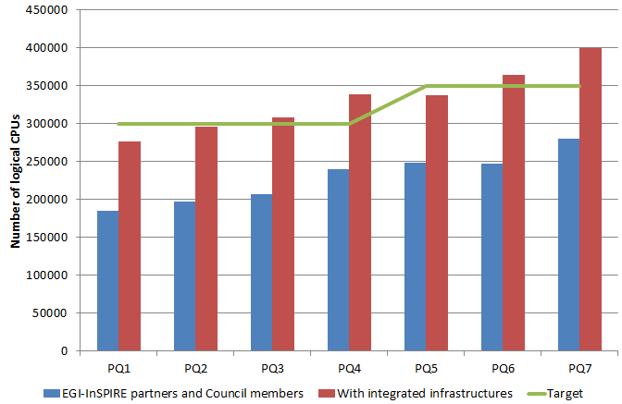
Installed Capacity
II. Resource infrastructure
Logical CPUs | Value (yearly increase)
EGI-InSPIRE and Council Partic. | 270,800 (+31%)
Including integrated RPs | 399,300
Storage | Value (yearly increase)
Disk (PB) | 139 PB (+31%)
Tape (PB) | 134 PB (+50%)
SA1 and JRA1 - EGI-InSPIRE Review 2012

Slide 12
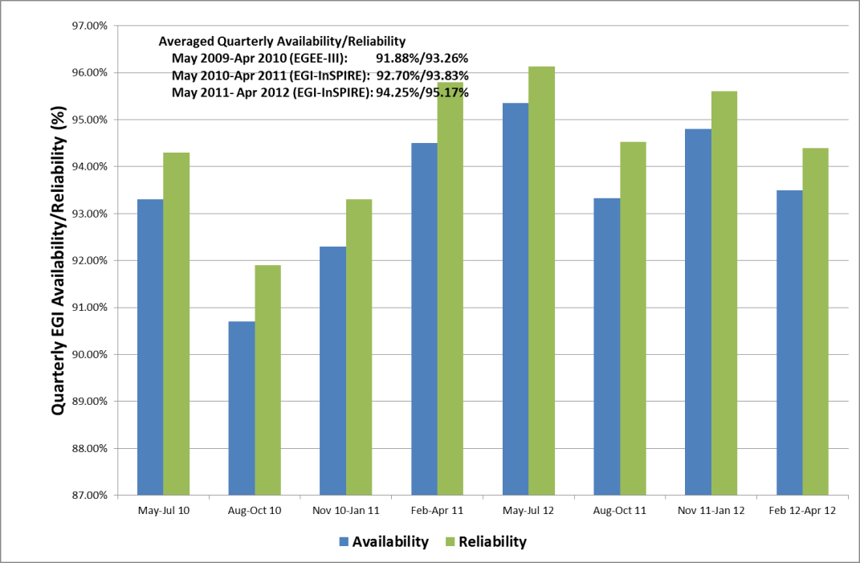
RC Service Levels and Targets
II. Resource infrastructure
Scope
RC services for resource access
New RC Operational Level Agreement and availability profile
Availability (uptime / total time) x 100
minimum RC availability: 70%
Reliability [uptime / (total time – scheduled time)] x 100
minimum RC reliability: 75%
Suspension policy
Suspension if RC availability < 70% for 3 consecutive months
from 50% to 70% as of PY2
16 RCs suspended (6 in PY1) and subsequently re-certified
PY2 EGI availability: 94.50% (+1.94% yearly increase)
PY2 EGI reliability: 95.17% (+1.70% yearly increase)
Reporting
RC monthly performance reports
ticket-based procedure for monitoring of underperforming RCs → new automated follow-up procedure under development
new procedure to request recalculation

Slide 13
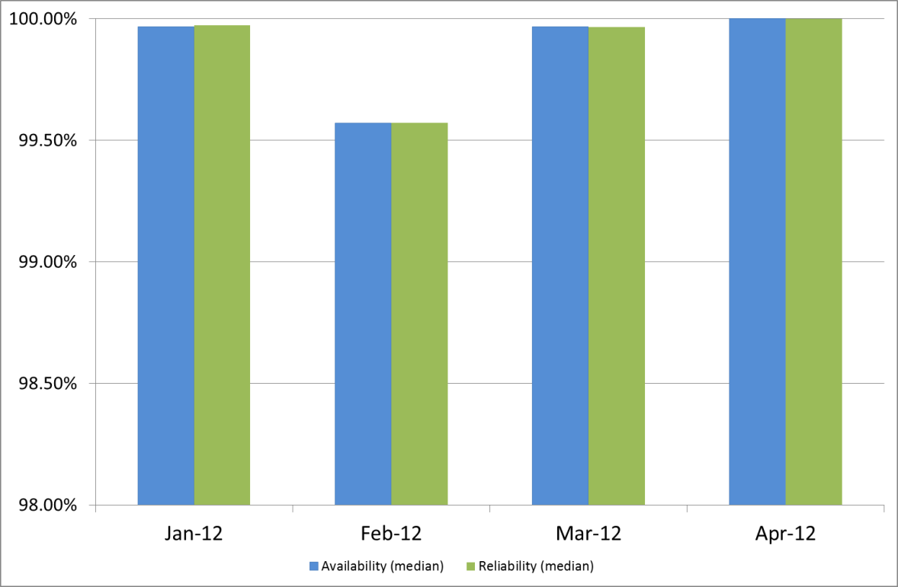
RP Service Levels and Targets
II. Resource infrastructure
Scope
central grid services provided by NGIs giving access to RCs
New RP Operational Level Agreement
pilot: Sep-Dec 2011
into force as of Jan 2012
being incrementally extended
Service levels and targets
new RP Operational Level Agreement
min Availability/Reliability: 99%/99%
max Regional Operator on Duty Performance Index: expired tickets and alarms : 10
Reporting
Monthly RP performance reports
New reporting framework extracting information from the SAM Programmatic Interface and the Operations Portal
Notes:
Adjust diagram → revise diagram

Slide 14
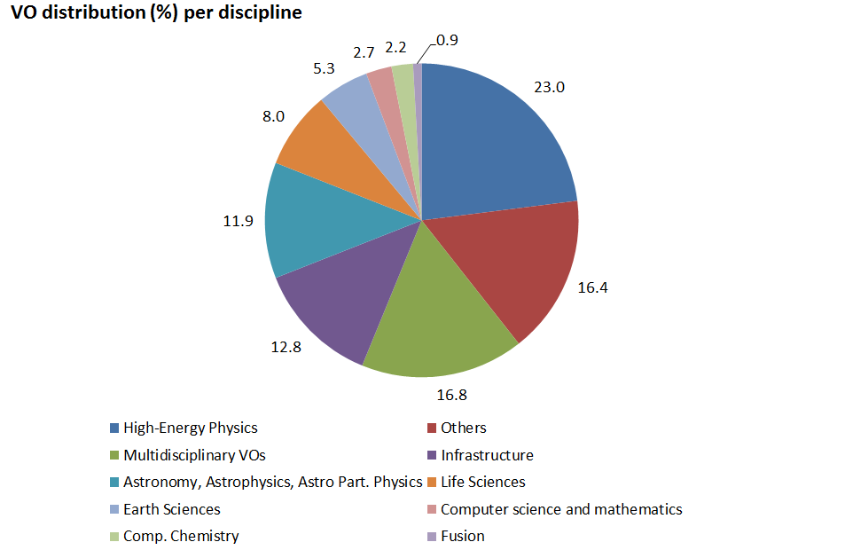
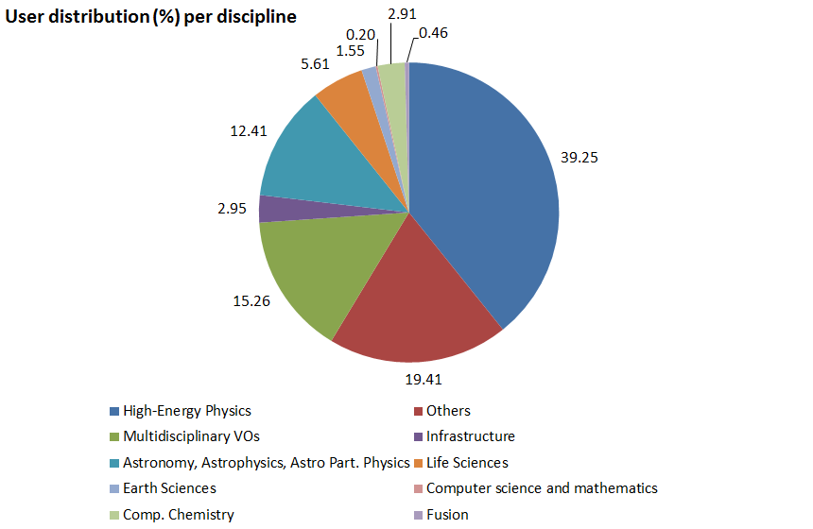
VO and user Statistics
II. Resource infrastructure
Metrics | Values (April 2012)
Registered VOs | 226 (+3.20%) – national and international VOs
Registered users | 20883 (+14.30%)
Active VOs | High: CPU time > 1 Year/Week Medium: CPU time > 1 Month/Week, < 1 Year/Week Low: CPU > 1 Day/Week, < 1 Month/Week | 25 23 8

Slide 15
CPU Usage
II. Resource infrastructure
PY2 Metrics |  | Value (yearly increase)
CPU wall clock time | Total normalized CPU wall clock time consumed (Billion HEP-SPEC 06 hours) | 10.5 (+52.91%)
Jobs | Job/year (Million) | 492.5 (+46.42% ) PY2 Target: 334.8 (+47.10%)
 | Average Job/day (Million) | 1.35
% of total norm. CPU wall time consumed | High-Energy Physics | 93.60% (+48.82%)
 | Astronomy and Astrophysics | 2.25% (+117.79)
 | Life Sciences | 1.30% (+1.97)
 | Various disciplines | 1.23% (+20.86)
 | Remaining disciplines | 1.62%

Slide 16
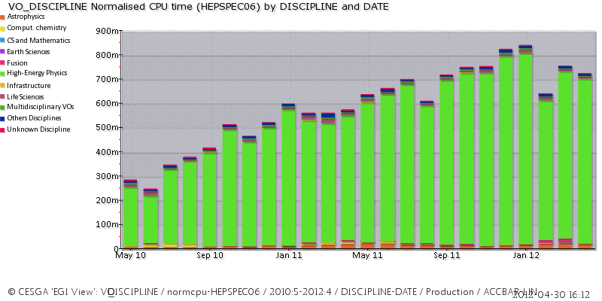
PY1-PY2 Trend
II. Resource infrastructure
PY1
PY2
CPU norm.
wall clock hours

Slide 17
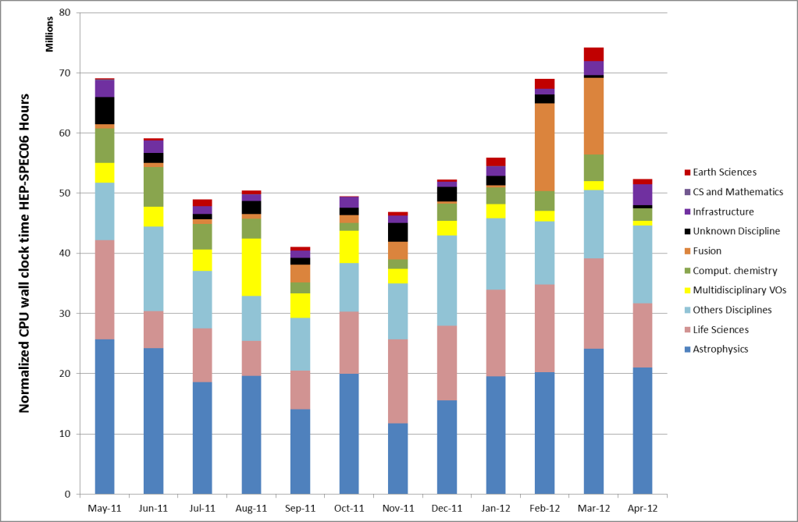
PY2 usage (non-HEP VOs)
II. Resource infrastructure

Slide 18
PART III
Introduction to SA1 and JRA1
Resource infrastructure
Service infrastructure
Analysis
Issues, use of resources, impact and plans

Slide 19
III. Service Infrastructure
Operations Service Catalogue
Operations services enables secure, interoperable and reliable access to
distributed resources.
EGI services are provided locally by Operations Centres and globally by EGI.eu.
and partners
Service categories:
Global Services
Resource Infrastructure
Resource Infrastructure
Resource Infrastructure
Resource Infrastructure
Infrastructure Services and Tools
Resource Infrastructure
II. Software
Deployment and Interoperations
III. Support Services
Local Services
IV. Operations Management
and Coordination
Operations Centres +
Resource Centres
Operations Centres
Operations Centres

Slide 20
Infrastructure Services and Tools
III. Service Infrastructure
Message brokers
TSA1.4, JRA1.2
Service Availability Monitoring
TSA1.4, JRA1.2, JRA1.3
Operations Portal
TSA1.4, JRA1.2, JRA1.5
Accounting and Metrics Portal
TSA1.5, JRA1.4
Helpdesk
TSA1.6, JRA1.2
Grid Configuration Database
TSA1.4, JRA1.2

Slide 21
Message Brokers
III. Service Infrastructure/Tools
Objectives: support to the configuration of the message broker network (JRA1, AUTH), deploy a production infrastructure for message exchange for monitoring and accounting
Achievements
3 ActiveMQ updates
support of authentication and authorization
performance improvement through the eviction of pending connections
message history retention and reliable message delivery through the migration from “topic” to “queue”
other operational tools, in particular the Operations Portal
provisioning of additional testing infrastructure (4 broker instances)

Slide 22
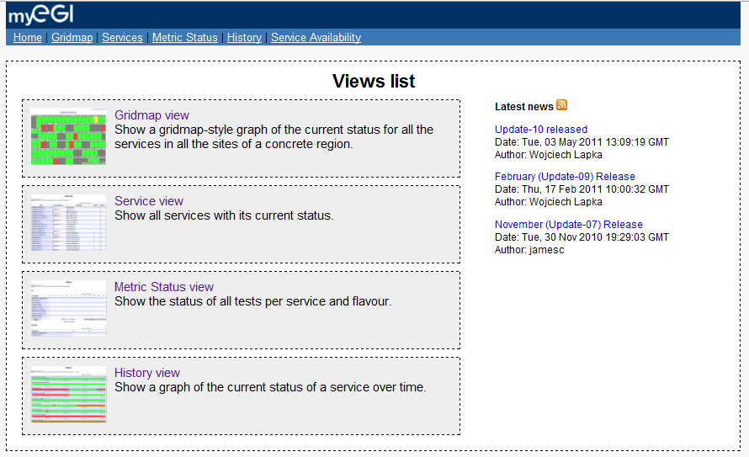
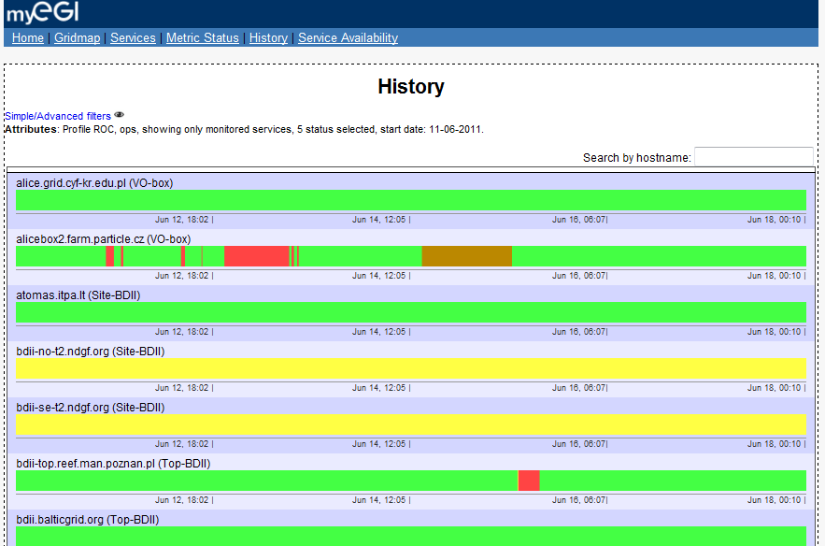
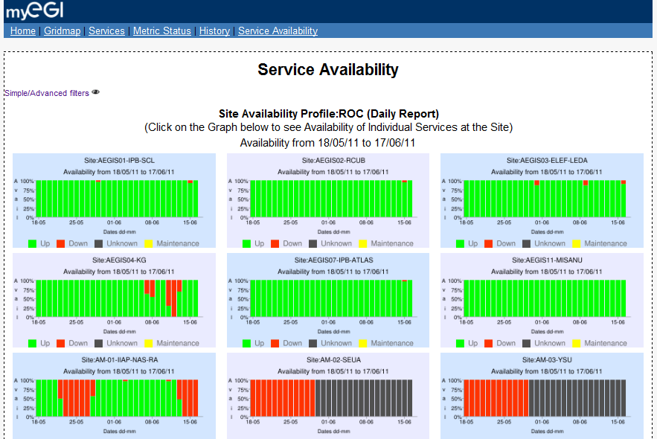
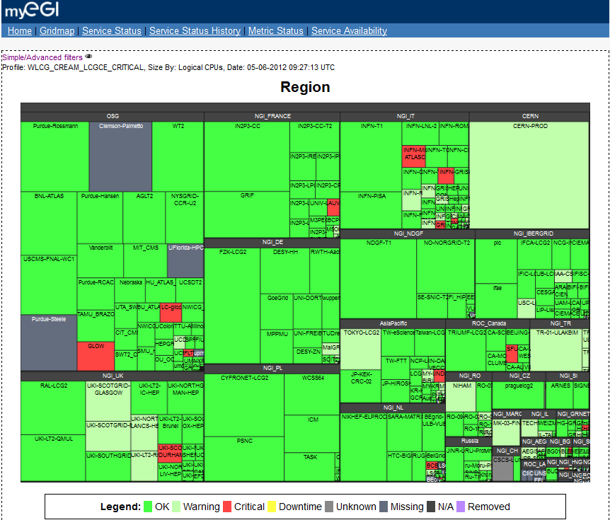
Service Availability Monitoring (SAM) 1/2
III. Service Infrastructure/Tools
SAM (CERN, SRCE, AUTH) monitoring framework for RCs and services
main data sources for the Operations Dashboard
data source to generate Availability/Reliability statistics
local/central components:
test submission framework: based on the Nagios system and customised by the Nagios Configurator Generator
databases for storage of information about topology (Aggregated Topology Provider), metrics (Metrics Description DataBase) and results (Metrics Results Store)
visualisation tool GUI: MyEGI

Slide 23
Service Availability Monitoring (SAM) 2/2
III. Service Infrastructure/Tools
Achievements
7 releases following the EGI software release process
main new features:
myEGI web interface and web services with different views, including gridmap and availability and reliability plots
prototype of profile management system (POEM) for probes/metrics
integration of new middleware service probes
UNICORE, ARC, GLOBUS; Desktop Grid and QosCosGrid (ongoing)
Worker Node probe
hot-standby failover system
cleanup of dependencies and meta-packages
support for monitoring of uncertified sites
improved usage of ActiveMQ for reliable delivery of messages
decommissioning of the old monitoring infrastructure:
gridmap
old SAM Portal, programmatic interface and database
SAM infrastructure
32 distributed instances serving 35 EGI partners, 2 federations, 3 integrated RPs

Slide 24
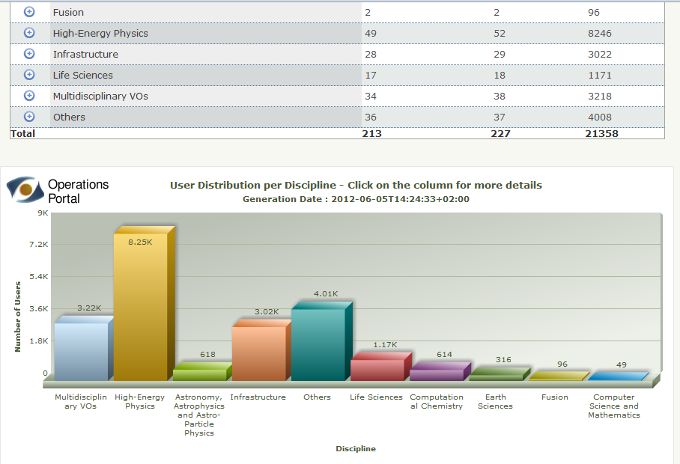
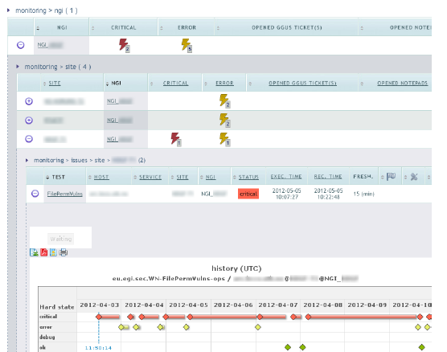
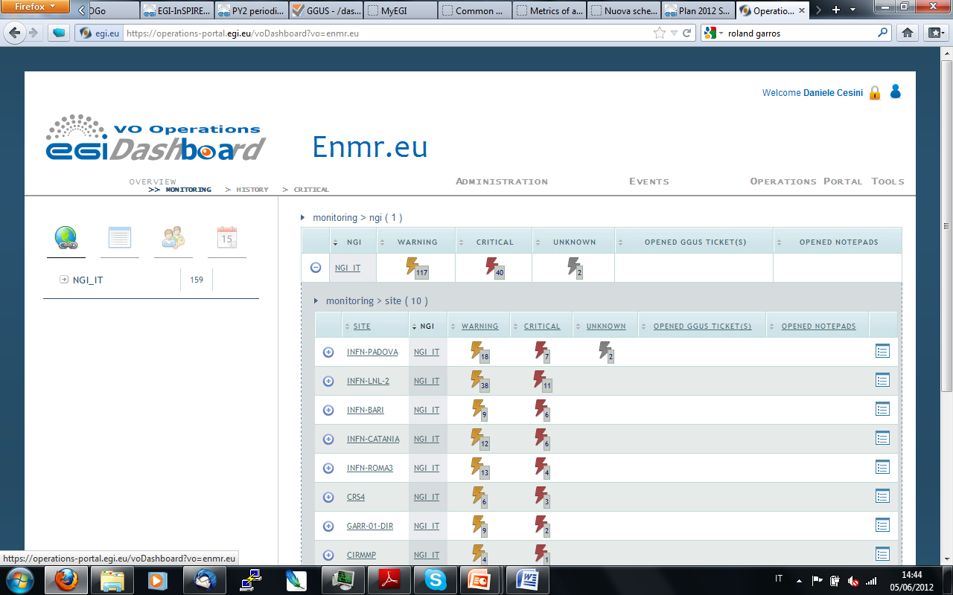
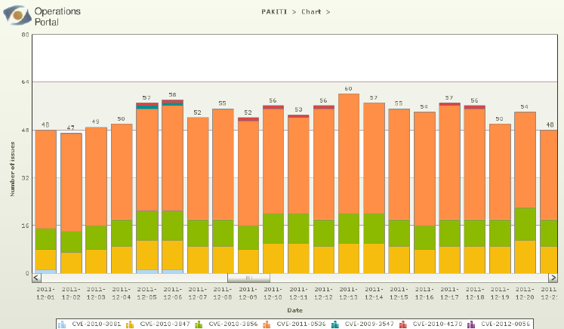
Operations Portal
III. Service Infrastructure/Tools
Operations Portal (CNRS)
provides a single access point to information, tools and facilities for various actors (NGI Operations Centres, VO managers, etc.). Modular structure:
Operation Dashboard
VO Id Card and VO Management
(new) Security Dashboard
(new) VO Operations Dashboard
Achievements
10 releases
two new modules
improved VO Management module
maintenance of the automatically synchronizing regional package

Slide 25
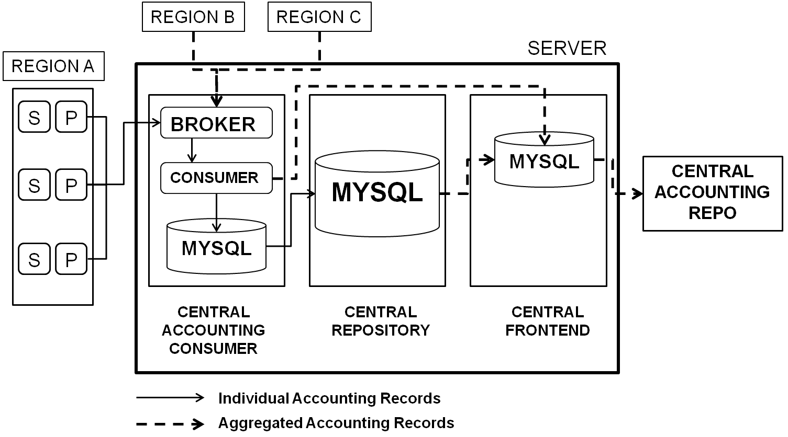
Accounting
III. Service Infrastructure/Tools
Accounting system: global/local service to collect and provide information about usage of compute resources within the production infrastructure
Central components
APEL usage record repositories (STFC)
Local components
Sensors, national /regional repositories and portal
Achievements (APEL repository)
release of Secure Stomp Messenger (SSM) for testing of a new transport method using the EGI messaging infrastructure
database major redesign
definition of the storage accounting record schema (collaboration with EMI)
prototype of an accounting systems for cloud resources (collaboration with the federated cloud Task Force)

Slide 26
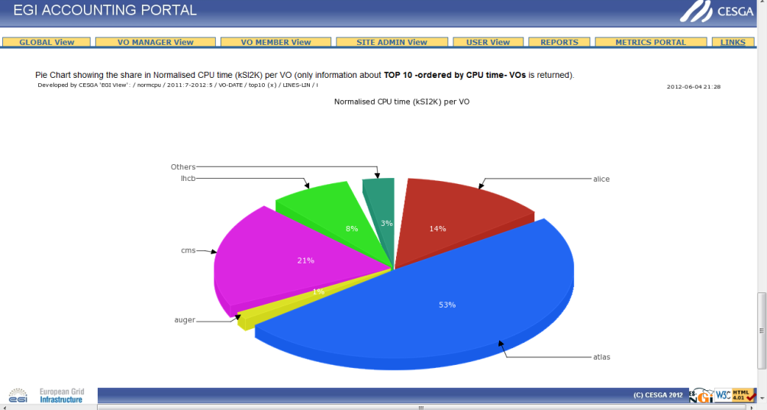
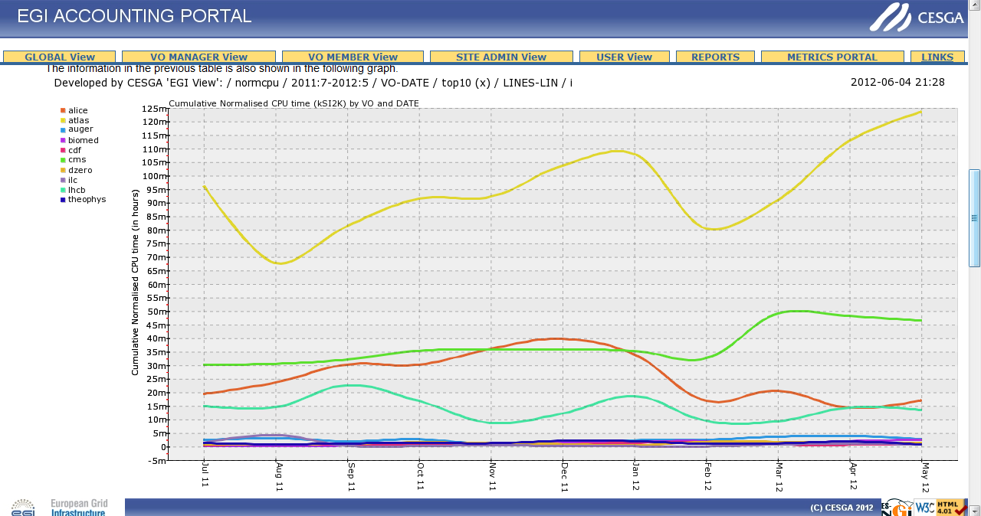
Accounting Portal
III. Service Infrastructure/Tools
Accounting Portal (FCTSG) Web GUI to access the data of the Accounting Repository
Achievements
2 major releases and various minor updates
complete redesign of the tool
new plot engine
extended “VO administrator” and “Site Administrator” views
XML interface to obtain data from the “Custom View”
XML interaction with the Operations Portal
prototype of the inter-NGI usage graphs

Slide 27
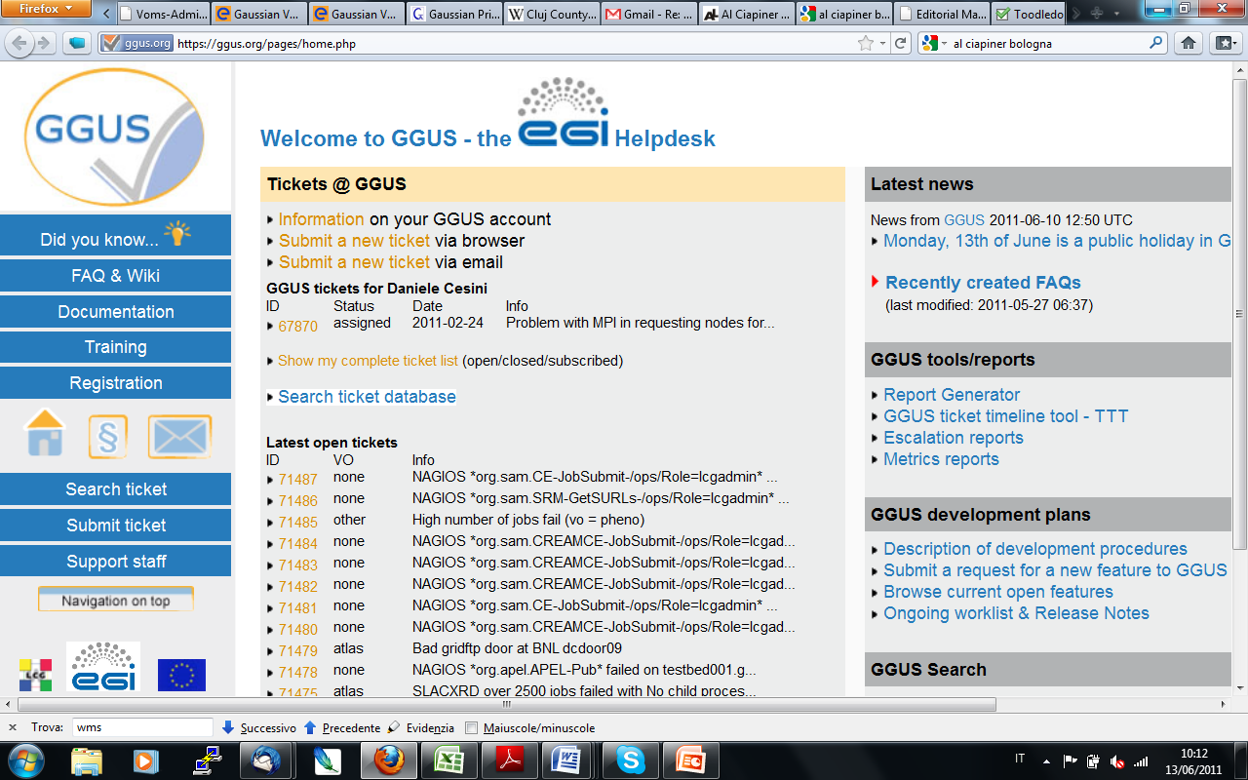
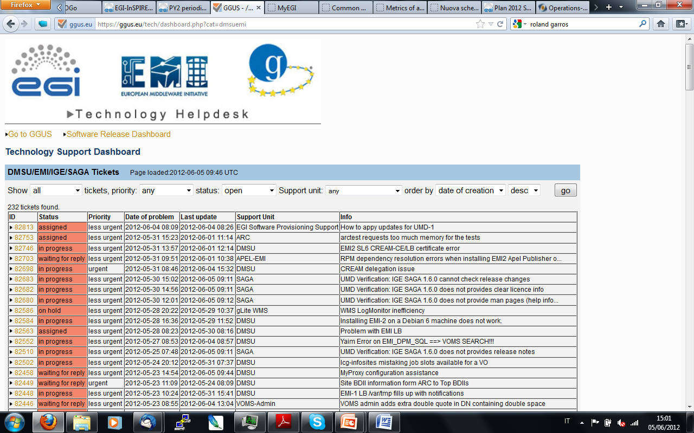
EGI Helpdesk
III. Service Infrastructure/Tools
EGI Helpdesk (KIT)
distributed system with a central component (Global Grid User Support - GGUS) interface to local helpdesks
Achievements
9 releases
major new features and development:
first prototype of the report generator
refinement of the Technology Helpdesk
active-active fail-over system for the data, the logic and the presentation layers
enhanced usability (notifications, search options, etc.)
Implementation of interface to the CERN helpdesk “Service NOW”
7 local interfaced helpdesks and 5 xGUS deployed instances

Slide 28
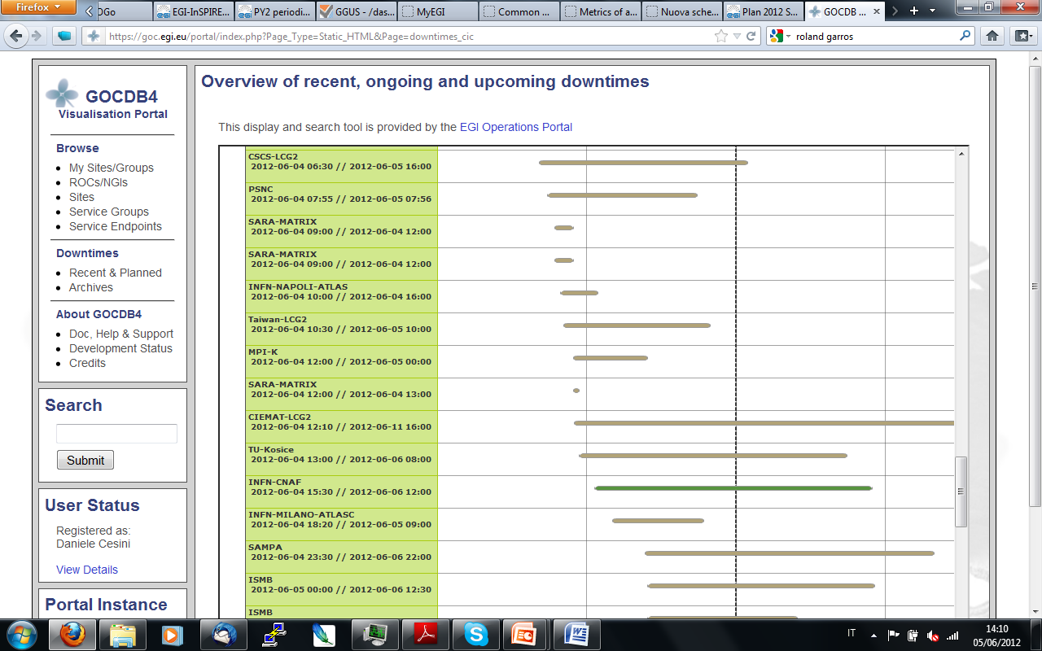
Central configuration repository
III. Service Infrastructure/Tools
GOCDB (STFC)
EGI relies on a central configuration database to record static information contributed by the resource providers as to the service instances that they are running and the individual contact, role and status information for those responsible for particular services
Achievements
3 major releases
major new features:
data scoping
service groups
new roles and permissions
new service types integrated
improved user interface and responsiveness
refactorization of the database internals
manual failover instance in production

Slide 29
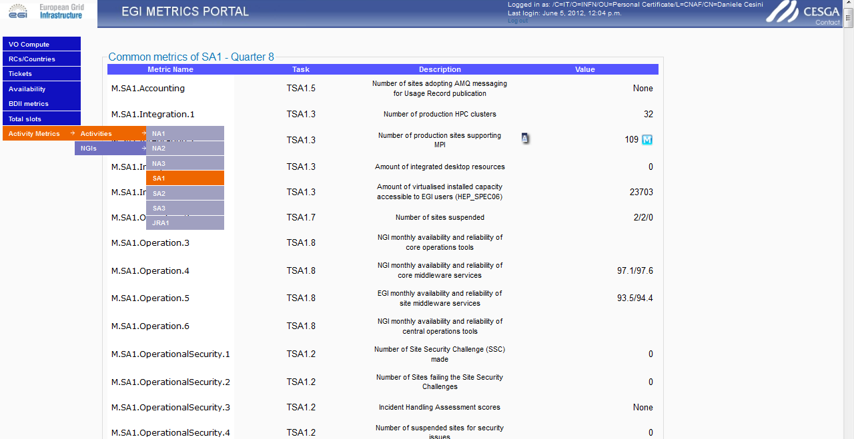
Metrics Portal
III. Service Infrastructure/Tools
Metrics Portal (FCTSG): tracking of project and partner performance indicators with the manual and automatic collection of EGI-InSPIRE metrics using different information sources
Achievements
2 major releases + minor updates
per country/activity metrics
heavy query optimization
data export in xls format
manual override of automatic metrics
validation of figures collected automatically

Slide 30
JRA1.3 Achievements
III. Service Infrastructure/Tools
Support of National Deployment Models ended at PM24
Completed
Operations Portal: regional instance synchronizing with central instance
GGUS: xGUS for customized helpdesk (hosted centrally)
Accounting Portal (requires local APEL repository)
Partial
SAM: fully distributed infrastructure
new requirements for monitoring of non-EGI sites (PQ9) and for custom probes (TBD)
GOCDB: central support for scoped sites and custom service types, stand-alone local installation possible
long-term requirement for a synchronizing regional instance to be re-assessed
Not available
APEL regional repository (planned at PQ11)
Task will be completed to achieve maximized regionalization

Slide 31
PART III
Introduction to SA1 and JRA1
Resource infrastructure
Service infrastructure
Infrastructure Services and Tools
Software Deployment and Interoperations
Requirements gathering (TSA1.1)
Software Staged Rollout (TSA1.3)
Interoperations (TSA1.3)
Grid Services (TSA1.8)

Slide 32
Staged Rollout
III. Software Deployment and Interoperations
New software updates (grid middleware and tools) are deployed into the production infrastructure incrementally through a staged rollout to ensure that they are reliable in actual use, following successful verification of the software component against published criteria
Extension of Staged Rollout activities to EMI and IGE releases
Periodic revision of early adoption procedures and support tools
Reallocation of Staged Rollout effort for multi platform testing
Achievements | PQ2 Value/Yearly increase
Staged Rollout tests | 192
Components tested/rejected | 122/8
Number of EA teams | 60 (+33%)
Middleware stacks/components | ARC, gLite, (new) Globus, UNICORE, SAM, CA trust chain

Slide 33
Interoperations
III. Software Deployment and Interoperations
Objective: evolve the operations infrastructure and tools to make them software agnostic and foster integration of different DCIs
Accomplishments
completed: ARC
almost completed
Desktop Grid (EDGI), GLOBUS (IGE), UNICORE (EMI)
accounting integration in progress - TCB accounting task force coordinating efforts
in progress: QosCosGrid
to support multi-scale simulations across EGI and PRACE addressing MAPPER requirements
collaboration with EUDAT and PRACE → shared operations integration roadmap
workshops for the integration of platforms into a unified Information Discovery System

Slide 34
Grid services and VO services
III. Software Deployment and Interoperations
Operations services
infrastructure for the DTEAM VO membership management (grid troubleshooting) → replicated VOMS servers
membership management for OPS VO (monitoring)
enhanced infrastructure for monitoring of uncertified sites
VO services
EGI Catch-All Certification Authority for new user communities and emerging grid infrastructure → 5 countries: Albania, Azerbaijan, Bosnia and Herzegovina, Georgia and Senegal)
grid services provisioned by EGI.eu for new/small VOs
+360 collective grid service instances
VO SAM
VO Administration Dashboard
LFCBrowseSE
new VO Operations Dashboard

Slide 35
PART III
Introduction to SA1 and JRA1
Resource infrastructure
Service infrastructure
Infrastructure Services and Tools
Software Deployment and Interoperations
Support
Operations Management and Coordination
Analysis
Issues, use of resources, impact and plans

Slide 36
Support activities
III. Support
Technical Services | SA1 tasks
1st level support | TSA1.7
Grid oversight | TSA1.7
Network Support | TSA1.7
Central components
User and operations support Triage of tickets in GGUS
Central operations support and escalation of tickets not managed locally Service level management
Support to connectivity and performance problems (contact point to the NREN PERT teams)
Local components
1st and 2nd level users/operations support for tickets opened through local helpdesks
Local operations support
2nd level support: Deployment Middleware Support Unit (SA2)
3rd level support: Technology providers

Slide 37
III. Support
Achievements
EGI Helpdesk for VO-specific/operations incidents and for specialized support to users and operations
Grid oversight (COD)
monthly follow-up of underperforming RCs and RPs
oversight of monitoring infrastructure
monthly grid oversight newsletter
revised ticket escalation procedure and support tools
new local grid oversight performance indicator
COD certification of new RPs
→ Proposed refactoring of EGI support services (SA1.7 and SA2.5) into a single support task for better coverage and optimization of support tasks

Slide 38
PART III
Introduction to SA1 and JRA1
Resource infrastructure
Service infrastructure
Infrastructure Services and Tools
Software Deployment and Interoperations
Support
Operations Management and Coordination
Service Level Management (TSA1.8)
Operational Security (TSA1.2)
Documentation (TSA1.8)
Operations Management (TSA1.1)

Slide 39
Operational security
III. Operations Management and Coordination/Security
Security Coordination Group coordinate overall EGI security activities
EGI CSIRT
Software Vulnerability Group
Handling reported
vulnerabilities,
vulnerability assessment,
secure coding education
Security Policy Group
Develop and maintain security policies
Incident Response Task Force
(incident handling and coordination)
Security monitoring
(Pakiti, Security Nagios, Security Dashboard)
Security drills
Training and dissemination
EUGridPMA
External software providers (EMI/IGE/…)
PRACE/XEDE/OSG/…

Slide 40
EGI CSIRT
Incident Prevention (security monitoring, security intelligence group, assessing known vulnerabilities with the support of SVG, preparation of advisories)
Incident Response (incident handling including investigation, heads up, coordination with site CSIRTs, forensics, technical support, advisories, reports)
Listed team in the European database of CSIRTs
accreditation by Trusted Introducer under discussion (external audit)

Slide 41
Achievements 1/3
III. Operations Management and Coordination/Security
EGI CSIRT | 10 security incidents handled (none related to grid middleware vulnerabilities, mostly single site: stolen/weak passwords unprotected ssh keys vulnerable services open unpatched software 4 advisories issued (1 critical, 2 high risk) 2 security training sessions (forensics, RTIR) No site suspended because of a critical vulnerability New ticketing system for Incident Response (RTIR) New security dashboard for EGI CSIRT, NGIs and RCs Updated security Nagios probes

Slide 42
Achievements 2/3
III. Operations Management and Coordination/Security
Security Service Challenge 5 | Assessment of the full response chain involving: site security contacts, VO CSIRT CAs EGI and NGI CSIRT 40 RCs tested, 20 countries new monitoring and management framework usable for SSC-5 runs in NGIs
SVG | 23 software vulnerabilities reported (of those fully evaluated 2 High, 3 Moderate, 10 Low) - of which 13 in grid middleware 7 advisories issued by SVG 2 vulnerability assessment completed (ARGUS and VOMS) Improved co-ordination of fixing of issues and release of advisories, with EMI and the EGI DMSU

Slide 43
Achievements 3/3
III. Operations Management and Coordination/Security
 | Achievements
D4.4 | Review of security of the infrastructure (scope, assets) Security threat risk assessment plan
Procedures | 1 new procedure EGI CSIRT Critical Vulnerability Operational Procedure 2 updated procedures EGI Security Incident Handling Procedure EGI Software Vulnerability Issue Handling Procedure
Policies | 2 new policies Security Policy for the Endorsement and Operation of Virtual Machine Images Service Operations Security Policy (replacing “Site Operations Policy”) 15 policies in total (users/VOs/RCs)
Notes:
https://wiki.egi.eu/wiki/EGI_CSIRT:Policies
https://wiki.egi.eu/wiki/SPG:Documents

Slide 44
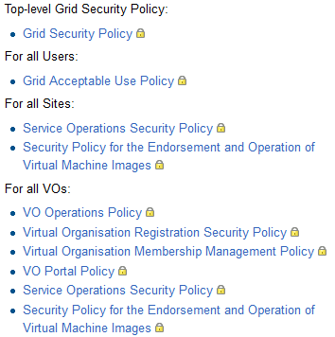
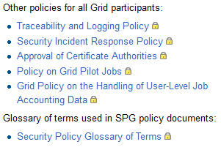
Security Policies

Slide 45
Collaborations
III. Operations Management and Coordination/Security
Security for Collaborating Infrastructures
define trust and policy standards between infrastructures
EGI leading this activity
EGI, WLCG, PRACE, XSEDE, OSG, ...
Grid-SEC
coordinated response to cross-grid security incidents (vetted security representatives from WLCG, OSG, XSEDE, EGI)
International Grid Trust Federation
Research and education identity federations worldwide (REFEDS)
Federated Identity Management for research collaborations (European E-infrastructure Forum)
OGF

Slide 46
EGI Security Threat Risk Assessment 1/3
III. Operations Management and Coordination/Security
Assets and identified threat categories
Reputation and Trust
Management, Organization, Human capital, Digital identities
from/to users or trusted staff
manipulating people to perform malicious actions
from security staff actions and inactions
AAI infrastructure
Processes, Knowledge, Information and data, Intellectual property
software security and integrity
data integrity, availability, confidentiality
illegal use and general misuse
Services, Software, Infrastructure, Network
Software and infrastructure
software vulnerability
operations and configuration
from security incidents
technical/physical security threats to the infrastructure and to external parties
Other technologies
from virtualization
from new software and technologies
availability and reliability of general IT services

Slide 47
EGI Security Threat Risk Assessment 2/3
III. Operations Management and Coordination/Security
Team established to carry out assessment
Identified 75 threats in 20 categories
Method for risk assessment
each team member asked to produce their rating for ‘likelihood’ and ‘impact’
Likelihood: 1 (Unlikely) – 5 (Once a month or more)
Impact: 1 (Minimal affecting local services) – 5 (Very serious disruption at multi-national level for 1 week or more)
Risk = Likelihood * impact
guidelines for these ratings given in order to improve objectivity – still large element of judgement
based on current situation and mitigation
initial analysis of threats with average computed risk ≥ 8

Slide 48
III. Operations Management and Coordination/Security
EGI Security Threat Risk Assessment 3/3
Initial findings
13 threats found with risk 8 or more. Top 4:
incident due to exploit of vulnerability in software other than Grid middleware (11.9)
new software or technology may be installed which leads to security problems (10.9)
incident spreads across the Grid (10.7)
security problems arising from the move to IPv6 (10.4)
Mitigations
CSIRT Security Intelligence Group monitoring newly discovered vulnerabilities and exploits
EGI CSRIT and SVG assessing vulnerability found in software widely deployed, recommending updates
Proactive monitoring of RCs (Pakiti, Security Dashboard) to ensure no vulnerable versions of software are run

Slide 49
PART IV
Introduction to SA1 and JRA1
Resource infrastructure
Service infrastructure
Analysis
Issues, use of resources, impact and plans

Slide 50
Issues/SA1
IV. Analysis
Third-party software repositories, software maintenance and specialized support challenged by the end of EMI and IGE
EGI software provisioning processes, service level targets, responsiveness to reported incidents
PY3 mitigation: revision of procedures, strengthening of EGI specialized support, sustainability
Expanding set of products and platforms to be staged rollout.
PY3 mitigation: revision of SA1.3 effort, reallocation of resources, policies and priorities
Several infrastructures in the Eastern Europe region underperforming
PY3 mitigation: support action in collaboration with GRNET, training, better support of testing in the operational tools (PY3)

Slide 51
Issues/JRA1
IV. Analysis
2nd level support of regionalized operational tools
accounting, monitoring, operations portal, currently relying on voluntary contributions
PY3 mitigation: proposed revised structure of EGI support tasks and effort allocation
Insufficient effort for innovation to address new “high impact requirements”
JRA1.3 regionalization, JRA1.2 SAM, JRA1.5 operations portal (assessment in D7.2)
PY3 mitigation: re-scoping of development activities

Slide 52
Use of Resources/SA1
IV. Analysis
104% PMs achieved (aggregated)
EGI.eu Global Services
96% PMs achieved (aggregated) compensating PY1 over reporting due to transition from EGEE
some tasks affected by personnel turnover (coordination of integration TSA1.3, documentation TSA1.8) → handover of coordination to EGI.eu (PY3-PY4)
catch all services/availability (TSA1.8) → partner affected by hiring freeze in the public sector, but services successfully delivered
NGI Local Services
few cases of under/over reporting that will be compensated over the duration of the project

Slide 53
IV. Analysis
Use of Resources/JRA1
87% PMs achieved (aggregated)
112% WP7-E tasks (TJRA1.1, TJRA1.2)
69% general tasks (TJRA1.2, TJRA1.4, TJRA1.5)
PY2 compensating PY1 deviations
95% for TJRA1.3 (PY1+PY2)
100% for TJRA1.2 (PY1+PY2)
Over reporting
TJRA1.2 146% (CSIC): restructuring of both accounting portal and metrics portal
Under reporting
TJRA1.4: 52% achieved, requirements gathering phase, compensation in PY3

Slide 54
SA1 Plans for next year
IV. Analysis
Security
complete security threat risk assessment, consolidation of security tools, NGI SSC5, revise policies and new one on data protection
Middleware upgrade campaign
Extended staged rollout
Phasing out of gLite 3.1/3.2
GLUE 2.0: upgrade plan, EGI profiling and information validation
Service level management
EGI.eu OLA
extended monitoring and reporting of EGI.eu and NGI services
consolidation of NGI services (including NGI SAM)
DCI integration
EUDAT and PRACE roadmap
Accounting of Globus, Unicore, Desktop Grids, QosCosGrid
Migration to SSM of infrastructures publishing summary records
IPv6 compliance testing

Slide 55
JRA1 Plans for next year
IV. Analysis
Operations Portal
Mobile devices support
Service level reporting module
Monitoring of Virtual Sites
GOCDB
GLUE2.0 compatibility and rendering
Accounting
add new resource types in production (storage, clouds, parallel jobs)
regional repository
Messaging
deployment of the supported authorization and authentication framework
GGUS
Production version of the Report Generator
Improvement of high availability configuration (including DBMS)
SAM
Integration of middleware probes from EMI
Production version of profile management service (POEM)

Slide 56
Impact and value
IV. Analysis
O1 The continued operation and expansion of today’s production infrastructure | 352 production RCs, (+30.7% compute capacity, +50% storage capacity) +1.9% yearly increase of availability
O2 Continued support of researchers | +3.20% new registered VOs +46.42% yearly increase of resource usage Astronomy Astrophysics and Astro-particle Physics ramping up
O4 Interfaces that expand access to new user communities | New GOCDB service types and SAM probes 34 operational tool releases Integration of accounting in progress 55 grid middleware requirements
O5 Mechanisms to integrate existing infrastructure providers in Europe and around the world | RP Operational Level Agreement 2 new RP MoUs Moldova, South Africa, Ukraine being integrated Collaboration with PRACE
O6 Establish processes and procedures to allow the integration of new DCI technologies | Collaboration with EUDAT ARC, gLite, GLOBUS, UNICORE, Desktop Grid, QosCosGrid

Slide 57
Summary
SA1 and JRA1 contribute to meet the project objectives and support the EGI Strategy 2020
Leadership
with the expansion of the resource infrastructure and increasing usage
Openness
with a growing level of integration
Reliability
with continued operation and increasing performance
Innovation
with evolving tools, procedures and policies and requirements

Slide 58
References
Security Risk Assessment of the EGI Infrastructure, deliverable D4.4, http://go.egi.eu/863
Security procedures: https://wiki.egi.eu/wiki/EGI_CSIRT:Policies
Security policies: https://wiki.egi.eu/wiki/SPG:Documents
Operations procedures: https://wiki.egi.eu/wiki/Operations_Procedures
Operations documentation: https://wiki.egi.eu/wiki/Documentation

Slide 59
Backup

Slide 60
III. Software Deployment and Interoperations
Requirements gathering
Analysis and prioritization of requirements (every quarter)
+54 requirements for grid middleware and tools/34 accepted
Major requirements campaign on an annual basis and contribution to EGI-InSPIRE JRA1, EMI and IGE technical roadmaps
Gathering
Prioritisation
Discussion with
Technology Providers
EGI Request Tracker
User Community Board
Technology Coordination Board
and
EGI- JRA1
Virtual research communities
Virtual Organisation
Operations Tools Advisory Group
Resource Centres
Resource infrastructure Providers
Operations Management Board

Slide 61
Requirement statistics
Status | # tickets | Comment
delivered | 7 | The fix has been delivered in one TP's release
endorsed | 17 | The requirement is clear and accepted by TP
planned | 11 | The requirement has a deadline for the delivery
clarification | 3 | In clarification within OMB
on_hold | 4
rejected | 5 | Not accepted by TCB or TP
submitted | 5 | Without an answer from TP
tech_Under_discussion | 2 | Internally evaluated by TP
Total | 54
Total tickets accepted | 35
ticket because a duplicate | 1

Slide 62
Tickets (May 2011-May 2012)
Operations tickets
533 ticket/month
Solution time median (service hours): 17h 20’
VO support
16 ticket/month
Solution time median (service hours): 152h 59’
All support units
728 ticket/month
Solution time median (service hours): 17h 33’

Slide 63
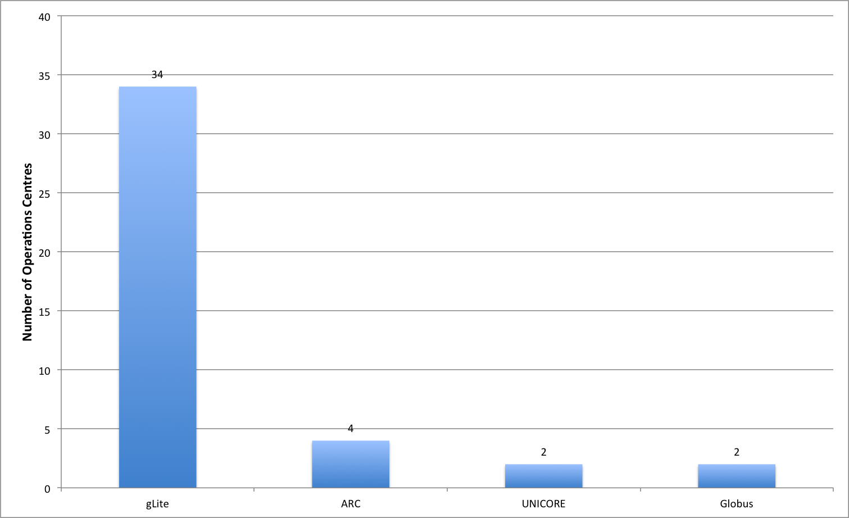
Deployment of software platforms
III. Software Deployment and Interoperations

Slide 64
Operations Portal synchronization

Slide 65
Operations Portal architecture

Slide 66
GGUS failover system

Slide 67
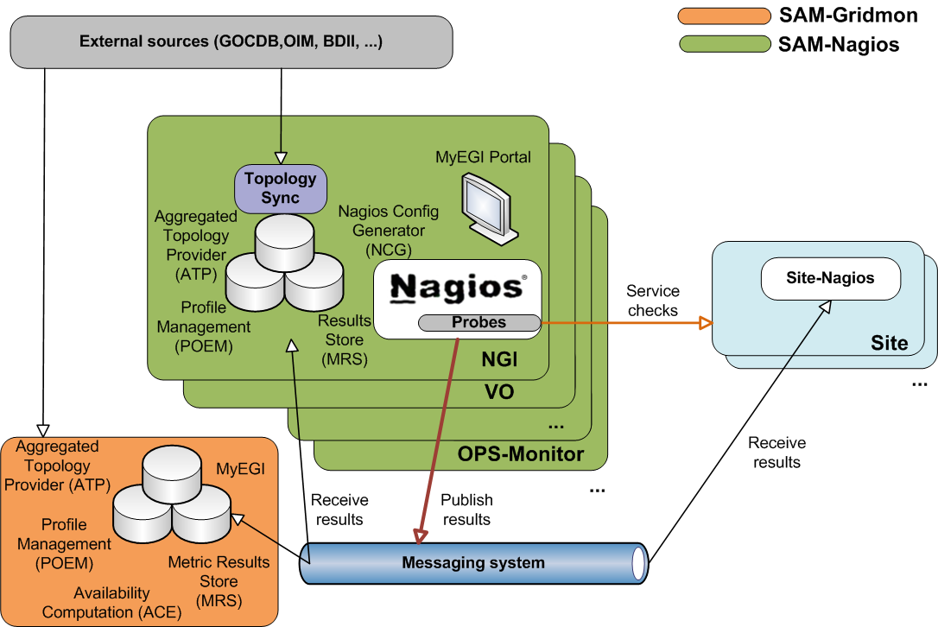
SAM architecture

Slide 68
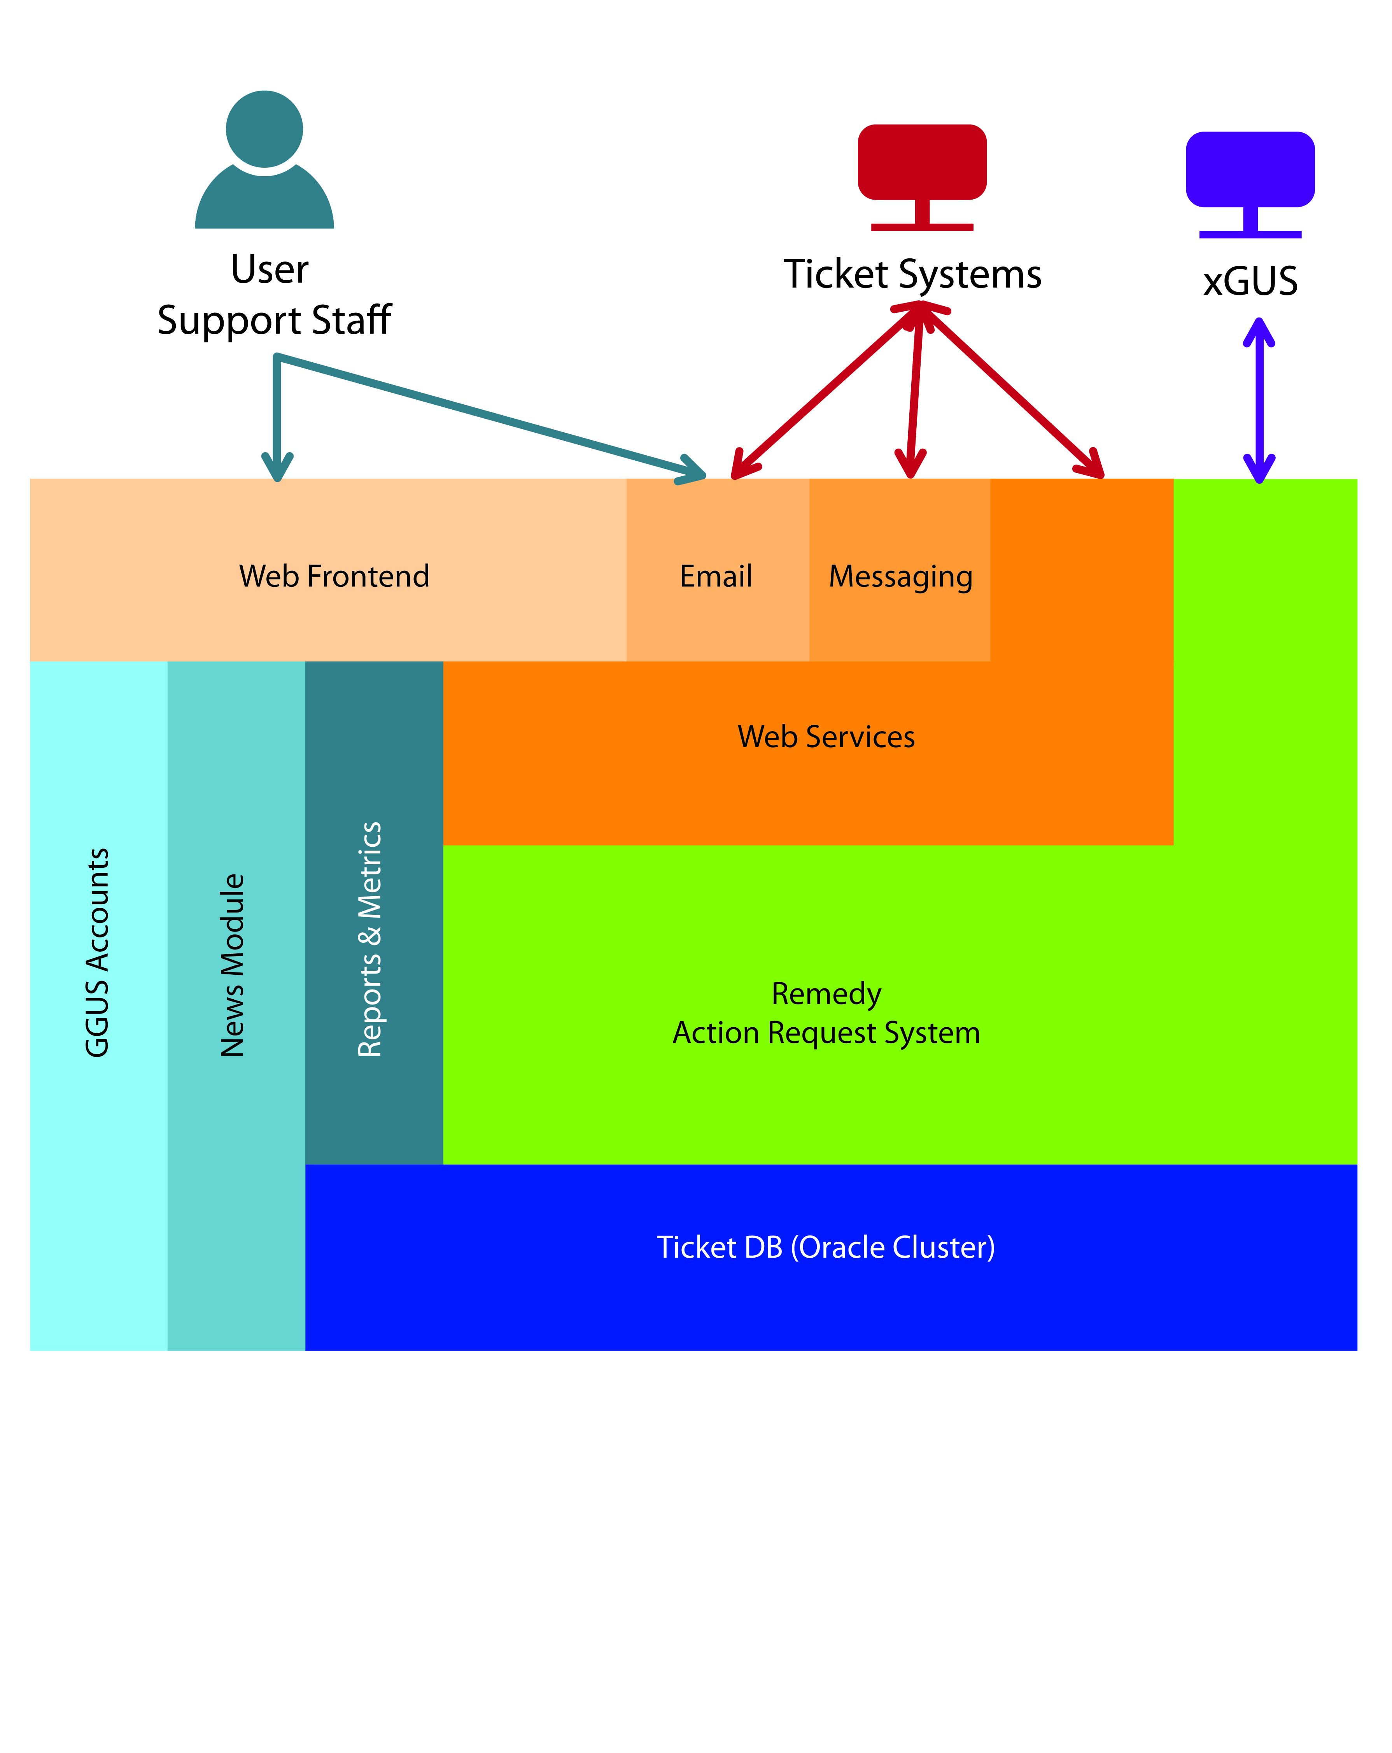
GGUS architecture

Slide 69
GGUS Technology Helpdesk
TPM
Technology Helpdesk
DMSU
EGI-SA2
GGUS
RT
accept/reject
announce
Technology Provider (EMI / IGE)

Slide 70
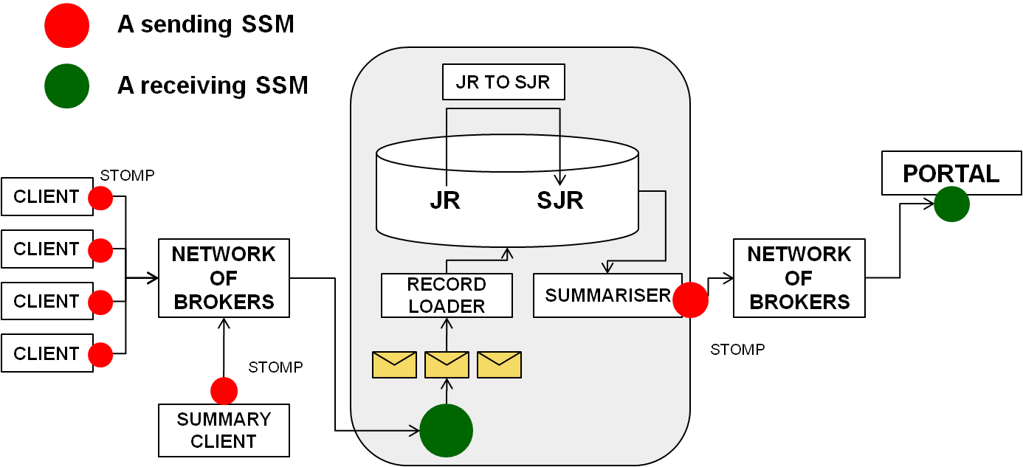
Accounting Repository architecture

