Slide 1
SA1 and JRA1
Operations and Operational Tools
EGI-InSPIRE PY2 Review
27-28 June 2012
T. Ferrari, Chief Operations Officer/EGI.eu

Slide 2
Contents
Introduction to SA1 and JRA1
Resource infrastructure
Service infrastructure
Analysis

Slide 3
PART I
Introduction to SA1 and JRA1
  resources
  partners
  objectives
Resource infrastructure
Service infrastructure
Analysis

Slide 4
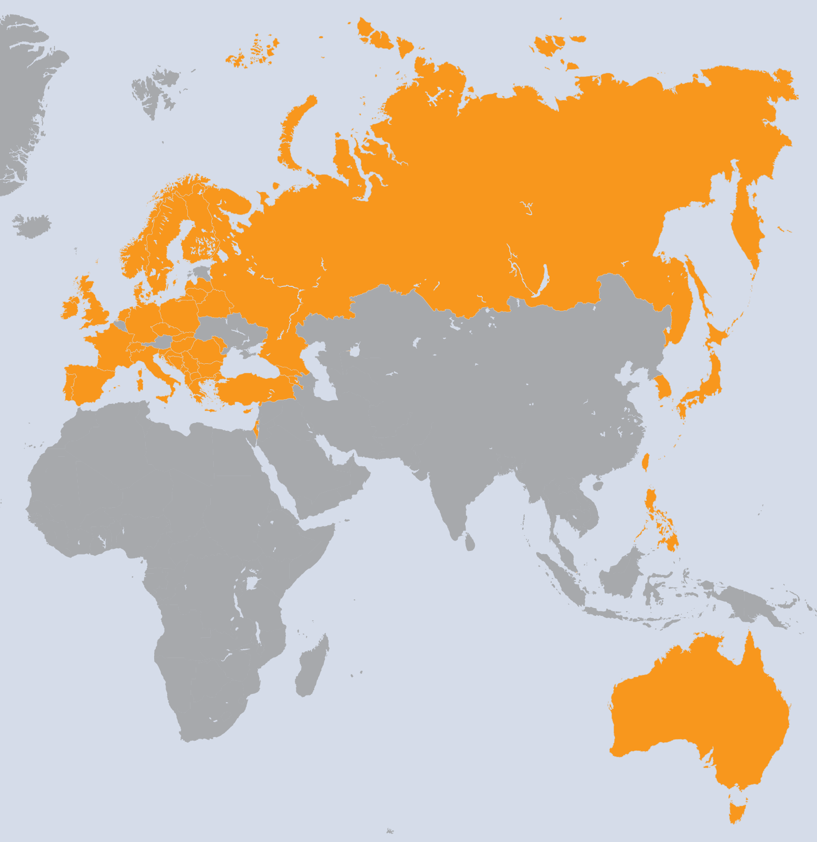
SA1 Overview
I. Introduction
France
Finland
Spain
Poland
Greece
Italy
Germany
Portugal
Netherlands
Croatia
UK
Sweden
Slovenia
Czech Republic
Russia
Georgia
Romania
Bulgaria
Armenia
Latvia
Serbia
Israel
Hungary
Moldova
Norway
Switzerland
Ireland
Turkey
Denmark
Cyprus
Slovakia
Belarus
FYR Macedonia
Bosnia & Herzegovina
Montenegro
Albania
Lithuania
Taiwan
Philippines
Japan
Korea
Australia
Singapore
WP | Beneficiary | Total PM
WP4-E | EGI.eu | 55
WP4-E | CERN | 59
WP4-E | CNRS | 12
WP4-E | CSC | 23
WP4-E | CSIC | 29
WP4-E | CYFRONET | 23
WP4-E | FOM | 35
WP4-E | GRNET | 70
WP4-E | INFN | 48
WP4-E | VR-SNIC | 11
WP4-E | KIT-G | 70
WP4-E | LIP | 17
WP4-E | SRCE | 39
WP4-E | STFC | 67
WP4-N | ARNES | 94
WP4-N | CESNET | 124
WP4-N | CNRS | 312
WP4-N | CSC | 63
WP4-N | CSIC | 364
WP4-N | CYFRONET | 152
WP4-N | E-ARENA | 71
WP4-N | FOM | 155
WP4-N | GRENA | 19
WP4-N | GRNET | 176
WP4-N | ICI | 54
WP4-N | IICT-BAS | 124
WP4-N | IIAP NAS RA | 19
WP4-N | IMCS-UL | 48
WP4-N | INFN | 374
WP | Beneficiary | Total PM
WP4-N | IPB | 114
WP4-N | IUCC | 25
WP4-N | KIT-G | 274
WP4-N | VR-SNIC | 80
WP4-N | LIP | 103
WP4-N | MTA KFKI | 108
WP4-N | RENAM | 16
WP4-N | SIGMA | 78
WP4-N | SRCE | 72
WP4-N | STFC | 273
WP4-N | SWITCH | 83
WP4-N | TCD | 90
WP4-N | TUBITAK | 126
WP4-N | UCPH | 81
WP4-N | UCY | 48
WP4-N | UI SAV | 92
WP4-N | UIIP NASB | 26
WP4-N | UKIM | 71
WP4-N | UOBL ETF | 71
WP4-N | UOM | 71
WP4-N | UPT | 28
WP4-N | VU | 22
WP4-N | ASGC | 193
WP4-N | ASTI | 156
WP4-N | KEK | 1
WP4-N | KISTI | 92
WP4-N | UNIMELB | 36
WP4-N | NUS | 14
43 Countries
45 Beneficiaries
5151 PMs
107,3 FTEs
SA1 Effort

Slide 5
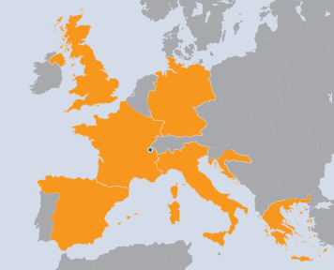
JRA1 Overview
I. Introduction
7 Countries
8 Beneficiaries
315 PMs
8.67 FTE
Italy
Germany
Spain
Greece
Croatia
CERN
France
UK
WP | Task | Beneficiary | Total PMs
WP7-E | TJRA1.1 | INFN | 24
WP7-E | TJRA1.2 | KIT-G | 47
WP7-E | TJRA1.2 | CSIC | 12
WP7-E | TJRA1.2 | CNRS | 12
WP7-E | TJRA1.2 | GRNET | 12
WP7-E | TJRA1.2 | SRCE | 12
WP7-E | TJRA1.2 | STFC | 24
WP7-E | TJRA1.2 | CERN | 12
WP7-G | TJRA1.3 | CSIC | 3
WP7-G | TJRA1.3 | CNRS | 3
WP7-G | TJRA1.3 | SRCE | 3
WP7-G | TJRA1.3 | STFC | 3
WP7-G | TJRA1.3 | CERN | 6
WP7-G | TJRA1.4 | KIT-G | 18
WP7-G | TJRA1.4 | CSIC | 18
WP7-G | TJRA1.4 | INFN | 26
WP7-G | TJRA1.4 | STFC | 27
WP7-G | TJRA1.5 | CNRS | 53
JRA1 Effort

Slide 6
SA1 tasks and resource distribution
I. Introduction
 | Task | Leader/Partner | Task effort distribution
TSA1.1 | Activity Management | T. Ferrari/EGI.eu | 1%
TSA1.2 | Secure Infrastructure | M. Ma/STFC | 9%
TSA1.3 | Service Deployment Validation | M. David/LIP | 11%
TSA1.4 | Infrastructure for Grid Management | E. Imamagic/ SRCE | 21%
TSA1.5 | Accounting | J. Gordon/STFC | 6%
TSA1.6 | Helpdesk Infrastructure | T. Antoni/KIT | 9%
TSA1.7 | Support Teams | R. Trompert/SARA | 28%
TSA1.8 | Providing a Reliable Grid Infrastructure and core services | C. Kanellopoulos/AUTH | 15%

Slide 7
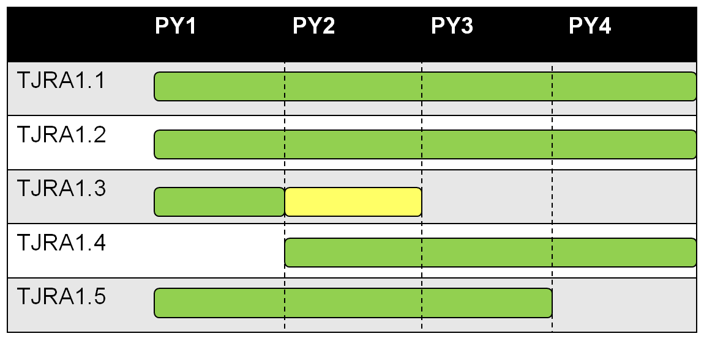
JRA1 tasks and resource distribution
I. Introduction
 | Task and Effort Distribution | Leader
TJRA1.1 | Activity Management (7%) | D. Cesini/INFN
TJRA1.2 | Maintenance and development of the deployed operational tools (42%) | T. Antoni/KIT
TJRA1.3 | Supporting National Deployment Models (6%) | P. Solagna/EGI.eu
TJRA1.4 | Accounting for usage of different resource types (28%) Cloud, HPC, Desktop Grid, Storage/Data Usage Application Usage Billing system | J. Gordon/SFTC
TJRA1.5 | Integrated Operations Portal (17%) Service Oriented model Porting to Symfony New DCI integration Support of mobile devices | C. L’Orphelin/CNRS

Slide 8
Objectives
I. Introduction
Operate a secure, reliable European-wide federated production grid infrastructure that is integrated and interoperates with other grids worldwide
 | Tasks | Task Objectives
O1 | TSA1.2 | Maintain a secure infrastructure
O2 | TSA1.3 | Validate new technology releases (tools and middleware)
O3 | TSA1.7 | Support end-users and Resource Centre administrators
O4 | TSA1.8 | Service Level Management, grid oversight, documentation and procedures
O5 | TSA1.4 TSA1.5 TSA1.6 | Operate tools, the accounting infrastructure and the EGI Helpdesk
O6 | JRA1.2 JRA1.3 JRA1.4 JRA1.5 | Evolve the operational tools used by the production infrastructure Maintenance, development and support of national deployment Accounting for the use of new resources (desktop, virtualisation, storage, data, application and billing)

Slide 9
PART II
Introduction to SA1 and JRA1
Resource infrastructure
  Resource Centres
  Operations Centres
  Usage

Slide 10
Resource infrastructure Providers (RPs)
II. Resource infrastructure
Metrics (April 2012) |  | Value (yearly increase)
Resource Centres (RCs) | EGI-InSPIRE and Council Participants | 326 (+3%)
 | Including integrated infrastructures | 352
 | Supporting MPI | 90 (+20%)
Countries | EGI-InSPIRE and Council members | 42
 | Including integrated RPs | 54
Operations Centres | Total (National, Federated, EIRO) | 37 (27, 9, 1)
 | New | NGI_FI, NGI_IE, NGI_UK

Slide 11
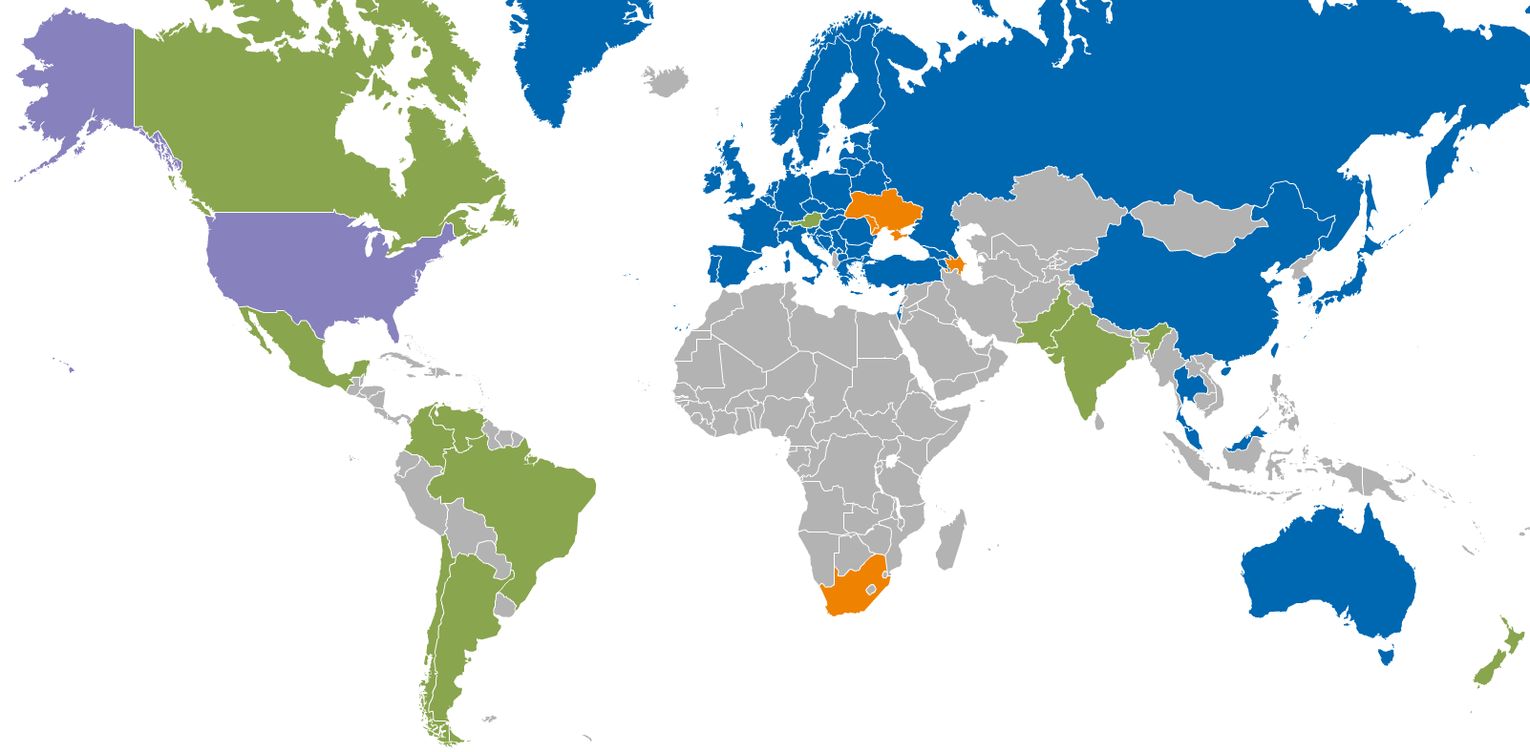
Resource infrastructure Providers (RPs)
II. Resource infrastructure
Metrics (April 2012) |  | Value (yearly increase)
Resource Centres (RCs) | EGI-InSPIRE and Council Participants | 326 (+3%)
 | Including integrated infrastructures | 352
 | Supporting MPI | 90 (+20%)
Countries | EGI-InSPIRE and Council members | 42
 | Including integrated RPs | 54
Operations Centres | Total (National, Federated, EIRO) | 37 (27, 9, 1)
 | New | NGI_FI, NGI_IE, NGI_UK
Integrated EGI-InSPIRE Partners and EGI Council Members
Internal/External RPs being integrated
External RP
Peer RP

Slide 12
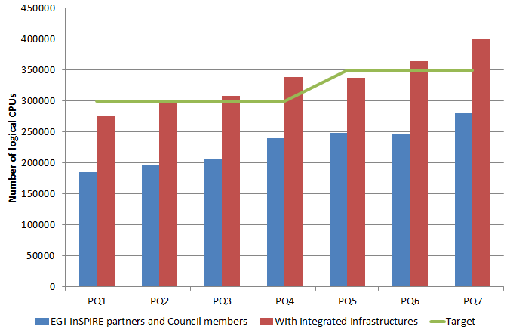
Installed Capacity
II. Resource infrastructure
Logical CPUs | Value (yearly increase)
EGI-InSPIRE and Council Partic. | 270,800 (+31%)
Including integrated RPs | 399,300
Storage | Value (yearly increase)
Disk (PB) | 139 PB (+31%)
Tape (PB) | 134 PB (+50%)
SA1 and JRA1 - EGI-InSPIRE Review 2012

Slide 13
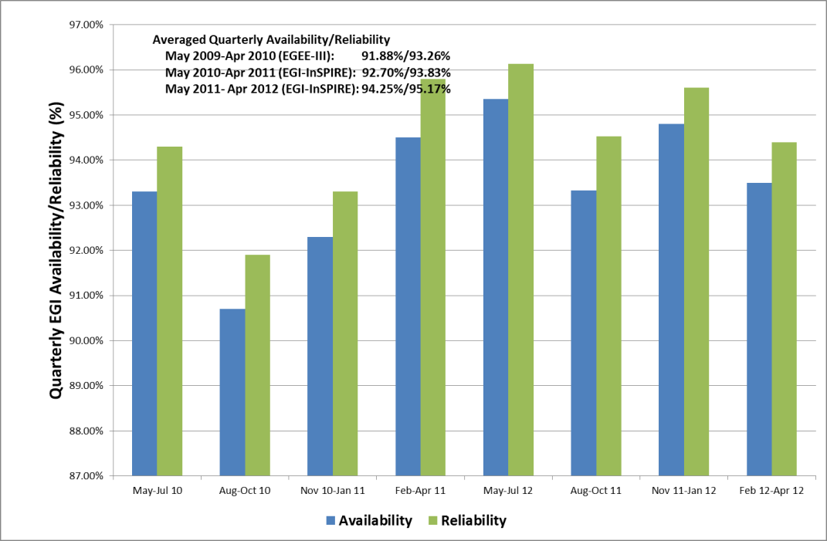
RC Service Levels and Targets
II. Resource infrastructure
Scope
  RC services for resource access
New RC Operational Level Agreement and availability profile
  Availability (uptime / total time) x 100
    minimum RC availability: 70%
  Reliability [uptime / (total time – scheduled time)] x 100
    minimum RC reliability: 75%
Suspension policy
  Suspension if RC availability < 70% for 3 consecutive months
  from 50% to 70% as of PY2
  16 RCs suspended (6 in PY1) and subsequently re-certified
PY2 EGI availability: 94.50% (+1.94% yearly increase)
PY2 EGI reliability: 95.17% (+1.70% yearly increase)
Reporting
  RC monthly performance reports
  ticket-based procedure for monitoring of underperforming RCs → new automated follow-up procedure under development
  new procedure to request recalculation

Slide 14
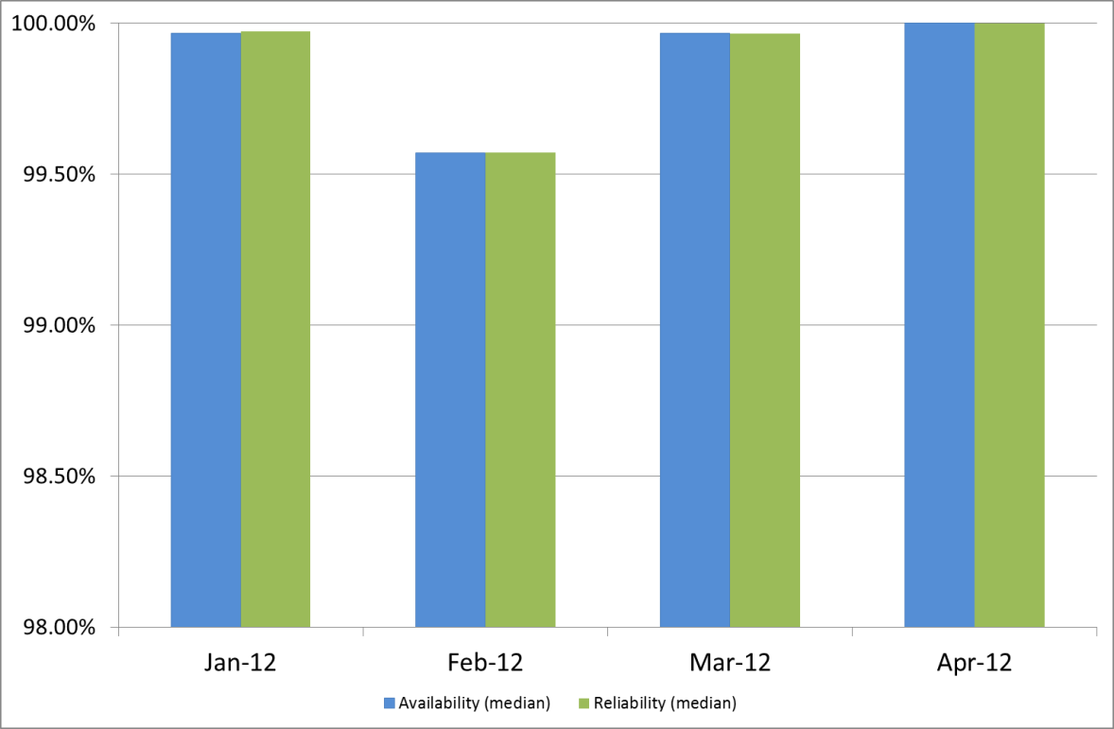
RP Service Levels and Targets
II. Resource infrastructure
Scope
  central grid services provided by NGIs giving access to RCs
New RP Operational Level Agreement
  pilot: Sep-Dec 2011
  into force as of Jan 2012
  being incrementally extended
Service levels and targets
  new RP Operational Level Agreement
  min Availability/Reliability: 99%/99%
  max Regional Operator on Duty Performance Index: expired tickets and alarms : 10
Reporting
  Monthly RP performance reports
  New reporting framework extracting information from the SAM Programmatic Interface and the Operations Portal
Notes:
Adjust diagram → revise diagram

Slide 15
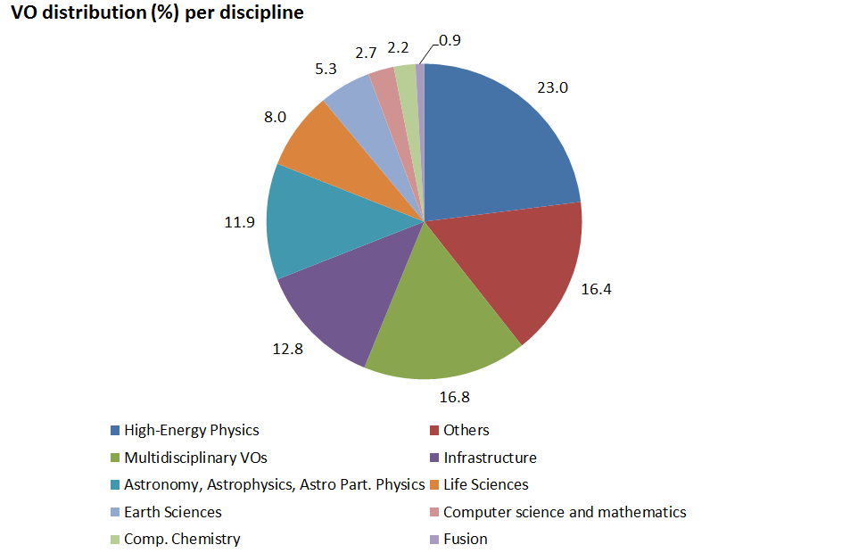
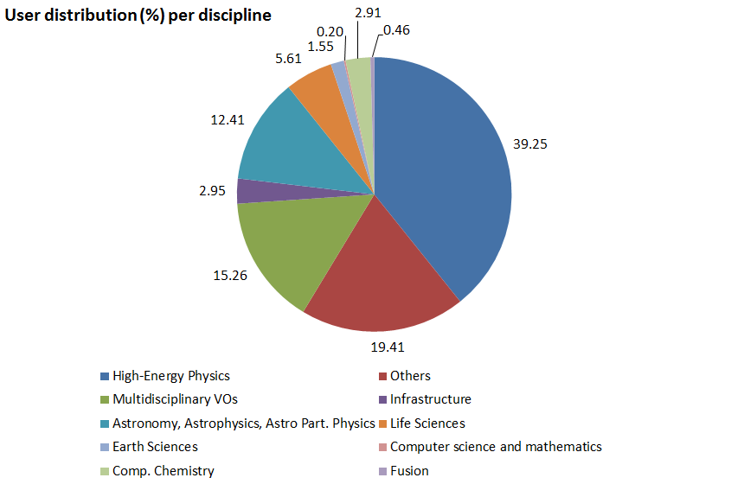
VO and user Statistics
II. Resource infrastructure
Metrics | Values (April 2012)
Registered VOs | 226 (+3.20%) – national and international VOs
Registered users | 20883 (+14.30%)
Active VOs | High: CPU time > 1 Year/Week Medium: CPU time > 1 Month/Week, < 1 Year/Week Low: CPU > 1 Day/Week, < 1 Month/Week | 25 23 8

Slide 16
CPU Usage
II. Resource infrastructure
PY2 Metrics |  | Value (yearly increase)
CPU wall clock time | Total normalized CPU wall clock time consumed (Billion HEP-SPEC 06 hours) | 10.5 (+52.91%)
Jobs | Job/year (Million) | 492.5 (+46.42% ) PY2 Target: 334.8 (+47.10%)
 | Average Job/day (Million) | 1.35
% of total norm. CPU wall time consumed | High-Energy Physics | 93.60% (+48.82%)
 | Astronomy and Astrophysics | 2.25% (+117.79)
 | Life Sciences | 1.30% (+1.97)
 | Various disciplines | 1.23% (+20.86)
 | Remaining disciplines | 1.62%

Slide 17
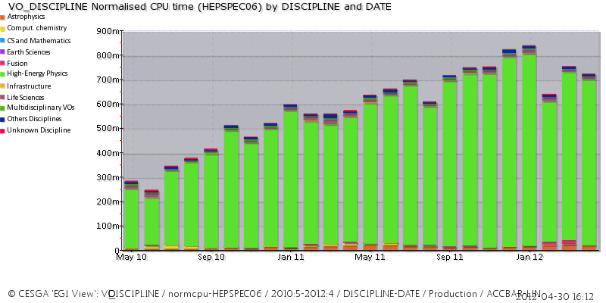
PY1-PY2 Trend
II. Resource infrastructure
PY1
PY2
CPU norm.
wall clock hours

Slide 18
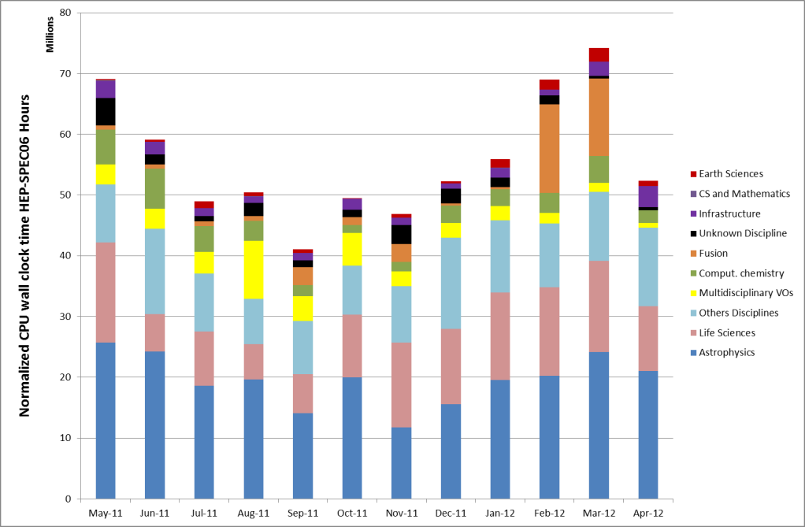
PY2 usage (non-HEP VOs)
II. Resource infrastructure

Slide 19
PART III
Introduction to SA1 and JRA1
Resource infrastructure
Service infrastructure
Analysis
  Issues, use of resources, impact and plans

Slide 20

III. Service Infrastructure
Operations Service Catalogue
Operations services enables secure, interoperable and reliable access to
distributed resources.
EGI services are provided locally by Operations Centres and globally by EGI.eu.
and partners
Service categories:
Global Services
Resource Infrastructure
Resource Infrastructure
Resource Infrastructure
Resource Infrastructure
Infrastructure Services and Tools
Resource Infrastructure
II. Software
Deployment and Interoperations
III. Support Services
Local Services
IV. Operations Management
and Coordination
Operations Centres +
Resource Centres
Operations Centres
Operations Centres

Slide 21
Infrastructure Services and Tools
III. Service Infrastructure
Message brokers
  TSA1.4, JRA1.2
Service Availability Monitoring
  TSA1.4, JRA1.2, JRA1.3
Operations Portal
  TSA1.4, JRA1.2, JRA1.5
Accounting and Metrics Portal
  TSA1.5, JRA1.4
Helpdesk
  TSA1.6, JRA1.2
Grid Configuration Database
  TSA1.4, JRA1.2

Slide 22
Message Brokers
III. Service Infrastructure/Tools
Objectives: support to the configuration of the message broker network (JRA1, AUTH), deploy a production infrastructure for message exchange for monitoring and accounting
Achievements
3 ActiveMQ updates
support of authentication and authorization
performance improvement through the eviction of pending connections
message history retention and reliable message delivery through the migration from “topic” to “queue”
  other operational tools, in particular the Operations Portal
provisioning of additional testing infrastructure (4 broker instances)

Slide 23
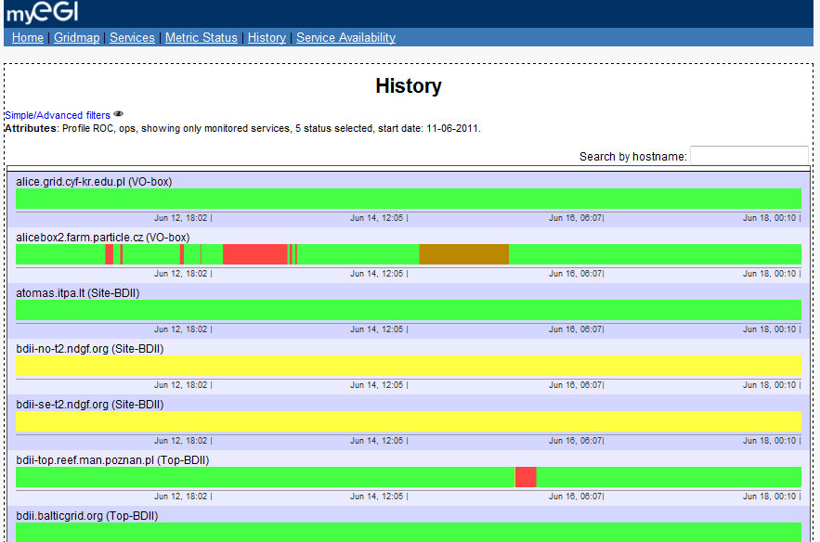
Service Availability Monitoring (SAM) 2/3
III. Service Infrastructure/Tools
SAM (CERN, SRCE, AUTH) monitoring framework for RCs and services
main data sources for the Operations Dashboard
data source to generate Availability/Reliability statistics
local/central components:
  test submission framework: based on the Nagios system and customised by the Nagios Configurator Generator
  databases for storage of information about topology (Aggregated Topology Provider), metrics (Metrics Description DataBase) and results (Metrics Results Store)
  visualisation tool GUI: MyEGI

Slide 24
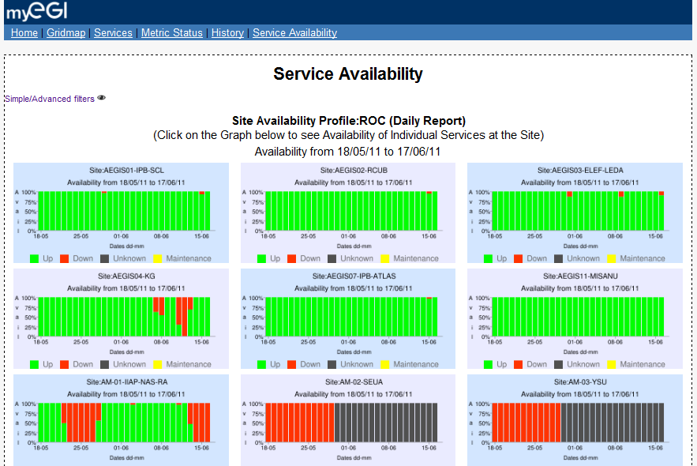
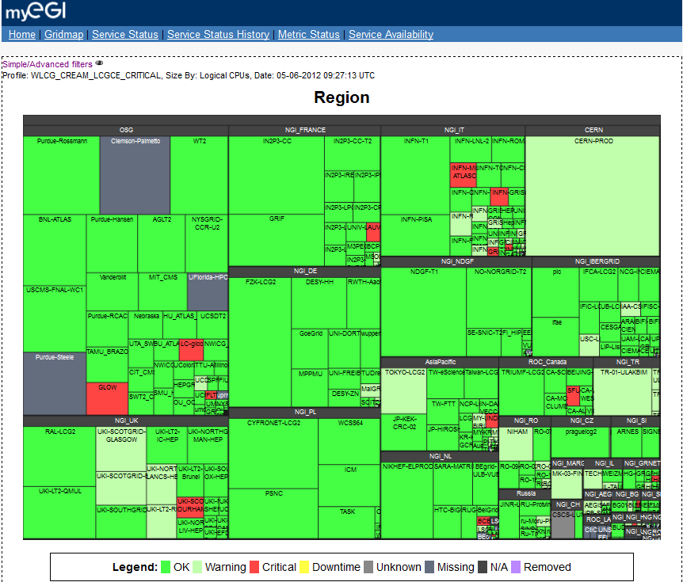
Service Availability Monitoring (SAM) 3/3
III. Service Infrastructure/Tools

Slide 25
Service Availability Monitoring (SAM) 2/2
III. Service Infrastructure/Tools
Achievements
7 releases following the EGI software release process
main new features:
  myEGI web interface and web services with different views, including gridmap and availability and reliability plots
  prototype of profile management system (POEM) for probes/metrics
  integration of new middleware service probes
    UNICORE, ARC, GLOBUS; Desktop Grid and QosCosGrid (ongoing)
    Worker Node probe
hot-standby failover system
cleanup of dependencies and meta-packages
support for monitoring of uncertified sites
improved usage of ActiveMQ for reliable delivery of messages
decommissioning of the old monitoring infrastructure:
  gridmap
  old SAM Portal, programmatic interface and database
SAM infrastructure
  32 distributed instances serving 35 EGI partners, 2 federations, 3 integrated RPs

Slide 26
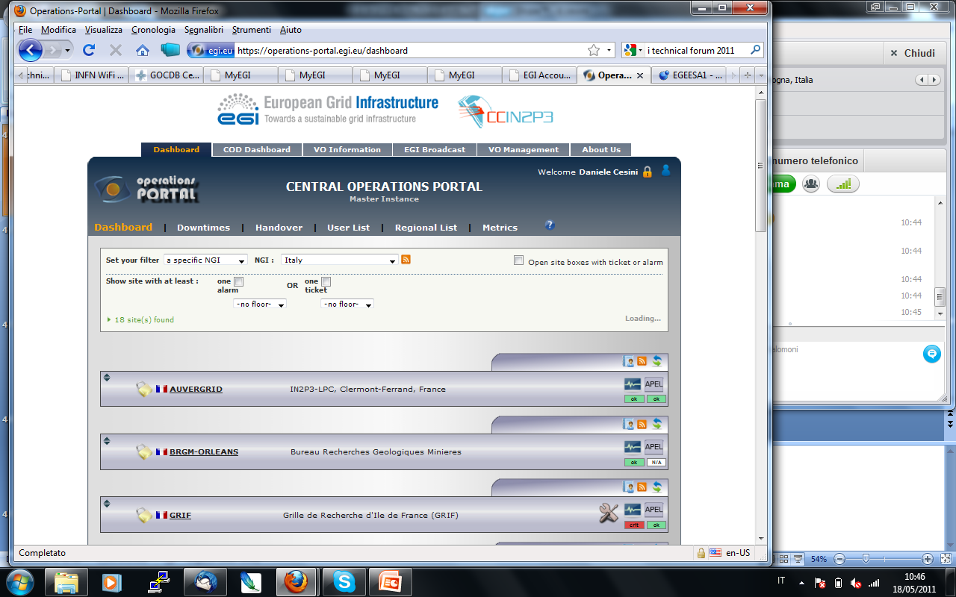
Operations Portal 1/2
III. Service Infrastructure/Tools
Operations Portal (CNRS)
provides a single access point to information, tools and facilities for various actors (NGI Operations Centres, VO managers, etc.). Modular structure:
Operation Dashboard
VO Id Card and VO Management
(new) Security Dashboard
(new) VO Operations Dashboard
Achievements
10 releases
two new modules
improved VO Management module
maintenance of the automatically synchronizing regional package

Slide 27
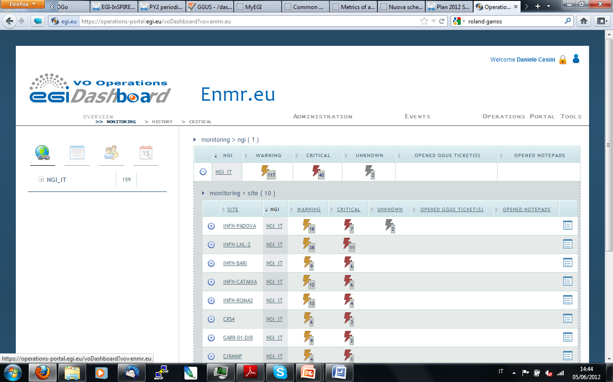
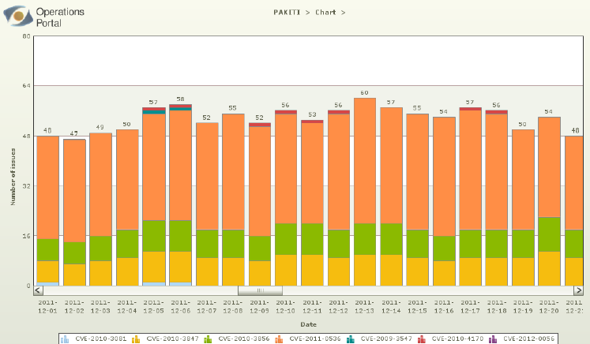
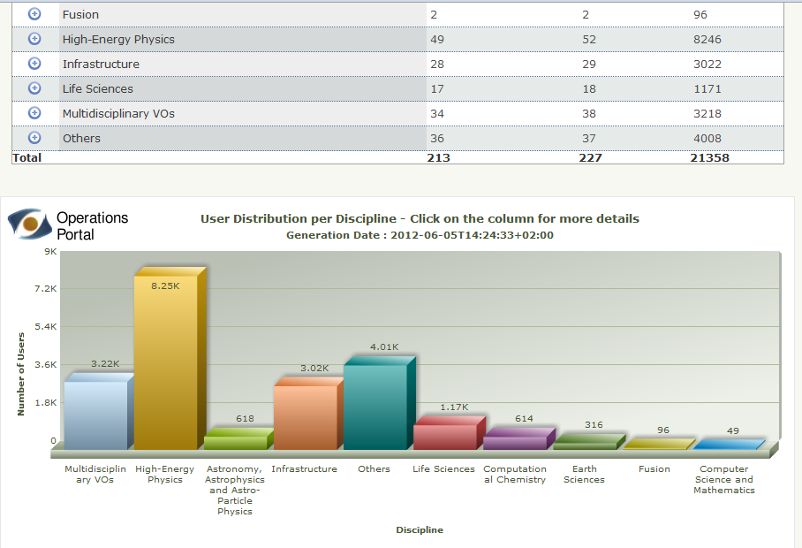
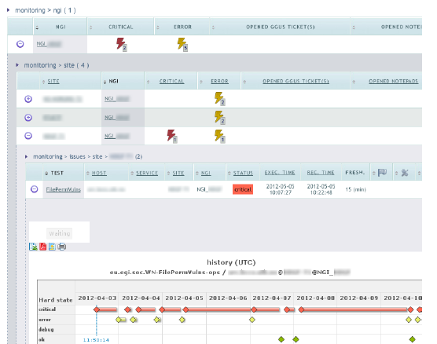
Operations Portal 2/2
III. Service Infrastructure/Tools

Slide 28
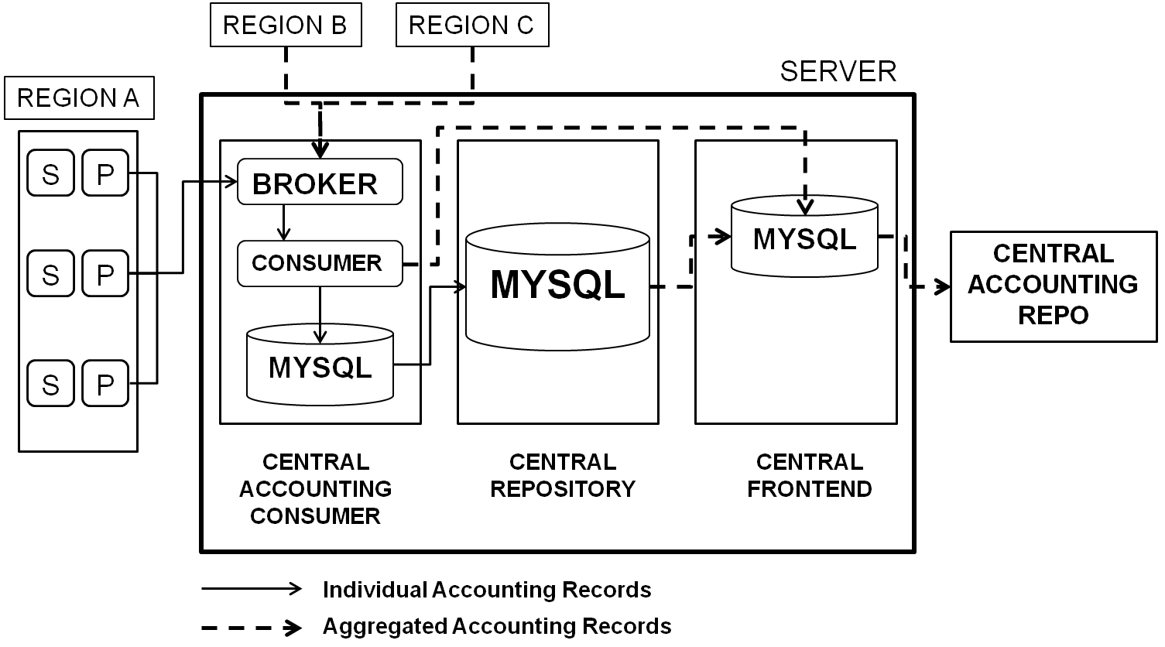
Accounting
III. Service Infrastructure/Tools
Accounting system: global/local service to collect and provide information about usage of compute resources within the production infrastructure
Central components
  APEL usage record repositories (STFC)
Local components
  Sensors, national /regional repositories and portal
Achievements (APEL repository)
release of Secure Stomp Messenger (SSM) for testing of a new transport method using the EGI messaging infrastructure
database major redesign
definition of the storage accounting record schema (collaboration with EMI)
prototype of an accounting systems for cloud resources (collaboration with the federated cloud Task Force)

Slide 29
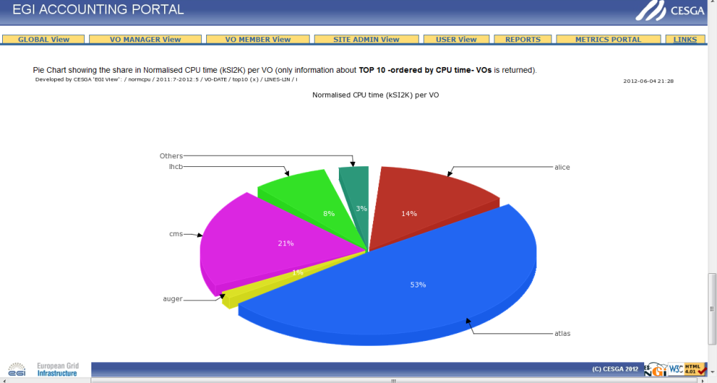
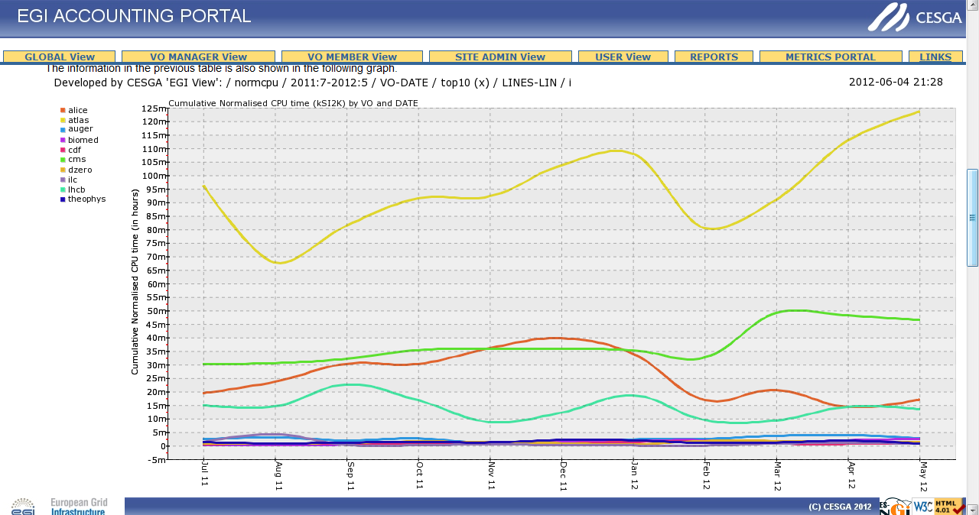
Accounting Portal
III. Service Infrastructure/Tools
Accounting Portal (FCTSG) Web GUI to access the data of the Accounting Repository
Achievements
2 major releases and various minor updates
complete redesign of the tool
new plot engine
extended “VO administrator” and “Site Administrator” views
XML interface to obtain data from the “Custom View”
XML interaction with the Operations Portal
prototype of the inter-NGI usage graphs

Slide 30
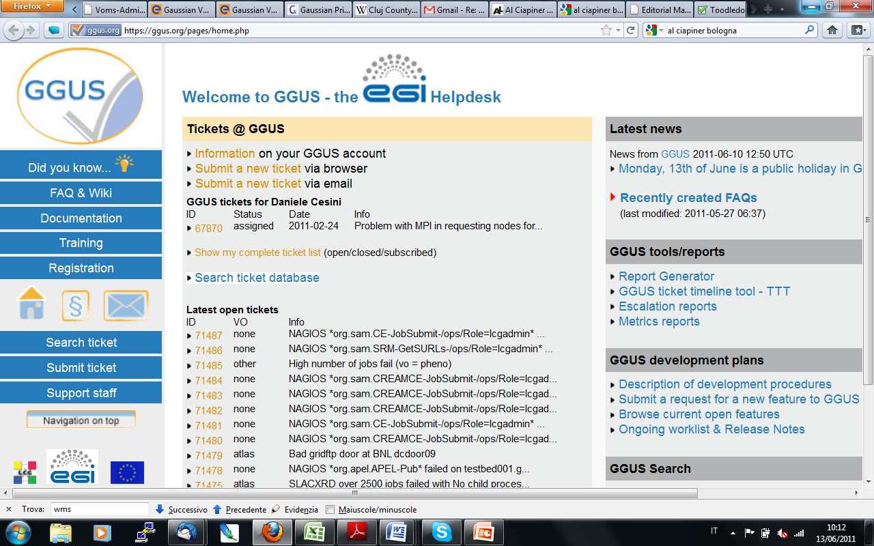
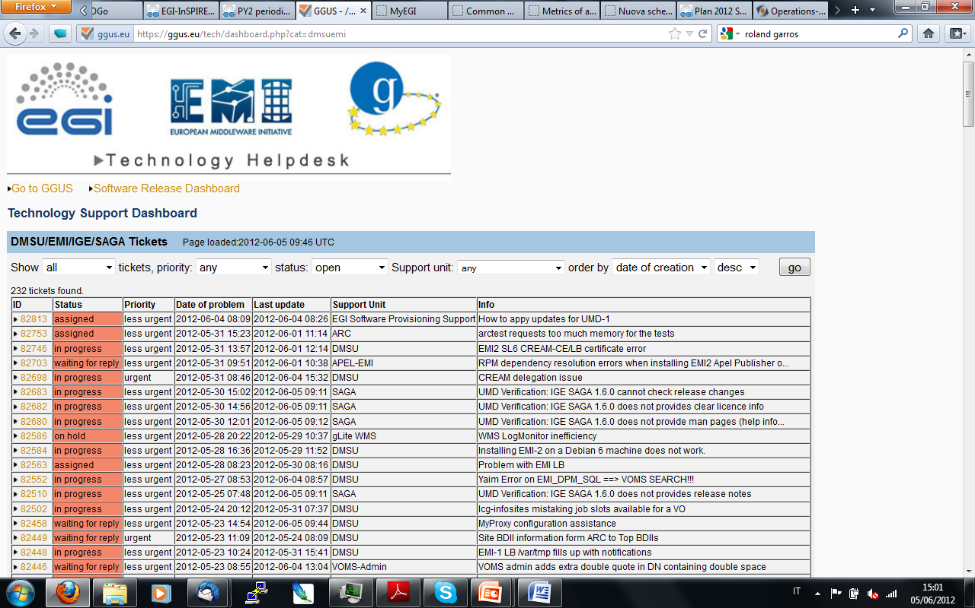
EGI Helpdesk
III. Service Infrastructure/Tools
EGI Helpdesk (KIT)
distributed system with a central component (Global Grid User Support - GGUS) interface to local helpdesks
Achievements
9 releases
major new features and development:
  first prototype of the report generator
  refinement of the Technology Helpdesk
active-active fail-over system for the data, the logic and the presentation layers
enhanced usability (notifications, search options, etc.)
Implementation of interface to the CERN helpdesk “Service NOW”
7 local interfaced helpdesks and 5 xGUS deployed instances

Slide 31
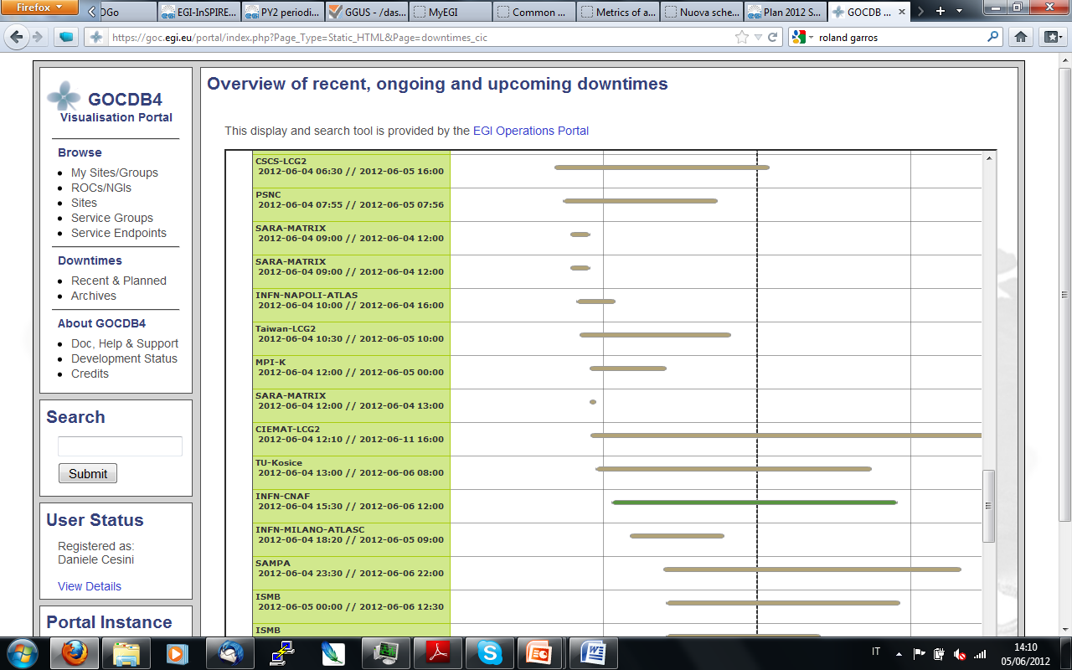
Central configuration repository
III. Service Infrastructure/Tools
GOCDB (STFC)
EGI relies on a central configuration database to record static information contributed by the resource providers as to the service instances that they are running and the individual contact, role and status information for those responsible for particular services
Achievements
3 major releases
major new features:
  data scoping
  service groups
  new roles and permissions
new service types integrated
improved user interface and responsiveness
refactorization of the database internals
manual failover instance in production

Slide 32
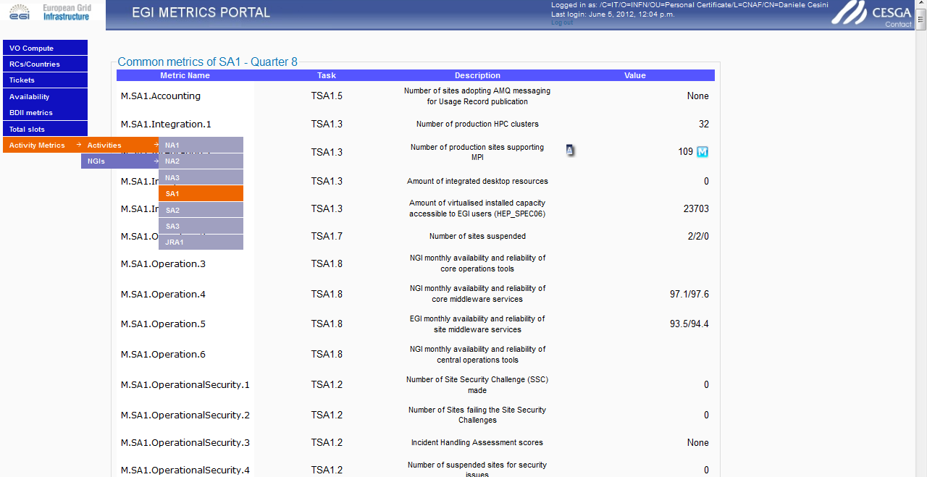
Metrics Portal
III. Service Infrastructure/Tools
Metrics Portal (FCTSG): tracking of project and partner performance indicators with the manual and automatic collection of EGI-InSPIRE metrics using different information sources
Achievements
2 major releases + minor updates
per country/activity metrics
heavy query optimization
data export in xls format
manual override of automatic metrics
validation of figures collected automatically

Slide 33
JRA1.3 Achievements
III. Service Infrastructure/Tools
Support of National Deployment Models ended at PM24
Completed
  Operations Portal: regional instance synchronizing with central instance
  GGUS: xGUS for customized helpdesk (hosted centrally)
  Accounting Portal (requires local APEL repository)
Partial
  SAM: fully distributed infrastructure
    new requirements for monitoring of non-EGI sites (PQ9) and for custom probes (TBD)
  GOCDB: central support for scoped sites and custom service types, stand-alone local installation possible
    long-term requirement for a synchronizing regional instance to be re-assessed
Not available
  APEL regional repository (planned at PQ11)
Task will be completed to achieve maximized regionalization

Slide 34
PART III
Introduction to SA1 and JRA1
Resource infrastructure
Service infrastructure
  Infrastructure Services and Tools
  Software Deployment and Interoperations
    Requirements gathering (TSA1.1)
    Software Staged Rollout (TSA1.3)
    Interoperations (TSA1.3)
    Grid Services (TSA1.8)

Slide 35
Staged Rollout
III. Software Deployment and Interoperations
New software updates (grid middleware and tools) are deployed into the production infrastructure incrementally through a staged rollout to ensure that they are reliable in actual use, following successful verification of the software component against published criteria
Extension of Staged Rollout activities to EMI and IGE releases
Periodic revision of early adoption procedures and support tools
Reallocation of Staged Rollout effort for multi platform testing
Achievements | PQ2 Value/Yearly increase
Staged Rollout tests | 192
Components tested/rejected | 122/8
Number of EA teams | 60 (+33%)
Middleware stacks/components | ARC, gLite, (new) Globus, UNICORE, SAM, CA trust chain

Slide 36
Interoperations
III. Software Deployment and Interoperations
Objective: evolve the operations infrastructure and tools to make them software agnostic and foster integration of different DCIs
Accomplishments
  completed: ARC
  almost completed
    Desktop Grid (EDGI), GLOBUS (IGE), UNICORE (EMI)
    accounting integration in progress - TCB accounting task force coordinating efforts
  in progress: QosCosGrid
    to support multi-scale simulations across EGI and PRACE addressing MAPPER requirements
  collaboration with EUDAT and PRACE → shared operations integration roadmap
  workshops for the integration of platforms into a unified Information Discovery System

Slide 37
Grid services and VO services
III. Software Deployment and Interoperations
Operations services
  infrastructure for the DTEAM VO membership management (grid troubleshooting) → replicated VOMS servers
  membership management for OPS VO (monitoring)
  enhanced infrastructure for monitoring of uncertified sites
VO services
  EGI Catch-All Certification Authority for new user communities and emerging grid infrastructure → 5 countries: Albania, Azerbaijan, Bosnia and Herzegovina, Georgia and Senegal)
  grid services provisioned by EGI.eu for new/small VOs
  +360 collective grid service instances
  VO SAM
  VO Administration Dashboard
  LFCBrowseSE
  new VO Operations Dashboard

Slide 38
PART III
Introduction to SA1 and JRA1
Resource infrastructure
Service infrastructure
  Infrastructure Services and Tools
  Software Deployment and Interoperations
  Support
  Operations Management and Coordination
Analysis
  Issues, use of resources, impact and plans

Slide 39
Support activities
III. Support
Technical Services | SA1 tasks
1st level support | TSA1.7
Grid oversight | TSA1.7
Network Support | TSA1.7
Central components
User and operations support Triage of tickets in GGUS
Central operations support and escalation of tickets not managed locally Service level management
Support to connectivity and performance problems (contact point to the NREN PERT teams)
Local components
1st and 2nd level users/operations support for tickets opened through local helpdesks
Local operations support
2nd level support: Deployment Middleware Support Unit (SA2)
3rd level support: Technology providers

Slide 40
III. Support
Achievements
EGI Helpdesk for VO-specific/operations incidents and for specialized support to users and operations
Grid oversight (COD)
  monthly follow-up of underperforming RCs and RPs
  oversight of monitoring infrastructure
  monthly grid oversight newsletter
  revised ticket escalation procedure and support tools
  new local grid oversight performance indicator
  COD certification of new RPs
→ Proposed refactoring of EGI support services (SA1.7 and SA2.5) into a single support task for better coverage and optimization of support tasks

Slide 41
PART III
Introduction to SA1 and JRA1
Resource infrastructure
Service infrastructure
  Infrastructure Services and Tools
  Software Deployment and Interoperations
  Support
  Operations Management and Coordination
    Service Level Management (TSA1.8)
    Operational Security (TSA1.2)
    Documentation (TSA1.8)
    Operations Management (TSA1.1)

Slide 42

Operational security
III. Operations Management and Coordination/Security
Security Coordination Group coordinate overall EGI security activities
EGI CSIRT
Software Vulnerability Group
Handling reported
vulnerabilities,
vulnerability assessment,
secure coding education
Security Policy Group
Develop and maintain security policies
Incident Response Task Force
(incident handling and coordination)
Security monitoring
(Pakiti, Security Nagios, Security Dashboard)
Security drills
Training and dissemination
EUGridPMA
External software providers (EMI/IGE/…)
PRACE/XEDE/OSG/…

Slide 43
EGI CSIRT
Incident Prevention (security monitoring, security intelligence group, assessing known vulnerabilities with the support of SVG, preparation of advisories)
Incident Response (incident handling including investigation, heads up, coordination with site CSIRTs, forensics, technical support, advisories, reports)
Listed team in the European database of CSIRTs
  accreditation by Trusted Introducer under discussion (external audit)

Slide 44
Achievements 1/3
III. Operations Management and Coordination/Security
EGI CSIRT | 10 security incidents handled (none related to grid middleware vulnerabilities, mostly single site: stolen/weak passwords unprotected ssh keys vulnerable services open unpatched software 4 advisories issued (1 critical, 2 high risk) 2 security training sessions (forensics, RTIR) No site suspended because of a critical vulnerability New ticketing system for Incident Response (RTIR) New security dashboard for EGI CSIRT, NGIs and RCs Updated security Nagios probes

Slide 45
Achievements 2/3
III. Operations Management and Coordination/Security
Security Service Challenge 5 | Assessment of the full response chain involving: site security contacts, VO CSIRT CAs EGI and NGI CSIRT 40 RCs tested, 20 countries new monitoring and management framework usable for SSC-5 runs in NGIs
SVG | 23 software vulnerabilities reported (of those fully evaluated 2 High, 3 Moderate, 10 Low) - of which 13 in grid middleware 7 advisories issued by SVG 2 vulnerability assessment completed (ARGUS and VOMS) Improved co-ordination of fixing of issues and release of advisories, with EMI and the EGI DMSU

Slide 46
Achievements 3/3
III. Operations Management and Coordination/Security
 | Achievements
D4.4 | Review of security of the infrastructure (scope, assets) Security threat risk assessment plan
Procedures | 1 new procedure EGI CSIRT Critical Vulnerability Operational Procedure 2 updated procedures EGI Security Incident Handling Procedure EGI Software Vulnerability Issue Handling Procedure
Policies | 2 new policies Security Policy for the Endorsement and Operation of Virtual Machine Images Service Operations Security Policy (replacing “Site Operations Policy”) 15 policies in total (users/VOs/RCs)
Notes:
https://wiki.egi.eu/wiki/EGI_CSIRT:Policies
https://wiki.egi.eu/wiki/SPG:Documents

Slide 47
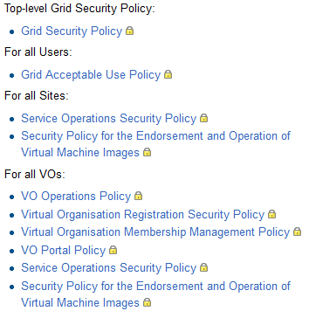
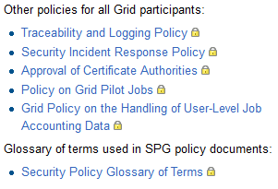
Security Policies

Slide 48
Collaborations
III. Operations Management and Coordination/Security
Security for Collaborating Infrastructures
  define trust and policy standards between infrastructures
  EGI leading this activity
  EGI, WLCG, PRACE, XSEDE, OSG, ...
  Grid-SEC
    coordinated response to cross-grid security incidents (vetted security representatives from WLCG, OSG, XSEDE, EGI)
  International Grid Trust Federation
  Research and education identity federations worldwide (REFEDS)
  Federated Identity Management for research collaborations (European E-infrastructure Forum)
  OGF

Slide 49
EGI Security Threat Risk Assessment 1/3
III. Operations Management and Coordination/Security
Assets and identified threat categories
  Reputation and Trust
  Management, Organization, Human capital, Digital identities
    from/to users or trusted staff
    manipulating people to perform malicious actions
    from security staff actions and inactions
    AAI infrastructure
  Processes, Knowledge, Information and data, Intellectual property
    software security and integrity
    data integrity, availability, confidentiality
    illegal use and general misuse
  Services, Software, Infrastructure, Network
    Software and infrastructure
      software vulnerability
      operations and configuration
      from security incidents
      technical/physical security threats to the infrastructure and to external parties
    Other technologies
      from virtualization
      from new software and technologies
      availability and reliability of general IT services

Slide 50
EGI Security Threat Risk Assessment 2/3
III. Operations Management and Coordination/Security
Team established to carry out assessment
  Identified 75 threats in 20 categories
Method for risk assessment
  each team member asked to produce their rating for ‘likelihood’ and ‘impact’
      Likelihood: 1 (Unlikely) – 5 (Once a month or more)
  Impact: 1 (Minimal affecting local services) – 5 (Very serious disruption at multi-national level for 1 week or more)
  Risk = Likelihood * impact
  guidelines for these ratings given in order to improve objectivity – still large element of judgement
  based on current situation and mitigation
  initial analysis of threats with average computed risk ≥ 8

Slide 51
III. Operations Management and Coordination/Security
EGI Security Threat Risk Assessment 3/3
Initial findings
  13 threats found with risk 8 or more. Top 4:
    incident due to exploit of vulnerability in software other than Grid middleware (11.9)
    new software or technology may be installed which leads to security problems (10.9)
    incident spreads across the Grid (10.7)
    security problems arising from the move to IPv6 (10.4)
Mitigations
  CSIRT Security Intelligence Group monitoring newly discovered vulnerabilities and exploits
  EGI CSRIT and SVG assessing vulnerability found in software widely deployed, recommending updates
  Proactive monitoring of RCs (Pakiti, Security Dashboard) to ensure no vulnerable versions of software are run

Slide 52
PART IV
Introduction to SA1 and JRA1
Resource infrastructure
Service infrastructure
Analysis
  Issues, use of resources, impact and plans

Slide 53
Issues/SA1
IV. Analysis
  Third-party software repositories, software maintenance and specialized support challenged by the end of EMI and IGE
  EGI software provisioning processes, service level targets, responsiveness to reported incidents
  PY3 mitigation: revision of procedures, strengthening of EGI specialized support, sustainability
Expanding set of products and platforms to be staged rollout.
  PY3 mitigation: revision of SA1.3 effort, reallocation of resources, policies and priorities
Several infrastructures in the Eastern Europe region underperforming
  PY3 mitigation: support action in collaboration with GRNET, training, better support of testing in the operational tools (PY3)

Slide 54
Issues/JRA1
IV. Analysis
2nd level support of regionalized operational tools
  accounting, monitoring, operations portal, currently relying on voluntary contributions
  PY3 mitigation: proposed revised structure of EGI support tasks and effort allocation
Insufficient effort for innovation to address new “high impact requirements”
  JRA1.3 regionalization, JRA1.2 SAM, JRA1.5 operations portal (assessment in D7.2)
  PY3 mitigation: re-scoping of development activities

Slide 55
Use of Resources/SA1
IV. Analysis
104% PMs achieved (aggregated)
EGI.eu Global Services
  96% PMs achieved (aggregated) compensating PY1 over reporting due to transition from EGEE
  some tasks affected by personnel turnover (coordination of integration TSA1.3, documentation TSA1.8) → handover of coordination to EGI.eu (PY3-PY4)
  catch all services/availability (TSA1.8) → partner affected by hiring freeze in the public sector, but services successfully delivered
NGI Local Services
  few cases of under/over reporting that will be compensated over the duration of the project

Slide 56
IV. Analysis
Use of Resources/JRA1
87% PMs achieved (aggregated)
  112% WP7-E tasks (TJRA1.1, TJRA1.2)
  69% general tasks (TJRA1.2, TJRA1.4, TJRA1.5)
PY2 compensating PY1 deviations
  95% for TJRA1.3 (PY1+PY2)
  100% for TJRA1.2 (PY1+PY2)
Over reporting
  TJRA1.2 146% (CSIC): restructuring of both accounting portal and metrics portal
Under reporting
  TJRA1.4: 52% achieved, requirements gathering phase, compensation in PY3

Slide 57
SA1 Plans for next year
IV. Analysis
Security
  complete security threat risk assessment, consolidation of security tools, NGI SSC5, revise policies and new one on data protection
Middleware upgrade campaign
  Extended staged rollout
  Phasing out of gLite 3.1/3.2
  GLUE 2.0: upgrade plan, EGI profiling and information validation
Service level management
  EGI.eu OLA
  extended monitoring and reporting of EGI.eu and NGI services
  consolidation of NGI services (including NGI SAM)
DCI integration
  EUDAT and PRACE roadmap
  Accounting of Globus, Unicore, Desktop Grids, QosCosGrid
Migration to SSM of infrastructures publishing summary records
IPv6 compliance testing

Slide 58
JRA1 Plans for next year
IV. Analysis
Operations Portal
  Mobile devices support
  Service level reporting module
  Monitoring of Virtual Sites
GOCDB
  GLUE2.0 compatibility and rendering
Accounting
  add new resource types in production (storage, clouds, parallel jobs)
  regional repository
Messaging
  deployment of the supported authorization and authentication framework
GGUS
  Production version of the Report Generator
  Improvement of high availability configuration (including DBMS)
SAM
  Integration of middleware probes from EMI
  Production version of profile management service (POEM)

Slide 59
Impact and value
IV. Analysis
O1 The continued operation and expansion of today’s production infrastructure | 352 production RCs, (+30.7% compute capacity, +50% storage capacity) +1.9% yearly increase of availability
O2 Continued support of researchers | +3.20% new registered VOs +46.42% yearly increase of resource usage Astronomy Astrophysics and Astro-particle Physics ramping up
O4 Interfaces that expand access to new user communities | New GOCDB service types and SAM probes 34 operational tool releases Integration of accounting in progress 55 grid middleware requirements
O5 Mechanisms to integrate existing infrastructure providers in Europe and around the world | RP Operational Level Agreement 2 new RP MoUs Moldova, South Africa, Ukraine being integrated Collaboration with PRACE
O6 Establish processes and procedures to allow the integration of new DCI technologies | Collaboration with EUDAT ARC, gLite, GLOBUS, UNICORE, Desktop Grid, QosCosGrid

Slide 60
Summary
SA1 and JRA1 contribute to meet the project objectives and support the EGI Strategy 2020
  Leadership
    with the expansion of the resource infrastructure and increasing usage
  Openness
    with a growing level of integration
  Reliability
    with continued operation and increasing performance
  Innovation
    with evolving tools, procedures and policies and requirements

Slide 61
References
Security Risk Assessment of the EGI Infrastructure, deliverable D4.4, http://go.egi.eu/863
Security procedures: https://wiki.egi.eu/wiki/EGI_CSIRT:Policies
Security policies: https://wiki.egi.eu/wiki/SPG:Documents
Operations procedures: https://wiki.egi.eu/wiki/Operations_Procedures
Operations documentation: https://wiki.egi.eu/wiki/Documentation

