Slide 1
SA2 – Software Provisioning
Michel Drescher
Technical Manager, EGI.eu
Presented by Peter Solagna, EGI.eu

Slide 2
Agenda
Overview
Achievements
Plans for PY3
Summary

Slide 3
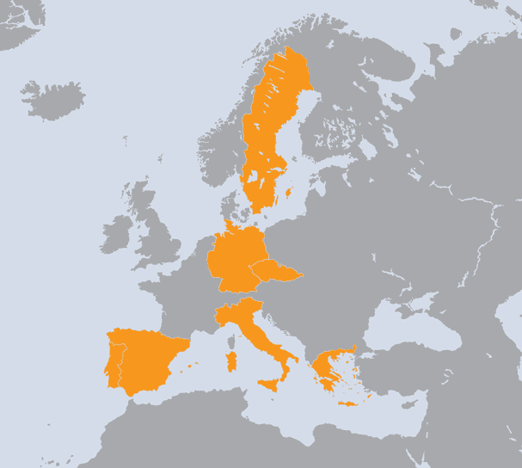
SA2 Overview
The Netherlands
Spain
Portugal
Czech Republic
Greece
Germany
Italy
Sweden
WP | Task | Beneficiary | Total PMs
WP5-E | TSA2.1 | EGI.eu | 42
WP5-E | TSA2.2 | CSIC | 35
WP5-E | TSA2.2 | LIP | 35
WP5-E | TSA2.3 | CSIC | 35
WP5-E | TSA2.3 | LIP | 35
WP5-E | TSA2.4 | CESNET | 60
WP5-E | TSA2.4 | GRNET | 95
WP5-E | TSA2.5 | CESNET | 65
WP5-E | TSA2.5 | KIT-G | 24
WP5-E | TSA2.5 | INFN | 47
WP5-E | TSA2.5 | VR-SNIC | 24
WP5-E | TSA2.5 | NORDUNET | 6
8 Countries
8 Beneficiaries
503 PMs
10.5 FTEs
SA2 Effort

Slide 4
Objectives
Task |  | Objective
TSA2.1 | 7% | O1 | Establish agreements with key software providers
 |  | O2 | Maintain the UMD Roadmap
TSA2.2 | 14% | O3 | Define general and component specific quality criteria to be applied to software components
TSA2.3 | 14% | O4 | Verify the software components against these criteria
TSA2.4 | 30% | O5 | Provide a repository for the software components within UMD and the related support tools
TSA2.5 | 35% | O6 | Provided a distributed support unit within the EGI Helpdesk infrastructure with expertise on the deployed middleware in production use.
TSA2.1: Michel Drescher, EGI.eu | TSA2.4: Kostas Koumantaros, GRNET
TSA2.2: Enol Fernandez, CSIC | TSA2.5: Ales Krenek, CESNET
TSA2.3: Alvaro Simon, FCTSG

Slide 5
Software Provisioning
Technology Coordination Board
Operations Management Board
User Community Board
Strategic
Coordination
Prioritised Requirements
External Technology Providers
Quality Criteria
Software
Operations (SA1)
Criteria
Definition
Criteria
Verification
Staged
Rollout
Production
Deployed Middleware Support Unit
Provisioning Infrastructure

Slide 6
Technology Coordination Board
Regular F2F and phone conferences
6 meetings in 6-week alternating cycle
Top topics
Defined Requirements Process:
Deal with strategic or cross-TP issues
43 requirements from EGI User Communities
18 requirements from EGI Operations
Task Forces:
Accounting TF, Federated Cloud TF
Technology Providers:
Software roadmaps
Performance within SLA

Slide 7
Technology Management
Agreements with Technology Providers
Memorandum of Understanding
Observer status on the TCB
Used to build a collaborative relationship
Service Level Agreements
Voting status on the TCB
Focus on delivering & supporting software
2 New Technology Providers planned for PY3
Genesis II, QosCosGrid
Annual Planning
EGI Technology Roadmap
Includes the UMD Roadmap and other technical plans
EGI Platform Roadmap

Slide 8
Maintaining Quality Criteria
Formalising EGI’s software requirements
Aligned to UMD Capabilities
100% coverage through 204 quality criteria
Overview and review using EGI wiki
Criteria change management
6 monthly revisions
2 public reviews per revision
To be adaptable and improve in comprehensiveness

Slide 9
Software Verification
Verification test-bed
Private cloud for EGI hosted at CESGA
Multi-OS infrastructure
SL5, SL6, Debian6
Verification is a community effort
16 verifiers, 12 institutes, 7 countries
Documentation of process, guidelines & testbed
Structured reporting forms
Allows unfunded & external verification effort

Slide 10
Software Verification in numbers
7 UMD releases were published
104 updates for 57 products (EMI, IGE)
134 verified, 20 rejected, 10 superseded

Slide 11
Repository & Infrastructure
Software Repository
Frontend for human consumption
Backend for production infrastructure access
Software Provisioning Infrastructure
Re-use project IT support where applicable
Develop integration tools where necessary
All services serving IPv4 and IPv6

Slide 12
Improvements in PY2
Public stable provisioning repositories
Maintain transient repositories for management
Initial support for multiple OS platforms
Automation tools at different levels to streamline the process
Stratuslab Marketplace and Appliance repository
Available for EGI Community

Slide 13
EGI Repository Usage
EGI Software repository hosts:
UMD releases, EGI releases, gLite 3.2 mirror
Mirroring facility available based on rsync
1.0.0
1.2.0
1.3.0
1.4.0
1.5.0
1.6.0
1.1.0

Slide 14
Deployed Middleware SU
2nd level SU for Deployed Middleware
Resolving middleware service requests
Produce operational documentation
FAQs: Best Practices, Workarounds, etc.
Specific service documentation
Support request follow-up
Ticket oversight for 3rd level expert support

Slide 15
Deployed Middleware SU
Metric | PQ5 | PQ6 | PQ7 | PQ8
Assigned | 218 | 183 | 173 | 212
Solved | 37 | 27 | 53 | 53
To TPM | 20 | 18 | 23 | 22
To 3rd level | 175 | 137 | 118 | 139
Avg. (median) solution time | 24 (4.2) | 17(11) | 21(5.1) | 11(1.9)
786 tickets handled
170 requests solved
3rd level support requests
Concern software problems, lacking documentation
Require analysis before forwarding
DMSU & TP assess ticket priority

Slide 16
3rd level support follow-up
334 tickets solved – 157 still open
12 tickets solved – 5 still open
High-priority requests
Deadline agreed with TP
Monitored and reported to TCB
Enforced in PY3
Low-priority requests
All tickets >6 months are assessed
Feasible tickets are scheduled for next release
All others closed as unsolved by TP
All remaining closed as unsolved by DMSU after 2 weeks grace period

Slide 17
EMI ticket turnover in PY2
High priority tickets are being promptly solved
Policy of closing old low-priority tickets to reduce backlog

Slide 18
Federated Clouds Task Force
Objectives
Integrate virtualised resources into EGI
Elicit requirements for community facing services
Provide technical feedback to Technology Providers
Work with interested research communities
Provide recommendations for the EGI ecosystem
Blueprint
How to set up integration-ready virtualised resources
How to utilise the federated Cloud infrastructure
Standards orientated
Facilitate choice while retaining interoperability

Slide 19
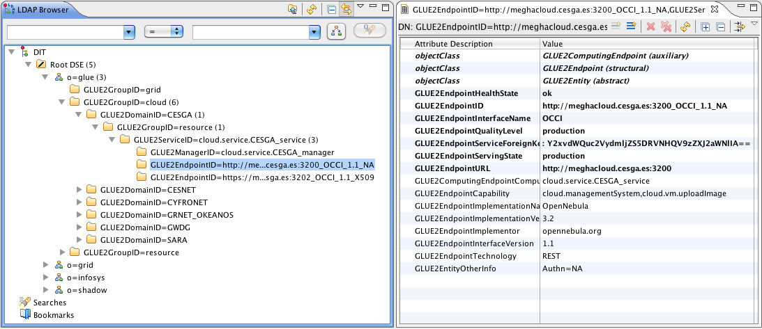
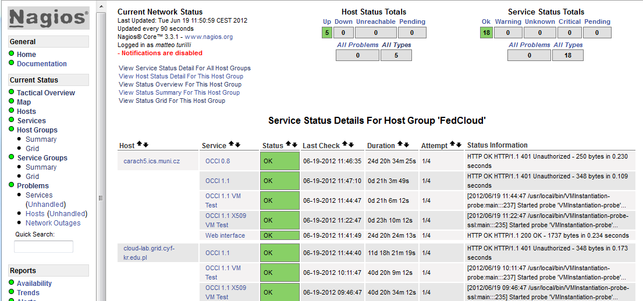
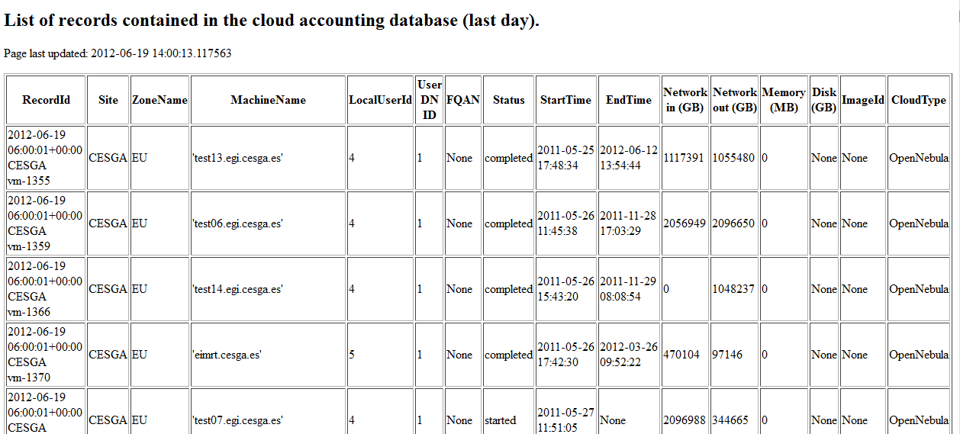
Federated Clouds Task Force
Community driven testbed activity
61 individuals, 23 institutions, 13 countries
Diverse stakeholders
15 Resource Providers, 7 Technology Providers, 4 Research Communities
Many Cloud management solutions
7 OpenNebula, 5 OpenStack, 3 StratusLab, …
Prototype demonstration in March 2012
7 Resource Provider participating
4 services: Information System, Marketplace, Monitoring and Accounting
2 Management interfces: OCCI and CDMI

Slide 20
EGI’s Cloud Strategy
Personalised environments for individual research communities
in the European Research Area
SaaS
Community Services
Community Services
Globus
Genesis II
Community Platform
EGI.eu Coordination
Core software and support
PaaS
dCache
gLite
ARC
Globus
UNICORE
VM Mgmt
Data
Information
VM Mgmt
Data
Information
VM Mgmt
Data
Information
VM Mgmt
Data
Information
NGI
NGI
NGI
Commercial
IaaS
Monitoring
Accounting
Notification
Monitoring
Accounting
Notification
Monitoring
Accounting
Notification
Monitoring
Accounting
Notification
EGI-wide message bus

Slide 21
Use of resources in SA2
 |  | Project Period 2 |  |  | Project Period 1 |  |  | Project Period 1 + 2
Task | Partner | Worked PM Funded | Committed PM | Achieved PM % | Worked PM Funded | Committed PM | Achieved PM % | Worked PM Funded | Committed PM | Achieved PM %
TSA2.1 | 1-EGI.EU | 9.0 | 10.5 | 86% | 8.1 | 9.0 | 90% | 17.1 | 19.5 | 88%
TSA2.2 | 12A-CSIC | 8.1 | 8.8 | 93% | 6.7 | 8.8 | 76% | 14.8 | 17.6 | 84%
TSA2.2 | 29-LIP | 8.9 | 8.8 | 102% | 7.5 | 8.8 | 85% | 16.4 | 17.6 | 93%
TSA2.3 | 12A-CSIC | 12.2 | 8.8 | 139% | 10.5 | 8.8 | 119% | 22.7 | 17.6 | 129%
TSA2.3 | 29-LIP | 9.0 | 8.8 | 103% | 6.8 | 8.8 | 77% | 15.8 | 17.6 | 90%
TSA2.4 | 9-CESNET | 13.5 | 15.0 | 90% | 13.7 | 15.0 | 91% | 27.2 | 30.0 | 91%
TSA2.4 | 16A-GRNET | 19.3 | 23.8 | 81% | 15.5 | 23.9 | 65% | 34.8 | 47.7 | 73%
TSA2.5 | 9-CESNET | 11.3 | 16.3 | 70% | 11.7 | 11.8 | 99% | 23.0 | 28.1 | 82%
TSA2.5 | 10B-KIT-G | 6.3 | 6.0 | 104% | 5.0 | 6.0 | 83% | 11.3 | 12.0 | 94%
TSA2.5 | 21A-INFN | 9.7 | 11.8 | 82% | 11.7 | 11.8 | 99% | 21.4 | 23.6 | 91%
TSA2.5 | 38-VR-SNIC | 5.5 | 6.0 | 91% | 4.3 | 6.0 | 72% | 9.8 | 12.0 | 81%
Total: |  | 112.8 | 124.3 | 91% | 112.8 | 125.8 | 90% | 225.6 | 250.0 | 90%
12A-CSIC over reporting in PY2
Under control, trend is going down (101% in PQ8)
16A-GRNET under reporting in PY2
Reduced salaries are translated into reduced effort in PPT
Hiring stop in Greece
9-CESNET under reporting in PY2
Proposing merging DMSU into TSA1.7 with expanded software support

Slide 22
Plans for next year
Quality Criteria consolidation
Publication roadmap
Provisioning consolidation
Review effort spending per product
Provision Grid middleware as Cloud appliances
Expanded provisioning support
Multiple UMD repositories (UMD-1, UMD-2)
Expand support for multiple OS (SL5, SL6, Debian 6)
Provisioning infrastructure consolidation
Define an IaaS to be provided to research communities
Federated Cloud activities consolidation
Propose a new task SA2.6 for integrating institutional private clouds into EGI
Begin the migration to production instances of existing services (e.g. Monitoring, Accounting, Information Services)

Slide 23
Summary
All objectives for SA2 have been achieved
All implemented processes work as designed
Mature enough to facilitate routine work
Flexible enough to allow for change
Alignment with EGI’s 2020 Strategy
Provisioning technology for the EGI now
Cloud Infrastructure Platform for EGI future

