Slide 1
SA2 – Software Provisioning
Michel Drescher
Technical Manager, EGI.eu
Presented by Peter Solagna, EGI.eu

Slide 2
Agenda
Overview
Achievements
Plans for PY3
Summary

Slide 3
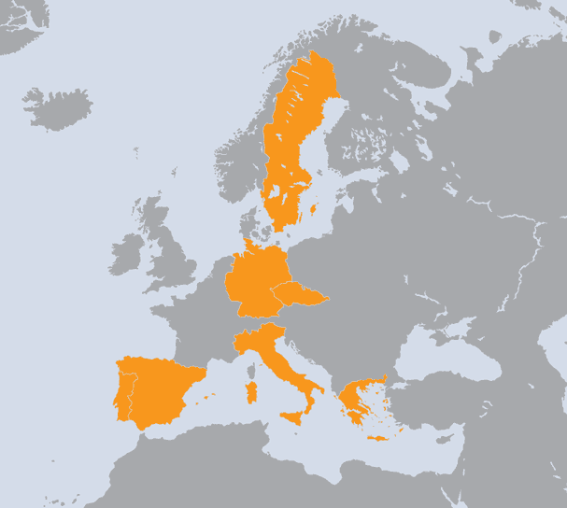
SA2 Overview
The Netherlands
Spain
Portugal
Czech Republic
Greece
Germany
Italy
Sweden
WP | Task | Beneficiary | Total PMs
WP5-E | TSA2.1 | EGI.eu | 42
WP5-E | TSA2.2 | CSIC | 35
WP5-E | TSA2.2 | LIP | 35
WP5-E | TSA2.3 | CSIC | 35
WP5-E | TSA2.3 | LIP | 35
WP5-E | TSA2.4 | CESNET | 60
WP5-E | TSA2.4 | GRNET | 95
WP5-E | TSA2.5 | CESNET | 65
WP5-E | TSA2.5 | KIT-G | 24
WP5-E | TSA2.5 | INFN | 47
WP5-E | TSA2.5 | VR-SNIC | 24
WP5-E | TSA2.5 | NORDUNET | 6
8 Countries
8 Beneficiaries
503 PMs
10.5 FTEs
SA2 Effort

Slide 4
Objectives
Task |  | Objective
TSA2.1 | 7% | O1 | Establish agreements with key software providers
 |  | O2 | Maintain the UMD Roadmap
TSA2.2 | 14% | O3 | Define general and component specific quality criteria to be applied to software components
TSA2.3 | 14% | O4 | Verify the software components against these criteria
TSA2.4 | 30% | O5 | Provide a repository for the software components within UMD and the related support tools
TSA2.5 | 35% | O6 | Provided a distributed support unit within the EGI Helpdesk infrastructure with expertise on the deployed middleware in production use.
TSA2.1: Michel Drescher, EGI.eu | TSA2.4: Kostas Koumantaros, GRNET
TSA2.2: Enol Fernandez, CSIC | TSA2.5: Ales Krenek, CESNET
TSA2.3: Alvaro Simon, FCTSG

Slide 5
Software Provisioning
Technology Coordination Board
Operations Management Board
User Community Board
                Strategic
                Coordination
Prioritised Requirements
External Technology Providers
Quality Criteria
Software
Operations (SA1)
Criteria
Definition
Criteria
Verification
Staged
Rollout
Production
Deployed Middleware Support Unit
Provisioning Infrastructure

Slide 6
Technology Coordination Board
Regular F2F and phone conferences
  6 meetings in 6-week alternating cycle
Top topics
  Defined Requirements Process:
    Deal with strategic or cross-TP issues
    43 requirements from EGI User Communities
    18 requirements from EGI Operations
  Task Forces:
    Accounting TF, Federated Cloud TF
  Technology Providers:
    Software roadmaps
    Performance within SLA

Slide 7
Technology Management
Agreements with Technology Providers
  Memorandum of Understanding
    Observer status on the TCB
    Used to build a collaborative relationship
  Service Level Agreements
    Voting status on the TCB
    Focus on delivering & supporting software
  2 New Technology Providers planned for PY3
    Genesis II, QosCosGrid
Annual Planning
  EGI Technology Roadmap
    Includes the UMD Roadmap and other technical plans
  EGI Platform Roadmap

Slide 8
Maintaining Quality Criteria
Formalising EGI’s software requirements
  Aligned to UMD Capabilities
    100% coverage through 204 quality criteria
  Overview and review using EGI wiki
Criteria change management
  6 monthly revisions
  2 public reviews per revision
  To be adaptable and improve in comprehensiveness

Slide 9
Software Verification
Verification test-bed
  Private cloud for EGI hosted at CESGA
  Multi-OS infrastructure
    SL5, SL6, Debian6
Verification is a community effort
  16 verifiers, 12 institutes, 7 countries
  Documentation of process, guidelines & testbed
    Structured reporting forms
    Allows unfunded & external verification effort

Slide 10
Software Verification in numbers
7 UMD releases were published
  104 updates for 57 products (EMI, IGE)
    134 verified, 20 rejected, 10 superseded

Slide 11
Repository & Infrastructure
Software Repository
  Frontend for human consumption
  Backend for production infrastructure access
Software Provisioning Infrastructure
  Re-use project IT support where applicable
  Develop integration tools where necessary
All services serving IPv4 and IPv6

Slide 12
Improvements in PY2
Public stable provisioning repositories
  Maintain transient repositories for management
  Initial support for multiple OS platforms
Automation tools at different levels to streamline the process
StratusLab Marketplace and Appliance repository
  Available for EGI Community

Slide 13
EGI Repository Usage
EGI Software repository hosts:
  UMD releases, EGI releases, gLite 3.2 mirror
Mirroring facility available based on rsync
1.0.0
1.2.0
1.3.0
1.4.0
1.5.0
1.6.0
1.1.0

Slide 14
Deployed Middleware SU
2nd level SU for Deployed Middleware
  Resolving middleware service requests
Produce operational documentation
  FAQs: Best Practices, Workarounds, etc.
  Specific service documentation
Support request follow-up
    Ticket oversight for 3rd level expert support

Slide 15
Deployed Middleware SU
Metric | PQ5 | PQ6 | PQ7 | PQ8
Assigned | 218 | 183 | 173 | 212
Solved | 37 | 27 | 53 | 53
To TPM | 20 | 18 | 23 | 22
To 3rd level | 175 | 137 | 118 | 139
Avg. (median) solution time | 24 (4.2) | 17(11) | 21(5.1) | 11(1.9)
786 tickets handled
170 requests solved
3rd level support requests
  Concern software problems, lacking documentation
  Require analysis before forwarding
  DMSU & TP assess ticket priority

Slide 16
3rd level support follow-up
334 tickets solved – 157 still open
12 tickets solved – 5 still open
High-priority requests
  Deadline agreed with TP
  Monitored and reported to TCB
    Enforced in PY3
Low-priority requests
  All tickets >6 months are assessed
  Feasible tickets are scheduled for next release
  All others closed as unsolved by TP
  All remaining closed as unsolved by DMSU after 2 weeks grace period

Slide 17
EMI ticket turnover in PY2
High priority tickets are being promptly solved
Policy of closing old low-priority tickets to reduce backlog

Slide 18
Federated Clouds Task Force
Objectives
  Integrate virtualised resources into EGI
  Elicit requirements for community facing services
  Provide technical feedback to Technology Providers
  Work with interested research communities
  Provide recommendations for the EGI ecosystem
Blueprint
  How to set up integration-ready virtualised resources
  How to utilise the federated Cloud infrastructure
Standards orientated
  Facilitate choice while retaining interoperability

Slide 19
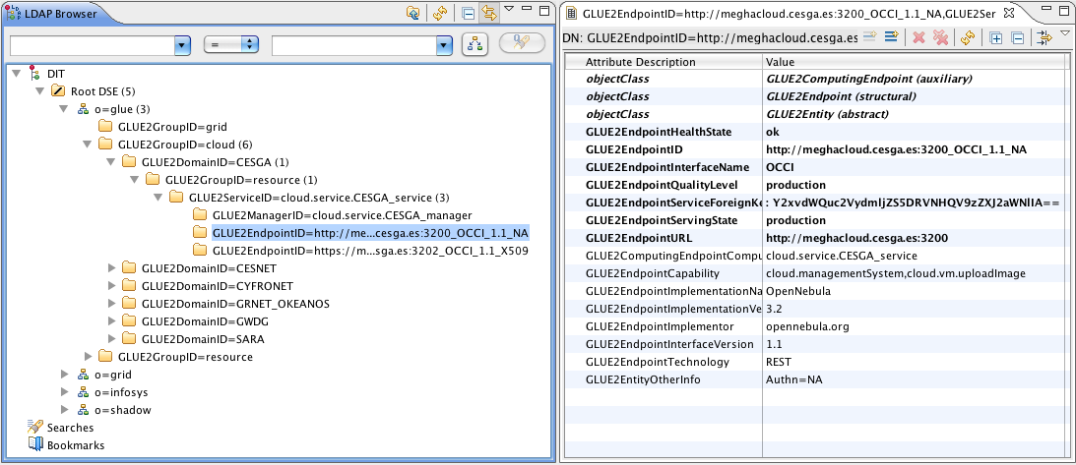
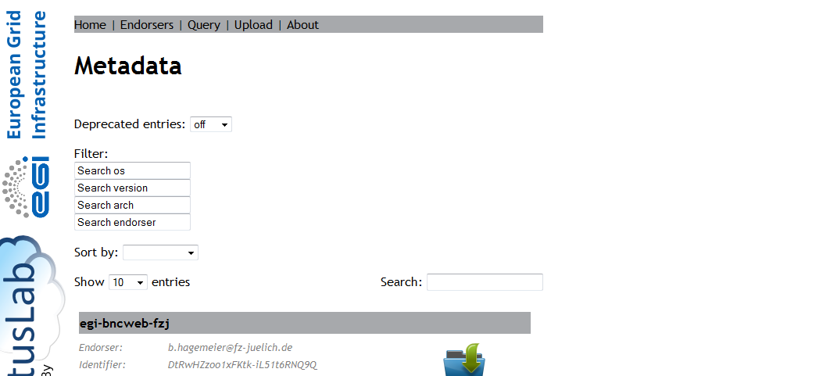
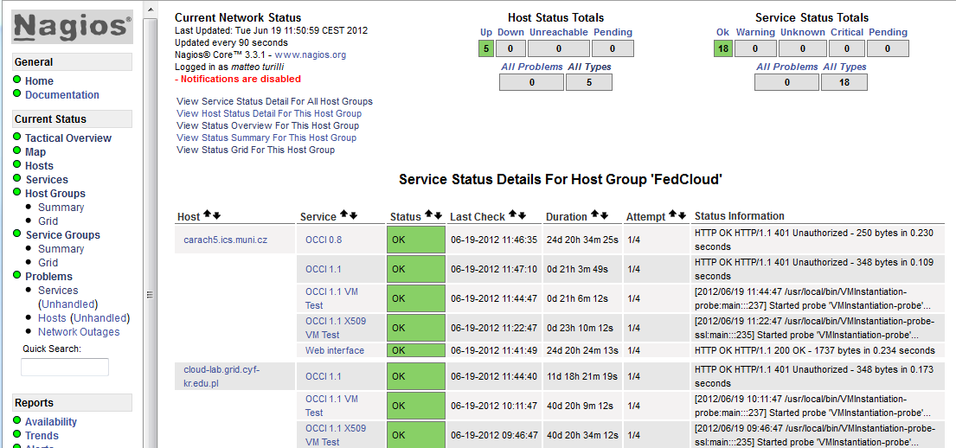
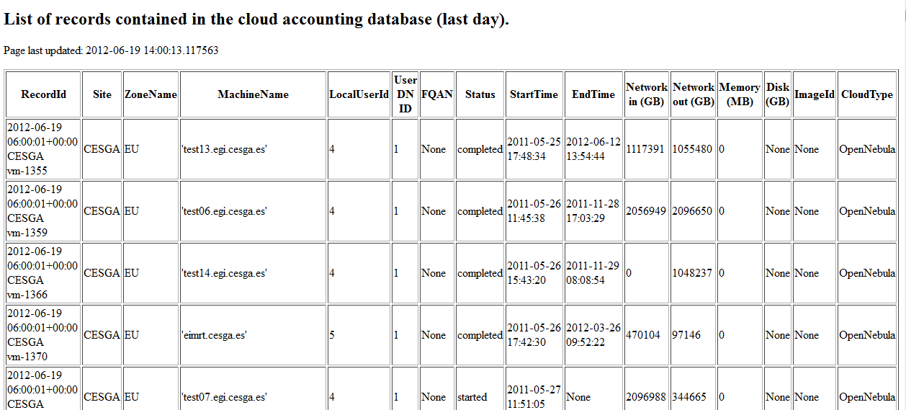
Federated Clouds Task Force
Community driven testbed activity
  61 individuals, 23 institutions, 13 countries
  Diverse stakeholders
    15 Resource Providers, 7 Technology Providers, 4 Research Communities
  Many Cloud management solutions
    7 OpenNebula, 5 OpenStack, 3 StratusLab, …
Prototype demonstration in March 2012
  7 Resource Provider participating
  2 Cloud Management interfaces: OCCI and CDMI
  4 services: Information System, Marketplace, Monitoring and Accounting

Slide 20

EGI’s Cloud Strategy
Personalised environments for individual research communities
in the European Research Area
SaaS
Community Services
Community Services
Globus
Genesis II
Community Platform
EGI.eu Coordination
Core software and support
PaaS
dCache
gLite
ARC
Globus
UNICORE
VM Mgmt
Data
Information
VM Mgmt
Data
Information
VM Mgmt
Data
Information
VM Mgmt
Data
Information
NGI
NGI
NGI
Commercial
IaaS
Monitoring
Accounting
Notification
Monitoring
Accounting
Notification
Monitoring
Accounting
Notification
Monitoring
Accounting
Notification
EGI-wide message bus

Slide 21
Use of resources in SA2
 |  | Project Period 2 |  |  | Project Period 1 |  |  | Project Period 1 + 2
Task | Partner | Worked PM Funded | Committed PM | Achieved PM % | Worked PM Funded | Committed PM | Achieved PM % | Worked PM Funded | Committed PM | Achieved PM %
TSA2.1 | 1-EGI.EU | 9.0 | 10.5 | 86% | 8.1 | 9.0 | 90% | 17.1 | 19.5 | 88%
TSA2.2 | 12A-CSIC | 8.1 | 8.8 | 93% | 6.7 | 8.8 | 76% | 14.8 | 17.6 | 84%
TSA2.2 | 29-LIP | 8.9 | 8.8 | 102% | 7.5 | 8.8 | 85% | 16.4 | 17.6 | 93%
TSA2.3 | 12A-CSIC | 12.2 | 8.8 | 139% | 10.5 | 8.8 | 119% | 22.7 | 17.6 | 129%
TSA2.3 | 29-LIP | 9.0 | 8.8 | 103% | 6.8 | 8.8 | 77% | 15.8 | 17.6 | 90%
TSA2.4 | 9-CESNET | 13.5 | 15.0 | 90% | 13.7 | 15.0 | 91% | 27.2 | 30.0 | 91%
TSA2.4 | 16A-GRNET | 19.3 | 23.8 | 81% | 15.5 | 23.9 | 65% | 34.8 | 47.7 | 73%
TSA2.5 | 9-CESNET | 11.3 | 16.3 | 70% | 11.7 | 11.8 | 99% | 23.0 | 28.1 | 82%
TSA2.5 | 10B-KIT-G | 6.3 | 6.0 | 104% | 5.0 | 6.0 | 83% | 11.3 | 12.0 | 94%
TSA2.5 | 21A-INFN | 9.7 | 11.8 | 82% | 11.7 | 11.8 | 99% | 21.4 | 23.6 | 91%
TSA2.5 | 38-VR-SNIC | 5.5 | 6.0 | 91% | 4.3 | 6.0 | 72% | 9.8 | 12.0 | 81%
Total: |  | 112.8 | 124.3 | 91% | 112.8 | 125.8 | 90% | 225.6 | 250.0 | 90%
12A-CSIC over reporting in PY2
  Under control, trend is going down (101% in PQ8)
16A-GRNET under reporting in PY2
  Reduced salaries are translated into reduced effort in PPT
  Hiring stop in Greece
9-CESNET under reporting in PY2
  Proposing merging DMSU into TSA1.7 with expanded software support

Slide 22
Plans for next year
Quality Criteria consolidation
  Publication roadmap
Provisioning consolidation
  Review effort spending per product
  Provision Grid middleware as Cloud appliances
Expanded provisioning support
  Multiple UMD repositories (UMD-1, UMD-2)
  Expand support for multiple OS (SL5, SL6, Debian 6)
Provisioning infrastructure consolidation
  Define an IaaS to be provided to research communities
Federated Cloud activities consolidation
  Propose a new task SA2.6 for integrating institutional private clouds into EGI
  Begin the migration to production instances of existing services
  (e.g. Monitoring, Accounting, Information Services)

Slide 23
Summary
All objectives for SA2 have been achieved
All implemented processes work as designed
  Mature enough to facilitate routine work
  Flexible enough to allow for change
Alignment with EGI’s 2020 Strategy
  Provisioning technology for the EGI now
  Cloud Infrastructure Platform for EGI future

