Slide 1
NA1: Project Management, Administration & Finances
Catherine Gater
Deputy Director, EGI.eu

Slide 2
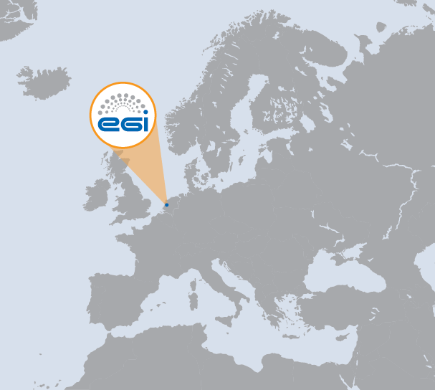
NA1 Overview
WP | Task | Beneficiary | Effort (PM)
WP1-M | TNA1.1 | EGI.eu | 24
WP1-E | TNA1.2E | EGI.eu | 149
WP1-M | TNA1.2M | EGI.eu | 95
WP1-M | TNA1.3 | EGI.eu | 36
WP1-M | TNA1.4 | EGI.eu | 24
1 International organisation
1 Beneficiary
321 PMs
6.69 FTEs
NA1 Effort

Slide 3
Contents
Consortium and management structure
Deliverables and milestones
Provisional financial status and effort
Quality assurance
NA1 achievements
NA1 issues
Summary

Slide 4
Consortium and Management Structure

Slide 5
Project Activities (PY1)
Networking
NA1: Project management (WP1)
NA2: External relations (WP2)
NA3: User community coordination (WP3)
Services
SA1: Operation of the production infrastructure (WP4)
SA2: Provisioning the software infrastructure (WP5)
SA3: Support for Heavy User Communities (WP6: PY1-PY3 only)
Joint Research
JRA1: Support for operational tools (WP7)
Total Effort by Activity

Slide 6
Project Activities (>PM18)
Networking
NA1: Project management (WP1)
NA2: Community Engagement (WP2)
Services
SA1: Operation of the production infrastructure (WP4)
SA2: Provisioning the software infrastructure (WP5)
SA3: Support for Heavy User Communities (WP6: PY1-PY3 only)
Joint Research
JRA1: Support for operational tools (WP7)
Total Effort by Activity

Slide 7
Relationship Between WPs
NA2 Community Engagement
JRA1 Operational Tools
SA2 Provisioning the Software Infrastructure
SA3 Services for Heavy Users
SA1 Operations
NA1 Management

Slide 8
Project Governance
Group = regional grouping (IBERGRID, CE, UK.IE.NL, NBIS, SEE, IT-RU, FRRO, APGI, DACH)
1 rep per partner:
Met 2 times F2F
6 members: Met 2 times F2F
1 rep per group: Met 7 times (6 F2F)
EAC Members:
Alexandre Bonvin (WeNMR) Thomas Eickermann (PRACE)
Roger Jones (WLCG)
Wouter Los (EERI)
Ivan Maric (NREN PC)
Ruth Pordes (OSG)
1 rep per group: Met 3 times (twice F2F)
Activity leaders: Met weekly by phone

Slide 9
EGI-InSPIRE & EGI
EGI COUNCIL STRUCTURE
EGI
Collaboration
EGI Council
Collaboration Board
Executive Board
PMB
Advisory Groups
Director
NGI / EIRO & Project Partner
EGI-InSPIRE PROJECT STRUCTURE
NGI / EIRO

Slide 10
Project Partners
Project Partners (50)
EGI.eu, 38 NGIs, 2 EIROs, Asia Pacific (9 partners)
38 NGIs
Albania
Armenia
Bosnia and Herzegovina
Bulgaria
Belarus
Croatia
Denmark
Switzerland
Cyprus
Czech Republic
Finland
France
Georgia
Germany
Greece
Hungary
Ireland
Israel
Italy
Latvia
Lithuania
Moldova
Montenegro
FYR Macedonia
Netherlands
Norway
Poland
Portugal
Romania
Russian Federation
Serbia
Slovakia
Slovenia
Spain
Sweden
Switzerland
Turkey
United Kingdom
2 EIROs
CERN
EMBL

Slide 11
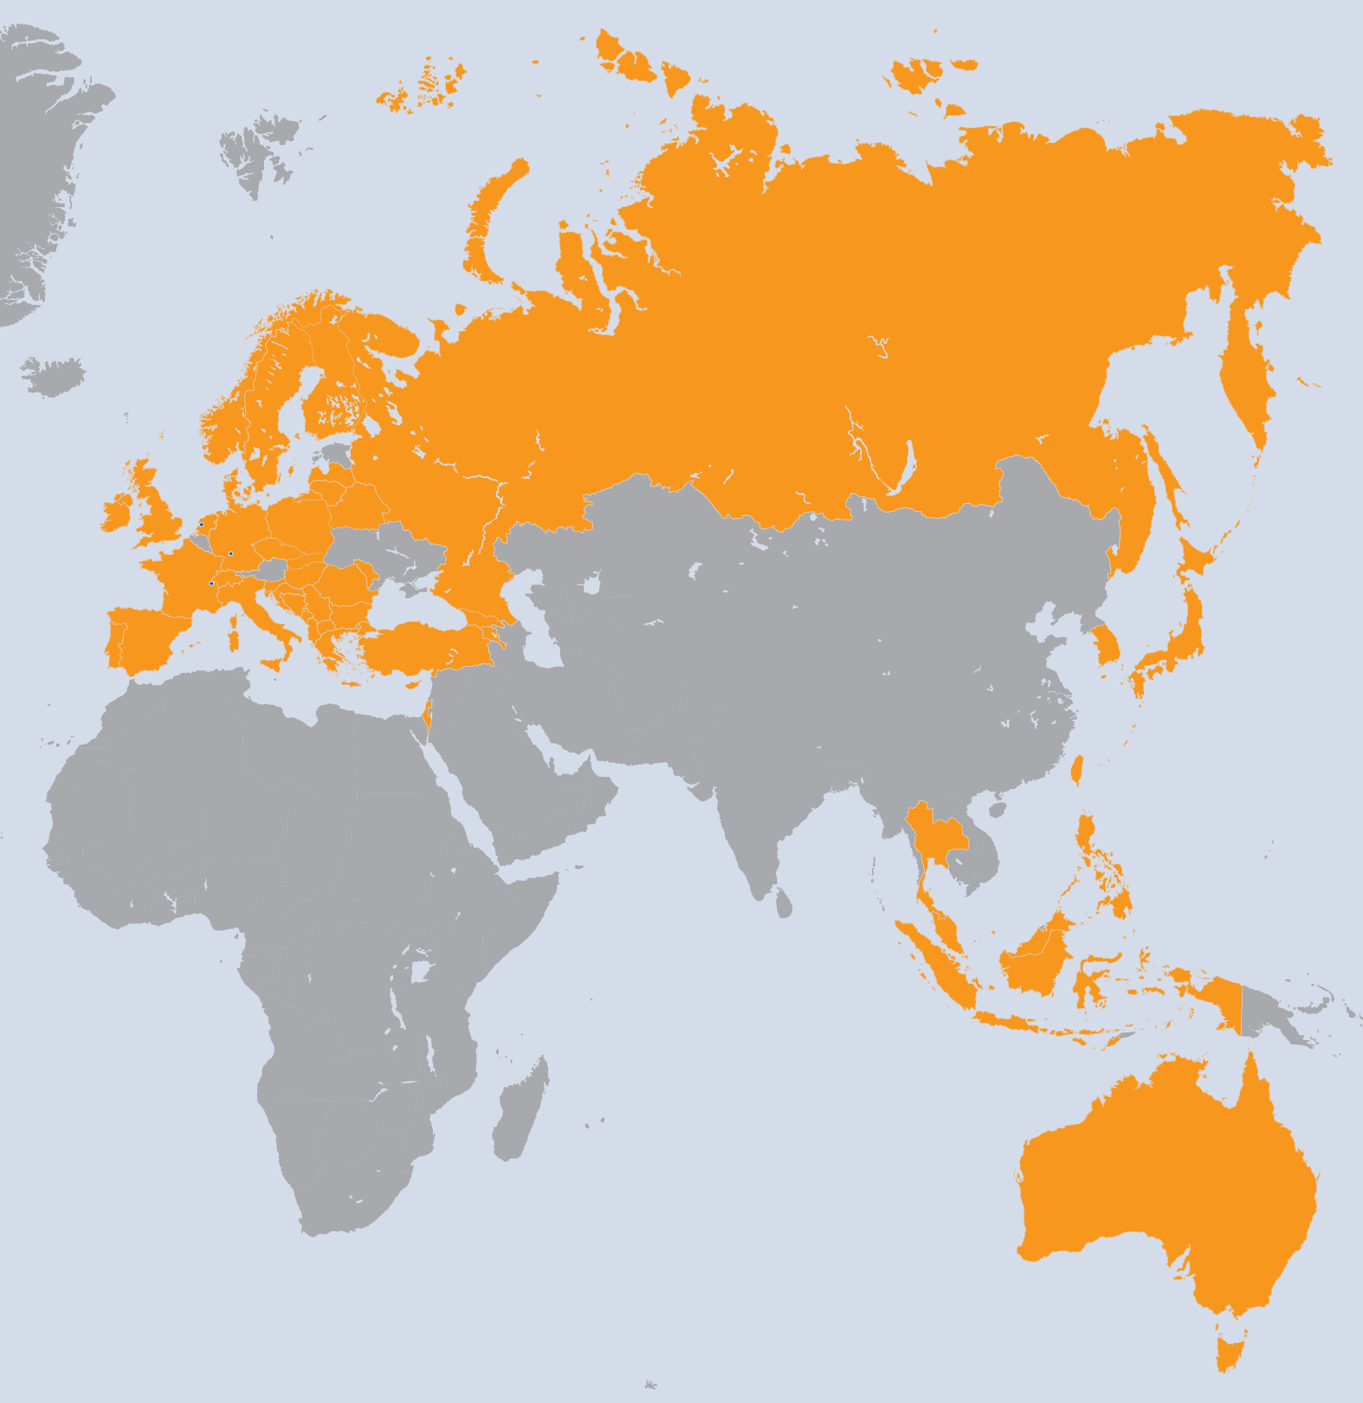
Project Partners
9 Asia Pacific
Australia
Indonesia
Japan
Malaysia
Philippines
Republic of Korea
Singapore
Taiwan
Thailand

Slide 12
NA1: Tasks and Objectives
TNA1.1 Activity management
Overall project management and reporting to the EC
TNA1.2 Project and consortium management
Establishment of a Project Office to support the very large project and consortium
Financial and effort management
TNA1.3 Technical management
Management of technical activities
TNA1.4 Quality assurance
Monitoring progress against defined metrics
Management of document review process

Slide 13
Deliverables and Milestones

Slide 14
PY2 Review Process
Table of Contents
INTERNAL
REVIEW
MODERATOR
Drafts
External Review
2 WEEKS
3 WEEKS
MANAGEMENT
SHEPHERD
AMB
Review
REVIEW
PMB
Review
2 WEEKS
1st of PM DUE
SUBMISSION TO EC

Slide 15
Deliverables & Milestones
24 Deliverables
40 Milestones
At the end of PY1, ~ 6 weeks late on average
By the end of PY2, 33 days late
Time through review process is 32 days
Indicates that the initial draft is late but the review process is on time

Slide 16
Provisional Financial Status and Effort

Slide 17
Provisional Financial Status
Total eligible costs = 16.6 Mill Euros
97% of total budgeted costs for PY2 (€18.2M)
Total requested contribution = 6.62 Mill Euros
97% of budgeted requested contribution (€ 7.26M)
Direct personnel and travel costs are 63% of the total
Other costs are overheads, materials etc

Slide 18
Provisional Financial Status
EGI-InSPIRE Total Costs by Activity after amendment (excl unfunded partners)
PY2 Requested EC Contribution (Euros)

Slide 19
Provisional Financial Status
PENDING
PAID

Slide 20
Consumed Effort Figures
Type | Work Package | Worked PM Funded | Committed PM | Achieved PM%
MGT | WP1 | 83.7 | 84.2 | 99%
COORD | WP2 | 262.4 | 294.2 | 89%
COORD | WP3 | 124.1 | 97.0 | 128%
SUPPORT | WP4 | 1,251.7 | 1,195.4 | 105%
SUPPORT | WP5 | 115.6 | 125.8 | 92%
SUPPORT | WP6 | 238.0 | 241.7 | 98%
RTD | WP7 | 82.4 | 95.1 | 87%
 | Total | 2,158.1 | 2,133.2 | 101%
Consumed Effort PY2
Total Planned Effort by Activity PY2

Slide 21
PY1 and PY2 figures
(Excludes Asia Pacific partners)
Consumed Effort PY2
Consumed Effort PY1 + PY2

Slide 22
Over-reporting Beneficiaries
 |  | Project Period 2 |  |  | PY1
Beneficiary | Country | Worked PM | Committed PM | Achieved PM | Achieved PM
14A-CNRS | France | 187.7 | 151.6 | 124% | 125%
15-GRENA | Georgia | 7.6 | 6.2 | 122% | 86%
23-RENAM | Moldova | 10.4 | 7.9 | 131% | 169%
25-UKIM | FYR Macedonia | 24.3 | 17.8 | 137% | 124%
28A-CYFRONET | Poland | 79.0 | 58.9 | 134% | 111%
51A-ICI | Romania | 33.3 | 14.6 | 228% | 115%
IMPACT
Small numbers of PMs affected
Balancing effort across the CNRS partners for Healthgrid

Slide 23
Underreporting Beneficiaries
 |  | Project Period 2 |  |  | PY1
Beneficiary | Country | Worked PM | Committed PM | Achieved PM | Achieved PM
5A-IICT-BAS | Bulgaria | 14.4 | 34.4 | 42% | 32%
6-UIIP NASB | Belarus | 5.2 | 7.6 | 69% | 150%
8-UCY | Cyprus | 10.5 | 16.0 | 66% | 71%
22-VU | Lithuania | 8.8 | 13.7 | 64% | 67%
24-UOM | Montenegro | 12.3 | 17.8 | 69% | 70%
27A-SIGMA | Norway | 17.2 | 27.4 | 63% | 32%
36-UCPH | Denmark | 14.2 | 26.9 | 53% | 35%
IMPACT
Small numbers of PMs affected and no global tasks
Small partners report difficulties attracting matching funding
Low level of travel in small partners as not all travel is refunded at 100%, depending on the work package

Slide 24
Non-Reporting Beneficiaries
 |  | Project Period 2 |  |  | PY1
Beneficiary | Country | Worked PM Funded | Committed PM | Achieved PM | Achieved PM
2-UPT | Albania | 0 | 13.1 | 0% | 0%
37-EMBL | EIRO | 0 | 12.3 | 0% | 0%
IMPACT
Small amounts of PMs and no global tasks
Plan agreed with EMBL for PY3 following new appointments
Russia JRU has been unable to distribute project funds due to a change in JRU structure, to be formally confirmed shortly

Slide 25
Impact of Effort Figures
Global Task (E): Committed vs worked PMs
InternationalTask (N): Committed vs worked PMs
TNA2.1N
TNA2.6N
E tasks
level

Slide 26
NA2 / NA3 Merger
Partner | Country | TNA2.1N | TNA2.6N | Total | Committed PM | Achieved PM %
2-UPT | Albania | 0 |  | 0 | 5 | 0%
3-IIAP NAS RA | Armenia | 0 |  | 0 | 1.2 | 0%
5A-IICT-BAS | Bulgaria | 0.1 |  | 0.1 | 2.8 | 4%
7C-SWITCH | Switzerland | 0.6 | 0.5 | 1.1 | 3.2 | 34%
8-UCY | Cyprus | 1.8 |  | 1.8 | 2 | 90%
9-CESNET | Czech Republic | 3.2 | 1.5 | 4.7 | 4.8 | 98%
10B-KIT-G | Germany | 11.8 |  | 11.8 | 11.2 | 105%
12A-CSIC | Spain | 6.7 | 8 | 14.7 | 8.2 | 179%
13-CSC | Finland | 1.1 | 0.2 | 1.3 | 6 | 22%
14A-CNRS | France | 3.4 | 5.3 | 8.7 | 8 | 109%
15-GRENA | Georgia | 0.6 |  | 0.6 | 0.8 | 75%
18A-MTA KFKI | Hungary | 2.2 | 0.7 | 2.9 | 3.2 | 91%
19-TCD | Ireland | 0.8 | 1.6 | 2.4 | 2.7 | 89%
20-IUCC | Israel | 0.3 |  | 0.3 | 1.5 | 20%
21A-INFN | Italy | 2.6 |  | 2.6 | 8.6 | 30%
22-VU | Lithuania | 0.9 |  | 0.9 | 5.7 | 16%
23-RENAM | Moldova | 0.3 |  | 0.3 | 0.3 | 100%
26-FOM | Netherlands | 0.3 | 0.7 | 1 | 2.1 | 48%
27A-SIGMA | Norway | 0 |  | 0 | 6.4 | 0%
28A-CYFRONET | Poland | 2.6 |  | 2.6 | 7.5 | 35%
29-LIP | Portugal | 0.2 |  | 0.2 | 5.2 | 4%
30-IPB | Serbia | 3.7 |  | 3.7 | 3.7 | 100%
31-ARNES | Slovenia | 0 |  | 0 | 6.9 | 0%
32-UI SAV | Slovakia | 0.7 | 4.3 | 5 | 7 | 71%
33-TUBITAK ULAKBIM | Turkey | 3.8 |  | 3.8 | 6.7 | 57%
34A-STFC | UK | 6.3 |  | 6.3 | 8.2 | 77%
36-UCPH | Denmark | 4.8 |  | 4.8 | 6 | 80%
38-VR-SNIC | Sweden | 0.4 |  | 0.4 | 3.1 | 13%
39-IMCS-UL | Latvia | 0.2 |  | 0.2 | 4.1 | 5%
40A-E-ARENA | Russia | 1.1 |  | 1.1 | 2.6 | 42%
Total: |  | 60.5 | 22.8 | 83.3 | 144.7 | 58%

Slide 27
NA2 / NA3 Merger
Partner | Country | TNA2.1N | TNA2.6N | Total | Committed PM | Achieved PM %
2-UPT | Albania | 0 |  | 0 | 5 | 0%
3-IIAP NAS RA | Armenia | 0 |  | 0 | 1.2 | 0%
5A-IICT-BAS | Bulgaria | 0.1 |  | 0.1 | 2.8 | 4%
7C-SWITCH | Switzerland | 0.6 | 0.5 | 1.1 | 3.2 | 34%
8-UCY | Cyprus | 1.8 |  | 1.8 | 2 | 90%
9-CESNET | Czech Republic | 3.2 | 1.5 | 4.7 | 4.8 | 98%
10B-KIT-G | Germany | 11.8 |  | 11.8 | 11.2 | 105%
12A-CSIC | Spain | 6.7 | 8 | 14.7 | 8.2 | 179%
13-CSC | Finland | 1.1 | 0.2 | 1.3 | 6 | 22%
14A-CNRS | France | 3.4 | 5.3 | 8.7 | 8 | 109%
15-GRENA | Georgia | 0.6 |  | 0.6 | 0.8 | 75%
18A-MTA KFKI | Hungary | 2.2 | 0.7 | 2.9 | 3.2 | 91%
19-TCD | Ireland | 0.8 | 1.6 | 2.4 | 2.7 | 89%
20-IUCC | Israel | 0.3 |  | 0.3 | 1.5 | 20%
21A-INFN | Italy | 2.6 |  | 2.6 | 8.6 | 30%
22-VU | Lithuania | 0.9 |  | 0.9 | 5.7 | 16%
23-RENAM | Moldova | 0.3 |  | 0.3 | 0.3 | 100%
26-FOM | Netherlands | 0.3 | 0.7 | 1 | 2.1 | 48%
27A-SIGMA | Norway | 0 |  | 0 | 6.4 | 0%
28A-CYFRONET | Poland | 2.6 |  | 2.6 | 7.5 | 35%
29-LIP | Portugal | 0.2 |  | 0.2 | 5.2 | 4%
30-IPB | Serbia | 3.7 |  | 3.7 | 3.7 | 100%
31-ARNES | Slovenia | 0 |  | 0 | 6.9 | 0%
32-UI SAV | Slovakia | 0.7 | 4.3 | 5 | 7 | 71%
33-TUBITAK ULAKBIM | Turkey | 3.8 |  | 3.8 | 6.7 | 57%
34A-STFC | UK | 6.3 |  | 6.3 | 8.2 | 77%
36-UCPH | Denmark | 4.8 |  | 4.8 | 6 | 80%
38-VR-SNIC | Sweden | 0.4 |  | 0.4 | 3.1 | 13%
39-IMCS-UL | Latvia | 0.2 |  | 0.2 | 4.1 | 5%
40A-E-ARENA | Russia | 1.1 |  | 1.1 | 2.6 | 42%
Total: |  | 60.5 | 22.8 | 83.3 | 144.7 | 58%

Slide 28
NGIs in Virtual Teams
 | VT Intelligence Collection | VT ESFRI Contact List | VT MPI within EGI | VT Federated Identity Providers Assessment | VT EGI Compendium | VT EGU-GA-2012 | DCH-EGI Integration | VT Fire Simulation | VT SPEED | VT Inter NGI Usage Report | VT Website Content
Spain | 1 | 1 | 1 |  |  |  | 1 | 1 |  | 1 | 1
UK | 1 | 1 | 1 |  |  |  |  |  | 1 | 1 | 1
Ireland |  |  | 1 | 1 | 1 | 1 |  |  | 1 |  | 1
Italy |  | 1 | 1 | 1 |  | 1 | 1 |  |  | 1 | 1
Switzerland | 1 | 1 |  | 1 |  | 1 |  |  | 1 | 1
Czech Republic |  | 1 | 1 | 1 |  |  |  |  |  |  | 1
France | 1 |  |  | 1 |  | 1 |  |  |  |  | 1
Portugal |  |  | 1 |  |  |  |  | 1 |  |  | 1
Germany | 1 |  |  | 1 |  | 1 |  |  |  | 1 | 1
Greece |  |  | 1 | 1 |  |  |  |  |  | 1 | 1
Hungary | 1 | 1 |  |  |  | 1 | 1 |  |  |  | 1
Slovakia | 1 |  | 1 |  |  |  |  | 1 | 1 |  | 1
Lithuania | 1 | 1 |  |  |  |  |  |  |  | 1
Netherlands | 1 | 1 | 1 |  |  |  |  |  |  |  | 1
Belgium |  |  |  |  |  |  | 1
Finland | 1
Moldova |  |  |  |  | 1
Serbia |  |  |  |  |  |  |  |  |  |  | 1
Israel |  |  |  |  |  |  |  |  |  |  | 1
Croatia |  |  | 1 |  |  |  |  |  |  | 1
Poland | 1 | 1 |  |  |  |  | 1
Sweden |  |  |  |  |  |  | 1
Turkey |  | 1
Taiwan
Denmark
Georgia
Latvia
Romania
Russia

Slide 29
Effort Consumption
Total project PMs = 9,167 (adjusted from CA)
PY2 project PMs = 2,039 (funded)
PY2 FTE = 170
For under, over and non-reporting partners, small numbers of PMs are affected and no global tasks
Small partners report difficulties attracting matching funding
Low level of travel in small partners as not all travel is refunded at 100% - addressed in DoW amendment
Plan agreed with EMBL for PY3

Slide 30
Quality Assurance

Slide 31
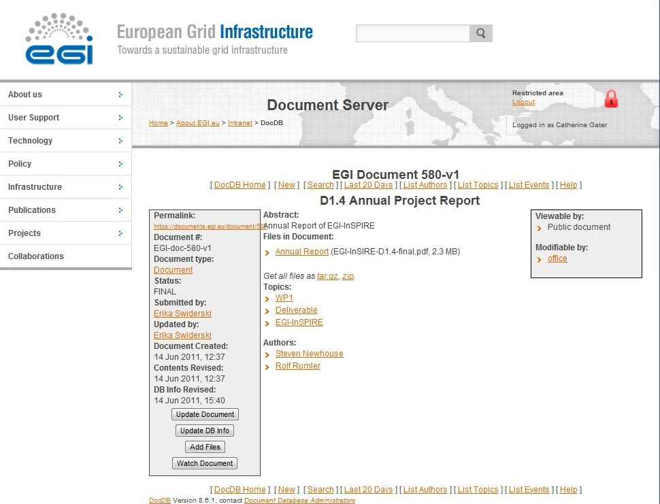
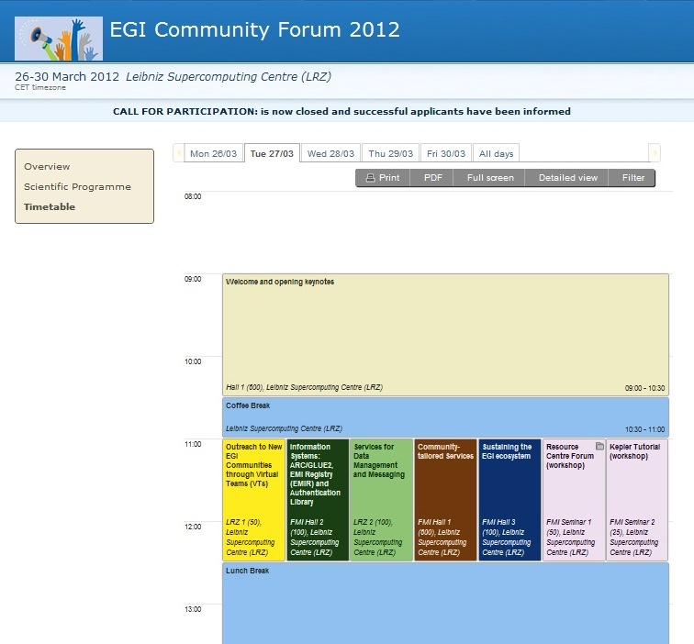
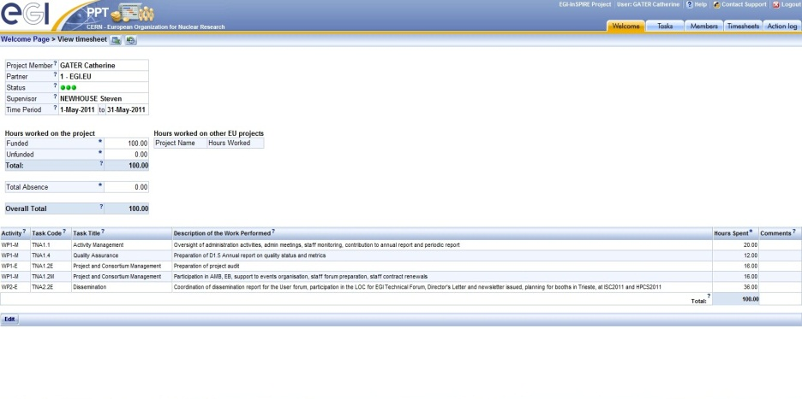
Quality Assurance
Quality assurance processes outlined in D1.5 & D1.9 Quality Plan in PQ5 & PQ8
Document management and review processes described
Tools for QA
DocDB repository
RT tickets tool
Indico meetings
Metrics portal
PPT

Slide 32
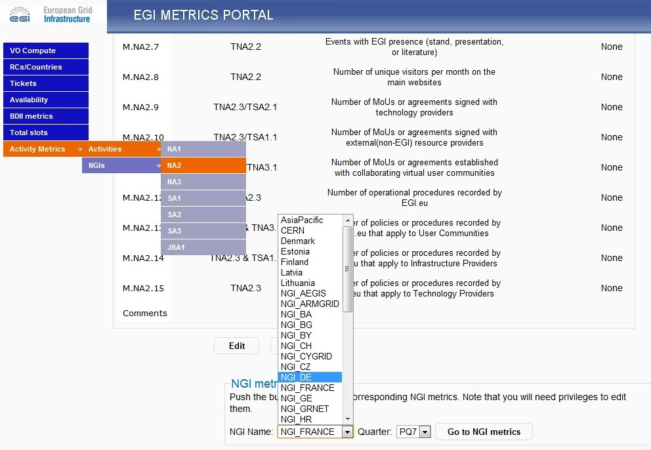
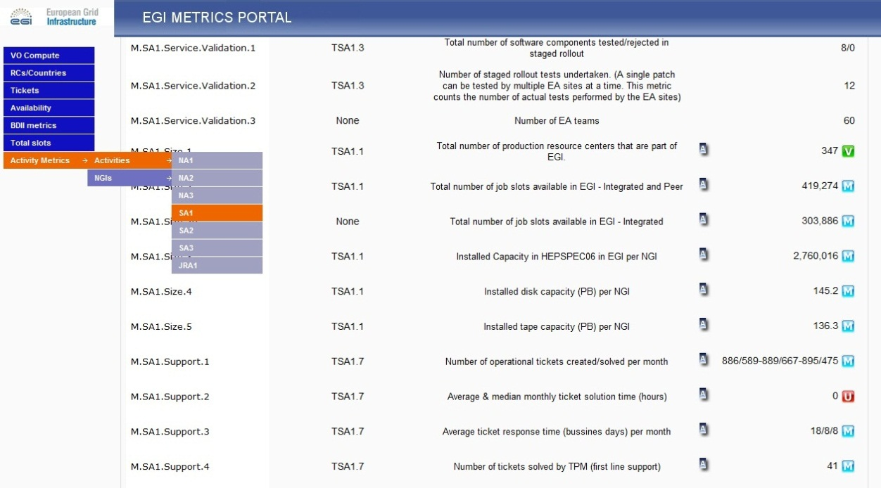
Metrics Portal
Upgraded by CESGA in PY2
Some SA1 metrics automatically populated, then verified
Upload of manual metrics for other activities
Overview of quarterly trends
Download of data to Excel for analysis

Slide 33
Project Level Objectives
PO1: Operate and expand today’s production infrastructure; transition to a governance model and operational infrastructure increasingly sustainable outside project funding.
PO2: Support researchers within Europe and international collaborators using the current production infrastructure.
PO3: Support current heavy users of the infrastructure in Earth Science, Astronomy & Astrophysics, Fusion, Computational Chemistry and Materials Science Technology, Life Sciences and High Energy Physics; move to sustainable models.
PO4: Interfaces that expand access to new user communities, including new potential heavy users of the infrastructure from the ESFRI projects.
PO5: Integrating existing infrastructure providers in Europe and around the world into the production infrastructure; transparent access to all authorised users.
PO6: Integrate new DCI technologies (e.g. clouds, volunteer desktop grids, etc.) and heterogeneous resources (e.g. HTC and HPC) into a seamless production infrastructure.

Slide 34
Metrics collection
Types of metrics
Activity level metrics: activity level tracking
Project level metrics: progress against EGI-InSPIRE objectives
Strategy metrics: progress against EGI Strategy
Value of metrics
Project level metrics collection to continue quarterly for long term comparisons with EGEE ie PY1-4
Strategy level metrics defined during PY2, to be collected during PY3 & PY4 (and beyond)
The NGI Compendium VT will work to collect national statistics eg national funding

Slide 35
Overall Project Metrics
Project Objectives | Metrics | Target PY2 | Achieved by PQ4 | Achieved by PQ8
PO1: Expansion of a nationally based production infrastructure | Total number of production resource centres in EGI (M.SA1.Size.1) | 330 | 347 | 347
 | Total number of job slots available in EGI-Integrated and peer infrastructures (M.SA1.Size.2) | 350 000 | 338 895 | 419 274
 | EGI monthly reliability [availability] of site middleware services (M.SA1.Operation.5) | 91% | 94.6% | 94.4%
PO2: Support of European researchers and international collaborators through VRCs | (Cumulative) MoUs with VRCs (M.NA2.11) | 10 | 1 | 3
 | (Cumulative) Number of papers from EGI Users (M.NA2.5) | 60 | 110 | 85
 | Number of jobs done per day (M.SA1.Usage.1) | 525 000 | 960 053 | 1 350 000
PO3: Sustainable support for Heavy User Communities | Number of production sites supporting MPI (M.SA1.Integration.2) | 100 | 96 | 109
 | Number of users from HUC VOs (M.NA3.12) | 5500 | 7103 | 10 966
PO4: Addition of new user communities | Amount of integrated desktop resources (M.SA1.Integration.3) (no of resource centres) | 5 | 1 | 0
 | Number of users from non-HUC VOs (From M.NA3.12) | 1000 | 4075 | 7 269
 | Public events organised by EGI.eu & NGI teams, calculated in cumulative attendee days (M.NA2.6) | 2000 | 10 123 | 14 047
PO5: Transparent integration of other infrastructures | (Cumulative) MoUs or agreements signed with external (non-EGI) Resource Infrastructure Providers (M.NA2.10) | 5 | 1 | 2
PO6: Integration of new technologies and resources | (Cumulative) Number of MoUs or agreements with Technology providers (M.NA2.9) | 4 | 4 | 0
 | Number of production HPC clusters (M.SA1.Integration.1) | 3 | 55 | 32
 | Amount of virtualised installed capacity accessible to EGI users (HEPSPEC) (M.SA1.Integration.4) number of Research Centres | 1 | 1 | 7

Slide 36
Overall Project Metrics
Project Objectives | Metrics | Target PY2 | Achieved by PQ4 | Achieved by PQ8
PO1: Expansion of a nationally based production infrastructure | Total number of production resource centres in EGI (M.SA1.Size.1) | 330 | 347 | 347
 | Total number of job slots available in EGI-Integrated and peer infrastructures (M.SA1.Size.2) | 350 000 | 338 895 | 419 274
 | EGI monthly reliability [availability] of site middleware services (M.SA1.Operation.5) | 91% | 94.6% | 94.4%
PO2: Support of European researchers and international collaborators through VRCs | (Cumulative) MoUs with VRCs (M.NA2.11) | 10 | 1 | 3
 | (Cumulative) Number of papers from EGI Users (M.NA2.5) | 60 | 110 | 85
 | Number of jobs done per day (M.SA1.Usage.1) | 525 000 | 960 053 | 1 350 000
PO3: Sustainable support for Heavy User Communities | Number of production sites supporting MPI (M.SA1.Integration.2) | 100 | 96 | 109
 | Number of users from HUC VOs (M.NA3.12) | 5500 | 7103 | 10 966
PO4: Addition of new user communities | Amount of integrated desktop resources (M.SA1.Integration.3) (no of resource centres) | 5 | 1 | 0
 | Number of users from non-HUC VOs (From M.NA3.12) | 1000 | 4075 | 7 269
 | Public events organised by EGI.eu & NGI teams, calculated in cumulative attendee days (M.NA2.6) | 2000 | 10 123 | 14 047
PO5: Transparent integration of other infrastructures | (Cumulative) MoUs or agreements signed with external (non-EGI) Resource Infrastructure Providers (M.NA2.10) | 5 | 1 | 2
PO6: Integration of new technologies and resources | (Cumulative) Number of MoUs or agreements with Technology providers (M.NA2.9) | 4 | 4 | 0
 | Number of production HPC clusters (M.SA1.Integration.1) | 3 | 55 | 32
 | Amount of virtualised installed capacity accessible to EGI users (HEPSPEC) (M.SA1.Integration.4) number of Research Centres | 1 | 1 | 7

Slide 37
Stretch Targets for PY3
No | Objective Summary | Metrics | Target PY1 | Target PY2 | Target PY3
PO1 | Expansion of a nationally based production infrastructure | Number of resource centres in EGI-InSPIRE and integrated partners (M.SA1.Size.1) | 300 | 330 | 350 (355) (355)
 |  | Number of job slots available in EGI-InSPIRE and integrated partners (M.SA1.Size.2) | 200,000 | 250,000 | 300,000 (325,000) (333,000)
 |  | Reliability of resource centre functional services (M.SA1.Operation.5) | 90% | 91% | 95% (96%) (97%)
 |  | Reliability of NGI functional services (MSA1.Operations.4) |  |  | 97% (98.5%) (99%)
 |  | Reliability of critical operations tools (MSA1.Operations.6a) |  |  | 97% (98.5%) (99%)
PO2 | Support of European researchers and international collaborators through VRCs | Number of papers from EGI Users (M.NA2.5) | 50 | 60 | 70 (80) (90)
 |  | Number of jobs done a day (M.SA1.Usage.1) | 500,000 | 525000 | 1.2M (1.4M) (1.5M)
PO3 | Sustainable support for Heavy User Communities | Number of sites with MPI (M.SA1.Integration.2) | 50 | 100 | 120 (130) (140)
 |  | Number of users from HUC VOs (M.SA1.VO.6) | 5000 | 5500 | 12,000 (15,000) (17,000)
PO4 | Addition of new User Communities | Peak number of cores from desktop grids (M.SA1.Integration.3) | 0 | 0 | 1,000 (5,000) (7,500)
 |  | Number of users from non-HUC VOs (M.SA1.vo.5) | 500 | 1000 | 10,000 (12,000) (13,000)
 |  | Public events organised (attendee days) (M.NA2.6) | 1500 | 2000 | 15 000 (17 000) (19 000)
PO5 | Transparent integration of other infrastructures | MoUs with resource providers (M.NA2.10) | 3 | 5 | 4 (5) (5)
PO6 | Integration of new technologies and resources | Number of HPC resources (M.SA1.Integration.1) | 1 | 3 | 50 (50) (50)
 |  | Number of resource centres part of the EGI Federated Cloud (M.SA2.19) | 0 | 1 | 10 (15) (20)
Target – expected
Target – optimal
Target – stretch

Slide 38
Strategic Metrics
EGI Balance Scorecard relates the EGI Strategy to the metrics gathered
Based on linked performance measures from a range of perspectives:
Learning & growth – how EGI must develop as an organisation
Processes – where to excel to satisfy beneficiaries and funders
Direct beneficiaries – needs of the beneficiaries
Funders – return on investment
Income – effect of success on income

Slide 39
Vision
Support the digital ERA through a pan-European e-infrastructure based on an open federation of reliable services that provide uniform access to national computing, storage and data resources
Mission
Connect researchers from all disciplines with the reliable and innovative ICT services
they need to undertake their collaborative world-class research
Strategic Themes
Communication & Coordination
Operation Infrastructure
Virtual Research Environments
Income
Achieve continued European&national funding
Achieve community funding for continued operation
O1
Funders
Contribute to
EU2020 priorities
Contribute to national priorities
Cost effective management
Direct Beneficiaries
Easy and reliable access to the services that meet the needs of researchers
Promote the sharing and re-use of innovation
Support uniform operation of resource centers
O2
O3
O4
O1
O2
Processes
Develop EGI as
open ICT ecosystem
O6
O4
Integrate new physical
resources
Improve
technical outreach
Improve operational efficiency and effectiveness
Integrate new technologies
O1
O5
O4
O1
O2
O6
Learning & Growth
Strengthen governance
Strengthen strategic partnerships
Develop technical expertise
O1
O1
O6
O6
Core Values
Leadership
Openness
Reliability
Innovation

Slide 40
Strategy perspectives
Learning & growth
Develop technical expertise
Strengthen strategic partnerships
Strengthen governance
Processes
Develop EGI as an open ICT ecosystem
Integrate new physical resources
Integrate new technologies
Improve technical outreach
Improve operational efficiency and effectiveness
Beneficiaries
Easy and reliable access to the services that meet the needs of researchers
Promote the sharing and re-use of innovation
Support the uniform operation of resource centres
Funders
Contribute to EU2020 priorities
Contribute to national priorities
Cost effective management
Incomes
Achieve continued European and National funding
Achieve community funding for continued operation

Slide 41
NA1 Achievements
Consortium management – successfully coordinated the PY2 end of year project costs and global task costs through the Project Administration Committee
NA2/NA3 merger – updated PPT to reflect the WP merger, all reporting structures upgraded in time for the start of PQ7 to allow an in year change
establishment of the NILs, VTs and new NA2 tasks
First DoW amendment – amendment session submitted, including update to CA tables for the restructuring
EGI.eu organisational structure – Project Office and Secretariat support to Council, Boards and Committees
Finance – institutional, project and EC audits completed
Refinements to admin processes in response to the EC audits
Documentation – preparation and collection of project documentation, including end of year deliverables, EGI Strategy and Periodic Report
Technical management – restructuring around NA2 and NA3
Metrics – automatic and manual metrics uploaded to the portal for PY2
Stretch targets and strategic metrics developed with the policy team

Slide 42
NA1 Issues
Deliverable and Milestones delivery
Updated review process is now shorter, but documents are still late going into review
Unresponsive partners in PY2
Russian JRU has not distributed funds to partners due to administrative issues
EMBL programme of work agreed for PY3
Over/under reporting
Balancing of under and over reporting after PY1
Partners with known issues eg EMBL negotiating participation
Prioritisation
Consortium management, Project Office duties and events

Slide 43
NA1 Use of Resources
 |  | Project Period 2
Task | Partner | Worked PM Funded | Committed PM | Achieved PM %
TNA1.1 | EGI.EU | 4.9 | 6.0 | 82%
TNA1.2E | EGI.EU | 37.6 | 37.3 | 101%
TNA1.2M | EGI.EU | 23.3 | 23.8 | 98%
TNA1.3 | EGI.EU | 7.8 | 9.0 | 86%
TNA1.4 | EGI.EU | 5.1 | 6.0 | 84%
Total: |  | 78.7 | 82.1 | 96%

Slide 44
Plans for Next Year
Next steps
Finalisation of the Financial report, reallocation of resources unspent in PY2, second contract amendment (including proposed DoW changes) and release of PY2 costs
PPT upgrade
All project participants to be upgraded to the new version of PPT, which gives more flexibility to users
Financial profiling
Early foresight of partners and EGI.eu funds
Metrics
Gathering new project level and strategic metrics
Upload of manual project metrics quarterly by the NGI International Liaisons
Virtual teams
Tracking of input of NGIs and NILs into the Virtual Teams

Slide 45
Summary
Participants: EGI.eu, 38 NGIs, 2 EIROs, Asia Pacific (9 partners), 95 beneficiaries
2 non-reporting JRUs in PY2
EGI.eu fully recruited, NA1 at 96% for PY2
All PY1 Deliverables and Milestones submitted, delays decreasing
Quality assurance processes revised
Metrics targets established for PY3, including strategic metrics

Slide 46
Additional Material

Slide 47
Strategy: Learning/growth
Objectives | Description | Performance measures | Strategic Themes | Targets
Develop technical expertise | Develop the human capital within the EGI ecosystem Enhance technical effectiveness and local support | Number of NGI supported training/tutorial attendee days undertaken at NGI events a year. Number of EGI.eu supported training/tutorial attendee days undertaken through EGI Forums and dedicated events a year. | C&C | 1000 (1500) (2000) 100 (200) (300)
Strengthen strategic partnerships | Develop strategic relationships with organisations and projects that can expand the EGI ecosystem Broaden technology offer, consulting on IT service management, engaging with developing regions | Number of entries in the EGI ‘Yellow Pages’ would provide a directory of skilled consultants, services, strategic partnerships, etc. | C&C | 50 (75) (100)
Strengthen governance | Increase the diversity of our stakeholders eg associate participants who are not resource providers | Number of associate participants in the EGI Council | C&C | 5 (6) (7)

Slide 48
Strategy: Processes
Objectives | Description | Performance measures | Strategic Themes | Targets
Develop EGI as an open ICT ecosystem | Improve accessibility of the EGI ecosystem Better defined roles, processes and interfaces Stimulating competition to allow new actors to enter the ecosystem | Number of service offerings in the ecosystem that have been identified and documented as being able to be fulfilled independently. | C&C | 5 (7) (8)
Integrate new physical resources | Expand the installed physical capacity of EGI | Total number of job slots (LCPUs) available in EGI Installed disk capacity (PB) in EGI Installed tape capacity (PB) in EGI | O.I. | 300,000 (325,000) (333,000) 150 (160) (170) 150 (160) (170)
Integrate new technologies | Integrate new functional services into EGI’s Operational Infrastructure Increase the attractiveness of EGI to new research communities | Number of different operational service types in EGI as recorded in GOCDB. Number of resource centres offering federated cloud services accessible to authorised users. (See M.SA2.19) | O.I. VREs | 60 (63) (66) 10 (15) (20)
Improve technical outreach | Strengthen local technical outreach to existing and new research communities | Number of recorded geographical contacts across the NGIs that can represent EGI locally to external requests Number of NGIs with established and active NILs | C&C | 100 (150) (200) 20 (25) (30)
Improve operational efficiency and effectiveness | Improve the reliability and the delivery of the operational infrastructure Improvements in the operational tools and processes | Number of EGI Global Services meeting published OLAs Number of resource centres meeting the Resource Centre OLA. | O.I. | 7 (10) (12) 300 (310) (320)

Slide 49
Strategy: Beneficiaries
Objectives | Description | Performance measures | Strategic Themes | Targets
Easy and reliable access to the services that meet the needs of researchers | Increase number of researchers and the diversity of research communities who rely on EGI Support data driven research | Number of researchers using EGI’s resources (either directly or through affiliated services – i.e. portals or integrated research infrastructures) Number of scientific papers produced using NGI resources affiliated into EGI across different disciplines. | VREs, | 22,000 (25,000) (27,000) 500 (700) (800)
Promote the sharing and re-use of innovation | Improve the reuse of innovation developed within the EGI ecosystem elsewhere | Number of relevant software items registered in the EGI AppDB Number of relevant training materials and resources in the EGI Training Marketplace Number of relevant appliances (i.e. virtual machines) available in the EGI Marketplace Number of software components available in the EGI Repository Number of agreements established with external research communities to use EGI’s operational tools to monitor their deployed services in their infrastructures | VREs, C&C | 450 (500) (550) 40 (50) (60) 5 (10) (20) 60 (65) (70) 0 (1) (2)
Support the uniform operation of resource centres | Resource centres providing uniform operation and consistent access to services | Number of resource centres that run services for international VOs. | O.I. | 200 (250) (275)

Slide 50
Strategy: Funders
Objectives | Description | Performance measures | Strategic Themes | Targets
Contribute to EU2020 priorities | EGI shows a clear impact on enabling the Digital ERA and other key EU strategic objectives for 2020 | Establish a measurement framework that will track the EGI contribute to EU2020 key flagship initiatives (IU and DAE) | C&C | N/A
Contribute to national priorities | NGIs, by collaborating with EGI, show a clear impact on contributing to their national priorities | Number of NGIs with national ministry/government as a stakeholder in their governance structure (i.e. management or advisory body) Number of NGIs that are recognised in their national e-Infrastructure strategies or plans. | C&C | 10 (13) (15) 5 (8) (10)
Cost effective management | Demonstrate the cost effective management of EGI and utilisation of its resources | Cost (in Euro) of providing the operational tools and coordination needed to ensure the operation of EGI Percentage utilisation through EGI provisioned services by EGI VOs of the job slots (LCPUs) capacity made available for their use | O.I. | N/A N/A

Slide 51
Strategy: Income
Objectives | Description | Performance measures | Strategic Themes | Targets
Achieve continued European & national funding | The EGI ecosystem is able to attract funding for continued operation, Investment in physical resources Innovation in the virtual research environments | Total national funding received for the operation and replacement of the physical resource infrastructure. Total national funding for the staff needed to operate and provide technical outreach. Total national and European funding that is supporting technology innovation projects recorded in the EGI Yellow Pages | C & C VREs | N/A N/A N/A
Achieve community funding for continued operation | EGI Global Services are supported by funds available from the NGIs | The percentage of funds coming from outside the community that is needed to deliver the coordinated operation of the EGI Global services | O.I. | N/A

