Slide 1
SA3: Heavy User Communities
Jamie Shiers
CERN

Slide 2
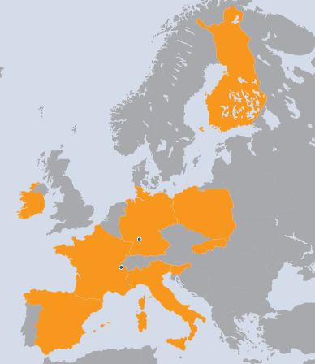
SA3 Overview
CERN
France
Slovenia
Slovakia
Italy
Spain
Finland
Poland
EMBL
Ireland
Germany
WP | Task | Beneficiary | Total PMs
WP6-G | TSA3.1 | CERN | 18
WP6-G | TSA3.2 | ARNES | 3
WP6-G | TSA3.2 | CERN | 120
WP6-G | TSA3.2 | CNRS | 30
WP6-G | TSA3.2 | CSC | 18
WP6-G | TSA3.2 | CSIC | 45
WP6-G | TSA3.2 | CYFRONET | 6
WP6-G | TSA3.2 | EMBL | 15
WP6-G | TSA3.2 | INFN | 36
WP6-G | TSA3.2 | TCD | 21
WP6-G | TSA3.2 | UI SAV | 18
 |  | Sub-total | 312
WP6-G | TSA3.3 | INFN | 60
WP6-G | TSA3.3 | CERN | 203
 |  | Sub-total | 263
WP6-G | TSA3.4 | CNRS | 53
WP6-G | TSA3.4 | EMBL | 22
 |  | Sub-total | 75
WP6-G | TSA3.5 | INFN | 30
WP6-G | TSA3.6 | KIT-G | 27
 |  | Sub-total | 57
 |  | TOTAL | 725
9 Countries
11 Beneficiaries
725 PMs
20.1 FTEs
SA3 Effort

Slide 3
SA3 Objectives
Transition to sustainable support:
  Identify tools of benefit to multiple communities
  Migrate these as part of the core infrastructure
  Establish support models for those relevant to individual communities

Slide 4
Achievements
Achievements and Future plans are based on D6.6 – the SA3 Annual Report
These are presented in a single pass:
  By community for TSA3.3 – TSA3.6
    HEP, LS, A&A, ES
  By tool for TSA3.2 (shared tools and services)
Sustainability plans and progress addressed both by D6.6 as well as D6.5

Slide 5
Achievements in Context
As an explicit example, we use the case of HEP / support for WLCG
The 3 phases of EGEE (I/II/III) overlapped almost exactly with final preparations for LHC data taking:
  WLCG Service Challenges 1-4, CCRC’08, STEP’09
EGI-InSPIRE SA3 covered virtually all the initial data taking run (3.5TeV/beam) of the LHC: first data taking and discoveries!
  The transition from EGEE to EGI was non-disruptive
  Continuous service improvement has been demonstrated
  Problems encountered during initial data taking were rapidly solved
  Significant progress in the identification and delivery of common solutions
  Active participation in the definition of the future evolution of WLCG

Slide 6
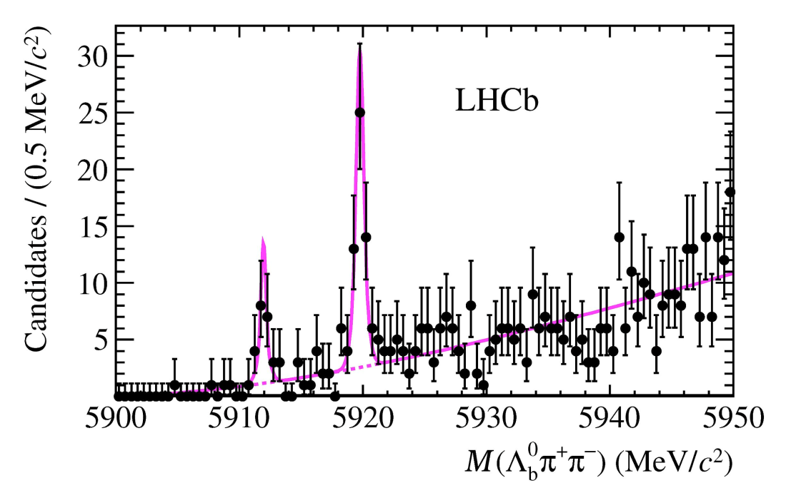
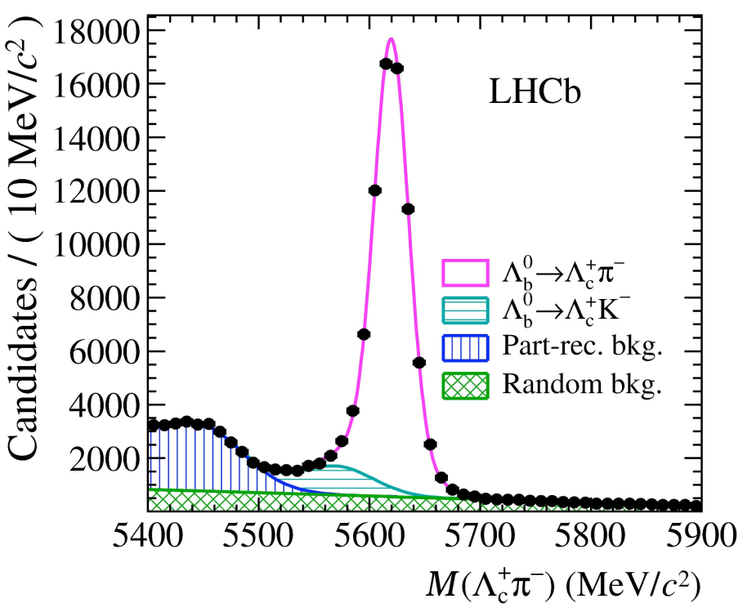
LHC(b) – Results!
See also plenary at CHEP 2012:
LHC experience so far
http://go.egi.eu/foitt
SA3 - June 2012

Slide 7
WLCG Service Incidents
These are significant service incidents
wrt targets defined in the WLCG MoU.
Basically mean major disruption to data
taking, distribution, processing or analysis.
A Service Incident Report is required.
Scale Test

Slide 8
WLCG Service Incidents
Start of Data Taking
Scale Test

Slide 9
WLCG Service Incidents
Start of Data Taking
Scale Test

Slide 10
Resolution of Incidents
Data taking

Slide 11
Resolution of Incidents
Incidents
Data taking

Slide 12
Resolution of Incidents
Incidents
Data taking

Slide 13
Resolution of Incidents
Incidents
Many of today’s incidents are largely “transparent” to users due to grid architecture and deployment models.
(There is an operational cost so further improvement needed).
Early incidents were highly disruptive.
Data taking

Slide 14
Resolution of Incidents
Incidents
Data taking

Slide 15
Achievements & Plans

Slide 16
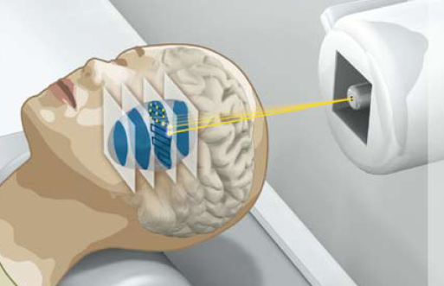
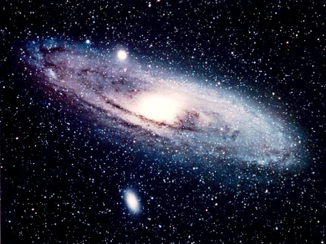
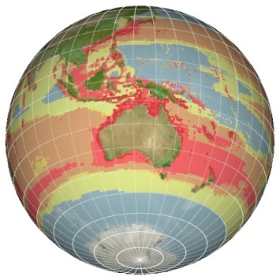
Communities & Activities
High Energy Physics
TSA3.3
The LHC experiments use grid computing for data distribution, processing and analysis. Strong focus on common tools and solutions. Areas supported include: Data Management, Data Analysis and Monitoring. Main VOs: ALICE, ATLAS, CMS, LHCb but covers many other HEP experiments + related projects.
Focuses on medical, biomedical and bioinformatics sectors to connect worldwide laboratories, share resources and ease access to data in a secure and confidential way. Supports 5 VOs (biomed, lsgri, vlemed, pneumogrid + medigrid) across 6 NGIs via the Life Science Grid Community
Life Sciences
TSA3.4
Life Sciences
Astronomy
&
Astrophysics
TSA3.5
Covers the European Extremely Large Telescope (E-ELT), the Square Kilometre Array (SKA) and Cerenkov Telescope Array (CTA) and others. Activities focus on visualisation tools and database/catalog access from the grid. Main VOs: Argo, Auger, Glast, Magic, Planck, CTA, plus others (total 23) across 7 NGIs.
Large variety of ES disciplines. Provides also access from the grid to resources within the Ground European Network for Earth Science Interoperations - Digital Earth Community (GENESI-DEC); assists scientists working on climate change via the Climate-G testbed. Main VOs: esr, egeode, climate-g, env.see-grid-sci.eu, meteo.see-grid-sci.eu, seismo.see-grid-sci.eu- support by ~20 NGIs
Earth Sciences
TSA3.6

Slide 17
Communities & Activities
These and other communities supported by shared tools & services
High Energy Physics
TSA3.3
The LHC experiments use grid computing for data distribution, processing and analysis. Strong focus on common tools and solutions. Areas supported include: Data Management, Data Analysis and Monitoring. Main VOs: ALICE, ATLAS, CMS, LHCb but covers many other HEP experiments + related projects.
Focuses on medical, biomedical and bioinformatics sectors to connect worldwide laboratories, share resources and ease access to data in a secure and confidential way. Supports 5 VOs (biomed, lsgri, vlemed, pneumogrid + medigrid) across 6 NGIs via the Life Science Grid Community
Life Sciences
TSA3.4
Life Sciences
Astronomy
&
Astrophysics
TSA3.5
Covers the European Extremely Large Telescope (E-ELT), the Square Kilometre Array (SKA) and Cerenkov Telescope Array (CTA) and others. Activities focus on visualisation tools and database/catalog access from the grid. Main VOs: Argo, Auger, Glast, Magic, Planck, CTA, plus others (total 23) across 7 NGIs.
Large variety of ES disciplines. Provides also access from the grid to resources within the Ground European Network for Earth Science Interoperations - Digital Earth Community (GENESI-DEC); assists scientists working on climate change via the Climate-G testbed. Main VOs: esr, egeode, climate-g, env.see-grid-sci.eu, meteo.see-grid-sci.eu, seismo.see-grid-sci.eu- support by ~20 NGIs
Earth Sciences
TSA3.6

Slide 18
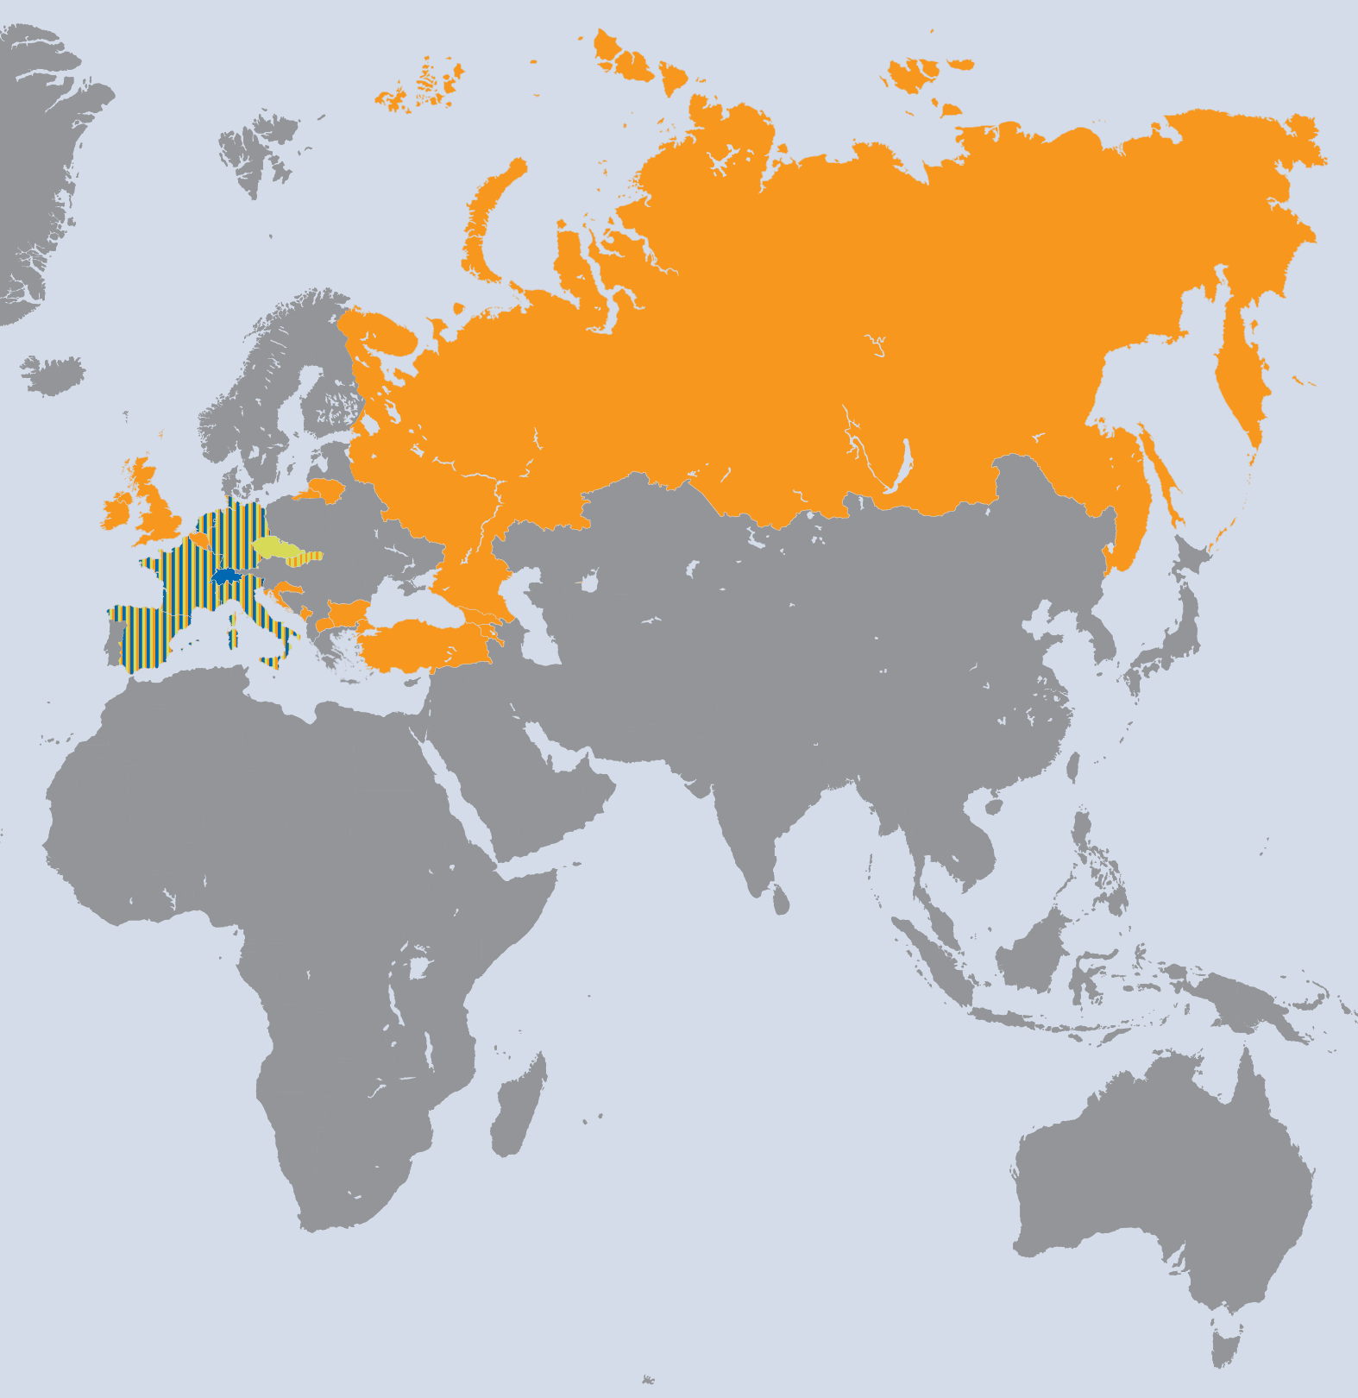
Communities & Activities
These and other communities supported by shared tools & services
High Energy Physics
TSA3.3
The LHC experiments use grid computing for data distribution, processing and analysis. Strong focus on common tools and solutions. Areas supported include: Data Management, Data Analysis and Monitoring. Main VOs: ALICE, ATLAS, CMS, LHCb but covers many other HEP experiments + related projects.
Focuses on medical, biomedical and bioinformatics sectors to connect worldwide laboratories, share resources and ease access to data in a secure and confidential way. Supports 5 VOs (biomed, lsgri, vlemed, pneumogrid + medigrid) across 6 NGIs via the Life Science Grid Community
Life Sciences
TSA3.4
Life Sciences
Astronomy
&
Astrophysics
TSA3.5
Covers the European Extremely Large Telescope (E-ELT), the Square Kilometre Array (SKA) and Cerenkov Telescope Array (CTA) and others. Activities focus on visualisation tools and database/catalog access from the grid. Main VOs: Argo, Auger, Glast, Magic, Planck, CTA, plus others (total 23) across 7 NGIs.
Large variety of ES disciplines. Provides also access from the grid to resources within the Ground European Network for Earth Science Interoperations - Digital Earth Community (GENESI-DEC); assists scientists working on climate change via the Climate-G testbed. Main VOs: esr, egeode, climate-g, env.see-grid-sci.eu, meteo.see-grid-sci.eu, seismo.see-grid-sci.eu- support by ~20 NGIs
Earth Sciences
TSA3.6

Slide 19
Services for HEP
Activity | PY2 Results
Distributed Analysis | Common Analysis Framework study for ATLAS and CMS initiated; first stage successfully completed (May 2012); next phase launched (Sep 2012);
Data Management | Dynamic caching / data popularity – move away from static data placement: common solutions deployed; others under development
Persistency Framework | Handles the event and detector conditions data from the experiments
Monitoring / Dashboards | All aspects of production and analysis: additional common solutions deployed
Task Leader: Maria Girone
Focus on Common Solutions Across (all) VOs
Common Solutions

Slide 20
LHC Timeline

Slide 21




Services for LS
LSGC User Management Tools
Life Sciences Grid Community User Management Tools
User support
  Technical assistance for end users
  Dissemination and knowledge transfer
Community resource monitoring
  All WMSs, CEs and SEs for the biomed VO
  Storage space monitoring tools
  Improvements to the Nagios monitoring probes
Improving user experience
  Deployment of redundant VOMS server
  Investigate viability of redundant LFC servers
  Improvements to storage decommissioning procedures
Future direction
Development of a HUC users database and management tools to assist VO administrators in their daily task
GOCDB

Slide 22



Services for LS
Hydra Encryption Service
Hydra – an EMI-developed service for handling the encryption and decryption of sensitive files.
Future direction
Distributed (3-servers) Hydra key-store deployment
Client packages compatible with the latest middleware release
Development highlights
Server deployed on gLite 3.1 and gLite 3.2
  Improvements to the installation and configuration procedure
Work on provisioning client for sites providing resources to Life Sciences
  Discussion with EMI to integrate the client in the official m/w releases
Prototype service available for testing
Hydra key stores
Fetch key
CE
Register
key
WN
WN
Get
encrypted
file
SE
Register
encrypted
file

Slide 23
Services for A&A
VisIVO
Visualization Interface for the Virtual Observatory
A visualization and analysis software for astrophysical data.
Recent work:
Fully compliant implementation of the VisIVO MPI utility developed provide compatibility with the gLite grid infrastructure.
A hybrid server was procured and deployed as a grid computing node to provide a combined GPU (Graphical Processing Unit) and CPU processing facility.
Plans for the future:
Ability of VisIVO to utilise GPUs on grid worker nodes.
Optimisation of VisIVO visualization component when running on huge user data tables.

Slide 24
Services for A&A
Heterogeneous resources, DBs and the VObs
Access to heterogeneous resources & databases and interoperability with the VOBs
Identification of use-cases and test-beds requiring simultaneous access to astronomical data (also that federated in the Virtual Observatory) and to computing resources of different nature.
Recent work:
Work in progress to integrate BaSTI (A Bag of Stellar Tracks and Isochrones) Astronomical Database and its feeding FARANEC code with grid technology.
  Web portal developed to facilitate grid execution of user-generated stellar evolution simulations.
Plans for the future:
GReIC is going to be evaluated for providing a mechanism to access databases from DCIs; a crucial requirement of the A&A community.
New upgraded web portal for BaSTI/FRANEC built on top of gUse/WS-PGRADE
Intensify the activity aimed to the harvesting of requirements, use-cases and test-beds to be brought in EGI and other strategic FP7 projects.
  Increase the number of A&A applications and workflows able to run on EGI DCI.

Slide 25
Services for ES
(SUB)TASK |  | PY2 RESULTS
TSA3.6 |  | Support ES Activities in ES communities and projects, and carried out by researchers & students in Universities
Main activity by proposal: access to GENESI-DEC
 | Status: Webservice available and maintained
 | Extensions of the service by ESSI-Lab GI-cat service to extend search of data
 | Further developments in Task: Integration with available GEOSS services to access ES Data not only from GENESI and Climate Data from ESG
Since January 2011 common developments with Earth System Grid (ESG)
 | Solution to access data from ESG nodes and from the EGI infrastructure and vice versa available
 | Main problem: authentication / authorization due to different federations 1st workaround in place
 | Institute IPSL/CNRS, IPGP still unfunded partner in TSA3.6
Task leader: Horst Schwichtenberg, Deputy: André Gemünd

Slide 26
Services for ES
The Earth System Grid
Distributed infrastructure developed to support CMIP5
  The Coupled Model Intercomparison Project, Phase 5
  Internationally co-ordinated set of climate model experiments
  Involving climate model centres from all over the world.
Recent work:
MPI implementation of ESG application code runs on EGI infrastructure
Implementation of multi-threaded climate data transfer program to download data from the ESG nodes
Investigation of a solution to streamline ESG data access from EGI infrastructure.
  Review and testing instance of NorduGrid Security Stack
  Problem communicated to other EGI representatives with situation description and possible solutions
  Collaboration between representatives of EGI, TSA3.6 and Earth System Grid Federation

Slide 27
Plans for next year (1/3)
Build on success in identifying and delivering common solutions
  Some significant successes seen – beyond expectations!
Further development of sustainability plans which have been demonstrated during project in some cases
  Collaborative support, less sensitive to changes at individual sites
Minor modifications to the DoW proposed:
  Synchronisation of MS619 with EGI CF 2013 PC
  Move MS620 to PM30 (from PM34) to reflect end of SA3 in PM 36
    (See next slide)
  D6.8 (sustainability – PM33) & D6.9 (annual report – PM35) could also be merged
  Significant overlap: both address sustainability

Slide 28
Plans for next year (2/3)
The SA3 work package ends in April 2013
All of the objectives must be achieved by then
Any developments must be completed, fully documented, put into production & their long-term support handed over
Even if, in some cases, there is on-going work the plans must take into account this reality

Slide 29
Plans for next year (3/3)
All disciplines supported by SA3 rely on external funding, typically through national funding agencies (including international organisations such as CERN – funded by member states);
The specific support provided by SA3 has ensured a smooth transition to EGI, brought new services to production and increased commonality, reducing long-term support costs;
It will be missed but we will (need to) adapt within individual communities to ensure continued support;
This adaption – together with completion of existing tasks – will define the work plan for PY3.

Slide 30
Review of Objectives 2011
Objective | Status
Supporting the tools, services and capabilities required by different HUCs | Achieved – work continues in PY2 / PY3
Identifying the tools, services and capabilities currently used by the HUCs that can benefit all user communities and to promote their adoption | Several additional items identified and shared across other communities – work will expand and continue in PY2 / PY3
Migrating the tools, services and capabilities that could benefit all user communities into a sustainable support model as part of the core EGI infrastructure | Not started – needs further work and discussion First steps: D6.2 (sustainability) & EGI TF w/s
Establishing a sustainable support model for the tools, services and capabilities that will remain relevant to single HUCs | Collaborative support is the basic model for sustainability that does not depend on individual partners nor specific project funding. A workshop on sustainability at the EGI TF is proposed – work continues and expands in PY2 and PY3. See also D6.2.

Slide 31
Review of Objectives 2012
Objective | Status
Supporting the tools, services and capabilities required by different HUCs | Achieved – work continues in PY3; support must be handed over prior to WP end!
Identifying the tools, services and capabilities currently used by the HUCs that can benefit all user communities and to promote their adoption | Several additional items identified and shared across communities – work expanded and will continue in PY3. By definition, the work has focused on production use, including enabling new (and old) VOs.
Migrating the tools, services and capabilities that could benefit all user communities into a sustainable support model as part of the core EGI infrastructure | The long-term support of these tools will depend on the communities that require them.
Establishing a sustainable support model for the tools, services and capabilities that will remain relevant to single HUCs | Collaborative support is the basic model for sustainability that does not depend on individual partners nor specific project funding. A workshop on sustainability at the EGI TF 2011 was held and is documented in D6.5.

Slide 32
Review of Objectives 2012
Objective | Status
Supporting the tools, services and capabilities required by different HUCs | Achieved – work continues in PY3; support must be handed over prior to WP end!
Identifying the tools, services and capabilities currently used by the HUCs that can benefit all user communities and to promote their adoption | Several additional items identified and shared across communities – work expanded and will continue in PY3. By definition, the work has focused on production use, including enabling new (and old) VOs.
Migrating the tools, services and capabilities that could benefit all user communities into a sustainable support model as part of the core EGI infrastructure | The long-term support of these tools will depend on the communities that require them.
Establishing a sustainable support model for the tools, services and capabilities that will remain relevant to single HUCs | Collaborative support is the basic model for sustainability that does not depend on individual partners nor specific project funding. A workshop on sustainability at the EGI TF 2011 was held and is documented in D6.5.
Some features required by HUC(s) have become an integral part of the core i/s, e.g. GGUS enhancements

Slide 33
Achievements in Context
SA3 has fostered and developed cross-VO and cross-community solutions beyond that previously achieved
  Benefits of multi-community WP
The production use of grid at the petascale and “Terra”scale has been fully and smoothly achieved
  Benefits of many years of grid funding

Slide 34
Achievements in Context
SA3 has fostered and developed cross-VO and cross-community solutions beyond that previously achieved
  Benefits of multi-community WP
The production use of grid at the petascale and “Terra”scale has been fully and smoothly achieved
  Benefits of many years of grid funding

Slide 35
Achievements in Context
SA3 has fostered and developed cross-VO and cross-community solutions beyond that previously achieved
  Benefits of multi-community WP
The production use of grid at the petascale and “Terra”scale has been fully and smoothly achieved
  Benefits of many years of grid funding

Slide 36
Summary
Successfully supported major production computing at an unprecedented scale – both quantitatively and qualitatively
Successfully delivered common solutions in a variety of areas – with exciting new activities in progress
Actively participated in EGI Technical & Community Forum via presentations, tutorials and demos
Extended and demonstrated sustainability models (e.g. collaborative development) in a number of key areas
Actively participated in WLCG Technology Evolution working groups and will be active in their implementation (extends post-SA3)

Slide 37
Summary
Reliability
Successfully supported major production computing at an unprecedented scale – both quantitatively and qualitatively
Successfully delivered common solutions in a variety of areas – with exciting new activities in progress
Actively participated in EGI Technical & Community Forum via presentations, tutorials and demos
Extended and demonstrated sustainability models (e.g. collaborative development) in a number of key areas
Actively participated in WLCG Technology Evolution working groups and will be active in their implementation (extends post-SA3)
Innovation
Openness
Leadership

Slide 38
Summary
Successfully supported major production computing at an unprecedented scale – both quantitatively and qualitatively
Successfully delivered common solutions in a variety of areas – with exciting new activities in progress
Actively participated in EGI Technical & Community Forum via presentations, tutorials and demos
Extended and demonstrated sustainability models (e.g. collaborative development) in a number of key areas
Actively participated in WLCG Technology Evolution working groups and will be active in their implementation (extends post-SA3)

