Slide 1
NA2.3 – Strategic Planning and Policy Support
Sergio Andreozzi
EGI-InSPIRE NA2.3 Task Leader
EGI.eu Strategy & Policy Manager

Slide 2
Outline
Objectives
Partners
Achievements of PY2
Plans for PY3

Slide 3
Objectives
Support the EGI strategic planning
Policy development
  For the EGI community
  To influence EU policy makers
  To align with EU policy aims (e.g., EU2020)
Establish and monitor collaborations
Added from PM18 to address 1st Year EC Review recommendation

Slide 4
TNA2.3 Partners (after PM18)
EGI.eu, NL
  Strategy and Policy Team (3FTE)
  STFC, UK
  Chair of Security and Policy Group (19PM/4y)
FOM, NL
  Liasion with EUGridPMA/IGTF (5PM/4y)
Notes:
Before PM18: Small effort throughout NGIs as an NGI international task, moved to support VT projects and NILs
FOM and STFC activities will be presented within SA1 presentation within the context of security activities

Slide 5
Strategic Planning
MISSION
Why we exist
CORE VALUES
What’s important to us
VISION
What we want to be
STRATEGY
How we want to get there
BALANCED SCORECARD
How we understand that we are getting there
IMPLEMENTATION PLANS
What we need to do
D2.30
EGI2020 Strategy
D2.18
Business Models
D2.13
Sustainability Plan
D1.9
Quality Plan
D2.31
Technical Plan
Unique Value Creation
Notes:
D2.30: market analysis, value analysis, ecosystem definition, EU2020 impact
D2.18: SWOT, Lean canvas
D1.9: strategy map + balanced scorecard
Value Prop: Empowering digital research and research collaborations in Europe and beyond

Slide 6
Strategic Planning:
EGI towards an open ICT Ecosystem
“Open ICT ecosystems enable efficiency, innovation and growth” http://go.egi.eu/oie
Open if
Interoperable
User-Centric
Collaborative
Sustainable
Flexible
EGI ecosystem definition, roles, responsibilities
Notes:
no linear value-chain -> network of organizations exchanging value
Interoperable: allowing, through open standards, the exchange, reuse, interchangeability and interpretation of data across diverse architectures
User-Centric: prioritizing services fulﬁlling user requirements over perceived hardware or software constraints
Collaborative: permitting other stakeholders to create, grow and reform communities of interested parties that can leverage strengths, solve common problems, innovate and build upon existing efforts
Sustainable: maintaining balance and resiliency while addressing organizational, technical, ﬁnancial and legal issues in a manner that allows an ecosystem to thrive and evolve
Flexible: adapting seamlessly and quickly to new information, technologies, protocols and relationships while integrating them as warranted into market-making and government processes

Slide 7
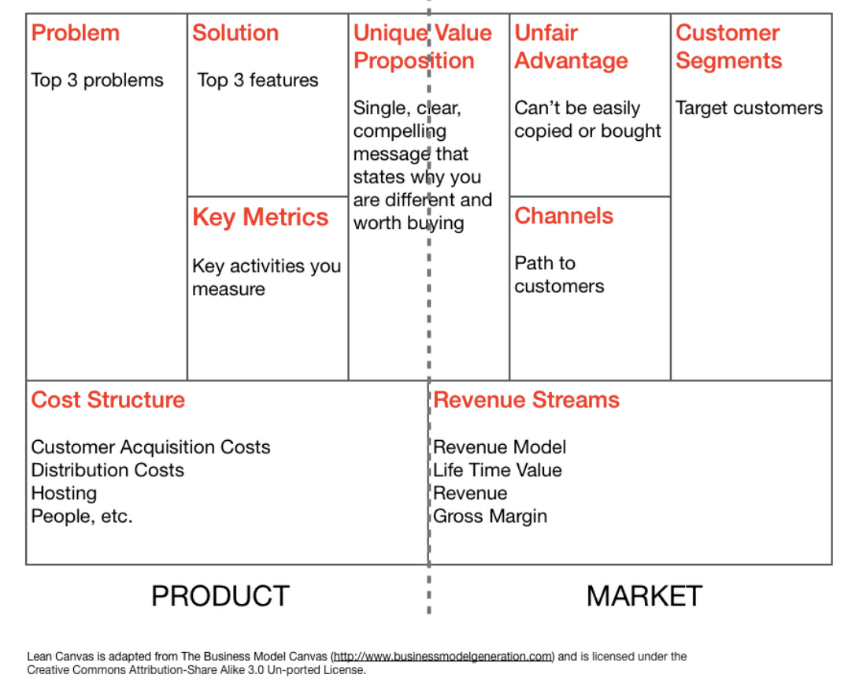
Strategic Planning:
Business Model(s)
“Rationale of how an organisation creates, delivers, and captures value sustainably”
For each key role
SWOT analysis
Lean canvas
  Fast
  Concise
  Portable
  Widely accepted
D2.18: http://go.egi.eu/1040

Slide 8
Strategic Planning:
EGI Business Model
Customers
Researchers and their grouping
Top 3 problems
Non-integrated and hard to use ICT resources slows digital research
Multi-disciplinary grand challenges
Difficult to discover/share problem solving tools
Top 3 solutions
Customisable VREs on top of federated infrastructure
Platform model
Collaboration tools

Slide 9
Strategic Planning:
EGI.eu Business Model
Customers
NGIs/EIROs, European Research Infrastructures, EC
Top 3 problems
Coordinate service delivery across distributed providers
Build a large/diverse community and attract new researchers to use EGI
Coordinate representation
Top 3 solutions
Cost-effective consensus driven coordination of service delivery
Marketing/events/tech. outreach
Single voice/legal representation with EC and other partners

Slide 10
Strategic Planning:
Business Space for Tech/Resource Providers
EGI-InSPIRE provides a framework to discuss individual business models
(dedicated workshops at next EGI TF12)
Unique and autonomous
Have a business space in which to operate

Slide 11
Strategic Planning:
EGI Compendium
  What?
  Body of information about NGIs/EIROs
  Why?
  To increase transparency and clarity among partners and outside
  To support strategic planning and execution
  How?
  Establishment through a VT project with questionnaire and process
  When?
  Annual iteration
  First iteration executed in April 2012
  First annual report expected in PQ9
New activity, not part of DoW
86 questions:
Identity and Contact
Strategy
Governance
Funding of the NGI
Funding and staffing of the NGI/EIRO e-infrastructure
Policy
Outreach
Services
Users
Infrastructure
Technology
From 2013, will include strategic metrics

Slide 12
Policy Development:
Influencing EU Policy Makers
Participation in EC Consultations
  EU Cloud Computing Consultation (survey)
  Common Strategic Framework for future EU Research and Innovation Funding (position paper)
  ERA Framework (position paper)
Participation in project studies
  ERINA+ (socio-economic impact assessment)
  Development of impact measures for e-Infrastructures (RI-Impact study)
  Infinity project questionnaire (e-Infrastructure catalogue for future Internet)
  OSIRIS (sustainability of research infrastructures, interview + questionnaire)
  SIENA Roadmap (standards roadmap for Grid and Clouds)
  e.nventory (e-Infrastructures observatory)

Slide 13
Policy Development:
Align with EU Policy Aims
EU2020
Digital Agenda for Europe
Innovation Union
EGI Contributions
EGI for the Digital Agenda for Europe
  Supports single digital market
  Stimulates competitiveness and interoperability
  Improves efficient spending
  Addresses grand challenges
EGI for the Innovation Union
  Enables the digital ERA
  Promotes skill development
  Enables worldwide collaboration

Slide 14
Policy Development:
Supporting the EGI policy groups
EGI Council
EGI.eu Executive Board
Terms of
Reference
(ToR)
Common
Process
(PDP)
Common
Glossary
(GCG)
Technology
TCB
Security
OMB
OTAG
Users
UCB
SPG
SCG
Operations
Accounting TF
FedCloud TF
SVG/RAT
CSIRT
Group meetings: 38 in PY2 (27 in PY1) – Secretarial support - Approved: 2 pol., 6 proc.

Slide 15
Policy Development:
Communicating Externally
Articles
11 blog posts,
4 Inspired newsletter articles,
3 e-IRG newsletter articles,
1 iSTGW article,
1 eChallenges paper,
Leaflets H2020/Struct.Funds
Wiki
Refactored for new SPT,
list of reports,
list of agreements,
EU2020 section,
VT EGI Compendium,
VT Scientific Pub. Repository
Website
Update policy group pages,
EGI in Europe page,
Collaborating partner pages

Slide 16
Collaborations (MoUs)
Technology Providers
EMI, IGE, StratusLab, SAGA
Resource Providers
Latin-America, South Africa, Ukraine
Others
MAPPER, GISELA, gSLM, e-ScienceTalk, DECIDE, CHAIN, EDGI, ScalaLife, SCI-BUS, SHIWA, SIENA, e-nventory
VRCs
WLCG, WeNMR, HMRC, LSGC
UVACSE*
DANTE*
LoI with DARIAH/CLARIN
Signed MoUs:
+7 (PY1)
+16 (PY2)
Negotiate
Execute
Close
*close to signature
http://www.egi.eu/community/collaborations/

Slide 17
Plans for Next Year
Strategic Planning
  EGI transition to ERIC - Report D2.11 (PM29) and dedicated workshop
  EGI Compendium 2011 – analysis report
  Implement the Balanced Scorecard Framework
  Evolving business model discussion
  Contribute to the EGI Community and Technical Forums through sessions relating to EGI’s governance, strategy, policy, sustainability and business models
Policy Development
  EU2020: monitor the EGI contribution
  Glossary: finalise and review annually (V.1 finalised on 1 June ‘12)
  Support EGI policy groups
  Security Policy Group to revise or establish a number of key policies regarding the infrastructures
  Continue to deliver focused messages and increase social media presence
Collaborations
  Monitor the execution of the existing agreements
  Establish new ones with key partners

Slide 18
Summary
Strategic planning
  Contributed to the EGI strategy definition and execution
  Defined ecosystem and framework to develop business models
Policy Development
  Strengthened the presence in EC policy activities
  Supported the policy development for EGI
Collaborations
  Monitored the activities within existing partnerships
  Expanded the network of strategic collaborations

