Slide 1
NA2.2 – Communications, Marketing & Events
Catherine Gater
Deputy Director, EGI.eu

Slide 2
Contents
NA2 / WP2 overview
Communications & marketing overview
Objectives & strategy
PY2 activities
Events
Plans for PY3
Summary

Slide 3
NA2 / WP2 overview

Slide 4
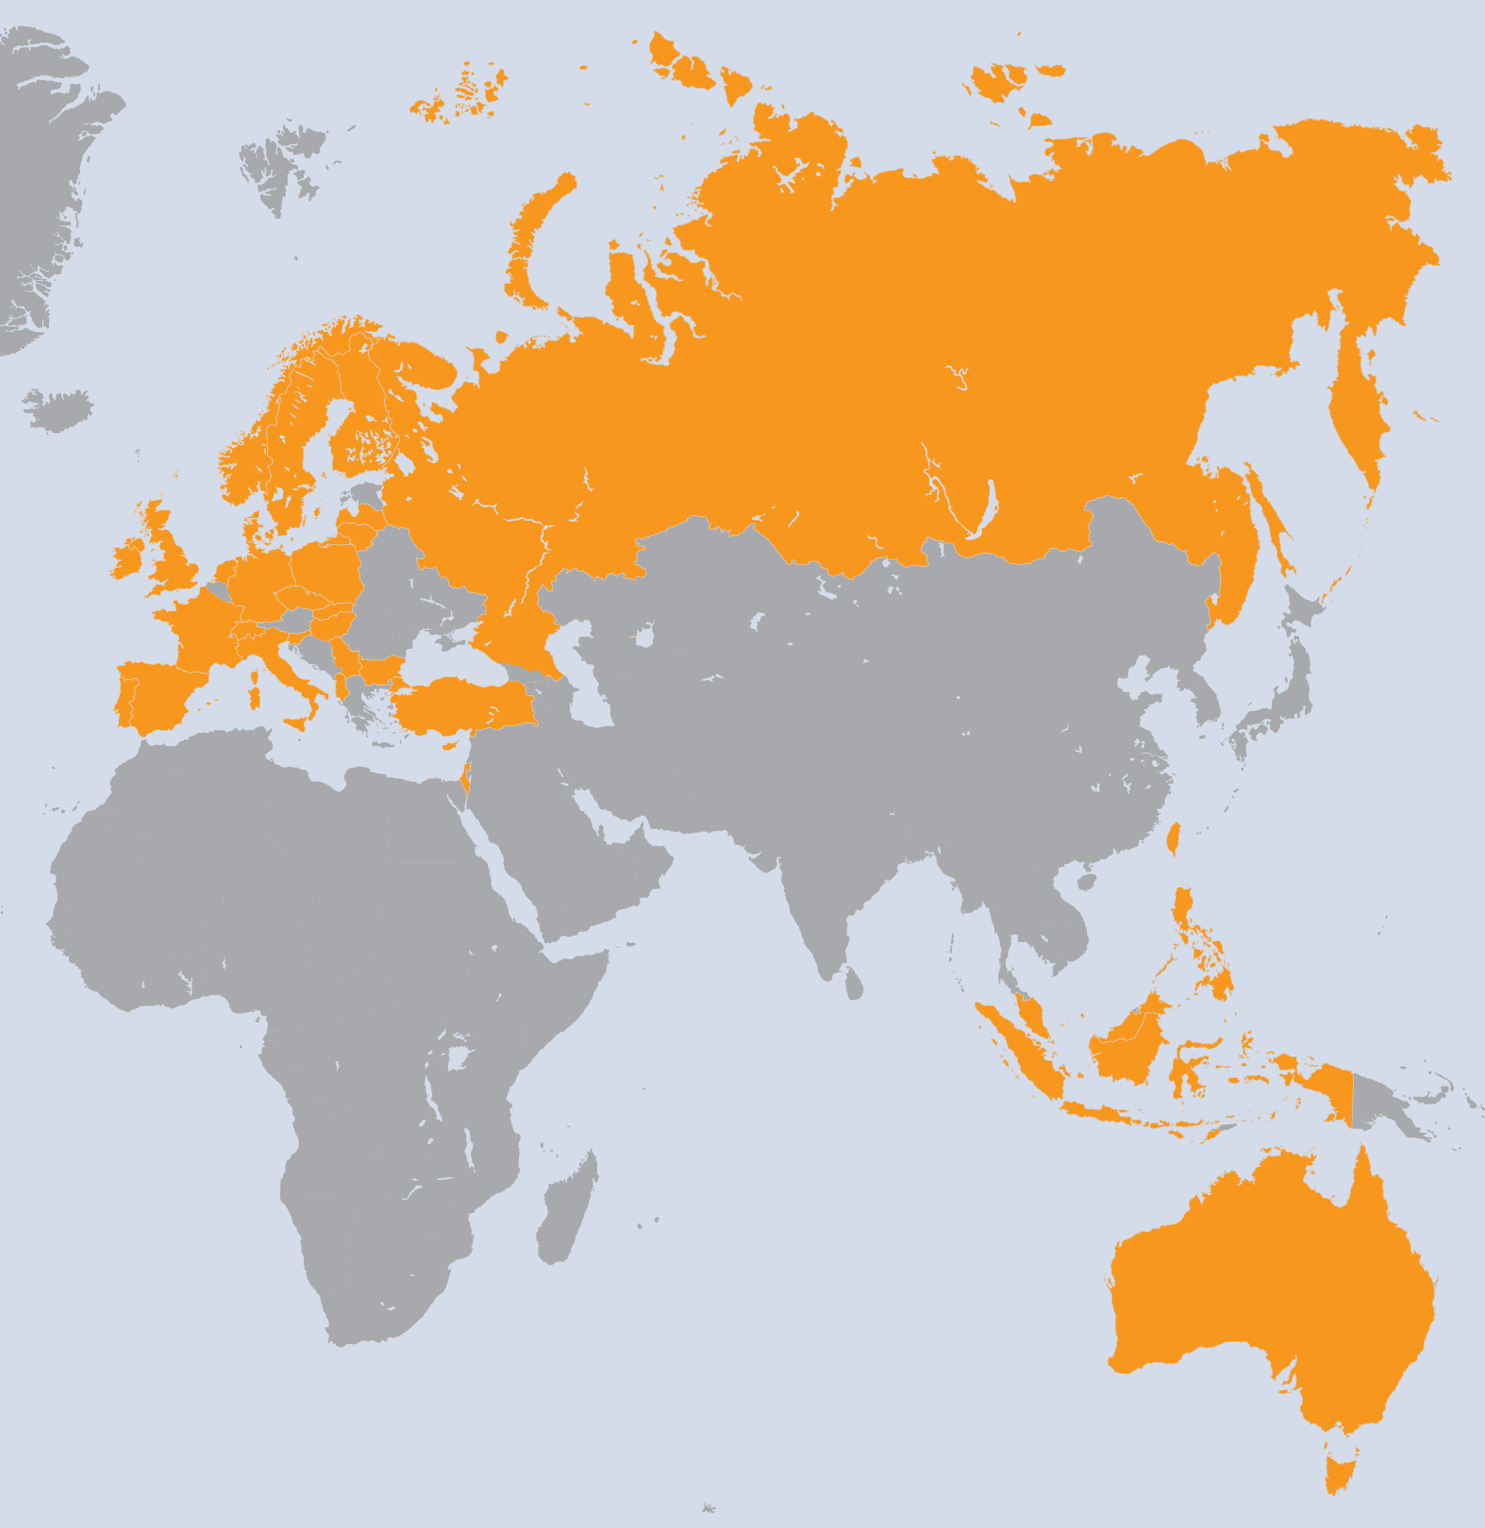
NA2 (PM13-18)
Ireland
Turkey
Denmark
Cyprus
Slovakia
Albania
Sweden
Lithuania
Taiwan
Phillippines
Indonesia
Australia
Singapore
Malaysia
WP | Beneficiary | Total PMs
WP2-E | EGI.eu | 308
WP2-E | FOM | 5
WP2-E | STFC | 19
WP2-N | ARNES | 28
WP2-N | CESNET | 8
WP2-N | CNRS | 21
WP2-N | CSC | 17
WP2-N | CSIC | 35
WP2-N | CYFRONET | 16
WP2-N | E-ARENA | 14
WP2-N | IICT-BAS | 8
WP2-N | IMCS-UL | 22
WP2-N | INFN | 20
WP2-N | IPB | 12
WP2-N | IUCC | 4
WP2-N | KIT-G | 17
WP2-N | LIP | 12
WP2-N | MTA KFKI | 4
WP | Beneficiary | Total PMs
WP2-N | FOM | 7
WP2-N | SIGMA | 6
WP2-N | STFC | 24
WP2-N | SWITCH | 7
WP2-N | TCD | 6
WP2-N | TUBITAK | 16
WP2-N | UCPH | 12
WP2-N | UCY | 8
WP2-N | UI SAV | 8
WP2-N | UPT | 12
WP2-N | VR-SNIC | 8
WP2-N | VU | 21
WP2-N | ASGC | 48
WP2-N | ASTI | 20
WP2-N | ITB | 3
WP2-N | UNIMELB | 4
WP2-N | NUS | 20
WP2-N | UPM | 12
33 Countries
34 Beneficiaries
812 PMs
16.8 FTEs
The Netherlands
UK
Slovenia
Czech Republic
France
Finland
Spain
Poland
Russia
Bulgaria
Latvia
Italy
Serbia
Israel
Germany
Portugal
Hungary
Norway
Switzerland
 | Task | Leader/Partner | WP Effort %
TNA2.1 | Activity Management | S. Newhouse/EGI.eu | 2%
TNA2.2 | Dissemination | C. Gater/EGI.eu | 44%
TNA2.3 | Policy Development | S. Andreozzi/EGI.eu | 44%
TNA2.4 | Events | R. v. d. Meer/EGI.eu | 10%

Slide 5
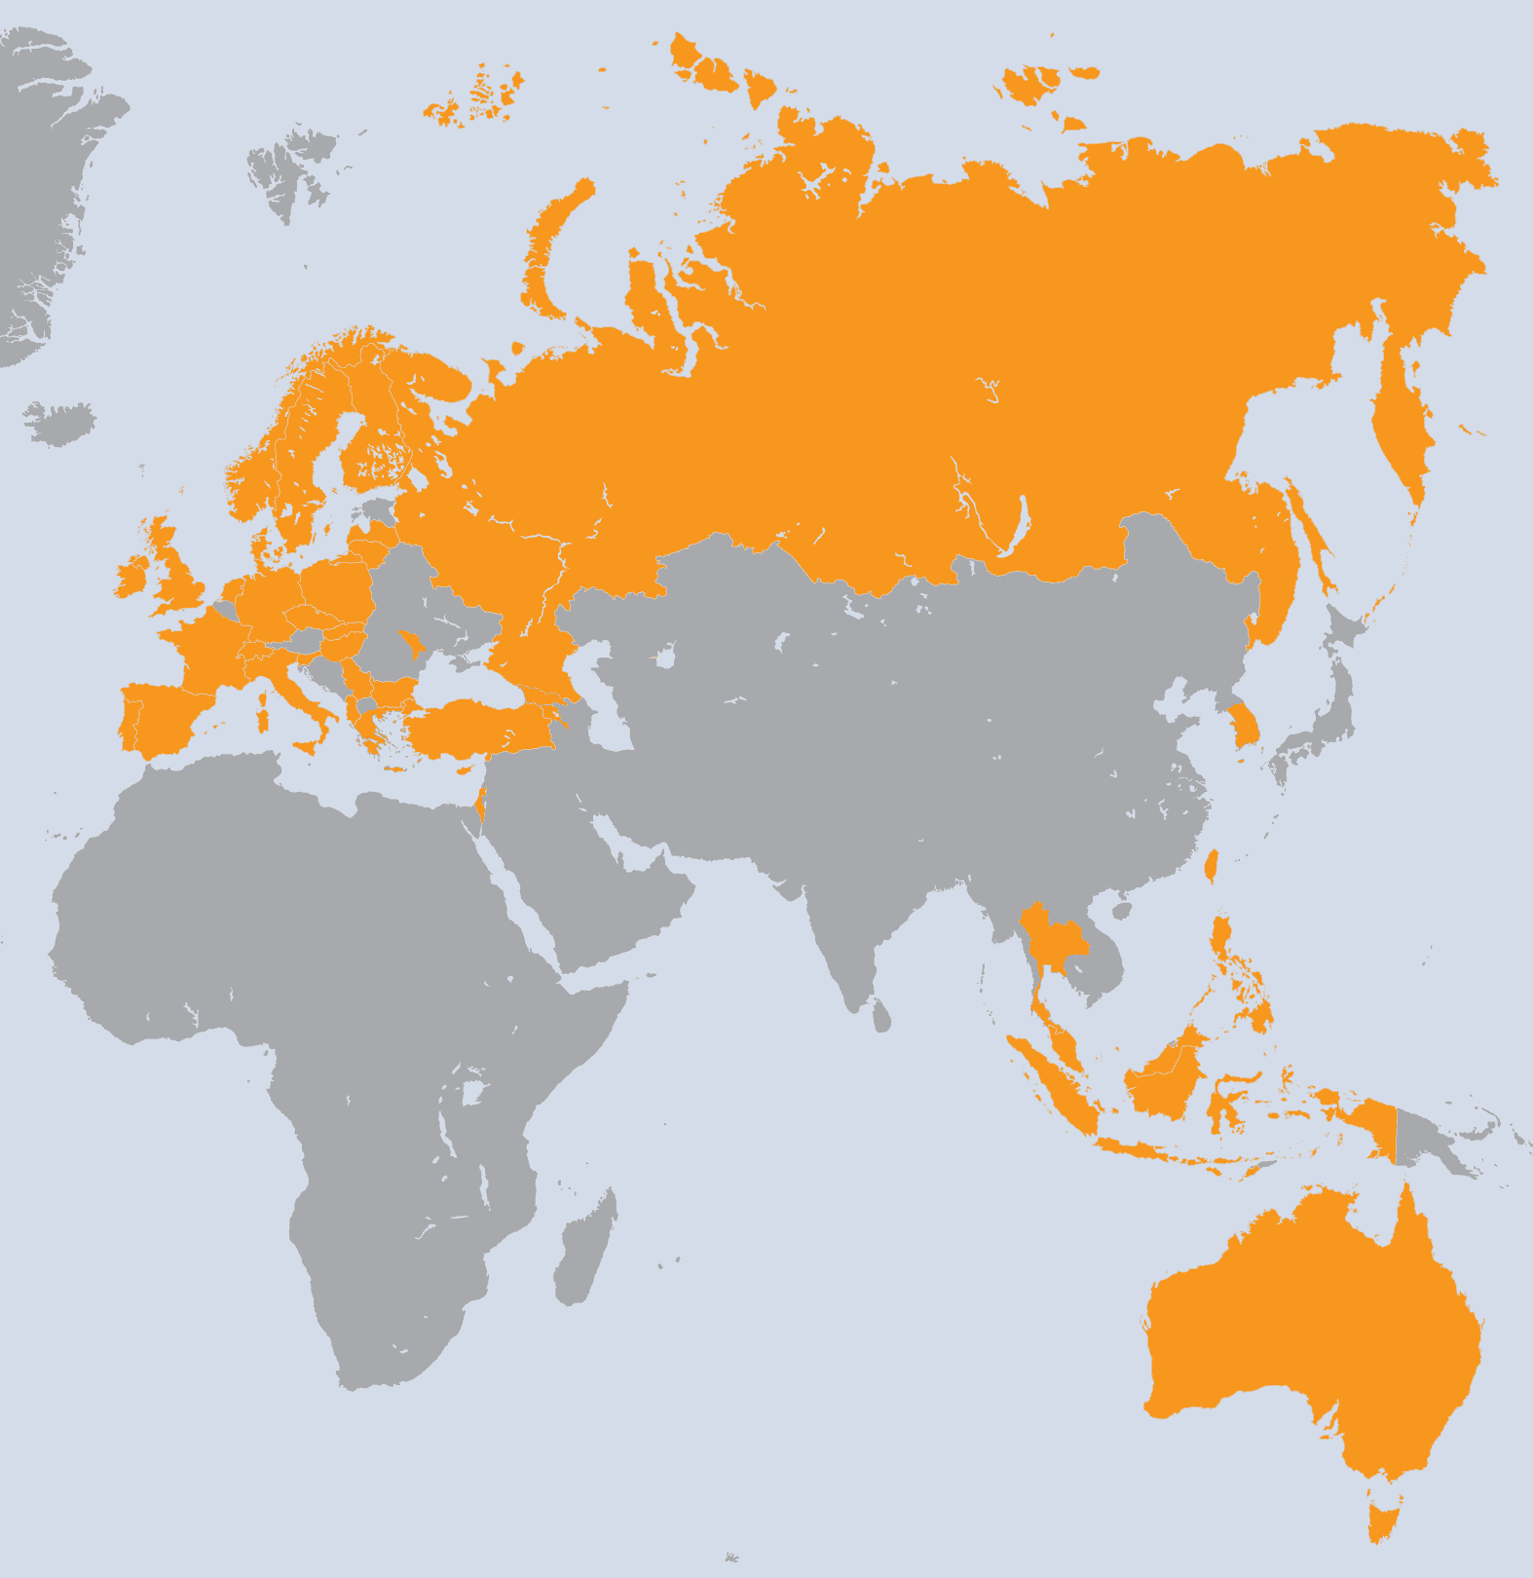
NA2 + NA3 merged
The Netherlands
UK
Slovenia
Czech Republic
France
Finland
Spain
Poland
Russia
Georgia
Armenia
Bulgaria
Latvia
Italy
Serbia
Israel
Germany
Greece
Portugal
Hungary
Moldova
Norway
Switzerland
Ireland
Turkey
Denmark
Cyprus
Slovakia
Albania
Sweden
Lithuania
Taiwan
Phillippines
Indonesia
Australia
Singapore
Malaysia
Korea
Thailand
WP | Beneficiary | Total PMs
WP2-E | EGI.eu | 483
WP2-E | CSIC | 12
WP2-E | FOM | 5
WP2-E | GRNET | 47
WP2-E | LIP | 12
WP2-E | STFC | 47
WP2-N | ARNES | 82
WP2-N | CESNET | 36
WP2-N | CNRS | 75
WP2-N | CSC | 41
WP2-N | CSIC | 62
WP2-N | CYFRONET | 51
WP2-N | E-ARENA | 21
WP2-N | FOM | 16
WP2-N | GRENA | 6
WP2-N | IIAP NAS RA | 6
WP2-N | IICT-BAS | 16
WP2-N | IMCS-UL | 22
WP2-N | INFN | 60
WP2-N | IPB | 28
WP2-N | IUCC | 17
WP2-N | KIT-G | 83
WP | Beneficiary | Total PMs
WP2-N | LIP | 40
WP2-N | MTA KFKI | 36
WP2-N | RENAM | 9
WP2-N | SIGMA | 33
WP2-N | STFC | 52
WP2-N | SWITCH | 19
WP2-N | TCD | 20
WP2-N | TUBITAK | 52
WP2-N | UCPH | 32
WP2-N | UCY | 16
WP2-N | UI SAV | 11
WP2-N | VR-SNIC | 17
WP2-N | VU | 36
WP2-N | ASGC | 169
WP2-N | ASTI | 240
WP2-N | ITB | 13
WP2-N | KISTI | 28
WP2-N | UNIMELB | 4
WP2-N | NUS | 44
WP2-N | UPM | 24
WP2-N | NECTEC | 4
39 Countries
40 Beneficiaries
2127 PMs
44.3 FTEs
NA2 Effort

Slide 6
NA2 + NA3 merged
The Netherlands
UK
Slovenia
Czech Republic
France
Finland
Spain
Poland
Russia
Georgia
Armenia
Bulgaria
Latvia
Italy
Serbia
Israel
Germany
Greece
Portugal
Hungary
Moldova
Norway
Switzerland
Ireland
Turkey
Denmark
Cyprus
Slovakia
Albania
Sweden
Lithuania
Taiwan
Phillippines
Indonesia
Australia
Singapore
Malaysia
Korea
Thailand
WP | Beneficiary | Total PMs
WP2-E | EGI.eu | 483
WP2-E | CSIC | 12
WP2-E | FOM | 5
WP2-E | GRNET | 47
WP2-E | LIP | 12
WP2-E | STFC | 47
WP2-N | ARNES | 82
WP2-N | CESNET | 36
WP2-N | CNRS | 75
WP2-N | CSC | 41
WP2-N | CSIC | 62
WP2-N | CYFRONET | 51
WP2-N | E-ARENA | 21
WP2-N | FOM | 16
WP2-N | GRENA | 6
WP2-N | IIAP NAS RA | 6
WP2-N | IICT-BAS | 16
WP2-N | IMCS-UL | 22
WP2-N | INFN | 60
WP2-N | IPB | 28
WP2-N | IUCC | 17
WP2-N | KIT-G | 83
WP | Beneficiary | Total PMs
WP2-N | LIP | 40
WP2-N | MTA KFKI | 36
WP2-N | RENAM | 9
WP2-N | SIGMA | 33
WP2-N | STFC | 52
WP2-N | SWITCH | 19
WP2-N | TCD | 20
WP2-N | TUBITAK | 52
WP2-N | UCPH | 32
WP2-N | UCY | 16
WP2-N | UI SAV | 11
WP2-N | VR-SNIC | 17
WP2-N | VU | 36
WP2-N | ASGC | 169
WP2-N | ASTI | 240
WP2-N | ITB | 13
WP2-N | KISTI | 28
WP2-N | UNIMELB | 4
WP2-N | NUS | 44
WP2-N | UPM | 24
WP2-N | NECTEC | 4
39 Countries
40 Beneficiaries
2127 PMs
44.3 FTEs
NA2 Effort
 | Task | Leader/Partner | WP Effort %
TNA2.1 | Activity Management + NILs | S. Newhouse/EGI.eu | 73%
TNA2.2 | Marketing & Communication | C. Gater/EGI.eu | 5%
TNA2.3 | Strategic Planning & Policy Support | S. Andreozzi/EGI.eu | 8%
TNA2.4 | Community Outreach | S. Brewer/EGI.eu | 2%
TNA2.5 | Technical Outreach | G. Sipos/EGI.eu | 12%

Slide 7
NA2 effort figures
Task | Partner | Worked PM | Committed PM | Achieved PM %
TNA2.1 | 1-EGI.EU | 1.8 | 1.0 | 181%
TNA2U.1E | 1-EGI.EU | 1.4 | 1.8 | 76%
TNA2.2E | 1-EGI.EU | 16.1 | 11.6 | 140%
TNA2U.2E | 1-EGI.EU | 15.1 | 14.7 | 103%
TNA2.3E | 1-EGI.EU | 22.6 | 14.9 | 152%
TNA2U.3E | 1-EGI.EU | 21.8 | 20.0 | 109%
TNA2.3E | 26A-FOM | 0.9 | 2.8 | 31%
TNA2U.3E | 26A-FOM | 1.1 | 0.7 | 156%
TNA2.3E | 34A-STFC | 2.5 | 2.1 | 118%
TNA2U.3E | 34A-STFC | 2.4 | 2.5 | 93%
TNA2.4E | 1-EGI.EU | 2.9 | 2.6 | 113%
TNA2U.4E | 1-EGI.EU | 11.5 | 6.6 | 173%
TNA2U.5E | 1-EGI.EU | 17.3 | 23.7 | 73%
TNA2U.5E | 12A-CSIC | 0 | 1.2 | 0%
TNA2U.5E | 16A-GRNET | 2.9 | 4.4 | 66%
TNA2U.5E | 16E-IASA | 0 | 1.3 | 0%
TNA2U.5E | 29-LIP | 6.2 | 1.6 | 390%
TNA2U.5E | 34A-STFC | 3.9 | 3.6 | 107%
Total: |  | 130.3 | 115.8 | 112%
Task | Worked PM | Committed PM | Achieved PM %
TNA2.1N | 68.4 | 144.9 | 47%
TNA2.2N | 18.9 | 19.0 | 99%
TNA2.3N | 14.0 | 10.1 | 139%
TNA2.4N | 3.3 | 4.2 | 79%
TNA2.6N | 27.6 | 0 | N/A
TNA2.6N +TNA2.1N | 96.0 | 144.9 | 66%
TNA2.X – PQ5 & PQ6
TNA2U.X – PQ7 & PQ8
E = Global task; N = National task
Management (TNA2.1) – 129%
Communications (TNA2.2) – 122%
Policy (TNA2.3) – 110%
Community outreach (TNA2.4) – 143%
Technical outreach (TNA2.5) – 106%
NGI International Liaisons – 66%

Slide 8
Relationship between tasks
TNA2.1N NGI International Liaisons
VTs
VTs
VTs
TNA2.4 Outreach & Events
TNA2.2 Marketing & Communications
TNA2.3 Strategic Planning & Policy Support
TNA2.5 Technical Outreach
VTs
VTs
VTs
TNA1.6N NGI Distributed Competency Centre

Slide 9
NGI and NILs
Around 50% of NGIs now reporting at 80% or more into TNA2.1N and TNA2.6N
Effort formerly in TNA2.2 and TNA2.3 now used in Virtual Team participation
Communications VTs: Website content (14 NGIs) and EGU General Assembly (6 NGIs)
Supplemented by activities in policy and dissemination at a national level

Slide 10
Communications & Marketing

Slide 11
Project Objectives
Project Objectives | Communications Objectives | Metrics
PO1: Expansion of a nationally based production infrastructure |  | Number of production resources in EGI (M.SA1.Size.1)
 |  | Number of job slots available in EGI (M.SA1.Size.2)- Integrated and peer infrastructure
 |  | Reliability of core middleware services (M.SA1.Operation.5)
PO2: Support of European researchers and international collaborators through VRCs |  | MoUs with VRCs (M.NA2.11)
 |  | Number of papers from EGI Users (M.NA2.5)
 |  | Number of jobs done a day (M.SA1.Usage.1)
PO3: Sustainable support for Heavy User Communities |  | Number of sites with MPI (M.SA1.Integration.2)
 |  | Number of users from HUC VOs (M.SA1.Size.7)
PO4: Addition of new user communities |  | Number of desktop resource (M.SA1.Integration.3)
 |  | Number of users from non-HUC VOs (From M.NA3.12)
 |  | Public events organised (M.NA2.6)
PO5: Transparent integration of other infrastructures |  | MoUs with resource providers (M.NA2.10)
PO6: Integration of new technologies and resources |  | MoUs with Technology providers (M.NA2.9)
 |  | Number of HPC resources (M.SA1.Integration.1)
 |  | Number of virtualised resources (M.SA1.Integration.4)
Disseminating the work of EGI & its communities:
Within the project
Worldwide
Supporting two large events each year with:
Partners in the European e-Infrastructure ecosystem
The community using e-Infrastructure services

Slide 12
Key target audiences
Research communities
Media and general public
Projects and policy makers
NGIs and EIROs

Slide 13
Communications strategy
Research Communities
Why?
Rely on an engaged and broadly satisfied user community
Success?
The number of people who investigate using grid as a tool in their research, as well as use it
Indirect indicators of success - wider range of user communities participating in events or promoting EGI at their local events
Media & General public
Why?
Mentions of grid in the mainstream media improve EGI’s visibility within the scientific community and with policy makers
Informs the public about the benefits of grid through case studies relevant to them
Success?
More discussions and mentions of the research done on the grid outside EGI channels

Slide 14
Communications strategy
Projects and policy makers
Why?
Policy makers hold the key to future funding and decide on strategic priorities
Keeps our work on their agenda and engaged beyond the hype attached to new technologies
Success?
Open, two-way communications channels to policy makers
NGIs and EIROS
Why?
EGI’s key stakeholders and source of funding, strategy and resources
Success?
Participation in EGI events remains steady or increases
NGIs continue to provide case studies, news items, newsletter features
NGIs participate actively in Virtual Teams
NGIs continue to be keen to be promoted by EGI through its central channels
NGIs continue to request EGI materials for distribution at their events and to policy makers

Slide 15
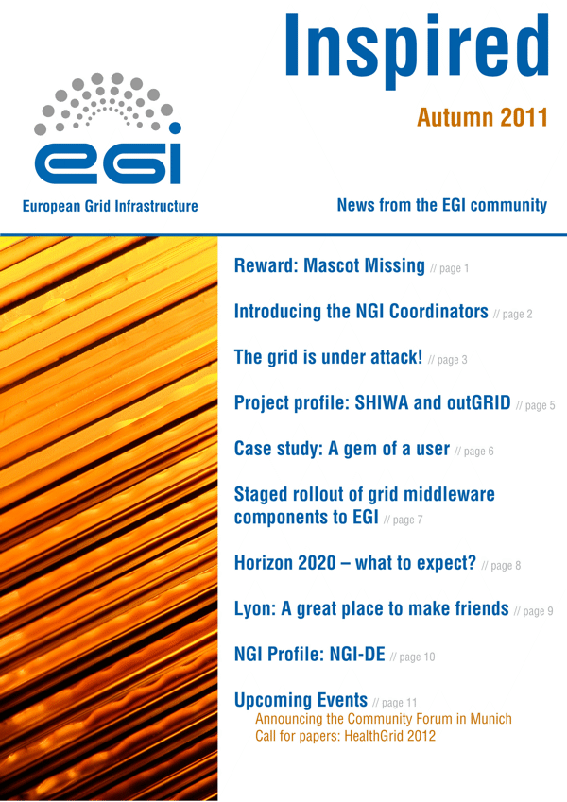
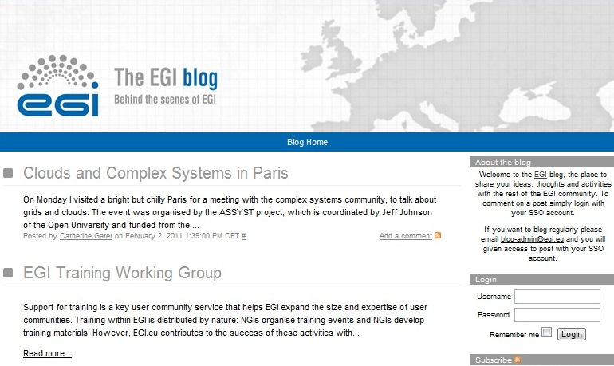
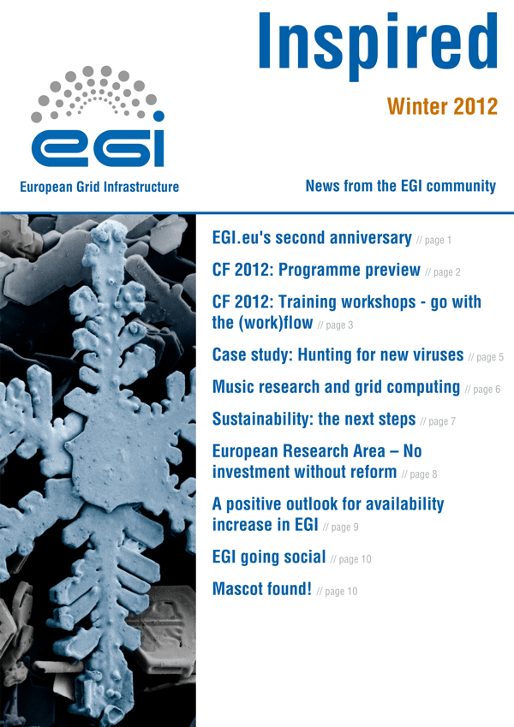
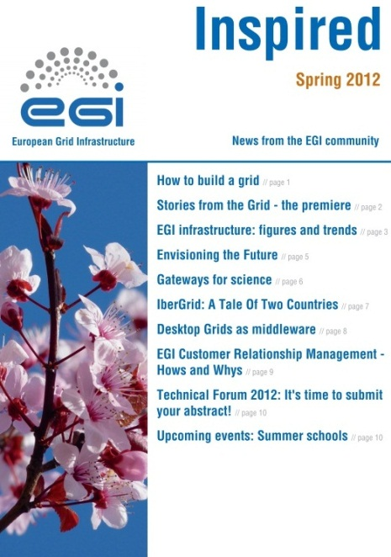
EGI channels
Website
Wiki
Newsletters
Blog
Letters
Social media
Posters
Brochures
Book of abstracts

Slide 16
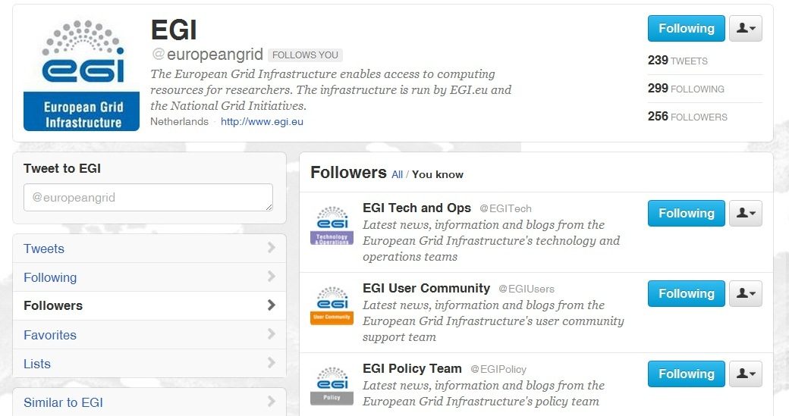
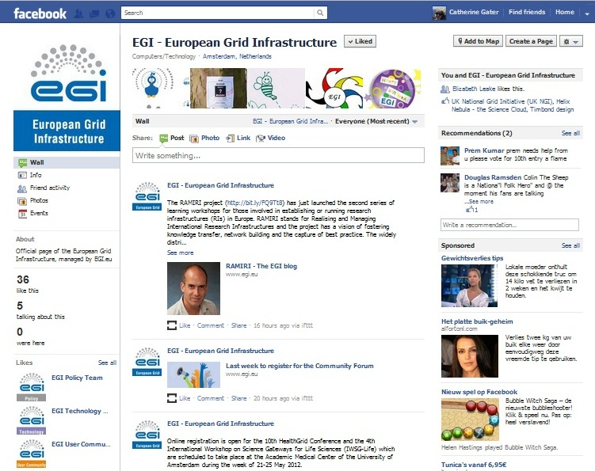
Website and social media
Website relaunched March 2012 for new audiences in collaboration with the website VT
Follow Tech & Ops, User Community, Policy and News social media feeds
Google+, LinkedIn, YouTube, managed by dashboard

Slide 17
Web and media stats
Over 100,000 unique visitors and more than 1 million page views
People who follow EGI have 750,000 followers
People who ‘like’ EGI have 18,000 friends
Tracking impact through social media tools eg Klout, Twiangulate, SocialMention, Topsy.com etc

Slide 18
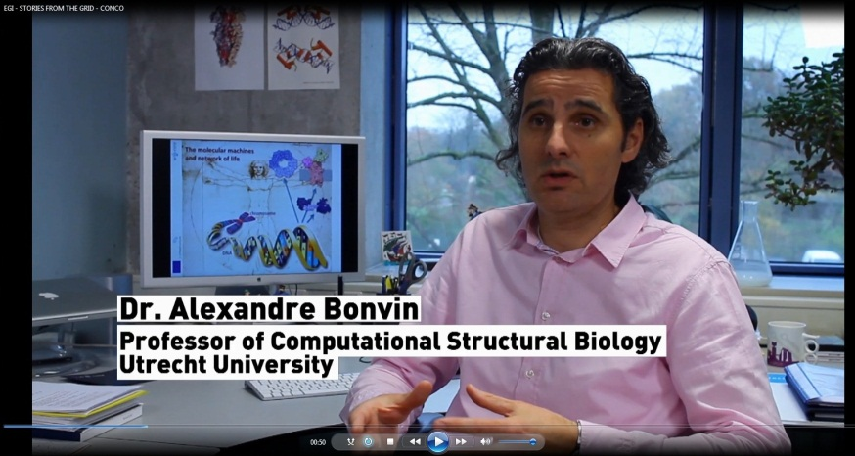
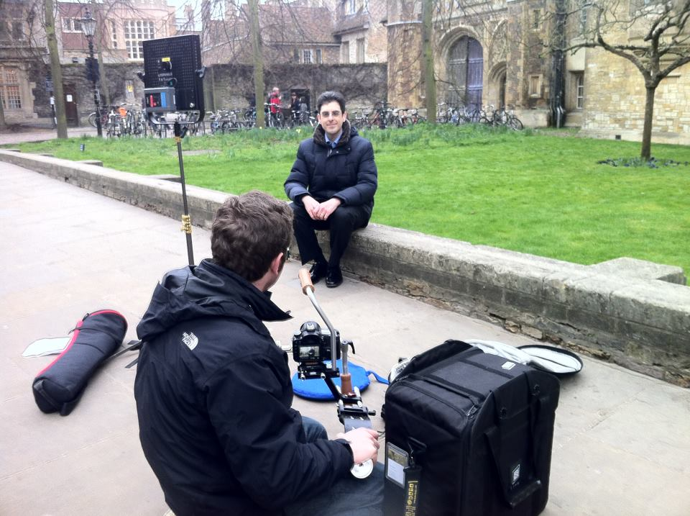
“Stories from the grid”
New series of YouTube videos launched: “Stories from the Grid”
Videos on WeNMR, Lost Sounds Orchestra, Top Quark grid research - 5600+ views
More case studies on the website at http://www.egi.eu/case-studies/

Slide 19
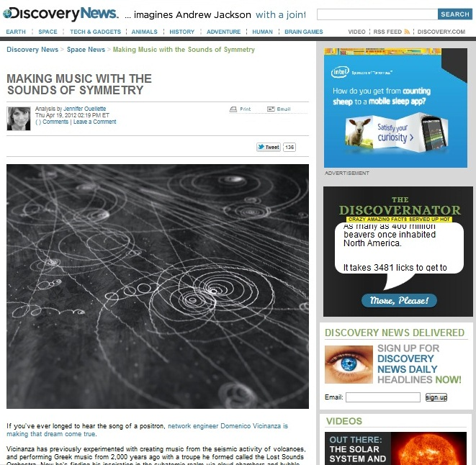
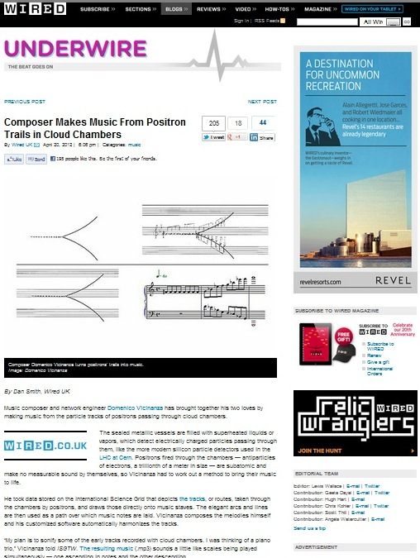
Press & media outreach
4 central press releases
38 clippings
114 blog posts
Published success stories in International Science Grid This Week, The Parliament, Public Service Review: European Union and Science & Technology, PanEuropeanNetworks, HPCwire, HPCintheCloud, Datanami, HostingTecNews
Clippings in Wired and Discovery News

Slide 20
Outreach at events

Slide 21
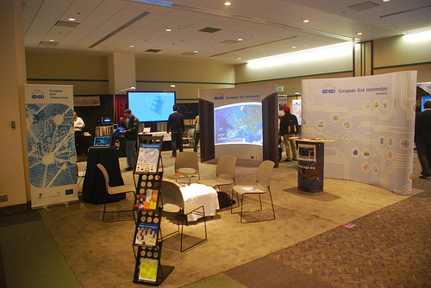
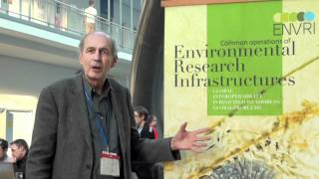
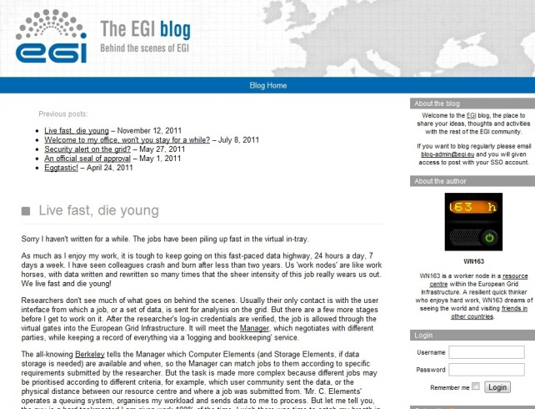
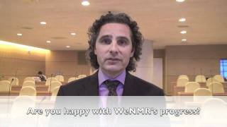
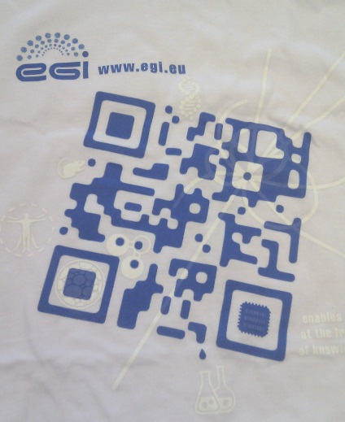
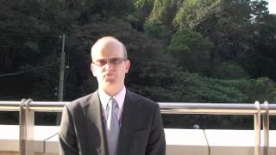
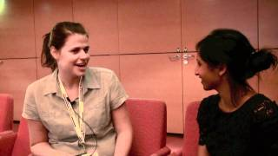
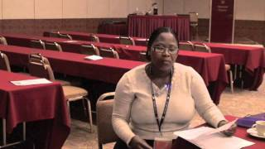
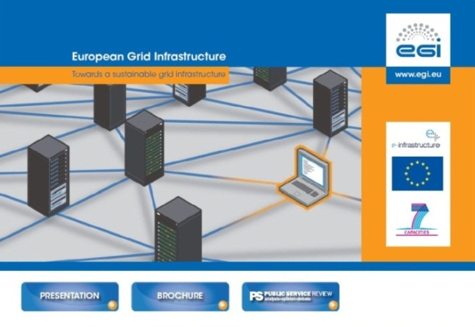
Events-based campaigns
GridCast channel (200K views)
T-shirt / ‘Easter egg’ page
(400 T-shirts distributed)
Mascot competition
(9000 Facebook votes)
SciTech Europe - booth, booklet, masterclass, DVD (distributed to 140K)

Slide 22
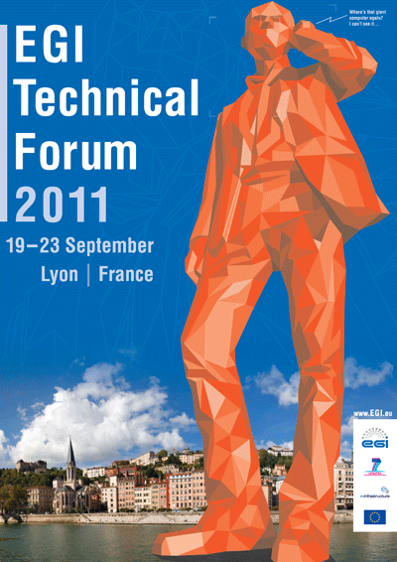
EGI Technical Forum 2011
Held in Lyon, France, 19-23 September 2011, with the French NGI and CC-IN2P3 computing centre
Theme: adoption of a federated virtualised infrastructure for European researchers
Co-located with 9th e-Infrastructure Concertation Meeting, OGF31, IEEE Grid2011, the 1st French Grid Day and the 1st GlobusEUROPE event
655 participants registered for the forum, making it the best attended EGI event
The sessions included 132 contributions.
The Technical Forum website (http://tf2012.egi.eu) received almost 4,000 unique visitors, with about 35,000 page views
The #tf2011 tag was mentioned in 250 Twitter posts; photographs uploaded to Flickr; 27 blog posts, 9 videos

Slide 23
EGI Community Forum 2012
Held in Munich, Germany, from 26-30 March, co-organised with the Munich Network Management
The event showcased the services, technologies and tools available to new and existing scientific communities
Held in conjunction with the 2nd EMI Technical Conference and co-located with the 2nd Annual European Globus Community Forum
518 registered for the event that featured 171 contributions
The Community Forum website (http://cf2012.egi.eu) was read by about 3,200 unique visitors, with about 20,000 page views.
The #cf2012 tag was mentioned in 403 Twitter posts; 221 photographs uploaded to Flickr; iPhone & android free apps downloaded by 154 users, 31 blog posts, 14 videos

Slide 24
Impact of events outreach
Event | Participants | Contributions | Speakers | Session convenors
EGI Technical Forum 2010 | 611 | 288 | 168 | 53
EGI User Forum 2011 | 427 | 196 | 173 | 34
EGI Technical Forum 2011 | 655 | 132 | 296 | 34
EGI Community Forum 2012 | 518 | 171 | 208 | 44
EGITF2011: 114 responses
EGICF2012: 122 responses

Slide 25
Scientific papers
High impact papers are generated by work done using the grid
Frisoni, G. B. et al. Nat. Rev. Neurol. 7 (429-438) 2011; doi:10.1038/nrneurol.2011.99
News Feature: High-energy physics: Down the petabyte highway 19 January 2011 | Nature 469, 282-283 (2011) | doi:10.1038/469282a
A. Rosato et al. Blind testing of routine, fully automated determination of protein structures from NMR data. Structure 20, 227-236 (2012). doi:10.1016/j.str.2012.01.002
Papers published by the project collaboration are collected through the quarterly reports – 85 reported in PY2
65 full papers published in Proceedings of Science (PoS) as a result of the Community Forum (plus a Book of Abstracts which has an ISBN)
VOs may be asked to provide details of papers generated by users as a condition for resource allocation
VT on gathering scientific papers from NGIs being set up
Case studies harvested from all these sources

Slide 26
Plans for next year

Slide 27
Research communities
Why?
Rely on an engaged and broadly satisfied user community
Success?
How many people investigate using grid as a tool in their research, as well as use it
Indirect indicators of success - wider range of user communities participating in events or promoting EGI at their local events
How?
EGI will “go to the user” at community events
Essay or Science Blog Competition for PhD students and early-career scientists
Case studies e.g. brochures, downloads, articles, blog posts and videos
Promote and communicate benefits, new features and improvements for existing users
Promote easy-to-use tools, portals, workflows and services suitable for non-expert users
Collaborate with VRC projects such as ENVRI, WeNMR, CLARIN, DARIAH through MoUs to publicise grid tools and services to their user communities.
VT on materials for EGI Champions and NGI outreach teams
Barriers / experiences?
EGI should engage the researcher on their terms, using their existing workflows and working practices

Slide 28
Media and general public
Why?
Improve EGI’s visibility within the scientific community and with policy makers
Informs the public about the benefits of grid through case studies relevant to them
Success?
More discussions and mentions of the research done on the grid outside EGI channels
How?
Judicious release of press releases
Building up relationships with individual journalists e.g. HPCinthecloud
Essay competition advertised to journalists
Commission relevant work e.g. infographics by people and social influencers who are watched by the media
Joint press releases or social media postings together with media friendly institutions e.g. CERN
Barriers / experiences?
Frequent, low impact press releases are generally not effective in targeting journalists
Biggest successes in marketing quirky visual stories directly to the general press
Targeting trade journals through media partnerships at EGI events

Slide 29
Projects & policy makers
Why?
Policy makers hold the key to future funding and decide on strategic priorities
Keeps our work on their agenda and engaged beyond the hype attached to new technologies
Success?
Open, two-way communications channels to policy makers
How?
High-level, high production value brochures and materials featuring EGI strategy and goals eg Annual Report
Opinion papers in high circulation publications e.g. Digital Agenda blog, Public Service Review and PanEuropean Networks, the e-IRG newsletter
High profile attendance at policy-related events e.g. eChallenges, SciTech Europe, European Parliament events, EC consultation events
Barriers / experience?
Publications in high circulation policy related journals have generated interest within the EC
Led to invitations to participate in consultation and high level strategy meetings e.g. ICRI

Slide 30
NGIs and EIROs
Why?
EGI’s key stakeholders and source of funding, strategy and resources
Success?
Participation in EGI events remains steady or increases
NGIs continue to provide case studies, news items, newsletter features
NGIs participate actively in Virtual Teams
NGIs continue to be keen to be promoted by EGI through its central channels
NGIs continue to request EGI materials for distribution at their events and to policy makers
How?
Provide international visibility for national bodies e.g. website, blogs, social media, press
Ask for and listen to suggestions for materials, resources e.g. the EGI compendium
Report successes e.g. through the newsletter, website and newsfeed
Build a community forum for sharing successes e.g. the Inspired newsletter, social media
Support local dissemination efforts e.g. provide materials, produce brochures in local languages
Barriers / experiences?
Building personal relationships with NGI staff e.g. NILs
Listening and responding to ideas and suggestions from the NGIs and EIROs

Slide 31
PY3 Plans - Summary
LEADERSHIP
EGI will “go to the user” at community events eg eChallenges, Lisbon, October 2012
Collaborate with VRC projects
VT on materials for EGI Champions and NGI outreach teams
Judicious release of press releases
High-level, high production value brochures and materials featuring EGI strategy and goals eg Annual Report
Opinion papers in high circulation publications e.g. Digital Agenda blog, Public Service Review and PanEuropean Networks, the e-IRG newsletter
INNOVATION
Essay or Science Blog Competition for PhD students and early-career scientists
Social media and events based campaigns
OPENNESS
Case studies e.g. brochures, downloads, articles, blog posts and videos
Promote and communicate benefits, new features and improvements for existing users
Promote easy-to-use tools, portals, workflows and services suitable for non-expert users
Building up relationships with individual journalists e.g. HPCinthecloud

Slide 32
PY2 Summary (1)
LEADERSHIP
Communicated EGI’s activity within the project and worldwide.
Developed the EGI branding and content for the project and event websites.
Produced monthly Director’s Letters, 4 issues of EGI Inspired
NILs contributed events, websites, materials, publications, papers, translations, press releases and outreach to policy makers.
INNOVATION
Produced a range of general and community focused brochures and posters eg policy, earth sciences, health sciences
EGI website has received over 100,000 unique visitors and over 1 million page views.
Website relaunched on 26 March 2012 for new audiences with increased functionality.
Social media and events based campaigns eg Easter egg, mascot competition, new social media feeds, videos

Slide 33
PY2 Summary (2)
OPENNESS
Attended a range of international events, including eChallenges in Florence, SciTech in Brussels, International Symposium on Grid and Clouds in Taipei, SuperComputing11 in the US, European Geophysics Union in Vienna and International Supercomputing in Hamburg.
Hosted booths at the EGI’s events, including the Technical and Community Forums, and ran outreach campaigns that included printed materials, press releases, social media feeds and blogs.
Published success stories in iSGTW, The Parliament, European Union and Science & Technology, PanEuropeanNetworks, HPCwire, HPCintheCloud, Datanami, HostingTecNews, clippings in Wired and Discovery News

Slide 34
NA2.2 – Extra material

Slide 35
Grid Use Cases
These case studies show some of the advantages of using the grid:
allows world-wide multi-disciplinary collaboration;
integrate distributed resources into a single whole;
customised grid services to meet the unique demands of researchers;
reliable service for computation, data transfer and storage of large data sets;
reduced analysis time and analysis on-demand;
scientifically useful results are generated more quickly;
long term support;
sharing sensitive data securely among a trusted community;
allows member institutions to contribute computing power to the community;
generate data-intensive stimulations in a shorter amount of time;
reduce technical workload (by following grid standards), so scientists can concentrate more effort on the science

Slide 36
Use Case: Large Hadron Collider
World’s largest particle accelerator
Supports 8,000 researchers
1 billion CPU hours in the last 12 months
15Pb of data created annually

Slide 37
Use Case: Large Hadron Collider
Some advantages of using the grid:
allows worldwide mass collaboration with thousands of physicists;
customised grid services to meet the unique demands of the experiments;
large data storage facility;
physicists can access the data using their own computer locally.

Slide 38
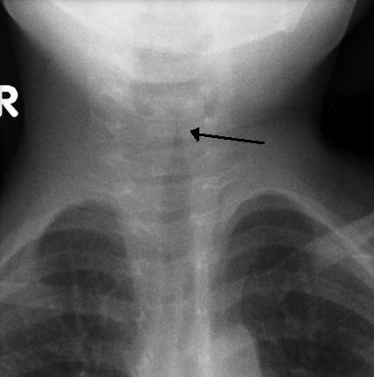
Use Case: New viruses
VIDISCA-454, new method to find new viruses from genetic material
Runs on grid computing thanks to customised workflows, allowing researchers to save time.
E.g. a test with 1444 samples produced 4,783,684 genetic sequences and was analysed in 14 hours. (Local server would need 17 days)
The method was used to identify a new type of coronavirus
Results published in Nature Medicine
Many children suffer from respiratory diseases caused by unknown viruses
http://go.egi.eu/virus

Slide 39
Use Case: The epigonion
The epigonion was the guitar of Ancient Greece – how did it sound?
Domenico Vincinanza recreated the sound of its 48 strings as digital files, using the grid-enabled ASTRA platform
It took him just a few hours - in a single core he would need a month.
The epigonion’s sounds can now be downloaded and played by any musician using a simple keyboard.
Stories from the Grid, episode 2
The Epigonion (video)
http://go.egi.eu/epigonion

Slide 40
Use Case: ITER
Investigating viability of fusion as a power source
Modelling and simulating the reactor
Used 1 million CPU hours in the last 12 months

Slide 41
Use Case: ITER
Some advantages of using the grid:
perform the intensive computations needed to test the feasibility of fusion power before building the reactor;
open to future development: dedicated project ‘EUPHORIA’ was set up to further push the limits of existing state-of-the-art computing resources.

Slide 42
Use Case: DECIDE
Diagnostic Enhancement of Confidence by an International Distributed Environment
Diagnostic tools for the medical community
Example: Their Statistical Parametric Mapping application can help doctors to diagnose Alzheimer’s disease in its early stages and track the progress of the symptoms over time

Slide 43
Use Case: DECIDE
Some advantages of using the grid:
a single European-wide master database of images stored on the grid for doctors to use;
can set up diagnostic tools with a dedicated grid infrastructure;
customisable: dedicated software to track progression of the disease over time;
sharing medical data securely.

Slide 44
Use Case: Earthquakes
Earthquakes are caused by seismic waves that propagate as ripples on a pond
By studying how seismic waves travel it’s possible to predict how a site will respond to an earthquake
The Finite-Difference (FD) method simulates wave propagation by solving differential equations
But building one accurate model means solving millions of equations!
Grid computing allows scientists to solve the equations in parallel, saving time and resources.
The concept was applied in Thessaloniki, Greece.
The model helps local authorities to prepare the regional response to earthquakes
Earthquakes are not predictable, but their effects can be mitigated by modelling and planning
http://go.egi.eu/thess

Slide 45
Use Case: CTA
The Cherenkov Telescope Array
Future ground-based high energy gamma-ray instrument
132 institutes in 25 countries
Using applications and grid technology provided by the European grid

Slide 46
Use Case: CTA
Some advantages of using the grid:
allows member institutions to contribute computing power to the CTA community;
generate data-intensive stimulations in a shorter amount of time;
reduce technical workload (by following grid standards), so scientists can concentrate more effort on the science.

