Slide 1
NA2.5 – Technical Outreach to New Communities
Gergely Sipos
Technical Outreach Manager EGI.eu

Slide 2
Outline
Objectives, partners
Technical/Community services
Applications Database
Training Marketplace
Client Relationship Management system
Technical outreach
Sotware and use case areas, collaborations
Related Virtual Teams
Plans for PY3

Slide 3
Objectives
Europen level coordination and support to enable research communities to evolve into routine EGI users:
Integrating applications to the platforms
Developing and deploying new services
Support for training and consultancy
Identifying resources
Support the development and deployment of innovative, collaborative VREs
Knowing and driving technical activities
Knowing and responding to technical needs

Slide 4
TNA2.5 Partners
EGI.eu ‘Technical Outreach to New Communities’ team (3 FTE)
Providers of technical services (1.95 FTE)
Applications Database
IASA (Greece 0.98 FTE)
Training Marketplace
STFC (UK 0.47 FTE)
VO Services → Client Relationship Management system (from PM19)
CSIC (Spain 0.25 FTE) & LIP (Portugal 0.25 FTE)
NGI International Liaisons - NILs
Members of related Virtual Teams

Slide 5
Technical/Community services
To facilitate information exchange among
NGI support and outreach teams
Community-specific support teams
Project-specific support teams
User communities and individual users
EGI.eu staff
Main areas in PY2:
Integrating community features
Expanding the use of web gadgets
http://go.egi.eu/gadgets
Rescoping work according to DoW updates

Slide 6
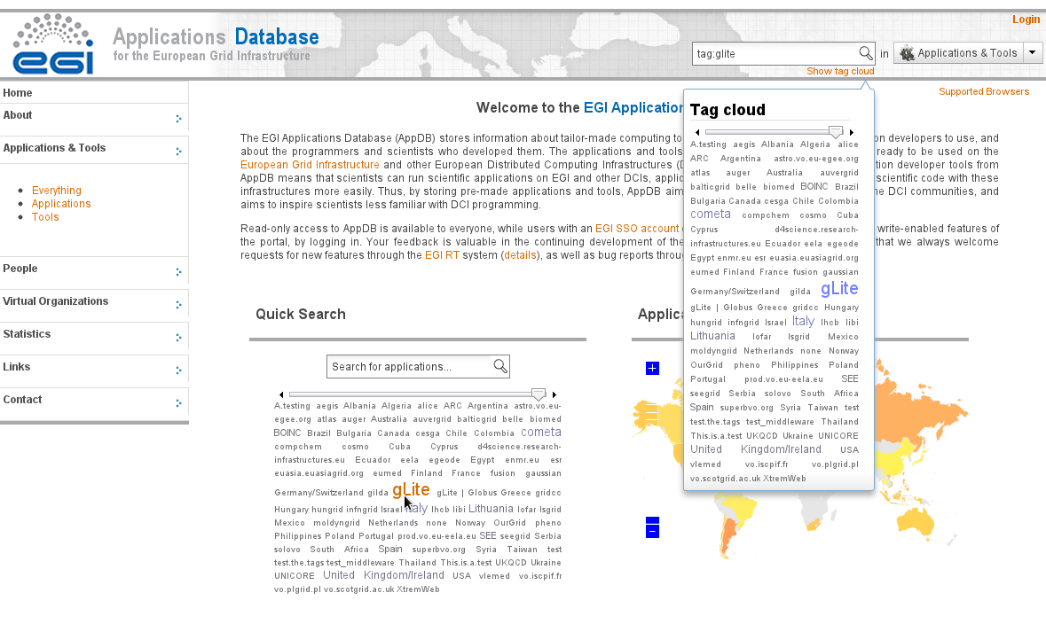
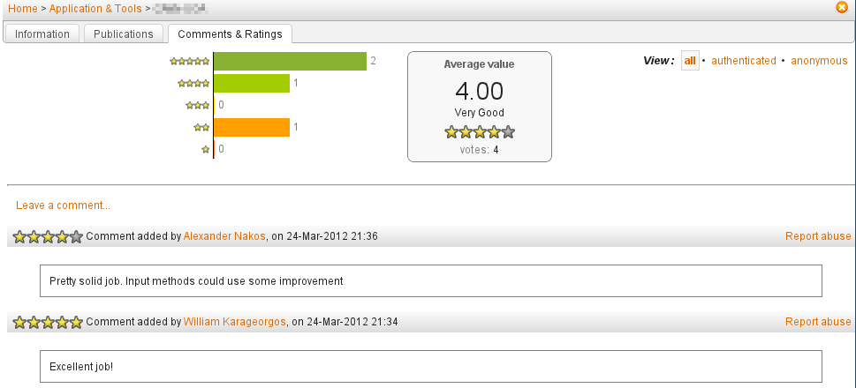
Community Services 1: Applications Database
Purpose:
Recognition to community applications, SW tools and their developers
New features in PY2:
Community features
E.g. Tagging, Commenting, Rating
Content maintenance
E.g. Broken link detection
Architecture & compatibility
E.g. Cross browser compatibility
http://go.egi.eu/applications

Slide 7
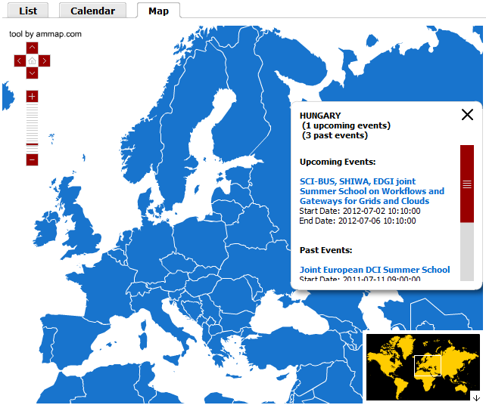
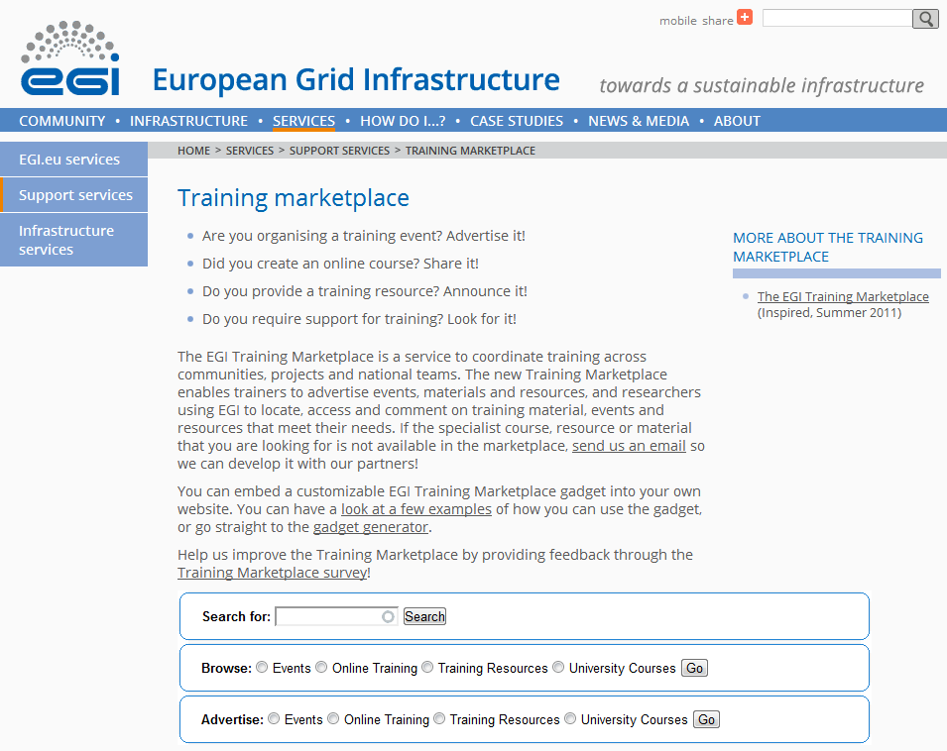
Community Services 2: Training Marketplace
Purpose:
Recognition to training related activites and resources
New features in PY2:
New ‘object’ types
Resources (e.g. VO, CA, Portal, ...)
University courses
Training needs → Already removed
Community features
E.g. Web gadgets, Commenting
Architecture
Separate provider (STFC) and content manager (EGI.eu) roles
http://go.egi.eu/training

Slide 8
Community Services 3: Client Relationship Management system
Ibergrid team refocused in PM19 (VO Services → SA1)
Chose and setup a CRM system
Configured the EGI CRM to the community’s needs
See related VT - https://wiki.egi.eu/wiki/VT_Intelligence_Collection
Provide the CRM for outreach teams since the end of March
Manual and access (with NILs): http://crm.egi.eu
EGI CRM – main capabilities (based on vTiger CRM):
Register projects/communities
Register personal leads
Register details about ‘Potential for EGI use’ and ‘Interest in e-infrastructures’

Slide 9
EGI CRM: Data structure and use cases
Summarise key findings about clusters of projects
Register projects and communities
Projects (ESFRI & non-ESFRI; National & International)
Summarise key findings about each project
Register institutes
Institutes (universities, research labs, etc.)
Register people
People (researchers, developers, etc.)
Interview people & register key findings

Slide 10
EGI CRM: Data structure and use cases
Summarise key findings about clusters of projects
Register projects and communities
Projects (ESFRI & non-ESFRI; National & International)
Done from ESFRI and EC websites (by EGI.eu)
~56 projects ~600 institutes
Expected to be able to identify in PY3
Summarise key findings about each project
Register institutes
Institutes (universities, research labs, etc.)
Started for ESFRI projects (by NGIs and EGI.eu)
Register people
People (researchers, developers, etc.)
Interview people & register key findings

Slide 11
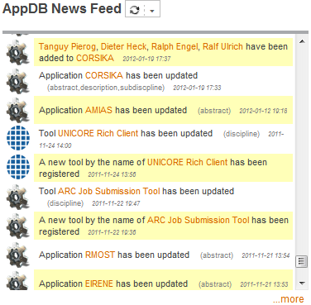
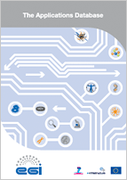
Uptake of Applications Database
Absolute use:
40 new applications (366 in total)
18 new tools (54 in total)
41 new persons (669 in total)
9 known gadget instances
Visitor statistics:
Growing number of visits:
3568 → 4888 → 6998 (in PQ6-PQ7-PQ8) /Piwik/
Growing percentage of returning visits
Stabilised bounce rate
Longer visits (both new and returns)
Brochures, blog posts, presentations...
Looking for synergies with external services
E.g. EMI ScienceSoft initiative

Slide 12
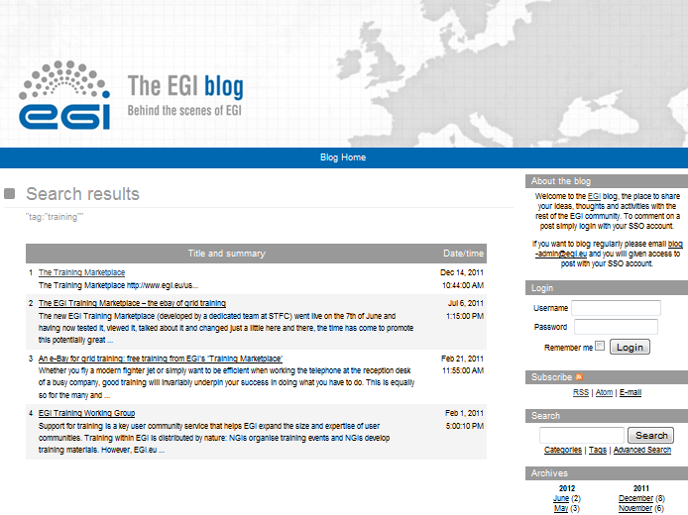
Uptake of Training Marketplace
Absolute use:
149 training days delivered
4 resources
9 online training
6 known gadget instances
Visitor statistics:
No quarterly trend (263→312→197→232)
Google Analytics does not see gadgets
Activities in PY3 to increase use:
Training & outreach materials
Webinar
Bookmark, blog posts, presentations
Gadget concept: uptake by SA3-GRelC & by SHIWA project

Slide 13
Community services Use of resources
 |  | Project Year 1 |  |  | Project Year 2 |  |  | Project Year 1 and 2
Service | Partner | Worked PM Funded | Committed PM | Achieved PM % | Worked PM Funded | Committed PM | Achieved PM % | Worked PM Funded | Committed PM | Achieved PM %
Applications Database | IASA | 14.6 | 11.8 | 124% | 8.4 | 11.8 | 71% | 23.0 | 23.6 | 97%
Training Marketplace | STFC | 5.6 | 5.8 | 107% | 3.9 | 3.6 | 107% | 9.5 | 9.4 | 107%
CRM | CSIC+LIP | 7.6 | 6.0 | 127% | 9.1 | 6.1 | 149% | 16.7 | 12.1 | 138%
Over reporting for CSIC and LIP
Overhead of service setups (PY1 – VO Services, PY2 – CRM)
Service maintenance will need less effort in PY3 & PY4

Slide 14
Technical outreach: VRE support
Catalogues of existing solutions
http://go.egi.eu/sciencegateways (36)
http://go.egi.eu/workflows (23)
Topical community workshops under EGI forums & NGI events
Leads from EGI.eu Community Outreach team
Topics from Requirement Tracker
Emerging themes:
Domain specific application clusters
Data management; data federation
Federated identity management
Monitoring community/user specific services
Partnerships with key partners and projects to provide services in EGI
Community specific Virtual Research Environment
Service access (Science gateways - portal/desktop/mobile)
EGI compatible science gateways & technologies
Service integration (workflows, pipelines)
EGI compatible workflows & workflow systems
Domain services (Applications & data)
EGI-NGI-domain solutions
Off-the-shelf and custom VM images
Scientific applications and algorithms
Data bases and repositories

Slide 15
Technical outreach: Virtual Teams
https://wiki.egi.eu/wiki/Virtual_Team_Projects
Completed:
Intelligence Collection & Analysis Process
Defined use cases and characteristics for CRM
ESFRI Contact list
Gathered and entered ESFRI project & partner details into CRM
Active:
MPI within EGI
Assessing the adoption of federated identity providers
Science gateway primer
GPGPU requirements (General-Purpose computation on Graphics Processing Units)
Fire and smoke simulation
Speech processing
Potential
ESFRI demonstrator
Top applications and their user communities
Application porting ‘howto’ guide

Slide 16
Plans for next year
Community services
Promotions – Webinars; training/outreach materials
AppDB: write API to enable service federations & rich gadgets
Training Marketplace: outreach to commercial content providers
Decide about consolidation/integration of related services (e.g. SW repository, VMI marketplace, EMI ScienceSoft initiative)
Technical outreach
Support for the uptake of EGI cloud (SA2)
Custom monitoring of VREs (JRA1, SA1)
VRE development topics (Data management, Identity federation)
Active and emerging VTs
Impactful applications by science domain
Technical collaborations with projects (ESFRI & FP7)

Slide 17
Summary
Technical support for open, innovative, user-centric services:
Technical services
Extended with community features
Use is increasing for AppDB, for the other two this is expected in PY3
Support for VREs
Established software areas & emerging topics
EGI Cloud Infrastructure as a new platform
Partnerships to deliver generic/specialised services
Support for NGI and domain specific community outreach
CRM setup with details about ~56 projects, ~600 institutes
Related active and new VTs

