Slide 1
Migration from unsupported middleware to UMD/EMI SHA-2
Status and plans
Peter Solagna – EGI.eu

Slide 2
Summary
Unsupported MW decommission
Timeline and current status
Next actions
Future plans for EMI-1
SHA-2 and RFC proxies
Current status and future plans

Slide 3
Unsupported middleware
Unsupported gLite products:
ARGUS, BDII, CREAM, LB, dCache, lcg-CE, VOMS, WMS
gLite products supported until 30/11/2012
WN, UI, FTS, GLEXEC, LFC, DPM
Products supported until 30/04/2013
gLite VOBOX, all EMI-1 components

Slide 4
Timeline
Policy decisions
March 2012, OMB agreed to decommission gLite 3.1 components by the end of September
July 2012, OMB agreed to decommission unsupported gLite 3.2 middleware by the end of October
August 2012, >1000 services to be decommissioned
August 2012, EGI PMB enacted a policy to decommission unsupported software within one month after the end of security support, if a replacement is available
August 2012, EGI CSIRT circulated a security advisory to all sites asking to upgrade unsupported middleware by the end of October 2012
NGIs and sites have been warned many times in the following two months
October 2012, sites are being actively monitored and followed up by EGI (COD and CSIRT)

Slide 5
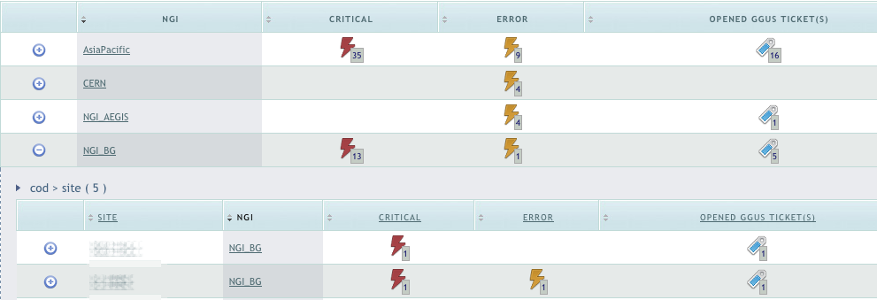
The monitoring process
EGI security dashboard has been extended to raise alarms for unsupported middleware
Tool used by EGI CSIRT and COD
NGIs have access, to check the status of their sites
GGUS tickets are opened by COD
Sites must acknowledge the ticket and provide a timeline for the upgrade or decommission of the services
Total of 261 tickets opened
Every site has max one ticket opened from the security dashboard
Tickets are kept open until there are no more alarms for the site

Slide 6
Issues
Not all the components publish (correctly) the gLite version
Custom probes for CREAM and dCache
Manually opened ticket for VOMS
Quattor based sites need templates for the EMI version of the product
Templates are now available for all the EMI-2 components

Slide 7
Current status
~120 sites deploying unsupported middleware
~200 services involved
~90: Sites planning to upgrade or decommission before the end of November
9: Sites with late plans
Proposing an upgrade timeline beyond middle December
They will be asked to open a downtime for the affected services on Dec 1st
4: Sites with no plans/no answers
These sites will be suspended today by EGI-CSIRT
ROC_Russia: 2
Ru-Troitsk-INR-LCG2
ITEP
NGI_BG: 1
BG01-IPP
NGI_DE: 1
MaiGRID

Slide 8
Sites suspension process
Nov 8, NGIs and VO Managers were warned about unresponsive sites risking suspension
Nov 13, NGIs were asked to open a downtime for the sites risking suspension
Starting today, sites with no timeline for the upgrade will be suspended by EGI CSIRT
Suspension will be validated site by site by EGI CSIRT and COO
To successfully be re-certified sites will need to decommission unsupported services

Slide 9
SHA-2: current status
EUGridPMA agreed in September 2012 the following timeline:
IGTF CAs shall enforce use of SHA-2 *not* before August 1st 2013
After the end of support of EMI-1
EGI asked EMI and IGE to assess for all their components:
Available support for SHA-2 certificates and RFC proxies
Not supporting SHA-2
EMI: StoRM (➔EMI-3), VOMS (➔Nov 2012), CREAM (➔EMI-3), dCache (evaluating CANL),
IGE: GSI-SSHTerm (➔Q2 2013), jGlobus1.x
Not answered, yet: DPM, LB (but it should be ok)
Copy of the documents available in the EGI document DB: Link
Product teams provided the version of the product where the SHA2 and RFC support was available first

Slide 10
SHA-2: future plans
UMD verification will check user authN with SHA-2 certificates and RFC proxies starting from one of the next UMD releases
Products that fail to handle SHA-2 (and RFC) certificates will trigger a warning sent to the developers
EGI is planning to set up Nagios probes to monitor that deployed middleware accepts SHA-2 certificates and RFC proxies
During the first months of 2013

Slide 11
Conclusions
Most of the sites have plans to upgrade to EMI/UMD within the end of the month
Unsupported services in downtime to mark them as ‘at risk’
Currently there are 4 site eligible for suspension
DPM and WN are the next steps
EMI-1 decommission and monitor of SHA-2 support
First half of 2013

Slide 12
Questions?
Acknowledgements
EGI COD team
EGI CSIRT team
Operations portal team
Emir, Paschalis for the security Nagios

