Slide 1
GGUS
First Ops Tools Long Term Sustainability F2F
T. Antoni, E. Buttitta, H. Dres, O. Dulov, G. Grein

Slide 2
Contents
Tool and PT Description
DoW Checkpoint
RT Checkpoint
Effort Evaluation
Future Involvement
Future Evolution

Slide 3
Tool and PT Description
Quick tool overview
GGUS is the central EGI Helpdesk System
PT composition and duties (in terms of partners)
GGUS is developed and maintained at KIT
the central instance and xGUS is run at KIT
Allocated effort
1 FTE for operation (SA1) 25/25/50%
1 FTE for development (JRA1) 25/25/50%

Slide 4
Tool Components
Tool components overview
Main tools components
Database backend
Oracle 10.2.0.4 / MySQL 5.1.52
Logic layer
BMC Action Request System 7.6.04 SP 2
Web front end
Programming language: PHP
Development Environment: PhpStorm
Version Control: SVN

Slide 5
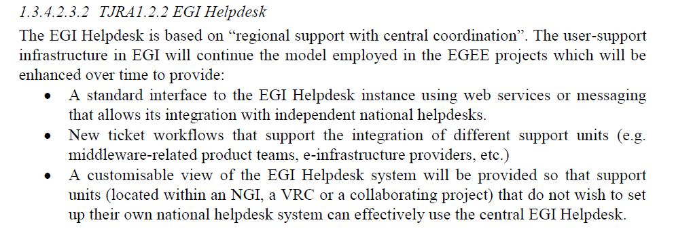
DoW Checkpoint
DoW Checkpoint
Main DoW requirements met

Slide 6
DoW Checkpoint
DoW Checkpoint
Main Dow requirements under development
Fine tuning of xGUS, Techology Helpdesk
Main DoW requirements that can be met by the end of the project
All
Main DoW requirements that probably won’t be met by the end of the project
None

Slide 7
RT Checkpoint
RT/Shopping List Checkpoint
Main RT requirements met
Report Generator (Prototype)
Main RT requirements under development
Report Generator (Production)
DB Abstraction layer
Consolidation of Support Units
Restructuring of TPM
On-going revision of usability
System high availability (ARS splitting, Interfaces)

Slide 8
RT Checkpoint
RT Checkpoint
Main RT requirements that can be met by the end of the project
All so far
Main RT requirements that need discussion
Security workflow for CSIRT
PRACE/EUDAT interface
Main RT requirements that probably won’t be met by the end of the project
None so far

Slide 9
Effort
Effort Evaluation and Splitting
Development vs Maintenance effort
DB: around 50%/50%
Logic layer: around 50%/50%
Web front end: around 50%/50%
Real effort tends more towards 2.5 FTE that the funded 2 FTE

Slide 10
Future Involvement
Involvement after EGI-InSPIRE
Is current PT interested in continuing developing/maintaining the tool after EGI-InSPIRE? (provided that a funding mechanism will guarantee a certain amount of effort available)
Yes, for the complete tool set (GGUS, xGUS)
If you have an estimation of the effort considered minimal to continue the development/maintenance please report it
See above

Slide 11
Future Evolution
Evolution after EGI-InSPIRE
How would you like to evolve the tool?
Vision for the tool
“People who have visions should go see a doctor!” (Helmut Schmidt, former German Chancellor)
GGUS as integration platform between UCs, DCIs, TPs
Describe any major changes that you consider advisable for the tool in order to improve usability, availability, sustainability
Technology changes
None foreseen
Components removal/addition
None foreseen

