Slide 1
Project Year Three and the future
Catherine Gater
e-ScienceTalk Project Coordinator, EGI.eu
www.e-sciencetalk.eu

Slide 2
Content
Impact and sustainability
Activities for PY3
DoW changes
Long term sustainability
Summary

Slide 3
Impact and sustainability
www.e-sciencetalk.eu

Slide 4
Impact and sustainability
Assessed the impact of each product during PY2
Estimated what is needed in terms of effort and/or funds to maintain the product beyond e-ScienceTalk
Exploring how this might be achieved

Slide 5
e-ScienceBriefings
Impact
People are aware of the Briefings at meetings
7200 downloads, 500 hits per Briefing plus social media shares
Distribution of future issues, and especially of yearly reports, should target policymakers more directly
Sustainability
In order to develop future issues of the e-ScienceBriefings, time and effort would have to be funded (3 weeks for content curation, 1-2 days design)
Sponsor would need to have over-arching policy aims e.g. e-IRG
Notes:
*Currently e-IRG features a summarised version of the Briefing

Slide 6
GridCast
Impact
Communicate impact back to stakeholders eg Star Bloggers, top articles
Creates a self-perpetuating cycle of information sharing
‘Long tail’ of interest after the event
Sustainability
Some funded effort needed for moderation and recruitment of bloggers
Videos are a major draw and again need funded effort
Could be funded through media partnerships and ESFRI cluster collaborations on a per event and per project basis

Slide 7
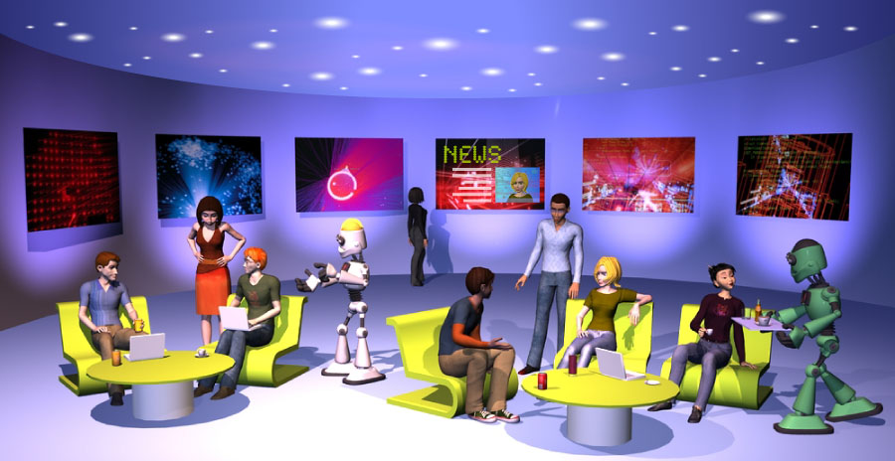
e-ScienceCity
GridCafé

Slide 8
GridCafé
Impact
9 minutes
~5000 backlinks
73% responders said the website was useful or very useful
16 out of 19 people found what they were looking for on the site

Slide 9
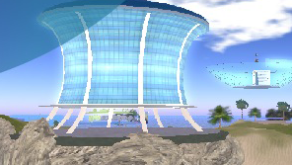
e-ScienceCity
CloudLounge Volunteer Garage
HPC Tower

Slide 10
e-ScienceCity
Sustainability
What is the main barrier to impact?
Improve discovery via pro-active marketing of GridCafé and e-ScienceCity
Have we demonstrated value?
Success drivers/ attributes for potential funders (high quality content, Open Access/ShareAlike, cross-disciplinary appeal)
Next year: assess both usability and value of sites as an information resource e.g. measure change in knowledge pre- and post-test visit for sites
Interest from partners in developing new sections e.g. data
Explore Google AdSense as a funding model

Slide 11
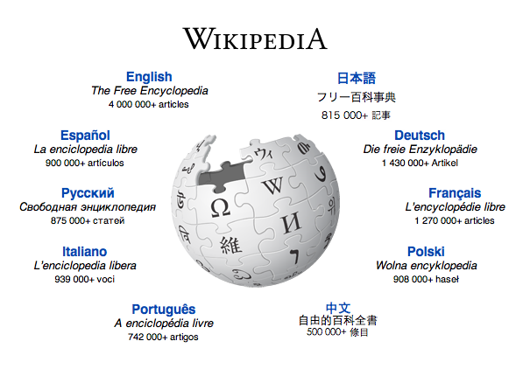
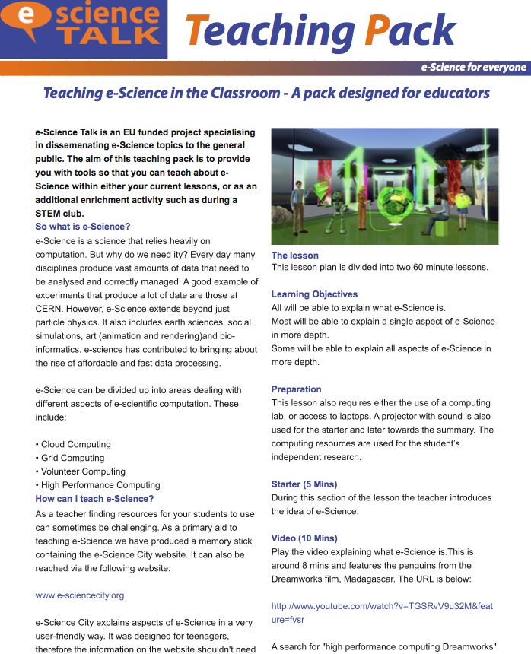
e-ScienceCity
Sustainability: PY3 Marketing
Marketing plan: wikipedia, social media, iSGTW, internal linking, schools pack, conferences, videos
Notes:
INSERT JAMES Marketing plan

Slide 12
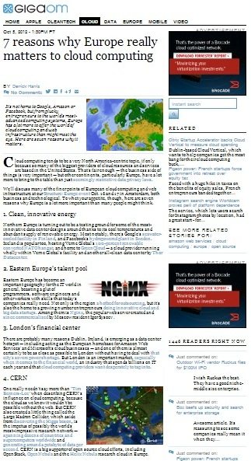
GridGuide and RTM
Impact
GridGuide
Now 66 sites on GridGuide
Visits are from Spain, France, UK, US and Switzerland.
Top referrers are e-ScienceTalk websites
Real Time Monitor
At 10 meetings with almost 12,000 attendees.
Visitors from UK, the US, and France.
Top five users are based in Italy, UK, Germany, France and Spain.

Slide 13
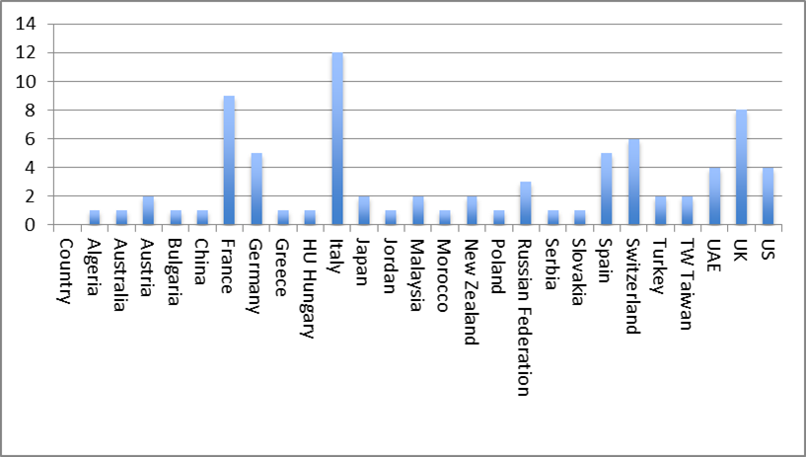
GridGuide and RTM
Significance
Who uses the Real Time Monitor?
IP analysis of top 100 users
What do people use it for?
Outreach, educational and demonstration purposes over a wide geographical spread.
All users (7) were positive/ and suggested lots of extra information they would like to add.
The RTM was “something we've looked at and been impressed by” (Science Museum, London)

Slide 14
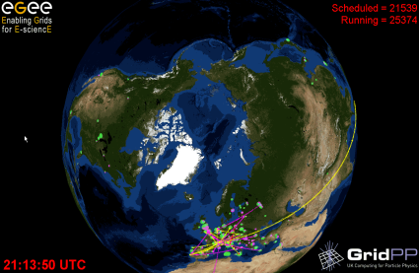
GridGuide and RTM
Sustainability
GridGuide
Low response to our campaign to increase the content on existing guides
Investigate incorporating GridGuide into the e-ScienceCity
RTM
One of our most popular products
Users are interested in developing the RTM
RTM can not be maintained using best effort or volunteer effort

Slide 15
iSGTW
Impact
Greater % referrals from social media and higher numbers of page views
Facebook referrals have increased by 300% and Twitter referrals have increased thirteen-fold

Slide 16
iSGTW
Sustainability
ISGTW continues to nurture a network of unfunded contributors from a wide range of projects in all its contributing regions.
One of the unique selling points is our independent voice in support of all areas of science and e-science.
Position iSGTW as the preferred channel for the research community and major e-infrastructures in Europe (e.g. ESFRI, PRACE etc.) and through media partnerships (ISC Cloud Conference 2012)
Indiana University has secured NSF funds for an iSGTW US editor for 5 years.
Funding also secured for ASGC for an Asia Pacific regional editor.
Funding is needed from the EU side for a dedicated editor role.

Slide 17
Sustainability
e-ScienceBriefings
Will not be produced after the e-ScienceTalk project has ended unless we can find a suitable project or partner to continue their publication. Could potentially be uploaded and monitored in an archived repository.
GridCafé and e-Science City
GridCafé is a long-lasting and sustainable product, having been launched in 2004.
Maintenance of the website in terms of updating content is expected to be relatively low after the e-ScienceCity is completed.
Seeking to build reciprocal and lasting relationships with supporting organisations, which could eventually lead to sponsorship or co-sponsorship.
Create plain static versions of the websites that do not use databases/scripts. Can be stored indefinitely by a project partner so that the resource remains online in an archive.

Slide 18
Sustainability
GridCast
GridCast was originally produced by CERN and therefore has already been shown to be sustainable.
Voluntary blogging by people outside the e-ScienceTalk project is building an online community of regular contributors.
Moderator needed to ensure content is up-to-date, relevant and appropriate to the users and to recruit bloggers.
Funded effort needed to continue video contributions.
GridGuide and Real Time Monitor
GridGuide audience not as well defined as the other e-ScienceTalk products.
Bring GridGuide into e-ScienceCity to make it more sustainable.
The RTM has previously received development funding from GridPP, the UK’s grid for physics.

Slide 19
Sustainability
iSGTW
iSGTW has built up many loyal subscribers over the years.
e-ScienceTalk will continue to explore media sponsorship and in-kind support from collaborating projects.
Due to its partnership with the Indiana University in the US, iSGTW cannot currently accept advertising revenues.
Covering more commercial topics could risk alienating the audience we have built so far.
Positioning iSGTW as the preferred channel for the research community and major e-infrastructures in Europe and beyond eg ESFRI clusters, ISC’12, XSEDE’12
Contributions of editorial effort from other institutions around the world, including in the Asia-Pacific region and US.
iSGTW continues to nurture a network of unfunded contributors from a wide range of projects.
Secure ongoing support for the website hosting and CMS maintenance.

Slide 20
Activities for PY3
WP1: Policy, Impact and Sustainability
Four more e-ScienceBriefings – next ones on TechnologyTransfer and Big Data.
Final printed compendium of all briefings.
Form closer ties with communications offices for European government digital projects by disseminating materials.
Integrate feedback collection into e-ScienceTalk products e.g. e-ScienceCity, GridGuide.
Attend policy events eg e-IRG meetings, eChallenges, Cloudscape V, PRACE, CRISP.
10th e-Infrastructure Concertation meeting.

Slide 21
Activities for PY3
WP2: GridCafe, GridGuide and GridCast
Final areas of e-ScienceCity - next is HPC Tower, Data Garden, Communications, News, People.
GridCasts from events such as SC12, ISGC2013, EGI Community Forum 2013, CRISP, EUDAT.
Integrate GridGuide into the e-ScienceCity.
RTM new sites and data transfers for PhEDEx data.
Build content in the 3D pilot site in NewWorldGrid and work with Virtus World on sustainability.

Slide 22
Activities for PY3
WP3: iSGTW
New editor for Asia Pacific region.
New editor for US at Indiana University.
Collaboration with PRACE and XSEDE.
Increase user interactivity with the site eg events, announcements.
Expand outreach through social media and to new types of reader.
Increase subscribers through media partnerships for events with new user communities.
Shape editorial policy and review the name.
Secure ongoing support for the website and CMS.

Slide 23
Activities for PY3
WP4: Management
MoUs with ESFRI support projects and others eg ENVRI, BioMedBridges, DASISH.
International collaborations eg ISGC2013.
Control travel and other costs.
Advance the sustainability plan for the e-ScienceTalk products.
Prepare for Horizon2020 calls.

Slide 24
DoW budget changes
Estimated underspent budget: 36k
Move estimated underspent budget to central budget for:
management travels
final e-Concertation meeting (6-7 March 2013)
Finalise costings for support of the iSGTW website to the end of the project
Legal protection of e-ScienceTalk products beyond the end of the project
Move MS3 from PM26 to PM31
Explore a possible short no-cost extension to the project beyond May 2013

Slide 25
Beyond e-ScienceTalk??
WP1: Policy and impact
Current: 1.6 FTE QMUL
In-kind after 2013: not currently foreseen
WP2: GridCafe, GridGuide and RTM
Current: 1 FTE APO, 0.5 FTE Imperial
In-kind after 2013: 0.1 - 0.2 FTE Imperial
APO hosting costs for websites
WP3: iSGTW
Current: 2 FTE CERN
In-kind after 2013: 1 fellow CERN editorial <1FTE, QMUL 0.1 FTE CMS and hosting.
WP4: Management
Current: 0.5 FTE EGI.eu
In-kind after 2013: 0.1 FTE to keep consortium together and coordinate project proposals.
In kind resources proposed on the assumption that the Commission foresees funding for these activities in Horizon2020.
E-ScienceTalk consortium is an ideal vehicle to provide communication channels for the e-Infrastructure projects, going into Horizon2020.
Support may lapse if not partnered by the Commission or focus may move away from the EC projects.
The reviewers further suggest that
the consortium explores a possible future role in providing a dissemination platform and services for e.g. eInfrastructure and other EU-funded projects. This approach could provide long-term sustainability for eScienceTalk products while assuring a useful and needed service.

Slide 26
Summary
Good impact in PY2 for the e-ScienceTalk products.
Tracking of cross promotion between products and events based statistics started in PY2 and will continue in PY3.
Close monitoring of impact to continue in PY3.
Sustainability activities ongoing to continue products beyond e-ScienceTalk.
Plans for PY3 on track.
Small modifications to the budget to cover e-Concertation costs, legal searches and website maintenance.
Establish e-ScienceTalk as an ongoing platform for promotion of e-Infrastructures by providing additional services.
Prepare for Horizon2020 calls.

