Slide 1
E-ScienceTalk PMB
E-ScienceTalk PMB Meeting 9
8 October 2012
Telcon

Slide 2
Open actions
ACTION | DESCRIPTION | RESPONSIBLE | DATE | STATUS
20110127:2 | Establish a plan for working with the Digital Library | Catherine Gater |  | Support for DL will end in May 2012, EC to be informed at review. CLOSED
20110511:5 | Contact EUDAT and ESFRI cluster projects via PMB contacts | Catherine / PMB | Next PMB | CRISP signed July 2012. Meeting with ENVRI, BioMedBridges and DASISH at EUDAT OPEN
20111018:1 | Allocate checking the trademarking and copyright actions to a member of staff. | Bob Jones | Next PMB | Check carried out. Actions for RTM and e-ScienceCity. CLOSED
20111018:3 | Send an MoU template or letter of intent to NewWorldGrid via APO. | Catherine Gater | Next PMB | MoU signed with Virtus in July 2012 CLOSED
20120612:1 | Propose an action plan for the GridGuide for approval by the PMB before the PY2 review | Catherine Gater | Next PMB | Slide prepared for PMB. CLOSED
20120612:2 | Investigate submitting a proposal to the Science in Society call in July | Catherine Gater | Next PMB | No suitable call. CLOSED

Slide 3
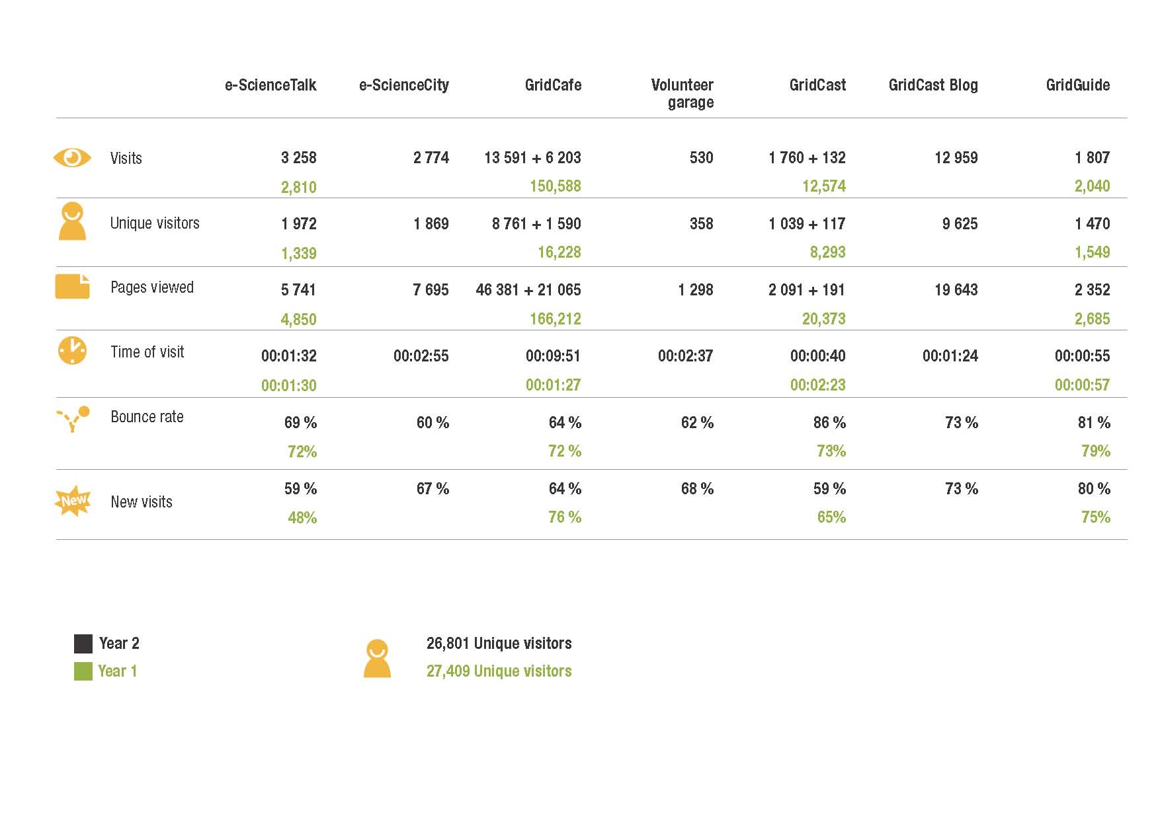
Web stats WP2 PY2
Unique page views and visitors over the last quarter

Slide 4
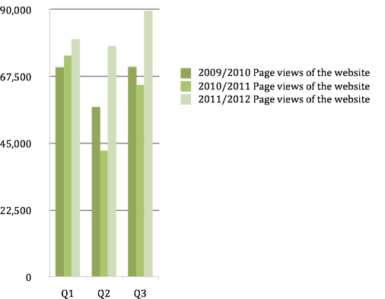
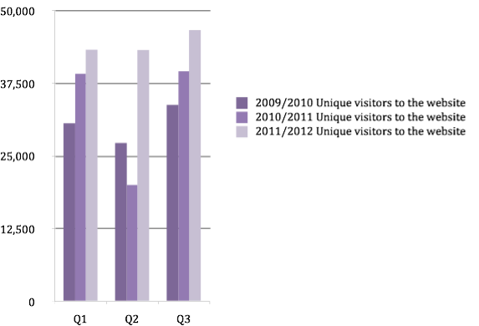
Web stats iSGTW

Slide 5
WP1: Grid policy outreach
Progress
James Cook joined as an intern at QMUL in July-August, worked on marketing and materials
Full paper accepted for eChallenges, 17-19 October, presentation on 17th
Gridcasts held at EGI Technical Forum, Prague (September), GISELA-CHAIN Workshop, Mexico, XSEDE’12
Briefing on Technology Transfer issued at the end of September
Next Briefing on Big Data for the end of December
MoUs signed with CRISP and Virtus

Slide 6
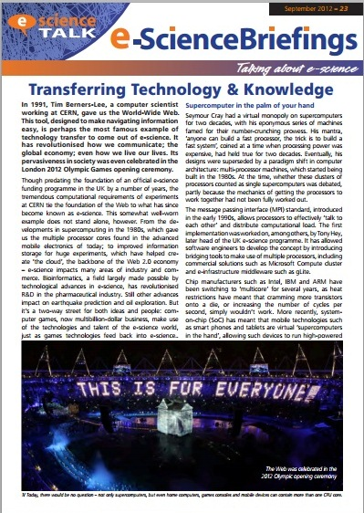
WP1: Grid policy outreach
Next steps
Briefings every 2 months in the final year
Compendium planned for the end of PY3
10th e-concertation meeting on 6/7 March at The Hotel – budget issue
Future topic ideas for briefings
International dimension of grids
eGovernment
Impact indicators - eNVENTORY
Digital Agenda for Europe / Horizon 2020
eInfrastructure governance
Exascale/future computing
Costs of cloud, e-infrastructure

Slide 7
WP2: GridCafé, GridCast, GridGuide
Progress
e-ScienceTalk
Tracking downloads and shares of e-ScienceBriefings
e-ScienceCity / GridCafé
HPC Tower, Cloud Lounge and Volunteer Computing areas all live – adding news feeds
Communications area including multimedia, image bank, news, People bay area live soon
Some graphics still needed to be able to push the site properly – driven by the 3D version
Moved to individual URLs for each area, now indexed by Google
Good traffic to and from the Virtual World area
GridCast
GridCasts held at EGI TF 2012 Prague and GISELA-CHAIN.
GridGuide / RTM
Working on organising the panels more intuitively ie gLite, PANDA, GEANT
New graphics ready for the data transfers panel
Now tracking heavy users of RTM – have approached them for feedback
Possibility that RTM will be added to a Science Museum exhibit on the LHC
Digital Library
Support for this ended May 2012
Will be presented at the review to the EC

Slide 8
WP2: GridCafé, GridCast, GridGuide
Next steps
e-ScienceCity
New areas in order: networking and data garden
Need to trademark e-ScienceCity and e-ScienceIsland – URLs all purchased
Marketing plan: wikipedia, social media, iSGTW, internal linking, schools pack, conferences, videos
GridCafé
Need a handover date for the old and new versions of GridCafe– site must be functionally complete to do this so can be done once common areas complete
Cannot redirect to an external site from a CERN URL any more – dead links
GridCast
Need to have a presence at events outside the usual community to increase the audience and advertise products such as iSGTW.
Next events are eChallenges, EUDAT conference, SC12, CRISP 2nd conference, ISGC’13, EGI CF13
Have lost access to CERN GridCast page – trying to set this up with CERN
GridGuide / RTM
All new sites now included in RTM
New beta version with Phedex data to be demo-ed at the review

Slide 9
Plan for GridGuide
Next steps
Indexed/tagged content could be displayed through a map interface – similar to the EGI trainers and events map interface at http://www.egi.eu/user-support/ngi_support/
Explore adding a mapping function to e-ScienceCity
Integration with RTM – include links to all 64 RTM sites in the GridGuide
Add any missing XSEDE, PRACE sites to bring total up to 75
Shrink sites to skeletons with links back to original websites
Remove all out of date content
Redirect www.gridguide.org to new pages in e-ScienceCity

Slide 10
WP3: iSGTW
Progress
Miriam Boon left on 15 June, Vivian Chang left on 1 June
EU Editor Andrew Purcell started at CERN on 1 August
Recruitment underway with Indiana University starting in November 2012
ASGC still committed to providing an Asia-Pacific editor, covering with existing staff for now
CG met with Maria Ramalha at ISC’12 PRACE workshop - new comms officer has started but not looking to get involved in the short term
Subscriptions hovering around 8200 but decrease due to defunct addresses doesn’t seem to have impacted so far
Continued good impact of social media policy – Twitter followers and Facebook fans continuing to increase, retweets by large accounts eg CERN, NatureNews is driving spikes of traffic to the website
iSGTW site and email now at QMUL – no major problems so far
Exploring also providing CMS support as a separate contract
Next iSGTW Advisory Board on 14 November at SC’12, with Indiana reps
Agreed 3rd party funds for website maintenance – 8K identified but no invoice from Xenomedia yet

Slide 11
WP3: iSGTW
Next steps / Issues
Freelancers identified for short term shortage, and possible on going support – but little billed so far
New name issue is still outstanding – to be reconsidered when the new US and EU editors are on board
Need to increase subscriber numbers as well as social media numbers – have crept up a bit
Ongoing funding is an issue

Slide 12
WP4: Management
Progress
Review is on 15 October, Brussels
One more e-Concertation meeting in March 2013, Brussels – insufficient budget and delegates cannot be charged
Weekly meetings continuing with the project team
Travel: CG will attend SC12 to meet with Tabor, the ISC’12 organisers and the iSGTW Advisory Board; iSGTW travel planned to end of project
Activities being implemented with CRISP – reports on website and social media delivered, video underway, media training dates being identified at DESY and ESRF.
SAGrid and REUNA agreements need to be pursued, as well as DiscovertheCosmos, BioMedBridges, DCH-RP, DASISH and ENVRI.
Leading a joint dissemination meeting at EUDAT conference with CRISP, BioMedBridges, ENVRI and DASISH. Media training for 20 delegates
Year 2 amendment session submitted and accepted

Slide 13
Project issues
WP1-WP4
GridCast and GridCafe access issues at CERN
Lack of sites for GridGuide – end of project milestone a concern
Funding for iSGTW – editorial effort and web support
iSGTW subscriber numbers may not reach the milestone, especially with the removal of the defunct email addresses
New name for iSGTW and development costs – no funds available
High travel costs for all WPs – funding for 2 people for CRISP meetings
Protection of current and future e-ScienceTalk product names
Non reporting of effort by partners for Quarterly Reports and at year end

Slide 14
Deliverables and milestones tracking
Months | 22 (Jun) | 23 (Jul) | 24 (Aug) | 25 (Sep | 26 (Oct) | 27 (Nov) | 28 (Dec) | 29 (Jan) | 30 (Feb) | 31 (Mar) | 32 (Apr) | 33 (May)
WP1 Policy
T1.1 Policy |  | D1.2.8 |  | D1.2.9 |  |  | D1.2.10 |  | D1.2.11 |  | D1.2.12 | D1.6
T1.2 Impact |  | D1.4 |  |  |  |  |  |  |  | D1.5
T1.3 Events |  |  |  |  | MS3 |  |  |  |  | MS3
WP2 GridCafé
T2.1 GridCafé |  |  |  |  |  |  |  |  |  |  |  | D2.5
T2.2 GridGuide |  | D2.3 |  |  |  |  |  |  |  |  | D2.4 | MS6
T2.3 GridCast | MS4 |  |  |  | MS4 |  |  | MS4 |  |  | MS4
WP3 iSGTW
T3.1 Weekly |  |  | D3.5 |  |  |  |  |  |  |  | D3.6 | MS9
T3.2 New media |  | MS7 |  |  |  | MS7 |  |  |  | MS7 |  | D3.7
WP4 Mgmt
T4.1 | MS10 |  | D4.4 MS14 | MS10 |  |  | MS10 |  | MS15 | MS10 | D4.5 | D4.6 MS10
Complete
In preparation
Overdue

Slide 15
Y2 Effort
Overall effort achieved in PY2 in PMs: per work package
Table 5: Overall effort achieved in YEAR2 (view 1)
Workpackage | Total | Project plan | Linear Y2 plan | YEAR 2 % achieved
WP1 | 15.34 | 46 | 16.7 | 92%
WP2 | 20.82 | 64 | 23.3 | 89%
WP3 | 17.68 | 52 | 18.9 | 93%
WP4-M | 5.24 | 17 | 6.2 | 85%
WP2-UNF | 0 | 8 | 2.9 | 0%
WP4-UNF | 0.7 | 5 | 1.8 | 39%
Total | 59.77 | 192.00 | 69.82 | 86%
Table 6: Overall effort achieved in YEAR2 (view 2)
Partner | Total | Year plan | Linear Y2 plan | YEAR 2 % achieved
CERN | 20 | 67 | 24.4 | 82%
APO | 10.64 | 34 | 12.4 | 86%
QMUL | 17.15 | 47 | 17.1 | 100%
IMPERIAL | 6.53 | 26 | 9.5 | 69%
EGI.eu | 5.47 | 18 | 6.5 | 84%
Total | 59.79 | 192.00 | 69.82 | 86%
Under reporting of effort across nearly all partners!
Timesheets must be filled in on time

Slide 16
Y2 Costs

Slide 17
PY2 Expenditure
Overall costs in PY2 in Euros: per partner
Partner | YEAR 2 Form C | YEAR 2 Planned Funding | % use
EGI.eu | 72,115 | 79,924 | 90%
QMUL | 90,955 | 107,778 | 84%
APO | 60,826 | 76,748 | 79%
IMPERIAL | 35,265 | 38,801 | 91%
CERN | 108,621 | 163,611 | 66%
Total | 367,930 | 466,863 | 79%
Under spent against plan for PY2
Costs at 79% against effort at 86%

Slide 18
Remaining Funds PY3
Overall costs in PY3 in Euros: per partner
Partner | TOTAL Funding | PY 3 Remaining | % Remaining
EGI.eu | 219,972 | 81,690 | 37%
QMUL | 296,389 | 141,249 | 48%
APO | 211,058 | 78,345 | 37%
IMPERIAL | 108,831 | 46,074 | 42%
CERN | 463,930 | 105,546 | 23%
Total | 1,300,000 | 452,576 | 35%
Remaining:
PM 25-33
27% of project

Slide 19
Sustainability
CRISP – willing to pay for e-ScienceTalk team services post May 2013 (but will not fund core work)
Support from other ESFRI projects is unclear
Freelancers for iSGTW – ongoing contracts for content on EU side
US funding for the iSGTW editor is potentially for 5 years
No cost extension of e-ScienceTalk – underspending partners?
Horizon2020 – earliest date for call to open is 1 January 2014

Slide 20
DoW changes PY3
Move underspent budget from Imperial to central budget for management travel
Move underspent budget to e-Concertation – 8-10K short
Move MS3 from PM26 to PM31

