Slide 1
WP1: Policy, Impact and
Sustainability
Stefan Janusz
WP1 Leader, QMUL
www.e-sciencetalk.org

Slide 2
Contents
Overview
How WP1 reports on the successes of e-science
Methodologies used to collect feedback and measure impact
Meetings, Gridcast and eConcertation

Slide 3
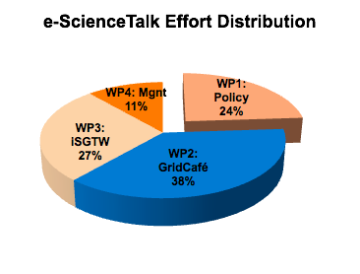
WP1 Overview
3 Beneficiaries
46 PMs
1.6 FTEs
Participant no. | Name | Effort (PM)
2 | QMUL | 28
3 | APO | 5
5 | CERN | 13
1.1 Production and distribution of e-science policy articles and reports
(QMUL and APO)
1.2 Impact and sustainability
(QMUL with CERN and APO))
1.3 Events attendance and media impact event organisation
(QMUL with CERN and APO)
Notes:
1.6 FTE= 1 FTE e-science impact reporter, 0.6 FTE

Slide 4
WP1 Objectives
Produce reports targeting policy makers in government and business
Expand audience and distribution list
Assess the impact of e-ScienceTalk’s products and formulate a sustainability plan
Identify, attend disseminate the outcomes of meetings in order to influence scientists, funders, industry
Assume a key leading and coordinating role in the concertation activities and meetings related to the e-Infrastructure area, maximising media impact.
Notes:
illustrate the scientific results and impacts from grid and cloud computing, e-infrastructures and related technologies.
e.g. the Americas, Australasia, Africa.
Identify and attend a series of events in order to influence policy makers and journalists and to distribute the e-ScienceBriefings.
Assume a key leading and coordinating role in the concertation activities and meetings related to the e-Infrastructure area, maximising media impact.

Slide 5
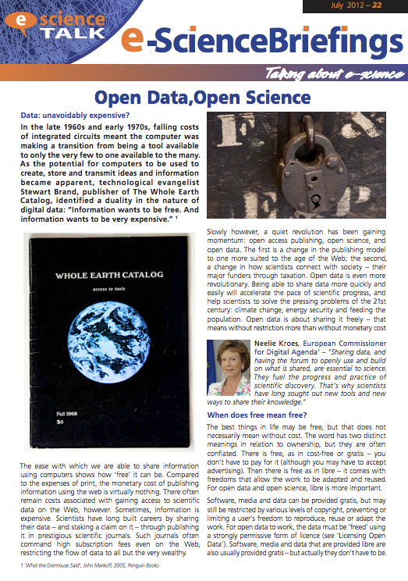
1.1 e-ScienceBriefings
Target policy makers in government and business
Provide overview of relevant projects
Leaders in the field
Read in about 10 minutes;
provide pointers for more in-depth coverage
With WP2–APO

Slide 6
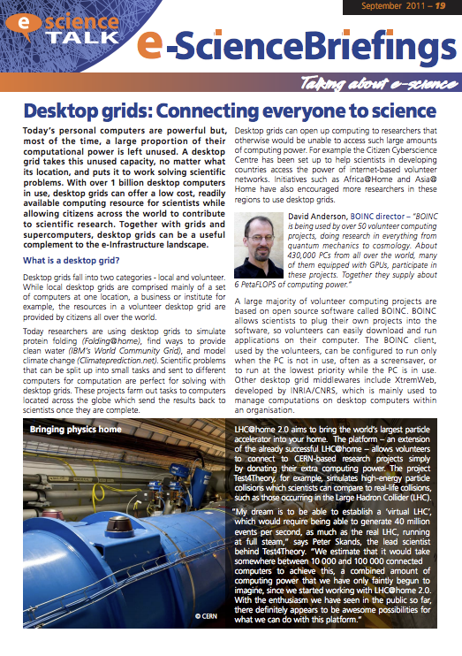
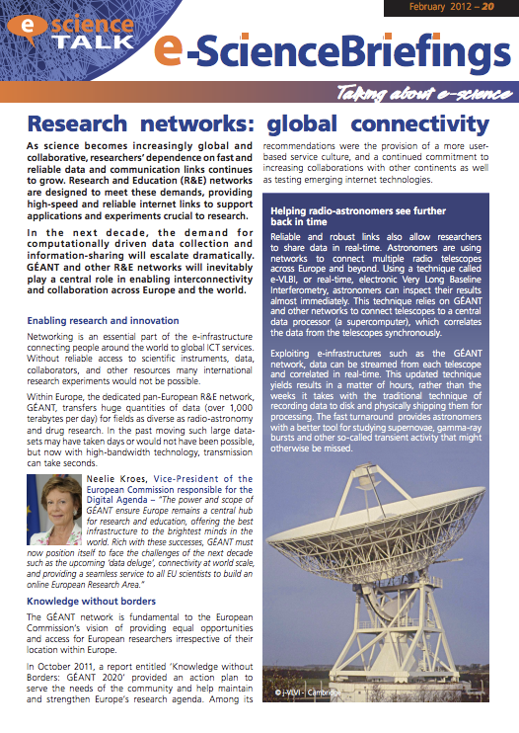
1.1 e-ScienceBriefings
September 2011: Desktop Grids
Volunteer computing through services such as BOINC means that citizen scientists can donate their spare computing cycles for projects requiring large scale effort.
February 2012: Research Networks
Today’s global science project requires substantial investment in e-infrastructrues to allow researchers to transfer data quickly and reliably. The European research network GÉANT is extending its reach beyond Europe to the Americas, Africa and Asia.
With WP2–APO

Slide 7
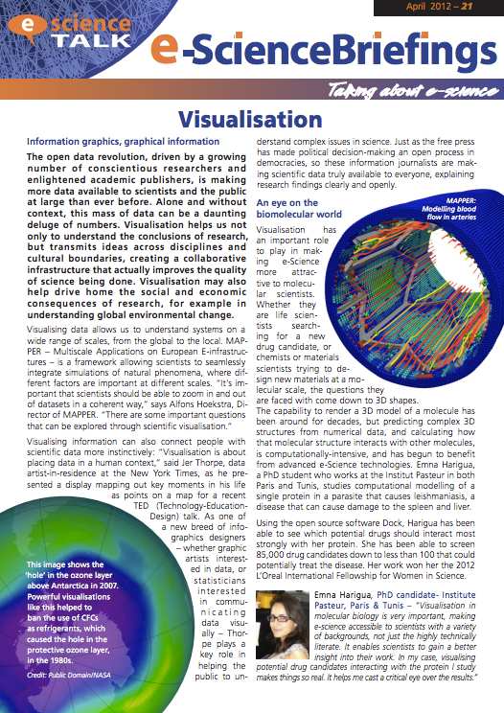
1.1 e-ScienceBriefings
April 2012: Visualisation
Powerful computers can produce graphics that elucidate patterns in complex data, helping scientists see further and across traditional disciplinary boundaries. There is an art to the visual display of quantitative information, making this an ever-evolving area of interest.
July 2012: Open Data, Open Science
Open Access publishing has grown to meet the different market landscape of the Web, but concerted effort is needed to make data sharable and accessible to meet the challenges of the 21st Century
With WP2–APO

Slide 8
1.1 e-ScienceBriefings
Reach
How large is the briefings audience?
Email subscribers: 126
Total number of downloads 7200 times.
AddThis shares (1 like, 26 tweets, 10 Shares, 3 Google+)
v.gd link shortening ~550 views of e-ScienceBriefings
With WP2–APO
Notes:
Need countries breakdown

Slide 9
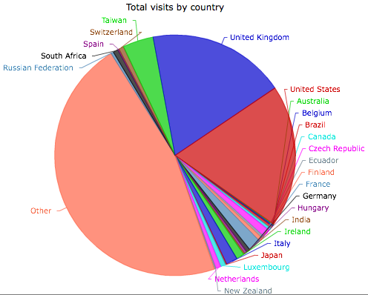
1.1 e-ScienceBriefings
Reach
~500/ issue
25 countries in Europe and beyond
With WP2–APO

Slide 10
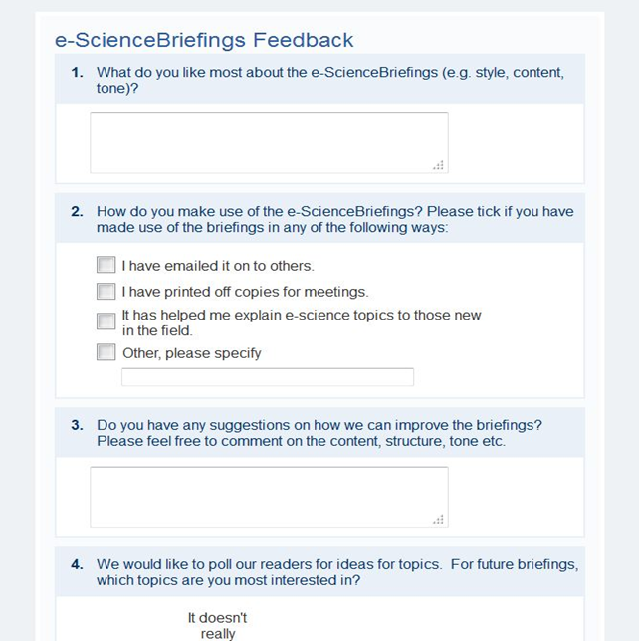
1.1 e-ScienceBriefings
Significance
Helps explain e-science topics to those new to the field.
What do people use e-Science Briefings for?
“I've been told that on a national level these briefings are used as material to show others as a ‘Hey!—Look at this and what they are doing…’ or ‘…what can be done.’”
“It is a beautiful publication. I love that it is printed. It is so important because it is a very graphical snapshot of what’s important today for the hands of legislators and policymakers. I actually stole one to show the National Science Foundation."
“Briefings [are] very interesting and cover the subject areas well”
With WP2–APO

Slide 11
1.1 e-ScienceBriefings
Sustainability
People are aware of the Briefings at meetings
Distribution of future issues, and especially of yearly reports, should target policymakers more directly...send to POST, Office for the Commissioner for Digital Agenda
How might sustainability be achieved?
In order to develop future issues of the e-ScienceBriefings, time and effort would have to be funded (3 weeks for content curation)
Sponsor would need to have over-arching aims e.g. e-IRG
With (2)–APO
Notes:
*Currently e-IRG features a summarised version of the Briefing

Slide 12
1.2 Impact & Sustainability
Feedback: Quality Assurance
Surveys – both web and of conference delegates to gauge e-ScienceTalk’s perceived value
Feedback sessions – focus groups
Acting on feedback from the PMB
iSGTW reader survey
Unsolicited feedback
Impact and sustainability reports
Notes:
EGI User, Technical Forums and e-Infrastructure Concertation meetings, and others as appropriate.
These allow more in-depth discussion of users’ experiences and views.
Ensure that the project is implemented in an efficient, timely and cost effective manner.
Conducted once a year (WP3), solicit readership’s views and how they use iSGTW…used to plan further developments
…inasmuch as possible, provides examples of how people in the community are using e-Science products and whether and to what extent they’re making a difference
produced by WP1 based on the metrics and feedback gathered during both phases of the project. (0.6FTE Collecting Feedback and helping to gauge impact of e-ScienceTalk)

Slide 13
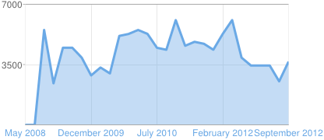
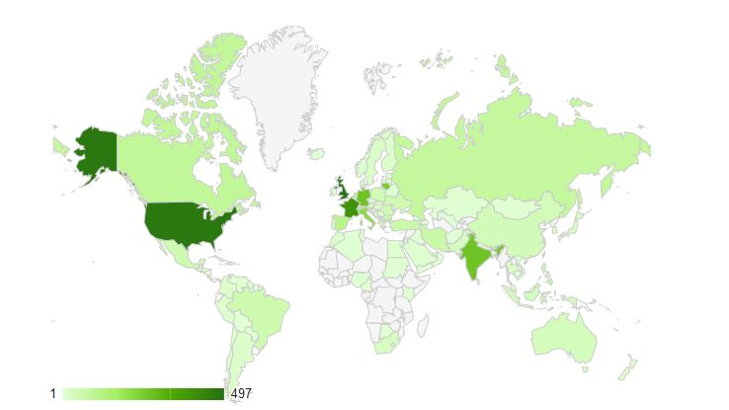
1.2 Impact & Sustainability
IMPACT=REACH+SIGNIFICANCE
“…read an article in iSGTW, and had a new idea for research”
Notes:
Important to collect feedback continually with a range of measures dependent on the product
Reach is a quantifiable metric…how many page views of Gridcast over time, or how RTM users are geographically distributed by country over a year.
Significance is what effect that information has had, whether they find it useful and if there’s a positive outcome.

Slide 14
1.2 Impact & Sustainability
Discrete banner after 30 seconds
Zoomerang

Slide 15
1.2 Impact & Sustainability
Reach: Diversity of Gridcast audience

Slide 16
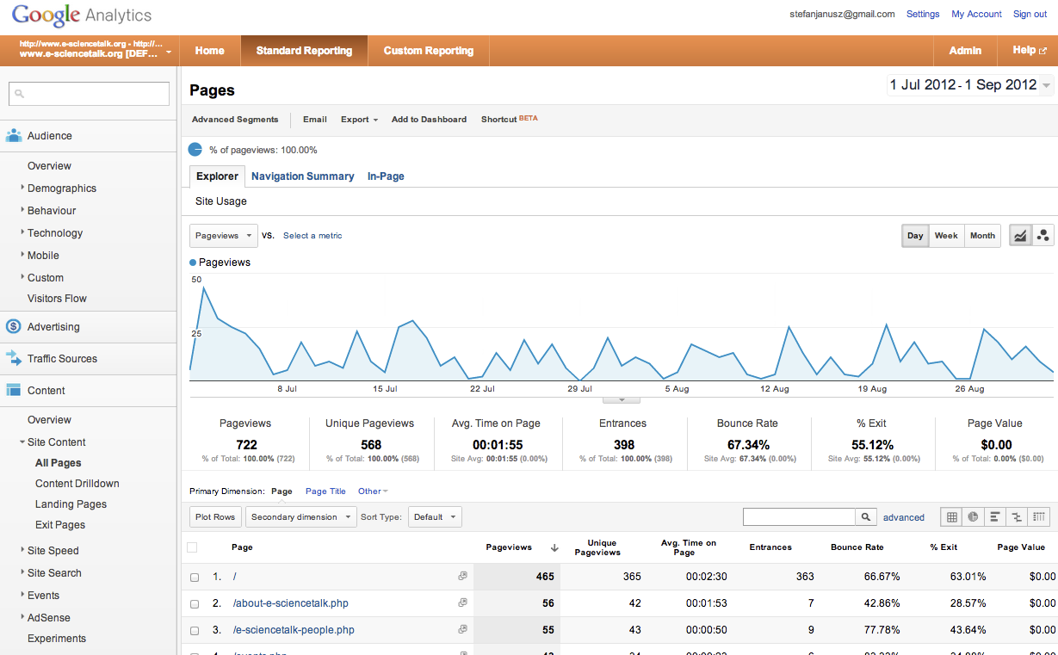
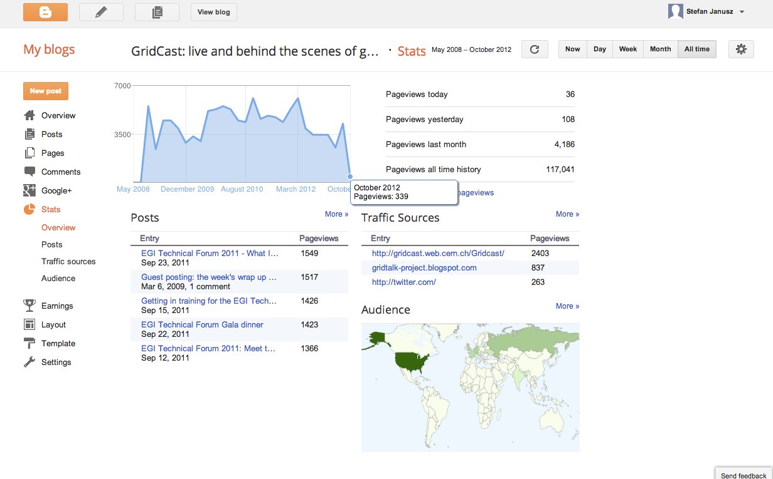
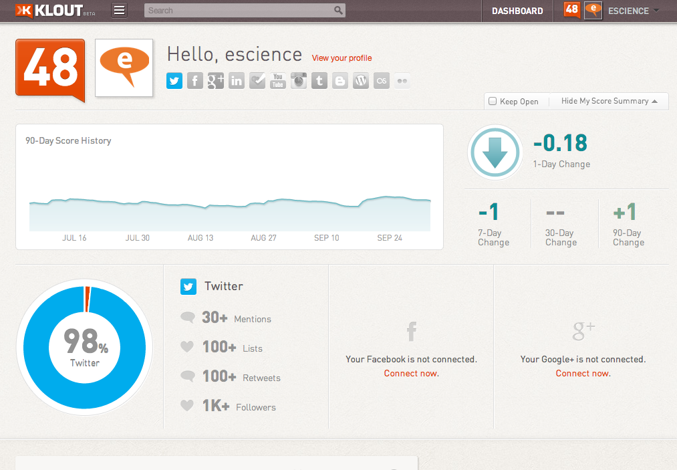
1.2 Impact & Sustainability
Tools
Google Analytics
Blogger Stats
Klout

Slide 17
1.2 Impact & Sustainability
Sustainability
Pass impact back on to stakeholders:
Star Bloggers, top articles
Creates a self-perpetuating cycle of information sharing
Makes the channel sustainable
Notes:
Stakeholders in this case are contributors to the blog

Slide 18
1.2 Sustainability for e-ST

Slide 19
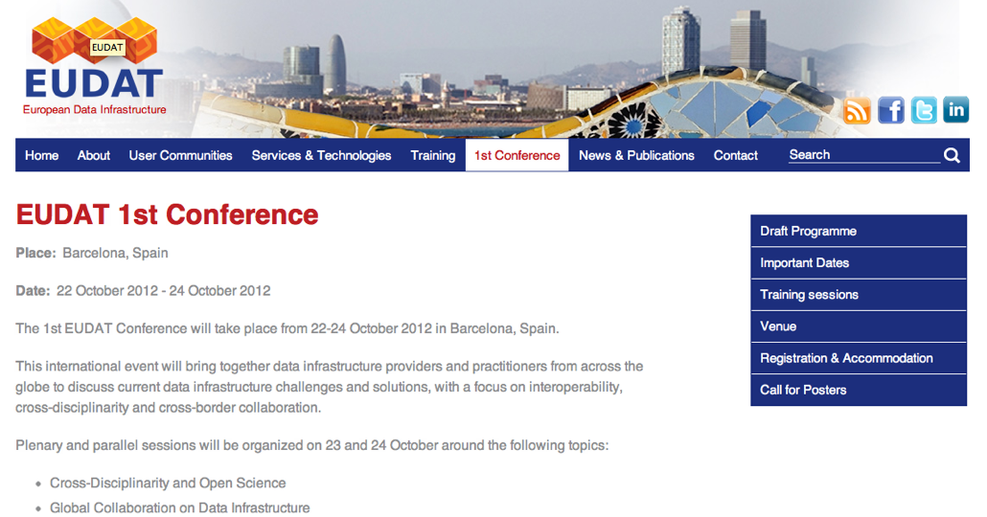
1.2 Sustainability for e-ST
Paper at eChallenges
Training sessions

Slide 20
1.3 Event attendance & Media Impact
EGI Technical Forum 2011, Lyon
e-Concertation 2011, Lyon
eChallenges 2011
Citizen Cyberscience Conference 2012, London
International Supercomputer, Grid and Cloud 2012, Taipei

Slide 21
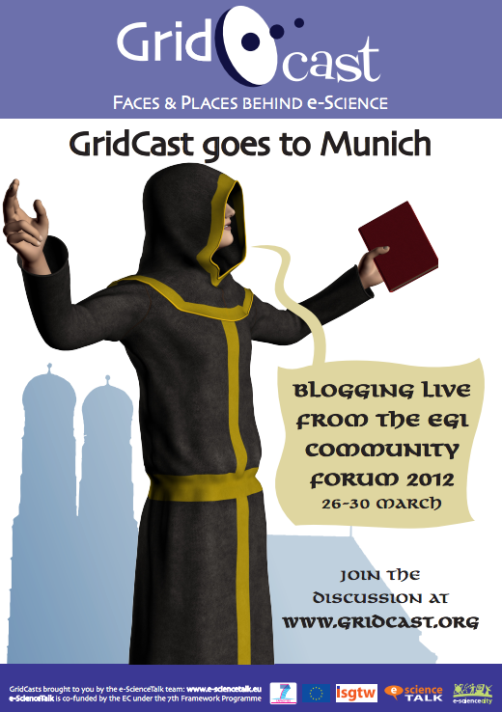
1.3 Event attendance & Media Impact
EGI Community Forum 2012, Munich
ERF Workshop on Socioeconomic impact of research infrastructures, Hamburg
e-IRG workshop, Copenhagen
GISELA-CHAIN, Mexico City
With WP2–APO

Slide 22
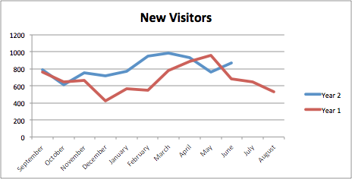
1.3 Event attendance & Media Impact
Reach
Peak events: >6000 views/month
>200 views/day
15–20% new visitors
2’23” visit time
Notes:
181 posts in Y2;

Slide 23
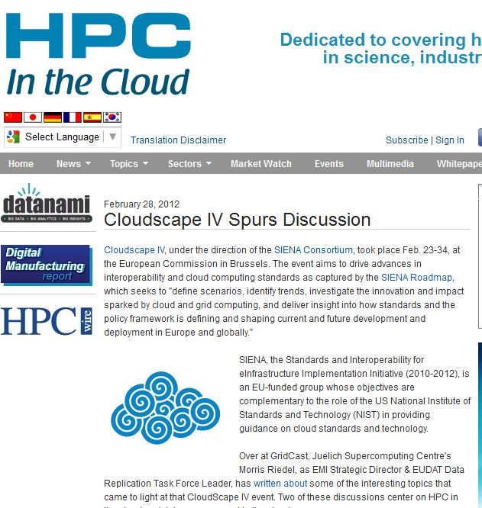
1.3 Event attendance & Media Impact
Significance
With WP2–APO

Slide 24
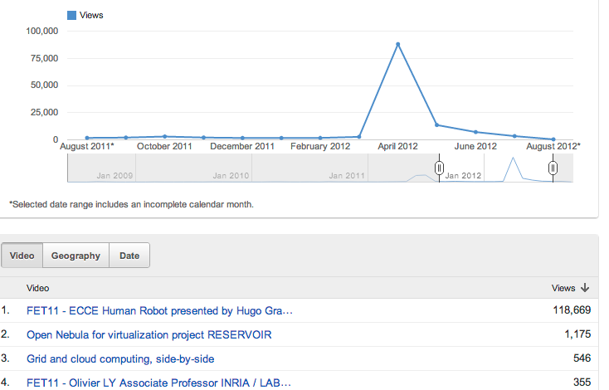
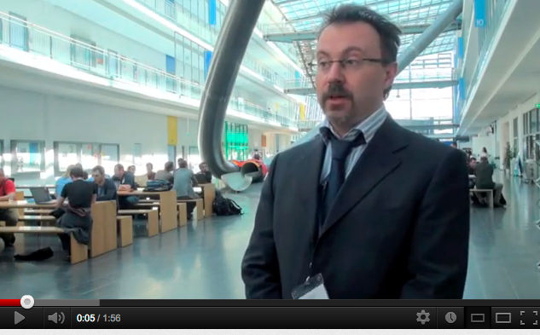
1.3 Event attendance & Media Impact
Significance
With WP2–APO
Notes:
We know that Gridcast is also a primary channel for people to ‘catch up’ on things they missed. Video views typically in the hundreds; could go viral

Slide 25
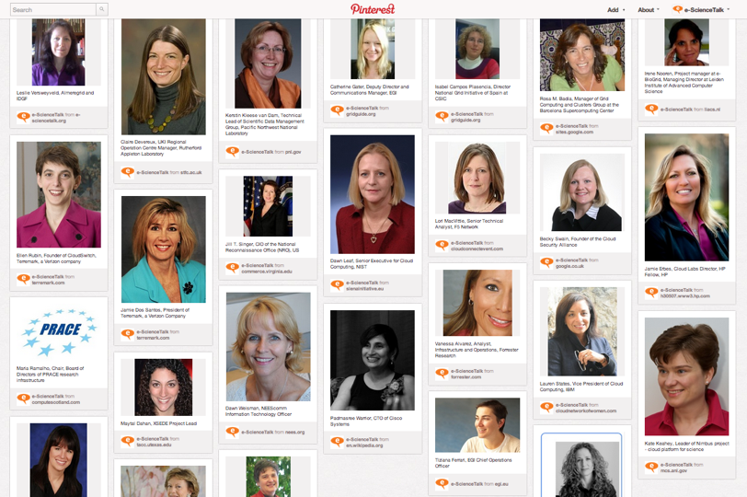
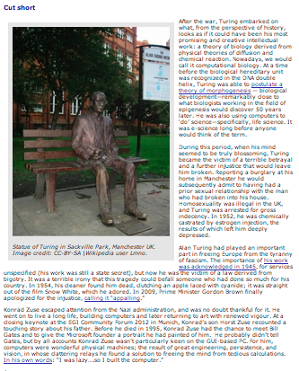
1.3 Event attendance & Media Impact
Notes:
March 8th, International Women’s day
Women in e-science Pinterest board

Slide 26
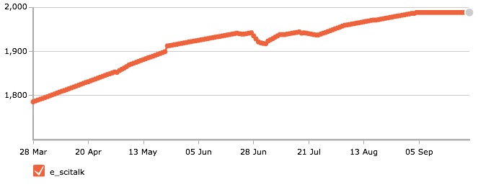
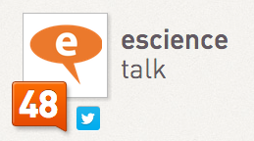
1.3 Event attendance & Media Impact
Notes:
Turing centernary

Slide 27
1.3 Event attendance & Media Impact
CERN,​ guardianscience,​sciencemuseum,​ChemistryWorld,​seedmag,​IdeasGate,​ psael,​TheComedyStore,​mediamuseum,​astroparticle,​symmetrymag,​ womenintech,​cheltfestivals,​junespringtech,​ENGINEERINGcom,​ TheCloudNetwork,​endthedisease,​cloudbook,​ALICEexperiment,​ cloud_connect,​QMUL,​DigitalAgendaEU,​Michael_GR,​momentofscience,​FMWF, ​USLHC,​particlenews,​milenio_ciencia,​NancyProctor,​DoTryThisAtHome,​ cloudtweaks,​HPCwire,​EPRINews,​CloudWSeries,​dmascia,​BritishSciFest,​ EnergeticFutura,​illuminantceo,​ChemHeritage,​geopense,​AmateurPhilosop, ​dubscience2012,​NVIDIATesla,​JoBrodie,​geekpop,​IN2P3_CNRS,​ CristyBurne,​Leigh_Phillips,​swissnexSF,​gridpp,​fusionenergy,​ EnablingGrids,​timClicks,​isgtw,​datanami,​benstill,​LBNLcs,​busuab,​ _Chemistry_,​giorgiawired,​OMG4Science,​TheSISTeam,​DrQz,​hartem,​ ScalableComp,​CyberSciCentre,​GEANTnews,​PhysicsatQM,​geekeconomist,​ pesinasiller,​johanlouwers,​mariocampolargo,​EuroAfrica_ICT,​RUCompSci,​ BeSTGRID,​billyzero,​SoftwareSaved,​bigodines,​Rechenkraft_net,​ ToshioMatsuda,​UbuntuNet,​StratusLab,​yoyo_rkn,​CloudyGrids,​ planet_gridpp,​rohanmittal,​igeproject_eu,​metropoledigi,​ibnkureshi,​ eela_na3,​gravitazeroeu,​GRDI2020,​eresearchnz,​Jregazzi,​oancan,​ horizonfuelcel,​Gorekasa,​nano86,​auzzie22314,​mit09
Notes:
Turing centernary

Slide 28
Hide Panel
Twiangulate making connections
Hello !
Hi | Home | Blog | Log out Access extra features
Build a map | Public maps
Influentials | Stat | Graph parameters
Login or Join Twiangulate to:
* Hide people you follow
* Easy follow
* Autofill search
* Watch searches
* Search recommendations
Follow Twiangulate or Review us!
* Reach
* Mutual followers
* Mutual friends
* Compare lists
* Inner circle
* Keywords
Table - Map
nickname - name - photo
<-> - >
AND
hot & dog
OR
hot | dog
NOT
hot !dog
exact
"hot dog"
Biggest - smallest
among friends of
@
e_scitalk
e_scitalk
(e-Science Talk)
1,998 followers,
246 friends
+
@
+
@
Retrieve
Include people I follow in results
example: Mitt Romney + Newt Gingrich
A d v a n c e d
People displayed: Hide tweeps followed by more than tweeps. Hide people following more than tweeps.
Copy search URL from here:
Close
What's Twiangulate good for? You tell us. Help us grow by explaining what you're doing.
58
Twitter
Tweet
close
x Close
intro
Visiting for the first time? Enter one name above, and we'll get you started. To find fascinating new tweeps, enter one to three peers, friends or rivals, then Twiangulate. Authenticate here to enjoy ID auto-fill, results sorting and easy-follow.
Got performance anxiety? Try warming up with these: dsearls + dweinberger + davewiner, carr2n + jayrosen_nyu + jeffjarvis, PerezHilton + ParisHilton + iamdiddy, markos + maddow + michellemalkin, TEDchris + SteveCase + pierre, robcorddry + rainnwilson + SarahKSilverman, hc + Jason + nicknotned or jimmy_wales + kevinrose + Caterina.
To highlight meaningful Tweeters, we've ignored all tweeps following more than 11k people or with a follower/friend ratio less than 1.5.
@e_scitalk’s 100 biggest followers? have a combined reach? of 1,681,309
1
People Name Bio Following Followers Location
Tweep
Website
Bio Following
Followers
Location
Follow CERN
CERN
CERN CERN, the European Organization for Nuclear Research, is the biggest particle physics laboratory in the world. 225 661,198 Geneva
Follow guardianscience
guardianscience
Guardian Science News, comment, all that stuff from the Guardian's science, health and environment team 1,391 279,299 London
Follow sciencemuseum
sciencemuseum
Science Museum Welcome to the Science Museum account! We tweet exhibitions, what we're working on & the latest science news. Look for #smnews from our news team, Antenna 7,542 188,619 Exhibition Road, London
Follow ChemistryWorld
ChemistryWorld
Chemistry World Chemistry magazine bringing you the latest chemistry news and research every day. Published by the RSC. 949 162,923 Cambridge
Follow seedmag
seedmag
Seed Magazine Science is Culture 2,176 24,901
Follow IdeasGate
IdeasGate
Ideas Gate We worked hardly to innovate the creative ideas globally and made our print very clear in our products. 7,125 22,493 Sarasota, FL
Follow psael
psael
Paulo Sá Elias IT/Computer & Aviation Nerd, Professor of Law, Writer & Lawyer. There's nothing like writing to force you to think & get your thoughts straight. (W. Buffett) 6,846 21,818 Brazil
Follow TheComedyStore
TheComedyStore
The Comedy Store The Greatest Comedy Club in the World 428 21,653 8433 Sunset Boulevard
Follow mediamuseum
mediamuseum
Nat. Media Museum The National Media Museum, Bradford, the world's 1st UNESCO City of Film is devoted to film, photography, TV & the web. 0844 856 3797 Tweets by Sophie & Emma. 2,647 16,042 Bradford, West Yorkshire, UK
Follow astroparticle
astroparticle
astroparticle Find here exciting astroparticle physics news! 1,056 13,896 Geneva
scroll to top
Follow symmetrymag
symmetrymag
symmetry magazine Dimensions of particle physics 512 12,575 United States
Follow womenintech
womenintech
Women in Technology IT Jobs - Careers Advice - IT Recruitment - Events - Training - Networking - News. Maggie Berry - MD. Follow us on Facebook http://ow.ly/5jqv0 2,339 12,196 London
Follow cheltfestivals
cheltfestivals
Cheltenham Festivals World class Jazz, Science, Music and Literature Festivals in Cheltenham, UK. Tweets from Marketing Coordinator Fenner Curtis. 2,624 11,845 Cheltenham, UK
Follow junespringtech
junespringtech
June Spring Tech June Spring Technologies is a leading software development company. A web and mobile application development services division of June Spring Group. 2,612 11,290 USA
Follow ENGINEERINGcom
ENGINEERINGcom
ENGINEERINGcom ENGINEERING.com is the premier online destination for engineers of all disciplines. 2,077 11,068
Follow TheCloudNetwork
TheCloudNetwork
The Cloud Network Facebook: http://facebook.com/cloudcomputingarchitect Linkedin: http://www.linkedin.com/in/cloudcomputingarchitect email: cloudarchitect@me.com 6,519 10,962 @TheCloudNetwork #TCN
Follow endthedisease
endthedisease
Mike Smith Help Defeat Cancer With World Community Grid And F@H While Winning Prizes http://www.facebook.com/EndTheDisease 3,570 10,868
Follow cloudbook
cloudbook
cloudbook Telling The Cloud Computing Story 6,187 10,536
Follow ALICEexperiment
ALICEexperiment
ALICE at LHC A Large Ion Collider Experiment is one of the largest experiments in the world devoted to research in the physics of matter at an infinitely small scale. 2,436 10,376 CERN, Geneva, Switzerland
Follow cloud_connect
cloud_connect
Cloud Connect The defining #cloud conference & expo for IT professionals, developers & leading cloud providers. Events in Silicon Valley & Chicago. #bigdata #analytics 2,941 9,644 Santa Clara, CA
scroll to top
Follow QMUL
QMUL
Queen Mary Uni Londn News and events and some other musings from Queen Mary, University of London. http://www.facebook.com/OfficialQMUL 4,769 9,137 London, UK
Follow DigitalAgendaEU
DigitalAgendaEU
Digital Agenda Official account of the EU's #DigitalAgenda policy flagship led by @NeelieKroesEU. Connecting with you to maximise the potential of #ICT in Europe is our goal. 2,060 8,680 Europe
Follow Michael_GR
Michael_GR
Michael G.R. I work for the Discovery Channel as a Science/Tech/Transportation writer for TreeHugger and Planet Green. 4,607 8,142 Ottawa, Canada
Follow momentofscience
momentofscience
A Moment of Science A Moment of Science answers thousands of common questions about the world we live in through radio programs and audio and video podcasts - A production of @wfiu 4,023 7,943 Bloomington, Indiana
Follow FMWF
FMWF
Women in Business Part of the Mail on Sunday we want to help women reach the very highest ranks in British business from #SMEs to #womenonboards Email: women@financialmail.co.uk 2,887 7,258 UK
Follow USLHC
USLHC
US LHC News from the U.S. community participating in the Large Hadron Collider project 112 6,976 32 U.S. states and Puerto Rico
Follow particlenews
particlenews
Interactions.org News from the world's particle physics laboratories. 120 6,669
Follow milenio_ciencia
milenio_ciencia
Milenio Ciencia Sección de MILENIO dedicada a la Divulgación de la CIENCIA. 877 6,588
Follow NancyProctor
NancyProctor
Nancy Proctor Mobile geek working with museums; loves art, history, languages, travel, feminist theory, good food and nice people. Views expressed here are my own. 3,037 6,521 Washington DC
Follow DoTryThisAtHome
DoTryThisAtHome
Henry, physics.org The voice behind physics.org, sharing the best physics on the web. 479 6,095 London
scroll to top
Follow cloudtweaks
cloudtweaks
Cloud Tweaks The Cloud Computing Authority. News & Analysis from some of the best cloud computing industry experts..#cloud 1,442 6,061 International
Follow HPCwire
HPCwire
HPCwire / HPC wire HPC, supercomputing, technology, science, engineering, financial, modeling, virtual reality, databases, computers, processors, memory, applications, networks 533 4,898 San Diego, CA
Follow EPRINews
EPRINews
EPRI News EPRI is an independent, non-profit company performing research, development and demonstration in the electricity sector for the benefit of the public. 1,500 4,858 Palo Alto, California
Follow CloudWSeries
CloudWSeries
Cloud World Series Organisers of the Cloud World Series, including the Cloud World Forum, 18-19 June 2013 at Olympia, London. Register for free at cloudwf.com 866 4,357 UK | Global Series
Follow dmascia
dmascia
David Mascia Entrepreneur. President of @VoltageDesign and @iSmartTech. Co-Owner of @MasciaGroup. 1,760 4,293 New Jersey
Follow BritishSciFest
BritishSciFest
British Science Fest British Science Festival: Aberdeen 4 - 9 Sep 2012 707 3,666 United Kingdom
Follow EnergeticFutura
EnergeticFutura
Energética Futura Blog/Tienda de AUTOCONSUMO ENERGÉTICO. Información de los últimos avances en materia de energías eenovables, tecnologías energéticas alternativas y eficientes. 1,193 3,528 Málaga (Spain)
Follow illuminantceo
illuminantceo
Simon @ Illuminant Founder and top banana of Illuminant, an award-winning PR and strategic communications agency in China, Hong Kong, Sydney and New York City. 1,800 3,520 NYC-PEK-HKG-SYD
Follow ChemHeritage
ChemHeritage
chemheritage The Chemical Heritage Foundation Library, Museum, and Center for Scholars: We tell the story of chemistry. 1,796 3,225 Philadelphia, PA
Follow geopense
geopense
géopense Tell me and I forget. Teach me and I remember. Involve me and I learn. - Benjamin Franklin 1,717 3,192 International
scroll to top
Follow AmateurPhilosop
AmateurPhilosop
Amateur Philosopher 497 3,124
Follow dubscience2012
dubscience2012
City of Science 2012 Dublin City of Science: A year long programme of science themed events to celebrate @ESOF2012 (Euroscience Open Forum, 2012) coming to town #dub2012 #esof2012 1,111 2,782 Dublin
Follow NVIDIATesla
NVIDIATesla
NVIDIA Tesla Official channel for GPU-accelerated High Performance Computing (HPC), computational science and supercomputing using NVIDIA Tesla GPUs. 795 2,612 Santa Clara, CA
Follow JoBrodie
JoBrodie
Jo Brodie Public Engagement Co-ordinator, @CHI_MED, EECS, QMUL http://www.chi-med.ac.uk. Views are my own etc. etc. :) Formerly Science Information Officer, Diabetes UK. 1,240 2,482 London, UK
Follow geekpop
geekpop
geekpop Commissioning and curating songs about science since 2008. Free downloads, live events, monthly podcasts. Tweets by @gingerbreadlady & @jimothybell 970 1,892 Bristol
Follow IN2P3_CNRS
IN2P3_CNRS
IN2P3 Les 2 infinis Institut national de physique nucléaire et de physique des particules - CNRS 586 1,865 PARIS
Follow CristyBurne
CristyBurne
Children's author Mum, science writer, author of the TAKESHITA DEMONS series of adventures in Japanese mythology for middle grade readers. 1,049 1,776 Australia
Follow Leigh_Phillips
Leigh_Phillips
Leigh Phillips Reporter for the EUobserver in Brussels. Europe correspondent for Red Pepper & Embassy Magazine. 665 1,701 Brussels
Follow swissnexSF
swissnexSF
swissnex S Francisco Connecting the dots between Switzerland and North America in science, education, art and innovation. Florencia Prada tweets for swissnex San Francisco. 1,088 1,700 San Francisco, CA
Follow gridpp
gridpp
Grid PP News from the GridPP website 244 1,610 UK
scroll to top
Follow fusionenergy
fusionenergy
fusionenergy CCFE wants to spread the word about what's happening on fusion research - to bring you a new form of energy! 498 1,521 Oxfordshire
Follow EnablingGrids
EnablingGrids
EGEE Enabling Grids for E-sciencE (EGEE) is the largest multi-disciplinary grid infrastructure in the world 174 1,400 Switzerland
Follow timClicks
timClicks
Tim Mc Namara connecting researchers with supercomputers at @NeSI_NZ. Interests include: #linkeddata #opendata #hfoss #ai #ml #nlproc 728 1,304 Wellington, New Zealand
Follow isgtw
isgtw
i SGTW We cover distributed computing and the science it enables. 783 1,301 CERN, Fermilab & ASGC
Follow datanami
datanami
Datanami New portal from the publishers of HPCwire; Real-time lens into big data, analytics at the massive scale, and the hardware/software backbone supporting these. 290 1,280
Follow benstill
benstill
Dr Ben Still Using the smallest building blocks of nature to answer some of the biggest questions in the Universe. Member #T2K neutrino experiment. Chair of @ScienceLondon 681 1,274 London and 東海
Follow LBNLcs
LBNLcs
Berkeley Lab CS Berkeley Lab Computing Sciences computer hardware and software, applied math and networking experts help deliver science solutions to the the world. 222 1,132 Berkeley, Ca
Follow busuab
busuab
Biblioteca UAB Sab. Biblioteca Universitària de Sabadell UAB - Emprius, 2 304 1,053 Sabadell
Follow _Chemistry_
_Chemistry_
Chemistry 425 895
Follow giorgiawired
giorgiawired
Giorgia Scaturro 460 874 London, UK
scroll to top
Follow OMG4Science
OMG4Science
OMG Science The Online Media Group for Science are producing a series of case studies exploring how different people use online media to communicate science. 268 685 UK
Follow TheSISTeam
TheSISTeam
Science in Society The team that brings you the Science Communication Conference, the x-change and the British Science Association Media Fellowships - We are Science in Society! 386 633 London
Follow DrQz
DrQz
Neil Gunther Computer scientist, performance analyst and theoretical physicist: the nexus being information (and ♬), in every particular order 287 624 The Other Hills, California
Follow hartem
hartem
Artem Harutyunyan 226 463 /proc/1
Follow ScalableComp
ScalableComp
Scalable Computing Scalable Computing, part of the ICT KTN 91 442 London
Follow CyberSciCentre
CyberSciCentre
Citizen Cyberscience Helping people and their computers contribute towards our biggest scientific challenges 69 407 CERN
Follow GEANTnews
GEANTnews
GÉANT NEWS THE pan-European data network, used by 40 million research and education users. Built and operated on behalf of Europe's NRENs by DANTE. Global connectivity. 152 369 Cambridge, UK
Follow PhysicsatQM
PhysicsatQM
Queen Mary Physics Welcome to the Queen Mary School of Physics & Astronomy's Twitter page: find updates on research and other activities. 161 341 London
Follow geekeconomist
geekeconomist
Carmela Asero Cloud Policy Strategist @ EGi.eu.Former EC Project Officer.Citzen diplomat.Passionate abt Space,Comms, RTD.Knight 4 media freedom & Human Rights.Twts R personal 189 319 The Cloud! :-)
Follow pesinasiller
pesinasiller
pepepe www.pesinasiller.tk 192 307 Mexico
scroll to top
Follow johanlouwers
johanlouwers
Johan Louwers Working on all kind of stuff in the IT world. ;-) 194 299 iPhone: 52.073103, 5.093673
Follow mariocampolargo
mariocampolargo
Mario Campolargo Director of the Net Futures Department, EC. Future Internet, Cloud, Web enterpreneurs, Future Networks 126 295
Follow EuroAfrica_ICT
EuroAfrica_ICT
Euro Africa-ICT Strengthening ICT research and policy links under the 8th Strategic Partnership 101 236
Follow RUCompSci
RUCompSci
RU Computer Science Headlines from the School of Computer Science at Reykjavik University. 133 227 Reykjavík, Iceland
Follow BeSTGRID
BeSTGRID
Be STGRID New Zealand national eresearch infrastructure development. Grid Computing, HPC, Middleware, Federated Identity & Access Management, Data. Science and Resear 72 212 New Zealand
Follow billyzero
billyzero
billy zero 47 185 Washington, DC
Follow SoftwareSaved
SoftwareSaved
SSI - software.ac.uk Working with you to ensure a future for research software. 88 178
Follow bigodines
bigodines
Matheus Mendes i like to code. period. 52 170 Floripa
Follow Rechenkraft_net
Rechenkraft_net
Rechenkraft.net Boinc distributed computing verteiltes rechnen computer science charity Verein 55 167 Germany
Follow ToshioMatsuda
ToshioMatsuda
松田利夫 SaaSパートナーズ協会専務理事／株式会社きっとエイエスピー代表取締役社長／山梨学院大学経営情報学部教授 30 154 東京都新宿区
scroll to top
Follow UbuntuNet
UbuntuNet
Ubuntu Net Alliance The regional research and education network for east and southern Africa. Enabling global collaboration in research and education over world class networks 82 144 Lilongwe, Malawi
Follow StratusLab
StratusLab
Stratus Lab Enhancing Grid Infrastructures with Virtualization and Cloud Technologies 49 133
Follow yoyo_rkn
yoyo_rkn
yoyo@home 29 89 Berlin
Follow CloudyGrids
CloudyGrids
Will Venters Lecturer in Information Systems, LSE. See http://personal.lse.ac.uk/venters 55 85 London
Follow planet_gridpp
planet_gridpp
Planet Grid PP RSS feed from planet.gridpp.ac.uk 18 80 UK
Follow rohanmittal
rohanmittal
Rohan Mittal Curious, :-) 48 78 India
Follow igeproject_eu
igeproject_eu
IGE Initiative for Globus in Europe - Bringing Globus Toolkit to the European Research Area (FP7-INFRA-2010-1.2.1.3, Grant #261560) 4 67
Follow metropoledigi
metropoledigi
Metrópole Digital 1 67 Natal/RN/Brasil
Follow ibnkureshi
ibnkureshi
Ibad Kureshi I am a simple guy who likes to keep his options open... current dilemma... phd in cluster computing or ma in filmmaking... what gets me the yacht first 24 66 Huddersfield
Follow eela_na3
eela_na3
EELA / NA3 Twitter written by Leandro Neumann Ciuffo, in charge of the NA3 activity (Application Support) of the EELA-2 project. 13 56 Catania, Italy
scroll to top
Follow gravitazeroeu
gravitazeroeu
Gravità Zero Blog di Divulgazione Scientifica 33 54 Torino
Follow GRDI2020
GRDI2020
GRDI2020 33 53
Follow eresearchnz
eresearchnz
e Research NZ Promoting NZ eResearch communities 16 50 New Zealand
Follow Jregazzi
Jregazzi
John Regazzi 23 40
Follow oancan
oancan
Oscar Ingeniero, Sureño, amante de las TICs y la emancipación social 17 30 Sur Eterno
Follow horizonfuelcel
horizonfuelcel
Taras Wankewycz 4 27
Follow Gorekasa
Gorekasa
Ryan Kelly WoW luver and gaming freak also i love football 14 25
Follow nano86
nano86
nano86 1 24
Follow auzzie22314
auzzie22314
Terry Hill Passivhaus promotor 6 23 Virginia
Follow mit09
mit09
mit 7 18
Refresh results
Tools http://bit.ly/yZct94 - Copy
Copy link to this search page
http://bit.ly/yZct94
Enjoy.
Export list of names.
Search results
CERN, ​guardianscience,​sciencemuseum,​ChemistryWorld,​seedmag,​IdeasGate,​ psael,​TheComedyStore,​mediamuseum,​astroparticle,​symmetrymag,​ womenintech,​cheltfestivals,​junespringtech,​ENGINEERINGcom,​ TheCloudNetwork,​endthedisease,​cloudbook,​ALICEexperiment,​ cloud_connect,​QMUL,​DigitalAgendaEU,​Michael_GR,​momentofscience,​FMWF, ​USLHC,​particlenews,​milenio_ciencia,​NancyProctor,​DoTryThisAtHome,​ cloudtweaks,​HPCwire,​EPRINews,​CloudWSeries,​dmascia,​BritishSciFest,​ EnergeticFutura,​illuminantceo,​ChemHeritage,​geopense,​AmateurPhilosop, ​dubscience2012,​NVIDIATesla,​JoBrodie,​geekpop,​IN2P3_CNRS,​ CristyBurne,​Leigh_Phillips,​swissnexSF,​gridpp,​fusionenergy,​ EnablingGrids,​timClicks,​isgtw,​datanami,​benstill,​LBNLcs,​busuab,​ _Chemistry_,​giorgiawired,​OMG4Science,​TheSISTeam,​DrQz,​hartem,​ ScalableComp,​CyberSciCentre,​GEANTnews,​PhysicsatQM,​geekeconomist,​ pesinasiller,​johanlouwers,​mariocampolargo,​EuroAfrica_ICT,​RUCompSci,​ BeSTGRID,​billyzero,​SoftwareSaved,​bigodines,​Rechenkraft_net,​ ToshioMatsuda,​UbuntuNet,​StratusLab,​yoyo_rkn,​CloudyGrids,​ planet_gridpp,​rohanmittal,​igeproject_eu,​metropoledigi,​ibnkureshi,​ eela_na3,​gravitazeroeu,​GRDI2020,​eresearchnz,​Jregazzi,​oancan,​ horizonfuelcel,​Gorekasa,​nano86,​auzzie22314,​mit09
Enjoy.
Create twitter list from results. Tweet it!
Sign in with Twitter
* Sign in with Twitter to make it easier to follow people, to filter out people you already know or to watch for cool new people your friends are following.
* We will never post to Twitter without your explicit permission first.
* You can revoke Twiangulate's access to your Twitter account at any time by changing your Connections settings on Twitter (link).
* You confirm that you accept our Terms of Service.
Cancel Sign in with Twitter
Sign in with Twitter?
To see newly found users you should be signed in with Twitter.
Cancel Sign in with Twitter
*
"Twiangulate can tell me who the people I listen to are, in turn, listening to"
*
"That's pretty hot stuff"
*
"Find connections you
might have in common"
*
"A good virtual parlor game"
*
"Discover the common followers of your three biggest competitors on Twitter"
*
"Twiangulate is one of the coolest online tools that I've found"
*
"Wow @twiangulate... is very cool Twitter follower analysis tool"
*
"Twiangulate makes Twitter start to look a little like LinkedIn, revealing a network of interests, not just strategic friends"
Like this? Please share: | |
Follow on Twitter Add to del.icio.us Submit to digg Submit to Reddit Submit to StumbleUpon Submit to Facebook
Build a map | Public maps | Home | Blog | FAQs | Terms | Contact
Brought to you by the team behind Blogads.com including these tweeps.
© 2009-2011 Pressflex LLC
Glad you're having fun!
Just sign in with Twitter, and you can keep right on twiangulating!
Email: (no sales or spam, cool tips only) Tweet this: 140 I'm at http://twiangulate.com where you can analyze your followers, search Twitter bios and uncover hidden connections. Follow @twiangulate Sign in with Twitter By clicking "Sign in with Twitter", you agree to our terms.
Cancel
1.3 Event attendance & Media Impact
9th e-Concertation, 22–23 September 2011, Lyon
150 attendees (8th e-Concertation:110)
Live web streaming: 825 page views from 36 countries on day 1; 403 visits from 21 countries on day 2
Gridcast: 249 visits, 36 countries
Notes:
The 9th e‐Infrastructure Concertation meeting was attended in person by 150 delegates. This is an increase of more than a third on last year’s attendance of 110 delegates. Attendees included representatives from the EC, as well as those involved in EC funded projects. In addition, a further 305 visitors made use of the live streaming via the web on the first day of the conference. On the second day 149 visitors accessed the live webcast.
This year, there was a great deal of interest from those who could not make the meeting. The first day of live streaming attracted 825 total page views from 36 countries. The meeting had a wide international appeal and the top 10 viewing countries were Italy, Germany, Belgium, Slovenia, Portugal, US, UK, Columbia and the Netherlands. On Friday 23rd of September, there were a total of 403 page views from 21 different countries. A number of non‐European countries such as Columbia, which was the sixth top connection, were tuning in on the second day of the meeting.
From the 22nd to 23rd September, there were 42 visits from 42 unique visitors to the e‐ScienceTalk website, which contained information on the e‐Infrastructure Concertation meeting. Forty nine percent of these visits were from new visitors to the site.
From the 22nd to the 23rd of September there were a total of 249 visits to the GridCast blog, from 176 unique visitors. On average visitors spent 3.48 minutes on the site when visiting and 51% of these visits were from new visitors. During the e‐Concertation meeting, there were 63 tweets on the first day and 34 on the second day. Tweets came from a number of sources including EUIndiaGrid2, Venus‐C, SIENA, EUBrazilOpenBio, EUMEDGRID and FP7 Training.
During the EGI‐TF there were 251 tweets in total.

Slide 29
Hide Panel
Twiangulate making connections
Hello !
Hi | Home | Blog | Log out Access extra features
Build a map | Public maps
Influentials | Stat | Graph parameters
Login or Join Twiangulate to:
* Hide people you follow
* Easy follow
* Autofill search
* Watch searches
* Search recommendations
Follow Twiangulate or Review us!
* Reach
* Mutual followers
* Mutual friends
* Compare lists
* Inner circle
* Keywords
Table - Map
nickname - name - photo
<-> - >
AND
hot & dog
OR
hot | dog
NOT
hot !dog
exact
"hot dog"
Biggest - smallest
among friends of
@
e_scitalk
e_scitalk
(e-Science Talk)
1,998 followers,
246 friends
+
@
+
@
Retrieve
Include people I follow in results
example: Mitt Romney + Newt Gingrich
A d v a n c e d
People displayed: Hide tweeps followed by more than tweeps. Hide people following more than tweeps.
Copy search URL from here:
Close
What's Twiangulate good for? You tell us. Help us grow by explaining what you're doing.
58
Twitter
Tweet
close
x Close
intro
Visiting for the first time? Enter one name above, and we'll get you started. To find fascinating new tweeps, enter one to three peers, friends or rivals, then Twiangulate. Authenticate here to enjoy ID auto-fill, results sorting and easy-follow.
Got performance anxiety? Try warming up with these: dsearls + dweinberger + davewiner, carr2n + jayrosen_nyu + jeffjarvis, PerezHilton + ParisHilton + iamdiddy, markos + maddow + michellemalkin, TEDchris + SteveCase + pierre, robcorddry + rainnwilson + SarahKSilverman, hc + Jason + nicknotned or jimmy_wales + kevinrose + Caterina.
To highlight meaningful Tweeters, we've ignored all tweeps following more than 11k people or with a follower/friend ratio less than 1.5.
@e_scitalk’s 100 biggest followers? have a combined reach? of 1,681,309
1
People Name Bio Following Followers Location
Tweep
Website
Bio Following
Followers
Location
Follow CERN
CERN
CERN CERN, the European Organization for Nuclear Research, is the biggest particle physics laboratory in the world. 225 661,198 Geneva
Follow guardianscience
guardianscience
Guardian Science News, comment, all that stuff from the Guardian's science, health and environment team 1,391 279,299 London
Follow sciencemuseum
sciencemuseum
Science Museum Welcome to the Science Museum account! We tweet exhibitions, what we're working on & the latest science news. Look for #smnews from our news team, Antenna 7,542 188,619 Exhibition Road, London
Follow ChemistryWorld
ChemistryWorld
Chemistry World Chemistry magazine bringing you the latest chemistry news and research every day. Published by the RSC. 949 162,923 Cambridge
Follow seedmag
seedmag
Seed Magazine Science is Culture 2,176 24,901
Follow IdeasGate
IdeasGate
Ideas Gate We worked hardly to innovate the creative ideas globally and made our print very clear in our products. 7,125 22,493 Sarasota, FL
Follow psael
psael
Paulo Sá Elias IT/Computer & Aviation Nerd, Professor of Law, Writer & Lawyer. There's nothing like writing to force you to think & get your thoughts straight. (W. Buffett) 6,846 21,818 Brazil
Follow TheComedyStore
TheComedyStore
The Comedy Store The Greatest Comedy Club in the World 428 21,653 8433 Sunset Boulevard
Follow mediamuseum
mediamuseum
Nat. Media Museum The National Media Museum, Bradford, the world's 1st UNESCO City of Film is devoted to film, photography, TV & the web. 0844 856 3797 Tweets by Sophie & Emma. 2,647 16,042 Bradford, West Yorkshire, UK
Follow astroparticle
astroparticle
astroparticle Find here exciting astroparticle physics news! 1,056 13,896 Geneva
scroll to top
Follow symmetrymag
symmetrymag
symmetry magazine Dimensions of particle physics 512 12,575 United States
Follow womenintech
womenintech
Women in Technology IT Jobs - Careers Advice - IT Recruitment - Events - Training - Networking - News. Maggie Berry - MD. Follow us on Facebook http://ow.ly/5jqv0 2,339 12,196 London
Follow cheltfestivals
cheltfestivals
Cheltenham Festivals World class Jazz, Science, Music and Literature Festivals in Cheltenham, UK. Tweets from Marketing Coordinator Fenner Curtis. 2,624 11,845 Cheltenham, UK
Follow junespringtech
junespringtech
June Spring Tech June Spring Technologies is a leading software development company. A web and mobile application development services division of June Spring Group. 2,612 11,290 USA
Follow ENGINEERINGcom
ENGINEERINGcom
ENGINEERINGcom ENGINEERING.com is the premier online destination for engineers of all disciplines. 2,077 11,068
Follow TheCloudNetwork
TheCloudNetwork
The Cloud Network Facebook: http://facebook.com/cloudcomputingarchitect Linkedin: http://www.linkedin.com/in/cloudcomputingarchitect email: cloudarchitect@me.com 6,519 10,962 @TheCloudNetwork #TCN
Follow endthedisease
endthedisease
Mike Smith Help Defeat Cancer With World Community Grid And F@H While Winning Prizes http://www.facebook.com/EndTheDisease 3,570 10,868
Follow cloudbook
cloudbook
cloudbook Telling The Cloud Computing Story 6,187 10,536
Follow ALICEexperiment
ALICEexperiment
ALICE at LHC A Large Ion Collider Experiment is one of the largest experiments in the world devoted to research in the physics of matter at an infinitely small scale. 2,436 10,376 CERN, Geneva, Switzerland
Follow cloud_connect
cloud_connect
Cloud Connect The defining #cloud conference & expo for IT professionals, developers & leading cloud providers. Events in Silicon Valley & Chicago. #bigdata #analytics 2,941 9,644 Santa Clara, CA
scroll to top
Follow QMUL
QMUL
Queen Mary Uni Londn News and events and some other musings from Queen Mary, University of London. http://www.facebook.com/OfficialQMUL 4,769 9,137 London, UK
Follow DigitalAgendaEU
DigitalAgendaEU
Digital Agenda Official account of the EU's #DigitalAgenda policy flagship led by @NeelieKroesEU. Connecting with you to maximise the potential of #ICT in Europe is our goal. 2,060 8,680 Europe
Follow Michael_GR
Michael_GR
Michael G.R. I work for the Discovery Channel as a Science/Tech/Transportation writer for TreeHugger and Planet Green. 4,607 8,142 Ottawa, Canada
Follow momentofscience
momentofscience
A Moment of Science A Moment of Science answers thousands of common questions about the world we live in through radio programs and audio and video podcasts - A production of @wfiu 4,023 7,943 Bloomington, Indiana
Follow FMWF
FMWF
Women in Business Part of the Mail on Sunday we want to help women reach the very highest ranks in British business from #SMEs to #womenonboards Email: women@financialmail.co.uk 2,887 7,258 UK
Follow USLHC
USLHC
US LHC News from the U.S. community participating in the Large Hadron Collider project 112 6,976 32 U.S. states and Puerto Rico
Follow particlenews
particlenews
Interactions.org News from the world's particle physics laboratories. 120 6,669
Follow milenio_ciencia
milenio_ciencia
Milenio Ciencia Sección de MILENIO dedicada a la Divulgación de la CIENCIA. 877 6,588
Follow NancyProctor
NancyProctor
Nancy Proctor Mobile geek working with museums; loves art, history, languages, travel, feminist theory, good food and nice people. Views expressed here are my own. 3,037 6,521 Washington DC
Follow DoTryThisAtHome
DoTryThisAtHome
Henry, physics.org The voice behind physics.org, sharing the best physics on the web. 479 6,095 London
scroll to top
Follow cloudtweaks
cloudtweaks
Cloud Tweaks The Cloud Computing Authority. News & Analysis from some of the best cloud computing industry experts..#cloud 1,442 6,061 International
Follow HPCwire
HPCwire
HPCwire / HPC wire HPC, supercomputing, technology, science, engineering, financial, modeling, virtual reality, databases, computers, processors, memory, applications, networks 533 4,898 San Diego, CA
Follow EPRINews
EPRINews
EPRI News EPRI is an independent, non-profit company performing research, development and demonstration in the electricity sector for the benefit of the public. 1,500 4,858 Palo Alto, California
Follow CloudWSeries
CloudWSeries
Cloud World Series Organisers of the Cloud World Series, including the Cloud World Forum, 18-19 June 2013 at Olympia, London. Register for free at cloudwf.com 866 4,357 UK | Global Series
Follow dmascia
dmascia
David Mascia Entrepreneur. President of @VoltageDesign and @iSmartTech. Co-Owner of @MasciaGroup. 1,760 4,293 New Jersey
Follow BritishSciFest
BritishSciFest
British Science Fest British Science Festival: Aberdeen 4 - 9 Sep 2012 707 3,666 United Kingdom
Follow EnergeticFutura
EnergeticFutura
Energética Futura Blog/Tienda de AUTOCONSUMO ENERGÉTICO. Información de los últimos avances en materia de energías eenovables, tecnologías energéticas alternativas y eficientes. 1,193 3,528 Málaga (Spain)
Follow illuminantceo
illuminantceo
Simon @ Illuminant Founder and top banana of Illuminant, an award-winning PR and strategic communications agency in China, Hong Kong, Sydney and New York City. 1,800 3,520 NYC-PEK-HKG-SYD
Follow ChemHeritage
ChemHeritage
chemheritage The Chemical Heritage Foundation Library, Museum, and Center for Scholars: We tell the story of chemistry. 1,796 3,225 Philadelphia, PA
Follow geopense
geopense
géopense Tell me and I forget. Teach me and I remember. Involve me and I learn. - Benjamin Franklin 1,717 3,192 International
scroll to top
Follow AmateurPhilosop
AmateurPhilosop
Amateur Philosopher 497 3,124
Follow dubscience2012
dubscience2012
City of Science 2012 Dublin City of Science: A year long programme of science themed events to celebrate @ESOF2012 (Euroscience Open Forum, 2012) coming to town #dub2012 #esof2012 1,111 2,782 Dublin
Follow NVIDIATesla
NVIDIATesla
NVIDIA Tesla Official channel for GPU-accelerated High Performance Computing (HPC), computational science and supercomputing using NVIDIA Tesla GPUs. 795 2,612 Santa Clara, CA
Follow JoBrodie
JoBrodie
Jo Brodie Public Engagement Co-ordinator, @CHI_MED, EECS, QMUL http://www.chi-med.ac.uk. Views are my own etc. etc. :) Formerly Science Information Officer, Diabetes UK. 1,240 2,482 London, UK
Follow geekpop
geekpop
geekpop Commissioning and curating songs about science since 2008. Free downloads, live events, monthly podcasts. Tweets by @gingerbreadlady & @jimothybell 970 1,892 Bristol
Follow IN2P3_CNRS
IN2P3_CNRS
IN2P3 Les 2 infinis Institut national de physique nucléaire et de physique des particules - CNRS 586 1,865 PARIS
Follow CristyBurne
CristyBurne
Children's author Mum, science writer, author of the TAKESHITA DEMONS series of adventures in Japanese mythology for middle grade readers. 1,049 1,776 Australia
Follow Leigh_Phillips
Leigh_Phillips
Leigh Phillips Reporter for the EUobserver in Brussels. Europe correspondent for Red Pepper & Embassy Magazine. 665 1,701 Brussels
Follow swissnexSF
swissnexSF
swissnex S Francisco Connecting the dots between Switzerland and North America in science, education, art and innovation. Florencia Prada tweets for swissnex San Francisco. 1,088 1,700 San Francisco, CA
Follow gridpp
gridpp
Grid PP News from the GridPP website 244 1,610 UK
scroll to top
Follow fusionenergy
fusionenergy
fusionenergy CCFE wants to spread the word about what's happening on fusion research - to bring you a new form of energy! 498 1,521 Oxfordshire
Follow EnablingGrids
EnablingGrids
EGEE Enabling Grids for E-sciencE (EGEE) is the largest multi-disciplinary grid infrastructure in the world 174 1,400 Switzerland
Follow timClicks
timClicks
Tim Mc Namara connecting researchers with supercomputers at @NeSI_NZ. Interests include: #linkeddata #opendata #hfoss #ai #ml #nlproc 728 1,304 Wellington, New Zealand
Follow isgtw
isgtw
i SGTW We cover distributed computing and the science it enables. 783 1,301 CERN, Fermilab & ASGC
Follow datanami
datanami
Datanami New portal from the publishers of HPCwire; Real-time lens into big data, analytics at the massive scale, and the hardware/software backbone supporting these. 290 1,280
Follow benstill
benstill
Dr Ben Still Using the smallest building blocks of nature to answer some of the biggest questions in the Universe. Member #T2K neutrino experiment. Chair of @ScienceLondon 681 1,274 London and 東海
Follow LBNLcs
LBNLcs
Berkeley Lab CS Berkeley Lab Computing Sciences computer hardware and software, applied math and networking experts help deliver science solutions to the the world. 222 1,132 Berkeley, Ca
Follow busuab
busuab
Biblioteca UAB Sab. Biblioteca Universitària de Sabadell UAB - Emprius, 2 304 1,053 Sabadell
Follow _Chemistry_
_Chemistry_
Chemistry 425 895
Follow giorgiawired
giorgiawired
Giorgia Scaturro 460 874 London, UK
scroll to top
Follow OMG4Science
OMG4Science
OMG Science The Online Media Group for Science are producing a series of case studies exploring how different people use online media to communicate science. 268 685 UK
Follow TheSISTeam
TheSISTeam
Science in Society The team that brings you the Science Communication Conference, the x-change and the British Science Association Media Fellowships - We are Science in Society! 386 633 London
Follow DrQz
DrQz
Neil Gunther Computer scientist, performance analyst and theoretical physicist: the nexus being information (and ♬), in every particular order 287 624 The Other Hills, California
Follow hartem
hartem
Artem Harutyunyan 226 463 /proc/1
Follow ScalableComp
ScalableComp
Scalable Computing Scalable Computing, part of the ICT KTN 91 442 London
Follow CyberSciCentre
CyberSciCentre
Citizen Cyberscience Helping people and their computers contribute towards our biggest scientific challenges 69 407 CERN
Follow GEANTnews
GEANTnews
GÉANT NEWS THE pan-European data network, used by 40 million research and education users. Built and operated on behalf of Europe's NRENs by DANTE. Global connectivity. 152 369 Cambridge, UK
Follow PhysicsatQM
PhysicsatQM
Queen Mary Physics Welcome to the Queen Mary School of Physics & Astronomy's Twitter page: find updates on research and other activities. 161 341 London
Follow geekeconomist
geekeconomist
Carmela Asero Cloud Policy Strategist @ EGi.eu.Former EC Project Officer.Citzen diplomat.Passionate abt Space,Comms, RTD.Knight 4 media freedom & Human Rights.Twts R personal 189 319 The Cloud! :-)
Follow pesinasiller
pesinasiller
pepepe www.pesinasiller.tk 192 307 Mexico
scroll to top
Follow johanlouwers
johanlouwers
Johan Louwers Working on all kind of stuff in the IT world. ;-) 194 299 iPhone: 52.073103, 5.093673
Follow mariocampolargo
mariocampolargo
Mario Campolargo Director of the Net Futures Department, EC. Future Internet, Cloud, Web enterpreneurs, Future Networks 126 295
Follow EuroAfrica_ICT
EuroAfrica_ICT
Euro Africa-ICT Strengthening ICT research and policy links under the 8th Strategic Partnership 101 236
Follow RUCompSci
RUCompSci
RU Computer Science Headlines from the School of Computer Science at Reykjavik University. 133 227 Reykjavík, Iceland
Follow BeSTGRID
BeSTGRID
Be STGRID New Zealand national eresearch infrastructure development. Grid Computing, HPC, Middleware, Federated Identity & Access Management, Data. Science and Resear 72 212 New Zealand
Follow billyzero
billyzero
billy zero 47 185 Washington, DC
Follow SoftwareSaved
SoftwareSaved
SSI - software.ac.uk Working with you to ensure a future for research software. 88 178
Follow bigodines
bigodines
Matheus Mendes i like to code. period. 52 170 Floripa
Follow Rechenkraft_net
Rechenkraft_net
Rechenkraft.net Boinc distributed computing verteiltes rechnen computer science charity Verein 55 167 Germany
Follow ToshioMatsuda
ToshioMatsuda
松田利夫 SaaSパートナーズ協会専務理事／株式会社きっとエイエスピー代表取締役社長／山梨学院大学経営情報学部教授 30 154 東京都新宿区
scroll to top
Follow UbuntuNet
UbuntuNet
Ubuntu Net Alliance The regional research and education network for east and southern Africa. Enabling global collaboration in research and education over world class networks 82 144 Lilongwe, Malawi
Follow StratusLab
StratusLab
Stratus Lab Enhancing Grid Infrastructures with Virtualization and Cloud Technologies 49 133
Follow yoyo_rkn
yoyo_rkn
yoyo@home 29 89 Berlin
Follow CloudyGrids
CloudyGrids
Will Venters Lecturer in Information Systems, LSE. See http://personal.lse.ac.uk/venters 55 85 London
Follow planet_gridpp
planet_gridpp
Planet Grid PP RSS feed from planet.gridpp.ac.uk 18 80 UK
Follow rohanmittal
rohanmittal
Rohan Mittal Curious, :-) 48 78 India
Follow igeproject_eu
igeproject_eu
IGE Initiative for Globus in Europe - Bringing Globus Toolkit to the European Research Area (FP7-INFRA-2010-1.2.1.3, Grant #261560) 4 67
Follow metropoledigi
metropoledigi
Metrópole Digital 1 67 Natal/RN/Brasil
Follow ibnkureshi
ibnkureshi
Ibad Kureshi I am a simple guy who likes to keep his options open... current dilemma... phd in cluster computing or ma in filmmaking... what gets me the yacht first 24 66 Huddersfield
Follow eela_na3
eela_na3
EELA / NA3 Twitter written by Leandro Neumann Ciuffo, in charge of the NA3 activity (Application Support) of the EELA-2 project. 13 56 Catania, Italy
scroll to top
Follow gravitazeroeu
gravitazeroeu
Gravità Zero Blog di Divulgazione Scientifica 33 54 Torino
Follow GRDI2020
GRDI2020
GRDI2020 33 53
Follow eresearchnz
eresearchnz
e Research NZ Promoting NZ eResearch communities 16 50 New Zealand
Follow Jregazzi
Jregazzi
John Regazzi 23 40
Follow oancan
oancan
Oscar Ingeniero, Sureño, amante de las TICs y la emancipación social 17 30 Sur Eterno
Follow horizonfuelcel
horizonfuelcel
Taras Wankewycz 4 27
Follow Gorekasa
Gorekasa
Ryan Kelly WoW luver and gaming freak also i love football 14 25
Follow nano86
nano86
nano86 1 24
Follow auzzie22314
auzzie22314
Terry Hill Passivhaus promotor 6 23 Virginia
Follow mit09
mit09
mit 7 18
Refresh results
Tools http://bit.ly/yZct94 - Copy
Copy link to this search page
http://bit.ly/yZct94
Enjoy.
Export list of names.
Search results
CERN, ​guardianscience,​sciencemuseum,​ChemistryWorld,​seedmag,​IdeasGate,​ psael,​TheComedyStore,​mediamuseum,​astroparticle,​symmetrymag,​ womenintech,​cheltfestivals,​junespringtech,​ENGINEERINGcom,​ TheCloudNetwork,​endthedisease,​cloudbook,​ALICEexperiment,​ cloud_connect,​QMUL,​DigitalAgendaEU,​Michael_GR,​momentofscience,​FMWF, ​USLHC,​particlenews,​milenio_ciencia,​NancyProctor,​DoTryThisAtHome,​ cloudtweaks,​HPCwire,​EPRINews,​CloudWSeries,​dmascia,​BritishSciFest,​ EnergeticFutura,​illuminantceo,​ChemHeritage,​geopense,​AmateurPhilosop, ​dubscience2012,​NVIDIATesla,​JoBrodie,​geekpop,​IN2P3_CNRS,​ CristyBurne,​Leigh_Phillips,​swissnexSF,​gridpp,​fusionenergy,​ EnablingGrids,​timClicks,​isgtw,​datanami,​benstill,​LBNLcs,​busuab,​ _Chemistry_,​giorgiawired,​OMG4Science,​TheSISTeam,​DrQz,​hartem,​ ScalableComp,​CyberSciCentre,​GEANTnews,​PhysicsatQM,​geekeconomist,​ pesinasiller,​johanlouwers,​mariocampolargo,​EuroAfrica_ICT,​RUCompSci,​ BeSTGRID,​billyzero,​SoftwareSaved,​bigodines,​Rechenkraft_net,​ ToshioMatsuda,​UbuntuNet,​StratusLab,​yoyo_rkn,​CloudyGrids,​ planet_gridpp,​rohanmittal,​igeproject_eu,​metropoledigi,​ibnkureshi,​ eela_na3,​gravitazeroeu,​GRDI2020,​eresearchnz,​Jregazzi,​oancan,​ horizonfuelcel,​Gorekasa,​nano86,​auzzie22314,​mit09
Enjoy.
Create twitter list from results. Tweet it!
Sign in with Twitter
* Sign in with Twitter to make it easier to follow people, to filter out people you already know or to watch for cool new people your friends are following.
* We will never post to Twitter without your explicit permission first.
* You can revoke Twiangulate's access to your Twitter account at any time by changing your Connections settings on Twitter (link).
* You confirm that you accept our Terms of Service.
Cancel Sign in with Twitter
Sign in with Twitter?
To see newly found users you should be signed in with Twitter.
Cancel Sign in with Twitter
*
"Twiangulate can tell me who the people I listen to are, in turn, listening to"
*
"That's pretty hot stuff"
*
"Find connections you
might have in common"
*
"A good virtual parlor game"
*
"Discover the common followers of your three biggest competitors on Twitter"
*
"Twiangulate is one of the coolest online tools that I've found"
*
"Wow @twiangulate... is very cool Twitter follower analysis tool"
*
"Twiangulate makes Twitter start to look a little like LinkedIn, revealing a network of interests, not just strategic friends"
Like this? Please share: | |
Follow on Twitter Add to del.icio.us Submit to digg Submit to Reddit Submit to StumbleUpon Submit to Facebook
Build a map | Public maps | Home | Blog | FAQs | Terms | Contact
Brought to you by the team behind Blogads.com including these tweeps.
© 2009-2011 Pressflex LLC
Glad you're having fun!
Just sign in with Twitter, and you can keep right on twiangulating!
Email: (no sales or spam, cool tips only) Tweet this: 140 I'm at http://twiangulate.com where you can analyze your followers, search Twitter bios and uncover hidden connections. Follow @twiangulate Sign in with Twitter By clicking "Sign in with Twitter", you agree to our terms.
Cancel
1.3 Event attendance & Media Impact
9th e-Concertation, 22–23 September 2011, Lyon
Programme Overview
Scientific Data: Digital Identifiers, interoperability
e-Science Environments: User-oriented services, gateways, workflows
e-HPC: Long-term perspectives of HPC in Europe, PRACE
Infrastructure Futures (Horizon 2020): Research networks, Internet of Things, training

Slide 30
Hide Panel
Twiangulate making connections
Hello !
Hi | Home | Blog | Log out Access extra features
Build a map | Public maps
Influentials | Stat | Graph parameters
Login or Join Twiangulate to:
* Hide people you follow
* Easy follow
* Autofill search
* Watch searches
* Search recommendations
Follow Twiangulate or Review us!
* Reach
* Mutual followers
* Mutual friends
* Compare lists
* Inner circle
* Keywords
Table - Map
nickname - name - photo
<-> - >
AND
hot & dog
OR
hot | dog
NOT
hot !dog
exact
"hot dog"
Biggest - smallest
among friends of
@
e_scitalk
e_scitalk
(e-Science Talk)
1,998 followers,
246 friends
+
@
+
@
Retrieve
Include people I follow in results
example: Mitt Romney + Newt Gingrich
A d v a n c e d
People displayed: Hide tweeps followed by more than tweeps. Hide people following more than tweeps.
Copy search URL from here:
Close
What's Twiangulate good for? You tell us. Help us grow by explaining what you're doing.
58
Twitter
Tweet
close
x Close
intro
Visiting for the first time? Enter one name above, and we'll get you started. To find fascinating new tweeps, enter one to three peers, friends or rivals, then Twiangulate. Authenticate here to enjoy ID auto-fill, results sorting and easy-follow.
Got performance anxiety? Try warming up with these: dsearls + dweinberger + davewiner, carr2n + jayrosen_nyu + jeffjarvis, PerezHilton + ParisHilton + iamdiddy, markos + maddow + michellemalkin, TEDchris + SteveCase + pierre, robcorddry + rainnwilson + SarahKSilverman, hc + Jason + nicknotned or jimmy_wales + kevinrose + Caterina.
To highlight meaningful Tweeters, we've ignored all tweeps following more than 11k people or with a follower/friend ratio less than 1.5.
@e_scitalk’s 100 biggest followers? have a combined reach? of 1,681,309
1
People Name Bio Following Followers Location
Tweep
Website
Bio Following
Followers
Location
Follow CERN
CERN
CERN CERN, the European Organization for Nuclear Research, is the biggest particle physics laboratory in the world. 225 661,198 Geneva
Follow guardianscience
guardianscience
Guardian Science News, comment, all that stuff from the Guardian's science, health and environment team 1,391 279,299 London
Follow sciencemuseum
sciencemuseum
Science Museum Welcome to the Science Museum account! We tweet exhibitions, what we're working on & the latest science news. Look for #smnews from our news team, Antenna 7,542 188,619 Exhibition Road, London
Follow ChemistryWorld
ChemistryWorld
Chemistry World Chemistry magazine bringing you the latest chemistry news and research every day. Published by the RSC. 949 162,923 Cambridge
Follow seedmag
seedmag
Seed Magazine Science is Culture 2,176 24,901
Follow IdeasGate
IdeasGate
Ideas Gate We worked hardly to innovate the creative ideas globally and made our print very clear in our products. 7,125 22,493 Sarasota, FL
Follow psael
psael
Paulo Sá Elias IT/Computer & Aviation Nerd, Professor of Law, Writer & Lawyer. There's nothing like writing to force you to think & get your thoughts straight. (W. Buffett) 6,846 21,818 Brazil
Follow TheComedyStore
TheComedyStore
The Comedy Store The Greatest Comedy Club in the World 428 21,653 8433 Sunset Boulevard
Follow mediamuseum
mediamuseum
Nat. Media Museum The National Media Museum, Bradford, the world's 1st UNESCO City of Film is devoted to film, photography, TV & the web. 0844 856 3797 Tweets by Sophie & Emma. 2,647 16,042 Bradford, West Yorkshire, UK
Follow astroparticle
astroparticle
astroparticle Find here exciting astroparticle physics news! 1,056 13,896 Geneva
scroll to top
Follow symmetrymag
symmetrymag
symmetry magazine Dimensions of particle physics 512 12,575 United States
Follow womenintech
womenintech
Women in Technology IT Jobs - Careers Advice - IT Recruitment - Events - Training - Networking - News. Maggie Berry - MD. Follow us on Facebook http://ow.ly/5jqv0 2,339 12,196 London
Follow cheltfestivals
cheltfestivals
Cheltenham Festivals World class Jazz, Science, Music and Literature Festivals in Cheltenham, UK. Tweets from Marketing Coordinator Fenner Curtis. 2,624 11,845 Cheltenham, UK
Follow junespringtech
junespringtech
June Spring Tech June Spring Technologies is a leading software development company. A web and mobile application development services division of June Spring Group. 2,612 11,290 USA
Follow ENGINEERINGcom
ENGINEERINGcom
ENGINEERINGcom ENGINEERING.com is the premier online destination for engineers of all disciplines. 2,077 11,068
Follow TheCloudNetwork
TheCloudNetwork
The Cloud Network Facebook: http://facebook.com/cloudcomputingarchitect Linkedin: http://www.linkedin.com/in/cloudcomputingarchitect email: cloudarchitect@me.com 6,519 10,962 @TheCloudNetwork #TCN
Follow endthedisease
endthedisease
Mike Smith Help Defeat Cancer With World Community Grid And F@H While Winning Prizes http://www.facebook.com/EndTheDisease 3,570 10,868
Follow cloudbook
cloudbook
cloudbook Telling The Cloud Computing Story 6,187 10,536
Follow ALICEexperiment
ALICEexperiment
ALICE at LHC A Large Ion Collider Experiment is one of the largest experiments in the world devoted to research in the physics of matter at an infinitely small scale. 2,436 10,376 CERN, Geneva, Switzerland
Follow cloud_connect
cloud_connect
Cloud Connect The defining #cloud conference & expo for IT professionals, developers & leading cloud providers. Events in Silicon Valley & Chicago. #bigdata #analytics 2,941 9,644 Santa Clara, CA
scroll to top
Follow QMUL
QMUL
Queen Mary Uni Londn News and events and some other musings from Queen Mary, University of London. http://www.facebook.com/OfficialQMUL 4,769 9,137 London, UK
Follow DigitalAgendaEU
DigitalAgendaEU
Digital Agenda Official account of the EU's #DigitalAgenda policy flagship led by @NeelieKroesEU. Connecting with you to maximise the potential of #ICT in Europe is our goal. 2,060 8,680 Europe
Follow Michael_GR
Michael_GR
Michael G.R. I work for the Discovery Channel as a Science/Tech/Transportation writer for TreeHugger and Planet Green. 4,607 8,142 Ottawa, Canada
Follow momentofscience
momentofscience
A Moment of Science A Moment of Science answers thousands of common questions about the world we live in through radio programs and audio and video podcasts - A production of @wfiu 4,023 7,943 Bloomington, Indiana
Follow FMWF
FMWF
Women in Business Part of the Mail on Sunday we want to help women reach the very highest ranks in British business from #SMEs to #womenonboards Email: women@financialmail.co.uk 2,887 7,258 UK
Follow USLHC
USLHC
US LHC News from the U.S. community participating in the Large Hadron Collider project 112 6,976 32 U.S. states and Puerto Rico
Follow particlenews
particlenews
Interactions.org News from the world's particle physics laboratories. 120 6,669
Follow milenio_ciencia
milenio_ciencia
Milenio Ciencia Sección de MILENIO dedicada a la Divulgación de la CIENCIA. 877 6,588
Follow NancyProctor
NancyProctor
Nancy Proctor Mobile geek working with museums; loves art, history, languages, travel, feminist theory, good food and nice people. Views expressed here are my own. 3,037 6,521 Washington DC
Follow DoTryThisAtHome
DoTryThisAtHome
Henry, physics.org The voice behind physics.org, sharing the best physics on the web. 479 6,095 London
scroll to top
Follow cloudtweaks
cloudtweaks
Cloud Tweaks The Cloud Computing Authority. News & Analysis from some of the best cloud computing industry experts..#cloud 1,442 6,061 International
Follow HPCwire
HPCwire
HPCwire / HPC wire HPC, supercomputing, technology, science, engineering, financial, modeling, virtual reality, databases, computers, processors, memory, applications, networks 533 4,898 San Diego, CA
Follow EPRINews
EPRINews
EPRI News EPRI is an independent, non-profit company performing research, development and demonstration in the electricity sector for the benefit of the public. 1,500 4,858 Palo Alto, California
Follow CloudWSeries
CloudWSeries
Cloud World Series Organisers of the Cloud World Series, including the Cloud World Forum, 18-19 June 2013 at Olympia, London. Register for free at cloudwf.com 866 4,357 UK | Global Series
Follow dmascia
dmascia
David Mascia Entrepreneur. President of @VoltageDesign and @iSmartTech. Co-Owner of @MasciaGroup. 1,760 4,293 New Jersey
Follow BritishSciFest
BritishSciFest
British Science Fest British Science Festival: Aberdeen 4 - 9 Sep 2012 707 3,666 United Kingdom
Follow EnergeticFutura
EnergeticFutura
Energética Futura Blog/Tienda de AUTOCONSUMO ENERGÉTICO. Información de los últimos avances en materia de energías eenovables, tecnologías energéticas alternativas y eficientes. 1,193 3,528 Málaga (Spain)
Follow illuminantceo
illuminantceo
Simon @ Illuminant Founder and top banana of Illuminant, an award-winning PR and strategic communications agency in China, Hong Kong, Sydney and New York City. 1,800 3,520 NYC-PEK-HKG-SYD
Follow ChemHeritage
ChemHeritage
chemheritage The Chemical Heritage Foundation Library, Museum, and Center for Scholars: We tell the story of chemistry. 1,796 3,225 Philadelphia, PA
Follow geopense
geopense
géopense Tell me and I forget. Teach me and I remember. Involve me and I learn. - Benjamin Franklin 1,717 3,192 International
scroll to top
Follow AmateurPhilosop
AmateurPhilosop
Amateur Philosopher 497 3,124
Follow dubscience2012
dubscience2012
City of Science 2012 Dublin City of Science: A year long programme of science themed events to celebrate @ESOF2012 (Euroscience Open Forum, 2012) coming to town #dub2012 #esof2012 1,111 2,782 Dublin
Follow NVIDIATesla
NVIDIATesla
NVIDIA Tesla Official channel for GPU-accelerated High Performance Computing (HPC), computational science and supercomputing using NVIDIA Tesla GPUs. 795 2,612 Santa Clara, CA
Follow JoBrodie
JoBrodie
Jo Brodie Public Engagement Co-ordinator, @CHI_MED, EECS, QMUL http://www.chi-med.ac.uk. Views are my own etc. etc. :) Formerly Science Information Officer, Diabetes UK. 1,240 2,482 London, UK
Follow geekpop
geekpop
geekpop Commissioning and curating songs about science since 2008. Free downloads, live events, monthly podcasts. Tweets by @gingerbreadlady & @jimothybell 970 1,892 Bristol
Follow IN2P3_CNRS
IN2P3_CNRS
IN2P3 Les 2 infinis Institut national de physique nucléaire et de physique des particules - CNRS 586 1,865 PARIS
Follow CristyBurne
CristyBurne
Children's author Mum, science writer, author of the TAKESHITA DEMONS series of adventures in Japanese mythology for middle grade readers. 1,049 1,776 Australia
Follow Leigh_Phillips
Leigh_Phillips
Leigh Phillips Reporter for the EUobserver in Brussels. Europe correspondent for Red Pepper & Embassy Magazine. 665 1,701 Brussels
Follow swissnexSF
swissnexSF
swissnex S Francisco Connecting the dots between Switzerland and North America in science, education, art and innovation. Florencia Prada tweets for swissnex San Francisco. 1,088 1,700 San Francisco, CA
Follow gridpp
gridpp
Grid PP News from the GridPP website 244 1,610 UK
scroll to top
Follow fusionenergy
fusionenergy
fusionenergy CCFE wants to spread the word about what's happening on fusion research - to bring you a new form of energy! 498 1,521 Oxfordshire
Follow EnablingGrids
EnablingGrids
EGEE Enabling Grids for E-sciencE (EGEE) is the largest multi-disciplinary grid infrastructure in the world 174 1,400 Switzerland
Follow timClicks
timClicks
Tim Mc Namara connecting researchers with supercomputers at @NeSI_NZ. Interests include: #linkeddata #opendata #hfoss #ai #ml #nlproc 728 1,304 Wellington, New Zealand
Follow isgtw
isgtw
i SGTW We cover distributed computing and the science it enables. 783 1,301 CERN, Fermilab & ASGC
Follow datanami
datanami
Datanami New portal from the publishers of HPCwire; Real-time lens into big data, analytics at the massive scale, and the hardware/software backbone supporting these. 290 1,280
Follow benstill
benstill
Dr Ben Still Using the smallest building blocks of nature to answer some of the biggest questions in the Universe. Member #T2K neutrino experiment. Chair of @ScienceLondon 681 1,274 London and 東海
Follow LBNLcs
LBNLcs
Berkeley Lab CS Berkeley Lab Computing Sciences computer hardware and software, applied math and networking experts help deliver science solutions to the the world. 222 1,132 Berkeley, Ca
Follow busuab
busuab
Biblioteca UAB Sab. Biblioteca Universitària de Sabadell UAB - Emprius, 2 304 1,053 Sabadell
Follow _Chemistry_
_Chemistry_
Chemistry 425 895
Follow giorgiawired
giorgiawired
Giorgia Scaturro 460 874 London, UK
scroll to top
Follow OMG4Science
OMG4Science
OMG Science The Online Media Group for Science are producing a series of case studies exploring how different people use online media to communicate science. 268 685 UK
Follow TheSISTeam
TheSISTeam
Science in Society The team that brings you the Science Communication Conference, the x-change and the British Science Association Media Fellowships - We are Science in Society! 386 633 London
Follow DrQz
DrQz
Neil Gunther Computer scientist, performance analyst and theoretical physicist: the nexus being information (and ♬), in every particular order 287 624 The Other Hills, California
Follow hartem
hartem
Artem Harutyunyan 226 463 /proc/1
Follow ScalableComp
ScalableComp
Scalable Computing Scalable Computing, part of the ICT KTN 91 442 London
Follow CyberSciCentre
CyberSciCentre
Citizen Cyberscience Helping people and their computers contribute towards our biggest scientific challenges 69 407 CERN
Follow GEANTnews
GEANTnews
GÉANT NEWS THE pan-European data network, used by 40 million research and education users. Built and operated on behalf of Europe's NRENs by DANTE. Global connectivity. 152 369 Cambridge, UK
Follow PhysicsatQM
PhysicsatQM
Queen Mary Physics Welcome to the Queen Mary School of Physics & Astronomy's Twitter page: find updates on research and other activities. 161 341 London
Follow geekeconomist
geekeconomist
Carmela Asero Cloud Policy Strategist @ EGi.eu.Former EC Project Officer.Citzen diplomat.Passionate abt Space,Comms, RTD.Knight 4 media freedom & Human Rights.Twts R personal 189 319 The Cloud! :-)
Follow pesinasiller
pesinasiller
pepepe www.pesinasiller.tk 192 307 Mexico
scroll to top
Follow johanlouwers
johanlouwers
Johan Louwers Working on all kind of stuff in the IT world. ;-) 194 299 iPhone: 52.073103, 5.093673
Follow mariocampolargo
mariocampolargo
Mario Campolargo Director of the Net Futures Department, EC. Future Internet, Cloud, Web enterpreneurs, Future Networks 126 295
Follow EuroAfrica_ICT
EuroAfrica_ICT
Euro Africa-ICT Strengthening ICT research and policy links under the 8th Strategic Partnership 101 236
Follow RUCompSci
RUCompSci
RU Computer Science Headlines from the School of Computer Science at Reykjavik University. 133 227 Reykjavík, Iceland
Follow BeSTGRID
BeSTGRID
Be STGRID New Zealand national eresearch infrastructure development. Grid Computing, HPC, Middleware, Federated Identity & Access Management, Data. Science and Resear 72 212 New Zealand
Follow billyzero
billyzero
billy zero 47 185 Washington, DC
Follow SoftwareSaved
SoftwareSaved
SSI - software.ac.uk Working with you to ensure a future for research software. 88 178
Follow bigodines
bigodines
Matheus Mendes i like to code. period. 52 170 Floripa
Follow Rechenkraft_net
Rechenkraft_net
Rechenkraft.net Boinc distributed computing verteiltes rechnen computer science charity Verein 55 167 Germany
Follow ToshioMatsuda
ToshioMatsuda
松田利夫 SaaSパートナーズ協会専務理事／株式会社きっとエイエスピー代表取締役社長／山梨学院大学経営情報学部教授 30 154 東京都新宿区
scroll to top
Follow UbuntuNet
UbuntuNet
Ubuntu Net Alliance The regional research and education network for east and southern Africa. Enabling global collaboration in research and education over world class networks 82 144 Lilongwe, Malawi
Follow StratusLab
StratusLab
Stratus Lab Enhancing Grid Infrastructures with Virtualization and Cloud Technologies 49 133
Follow yoyo_rkn
yoyo_rkn
yoyo@home 29 89 Berlin
Follow CloudyGrids
CloudyGrids
Will Venters Lecturer in Information Systems, LSE. See http://personal.lse.ac.uk/venters 55 85 London
Follow planet_gridpp
planet_gridpp
Planet Grid PP RSS feed from planet.gridpp.ac.uk 18 80 UK
Follow rohanmittal
rohanmittal
Rohan Mittal Curious, :-) 48 78 India
Follow igeproject_eu
igeproject_eu
IGE Initiative for Globus in Europe - Bringing Globus Toolkit to the European Research Area (FP7-INFRA-2010-1.2.1.3, Grant #261560) 4 67
Follow metropoledigi
metropoledigi
Metrópole Digital 1 67 Natal/RN/Brasil
Follow ibnkureshi
ibnkureshi
Ibad Kureshi I am a simple guy who likes to keep his options open... current dilemma... phd in cluster computing or ma in filmmaking... what gets me the yacht first 24 66 Huddersfield
Follow eela_na3
eela_na3
EELA / NA3 Twitter written by Leandro Neumann Ciuffo, in charge of the NA3 activity (Application Support) of the EELA-2 project. 13 56 Catania, Italy
scroll to top
Follow gravitazeroeu
gravitazeroeu
Gravità Zero Blog di Divulgazione Scientifica 33 54 Torino
Follow GRDI2020
GRDI2020
GRDI2020 33 53
Follow eresearchnz
eresearchnz
e Research NZ Promoting NZ eResearch communities 16 50 New Zealand
Follow Jregazzi
Jregazzi
John Regazzi 23 40
Follow oancan
oancan
Oscar Ingeniero, Sureño, amante de las TICs y la emancipación social 17 30 Sur Eterno
Follow horizonfuelcel
horizonfuelcel
Taras Wankewycz 4 27
Follow Gorekasa
Gorekasa
Ryan Kelly WoW luver and gaming freak also i love football 14 25
Follow nano86
nano86
nano86 1 24
Follow auzzie22314
auzzie22314
Terry Hill Passivhaus promotor 6 23 Virginia
Follow mit09
mit09
mit 7 18
Refresh results
Tools http://bit.ly/yZct94 - Copy
Copy link to this search page
http://bit.ly/yZct94
Enjoy.
Export list of names.
Search results
CERN, ​guardianscience,​sciencemuseum,​ChemistryWorld,​seedmag,​IdeasGate,​ psael,​TheComedyStore,​mediamuseum,​astroparticle,​symmetrymag,​ womenintech,​cheltfestivals,​junespringtech,​ENGINEERINGcom,​ TheCloudNetwork,​endthedisease,​cloudbook,​ALICEexperiment,​ cloud_connect,​QMUL,​DigitalAgendaEU,​Michael_GR,​momentofscience,​FMWF, ​USLHC,​particlenews,​milenio_ciencia,​NancyProctor,​DoTryThisAtHome,​ cloudtweaks,​HPCwire,​EPRINews,​CloudWSeries,​dmascia,​BritishSciFest,​ EnergeticFutura,​illuminantceo,​ChemHeritage,​geopense,​AmateurPhilosop, ​dubscience2012,​NVIDIATesla,​JoBrodie,​geekpop,​IN2P3_CNRS,​ CristyBurne,​Leigh_Phillips,​swissnexSF,​gridpp,​fusionenergy,​ EnablingGrids,​timClicks,​isgtw,​datanami,​benstill,​LBNLcs,​busuab,​ _Chemistry_,​giorgiawired,​OMG4Science,​TheSISTeam,​DrQz,​hartem,​ ScalableComp,​CyberSciCentre,​GEANTnews,​PhysicsatQM,​geekeconomist,​ pesinasiller,​johanlouwers,​mariocampolargo,​EuroAfrica_ICT,​RUCompSci,​ BeSTGRID,​billyzero,​SoftwareSaved,​bigodines,​Rechenkraft_net,​ ToshioMatsuda,​UbuntuNet,​StratusLab,​yoyo_rkn,​CloudyGrids,​ planet_gridpp,​rohanmittal,​igeproject_eu,​metropoledigi,​ibnkureshi,​ eela_na3,​gravitazeroeu,​GRDI2020,​eresearchnz,​Jregazzi,​oancan,​ horizonfuelcel,​Gorekasa,​nano86,​auzzie22314,​mit09
Enjoy.
Create twitter list from results. Tweet it!
Sign in with Twitter
* Sign in with Twitter to make it easier to follow people, to filter out people you already know or to watch for cool new people your friends are following.
* We will never post to Twitter without your explicit permission first.
* You can revoke Twiangulate's access to your Twitter account at any time by changing your Connections settings on Twitter (link).
* You confirm that you accept our Terms of Service.
Cancel Sign in with Twitter
Sign in with Twitter?
To see newly found users you should be signed in with Twitter.
Cancel Sign in with Twitter
*
"Twiangulate can tell me who the people I listen to are, in turn, listening to"
*
"That's pretty hot stuff"
*
"Find connections you
might have in common"
*
"A good virtual parlor game"
*
"Discover the common followers of your three biggest competitors on Twitter"
*
"Twiangulate is one of the coolest online tools that I've found"
*
"Wow @twiangulate... is very cool Twitter follower analysis tool"
*
"Twiangulate makes Twitter start to look a little like LinkedIn, revealing a network of interests, not just strategic friends"
Like this? Please share: | |
Follow on Twitter Add to del.icio.us Submit to digg Submit to Reddit Submit to StumbleUpon Submit to Facebook
Build a map | Public maps | Home | Blog | FAQs | Terms | Contact
Brought to you by the team behind Blogads.com including these tweeps.
© 2009-2011 Pressflex LLC
Glad you're having fun!
Just sign in with Twitter, and you can keep right on twiangulating!
Email: (no sales or spam, cool tips only) Tweet this: 140 I'm at http://twiangulate.com where you can analyze your followers, search Twitter bios and uncover hidden connections. Follow @twiangulate Sign in with Twitter By clicking "Sign in with Twitter", you agree to our terms.
Cancel
1.3 Event attendance & Media Impact
9th e-Concertation, 22–23 September 2011, Lyon
Scientific Data
agINFRA • diXa • ENGAGE • ESPAS
EUDAT • iMarine • OpenAIREplus
PanDataODI • SCIDIP‐ES • transPLANT
BioMedBridges • DASISH
ENVRI • SIM4RDM
e-Science Infrastructures
BioVeL • DRIHM • EarthServer • GLORIA N4U • SCI‐BUS • VERCE
Support Actions and NCP
BioVeL • DRIHM • EarthServer • GLORIA N4U • SCI‐BUS • VERCE

Slide 31
1.3 Event attendance & Media Impact
Gridcast Sustainability
How sustainable is the site?
Highly sustainable as dependent on volunteers (100 regular contributors).
Coordinator is also important.
Cultivate ‘Star Bloggers’ and build relationships with e-science bloggers
What is the USP?
Video production is a strong driver of success
Partners interested in using e-ScienceTalk as a visiting media team
With WP2–APO

Slide 32
WP1 Issues
Reaching target audience with Briefings
Attend events where high level policy makers are in attendance
Higgs event at Westminster Central Hall
Transient nature of web tools: Klout score change, Twitter API changes
Collect feedback and export data regularly
Staffing issues
WP1 leader recruited in PM19

Slide 33
PY3 Plans
Form closer ties with communications offices for European government digital projects by disseminating materials
Integrate feedback collection into e-ScienceTalk products e.g. e-Science City
e-Concertation in March
Pass on what we’ve learned as an independent e-science dissemination project to other projects in Europe and beyond
Notes:
coordinator

Slide 34
Summary
WP1 has expanded distribution of the Briefings to regions outside of Europe, pick-ups from twitter, v.gd important
Feedback gathering and impact assessment integral to all e-ScienceTalk products
Social media and online tools for data gathering used
Event attendance, media impact – Gridcast has large reach and viewed as significant to event success
E-Concertation
Notes:
+ material is summarised, distributed in e-IRG newsletter

