Slide 1
e-ScienceTalk – WP2
André-Pierre Olivier - WP2 Leader, APO

Slide 2
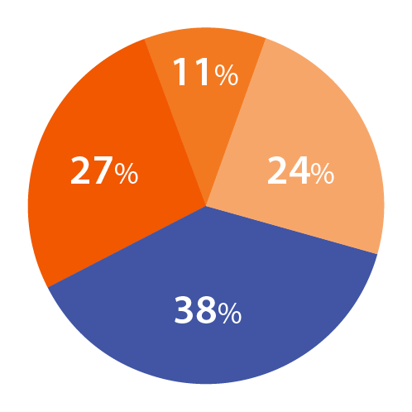
WP2 Overview
Participant
Effort distribution
Beneficiaries: 4
Effort: 72 PMs / 2.2 FTEs
WP4: Management
WP1: iSGTW
WP1:
Policy
23 PM
10 PM
WP2: GridCafé
25 PM
Task 2.1 GridCafé
APO and CERN
Task 2.2 Real Time Monitor and GridGuide Imperial with APO, CERN and QMUL
Task 2.3 GridCast
QMUL with APO and CERN
14 PM

Slide 3
WP2 Objectives
Keep the GridCafé at the cutting edge of grid and e-Science dissemination by refreshing the look and feel and keeping it constantly updated with new material, expanding the content to cover other forms of computing.
Explore interactive environments and new web tools to ensure that GridCafé and GridCast have impact on their audiences and are easy to use.
Update the GridCast website and expand the marketing of the GridCast site to the grid and e-Infrastructure community and beyond.
Expand the GridGuide to cover more sites, improve its impact and develop further interactive functionality between the GridGuide and the Real Time Monitor.
Explore the continuation of the BELIEF Digital Library and support the e-concertation meetings.

Slide 4
Web statistics - Y2
e-Science
Talk
e-Science
City
Grid
Café
Cloud
Lounge
Volunteer
Garage
Grid
Cast
GridCast
Blog
Grid
Guide
Visits
3,258
2,774
19,794
644
530
1,892
12,959
1,807
2,810
-
150,588
-
-
12,574
-
2,040
Unique
visitors
1,972
1,869
10,351
516
358
1,156
9,625
1,470
1,339
-
16,228
-
-
8,293
-
1,549
Pages
viewed
5,741
7,695
67,446
1388
1,298
2,282
19,643
2,352
4850
-
166,212
-
-
20,373
-
2,685
Time
of visit
00:01:32
00:02:55
00:09:51
00:01:53
00:02:37
00:00:40
00:01:24
00:00:55
00:01:30
-
00:01:27
-
-
00:02:23
-
00:00:57
Bounce
rate
69%
60%
64%
69%
62%
86%
73%
81%
72%
-
72%
-
-
73%
-
79%
New
visits
59%
67%
64%
80%
68%
59%
73%
80%
48%
-
76%
-
-
65%
-
75%
Unique Visitors : 27445
Unique Visitors : 27409

Slide 5
WP2 Major achievements

Slide 6
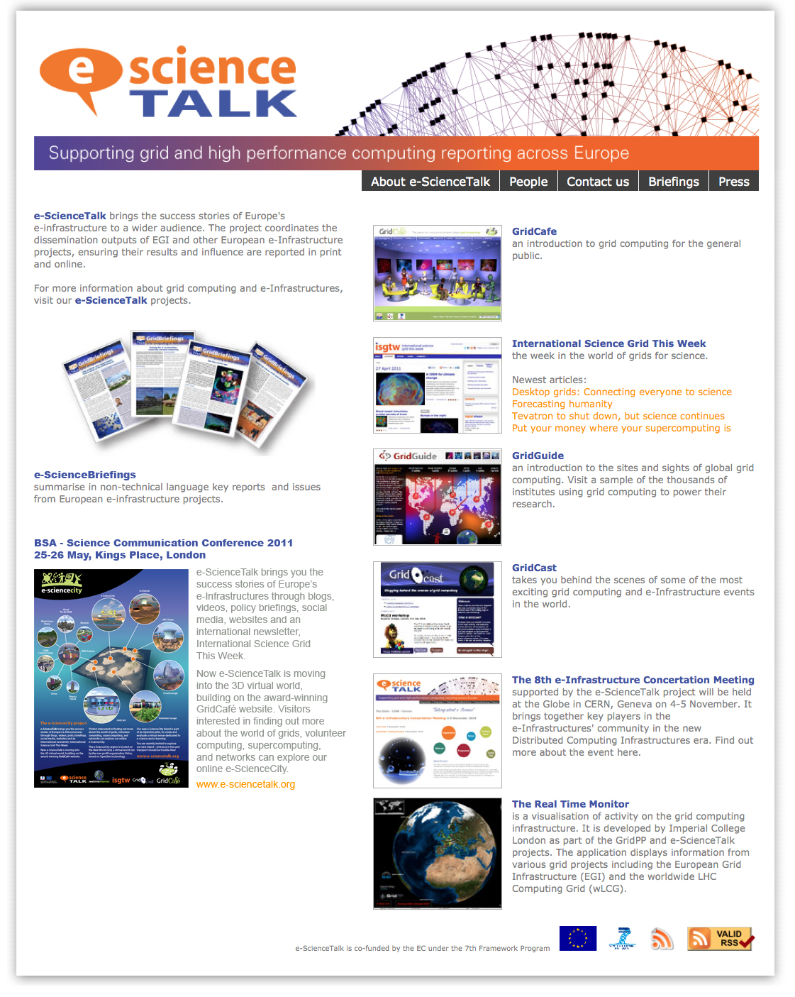
e-ScienceTalk website
e-ScienceTalk is the project website;
it is designed to be a simple-to-use portal,
guiding people to our different websites.
It also gives access to a lot of the project's material such as e-ScienceBriefings (in PDF and HTML versions), posters, leaflets, and other documents produced since the beginning of the project.
We add :
A partner section
New presentation for archive
Link to YouTube channel
Social media links
Twiter display on home page

Slide 7
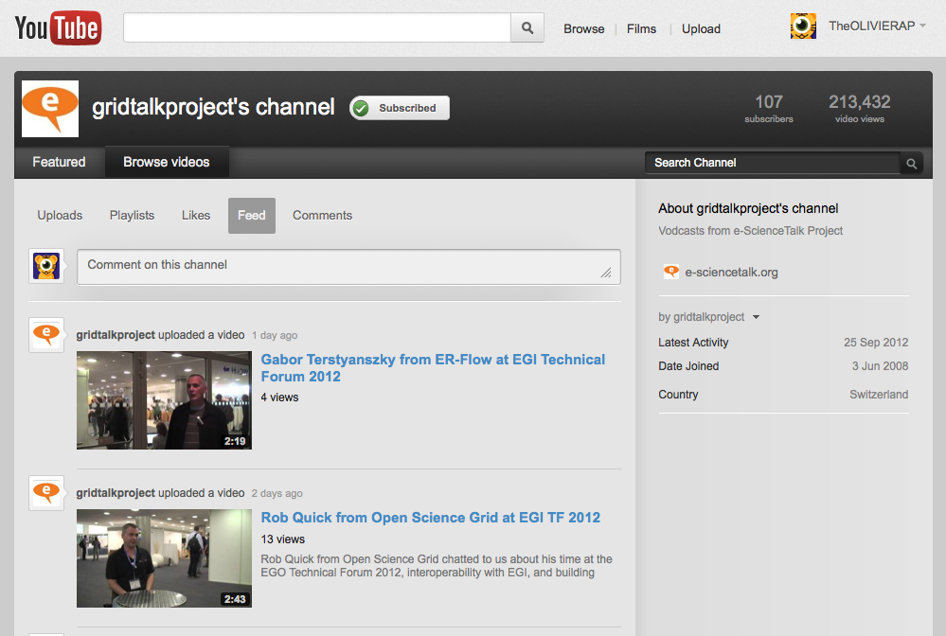
e-ScienceTalk YouTube
229 videos
107 Subscribers
213,280 video views

Slide 8
e-ScienceTalk
What has been done?
Update of portal web site
New You tube channel
Launch of e-Science City
New section in e-Science City
New content on virtual island
Grid Cast participation for 6 even
Launch of GridCast blog
New guides added to the Grid Guide
RTM improvement (need more info)

Slide 9
WP2 Major achievements

Slide 10
e-ScienceCity concept
e-ScienceCity replace the Grid Café as the main web. Grid café become one of the section of the site like the other : Cloud Lounge, Volunteer Garage, HPC Tower...
e-ScienceCity is constructed like a virtual town, with sections dedicated to different areas of e-science; it will also be available to navigate through a 3D virtual world hosted by New World Grid.
e-ScienceCity was launched in September 2011, and has been updated during year 2 of the project. We continue to create new content and sections to populate the site (Network Park...).

Slide 11
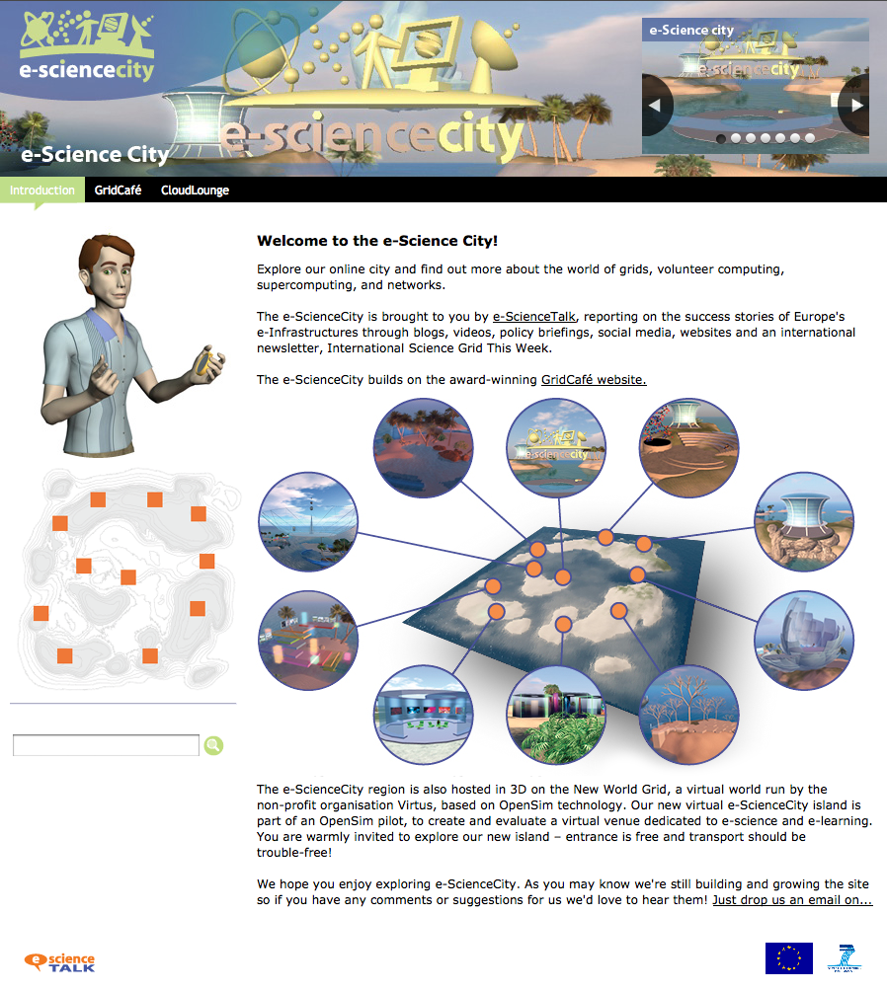
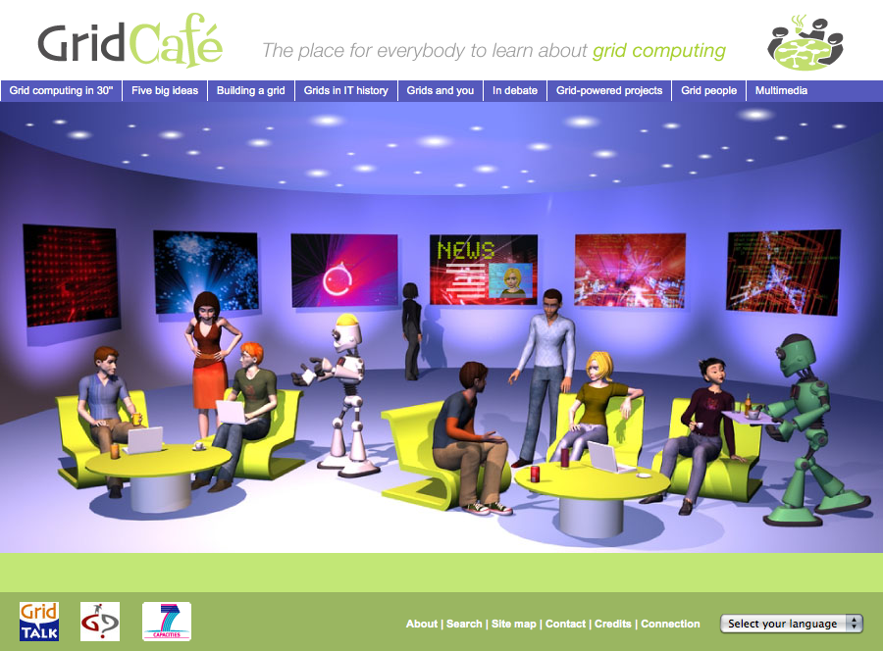
The evolution
From Grid Café to e-ScienceCity

Slide 12
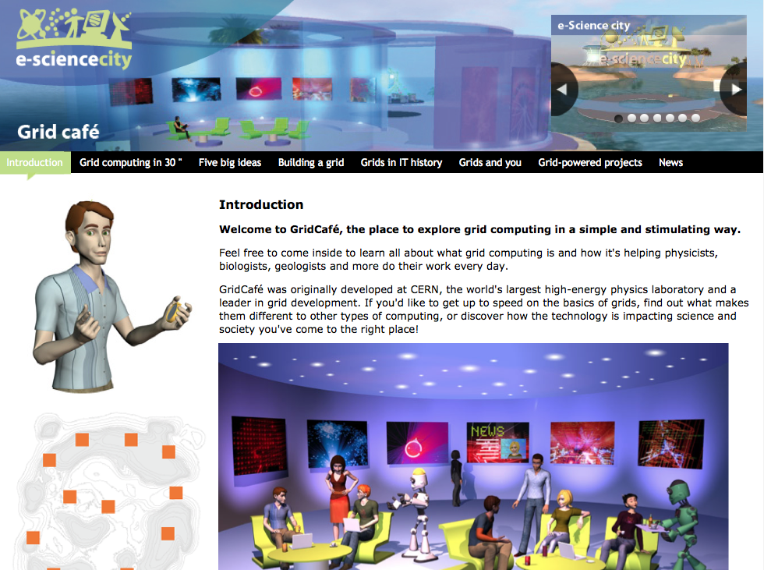
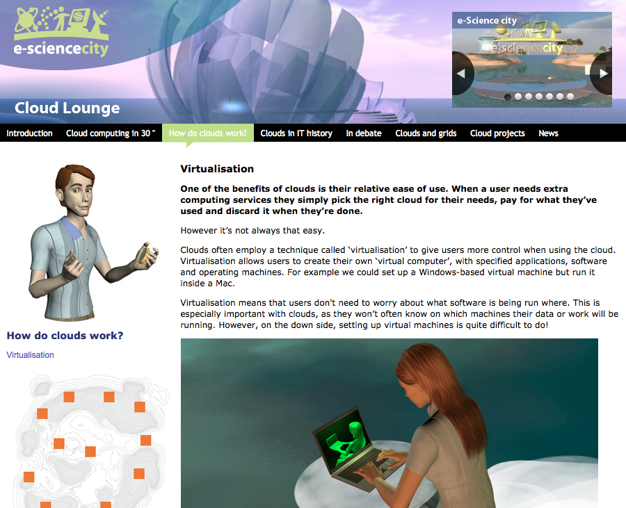
e-ScienceCity website - 1
e-ScienceCity
Homepage
GridCafé
Cloud Lounge

Slide 13
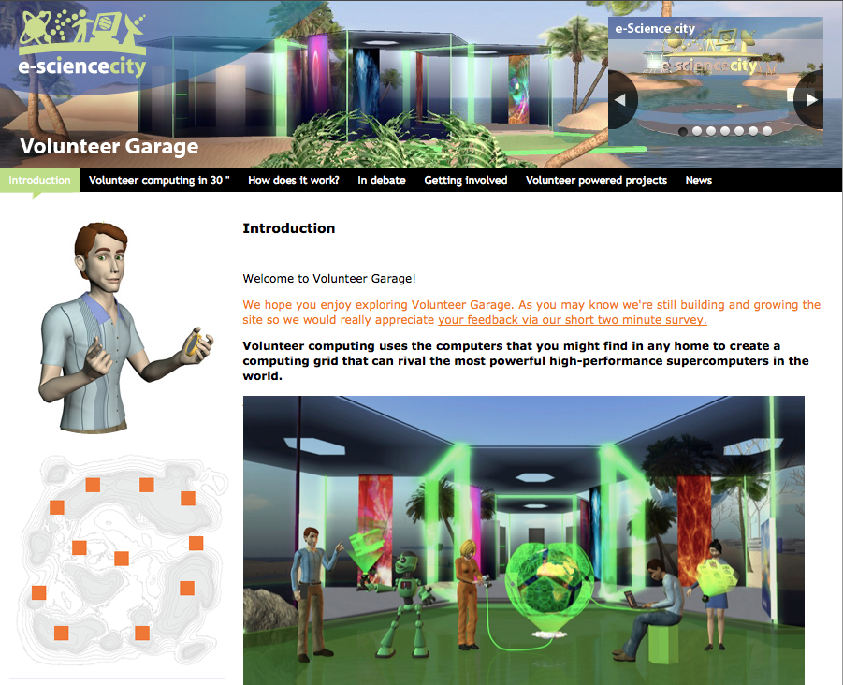
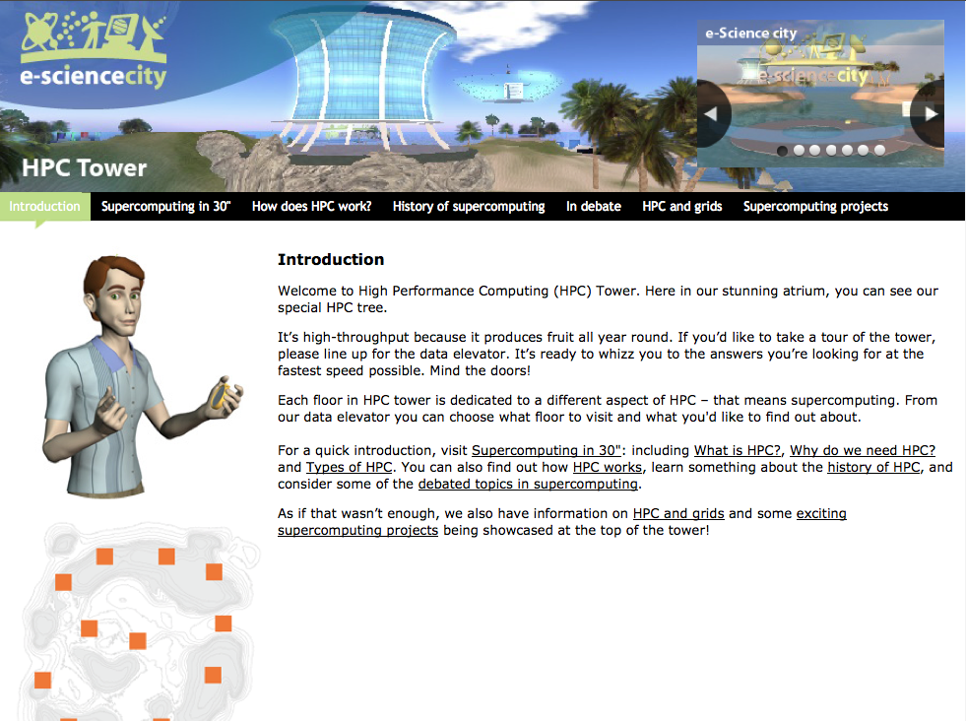
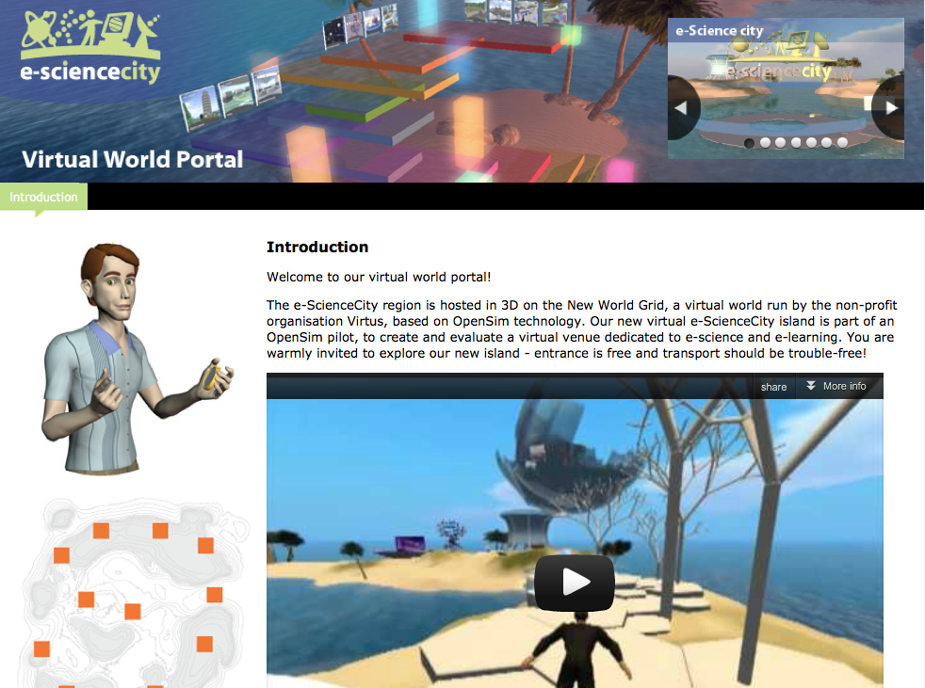
e-ScienceCity website - 2
Volunteer
Garage
HPC Tower
Virtual World
Portal

Slide 14
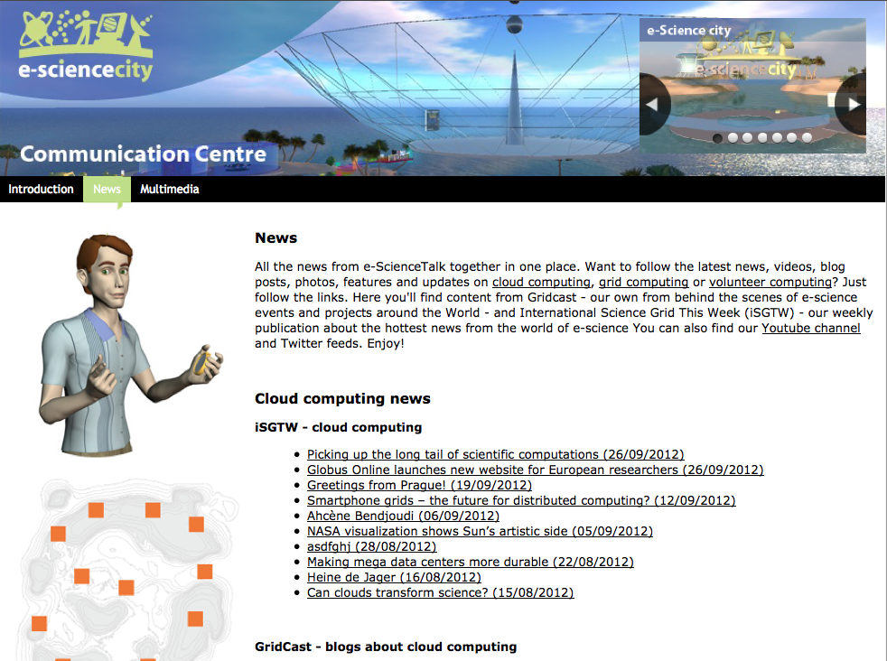
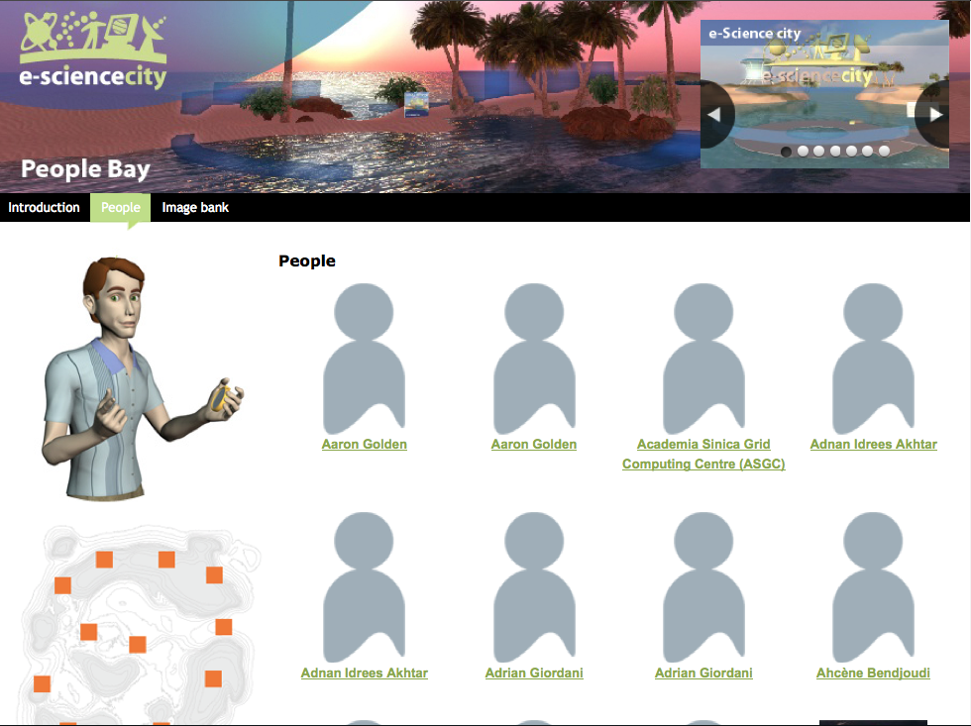
e-ScienceCity website - 3
Total page : 136
^{GridCafé : 39 pages}
^{CloudLounge : 19 pages}
^{Volunteer Garage : 31 pages}
^{HPC Tower : 35 pages}
People : intro page + 1 page by person
^{Virtual World portal :} ^{1 page}
^{Communication centre : 5 pages}
Communication Centre
People Bay

Slide 15
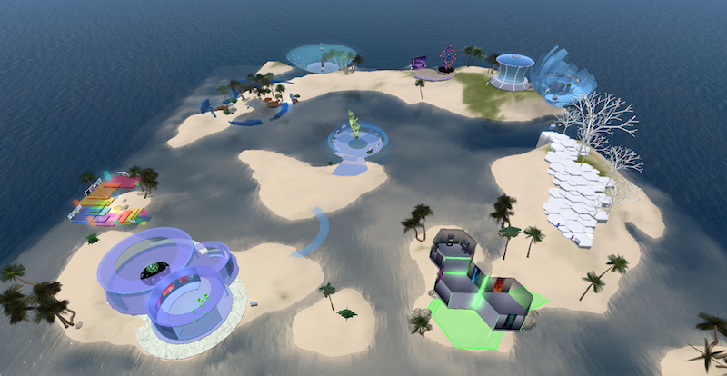
Virtual e-ScienceCity
General view of the virtual e-ScienceCity

Slide 16
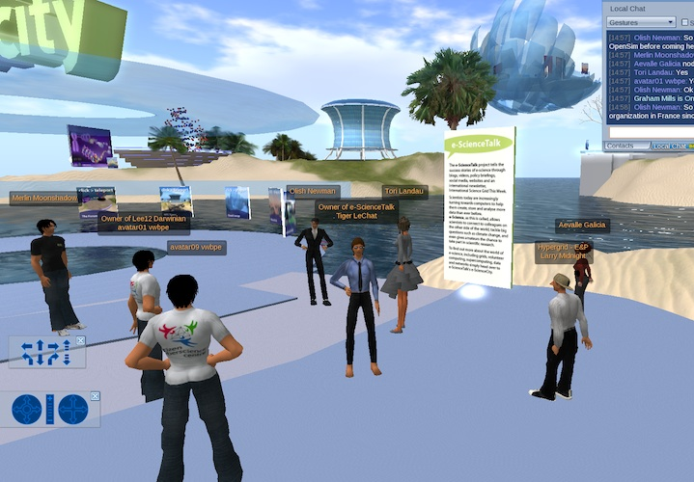
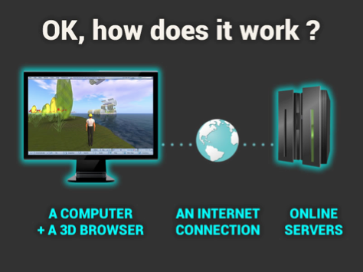
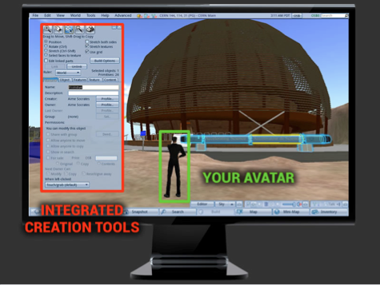
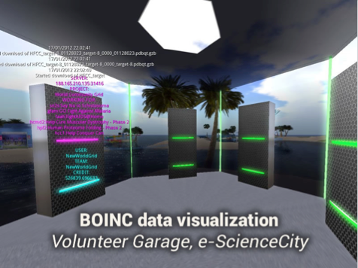
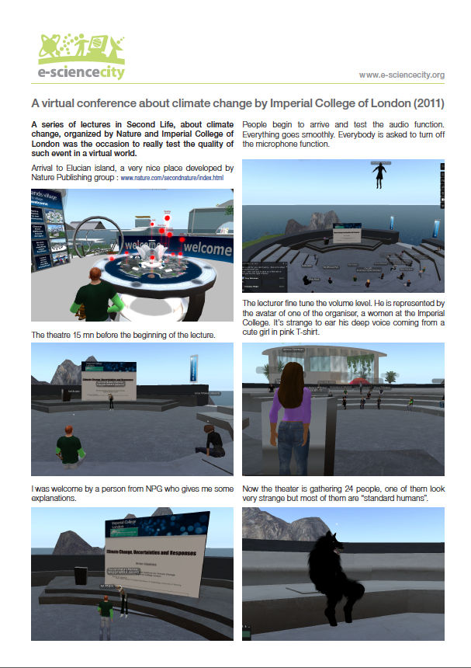
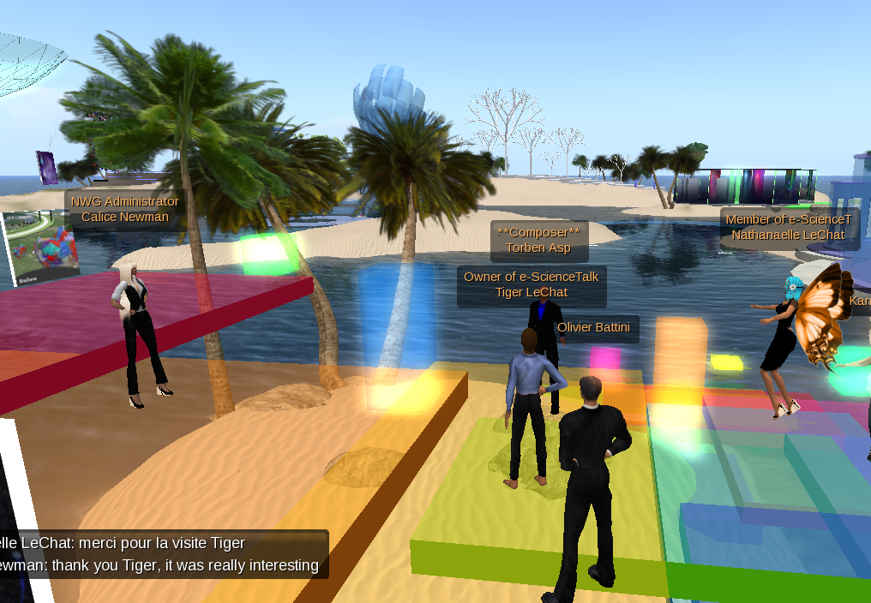
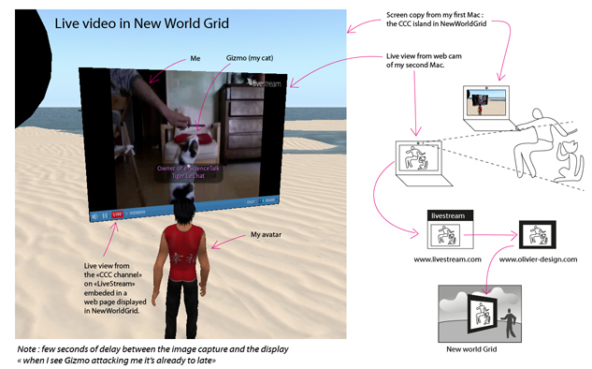
Virtual World promotion
CERN Web Fest with
CCC and Mozilla fondation
Virtual World Best Practice
in Education conference
Help, test and
tutorial about virtual world and OpenSim
New World Grid
OpenDay
^{E-Learning in Lyon}

Slide 17
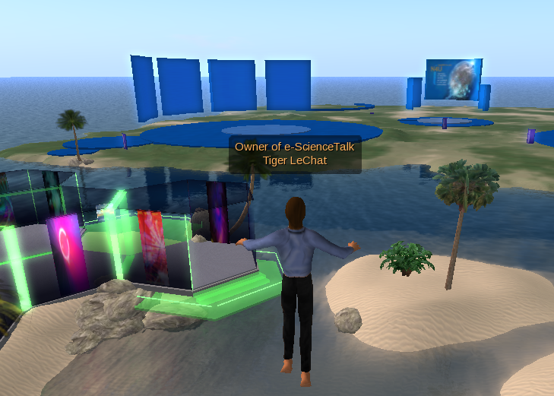
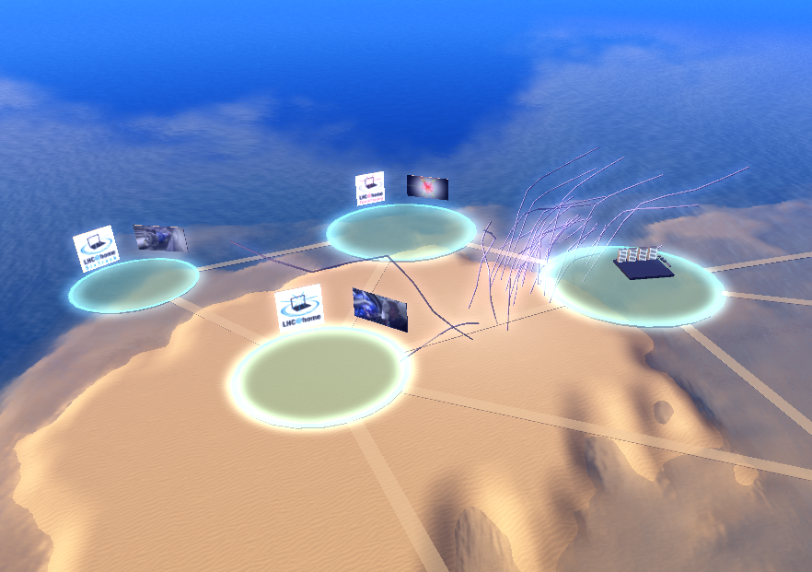
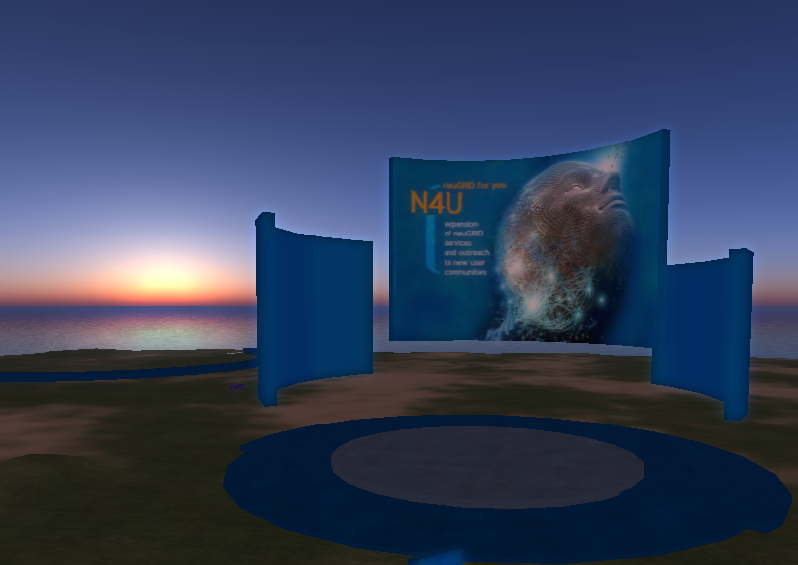
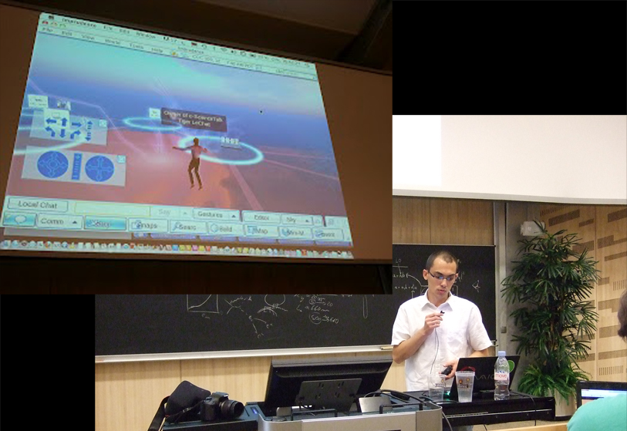
Virtual World linked projects
N4U project an example
of Grid Computing
CCC project examples
for Volunteer Computing

Slide 18
WP2 Major achievements
Notes:
GridCasts

Slide 19
Grid Cast - 1
GridCasts are blogs from major grid computing conferences, taking readers behind the scenes of these events. e-ScienceTalk has held 6 GridCasts and ??? "mini" GridCasts in total:
EGI Technical Forum : Lyon, 19 – 23 September 2011
CCC London Summit: London, 16-18 February 2012
International Symphosium on Grid and Cloud: Taipei, 25 Feb. 3 Mar. 2012
Notes:
GridCasts

Slide 20
Grid Cast - 2
EGI Community Forum : Munich, 26 - 30 March 2012
Gisela-Chain : Mexico, 27 - 29 June 2012
EGI Technical Forum : Prague, 27 – 29 October 2012
Notes:
GridCasts

Slide 21
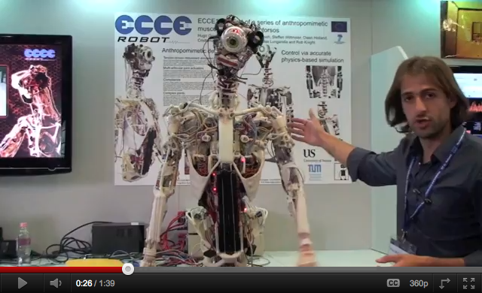
Grid Cast
Mini GridCasts
-
-
-
-
In total this represents --- posts and --- webcasts.
A video filmed by WP2 about a humanoid robot at FET’11 has been viewed more than 50,000 times http://www.youtube.com/watch?v=1dpB1yHxkuA
Notes:
GridCasts

Slide 22
WP2 Major achievements
Notes:
GridCasts

Slide 23
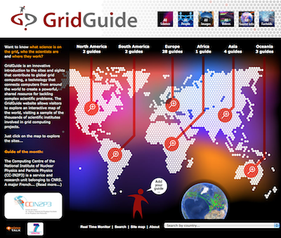
Grid Guide
GridGuide shows the sites and sights of grid computing. Users can view a sample of the sites worldwide that use the grid, introducing the scientists, the science and their institutions.
In total, 59 guides are currently available worldwide.
19 new guides (sites) have been added, with new content.
North America : 10 (+8)
South America : 4 (+2)
Europe : 36 (+ 8)
Africa : 1 (=)
Asia : 5 (+1)
Oceania : 3 (=)

Slide 24
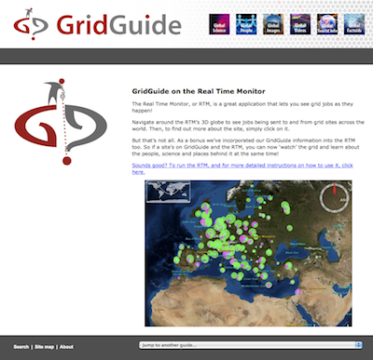
Grid Guide evolution
GridGuide will be transform into
a «e-Science Guide» including some new profil dedicated to other projects than Grid computing projects.
The e-ScienceGuide will be moved into the e-ScienceCity as a new section.
The related virtual venue will be created in the virtual e-ScienceCity

Slide 25
WP2 Major achievements
Notes:
GridCasts

Slide 26
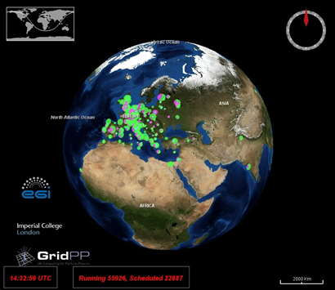
Real Time Monitor

Slide 27
WP2 Issues

Slide 28
WP2 Summary
Project website launched and branding rolled out to templates eg posters, briefings…
New you tube channel
New e-ScienceCity site and Cloud Lounge sites prepared
3D pilot of the e-ScienceCity available in NewWorldGrid
GridCasts at 6 events, and -- mini GridCasts
Total of --- posts and -- webcasts –
59 sites on the GridGuide, including 36 EU sites and 23 non-EU in the US and the Asia-Pacific region (-- in the RTM)
19 new sites added to the GridGuide in 4 continents
RTM ....
“I like the animations and layout, its imaginative”
“I wouldn't change anything”
“I found your site on the web and used it to dive into the topic. The animations and texts really help people with less information
about this topic to understand fast what the topic is all about.”

