Slide 1
WP3: International Science Grid This Week
Andrew Purcell
iSGTW editor, CERN
www.e-sciencetalk.eu

Slide 2
Overview
A typical issue
Top stories & conference coverage
Metrics and readership survey
Summary

Slide 3
WP3 Overview
3 Beneficiaries
52 PMs
1.6 FTEs
Participant no. | Name | Effort (PM)
5 | CERN | 39
2 | QMUL | 8
3 | APO | 5
Task 3.1 Weekly publication (CERN with QMUL)
Task 3.2 New media outlets eg Twitter, Nature Networks (CERN with APO and QMUL)

Slide 4
Objectives
Produce a weekly electronic newsletter to disseminate information about grid-related projects, as well as other e-infrastructure projects around the world, including:
clouds
volunteer grids
supercomputing
networks and data, etc.
Scope also includes EGI and its collaborating projects.
Not just reporting on e-infrastructure, but also the science it underpins.
Draw from the other e-ScienceTalk products and events for sources of stories and to maximise the impact of the work.

Slide 5
Structure
Currently one editor and one writer based at CERN.
New US editor to join the team by the end of the month.
- To be based at University of Indiana
Advisory board
- Currently includes: OSG, University of Indiana, Fermilab, EGI.eu, CERN.
- PRACE and XSEDE to be more formally involved in the future.
Notes:
In partnership with the US

Slide 6
Challenges
Staffing
US funding
Quantitative analysis of readership
Qualitative analysis of readers’ views
The name
Notes:
In partnership with the US

Slide 7
A typical issue
3 feature
articles
Broad,
in-depth
500 –
500 words
Visual
Picture, video or infographic
< 500 words
Spotlight
Fun, narrow focus
< 500 words
Notes:
This is what we see in the newsletter and on the homepage of the website.

Slide 8
A typical issue
calendar
Twitter feed
Most popular, top-rated and editor’s pick stories
Notes:
This is what we see in the newsletter and on the homepage of the website.

Slide 9
A typical issue
In the news News from other publications
Blogs
Other blogs about science or computing
Announcements
Press releases from other organisations
Notes:
In the news: such as HPC Wire, HPC in the cloud,
AUTO-POPULATE

Slide 10
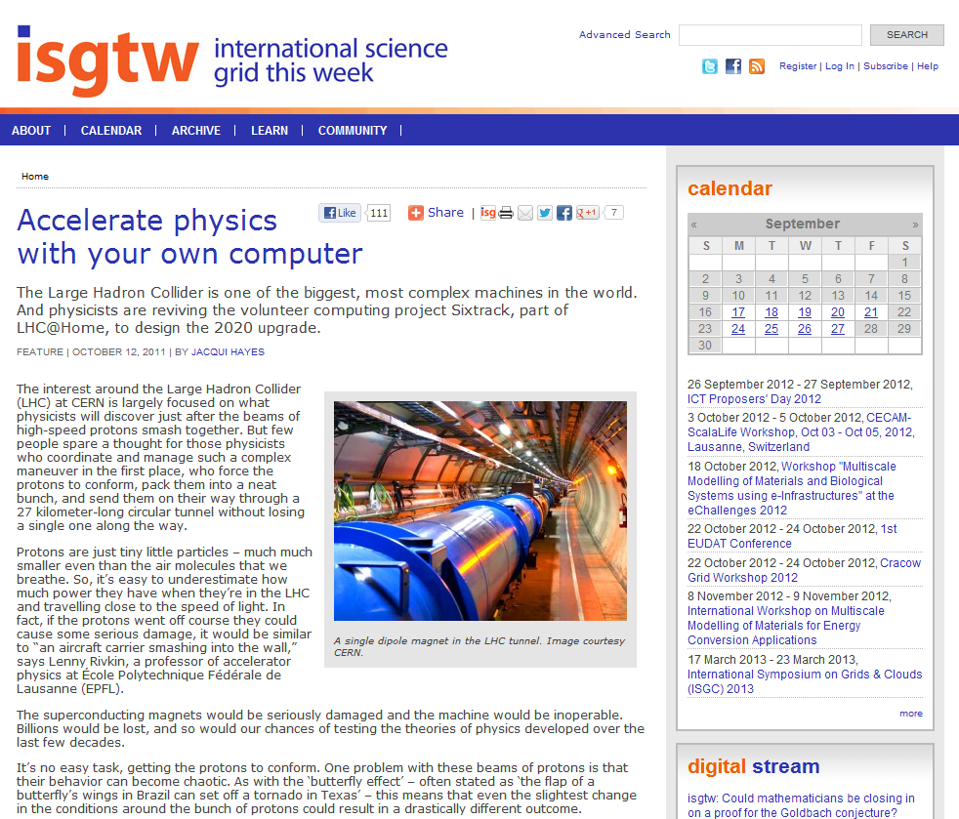
Our stories
Page views: 8,411
Average time
on page: 06:20
Notes:
http://www.isgtw.org/feature/accelerate-physics-your-own-computer

Slide 11
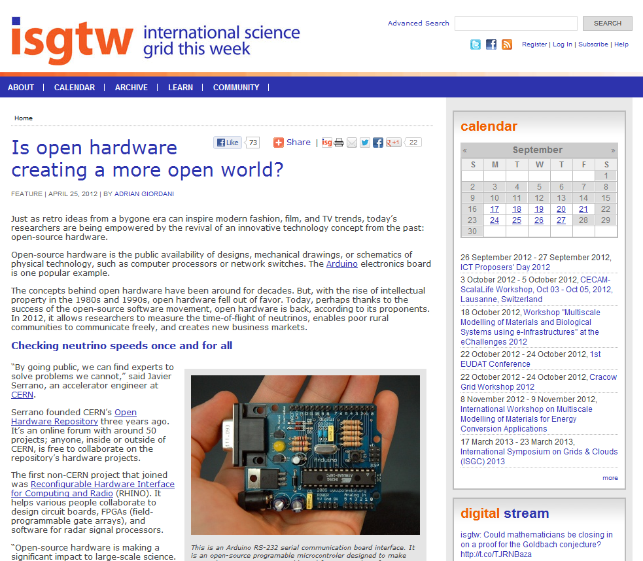
Our stories
Page views: 5,399
Average time
on page: 11:23
Notes:
http://www.isgtw.org/feature/open-hardware-creating-more-open-world

Slide 12
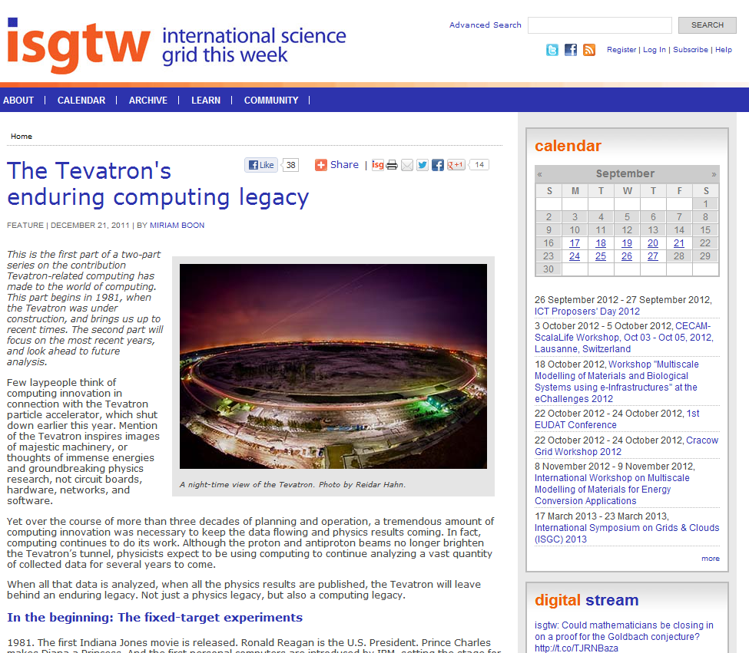
Our stories
Page views: 6,286
Average time
on page: 06:35
Notes:
http://www.isgtw.org/feature/tevatrons-enduring-computing-legacy

Slide 13
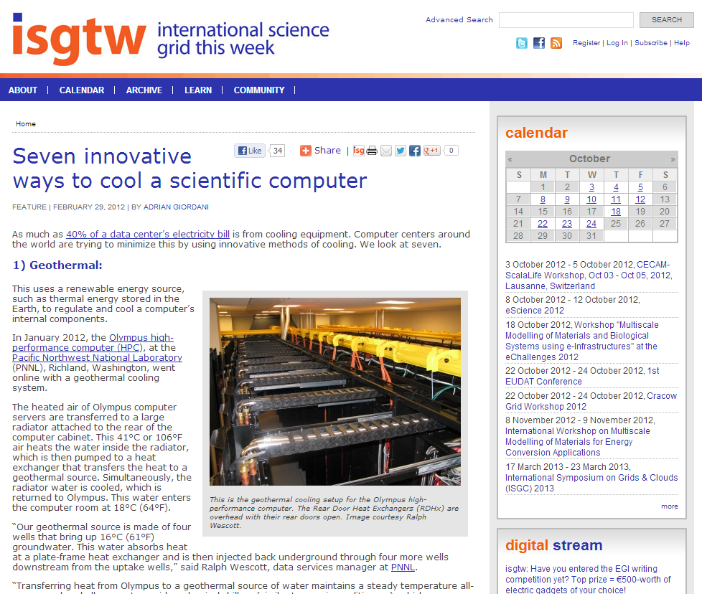
Our stories
Page views: 2,041
Average time
on page: 09:00
Notes:
http://www.isgtw.org/feature/seven-innovative-ways-cool-scientific-computer

Slide 14
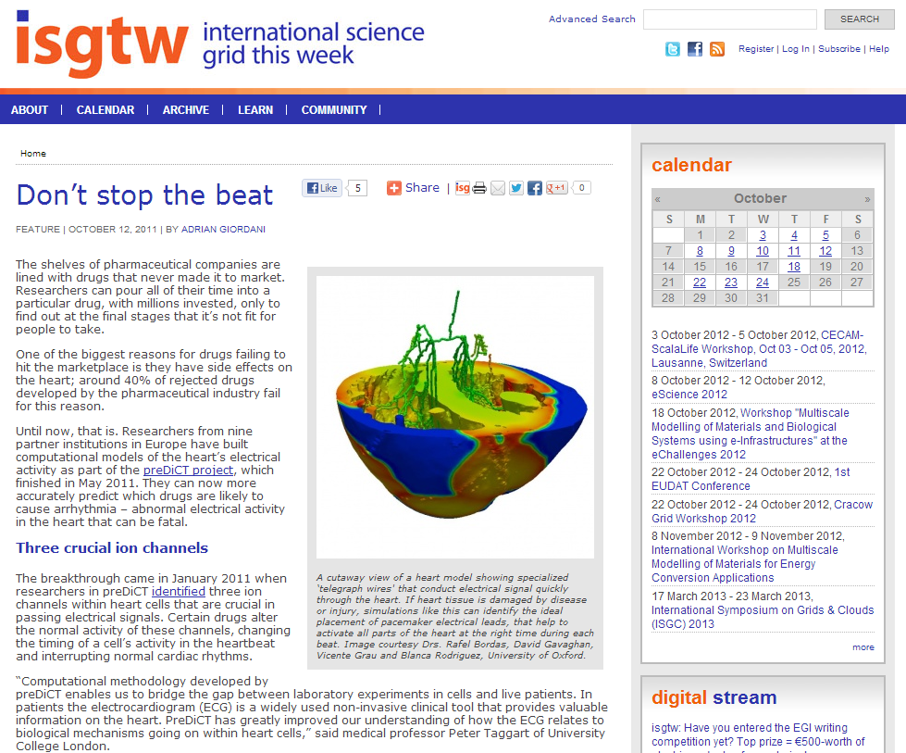
Our stories
Page views: 2,110
Average time
on page: 04:23
Notes:
http://www.isgtw.org/feature/don%E2%80%99t-stop-beat

Slide 15
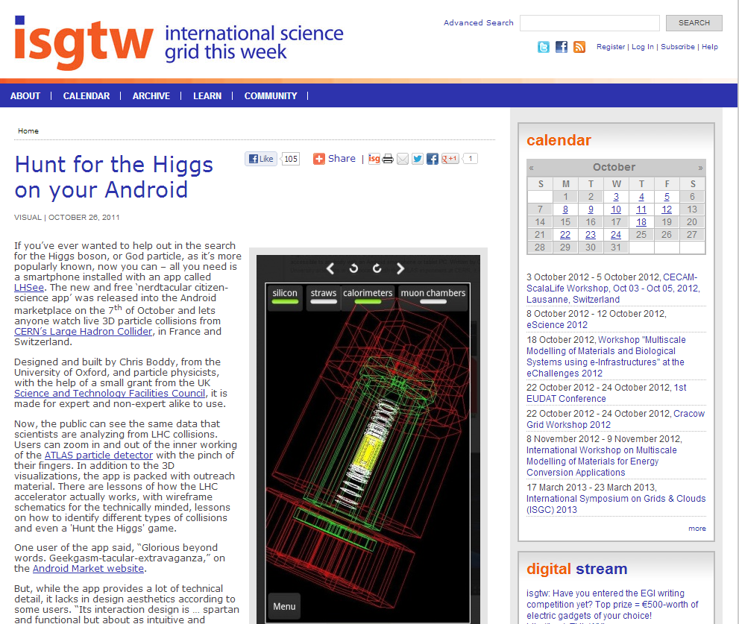
Our stories
Page views: 1,500
Average time
on page: 06:22
Notes:
http://www.isgtw.org/visualization/hunt-higgs-your-android

Slide 16
Conference coverage
Media partnerships
Event highlights
Exclusive stories
In-depth analysis
Brand awareness
Increase readership
Notes:
Munich egi community forum

Slide 17
Media partnerships
Notes:
Media partnership list from PY2 – from Adrian (EGI Technical Forum 2011, Citizen Cyberscience Summit, Cloudscape IV, ISGC'12, EGI Community Forum, HealthGrid'12, XSEDE'12)

Slide 18
Metrics & analysis
Newsletter subscriber numbers, some indication of how these subscribers interact with the newsletter.
Readers’ survey, conducted annually.
Website statistics from Google Analytics.
Social media interactions.

Slide 19
Subscribers
Subscriber numbers have reached a plateau.
No growth over the last year.
However…
8,250 newsletter subscribers

Slide 20
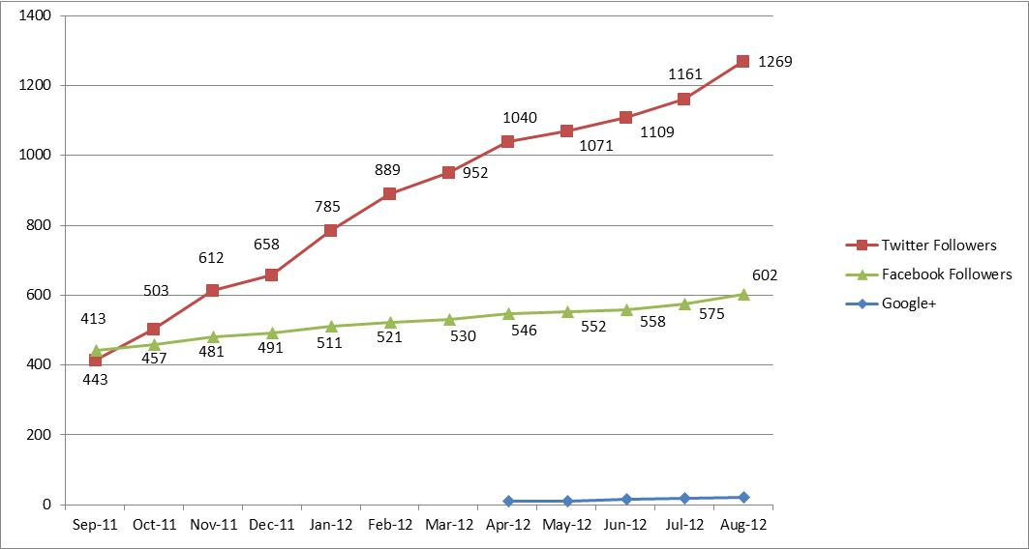
Social media
… growth in readership driven by social media (particularly Twitter) is compensating for this.
News aggregator sites also very important.
(e.g. Reddit, StumbleUpon, Slashdot, Digg, Paper.le, etc.)
1292 Twitter followers
638 Facebook likes
+23 on Google+
Klout score: 54
Notes:
In May 2011, we started a more aggressive campaign to promote iSGTW through branded social media and news aggregators.

Slide 21
Readers’ survey
Ran survey from May to July 2012
Predominately multiple choice
201 respondents
We asked readers for their age, profession, gender, interests, what they liked about iSGTW, how they access/use our website, etc.
Newsletter main source of traffic, but social media becoming more important
Big increase in female readership
Difficulty targeting young readers
Notes:
138 participants last year

Slide 22
Readers’ survey
Announcements/events section underused
Highly engaged readership
Most read more than half of each issue
81% have forwarded/discussed articles
Over 20% have cited or linked to iSGTW in a blog, paper, poster or talk
Inspiring research
Used as a source by others in media
Over 1 in 10 visitors to the site are journalists/science communicators
Articles pitched at right difficulty level and cover good range of topics

Slide 23
The future
Shape editorial policy
Targeting young readers
Continue with efforts to attract more female readers
Increasing visitors through social media
Improve usage of announcements/events section
Track impact more closely
Review the name

Slide 24
Summary
Building on progress from last year.
Maintaining broad scope, both geographically and in terms of subject areas.
Becoming more timely, and hence more relevant a news resource.
New US editor set to begin work next month.
Dedicated audience, which is growing. Making big improvements in terms of engagement via social media engagement.
At the heart of the distributed computing community
“Good informative magazine!”
“I enjoy the science presented - interesting research described.”
“Great job! Congratulations!”
“Keep up the excellent work.”
“Continue the same way, please!”
Notes:
Helping to sustain to sustain the commnity

