Slide 1
Operational Tools Roadmap Introduction
D.Cesini (INFN/IGI)

Slide 2
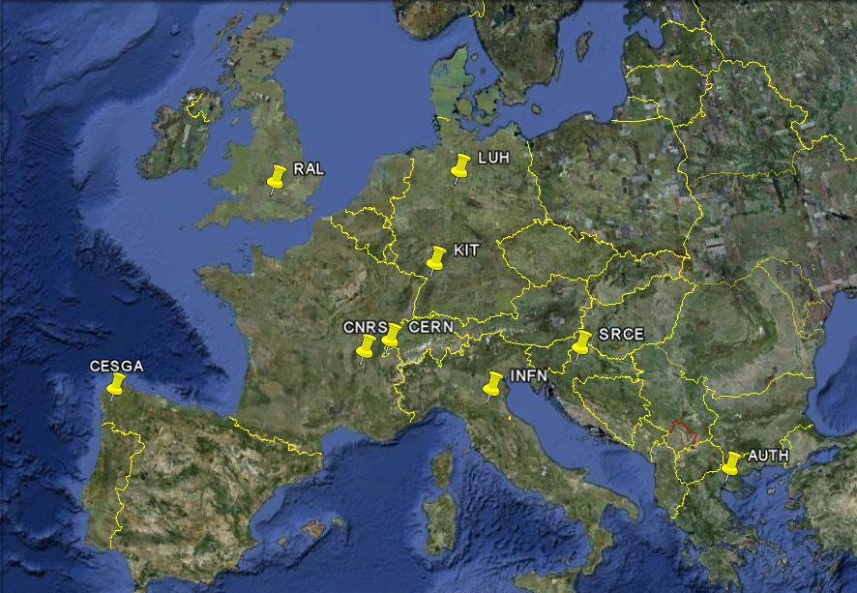
Tools developed by EGI-JRA1
Operation Portal (CNRS)
EGI Helpdesk (KIT)
GOCDB (RAL)
Accounting Repository (RAL)
Accounting Portal (CESGA)
SAM/MyEGI (CERN/SRCE)
Metrics Portal (CESGA)

Slide 3
Other activity tasks
Message Broker Configuration to support tools and operation (AUTH)
Accounting for different resource types (LUH/INFN/RAL)
Billing
Accounting of application usage
Accounting of data usage
Accounting of capacity and cloud computing usage

Slide 4
Focus during the first months
Setup of the activity and development infrastructure
Group, wiki, mailing list, PPT info, etc…
New Releases
Migration to egi.eu domain of the central tools urls and mailing lists
Regionalisation
Nagios probes to measure tools availability
Documentation review

Slide 5
Outcome of the first months
The activity is operative since the beginning of the projects:
3 GGUS releases (including xGUS)
4 NAGIOS/myEGI/Messaging updates
GOCDB4 PI in production and new Input System under test
Ops Portal regional package
Metrics Portal update to support GSTAT2

Slide 6
Tools developed outside EGI
GSTAT2.0 (CERN)
Availability Calculation Engine (CERN/BARC)
Gridview (CERN/BARC)
Network Monitoring tools
MyOSG Portal
Interaction through the new OAT

Slide 7
Requirements Collection
Through the Operational Tools Advisory Group (OTAG)
ToR available at: https://documents.egi.eu/secure/ShowDocument?docid=103
RT queue available containing previous OTAG open issues
Group, wiki and mailing list already defined
The first EGI OTAG during the next weeks

