Slide 1
Operations Portal WorkPlan
Cyril L’Orphelin IN2P3/CNRS
EGI Technical Forum 2010

Slide 2
Plan
Presentation of the Portal
Migration to SYMFONY
Regional PACKAGE
Lavoisier 2.0
GOC DB Harmonization
Integration of new resources

Slide 3
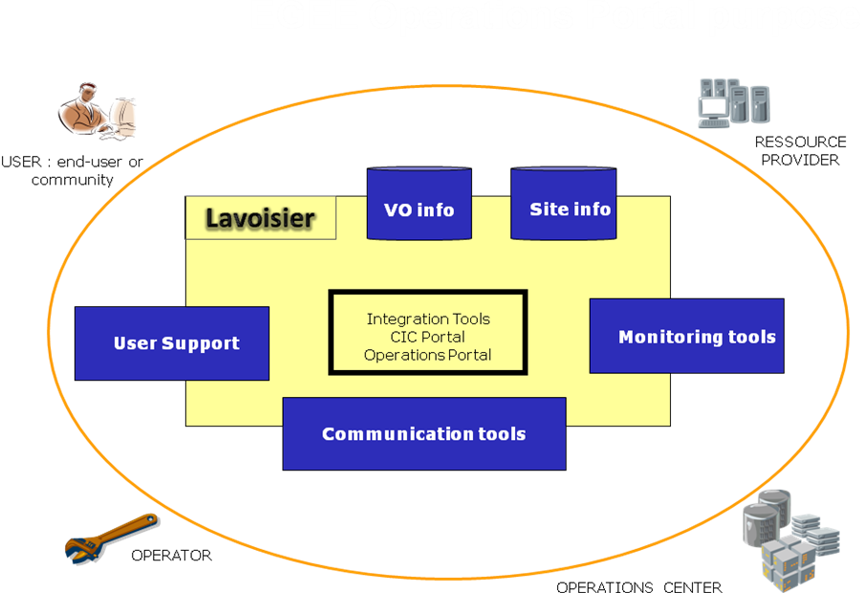
Presentation of the Portal
The operations portal proposes :
Tools for operations
Tools for communication
Tools to manage VO informations
For different actors:
Site administrators
Regional Managers
Vo Managers
End Users

Slide 4
Presentation of the Portal
The Operations Portal has been developed during EGEE project at IN2P3-CC in SA1 activity and is now integrated into the JRA1 activity of EGI-InSPIRE
The historical portal namely “CIC Portal”
http://cic.gridops.org
This portal is migrated step by step to Operations Portal
https://operations-portal.in2p3.fr
The dashboard is the first module we have migrated to Symfony .
The main objective of this year is to migrate completely the CIC portal under the new framework :
To ease the maintability
To ease the developments
To keep only one portal more clearer , and more robust
https://operations-portal.egi.eu

Slide 5
Migration to SYMFONY
THE VO ID CARD
The VO ID Card system records the life cycle of a given VO and links the VO managers to the project management for operations. The data is stored in the CIC DB, hosted at CC-IN2P3.
The next Symfony ported version will include:
a new “look and feel” of the features
the integration of new work-flows including :
yearly VO registration renewal
workflow for VO deregistration

Slide 6
Migration to SYMFONY
THE BROADCAST TOOL
With this tool every authenticated user (users with a grid certificates) are able to contact several categories of stakeholders impacted by a problem, an announcement, or a specific release. The aim is to provide to the different actors of the grid community with the information by mail or RSS feeds
The next version in Symfony will provide:
a new “look and feel” of the features revised for the EGI era
the integration of new mailing lists provided by EGI
the integration of templates
the possibility to add customized contact lists
the possibility to save personal settings for announcements for future use
the possibility to attach a file to the broadcast.

Slide 7
Migration to SYMFONY
THE NOTIFICATION MECHANISM
The mechanism provided is based on the "supply and demand" rule. A site manager registers a downtime and grid users request to be notified or not via a subscription through the Operations Portal.
This solution is currently based on mail notifications or RSS feed. We want to extend this solution to technologies based on messaging system (Java Messaging System – ActiveMQ)
The main idea is to create on the fly the topics dedicated to a specific downtime notification at different levels:
one topic about the downtimes declared for a NGI
one topic about the downtimes declared for a site
one topic about the downtimes declared for a service endpoint
one topic about the downtimes impacting a specific VO

Slide 8
REGIONAL PACKAGE
A regional package has been developped and is available via SVN
https://cvs.in2p3.fr/operations-portal/package/
The regional application is composed with the same architecture than the central one :
A web service module named Lavoisier
A php module used to deploy the database
Already deployed in NGI_CZ and NGI_GRNET
The central instance and the regional ones are synchronized
This regional package will be constantly improved during the coming year:
To add some of the other features that will be integrated step by step into the Central Instance.
These features will be added one by one into the central instance and if relevant to a regional instance we will provide an update to the package.
To ease upgrade and set-up of the package in the regions

Slide 9
Lavoisier 2.0
Lavoisier :The mechanism used to build unified views from heterogeneous data sources
Refactoring of core engine
based on JMS to increase flexibility for notifications
within a Lavoisier instance (through in-memory messages)
between Lavoisier instances (though OpenWire protocol)
improve extensibility with adapter interfaces
Data protocol connectors and data format transformers
Cache content managers
Cache refresh triggers
Cache refresh schedule
Propose a programmatic interface on the top of Lavoisier with XQuery and XPath queries

Slide 10
GOC DB Harmonization
This work deals with the integration of GOCDB and the Operations Portal under a common interoperable toolkit for grid operations which will be done following two main directions:
Integration of a common central human interface allowing users to access both central services through a single entry point.
Integration of interoperable back ends for distribution to NGIs as a single package if possible.
This work has already started (some information are exchanged between GOC DB and Operations Portal) but a study of a complete integration will be done in the next months.

Slide 11
Integration of new resources
The integration of different Information Systems present into different middlewares such as ARC, UNICORE, or Globus will be done via an abstraction layer.
One possibility could be the SAGA Service Discovery specification integrated into a Lavoisier plug-in which will permit to access information using different services .
https://www.egi.eu/indico/contributionDisplay.py?contribId=137&sessionId=98&confId=48

