Slide 1
Globus Online service for EGI VOs
http://www.globusonline.eu/
Gergely Sipos, Karolis Eigelis EGI.eu
ucst@egi.eu

Slide 2
Outline
Motivation
Experiences
GridFTP servers
SRM endpoints
Recommendations
For user communities (Cookbook)
For Globus Online developers
For EGI

Slide 3
Motivation
Using Globus Online in EGI is not trivial
Different storage types, not only GridFTP
Different information systems (GOCDB, BDIIs)
Different storage configurations
GOCDB includes 10 globus-GridFTP servers from 7 hosting sites
egee.srce.hr, egee.irb.hr, egee.fesb.hr, oxford-ngs2, DGIREF, LRZ-LMU, NGS-HUDDERSFIELD
BDII includes
SRM storages: 79 dCache, 217 DPM, 54 Storm
~50 other storages (e.g. bestman, ARC, castor, HDFS, xrootd)
299 (out of the 483) BDII storage elements include GridFTP servers
Versions: 2.3 | 2.7 | 2.8 | 3.23 | 3.28 | 3.33 | 6.10 | 6.14 | 6.5
GOALS:
Provide best practices on using EGI resources with the current service
Propose service improvements for an improved user experinence

Slide 4
Resources used for the tests
Globus Online:
http://www.globusonline.eu
MyProxy server:
px.grid.sara.nl
User Interface:
bosui.nikhef.nl
BDII:
bdii.grid.sara.nl
Storage Elements:
DPM 1.8.2 - tbn18.nikhef.nl dCache 2.2.4 - srm.grid.sara.nl Storm 1.8.2 - bostorm.bo.infn.it
VO: dteam
+ EGI Helpdesk, Globus Online helpdesk, & direct emails to people in IGE, VERCE, ...

Slide 5
Experience with GridFTP servers
Only 2 worked out of 10
Site name | Site contact | Result
egee.srce.hr | egee-cegc-sa1-siteadmin@srce.hr | No response
egee.irb.hr | lcg-admin@irb.hr | No response
egee.fesb.hr | egee-siteadmin@fesb.hr | No response
oxford-ngs2 | ngs-help@oerc.ox.ac.uk | No response
DGIREF | oleg.dulov@kit.edu | No response
LRZ-LMU | lcg-admin@lists.lrz.de | Access provided (some permission issues)
NGS-HUDDERSFIELD | i.kureshi@hud.ac.uk | Access provided (supports grid proxy, not VOMS proxy)
Issues (for EGI Operations to deal with):
There is no single process on how to access these services
These services operate outside of VOs
The site admins are unresponsive
Why are these services in GOCDB, while other services are in BDII?

Slide 6
Tranferring files between SRM sites Source: SRM 2.2 in General, Presentation by Patrick Fuhrmann, SRM Tutorial 2007: http://www.dcache.org/manuals/workshop-cologne-2008/srm-tutorial-theory-general-20080412.pdf
Missing from Globus Online
Missing from Globus Online
Source
Target

Slide 7
Experience with SRM endpoints
DPM and dCache work. The process:
Get the list of SEs that support your VO
Query the BDII
Find the SRM endpoint for the SEs
Query the BDII
Find your home directory on the SRM endpoint (This is where you can write files)
Query the BDII
For each SRM endpoint find it’s related GridFTP endpoint
This is not in BDII - Do an SRM file copy from command line
Register the GridFTP endpoints in Globus Online
Upload a proxy into a MyProxy server
Use your MyProxy server for the endpoints in Globus Online; Activate the endpoints; Define and run file transfers
Storm does not work.The problem must be with either
directory permissions (direct use via GridFTP is not allowed?) or
directory settings (wrong home directory published in BDII?)

Slide 8
Mixed use of GridFTP and SRM endpoints
Theoretically possible, but non-trivial:
globus-GridFTP endpoints use globus proxy, SRM endpoints use GridFTP with VOMS proxy
User needs to have two MyProxy accounts which store two different types of proxies
More proxies mean more work from command line
SARA MyProxy
stores proxies for 7 days
within this period provides proxies that are valid for 12 hours
These values can be modified when the proxy is uploaded

Slide 9
Using SRM storages through GridFTP?
Answers from EGI Helpdesk
srmPrepareToPut, srmPrepareToGet, copy, srmPutDone
Otherwise:
Server can break
Space allocation are not properly measured
Experience:
No breaking, no problem with space allocation

Slide 10
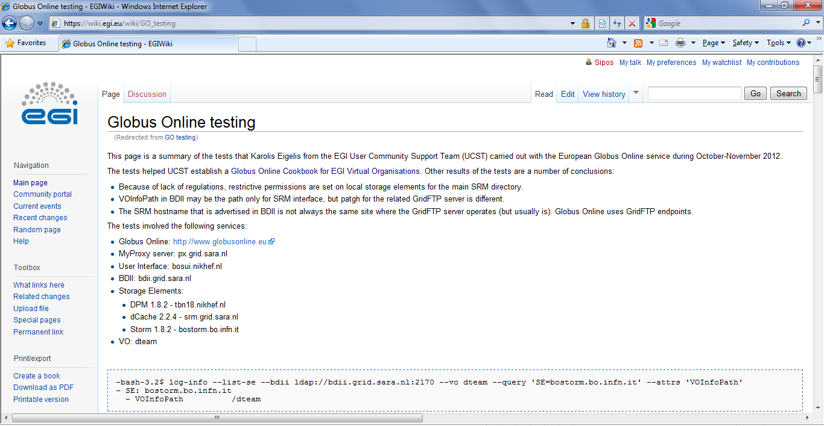
Test report
https://wiki.egi.eu/wiki/Globus_Online_testing

Slide 11
Globus Online cookbook for EGI VOs
https://wiki.egi.eu/wiki/Globus_Online_cookbook_for_EGI_VOs
DPM and dCache work. The process:
Get the list of SEs that support your VO
Query the BDII
Find the SRM endpoint for the Ses
Query the BDII
Find your home directory on the SRM endpoint (This is where you can write files)
Query the BDII
For each SRM endpoint fine its related GridFTP endpoint
This is not in BDII - Do an SRM file copy from command line
Register the GridFTP endpoints in Globus Online
Upload a proxy into a MyProxy server
Use your MyProxy server for the endpoints in Globus Online; Activate the endpoints; Define and run file transfers
VO Manager
VO Members

Slide 12
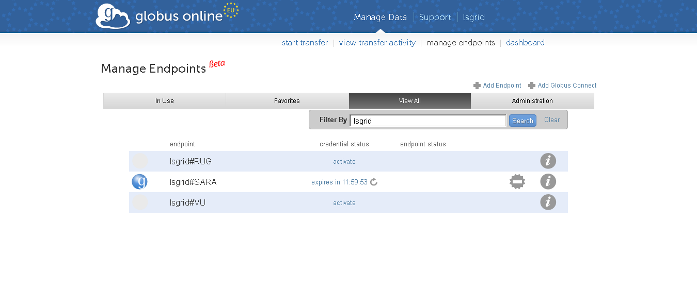
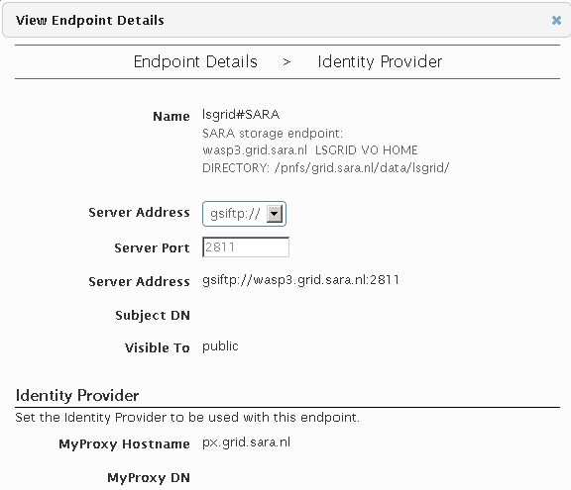
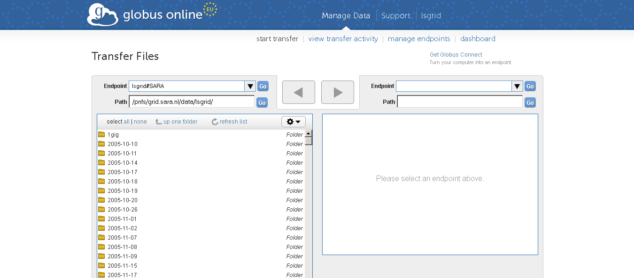
Example: The lsgrid VO in Globus Online

Slide 13
Recommendations for Globus Online
‘.’ should be allowed in endpoint names
Endpoints represent sites, sites have ‘.’ in their name.
‘.’ and ‘-’ should be allowed in user names
Username should represent VO name following the Cookbook
Many EGI VO names include ‘.’ and ‘-’
Directory permissions are not displayed
One cannot know who can read/write different directories
Error messages do not state failures because of permission-mismatch

Slide 14
Recommendations for EGI
Get the cookbook reviewed
By VOs - VERCE?
By SRM experts (what could go wrong?)
Setup a MyProxy server that VOs can use
Already ongoin at CESNET.
To use EGI SSO accounts
Deploy a graphical tool for proxy upload
NGS CertWizard?, P-GRADE Portlet?
New policy on how to configure and register storage endpoints in BDII
Users’ home directory is at the same place on every site
GridFTP endpoints of SRM sites are in BDII

Slide 15
Questions, discussion

