Slide 1
iSGTW Advisory Board Meeting
Wednesday 14 November, 2012
Salt Lake City, Utah
Status Report
Andrew Purcell
Editor

Slide 2
Overview
Recruitment
EC Project Review
Site stats
Readership Survey
Media Partners
Online Workflows
Andrew Purcell
Editor

Slide 3
Recruitment
Andrew Purcell
Editor
Started August
Based at CERN
Amber Harmon
US Editor
Started last Thursday
Based at Indiana University
Andrew Purcell
Editor

Slide 4
EC Project Review
Brussels
15 October, 2012
Site stats
Readership Survey
Feedback
Andrew Purcell
Editor

Slide 5
Site Stats
8,250 newsletter
subscribers
Subscriber numbers have reached a plateau.
No growth over the last year.
However…
Andrew Purcell
Editor

Slide 6
Site Stats
161,624 unique visitors
316,352 pages viewed
01:37 average duration of visit
71% bounce rate
76% new visits
Andrew Purcell
Editor
Notes:
125,000 unique visitors
266,000 pages viewed
01:36 average duration of visit
73% bounce rate
71% new visits

Slide 7
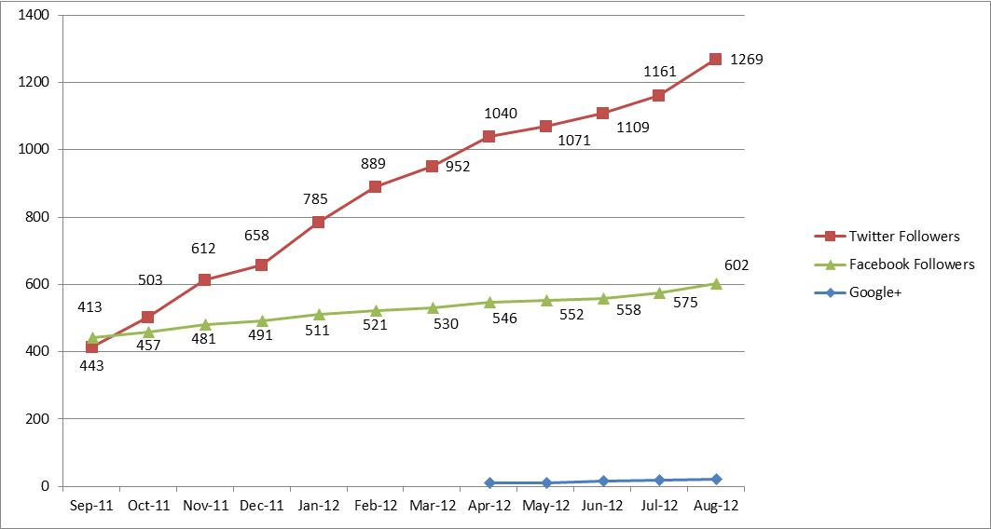
Site Stats
… growth in readership driven by social media (particularly Twitter) is compensating for this.
News aggregator sites also very important. (e.g. Reddit, StumbleUpon, Slashdot, Digg, Paper.li, etc.)
1292 Twitter followers
638 Facebook likes
+23 on Google+
Klout score: 54
Andrew Purcell
Editor

Slide 8
Readership Survey
Ran survey from May to July 2012
201 respondents
We asked readers for their age, profession, gender, interests, what they liked about iSGTW, how they access/use our website, etc.
Newsletter main source of traffic, but social media becoming more important
Big increase in female readership
Difficulty targeting young readers
Andrew Purcell
Editor

Slide 9
Readership Survey
Announcements/events section underused
Highly engaged readership
Most read more than half of each issue
81% have forwarded/discussed articles
Over 20% have cited or linked to iSGTW in a blog, paper, poster or talk
Inspiring research
Used as a source by others in media
Over 1 in 10 visitors to the site are journalists/science communicators
Articles pitched at right difficulty level and cover good range of topics
Andrew Purcell
Editor

Slide 10
Readership Survey
Shape editorial policy
Targeting young readers
Continue with efforts to attract more female readers
Increasing visitors through social media
Improve usage of announcements/events section
Track impact more closely
Andrew Purcell
Editor

Slide 11
Media Partners
Andrew Purcell
Editor
Notes:
Media partnership list from PY2 – (EGI Technical Forum 2011, Citizen Cyberscience Summit, Cloudscape IV, ISGC'12, EGI Community Forum, HealthGrid'12, XSEDE'12)

Slide 12
Online workflows
Online flatplan
Timeplan
Guidance for new contributors
Social media guidance
Style guide
Andrew Purcell
Editor

