Slide 1
iMarine Cool tools and high level experts for fisheries management and knowledge
Donatella Castelli
CNR-ISTI, Pisa

Slide 2
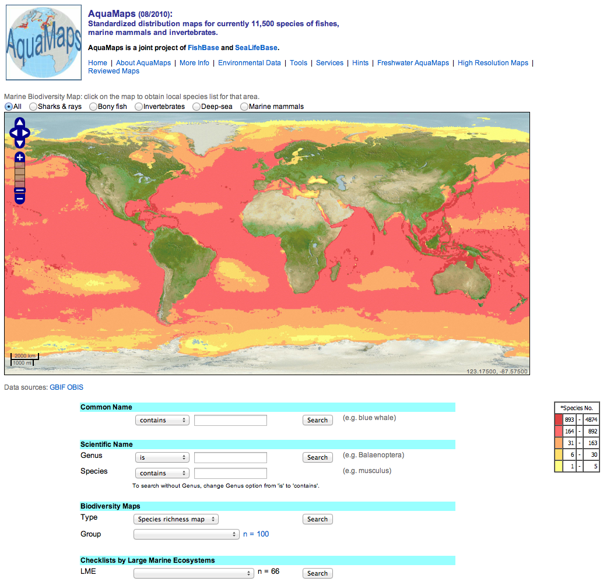
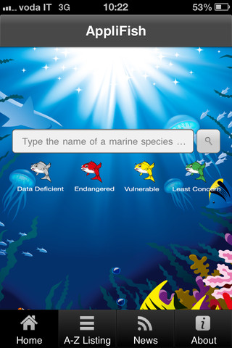
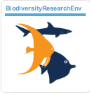
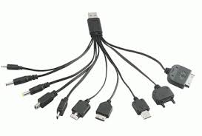
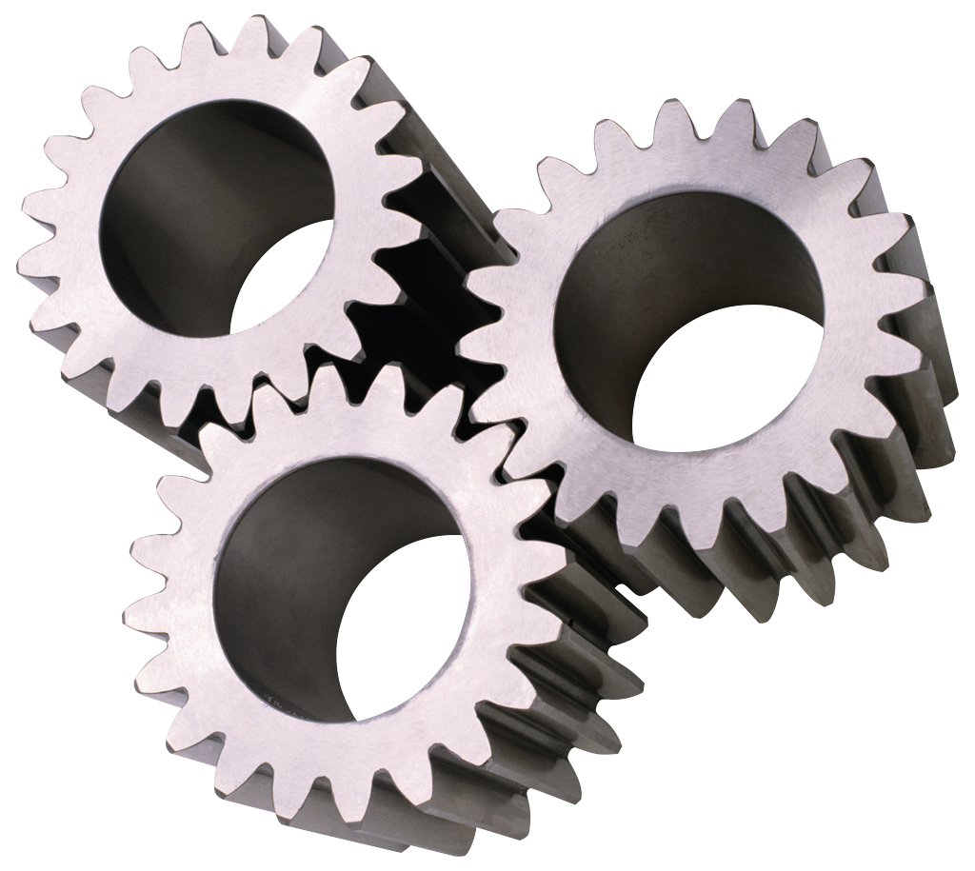
iMarine e-Infrastucture
Establishing and operating an e-infrastructure contributing to the implementation of the principles of the Ecosystem Approach to Fisheries Management and Conservation of Marine Living Resources
Virtual Research Environments
APIs
Notes:
Access anywhere anytime

Slide 3
AppliFish: Pocket book of marine knowledge
Data collected and produced from many scientists from all over the world
Several international organizations involved
A complex supporting data e-infrastructure
Basic information of over 550 marine species
Notes:
IUCN species conservation status
International Union for Conservation of Nature
FAO aquatic species fact sheets
AquaMaps species probability maps
AquaMaps species 2050 probability maps
Local names from Fishbase, SeaLifeBase and WoRMS
Links to data sources, such as OBIS, Fishbase/SeaLifeBase, FAO
The following FAO criteria were used for selecting species available in this app:
an annual catch exceeding 10 thousand MT
importance for local industry or social groups
commercial value
endangered or vulnerable species
importance to aquaculture
by-catch
potential future importance to fishery

Slide 4
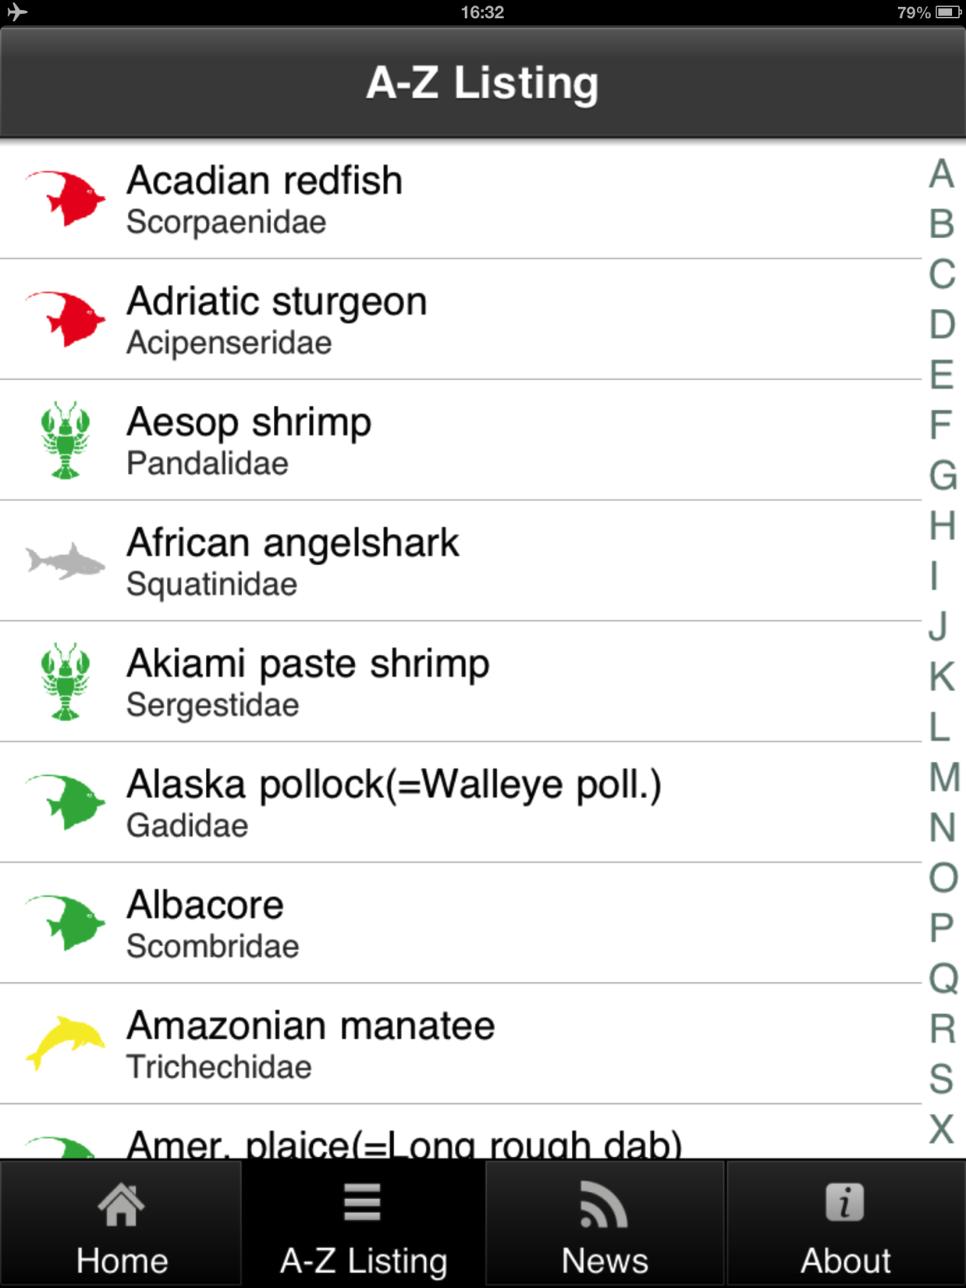
Species conservation status
Classification from IUCN
(International Union for Conservation of Nature)
Notes:
IUCN at a glance
Founded in 1948 as the world’s first global environmental organization
Today the largest professional global conservation network
A leading authority on the environment and sustainable development
More than 1,200 member organizations including 200+ government and 900+ non-government organizations
Almost 11,000 voluntary scientists and experts, grouped in six Commissions in some 160 countries
IUCN’s work is supported by over 1,000 staff in 45 offices and hundreds of partners in public, NGO and private sectors around the world. The Union’s headquarters are located in Gland, near Geneva, in Switzerland.
A neutral forum for governments, NGOs, scientists, business and local communities to find practical solutions to conservation and development challenges
Thousands of field projects and activities around the world
Governance by a Council elected by member organizations every four years at the IUCN World Conservation Congress
Funded by governments, bilateral and multilateral agencies, foundations, member organizations and corporations
Official Observer Status at the United Nations General Assembly

Slide 5
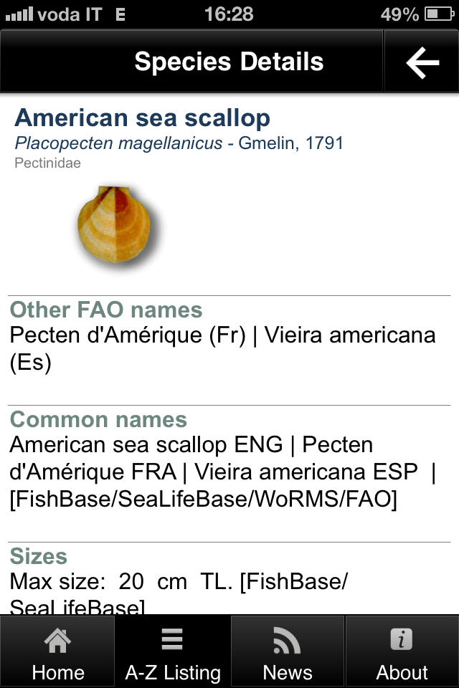
Species Details
Collection of FAO Factsheets
Each factsheet is produced by a team of invited Species information specialists
Collaboration with the FishFinder FAO Programme to exploit the iMarine reporting tool in producing hundreds of new factsheets for marine species of the Atlantic coast of South-America
Names from Fishbase, SeaLifeBase WoRMS and FAO
iMarine facility for supporting merging of common names
Notes:
FAO/FishFinder - The collaboration with the FAO FishFinder programme (ex FAO Species Identification and Data Programme) has been initiated in June 2012. The collaboration allows the e-Infrastructure access to a rich resource of species information, while FishFinder will be equipped with a reporting environment (Content Management System) to allow its network of Species information specialists to add Species Identification Sheets. The Toolset evidences the value of the iMarine reporting tools, including the work-flow and templating functions. The collaboration also aims at making available the iMarine reporting tool in developing countries thanks to a standalone plugin which can work off-line.
Fishbase
About 50 sucessive philippine staff since 1990, currently 16 incl. programmers + librarian
+ about successive 15 staff in FB Consortium, since 2001, 8 today
+ ca 1900 collaborators around the world
SeaLifeBase
About 12 successive staff since 2005, currently 5 not incl. the programmers counted above
+ 1 FBC staff
+ ca 230 collaborators around the world

Slide 6
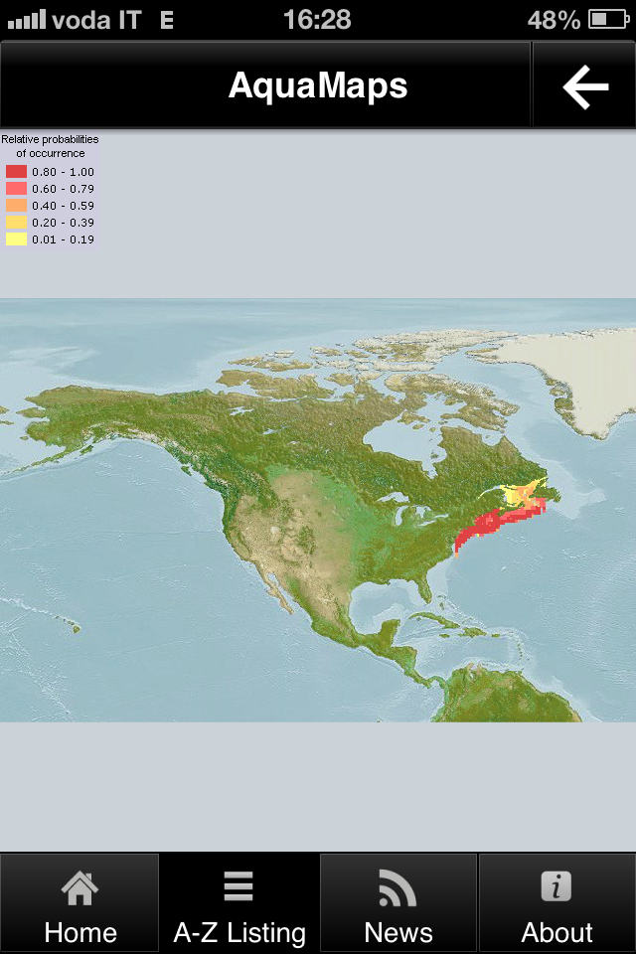
Predictive Distribution Maps (today and in 2050)
Data from GBIF and FishBase
iMarine provides a validated map generation service based on the AquaMaps algorithm

Slide 7
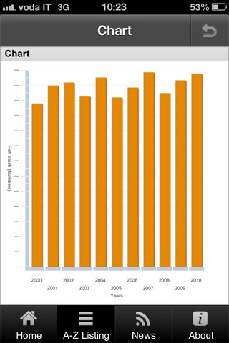
FAO Statistics
Collection of FAO Statistics
Based on data periodically collected from 180 Countries
iMarine provides facilities for time series validation, curation, and merging, and statistical analysis integrated with commonly used frameworks (e.g. R)

Slide 8
Try it!
AppliFish is available both for Android and iOS
www.i-marine.eu

