Slide 1


10th eConcertation meeting
Brussels, 6 March 2013
The costs of the HTC/HPC e-Infrastructures
Fotis Karagiannis, Sandra Cohen,
Independent/Athens University of Economics and Business-Research Center
e-FISCAL project director
www.efiscal.eu

Slide 2
Not trivial….
Hundreds of funding sources!
Comparing e-Infra costs with Cloud prices!
  Comparing 2011 costs with 2012-2013 prices
  Prices not always cost-based
  Multiple cloud instances: on-demand, reserved, etc.
Confidentiality/Anonymity of data
e-Infrastructure providers sensitivity on costs
Note: Moving to cloud a different exercise!
  Focusing on avoidable costs and time value of money
  In such case take into account the qualitative value of e-Infrastructures
      Cost is different from value!
Notes:
Prices not always cost-based; may serve marketing policies (profit margin – loss leader strategy)
Comparison not straightforward
Several instances: reserved vs. on-demand, low vs. high-end

Slide 3
e-FISCAL outputs
Pioneer costing federated computing e-Infrastructures
  in a highly distributed-heterogeneous environment!
  Hybrid methodology - Cost structures
    Questionnaire: 28 high quality answers from 16 countries
Estimation of several metrics
  Cost per core hour, CAPEX/OPEX ratio, depreciation rates, cost distribution, electricity/PUE, …
Comparisons with Clouds – Amazon EC2
  Benchmarking efforts (HPC/HTC vs. Amazon EC2)
http://www.efiscal.eu/state-of-the-art (50 articles)

Slide 4
Basis of costing exercise
6

Slide 5
Methodology
Cores, storage devices,
auxiliary equipment, connectivity devices
X
Costs per core, for storage, etc.
retrieved by
questionnaires
Approximation of the physical
infrastructure investment cost
Development of the financial model
Yearly Operational Expenditures
(OPEX)
Software, Personnel, Electricity,
Premises, Network connectivity,
Other operating costs
(questionnaire)
Yearly Capital Expenditures
(CAPEX)
Depreciation of
the physical infrastructure
costs
(questionnaire)
Total yearly cost of ownership
5

Slide 6
Countries contributing
We would like to
thank all contributors!
28 respondents from 16 countries
Belgium (5), Bulgaria, Cyprus, Finland, Germany, Greece (4), Hungary, Ireland, Italy, Latvia,
Norway, Poland, Romania, Spain (6), Turkey, UK
6

Slide 7
e-FISCAL main findings
In-house HPC/HTC e-Infrastructures are cost-effective
  With high utilisation rates & depreciation rates (as reported)
  However per application cost analysis is also needed
  ~ € 0,03 per core hour (median) - ~ € 0,07 per core hour (average)
Personnel ~50% of total costs; CAPEX/OPEX=30/70%
  Average salary ~50K, PUE~1,5
Larger sites have in general less FTEs/1000 cores
Small-scale benchmarking efforts between in-house e-Infras and Amazon instances:
  Average ~43% performance degradation of the latter for HPC, ~27% for HTC
Total annual cost of EU computing e-Infras: ~175-295M€

Slide 8
3-way analysis
Calculation of cost per core and cost per core hour under three alternatives
  Basic Case
    Use of average and median values of total sample
  Basic Case split into HPC and HTC
    Categorization based on centres self-declaration
  Case by case analysis
    Use of input per site
    Replacement of missing values of inputs with averages from total sample

Slide 9
Basic case
Also:
  Core useful lives: 5 years (literature usually cites 3 years)
  Interconnect equipment : 10% of hw costs
  Software costs: between 2% - 4% of hw costs
  Personnel cost per FTE in € in 2011: 49k - 54k
  Power Usage Effectiveness: approx. 1.50
06/03/2013
10th eConcertation meeting Brussels
9
Notes:
Disclaimer: Numbers should not be taken as accurate, rather as estimates

Slide 10
Costs breakdown
(2011-median)

Slide 11
Basic case split to HPC/HTC
HPC sites are larger on average
Multi-core
Good practices in energy / Green IT reported
HPCs
Modest size HPC centres similar to state-of-the-art HTC ones
Small HTC sites (<1000 cores) are the ones who drive averages higher
HTCs
06/03/2013
10th eConcertation meeting Brussels
11

Slide 12
Case by case analysis
Cost per core hour: Median all: 0.058, HPC Median: 0.039, HTC Median: 0.066
The larger the site the lower the number of FTEs/1,000 cores.
Statistically significant relationship
Cost per core hour is higher in small sites with < 1,000 cores
Cost per core hour are around € 0.09 for sites with < 1,000 cores
and € 0.05 for sites with > 1,000 cores.
06/03/2013
10th eConcertation meeting Brussels
12

Slide 13
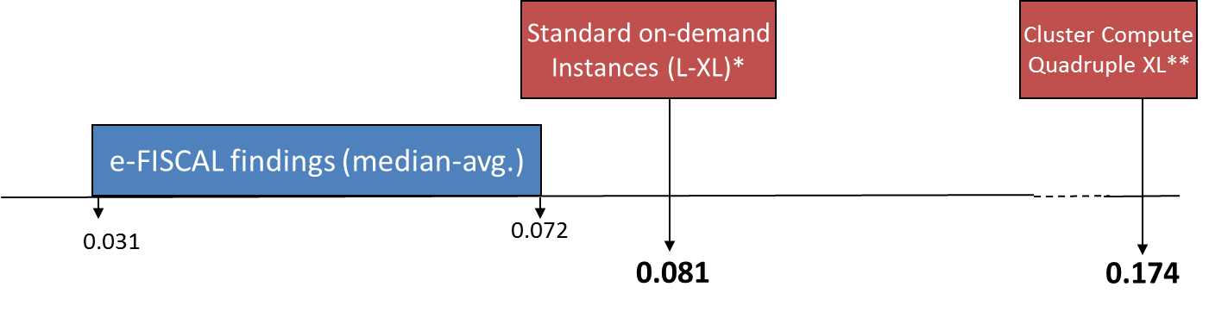
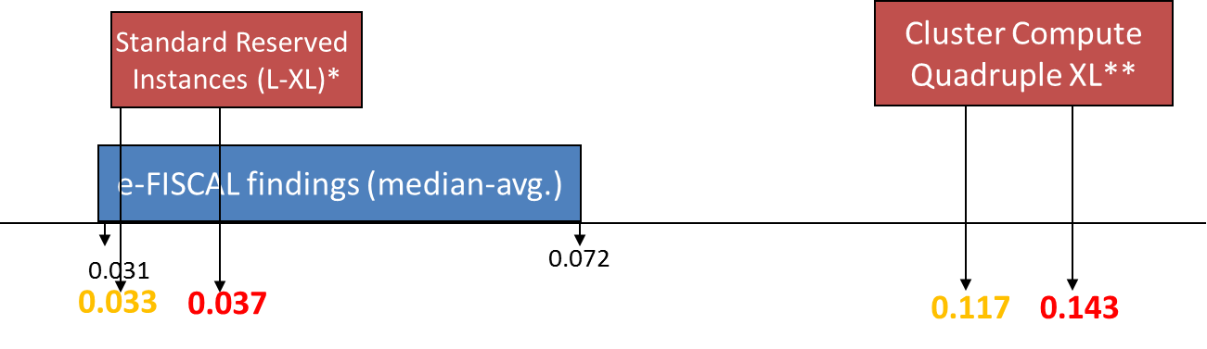
Comparison with Amazon
PERFORMANCE DEGRADATION INCLUDED
EC2 “on-demand” instances always more expensive
  Even standard ones
“Reserved” instances much more competitive
  However EC2 “cluster compute” (HPC in the cloud) > 1,5-2 times more expensive

Slide 14
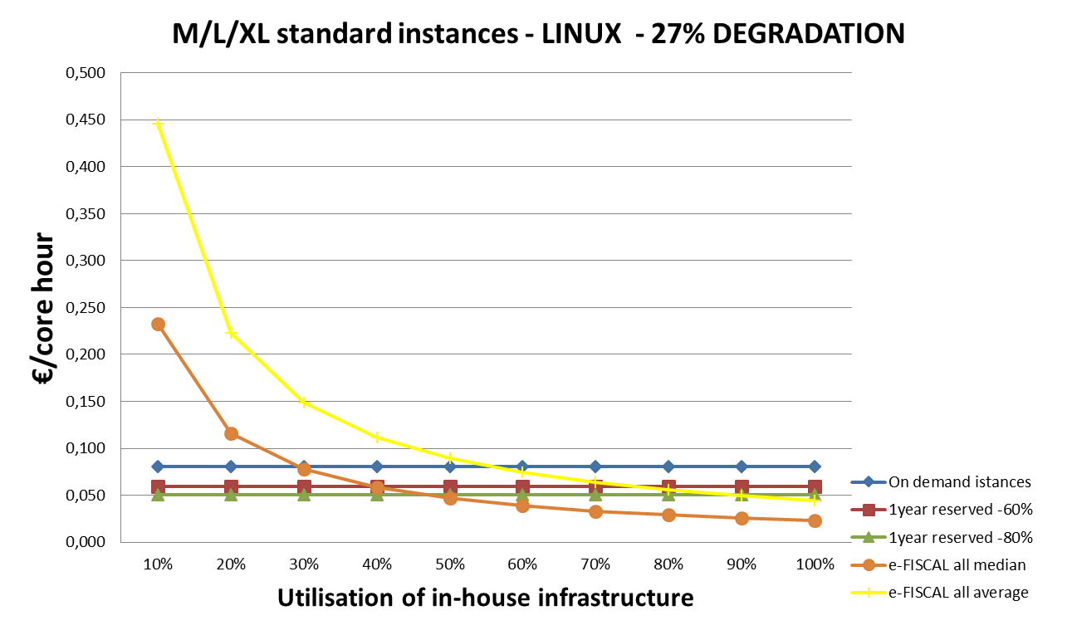
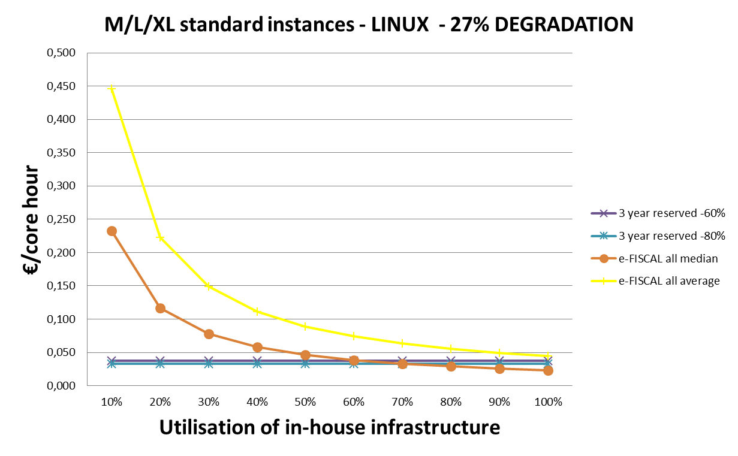
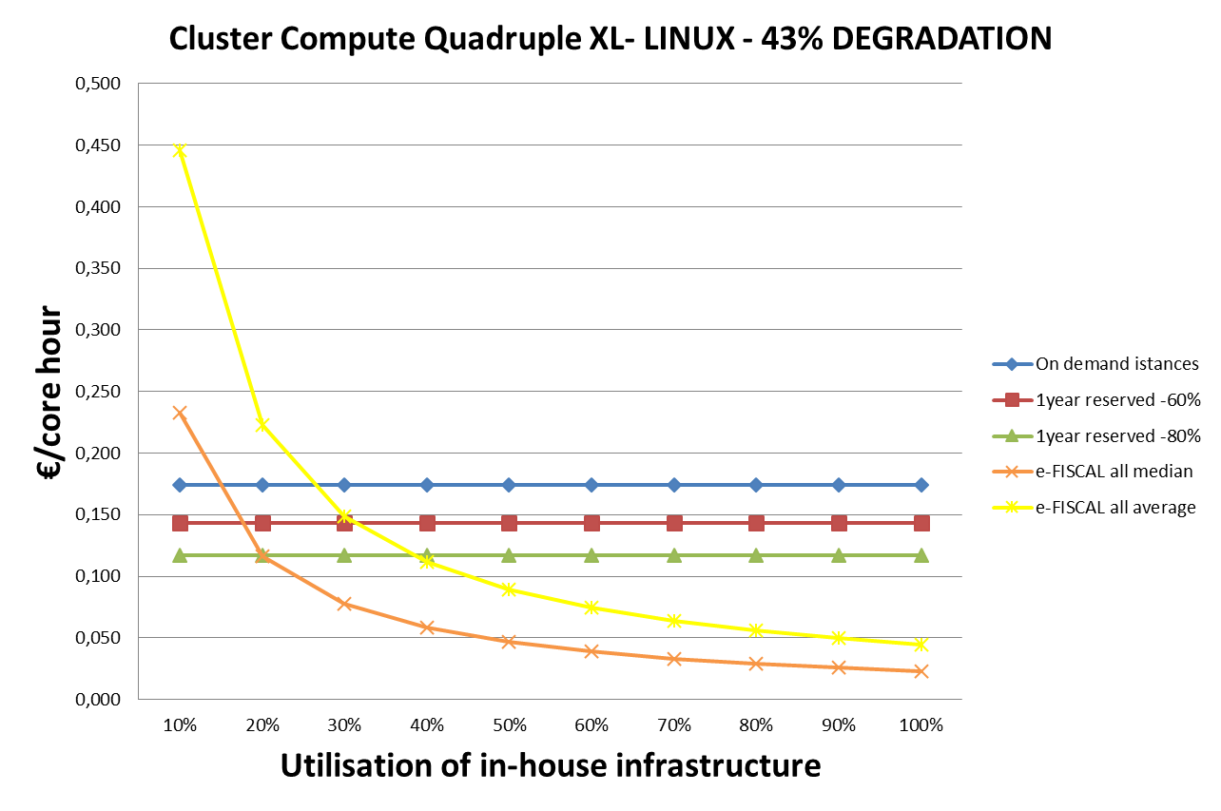
In-house utilisation vs. EC2…
PERFORMANCE DEGRADATION INCLUDED
Depends on specific instances:
“Standard” instances
  >30-55% compared to “on-demand” instances
  >40-90% compared to “1 year reserved ones”
  >65%-always cheaper compared to “3 year reserved”
“Cluster Compute” instances
  >15-27% compared to “on demand”
  >18-40% compared to “1 year reserved”

Slide 15
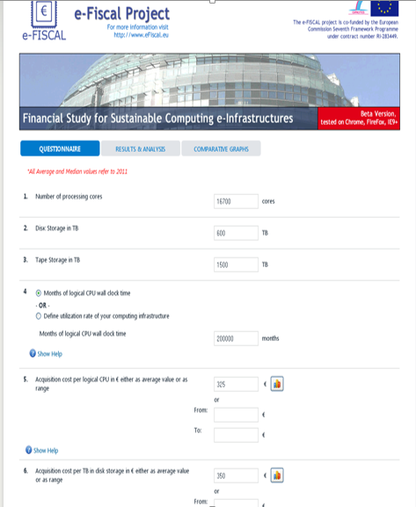
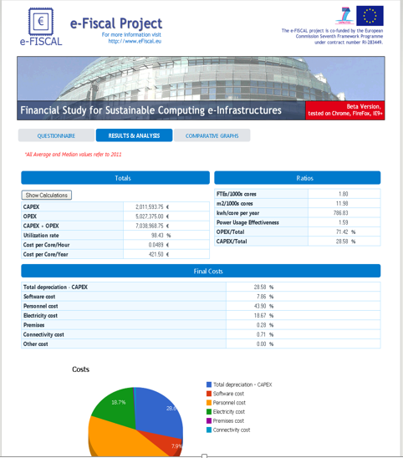
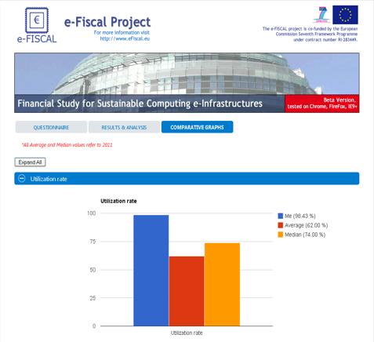
www.efiscal.eu/tools
15

Slide 16
e-FISCAL sustainability
Tools will remain available on the website
State of the art repository also
LinkedIn group on ICT cost assessment linkd.in/VqEth0 continues discussions
Cost collection/estimation to continue in part through the EGI compendium (go.egi.eu/EGI-Compendium-2011)
Consortium members can provide consultancy

Slide 17
Business models
High utilization key to maintain economic efficiency
A broker role is essential to facilitate demand meeting the right suppliers
Need to evolve funding streams and new pricing models

Slide 18
Way forward is…open!
Probably a mix of several e-infrastructure service components; each component has its merits!
  In-house HPC and HTC, Hybrid clouds: In-house HTC cloud + commercial HTC/HPC clouds
  Service-Oriented e-Infrastructure to provide e-Science as a Service….

Slide 19
Conclusions
e-Infrastructures have been a major European success story
  but cost awareness hasn't been its strong point
The challenge proved to be non-trivial from the accounting perspective -> required new methodology and domain experts
  accounting, e-Infrastructure service provision and policy areas
  Approach can be considered for a broad range of activities
Went into uncharted territory, spearheading role and prepared the ground for future activities
Appreciation of cost aspects: Nothing is free!
Understanding of e-Infrastructure cost ranges
Development of a community interest on costs
Cost ≠ value and strategy may influence decision-making more
19

Slide 20
Recommendations
To e-Infrastructure providers and HPC/HTC centre managers
  Keep track of cost structures and costs through a systematic way to assist in planning and determining their centres’ sustainability.
Research communities and end users
  Costs are not the main issue: Collect and document experiences on in-house vs. commercial clouds
e-Infrastructure policy makers and funding agencies
  Recognise the cost parameter as an important one in the sustainability of computing e-Infrastructures
20

Slide 21




Thanks!
www.efiscal.eu
  e-mail us at info @ efiscal.eu
Project acronym: e-FISCAL
Contract n°: RI-283449
Project type: CSA-SA
Start date: 01/08/2011
Duration: 18 months (end 31/1/2013)
Total budget: 392.523 €
Funding from the EC: 349 999 €
Total funded effort in PMs: 33.75
Web site: www.efiscal.eu

Slide 22




Consortium
AUEB-RC
EGI.eu
NUIG*
(ICHEC)
ETL
* National University of Ireland, Galway / Irish Centre for High End Computing (ICHEC)

