Slide 1
A New UK CA Portal
David Meredith
Jens Jensen
John Kewley

Slide 2
UK CA 2 Min Overview
UK CA – Issues IGTF accredited user and certificates for the UK (other certs too – code-sign).
33432issued in total, ~3000 currently valid, are 1691 host certs, 1243 certs processed using CertWizard.
RA operator network to assert user identities (check photo IDs) to managed certificate requests (approve/reject/revoke).
Personal TERENA certs not available to UK users (currently, free host certs but UK is not signed up and would have to pay personal certs and establish RA network).
UK CA certs required in EGI/international scope.

Slide 3
Components
Postgres CA DB
Holds certificates, CSRs (New and Renew requests), CRRs, RA list, RA operator details.
Does not store private keys
Signing
Offline - manually extract requests from CA DB
Signs requests (CSR + UK CA cert chain signatures => Cert)
Uploads certs back into the DB
Interfaces
OpenCA Portal (CA/RA ops) – crr/csr/approve/revoke/manage requests
Bespoke Scripts (CA ops) – CLI DB management
REST Server (User) – REST server used by new PECR + CertWiz
CertificateWizard (User) – GUI request/renew/revoke/manage certificates in stored in PKCS12 KeyStore file.
PECR Scripts (User) – CLI Perl client scripts to request certificates in bulk

Slide 4
Clients
Server
Offline
OpenCA:
/cgi-bin/pub/pki*
/cgi-bin/ra/RAServer*
Current Situation
Signing Machine
CA DB
Certs in browser
A. CSRs
REST Server:
/csr_user_request
/csr_host_request
/crr_request
/bulk_host_csr
B. Certs
Cwiz
PeCR
Cust
Other scripts:
‘roleChangeUtils.sh’
‘doOpList.sh’
‘doRaEmail.sh’
Certs in Standalone keyStore file
(PKCS12)

Slide 5
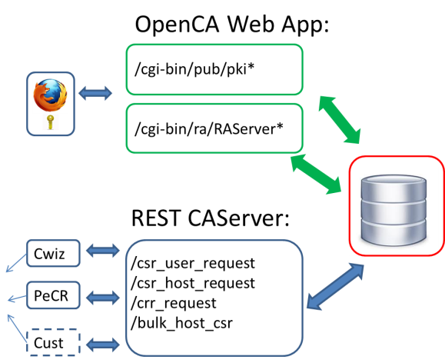
UK OpenCA
Our current version is old
Requires RH4, digest code :-(
Difficult to update to newer OpenCA due to bespoke DB changes
Want to evolve/improve our CA into the future
3 Options:
DB porting exercise to new off-shelf CA portal
Brownfield = Refactor + update current legacy OpenCA
Greenfield = Roll our own replacement

Slide 6
Refactor+Update or Roll Own?
Build on existing code-base – usually end up re-developing with replacement code anyway.
We want to customise our CA:
Recent policy changes will allow us to generate CSR + PrivKey on the server for subsequent download as .p12 file but with no retention of private key on server.
Allows us to replace current key generation in browser KeyStore (~spkac): Non standard with limited/varied browser support.
Can re-use CertWiz libs to gen CSR in new portal (imagine a portal version of CertWizard for requesting certs)

Slide 7
Roll Own CA Portal
/raop/*
/caop/*
/pub/request/*
/cert_owner/renew/*
1)
+/-
2)
Cwiz
/csr_user_request
/csr_host_request
/crr_request
/bulk_host_csr
PeCR
Cust
Replace OpenCA RA+CA Interfaces/scripts with a new RA-CA Portal
Depending on policy changes, +/- new User Portal (or just rely on CertWiz/PECR)

Slide 8
New CA Portal
Java/JSP, Spring MVC, Spring Security
Bootstrap CSS/JavaScript lib (from Twitter)
Spring Security: “a powerful and highly customizable authentication and access-control framework. Is a de-facto standard for securing Java (Web) apps.
I agree, its good, and so is Spring MVC

Slide 9
SpringSecurityConfig.xml
Spring Sec intercepts URL requests and applies different authentication filters
No cert required for:
REST URLs (use own message level authentication - PPPK)
Public pages
Inject ordered Auth provider chain
PTO

Slide 10
Auth Provider determines roles from DN
CaJdbcUserDetailsService

Slide 11
Role Based Content Display
viewRalist.jsp

Slide 12
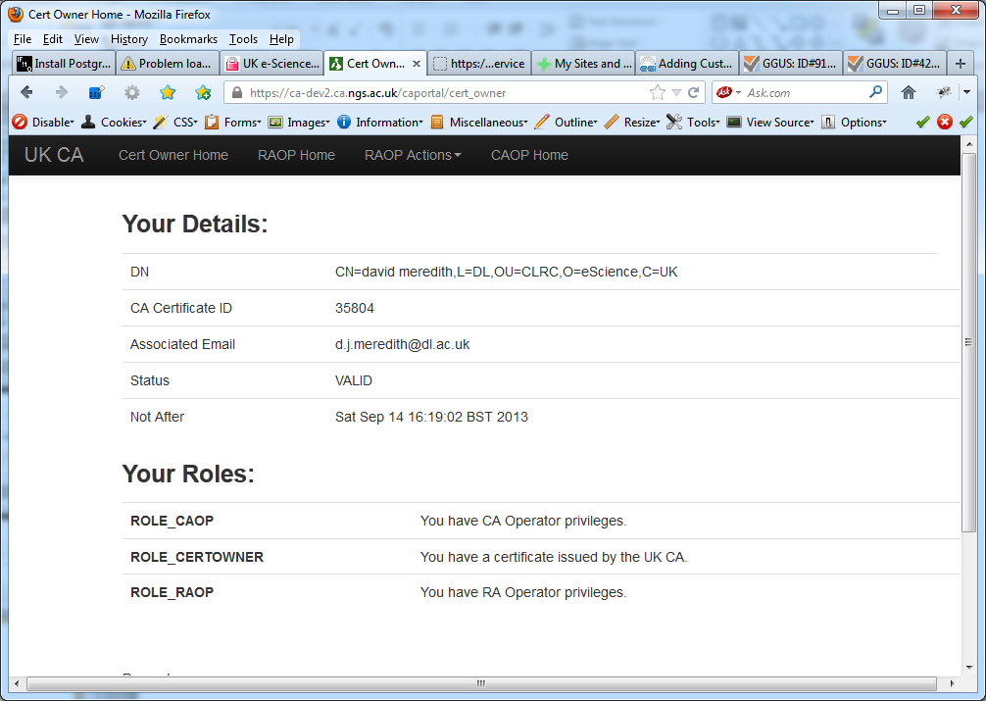
New RA-CA Portal /caporta/cert_owner

Slide 13
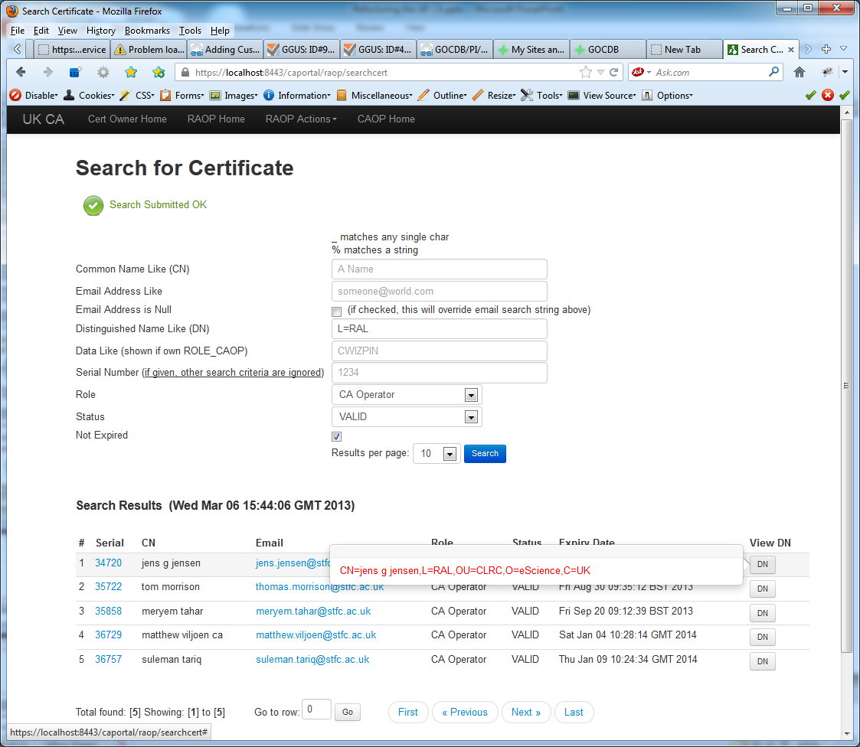
/caportal/raop/searchcert

Slide 14
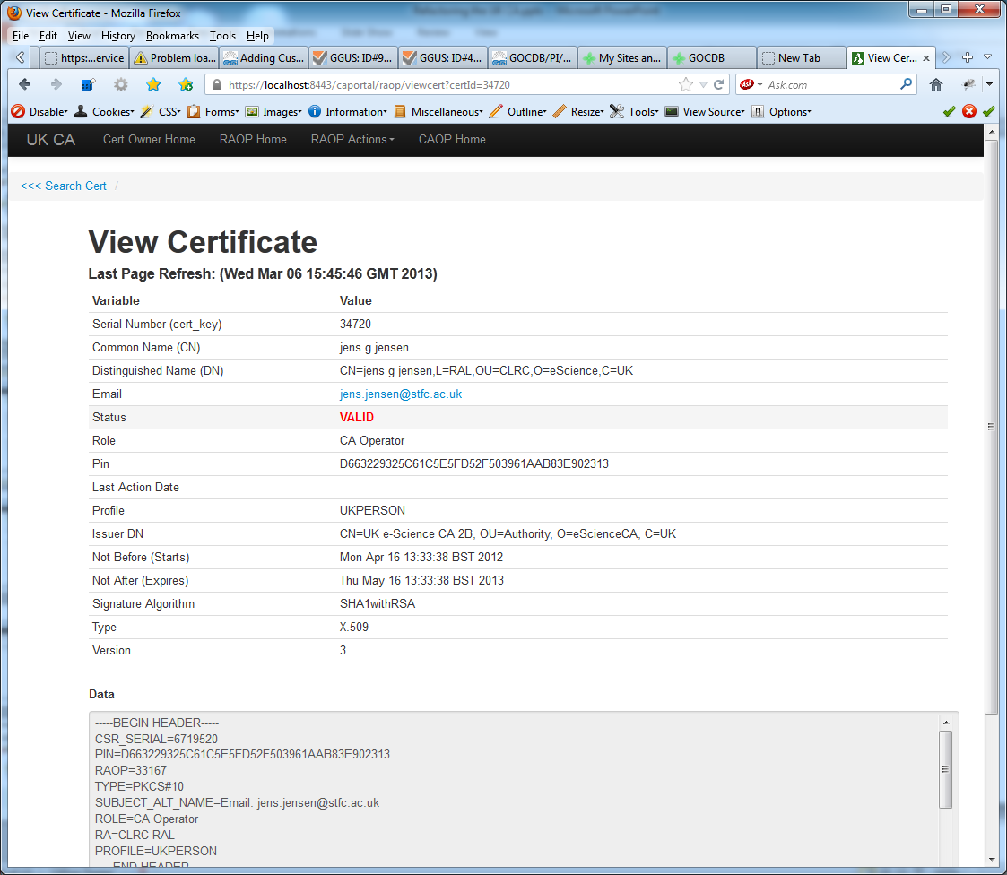
/caportal/raop/viewcert?certId=34720

Slide 15
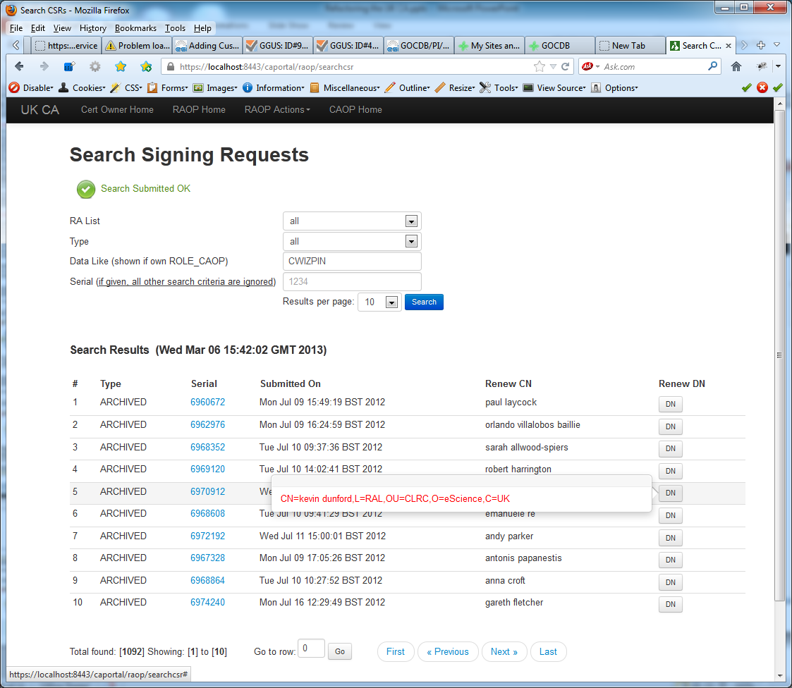
/caportal/raop/searchcsr

Slide 16
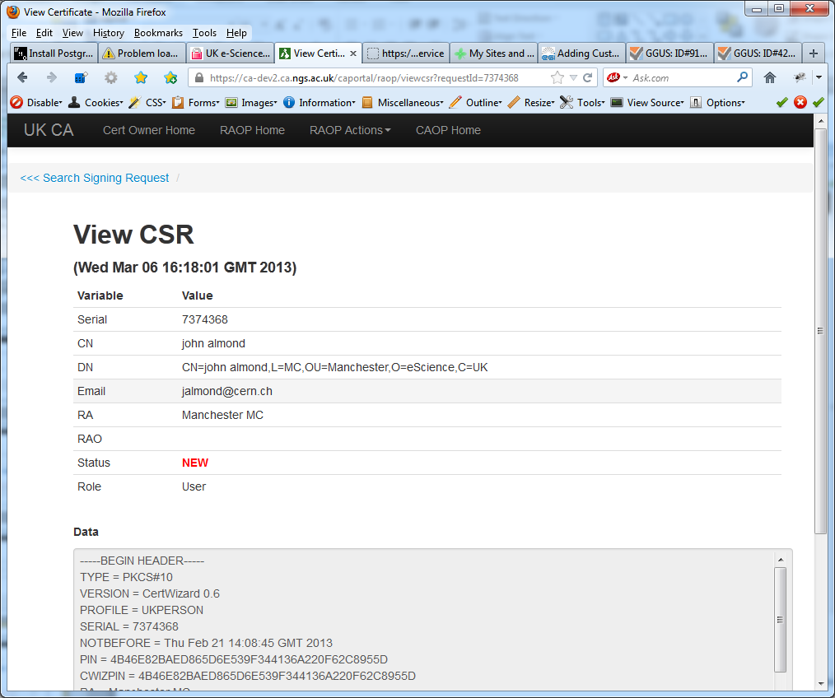
/caportal/raop/viewcsr?requestId=73743368

Slide 17
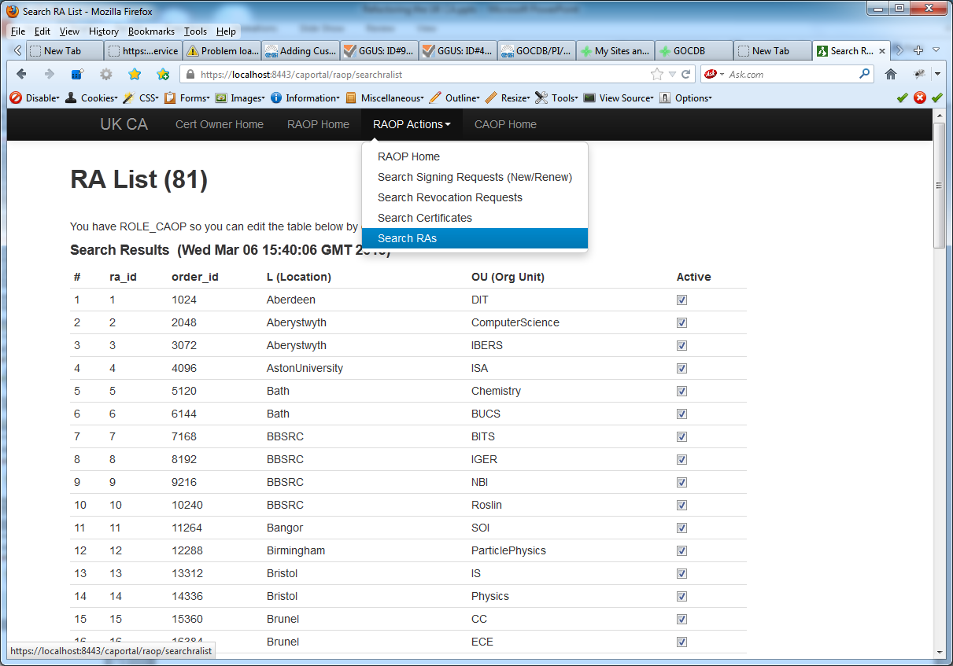
/caportal/raop/searchralist

Slide 18
Model
(MVC)
Domain Model
Maps to DB tables

Slide 19
View (MVC) Renders the Model – no logic
View

Slide 20
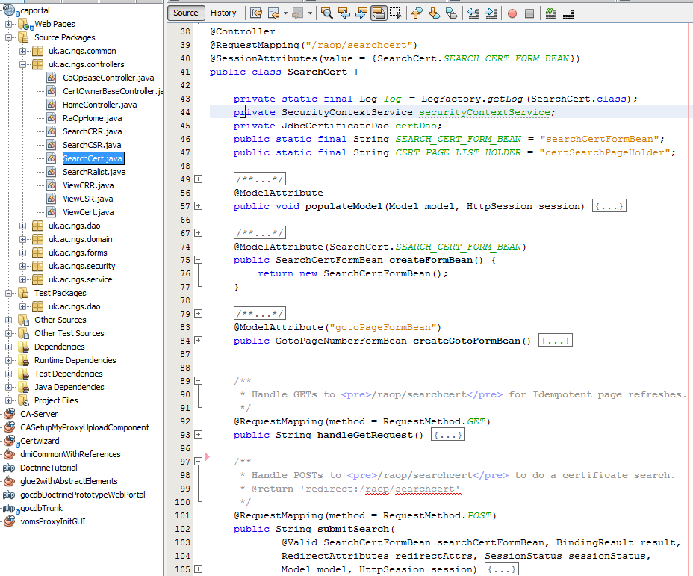
Controller (MVC) - Prepares Model for view
(HashMap containing domain objs + other data)
Controllers

Slide 21
TODO
Finish RA/CA actions
RA operator actions nearly fully reproduced
CA operator actions (e.g. edit RA list, DB actions…)
User interface for CSRs (NEW and RENEW)
Recently proposed policy changes means we can generate CSR+PrivKey on the server for subsequent download (e.g. as .p12 file)
Will make life far easier for me and for users

