Slide 1
EMI Registry (EMIR)
Shiraz Memon, Ivan Marton, Gabor Szigeti, Laurence Field
EGI Community Forum
Manchester, 11.04.2013

Slide 2
Outline
Introduction
Architecture
Security
Information Model
Demonstration

Slide 3
Introduction
Aims to unify all the EMI services’ endpoints
Designed from scratch to support federations
Self contained/decentralized registry
REST-ful API (for the management of endpoint information)
Hierarchical Network
Organize EMIR nodes in a rooted tree
Domain Service Registry (DSR): the nodes in the hierarchical network
Global Service Registry (GSR): the root of the hierarchy
Consistency
Event based synchronization: propagating (asynchronous) events from leaf to the root node (GSR)
Handles failures occurred within the hierarchy
P2P Network
Variation of a Pastry Distributed Hash Table
Always form at the root (GSR) level
Bootstraps from a globally published List containing addresses of all the root (GSR) nodes
Eventual consistent replication of GSRs
Notes:
Check slide 6

Slide 4
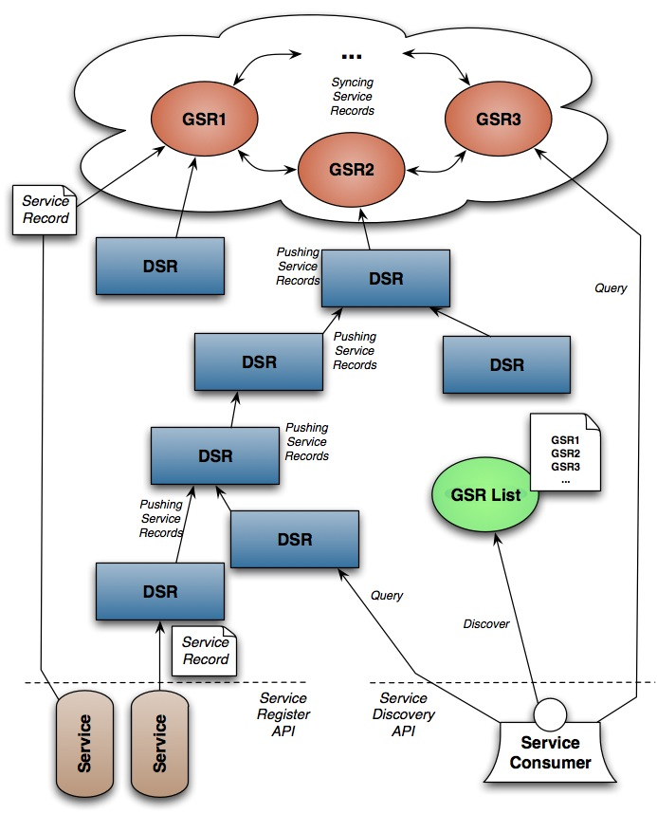
Architecture
Organised in a Hierarchy (A Rooted Tree)
Three Main Components:
Global Service Registry (GSR)
EMIR Service Endpoint Registration Publisher (SERP)
Domain Service Registry (DSR)
Several Hierarchies for different federations
SERP
Notes:
Organised in a hierarchical, several

Slide 5
EMIR: Security
Decentralised Security at every EMIR node
Authentication
Leverages from the EMI’s (Common Authentication) CaNL Library
SSL/TLS
Credential types: EEC, Proxy
and several credential formats formats: DER, PEM, P12, JKS
Types of Trust Anchors: OpenSSL, CA directories (IGTF), JKS
Access Control
Coarse Grained
Single Access Control List (ACL) file containing subject’s DN and associated pre-defined roles (very similar to GridMap file)
Highly Simplified with restrictions
Fine Grained (Expert level)
User attributes file: Mapping of User DN’s with multi-valued attributes
A directory of XACML policies
Customisable but complex

Slide 6
Client: EMIR SERP
EMIR Service Endpoint Publisher (EMIR-SERP)
Implemented as a OS’s background process
Registers with an EMIR Server
Updates Periodically
Supports X.509 certificates
Fetch and Translates endpoint information from BDII into EMIR data format (JSON)

Slide 7
Information Model

Slide 8
Information Model
OGF’s GLUE 2.0 Vocabulary to represent Services and Service Endpoints
JSON and XML for registrations
Schema-less: support for any number of custom attributes

Slide 9
Demonstration

Slide 10
Configuring a DSR

Slide 11
Configuring a DSR
url, anonymousPort and security attributes
emir.security.truststore.type=directory
emir.security.truststore.directoryLocations.1=/etc/grid-security/certificates/*.pem
emir.security.truststore.directoryEncoding=PEM
emir.security.truststore.directoryConnectionTimeout=100
emir.security.truststore.directoryDiskCachePath=/tmp
Credentials
emir.security.credential.format=pem
emir.security.credential.path=/etc/grid-security/hostcert.pem
emir.security.credential.keyPath=/etc/grid-security/hostkey.pem

Slide 12
Customize policies
<?xml version="1.0" encoding="UTF-8"?>
<fileAttributeSource>
<entry key="CN=.*[, OU=NIIF, OU=GRID, O=NIIF CA, C=HU]">
<attribute name="role">
<value>serviceowner</value>
</attribute>
<attribute name="empty"/>
</entry>
<entry key=".*">
<attribute name="role"><value>banned</value></attribute>
</entry>
</fileAttributeSource>

Slide 13
Configuring an EMIR-SERP

Slide 14
Configuring an EMIR-SERP
url, credentials (default) and one or more (from any type) information source
json_file_location: single JSON file to be published
json_dir_location: set of JSON files that can be extended during the operation lifetime
resource_bdii_url (new!): service endpoint information source Resource BDII

Slide 15
List of GLUE 2.0 Attributes
Mandatory
Service_ID
Service_Name
Service_Type
Service_Endpoint_ID
Service_Endpoint_URL
Service_Endpoint_Capability
Service_Endpoint_Technology
Service_Endpoint_InterfaceName
Service_Endpoint_InterfaceVersion
Service_ExpireOn
Optional
EMI_Version | Service_Location_Longitude
Service_QualityLevel | Service_Endpoint_HealthState
Service_Complexity | Service_Endpoint_ServingState
Service_CreationTime | Service_Endpoint_DowntimeStart
Service_Location_Address | Service_Endpoint_DowntimeEnd
Service_Location_Place | Service_Endpoint_WSDL
Service_Location_Country | Service_Endpoint_AccessPolicyRule
Service_Location_PostCode | Service_Endpoint_Semantics
Service_Location_Latitude | Service_Endpoint_SupportedProfile

Slide 16
Query the EMIR Service Index

Slide 17
Query the EMIR Service Index
First page of results (limit is 100 by default): http://asimov.grid.niif.hu:9127/services
First 10 results: http://asimov.grid.niif.hu:9127/services?pageSize=10
Next 10 results using reference: http://asimov.grid.niif.hu:9127/services?pageSize=10&ref=###### or http://asimov.grid.niif.hu:9127/services?limit=10&skip=10

Slide 18
Configuring a GSR

Slide 19
Configuring a GSR
Enable GSR functions
emir.global.enable=true
Define a well-known global list of entry GSRs
emir.global.providerList=http://szigeti.ki.iif.hu/EMIR_EGI_CF.list

Slide 20
Links
https://twiki.cern.ch/twiki/bin/view/EMI/EMIRegistry
https://github.com/eu-emi

Slide 21
Questions or problems?
Contact us! emir@niif.hu

