Slide 1
Building sustainable software for science …why good code is only the beginning 10 April 2013, EGI Community Forum, Manchester Mario Antonioletti, Neil Chue Hong, Steve Crouch, Simon Hettrick, Mike Jackson, Tim Parkinson, Shoaib Sufi
Where indicated slides licensed under

Slide 2
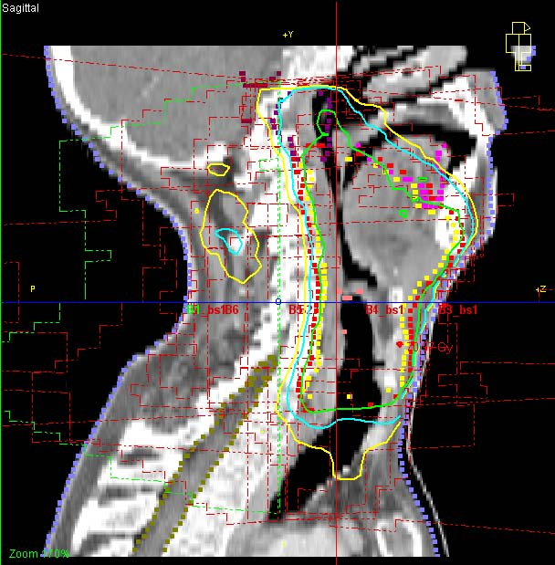
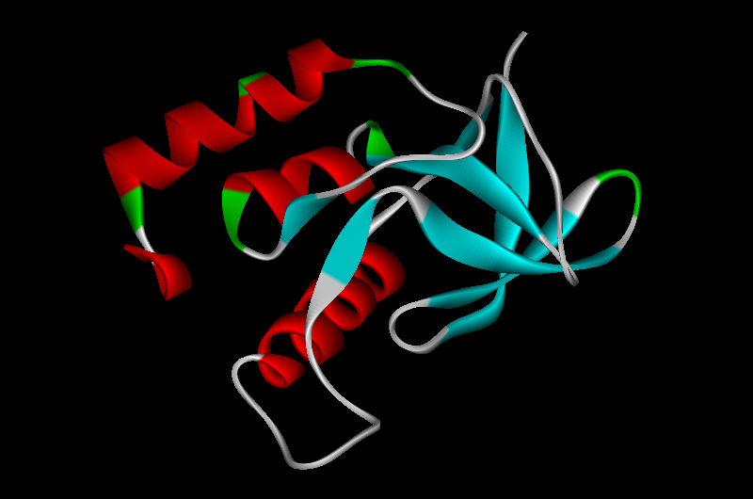
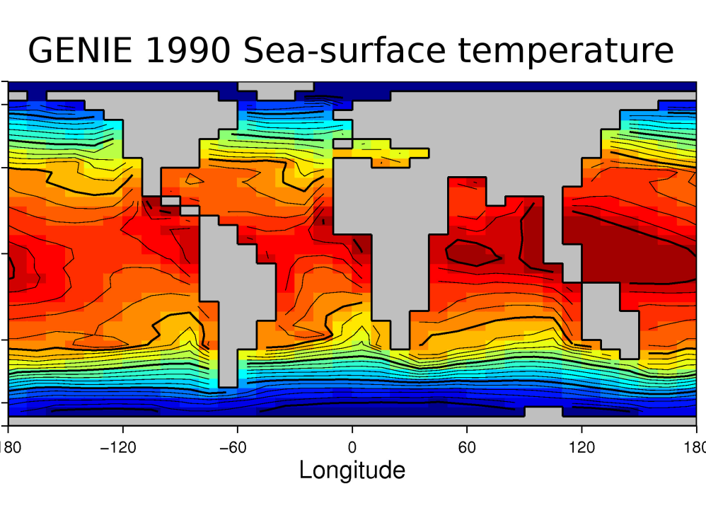
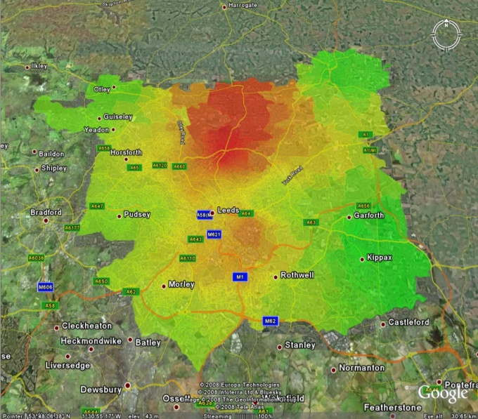
Software is pervasive in research
Notes:
Images courtesy of projects from the ENGAGE programme http://www.engage.ac.uk/

Slide 3
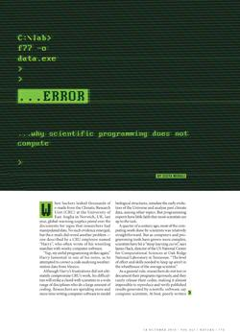
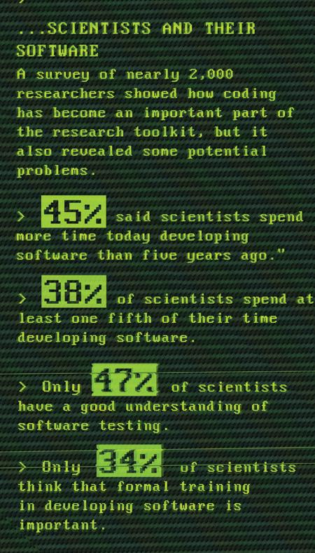
Just the Nature of the problem?
Maintenance is not fun
Hacking new stuff is fun
…why Scientific Computing does not compute
Published online 13 October 2010 | Nature 467, 775-777 (2010)
doi:10.1038/467775a
Notes:
Statistics from Greg Wilson
Are academics software developers?
Can research consortia manage production?
Are timing constraints different?
What is the role of the PI in software development management?
Are the skills for software and research the same?
- more and more researchers use computer software and hardware in
their day to day research, not just those researchers who could be
classed as being computational scientists, yet they find it
increasingly difficult to exploit due to a lack of coordination
([Gob10], also observed in [Han09])
- there is a wide variance in the levels of experience in scientific
computing and software development, and hence their use of computing,
which is present across all domains and levels of seniority ([Har09],
also ongoing as our result with the DIRAC consortium)
- software is often treated as if it was disposable, rather than the
subject of a £9m per year investment by EPSRC [SaaI12]

Slide 4
Organisation
Community Engagement (Lead: Shoaib Sufi)
Fellowship Programme
Events and Roadshows
Consultancy (Lead: Steve Crouch)
Open Call for Projects / Funded Collaborations
Software Evaluation
Policy and Communications (Lead: Simon Hettrick)
Recognition of software in research
Software career paths
Training (Lead: Mike Jackson)
Software Carpentry (500+ students/year)
Software Surgeries
Guides and top tips
Collaboration between universities of Edinburgh, Manchester, Oxford and Southampton.

Slide 5
More than code…
Broadly, our current work focuses on three key themes:
Recognition for software in research
Recognition of software career paths
Developing the software skills base

Slide 6
No recognition without reward
How do we reward people for important software contributions?
Traditionally: publish a research paper that happens to mention software
A Research Software Impact Manifesto
http://www.software.ac.uk/blog/2011-05-02-publish-or-be-damned-alternative-impact-manifesto-research-software
NB Authorship is hard
It works for data!
C.f. Heather Piowowar’s work
http://www.plosone.org/article/info:doi%2F10.1371%2Fjournal.pone.0000308
Notes:
c.f work of James Howison

Slide 7
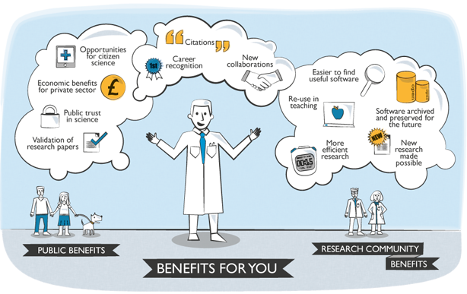
Journal of Open Research Software
http://openresearchsoftware.metajnl.com
Notes:
A metajournal which encourages the publication of information that encourages the reuse of software.
A way of using the current tools and practices to make software better recognised.

Slide 8
5 Stars of Research Software
Community
There is a community infrastructure
Open
Software has permissive license
Defined
Accurate metadata for the software
Extensible
Usable, modifiable for a new purpose
Runnable
Able to access and run software
C
R
O
E
D
c.f.
5 Stars of Linked Data (Berners-Lee)
5 Stars of Online Journals (Shotton)
More info: www.software.ac.uk/blog
“Golden Star”
Originally by Ssolbergj
CC-BY
Notes:
Star graphic modified under CC-BY from Ssolbergj
C.f.
5 Stars of Linked Data (Berners-Lee):
Available w/ open license, machine-readable, non-proprietary format, open standards, linked to provide context
5 Stars of Online Journals (Shotton):
Peer Review, Open Access, Enriched Content, Available Datasets, Machine-readable metadata
What about community?

Slide 9
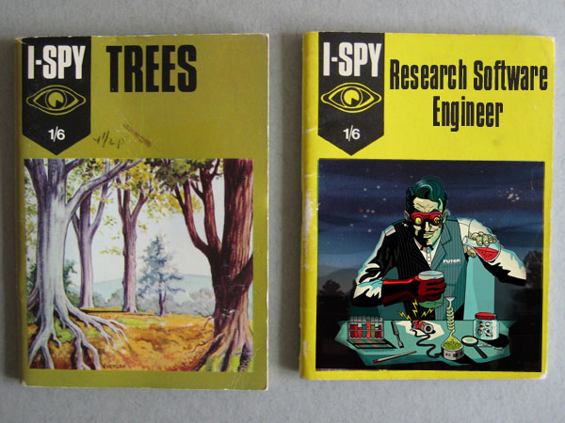
Recognition of software career path
There is no defined career for people in academia who care about software engineering
Research software engineers
Their work is highly valued but unrecognised
We are working to gain recognition for research software engineers
Starting by finding out how many there are, who they are, and what they need

Slide 10
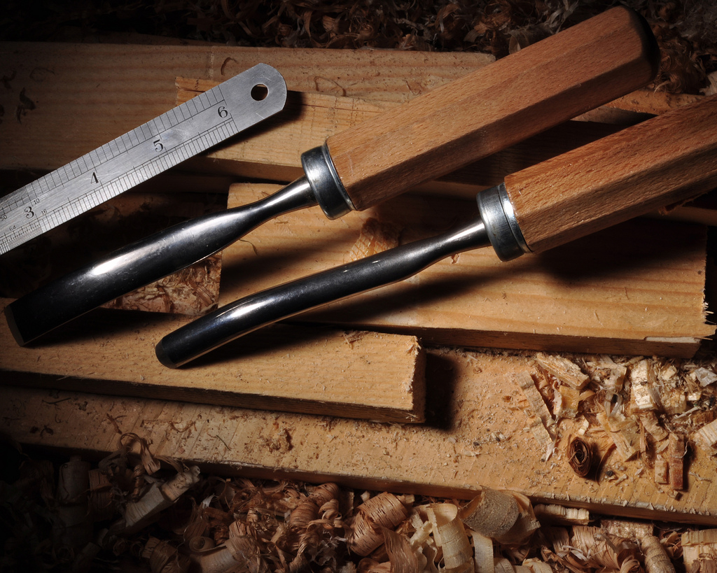
Developing skills
Software carpentry teaches basic software development skills
“get more done in less time, and with less pain, and with greater confidence in results
Training is provided through bootcamps
highly-interactive workshops, interleaving short tutorials with hands-on practical exercise

Slide 11
In conclusion…
Researchers are developing more software than ever, and trying to do it better
We are not adequately providing the training, recognition and reward, and career paths needed to improve the sustainability and quality of research software
This is more than just the availability of technically good code – we need good people and the right environment for them to work in

Slide 12
Blogs and articles
Why scientific computing does not compute
http://www.nature.com/news/2010/101013/full/467775a.html
Sharing Detailed Research Data Is Associated with Increased Citation Rate
http://www.plosone.org/article/info:doi%2F10.1371%2Fjournal.pone.0000308
A Research Software Impact Manifesto
http://www.software.ac.uk/blog/2011-05-02-publish-or-be-damned-alternative-impact-manifesto-research-software
Journal of Open Research Software
http://openresearchsoftware.metajnl.com/
Five stars of research software
http://www.software.ac.uk/blog/2013-04-09-five-stars-research-software
Notes:
c.f work of James Howison

Slide 13
A national facility for cultivating world-class research through software
Some of our collaborations
Become our next collaborators!
Website: www.software.ac.uk
Email: info@software.ac.uk
Twitter: twitter.com/SoftwareSaved
Notes:
Become our next collaborator – email info@software.ac.uk

Slide 14
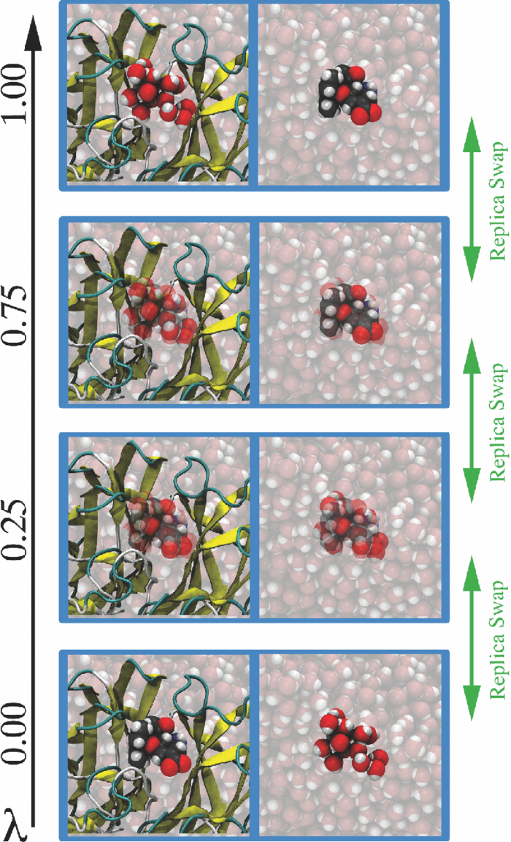
Case Study: Ligand Binding
Centre for Computational Chemistry, Bristol
New methods for rapid MC sampling of biomolecular systems modelled using QM/MM
Developed two codes ProtoMS (F77) + Sire (C++)
Water-Swap Reaction Coordinate method to calculate absolute protein-ligand binding free energies
SSI’s work is helping to scale development
ProtoMS and Sire both single developer codes
ASPIRE/ACQUIRE framework has multiple devs
Split architecture between ASPIRE (adaptive multiresolution hybrid MD simulation) and ACQUIRE (WorkPacket scheduling system with optimisation for time to result vs “green-ness”
http://www.siremol.org/adaptive_dynamics

