Slide 1
CookBook: Guidelines on how to kick-start and ROC/NGI
Kostas Koumantaros, GRNET

Slide 2
Chain-Reds Project.
Objectives
Support the stability of existing and emerging Regional Operation Centres (ROCs) so as to ensure interoperability of DCIs, with focus on Grids.
Maintain a set of guidelines for standard grid interfacing, customised for the type of region.
Investigate the emerging cloud solutions and propose the relevant interoperation approaches.
Analyse the existing HPC interoperation approaches and propose potential solutions.

Slide 3
What is an Operations Centre
“Operations Centre (OC): A centre offering operations services on behalf of the Resource Infrastructure Provider.”
“Resource Infrastructure Provider (RP): The legal organisation responsible for any matter that concerns the respective Resource Infrastructure. It provides, manages and operates (directly or indirectly) all the operational services required to an agreed level of quality as required by the Resource Centres and their user community. It holds the responsibility of integrating these operational services into EGI in order to enable uniform resource access and sharing for the benefit of their Users. The Resource infrastructure Provider liaises locally with the Resource Centre Operations Managers, and represents the Resource Centres at an international level. Examples of a Resource infrastructure Provider are the European Intergovernmental Research Organisations(EIRO) and the National Grid Initiatives (NGIs)”.

Slide 4
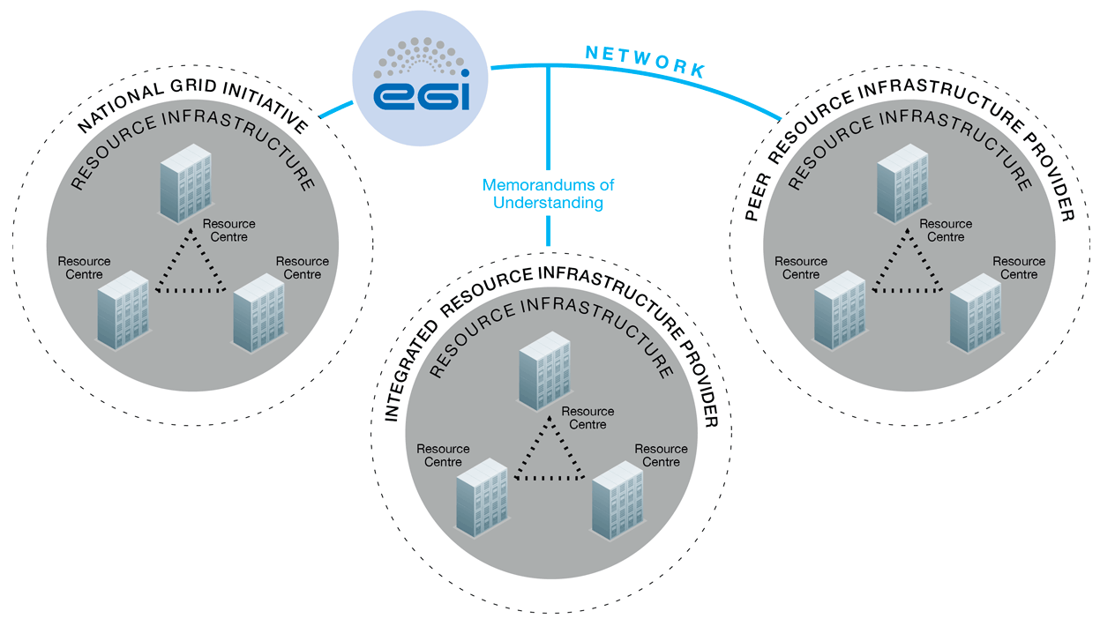
Operations Architecture

Slide 5
EGI Infrastructure providers
Integrated infrastructure providers → sharing policies, procedures, tools, QoS agreements and part of the same operations structure
Members of the EGI collaboration (EGI Council/EGI-InSPIRE)
External providers
Latin America, AfricaROC, ChinaROC
Peer providers → own operations tools and procedures, compatible policies, loose operations collaboration with EGI
CNCGRID (Under the wing of ChinaROC), Garuda GRID

Slide 6
Steps to become an Integrated Resource Infrastructure Provider
Sign an MoU & SLA with EGI.eu
Set-up your Operations Center that provides
Accounting/Monitoring Systems
a Helpdesk System Integrated with GGUS
Core Services as needed
Register your Sites to GOCDB
Addhere to EGIs Best Practices and Policies
Respond to tickets
Maintain you site availability and reliability high
Always run the recommended versions of middleware and OS.

Slide 7
Sign an MoU & SLA with EGI.eu
MoU Memorandum of understanding
defines what each party offers to this collaboration
Defines what are the obligations of each participant
2nd level Signed by each member of a federation (e.g institutes that offer sites) and and one Legal entity/representative of the federation
1st level signed between EGI.EU and the Legal Representative for the federation
SLA/OLA: Service/Operation Level Agreements
Defines the minimum level of Availability and Reliability of each service/site/roc
1st level of SLAs are signed between
2nd level of SLAs are signed between the RP and each Site

Slide 8
Organise your Operations Center
adhere to the Grid Security and Operational Policies and Procedures
Setup a Heldesk service integrated with a dedicated GGUS Support Unit
Organise teams for 1st and 2nd level of support
Setup Accounting and Monitoring services compatible with the EGI services.(e.g SAM/APEL)

Slide 9
Register your Sites to GOCDB
GOCDB is the central contact service of EGI.EU and is used to:
Collect Resource providers/Operations center management contacts
Collect Site contact points
Register Services offered by each site (visible or not to EGI)
Declare downtimes

Slide 10
Site Lifecycle
Candidate
1st step when a site is being set-up
Uncertified
When ready the site is switched to uncertified and starts to be monitored if stable enough it is declared as certified
Certified
This status signifies that a site is part of the production infrastructure
Suspended
Scheduled Downtime
Site is still being monitored but no alarms are raised if something fails. This is used for updates/upgrades and other technical actions that affect a sites availability.
Visible to EGI (On/OFF) Switch
ON to be part of the EGI infrastructure
OFF to be part of a regional infrastructure only.

Slide 11
ROC Africa&Arabia
Contacts | ✔ | Bruce Becker
Status | ✖ | 7 Sites (to be updated with all regional sites). The ROC is operational. Not registered in GOCDB.
Helpdesk | ✔ | https://support.africa-grid.org This is an XGUS instance
Accounting | ✖ | Accounting records are not published.
Monitoring | ✖ | Monitoring information is not published. The ROC runs SAM-NAGIOS but there is no data in it.
Website | ✔ | http://www.africagrid.org
Action Points |  | AP-AAROC-1: Sign MoU with EGI.eu as an Integrated Resource Infrastructure Provider AP-AAROC-2: Provide IGTF Accredited Certificate Services that will cover the whole AA ROC AP-AAROC-3: Create a new Operations Center in the EGi.eu GOCDB and register Resource Centers AP-AAROC-4: Setup and Operate a Grid Monitoring Service AP-AAROC-5: Publish accounting records to the EGI.eu Accounting System from all certified Resource Centers AP-AAROC-6: Adopt and employ Operational Policies and Procedures AP-AAROC-7: Set up dedicated Support Unit in GGUS

Slide 12
SEAsia ROC
Contacts | ✔ | Eric Yen
Status | ✔ | 65 Sites. The ROC is operational
Helpdesk | ✔ | https://ggus.eu
Accounting | ✔ | Accounting records are published.
Monitoring | ✔ | Monitoring information is published.
Website | ✔ | http://aproc.twgrid.org
Action Points |  | None defined.

Slide 13
LA ROC
Contacts | ✔ | Andres Holguin & Renato Santana & Luciano Diaz
Status | ✔ | 4 Sites. The ROC is operational (a lot more currently uncertified)
Helpdesk | ✔ | https://ggus.eu
Accounting | ✔ | Accounting records are published
Monitoring | ✔ | Monitoring information is published
Website | ✖ | http://www.roc-la.org (?) Site appears to be down
Action Points |  | AP-LAROC-1: Bring up / create the roc-la.org web site AP-LAROC-2: Write and publish an AUP AP-LAROC-3: Certify the rest of their sites.

Slide 14
China ROC
Contacts | ✔ | Shi, Jingyan & Yan, Xiaofei
Status | ✖ | 1 Site. The ROC is not operational and the 1 site belongs to ROC Canada
Helpdesk | ✔ | https://support.china-roc.cn The helpdesk is an XGUS instance. A person has the task to monitor the helpdesk for incoming tickets and provide responses. The help desk is not used with the ROC
Accounting | ✔ | http://goo.gl/D0KUe
Monitoring | ✔ | Nagios & Ganglia are used internally. Beijing-LCG2 is being monitored by ROC_Canada which published the results
Website | ✖ | http://www.china-roc.cn The site publishes information about ROC Africa
Action Points |  | AP-CHINAROC-1: Sign MoU with EGI.eu as an Integrated Resource Infrastructure Provider AP-CHINAROC-2: Update the information on the CHINA ROC website AP-CHINAROC-3: Setup and Operate a Grid Monitoring Service AP-CHINAROC-4: Create a new Operations Center in the EGi.eu GOCDB and transfer Resource Centers from ROC Canada to the newly established Operations Center AP-CHINAROC-5: Adopt and employ Operational Policies and Procedures AP-CHINAROC-6: Set up dedicated Support Unit in GGUS

Slide 15
CNGRID
Contacts | ✔ | Prof. Chi Xuebin
Status | ✔ | 14 Sites running GOS. ROC is operational. Sites are registered internally within GOS
Helpdesk | ✖ | No helpdesk Is operational (Needs clarification)
Accounting | ✖ | Does not publish accounting information. CNGridEye is used for accounting. (https://monitor.cngrid.org)
Monitoring | ✖ | Does not publish monitoring information. CNGridEye is use for monitoring (https://monitor.cngrid.org)
Website | ✔ | http://www.cngrid.org
Action Points |  | AP-CNGRID-1: Investigate the compatibility with the EGI policies AP-CNGRID-2: Register with EGI.eu as a Peer Resource Infrastructure Provider AP-CNGRID-3: Setup a specific Support Unit in the CHINA ROC Heldpesk AP-CNGRID-4: Set Up a dedicated Science Gateway through which European users can run jobs on the CNGrid infrastructure and CNGrid Users can run jobs on the EGI infrastructure AP-CNGRID-5 Investigate integration with the EGI Accounting System AP-CNGRID-6 Investigate the publishing of Service Information using Glue 1.3 or Glue 2.0 AP-CNGRID-7 Investigate integration with the EGI Monitoring Framework

Slide 16
Garuda ROC
Contacts | ✔ | Ms. M. Divya
Status | ✔ | 8 Sites running Globus Toolkit 4.0.7/4.0.8. ROC is operational.
Helpdesk | ✖ | https://gridsupport.garudaindia.in/ The helpdesk is an RT instance and it is not integrated with GGUS
Accounting | ✖ | Does not publish accounting information. Using and in-house developed tool.
Monitoring | ✖ | Does not publish monitoring information. Nagios is used internally for monitoring.
Website | ✔ | http://www.garudaindia.in
Action Points |  | AP-GARUDA-1: Investigate the compatibility with the EGI policies AP-GARUDA-2: Register with EGI.eu as a Peer Resource Infrastructure Provider AP-GARUDA-3: Create dedicated Support Unit in GGUS and Integrate GARUDA Request Tracker with GGUS AP-GARUDA-4: Set Up a dedicated Science Gateway through which European users can run jobs on the GARUDA infrastructure and GARUDA Users can run jobs on the EGI infrastructure AP-GARUDA-5 Investigate integration with the EGI Accounting System AP-GARUDA-6 Investigate the publishing of Service Information using Glue 1.3 or Glue 2.0 AP-GARUDA-7 Investigate integration with the EGI Monitoring Framework

Slide 17
References
EGI Resource Providers: https://www.egi.eu/community/resource-providers/index.html
EGI Procedures: https://wiki.egi.eu/wiki/Operations_Procedures
ISGC Presentation on EGI Procedures and Best Practices: http://indico3.twgrid.org/indico/contributionDisplay.py?sessionId=75&contribId=270&confId=370
Chain-Reds website: http://www.chain-project.eu
The cookbook attached to the agenda https://indico.egi.eu/indico/getFile.py/access?contribId=89&sessionId=20&resId=0&materialId=paper&confId=1222

