Slide 1


A GEANT4-based Application to Support
Intra-Operative Electron RadioTherapy
using the European Grid Infrastructure
C. Casarino¹, G. La Rocca² G. Russo¹, G. Candiano¹ ,R. Barbera^{2,3},
G. Borasi^{1,4}, C. Messa^{1,4,5}, G. Passaro⁷ and M. C. Gilardi^{1,4,6}
¹ IBFM CNR – LATO , Cefalu’ - Italy
² INFN, Division of Catania, Catania - Italy
³ Dep. of Physics and Astronomy of the University of Catania, Catania - Italy
⁴ University of Milano-Bicocca, Milan - Italy
⁵ San Gerardo Hospital, Monza - Italy
⁶ San Raffaele Scientific Institute, Milano - Italy
⁷ Consortium COMETA, Catania - Italy
EGI Community Forum 2013
8-12 April 2013 The University of Manchester
Manchester, UK
Notes:
Good morning, my name is carlo casarino researcher at Laboratorio di Tecnologie Oncologiche (San Raffaele G.Giglio Hospital) in Cefalù (Italy). The title of my talk is :

Slide 2
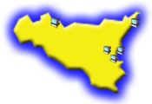

Outline
The Intra-Operative Electron Radiotherapy
iort_therapy : a Monte Carlo application based on the GEANT4 toolkit
The Catania Science Gateway components
Summary and Conclusions
References and Contacts
Notes:
I will illustrate to you in the order: the main features of intra-operative radiotherapy, the application iort_therapy, which we implemented to support this technique and how we have developed and used this application on the Grid

Slide 3
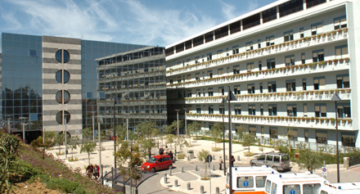
IBFM CNR – LATO Activities
IBFM CNR – LATO (LAboratorio di Tecnologie Oncologiche) @ HSR Giglio – Fondazione Istituto San Raffaele G. Giglio, Cefalù (ITALY)
Clinical and Research Activities:
Proteomic and Genomic
Morbid Anatomy
Intra-Operative Electron RadioTherapy (IOERT)
Magnetic Resonance
Nuclear Medicine
Magnetic Resonance guided Focused Ultrasound Surgery (MRgFUS)
Bio-Imaging elaboration
Notes:
my company, LAboratorio di Tecnologie Oncologiche, is working with the San Raffaele Giglio Hospital in Cefalù (Italy), and provides the following clinical services and research fields :

Slide 4
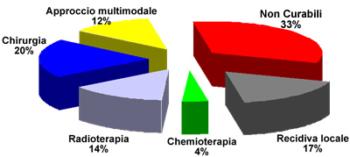
Cancer & Radiotherapy
At present, globally about 70% of cancers are treatable. 14% of patients are cured by radiotherapy alone and 12% uses a multimodal approach in which radiotherapy is an integral part.
Multimodal approach
Not treatable
Surgery
Radiotherapy
Chemotherapy
Local recurrence
the Radiotherapy plays an important role in cancer treatment.
Notes:
Today, 70% of cancers are curable and certainly radiotherapy is an efficient method of treatment comparable to surgical approach

Slide 5
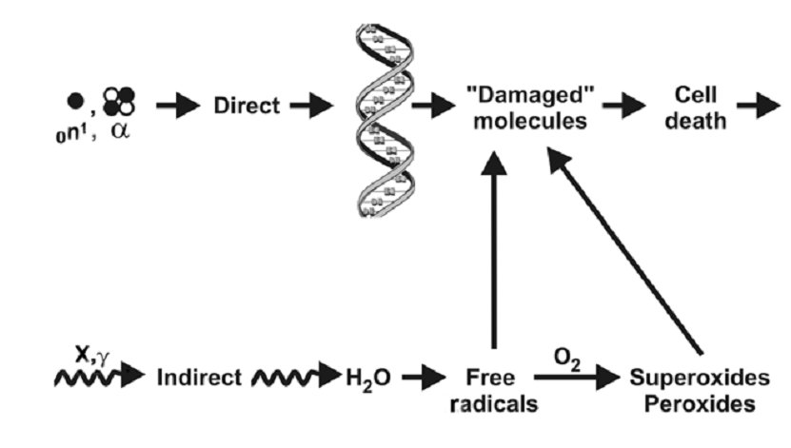
Cancer & Radiotherapy
This technique consists of delivering ionizing radiations (γ- and X-rays, photons, electrons, protons, etc.) inside cancerous tissues to control or block abnormal-cell growth.
The energy released (per unit of mass : DOSE) aims to damage cell DNA content and leads rapidly to cell death.
Notes:
The use of ionizing radiation makes it possible to control and block the growth and proliferation of cancer cells. Ionizing radiation can act releasing their energy directly on the chains of DNA, or indirectly on the surrounding water, producing harmful free radicals. In any case, the massive damage of DNA strands leads to rapid cell death.

Slide 6
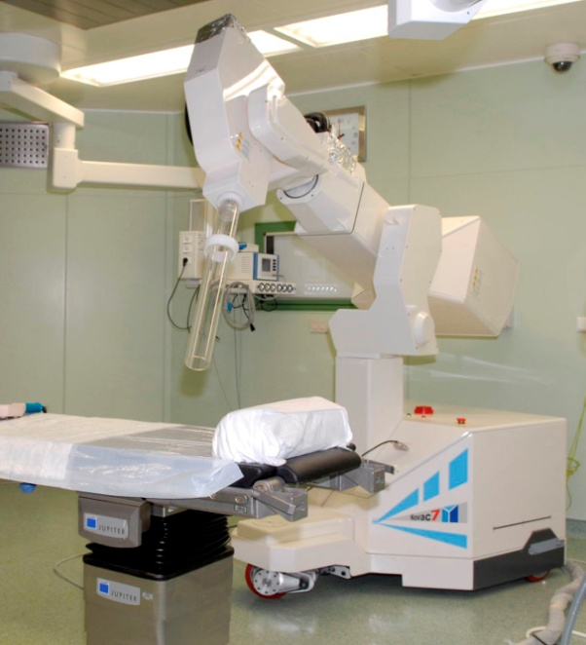
The Intra-Operative Electron Radio-Therapy (IOERT) technique
Intra-Operative Electron Radiotherapy (IOERT) is an advanced radiation therapy technique that allows treatment of tumors directly in the surgery room, after the surgeon have removed the tumor tissues
Ionizing radiations are represented by electrons
The electron beam is produced through dedicated and mobile accelerators, such as NOVAC7 (NRT, Aprilia, Italy).
Notes:
Intra-Operative Electron Radiotherapy (IOERT) is an advanced radiation therapy technique that allows tumors treatment directly in the surgery room, after the surgeon have removed the tumor tissues.
Ionizing radiation, in this case electrons, are provided with the equipment shown on the right. This is a mobile linear accelerator, named NOVAC7, and it is produced by the New Radiant Technology company.

Slide 7
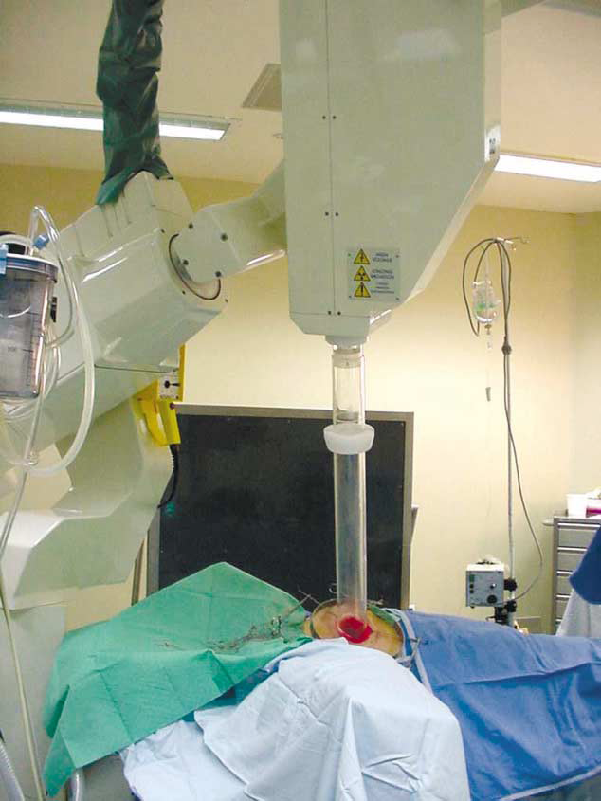
IOERT for Breast
placing a metal disc to protect healthy tissue
A single high DOSE is released to the target.
Electron
beam
Treatment
Zone
Healthy
Tissues
Notes:
In the case of IOERT for breast, the surgeon first places a metal disc between the area to be treated and the pectoral muscle in order to preserve the underlying healthy tissue. Then the collimation beam system is positioned and subsequently a single and intense dose is delivered.

Slide 8
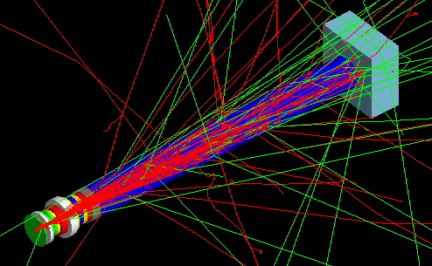
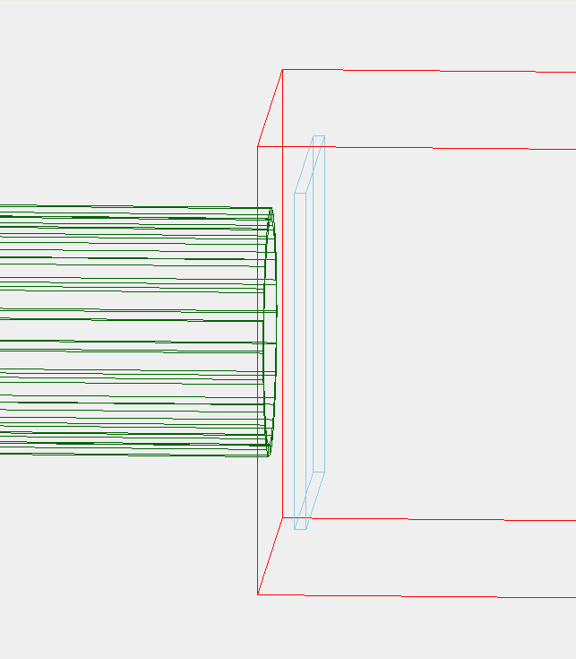
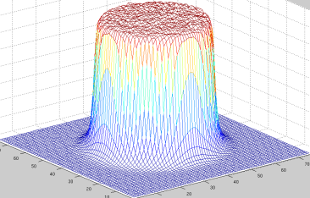
IOERT Computer Simulation Activities
Simulations of
ionizing radiation
transport
and
DOSE
distribution
NOVAC7 beam collimation system
are of fundamental importance both in clinical and technological radiotherapy activities.
Notes:
being able to simulate the transport of ionizing radiation around the collimation system but also to estimate the dose distribution to the patient is of fundamental importance both from the point of view of clinical and research. see why ...

Slide 9
Computer Simulation Activities
Clinicians & Medical Physicists
Clinicians & Medical Physics Requested Times : 1-3 months
Clinical
OPTIMIZATION
LINAC
Commissioning
Therapeutic Dose
Patient Radio-Protection
No commercial software available
Commercial software available, fast but imprecise (Treatment Planning System, TPS)
Notes:
in the days before the radiation treatment, to optimize the dose to the patient and take care that the healthy tissues and organs will not be damaged by ionizing radiation, the surgeon, radiation oncologist and medical physicist must plan carefully each action: [must examine the area to be treated, quantify the dose, choose the type of beam collimation fit.] During this planning stage they typically use commercial software called TPS, which, however, are often not very accurate.
On the other hand, the linear accelerator must be ready for use and with the aid of appropriate software, the device testing time can be significantly reduced.

Slide 10
IOERT Computer Simulation Activities
Technology
Company Requested Times : 1 - 6 months
Research Community Requested Times : 6 - 12 months
Design & Studies
beam collimation systems
Patients and workers radioprotection
No commercial software available
Notes:
The simulation activities are also essential in technology in order to design more accurate collimation systems and better patient and workers radiation protection devices.
In ambito TECNOLOGICO questa tecnica può avere delle criticità temporali diverse a seconda se viene usata per lavorare con delle
compagnie esterne o per comunità di ricerca.
Le risorse di grid aiutano a produrre i risultati per un’azienda in 4-5 giorni
Nel caso di compagnie => IOERT è stata utilizzata in passato per la progettazione di un collider accorciato.

Slide 11
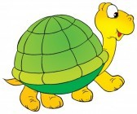
Monte Carlo method & computing environment
Monte Carlo simulation method offers the best software tool but, unfortunately, requires large computing power to achieve accurate results in reasonable times
ionizing radiation transports (histories) are processed sequentially
To achieve a correct statistical uncertainty in dose distribution values the number of histories may increase up to 10⁸ per simulation
A single standard CPU (3 GHz) can take even some months to complete a single simulation !
Clinical and research studies usually demand tens of dose distributions….
Notes:
Among many that have been developed in recent decades, Pure Monte Carlo simulation method is the most accurate. However it requires large computing power.
In a simulation the ionizing radiation transports, called histories, are processed one by one sequentially and to achieve a correct statistical uncertainty in dose distribution values the number of histories may increase up to 10⁸
In this way a single standard CPU can take even some months to complete a single simulation ! Obviously with this poor performance the software cannot be used for clinical and research purposes.

Slide 12


Monte Carlo method & computing environment
…….THE SOLUTION…….
Parallelized computation offers to serial processing a natural and appropriate practical support
A time-heavy simulation (of N histories) may be splitted in N’ smaller simulations, each one executed on a different CPU
A Grid infrastructure offering 200 CPU cores per user allows to reduce computing time by a factor of 200 (N/200=N’)
Notes:
The solution is simple. Parallelized computation offers to serial processing a natural and appropriate practical support. A time-heavy simulation (of N histories) may be splitted in N’ smaller simulations, each one executed on a different CPU. A Grid infrastructure offering 200 CPU cores per user allows to reduce computing time by the same factor

Slide 13
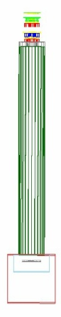
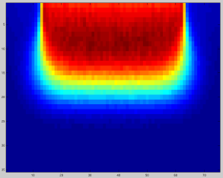
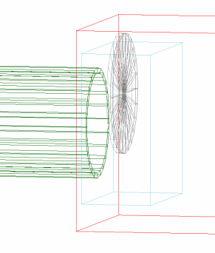
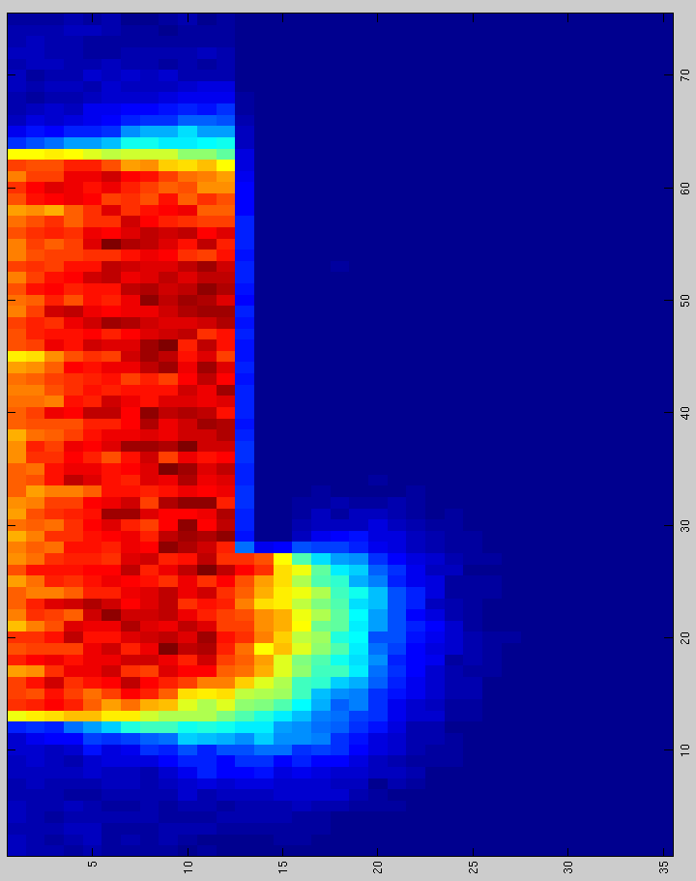
iort_therapy : a Monte Carlo application based on the GEANT4 toolkit
we have implemented a web-based application called iort_therapy
The application simulates the electron beam
and the collimation system of the NOVAC7
and it can be used for :
therapeutic dose optimization
radioprotection aspects
design of the collimation system, etc. etc.
Notes:
For this purpose we have implemented a web based Monte Carlo - GEANT4 toolkit named iort_therapy. The application simulates the final part of the head accelerator, the electron beam and the collimation system of the NOVAC7 and can be used to optimize the therapeutic dose to the patient , to study radioprotection aspects as, for example, the dose distribution in normal tissues when the metal disc is misaligned, or the design of the collimation system.

Slide 14
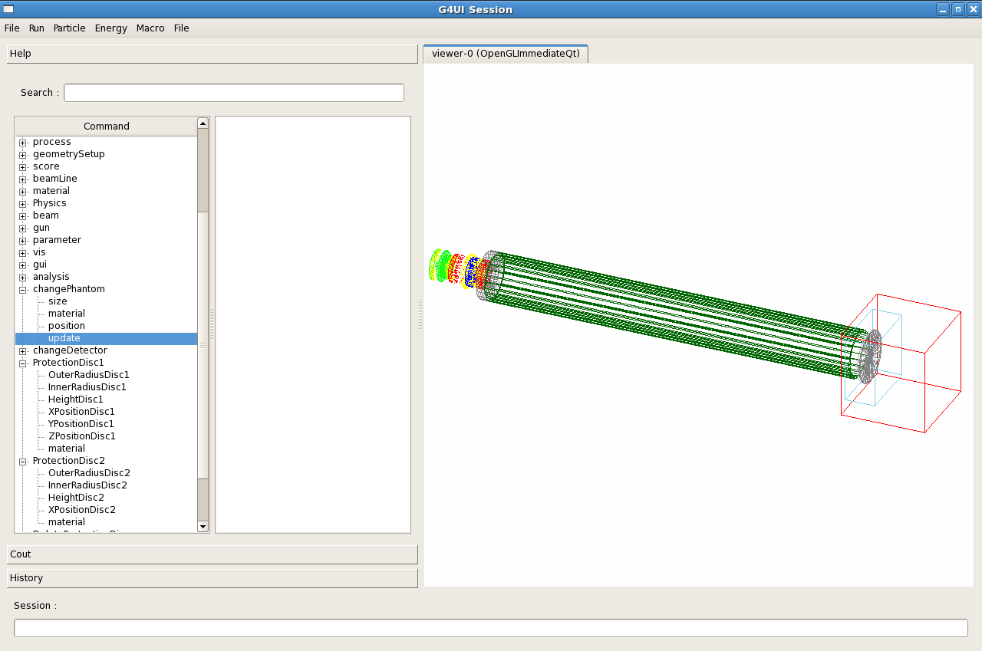
iort_therapy graphycal interface
Authors:
G.Russo^{(a,b,c)}, C.Casarino^{*(c)},
G.C. Candiano^{(c)}, G.A.P. Cirrone^{(d)}, F.Romano^{(d)} and S.Guatelli^{(e)}
^{(a)} Fondazione Istituto San Raffaele G.Giglio, Cefalù, Italy
^{(b)} IBFM-CNR , UOS of Cefalù, Italy
^{(c)} LATO (Laboratorio di Tecnologie Oncologiche), Cefalù, Italy
^{(d)} Laboratori Nazionali del Sud of the INFN, Catania, Italy
^{(e)} University of Wallongong, Australia
*Corresponding Author
Notes:
This is the graphical user interface of the iort_therapy application. By the interactive windows (on the left), or in batch mode via macro file the user can easily select the appropriate collimator and the geometric dimensions, positions, materials of the phantom, detector and shielding disc as well as the physic characteristics of the beam.

Slide 15
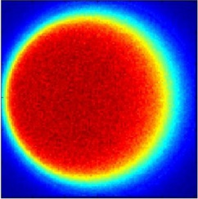
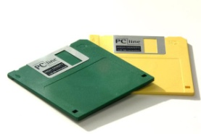
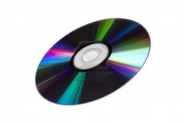
iort_therapy: a Monte Carlo application based on the GEANT4 toolkit
Starting from release 9.5 iort_therapy is officially supported by the GEANT4 collaboration
(http://geant4.web.cern.ch/geant4/)
By default, the application needs a full installation of GEANT4 toolkit and of some additional libraries (2.2 GB);
typical result: a dose distribution in a volume of 300 x 300 x 140 voxels
size output files (per simulation) :
from few MBs to tens of GBs
Before starting to use the Grid computing resources, the iort_therapy software tool has been re-compiled as a stand-alone executable (67 MB of size)
Notes:
Starting from release 9.5 iort_therapy is officially supported by the GEANT4 collaboration. By default, the application needs a full installation of GEANT4 toolkit. typical result: a dose distribution in a volume of 300 x 300 x 140 voxels with size output files (per simulation) : from few MBs to tens of GBs . Before starting to use the Grid computing resources, the iort_therapy software tool has been re-compiled as a stand-alone executable.

Slide 16

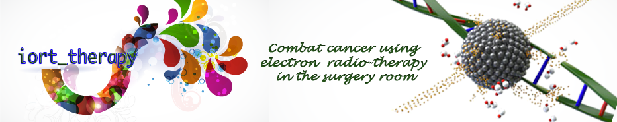
Porting of iort_therapy application to grid
The Consorzio COMETA
The Catania Science Gateway components
The iort_therapy application on the Science Gateway
iort_therapy’s results
iort_therapy’s post-processing & future plans
Summary & Conclusions

Slide 17


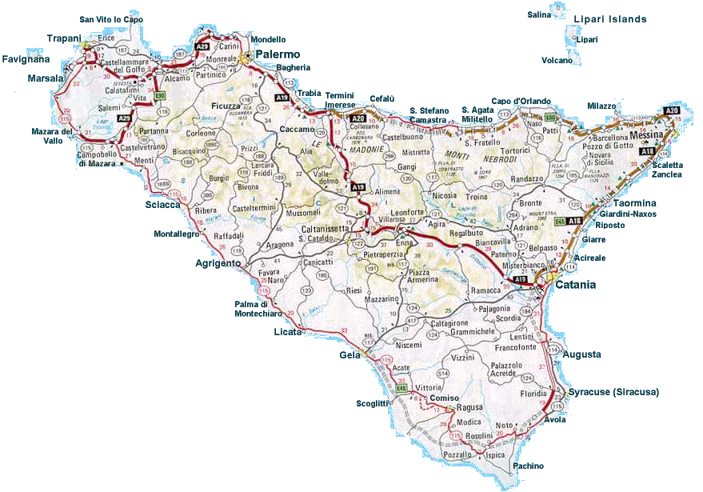

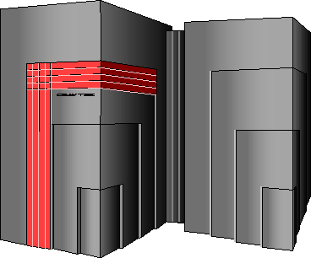




The Consorzio COMETA
(http://www.consorzio-cometa.it)
~2000 cores AMD Opteron 2218
2 GB of RAM per core
LSF as LRMS everywhere
Infiniband-4X at all sites
200+ TB of raw disk storage
Distributed/parallel GPFS file system
Notes:
These are the computing facilities of the COMETA consortium. It was founded in 2005 and is constituted by different institutions, including the university of Catania, Messina and Palermo, the nuclear physics national institute etc….
Contratto per poter fare simulazioni nasce 2006
Batch system mettono in coda I jobs e poi li smistano

Slide 18
The Catania Science Gateway components
The primary requirements that drove us in the design and implementation of the Science Gateway were:
  Use of standards;
  Simplicity;
  Easiness of use;
  Re-usability.
For the development of the basic elements of the Science Gateway we decided to adopt the JSR 286 standard and Liferay as portlet container;
Identity Federations based on the SAML 2.0 standard and on its implementation based on Shibboleth;
To access the computing resources we use SAGA and its JSAGA implementation;
For all grid transactions we rely on robot X.509 certificates and on the following standards: JAX-RS and PKCS#11;
We comply with the EGI VO Portal Policy and the EGI Grid
Security Traceability and Logging Policy !!
Notes:
the Catania Science Gateway Framework has been successfully adopted in the context of several EU funded projects such as DECIDE [17], EUMEDGRID-Support [18], GISELA [19], CHAIN [20] and INDICATE [21].
The Science Gateway uses JSR 286 standards (also known as “portlet 2.0”) to develop advanced tools that can be re-used and combined for resolving different and complex problems and Liferay as a portlet container.
The access to the Science Gateway relies on the use of Identity Federations based on the SAML 2.0 standard and on its implementation done by Shibboleth [22] and SimpleSAMLphp [23].
[A “catch-all” Identity Federation to gather all the users who do not already belong to any federations and a special IdP that allow people to get authenticated with the same credentials they already have with the most common and populated social networks (Facebook, Google+, LinkedIn, Twitter, Windows Live and Yahoo!) are also supported. The following authorization mechanism makes possible to simplifying the access to the infrastructure and widening its user base.]
The access to the underlying computing infrastructure relies on the SAGA standard [24] and on its JSAGA implementation.
For the authentication point of view, all grid transactions are secured using a robot certificate installed on a eToken PRO 64KB USB smart card plugged on a dedicated server which is in charge of generating, using PKCS#11 and JAX-RS standards, proxy certificates on behalf of users.
The iort_therapy Science Gateway has been implemented in order to be fully complaint with the strict rules of the EGI VO Portal [25] and EGI Grid Security Traceability and Logging Policy [26] policies.
Porting dell’applicazione : installazione sviluppo applicazione schermata grafica portale etc
Liferay
L’accesso è basato su federation Identity
Con Saga si può accedere a queste risorse di calcolo senza preoccuparsi di come sono strutturate le risoerse di calcolo in modo “trasperente
Certificati: sicurezza nell’accesso di tipo robot

Slide 19


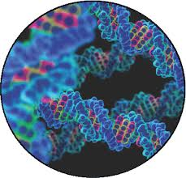
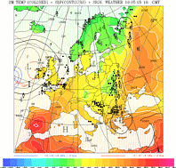
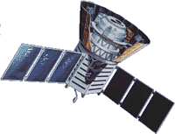







The Catania Science Gateway model
Science
Gateway
Administrator
Power User
Basic User
Standard-based (SAGA)
middleware-independent Grid Engine
Users from different organizations having different roles and privileges
Notes:
The reference model of the iort_therapy Science Gateway is shown in this figure.
Figure da aggiornare….vedi ppt JSAGA
Liferay portlet conteiner
Middleware differenti che offrono altre CPU e altri softaware e vicersa

Slide 20
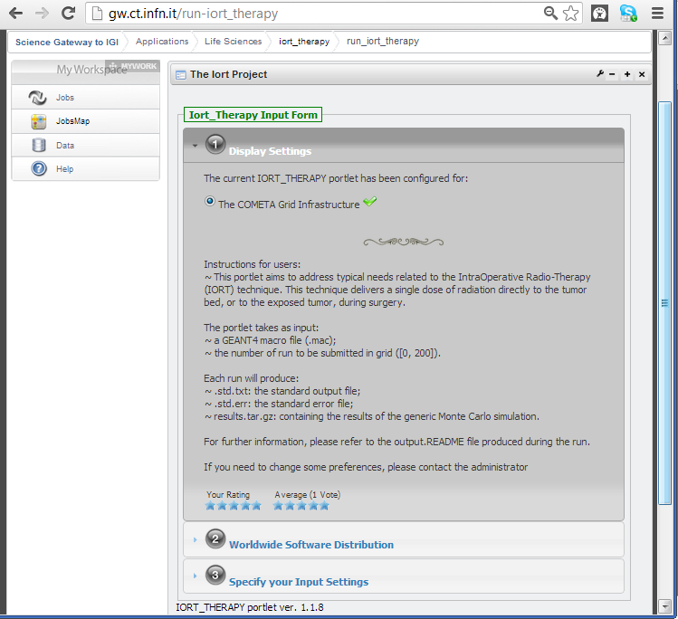


The iort_therapy application on the Science Gateway
running on http://gw.ct.infn.it
It provides some explanation about the application
Notes:
This is the web interface of iort_therapy on the Science Gateway. The first window provides some explanation about the application: what is it, how it works etc

Slide 21
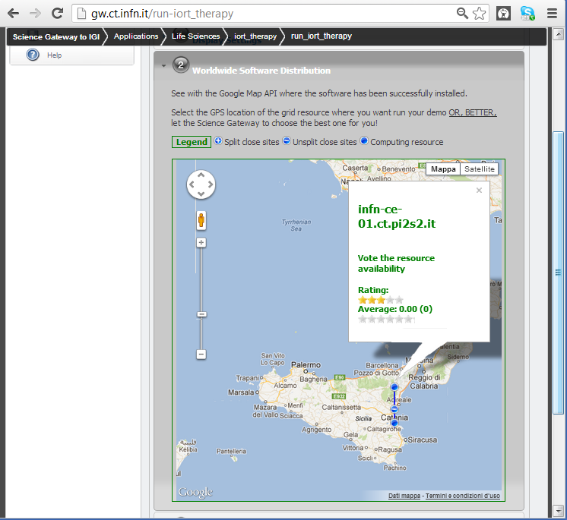

The iort_therapy application on the Science Gateway
running on http://gw.ct.infn.it
It shows the computing resources where iort_therapy has been successfully deployed
It is possible to rank the generic computing resource
Notes:
The second window shows the computing resources where iort_therapy can be runned

Slide 22
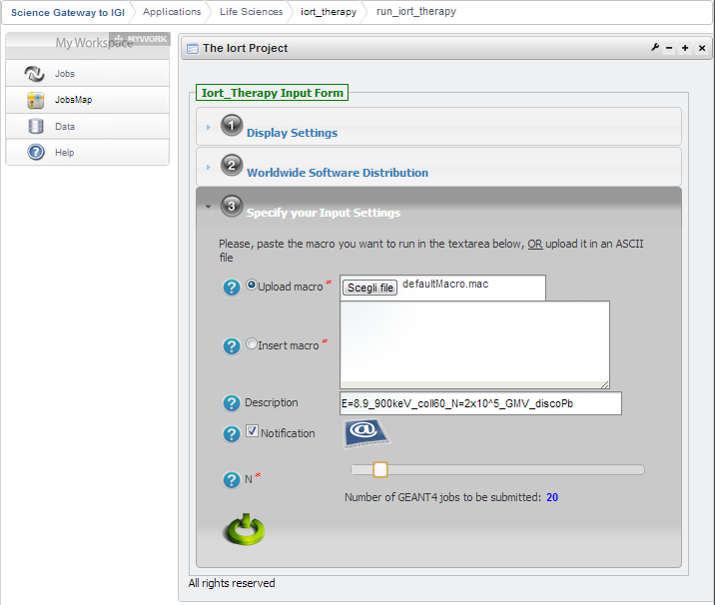

The iort_therapy application on the Science Gateway
running on http://gw.ct.infn.it
Uploading a iort_therapy macro as ASCII file or use the text-area
Job description
Enable e-mail notification
# of Monte Carlo jobs submitted
Notes:
By means of the third window with can upload the iort_therapy macro, write the job description and select the number of job to be runned

Slide 23
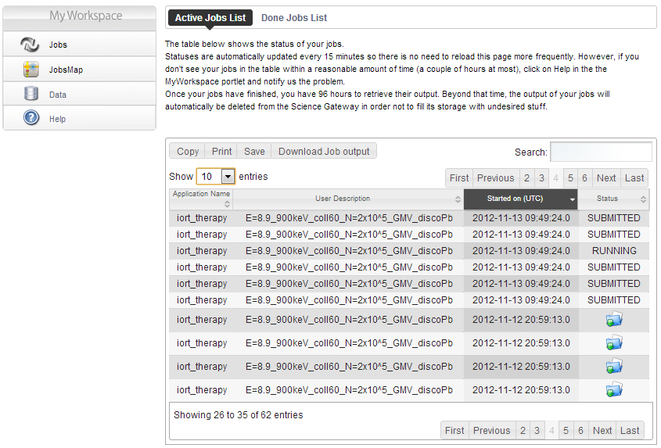
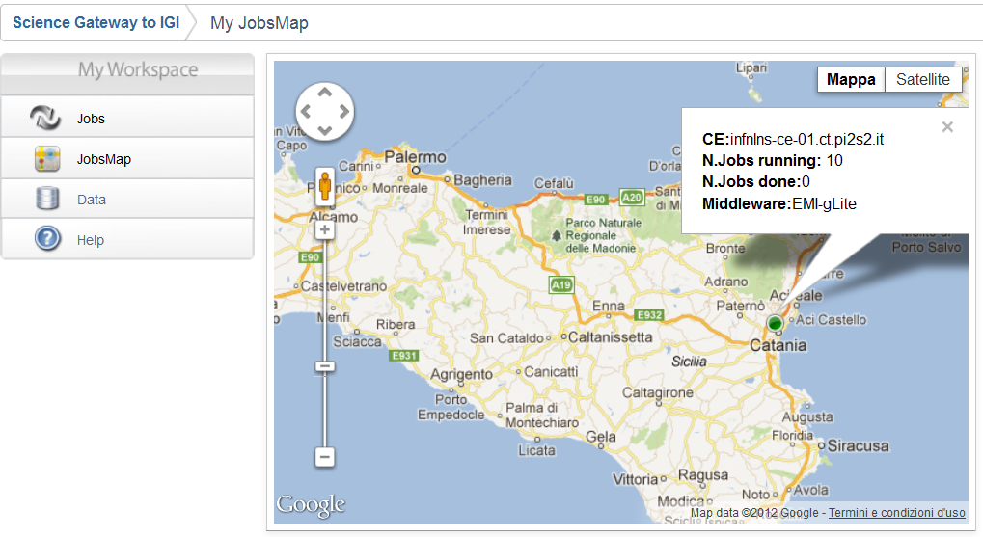
The iort_therapy application on the Science Gateway
Showing the status of the Monte Carlo simulations using Google Map
Showing the status of the Monte Carlo simulations
running on http://gw.ct.infn.it
Asking for support
Automatic jobs output downloading
Notes:
With the last window we can monitor the status of the jobs and see which of them have been completed or are still submitted or running

Slide 24
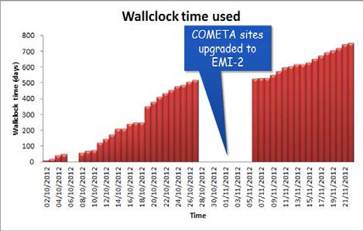
iort_therapy’s performance
The average data rate produced from the grid:
  partially address the IOERT Clinical requirements
  The NOVAC7 Commissioning could be done in 1 week
  fully address the IOERT Technical requirements
  The Grid infrastructure helps to fulfill Company and Research’s requirements
Notes:
With this performance iort_therapy on the Grid partially addresses IOERT clinical needs, but completely matches technical requirements. In this way Grid infrastructure meets Company and Research demands

Slide 25
Summary & Conclusions
Thanks to the computing capabilities of Consorzio COMETA, the IBFM-CNR LATO can then:
  sustain a research project to validate and improve commercial IOERT Treatment Planning System (TPS)
  collaborate with New Radiant Technology NRT S.p.a. company to optimize patient radioprotection and the design of the NOVAC7 collimation system
  promote the use and distribution of iort_therapy application in hospitals

Slide 26
References
Russo G, CASARINO C, Arnetta G Candiano, A Stefano. F Alongi, G Borasi,
C Messa, MC Gilardi (2012). Dose distribution changes with shielding disc misalignments and wrong orientations in breast IOERT: a Monte Carlo – GEANT4 and experimental study. Jour. App. Clin. Med. Phys., vol. 13 (5), pp.:74 - 92, May 2012
G Russo, CASARINO C., G Candiano, G Borasi, C Messa, MC Gilardi (2012). A GEANT4 application for the simulation of the NOVAC7: a support to optimize the clinical setup in IOERT treatment. In: 3rd European Workshop on Monte Carlo Treatment Planning. Sevilla, Spain, 15-18 May 2012
I Fazio, G Russo, CASARINO C., G Candiano, G Borasi, C Messa, MC Gilardi (2012). DOSE DISTRIBUTION CHANGES WITH SHIELDING DISC MISALIGNMENTS AND WRONG ORIENTATIONS IN BREAST IOERT: A MONTE CARLO – GEANT4 STUDY. In: ISIORT 7th International Conference of the International Society for Intraoperative Radiation Therapy (ISIORT). Baveno, Italy, June 22-24, 2012
V. Ardizzone, R. Barbera, A. Calanducci, M. Fargetta, E. Ingrà, I. Porro, G. La Rocca, S. Monforte, R. Ricceri, R. Rotondo, D. Scardaci, A. Schenone – 2012, The DECIDE Science Gateway, Journal of Grid Computing – Special Issue: Science Gateway, ISSN 1570-7873, 2012

Slide 27





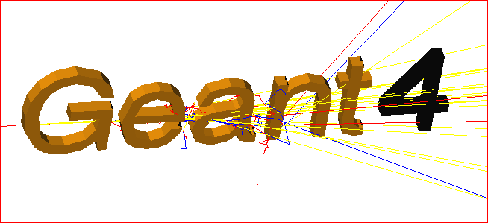


Contacts
Any questions, comments or remarks are very welcome.
Contacts: carlo.casarino@polooncologicocefalu.it
giuseppe.larocca@ct.infn.it

