Slide 1
EMI SA2 Report
Presented by:
Michele Carpené, CINECA (SA2.7)
Quality Control (QC)
Maria Alandes Pradillo (SA2.2)
Quality Assurance (QA)
EGI technical forum 2013, Manchester

Slide 2







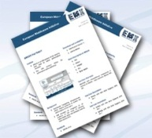



Heterogeneous context
4 major Middleware Providers
Developing middleware for the last decade
Limited resources for QA
28 independent Development Teams
Geographically distributed
Well established processes and tools
56 interdependent software products
Different technologies and programming languages
> 2 million SLOC
Common QA policies
Integrated Release
A set of Common QA policies is needed to provide an integrated EMI release

Slide 3
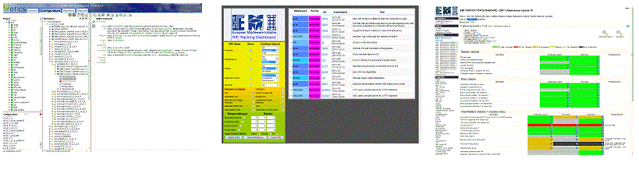
Need for automation
Apart from the heterogeneous nature of the EMI project:
  35 metrics to be calculated
  23 EMI 1 Updates, releasing more than 80 new product versions
  9 EMI 2 Updates, releasing more than 40 new product versions
  Several platforms supported (Debian, SL5, Sl6)
Automation and tools are necessary to ensure quality!
This can only be achieved with a set of Common QA policies

Slide 4
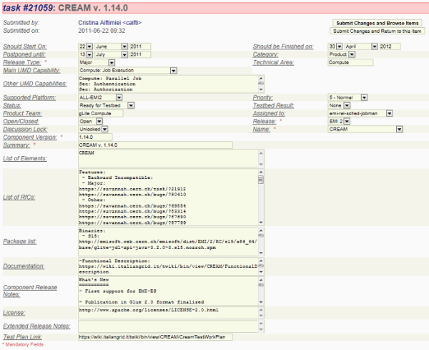
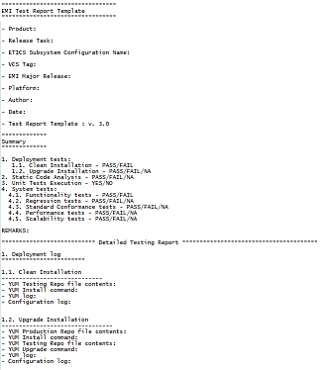
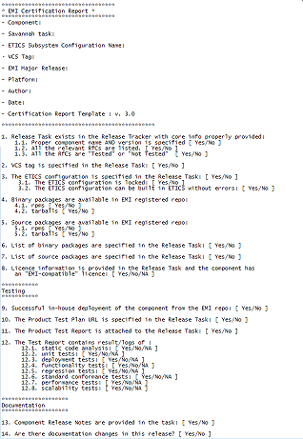
Certification and Testing policy
How can I extract information from 56 different software products?
Common testing and certification report
Common QA policies
Benefits
Support for quality control team offering a single view of the test results
Report generation and automatic processing in the verification dashboard
EGI Community Forum

Slide 5
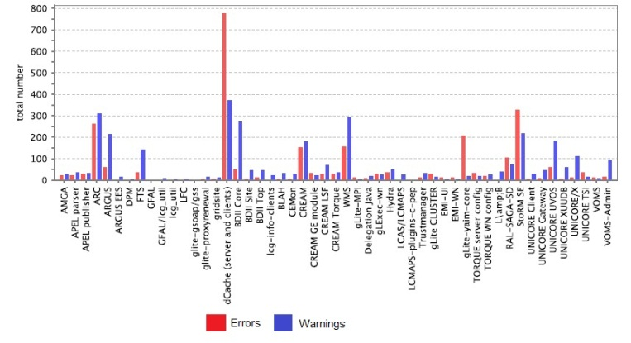
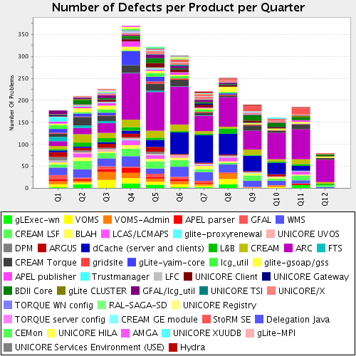
Package and Build policy
ETICS is the tool used to build and package EMI middleware.
The ETICS plugin framework collects metrics during build and test execution like RPMlint.
It enables the automation of product metrics generation.
Input from all QA tools (ETICS logs and XML data) are processed to build trend diagrams using the chart generation framework.
Benefits
Monitor whether project goals are being achieved.
Availability of metrics charts for report generation.

Slide 6
EMI 1,2&3: Metrics Monitoring
Little development required since tools are already fully functional.
Mostly metrics monitoring for the majority of year 3.
Summary of past 12 months:
  Metric generation for period reports
  Lintian Analyser
  Introduced EMI 3
6

Slide 7
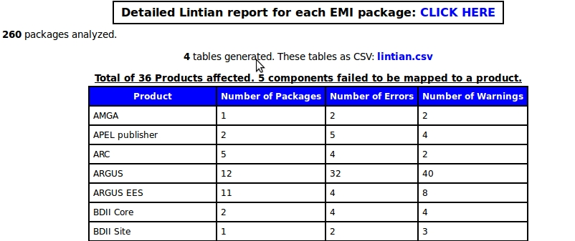
Lintian Analyser (Recent Work)
Collecting all the Lintian Reports into one location to provide an overview per Product.

Slide 8
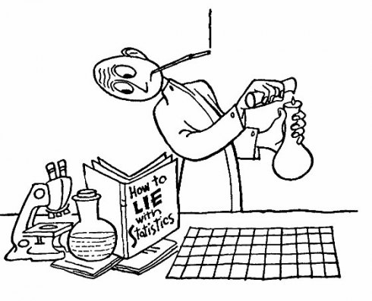
Quality Control – Task 2.7

Slide 9
Quality control activities
Verification of released products
Static analysis of product packages
Reporting of quality performance

Slide 10
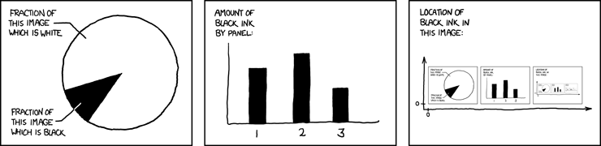
EMI 1,2&3: General Measurements
EPEL Conformity (cont.)
Availability of Binary and Source Packages
Mandatory tests
Associated tests
Certification report
Listed RfC
10

Slide 11
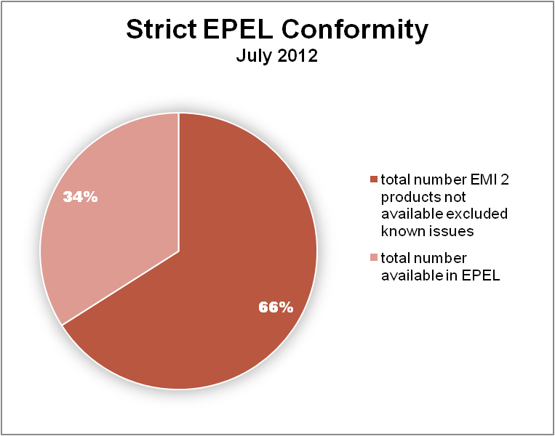
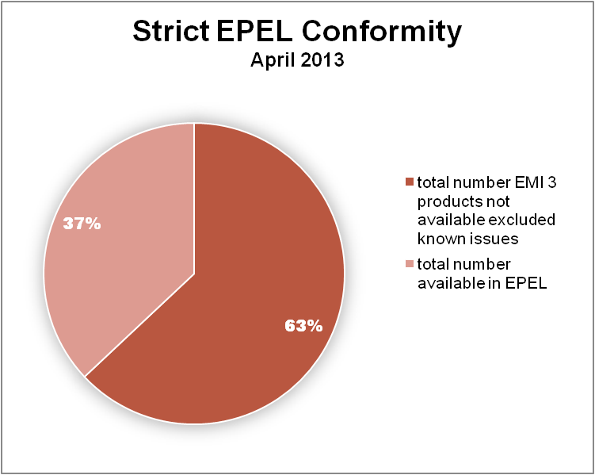
EMI 2-3: EPEL Conformity
14 over 36
Moving from July 2012 (EMI 2) to April 2013 (EMI 3) the total number of products available in EPEL increased.
11

Slide 12
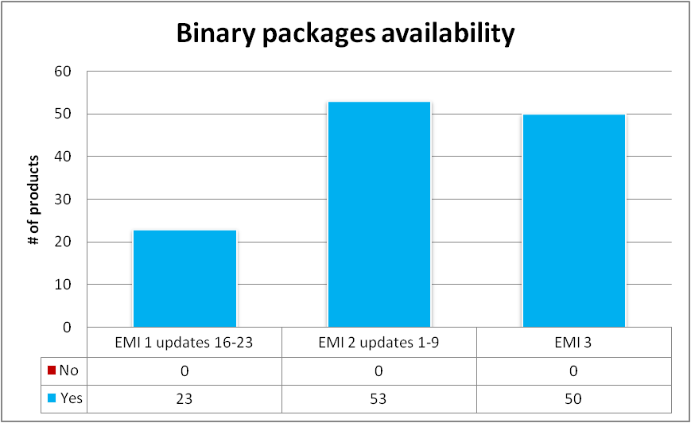
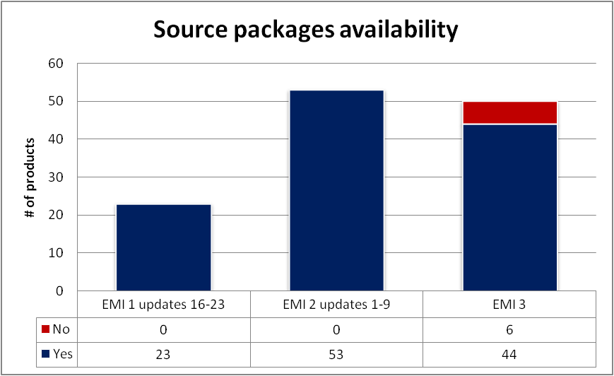
EMI 1-2-3: Source and Binary Packages
12

Slide 13
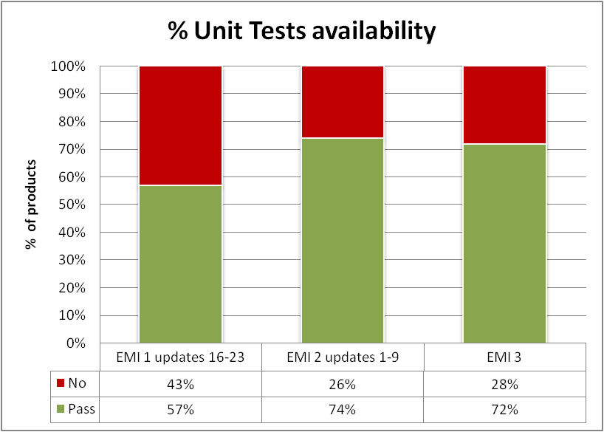
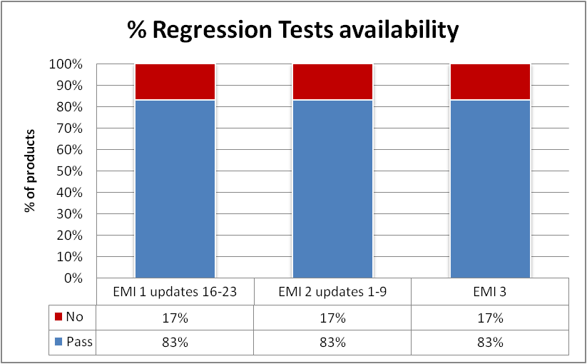
EMI 1–2–3: Fundamental tests
A slight improvement % can be observed during the last EMI year
13

Slide 14
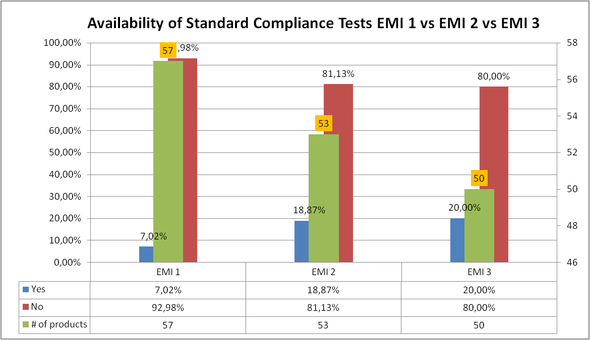
EMI 1–2–3 Standard Compliance Tests
A slight improvement % from EMI 1 to EMI 3 (major releases)
14

Slide 15
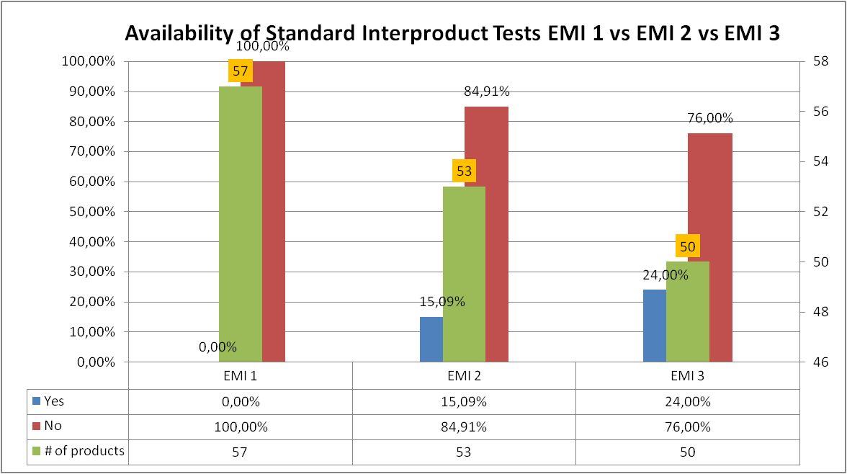
EMI 1–2–3 Standard Interproduct Tests
A slight improvement % from EMI 1 to EMI 3 (major releases)
15

Slide 16
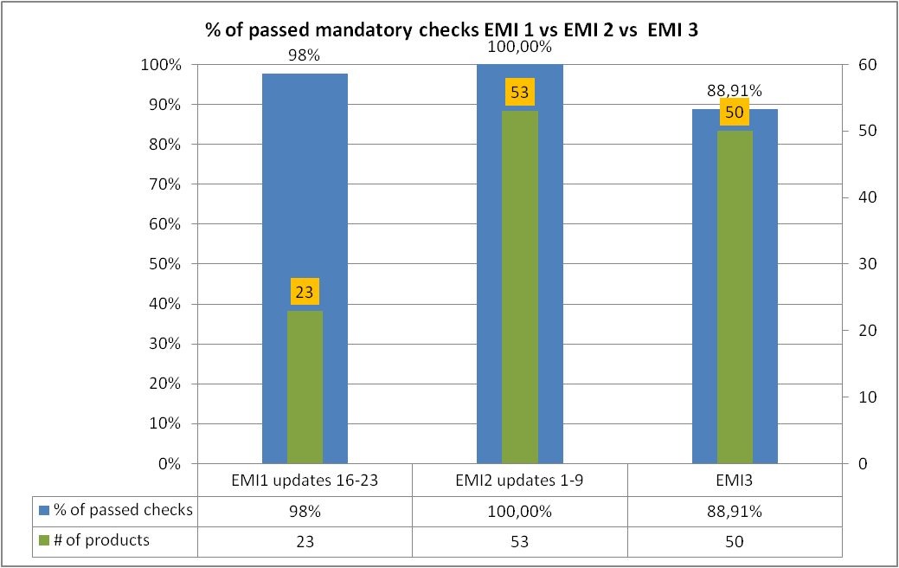
EMI 1-2-3: Passed checks
A small drop % from EMI 2 to EMI 3, but a good result!
16

Slide 17
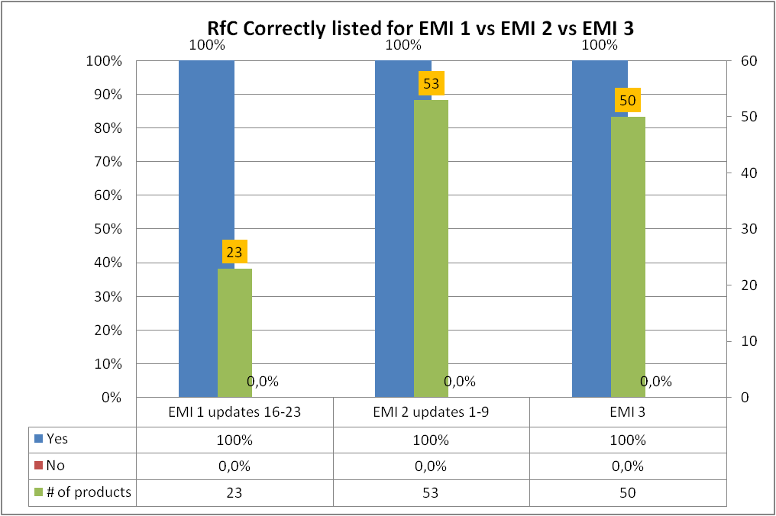
EMI 1-2-3: RfC correctly listed
17

Slide 18
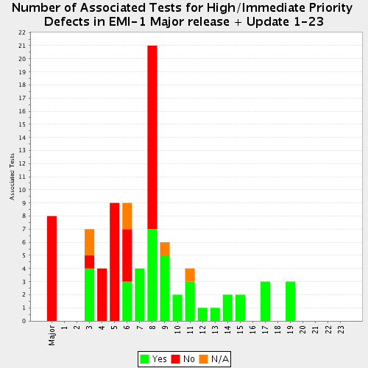
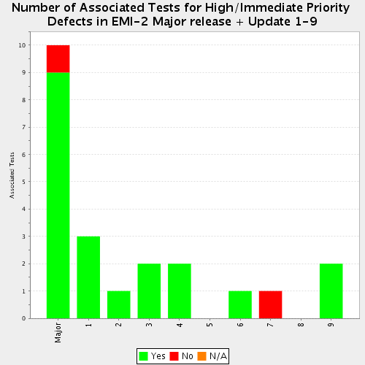
Associated Tests Defects – EMI 1 & 2
EMI 1 release + updates 1-23 show complete enforcement
of SA2.2 policies for the last updates (1-23)
EMI 2 release + updates 1-9 show complete enforcement
of SA2.2 policies, except done for an issue on update 7

Slide 19
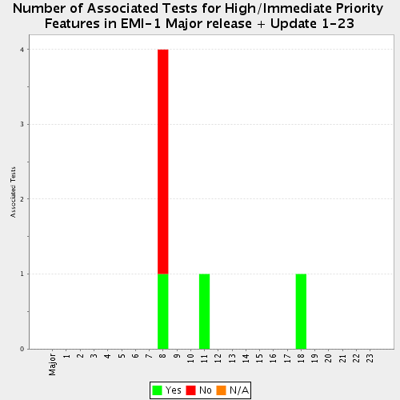
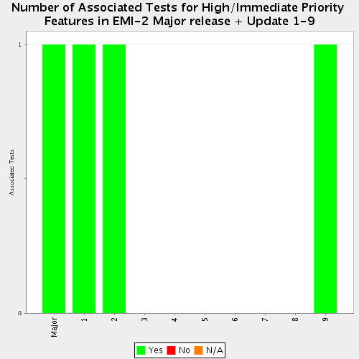
Associated Tests Features – EMI 1 & EMI 2

Slide 20
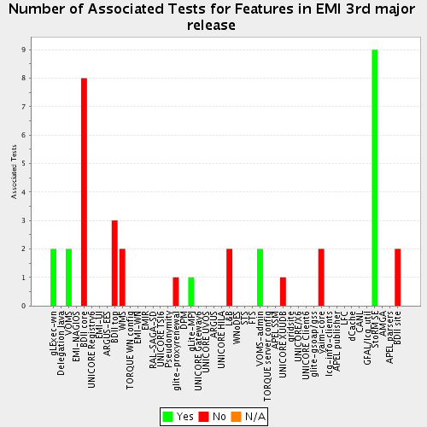
Associated Tests Features – EMI 3

Slide 21
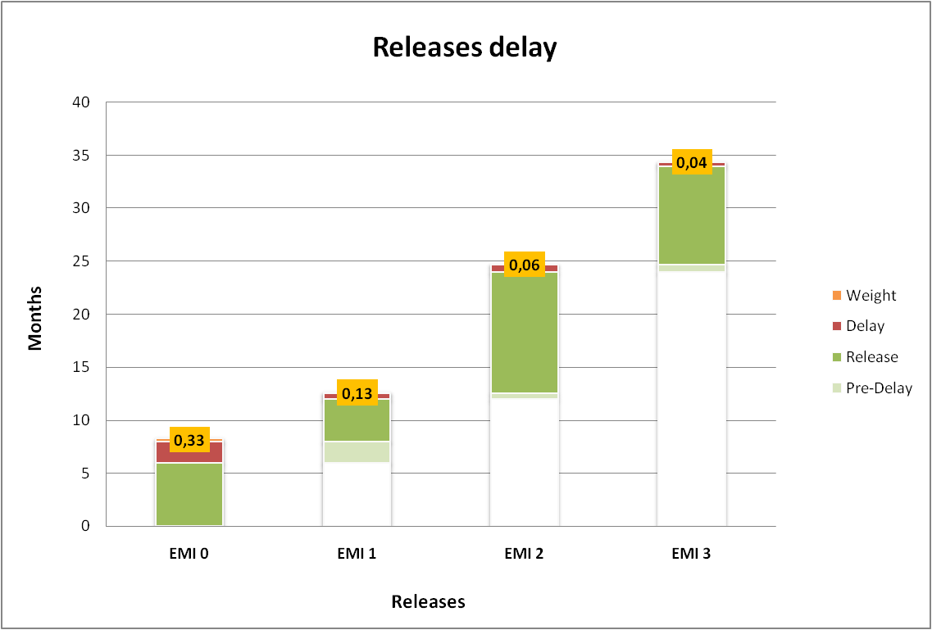
Major releases delay
21

Slide 22
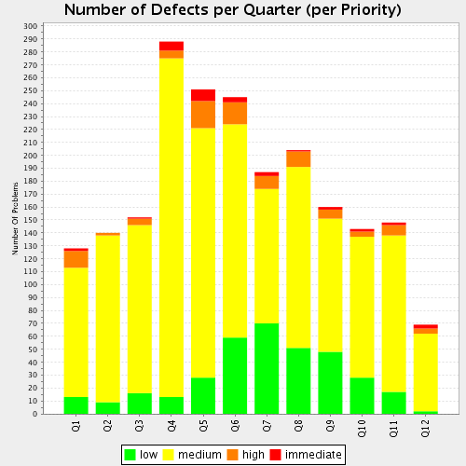
QC Conclusions
Overall verification results are good
New developments for EMI 3 report better performance on test availability than previous ones (e.g. EMI 2 Updates)
Level of conformity with EPEL policy is still increasing slightly
Number of defects per quarter is always decreasing over quarters
22

Slide 23
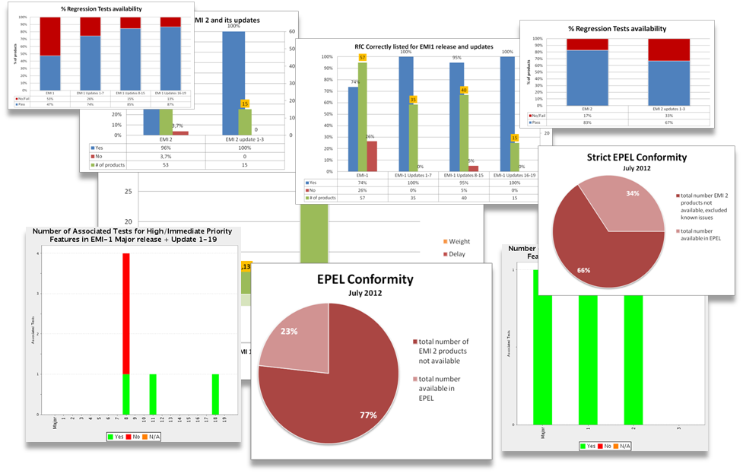
Thank you!
23

