Slide 1
CertWizard
John Kewley,
David Meredith and Jens Jensen
john.kewley@stfc.ac.uk
Notes:
The UK eScience CA one of the world's leading Grid Certification
Authorities (CA) and has issued around 30,000 certificates.
The National Grid Service (NGS) helpdesk receives many tickets relating
to certificates (and certificate
renewal in particular): largely due to browser incompatibilities.
This talk gives an introduction to the UK eScience CA and its associated
software and interfaces, including CertWizard: our new browser-independent
certificate tool.
It will show how modernisations are being made at various stages of the
certificate lifecycle, making it easier than ever to manage your
personal UK eScience Certificate.

Slide 2
Outline
The UK eScience CA
The components of our CA interface
A quick tour of CertWizard
Notes:
ABSTRACT:
Users find applying for and renewing of their certificates hard.
In fact one third of the tickets on the UK NGI Helpdesk in the last year
were related to certificates: a common theme being browser issues.
STFC staff have produced a browser-independent tool for managing
the certificates of the UK NGI user community. This tool, combined with
other service improvements, provides a simpler-to-use interface which is
more efficient and fully integrated with our already established
certificate tools.
The NGS runs the world's 2nd largest Grid Certification Authority: the
IGTF-accredited UK e-Science CA. It is trialing several innovations for x509
authentication including alternatives to year-long user certificates,
but their use will be needed for some time. The CA certificate
itself is due for renewal in 2011 and so the opportunity is being taken
to make changes at all levels of the service.
Up until now, users have used their browser to apply for and renew
their certificates. As browsers have evolved there have been a variety of
incompatibilities in the way they handle certificates and our list of
unsupported browsers has grown. The solution was to write a stand-alone
tool to manage these certificate requests without involving a browser.
The tool also adds the facility to renew a recently expired certificate and
change details such as the user's email address without having to revoke it
and apply for a new one like now. It has also been merged with our existing
VOMS-enabled MyProxy Upload Tool so that a single tool can be used to manage
all the user's certificate interactions. Further work is already underway
to add interfaces to provide analogous support for host certificates and
for RA Operators to approve both user and host certificate requests.
Although the CA part of our tool is tied in to the UK eScience CA, the
interface provided is well-defined and would not take too much effort to
generalise for other community CAs so we are keen to demonstrate its
functionality at the User Forum in Lyon.

Slide 3
What is a CA?
A CA (Certification Authority) is a trusted identity that issues and manages digital certificates (security credentials).
Trusting a particular CA means that you trust the identity of its certificate holders

Slide 4
The UK e-Science CA
The UK e-Science CA issues 13 month certificates for use by users, services and hosts from the UK e-Science Grid community.
Since it follows international standards and is accredited by the IGTF, its certificates are accepted by Grids around the world.

Slide 5
UK CA
UK CA – Issues IGTF accredited user and certificates for the UK (other certs too – code-sign).
31920 issued in total, 2809 currently valid, are 1691 host certs, 1092 certs processed using CertWizard.
RA operator network to assert user identities (check photo IDs) to managed certificate requests (approve/reject/revoke).

Slide 6
Certificate Lifecycle
Apply
Renew
VALID
Revoke
REVOKED
EXPIRED
Retire

Slide 7
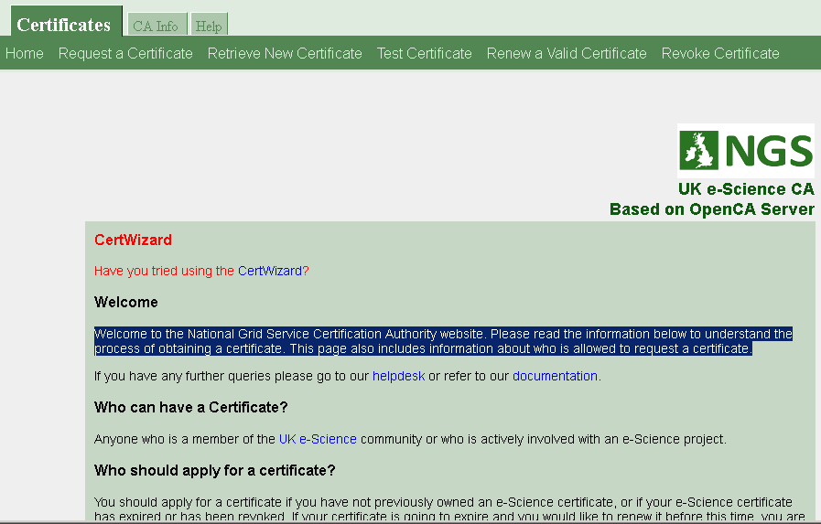
Old Web Interface

Slide 8
Browser/OS Problems
We receive many certificate problems on our helpdesk, mostly expiries or browser issues
Browsers change, we can't support them all
OpenCA s/w was problematic to update.
http://www.ngs.ac.uk/supported-internet-browsers

Slide 9
Old vs New
CA-Sign
CA DB
Old
New
OpenCA
CA-Server
https
REST
Browsers
Bulk
New Bulk
RA
CertWizard

Slide 10
CertWizard
Platform and browser independent
Integrated into our existing MyProxy tool
http://www.ngs.ac.uk/tools/certwizard

Slide 11
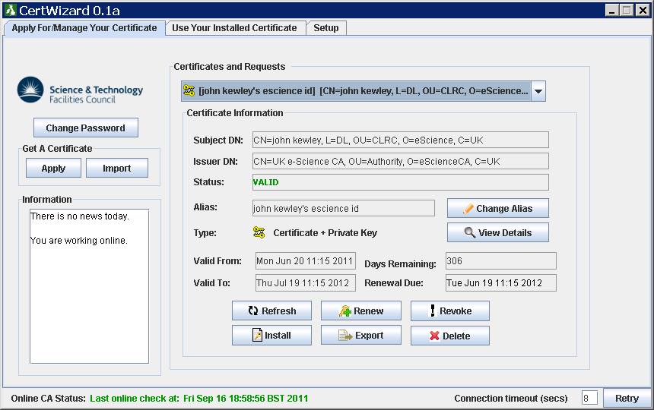

Slide 12
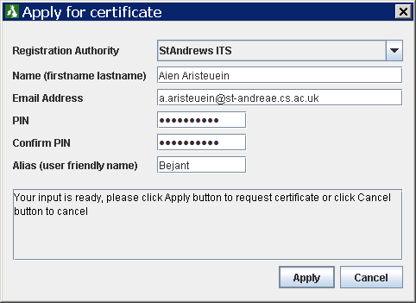

Slide 13
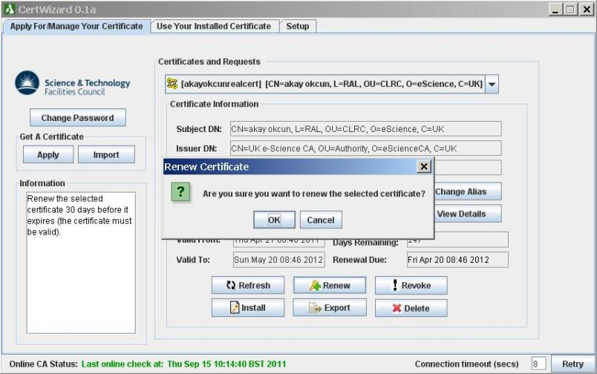
Renew Certificate

Slide 14
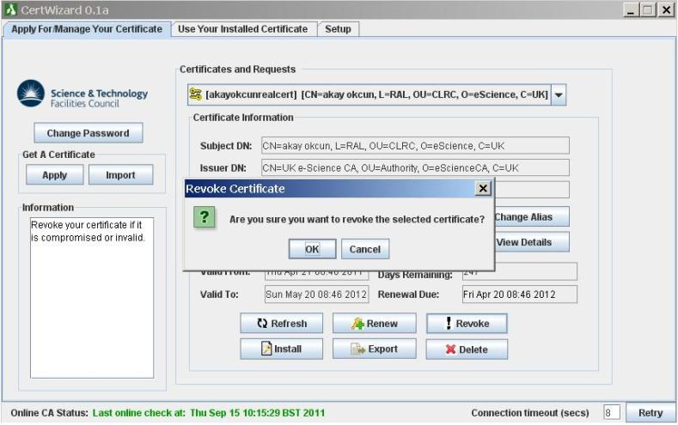
Request Revocation

Slide 15
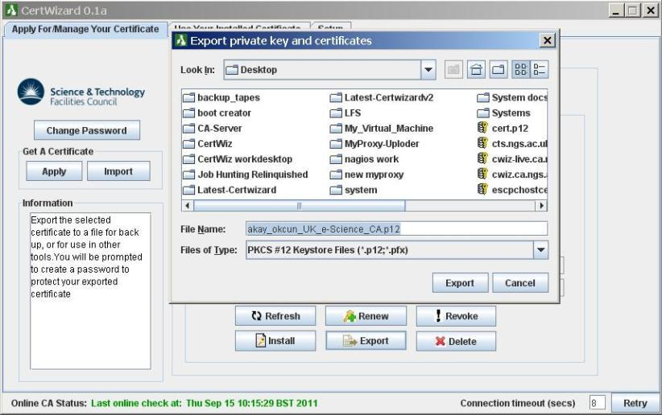
Export/Backup

Slide 16
Install

Slide 17
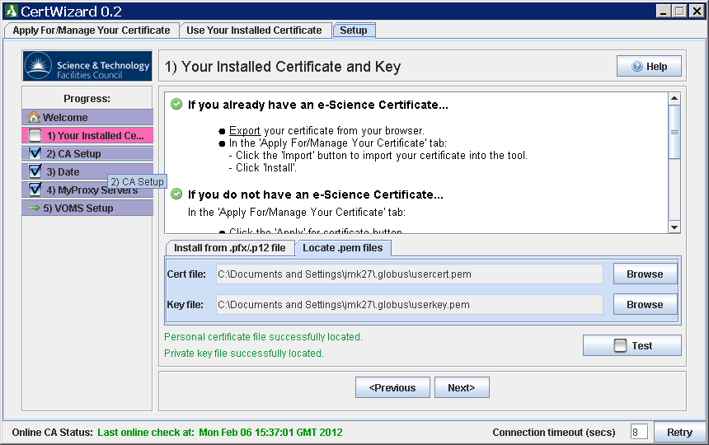
Configuration
CA Certificates
MyProxy servers
VOMS servers
Your Certificate

Slide 18
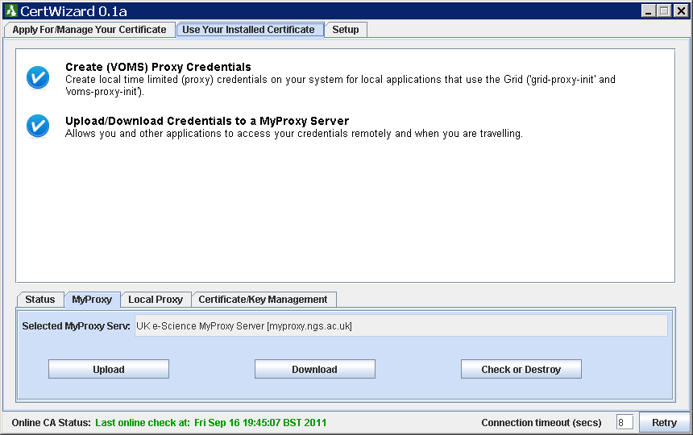
MyProxyUploader

Slide 19
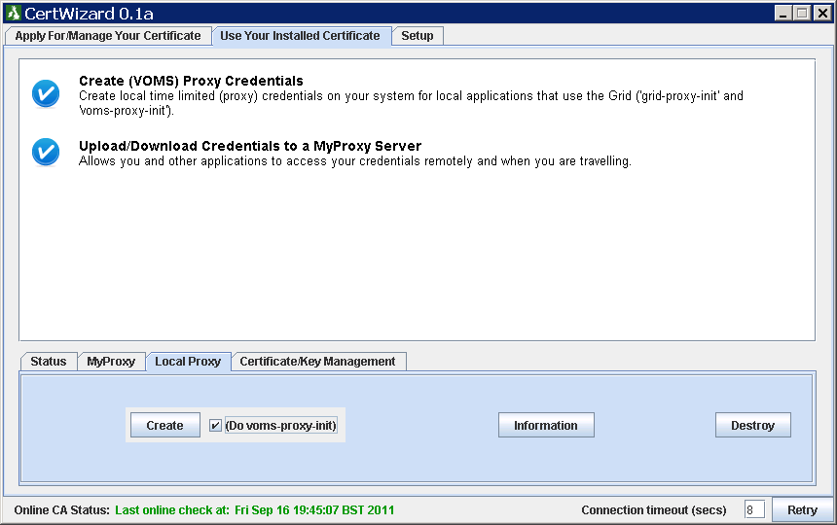
Local Proxy

Slide 20
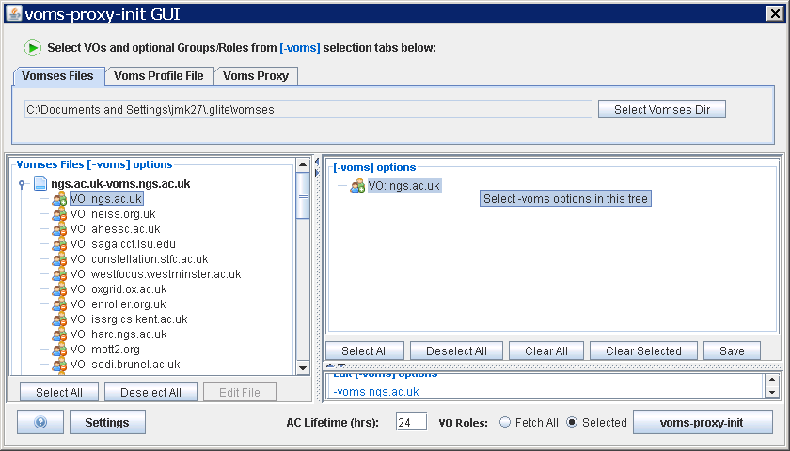
VOMS attributes

Slide 21
Future/in-Progress Work
RA i/f
Key generation
Retiring Certs
Change requests
Service certs
Special features – code-sign, robot

Slide 22
Acknowledgements
Jens Jensen and David Meredith
NGS/NES
STFC
The next NGS Seminar will be by Josh Howlett of JANET and will be entitled:
"Moonshot - next generation federated identity"
http://www.ngs.ac.uk/news/ngs-seminar-series-february-2012

Slide 23
PPPK

