Slide 1
Here Come the Feds
Federated identity management:
the consumer’s perspective
Jens Jensen, STFC
On behalf of EUDAT AAI TF
EGI CF Manchester April 2013

Slide 2
Background – EUDAT in nuce
EUDAT is building a data e-infrastructure
Support user communities (ESFRI)
CLARIN (linguistics, heterogeneous + long tail)
ENES (climate)
EPOS (Earth obs)
VPH (human physiology)
LifeWatch (biodiversity)
Move data in and out of EUDAT: PRACE, EGI, …
Move data between sites (replication)
Data storage for individual users

Slide 3
Principles: AAI
Authentication
Make use of existing infrastructures
SSO whenever possible
Make use of existing code - pragmatic
Authorisation
Link to community rôles (users can be in more than one community)
Infrastructure
Like the grids, secure with IGTF+commercial

Slide 4
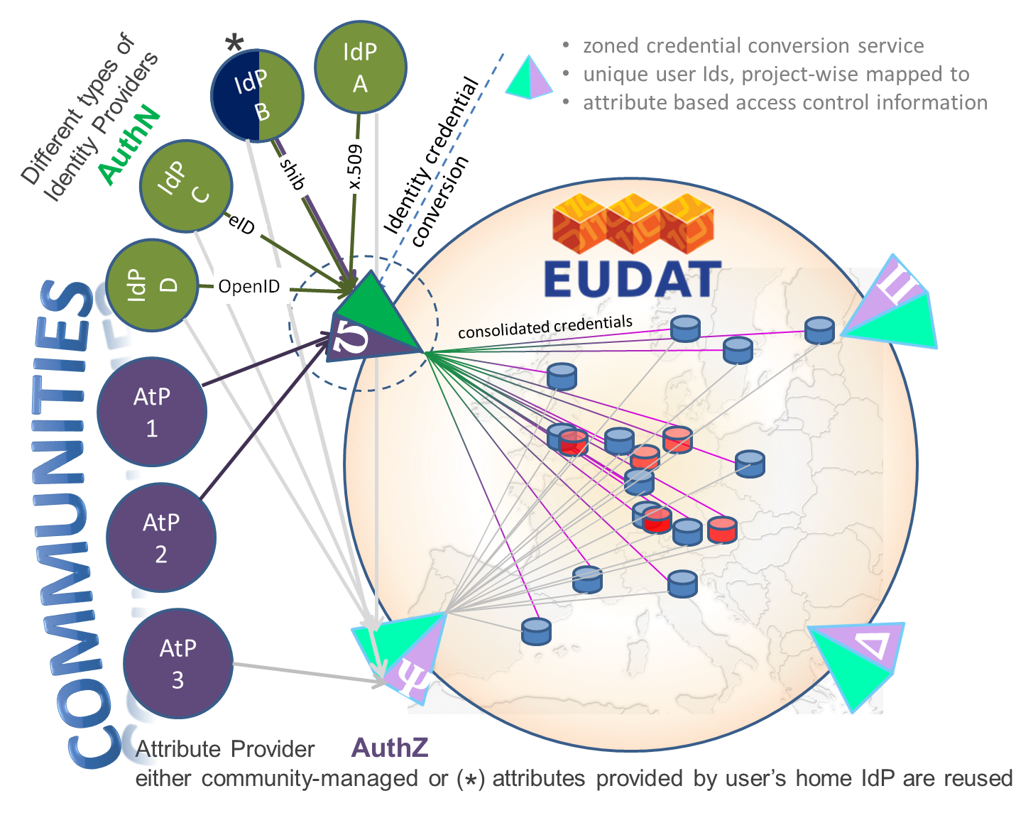

Slide 5
Requirements
Scalable (10**7 users)
Easy enough to use for “non-technical” users
Support long tail researchers (aka homeless)
Portal and command line login
Mature, robust, performant
Standards-based
Work with existing community practices (if pos.)
Communities manage authorisation policies

Slide 6
Premise
Support existing user communities
CLARIN already using Shib (note the ePTID problem)
ENES already use OpenID (in ESGF)
Provide “authentication services”
Federated identity management
Must work with iRODS for data storage
Must work with GridFTP (and GlobusOnline) for data movement
Must work with Invenio (ORCID)

Slide 7
Plan A and Plan B API
Redirect to EUDAT
Obtain Access Token
Call CA API
Plan A
Plan B

Slide 8
Evaluations – 2010
Standalone Shib (or SAML)
Work with a single community’s portal
Use SimpleSAMLPhp
EGI or GEMBUS STS
Contrail AAI code – see Yvon’s talk
Moonshot

Slide 9
Findings
Code satisfying most requirements least mature
Need X.509 – at least internally (GridFTP)
Need good docs for integrators – and effort!
Need to be able to work with betas
Technical collaborations: EGI, EUDAT, Contrail
Supporting multiple communities:
Ends up being kludgy
MyProxy for GO, OAuth2 for ORCID, …
Requirements change regularly
Can spend ∞ time on evaluations

