Slide 1
Massive Open Online Course Development
EGI-InSPIRE Mini-Project
EGI Community Forum 2013
Anatoli Danezi (SURFsara)

Slide 2
What is MOOC ?
Virtual classes offered via web to educate large numbers of students with the provision of high quality courses for free.
Massive
Open
Online
Course
student
teacher
content

Slide 3
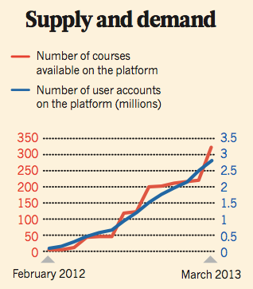
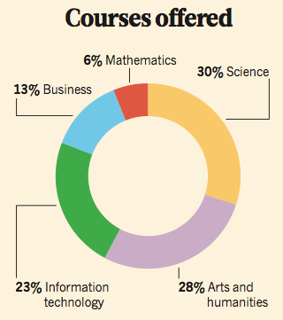
MOOC hype
MIT OpenCourseWare
1st MOOC course: Stanford, 160000 students
Coursera hosts 328 courses
2.9 m users
Source: M. Mitchell Waldrop, Campus 2.0, ,160 NATURE VOL495, 14 March 2013 Macmillan Publishers Limited
Wide range of courses:
Arts and Humanities
Computer Science
Business
Life sciences
Social Sciences
Mathematics
…
Source: M. Mitchell Waldrop, Campus 2.0, ,160 NATURE VOL495, 14 March 2013 Macmillan Publishers Limited

Slide 4
Major players

Slide 5
Our vision
Develop MOOCs based on e-infrastructure topics:
EGI Grid
Cloud (Federated)
Hadoop
Courses openly available to both current EGI participants and potential new users

Slide 6
Joint effort
SURFsara
Dutch e-Infrastructure provider
Multiple workshops on Grid & Cloud computing to students of Universities and University Medical Centers.
Team dedicated to visualization and user interaction
EGI.eu
Coordinating institute of EGI
User support teams in the NGIs and domain specific projects that exist within the EGI community

Slide 7
Target groups
other
Researchers
Students
Computing Centers
Universities
Research Institutes

Slide 8
Beyond the MOOC
On a strategic level:
Increase visibility of available EGI and alternative services
Increase availability of knowledge on distributed computing and parallel platform infrastructure
Enhance EGI content
Feedback on suitability of different resources for a variety of the research areas
Photo Credit: Flickr user lumaxart

Slide 9
Towards the MOOC
Coordination
Partnerships
MOOC platform
EGI Grid course
Hadoop course
Cloud (federated) course
Publish the first online course: in the fall of 2013

Slide 10
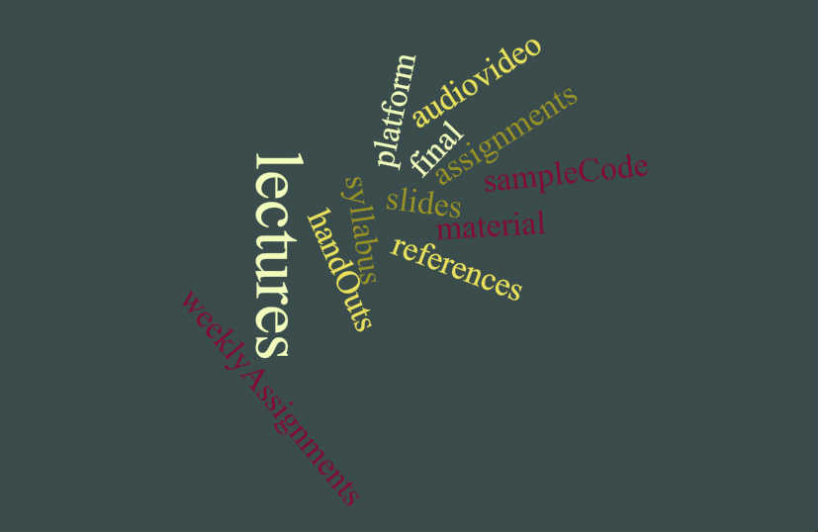
Virtual class
Duration 7 weeks
3 lectures/week
Availability of the online material afterwards

Slide 11
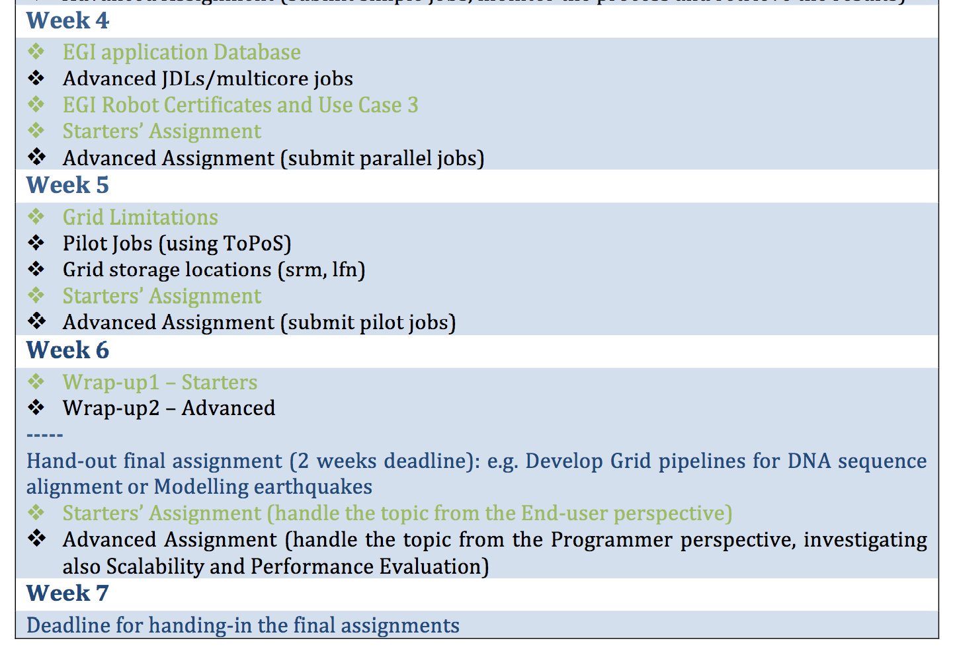
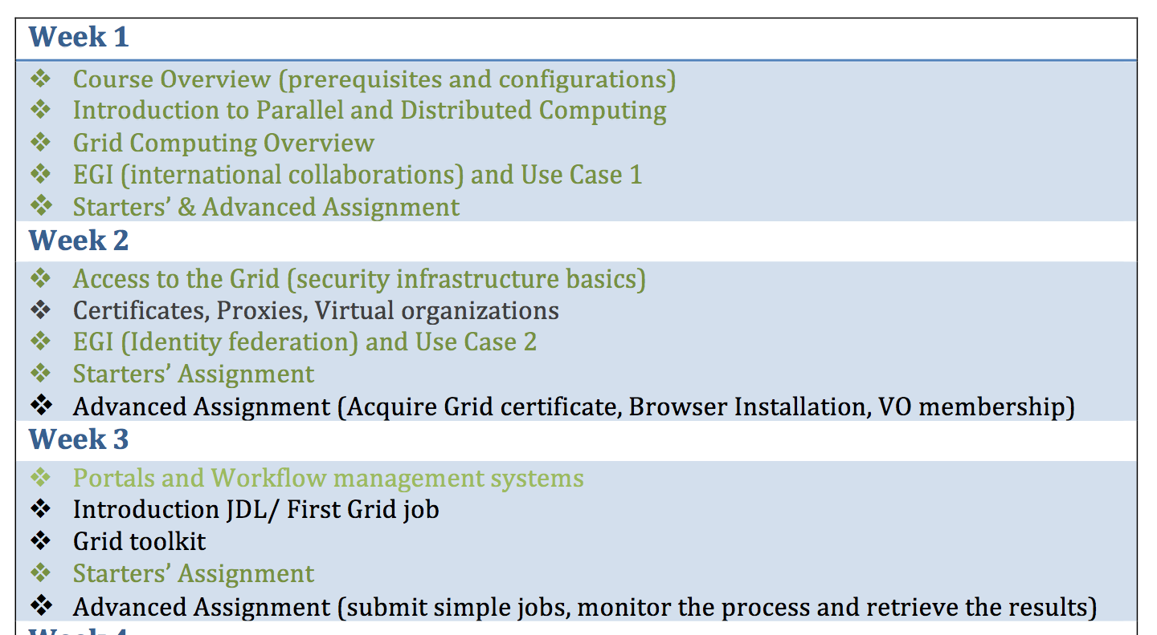
Grid course Syllabus

Slide 12
Measurement of goals
A count of attendees
Definition of “done”: rate of dropouts
Availability of the course material
Hand-ins evaluation
Successful completion
Feedback by students

Slide 13
How to get involved
Photograph: Gail Shumway/Getty Images
Notes:
There is a call for participation that went out to the various NGI Liaisons and user support teams. We would like you to reflect to this call:
1. Provide feedback on the grid course syllabus
2. Send us any existing video material that would fit into, and could be used in the grid course
3. Volunteer for the development of a 5-15 minutes long video lecture
4. Any experience on MOOCs that you want to share with us
For further details, please contact: Anatoli Danezi, anatoli.danezi@surfsara.nl

Slide 14
Thank you for your attention
Contact: Anatoli Danezi, anatoli.danezi@surfsara.nl

