Slide 1
European Grid Infrastructure
Tiziana Ferrari/EGI.eu
EGI Chief Operations Officer

Slide 2
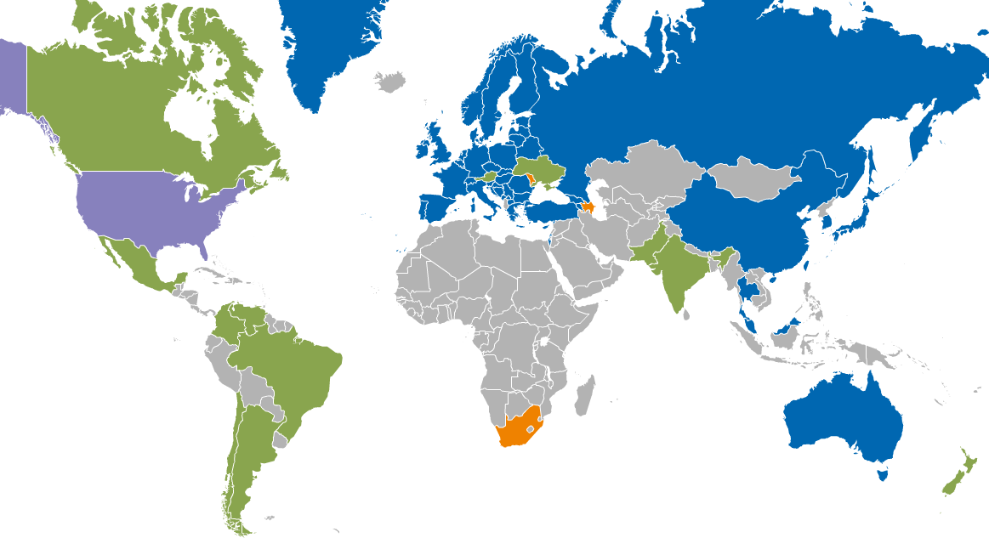
EGI Resource Infrastructure Providers
Resource Centres | Including integrated RPs | 351
 | Supporting MPI | 87
Countries | EGI-InSPIRE & EGI Council members | 43
 | Including integrated RPs | 59
Integrated EGI-InSPIRE Partners and EGI Council Members
Internal/External Resource Providers (being integrated)
External Resource Providers (integrated)
Peer Resource Providers

Slide 3
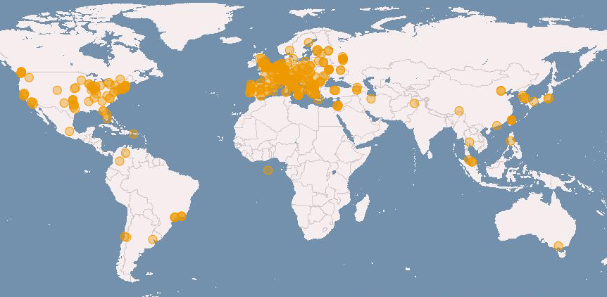
Installed Capacity
Logical CPUs | Value
EGI-InSPIRE and Council Participants | 306,000
Including integrated and peer RPs | 429,000
Storage | Value
Disk (PB) | 155 PB
Tape (PB) | 150 PB
European Grid Infrastructure - EGI/EUDAT/PRACE workshop, 27-11-2012

Slide 4
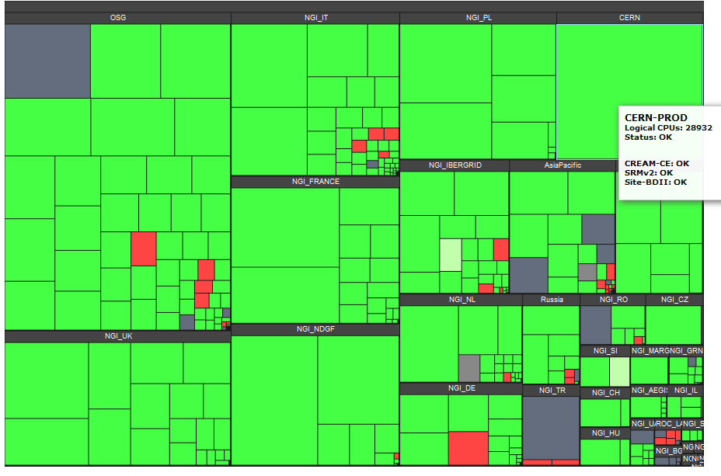
Distribution of compute resources

Slide 5
CPU Usage
Usage metrics Nov 2012 |  | Value
CPU wall clock time | Million hour/day | 50.6
Jobs | Average Job/day (Million) | 1.8
Distribution of usage (main disciplines) | High-Energy Physics | 88.23%
 | Astronomy and Astrophysics | 2.00 %
 | Life Sciences | 1.11%
 | Remaining disciplines | 8.40%

Slide 6
Services 1/2
Federated offering of compute and storage resources
Transparent access to heterogeneous systems
Highly distributed
User authentication and authorization
Experimenting federated identify provisioning and translation of user credentials into short term X.509 certificates (on-line CAs)
Username/password over http/https
Integrated compute – data management services through delegation of user credentials

Slide 7
Services 2/2
Data access
File-based
SRM → WebDAV (Web-based Distributed Authoring and Versioning): http-based methods enabling users to access, edit and manage remote files through a web interface
Data transfer and replication
FTS: Bulk data streaming, third-party GridFTP or SRM Copy
Globus Online
File catalogues to track the location of copies of data

Slide 8
Federating resources
Technology agnostic
Different services and resources can be integrated according to user requirements
Desktop Grid computing
QCG software stack // MAPPER
Compute: ARC, CREAM, UNICORE, …
Monitoring, accounting, service registry, availability/reliability reporting, user support are extensible
Compute accounting
Storage accounting

Slide 9
Experimental services
Federated identity-based authentication
Federated cloud services
Includes storage as a service
Central offering of a distributed pool of resources

Slide 10
Summary
EGI added value
Federation of distributed resources
Contributed by user communities
Hosted by 3rd party (cloud-provisioning model)
Standard protocols
Heterogeneous software stacks
Integrated user authentication and authorization
Operations services and structures (NGIs) that are technology agnostic
Integration with EUDAT/PRACE for better support of European science

