Slide 1




Supporting user communities across EGI and OSG: the WeNMR use case
EGI Community Forum 2013
Manchester, UK, 08-12 April 2013
Marco Verlato
INFN (National Institute of Nuclear Physics)
Division of Padova
Italy
marco.verlato@pd.infn.it
Notes:
1
1
1
1

Slide 2





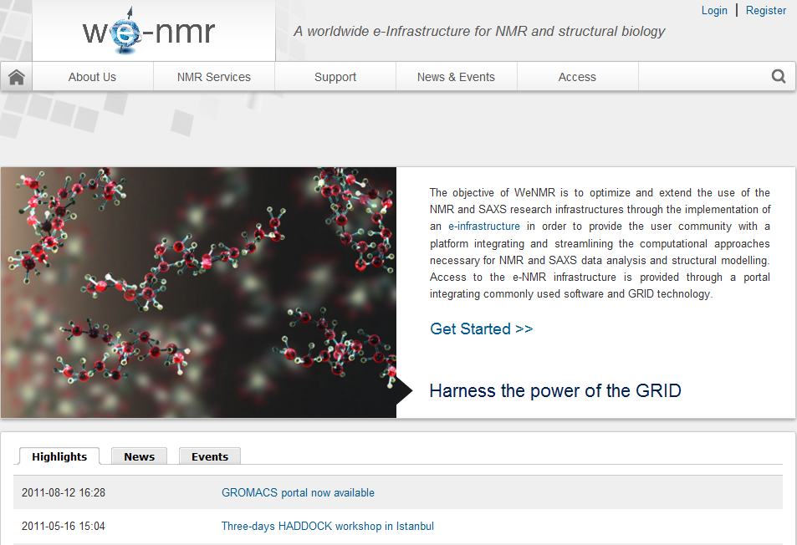




The WeNMR Project
A Worldwide e-Infrastructure for NMR and structural biology
Contract n°: RI-261572
Project type: CP-CSA
Duration: 36 months (Oct.2013)
Total budget: 2’434’000 €
EC Funding: 2’150’000 €
Project Coordinator:
Prof. Alexandre M.J.J. Bonvin, Utrecht University, NL
The team
Utrecht University, Bijvoet Center for Biomolecular Research, NL
Johann Wolfgang Goethe Universität Frankfurt a.M., Center for Biomolecular Magnetic Resonance DE
University of Florence, Magnetic Resonance Center, IT
Istituto Nazionale di Fisica Nucleare , Padova, IT
Raboud University, Nijmegen, NL
University of Cambridge UK
European Molecular Biology Laboratory, Hamburg, DE
Spronk NMR Consultancy, LT
+ Academia Sinica,TW, since 2012
www.wenmr.eu
4
Linked with Bio-NMR and EAST-NMR EU projects and INSTRUCT ESFRI
1st VRC recognized by EGI
Notes:
2
2

Slide 3
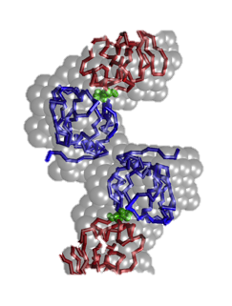
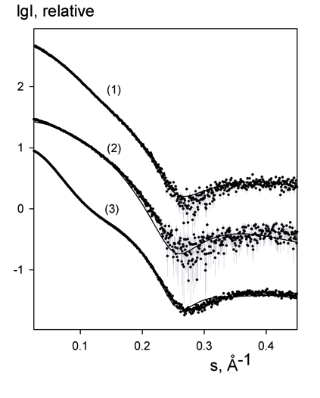

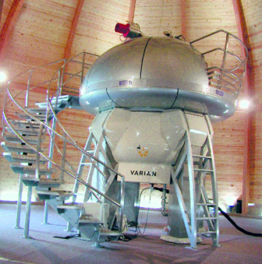

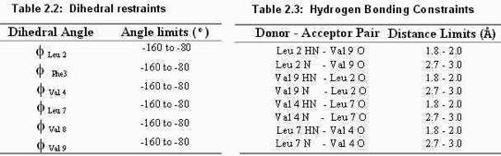
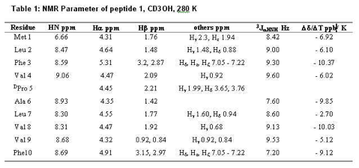


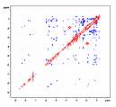
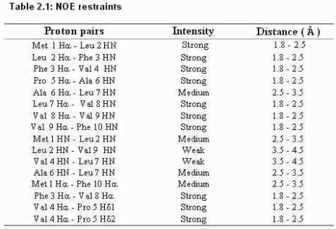
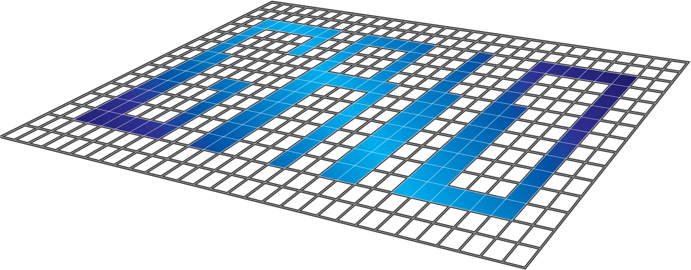
Exploiting GRID resources in structural biology…
NMR data collection and processing SAXS data analysis
# Number of dimensions 2
# INAME 1 1H
# INAME 2 1H
12 2.137 2.387 1 T 0.000e+00 0.00e+00 - 0 2756 2760 0
14 2.387 4.140 1 T 0.000e+00 0.00e+00 - 0 2760 2752 0
32 1.849 4.432 1 T 0.000e+00 0.00e+00 - 0 2259 2257 0
36 1.849 3.143 1 T 0.000e+00 0.00e+00 - 0 2259 2587 0
39 1.760 4.432 1 T 0.000e+00 0.00e+00 - 0 2260 2257 0
40 1.760 1.849 1 T 0.000e+00 0.00e+00 - 0 2260 2259 0
43 1.760 3.143 1 T 0.000e+00 0.00e+00 - 0 2260 2587 0
46 1.649 4.432 1 T 1.035e+05 0.00e+00 r 0 2583 2257 0
47 1.649 1.849 1 T 0.000e+00 0.00e+00 - 0 2583 2259 0
Data
interpretation
assign ( resid 501 and name OO )
( resid 501 and name Z )
( resid 501 and name X )
( resid 501 and name Y )
( resid 2 and name CA ) -0.1400 0.15000
assign ( resid 501 and name OO )
( resid 501 and name Z )
( resid 501 and name X )
( resid 501 and name Y )
( resid 3 and name CA ) -0.0100 0.15000
Computations
Structure, dynamics & interactions
➔ impact on research and health:
  origin of disease
- design of new experiments
- drug design …

Slide 4
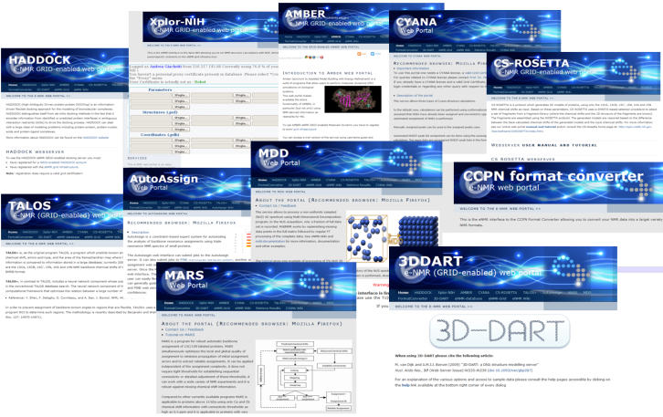
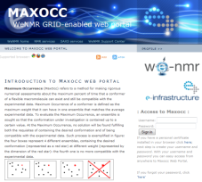
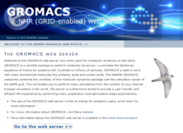
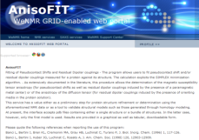
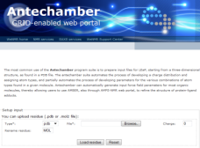
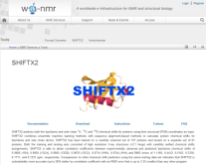
The WeNMR service portfolio
Our policy is to shield as much as possible the end user from the grid and all middleware related issues and commands
We chose to develop mainly web portal providing “protocolized” access to the grid
To facilitate operation, we use when possible robot certificates
29 portals (5 developed by external teams) are currently embedded in the WeNMR gateway and provide services for NMR and SAXS spectroscopists
11 of these run calculations on the grid

Slide 5
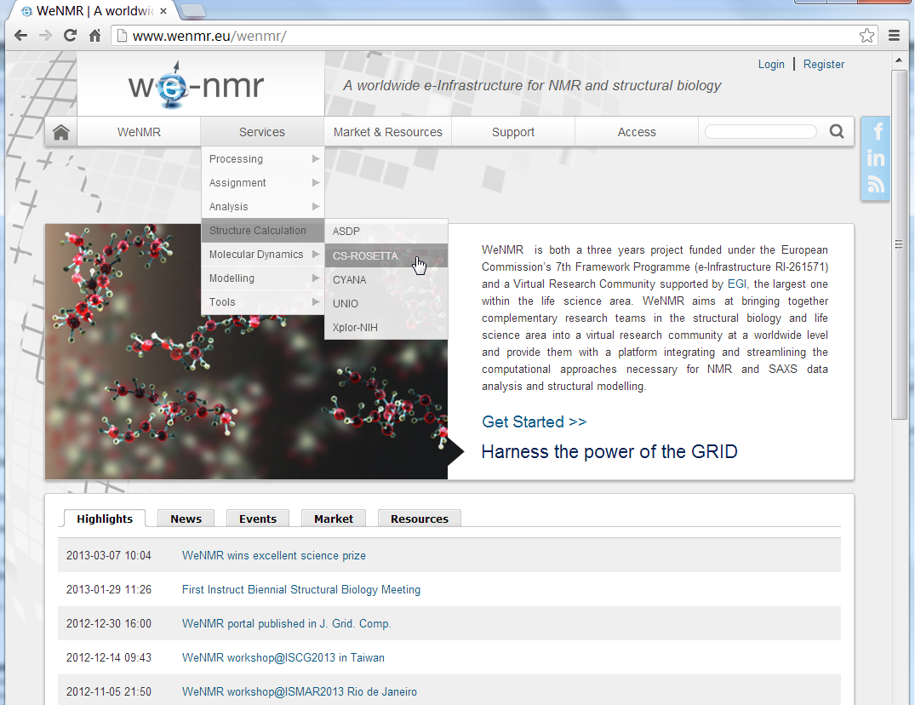
The VRC portal: www.wenmr.eu

Slide 6

The WeNMR VRC
Consultancy
Third-party aggregation
52 Tutorials
70 Wiki docs
20 Movies
Knowledge
Grid
Services
VRC
42 Help Centers
Marketplace
New!
SSO
Portals
Blogs, news,
events…
(often picked up
from eScienceTalk/GridCast)
Exposure
Facebook,
Linkedin
Users
www.wenmr.eu
Notes:
Marketplace: community specific non-intrusive advertisement
The marketplace allows the members of the worldwide NMR community to list, advertise and search information about Events, Jobs, Products, Services and Training
Disperse and aggregates news; blogs, events.. Often picked up by eScience Talk and GridCast

Slide 7
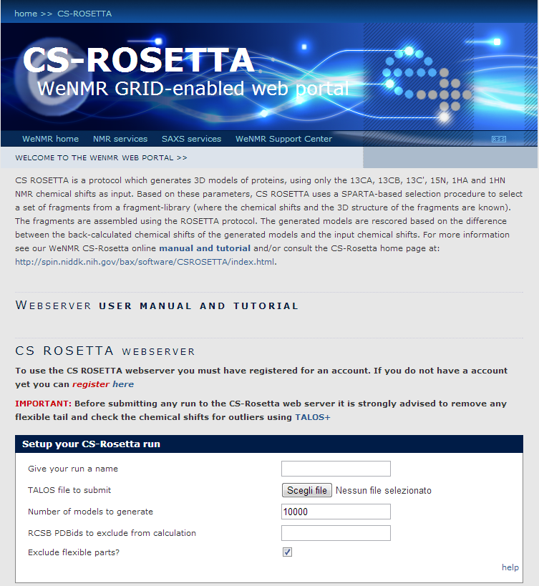
Example: CS-ROSETTA
Web portal to chemical shift-based structure calculations with Rosetta
Rosetta is extremly CPU intensive and can perfectly make use of the grid resources
One typical run would require between 1000 and 5000 CPU hours on a single processor!
Only a few days on the GRID depending on the load
7
Notes:
7
7

Slide 8
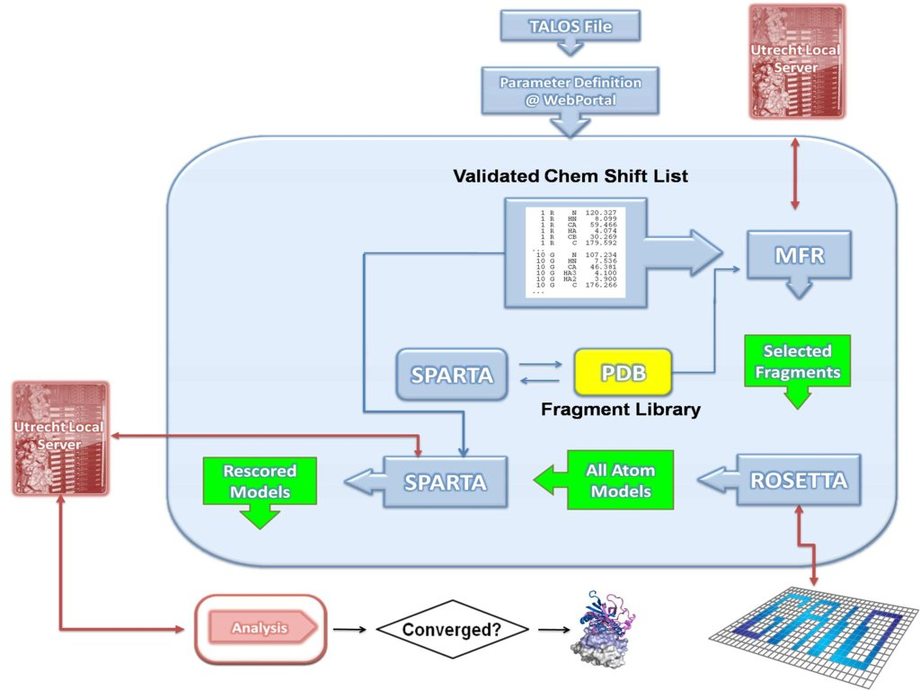
CS-ROSETTA Workflow
Parts of the computations are done locally
The most CPU demanding ones
are done on the grid
8
Notes:
8
8

Slide 9
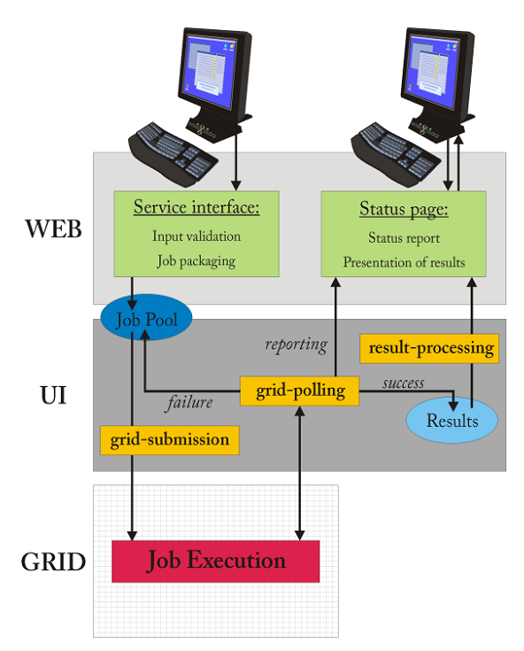
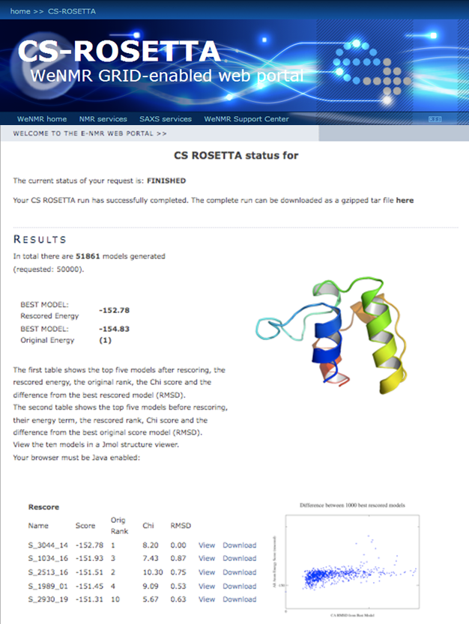
Grid daemon beyond a portal
9
Notes:
9
9

Slide 10
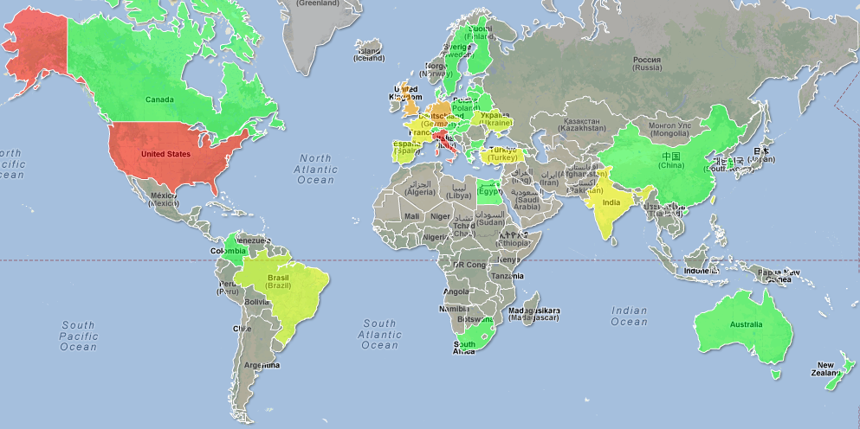
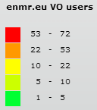
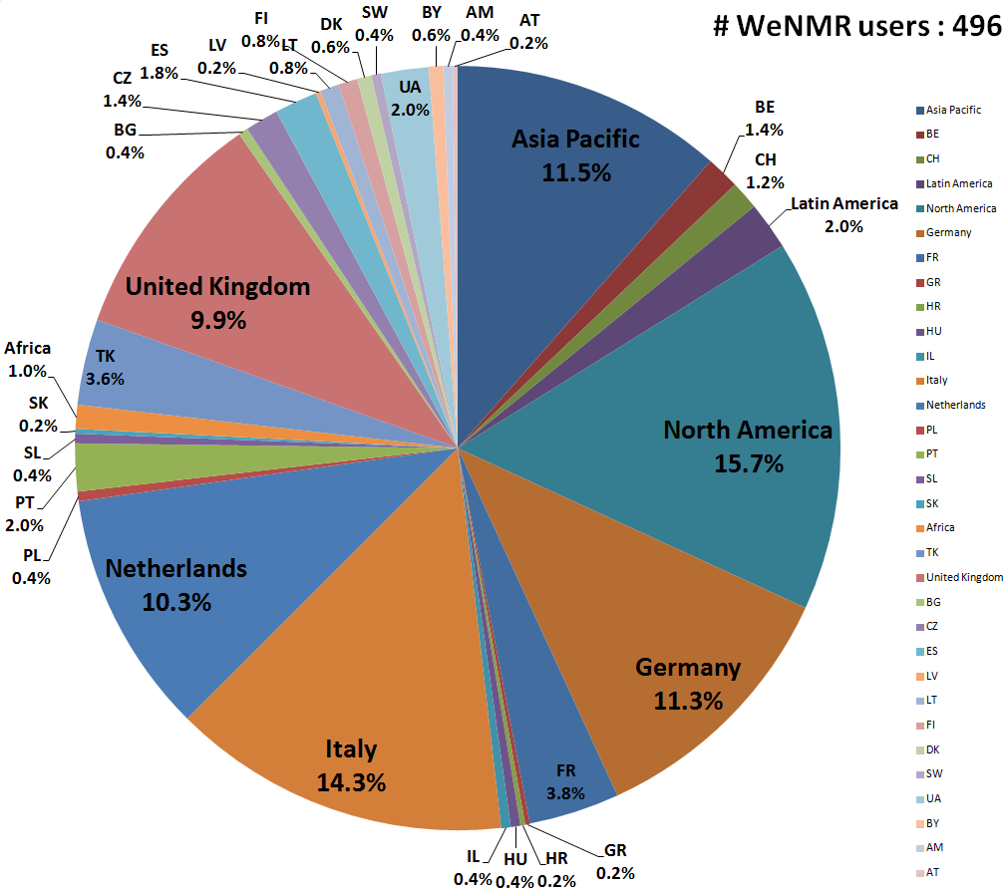
VO registered user distribution
>500 users from 50 countries
30% outside Europe
10 users/month steady growth
enmr.eu is the largest VO in Life Sciences
Notes:
10
10
10

Slide 11
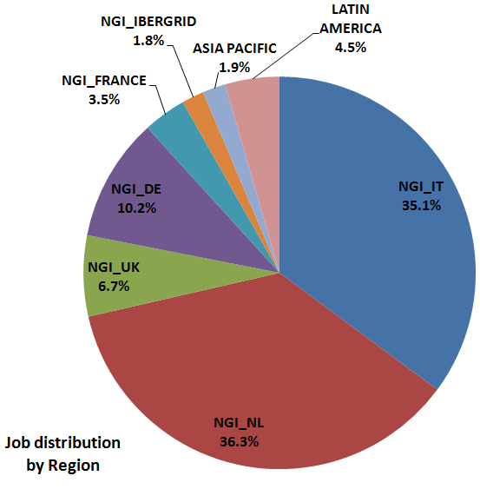
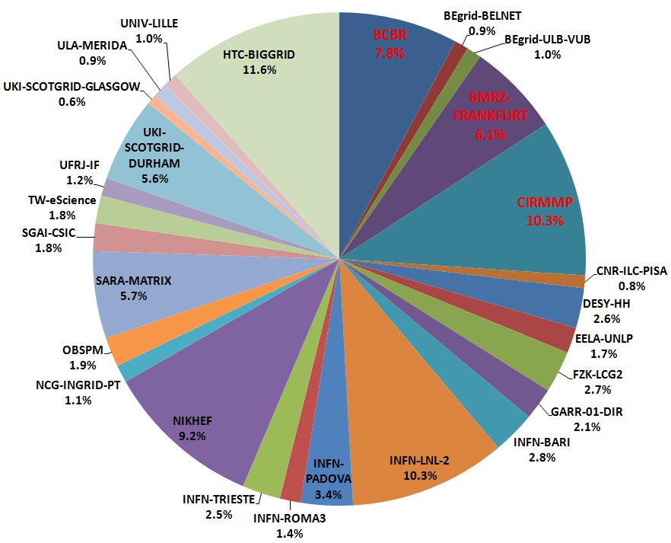
Distribution and usage of resources
Support from 7 European National Grid Initiatives:
  France, Germany, Italy, Netherlands, Portugal, Spain, UK
Support from Africa, Asia and Latin America:
  South Africa (SAGrid), Taiwan (TWGrid), Brazil, Argentina, Venezuela (GISELA)
~50,000 CPU-cores (24 opportunistic sites) and 320 CPU-cores (3 owned sites)
24% of jobs (16% of CPU-time) provided by the owned sites
NEW!
48 job/slots from
MY-BIRUNI
NEW!
10 job/slots from
BEIJING-LCG2

Slide 12
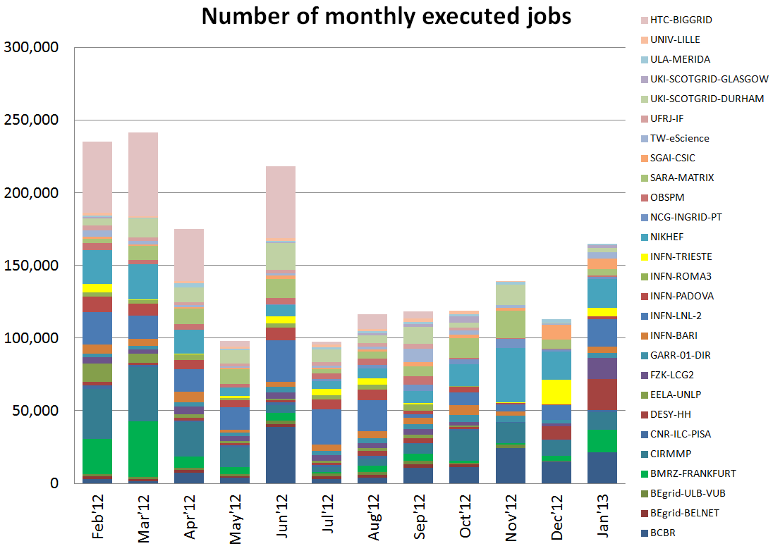
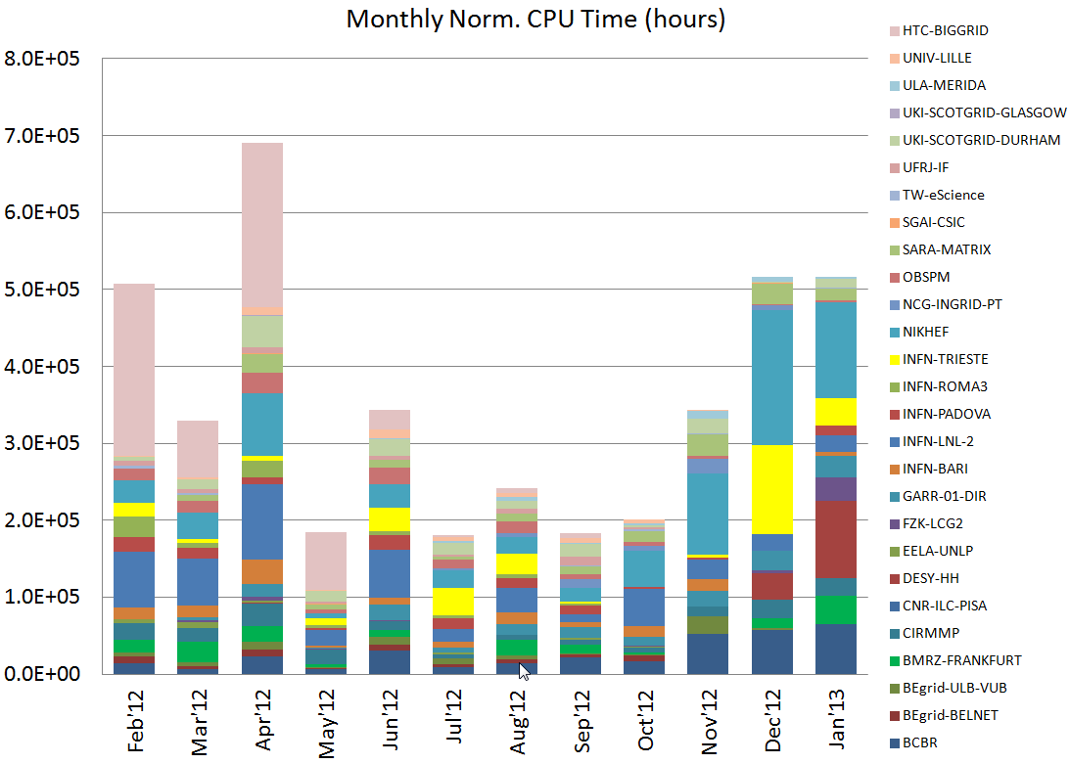
Distribution and usage of resources
153,000 jobs/month
1.8M jobs last year
353,000 CPU.hours/month
4.2M CPU.hours last year
Notes:
30,000 Euro/month cost of WP4+WP6 (estimated cost for maintaining WeNMR grid + portal operations) → 8.5 eurocent/CPU.hour
19,200 Euro/month cost of 353,000 CPU.hours with Amazon calculator → 5.5 Eurocent/CPU.hour

Slide 13
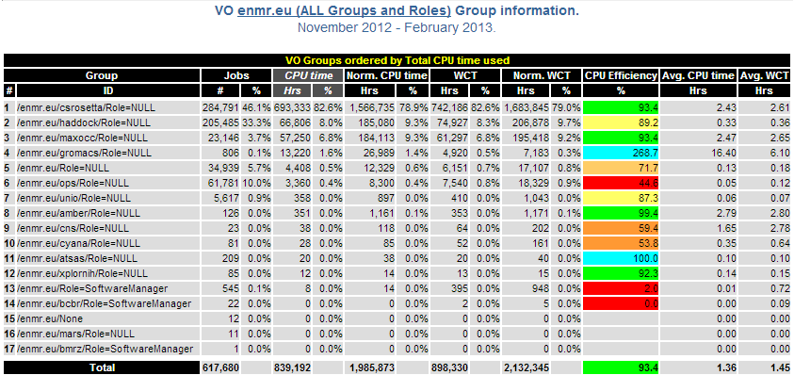
Application accounting
Implemented by exploiting the granularity made available by the VOMS service:
  a VOMS group defined for each application
  e.g.: voms-proxy-init –voms enmr.eu:/enmr.eu/haddock
  the user proxy carries the VOMS group info
Notes:
The usage records collected and stored by the grid accounting services have the VOMS group information and allow the aggregate usage of each application to be measured and shown through the accounting visualization tools

Slide 14
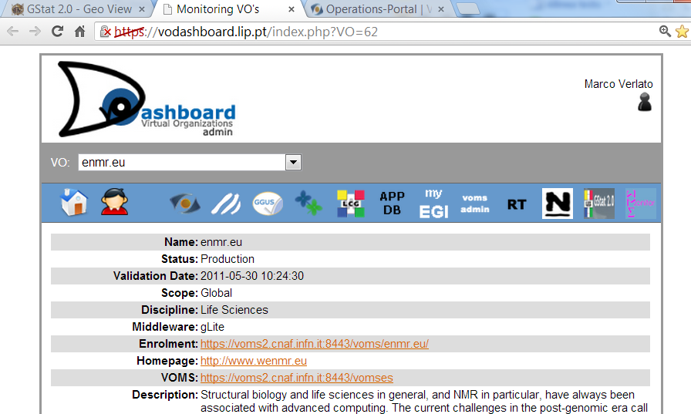
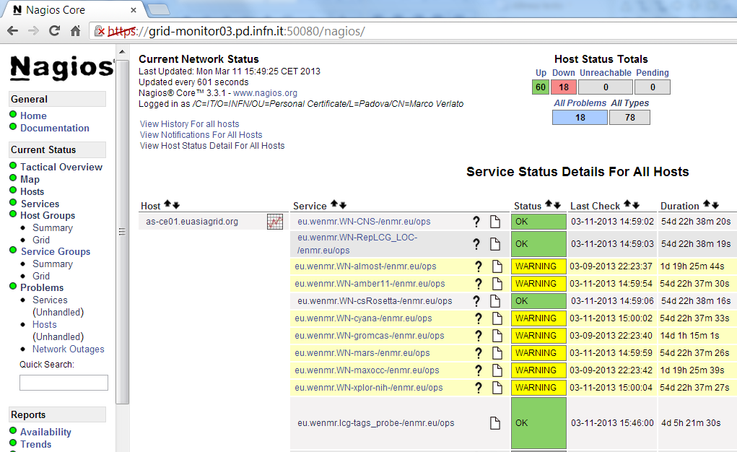
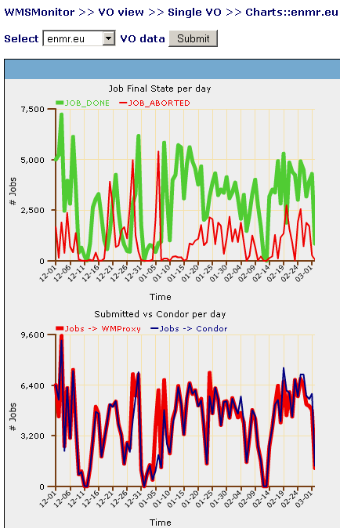
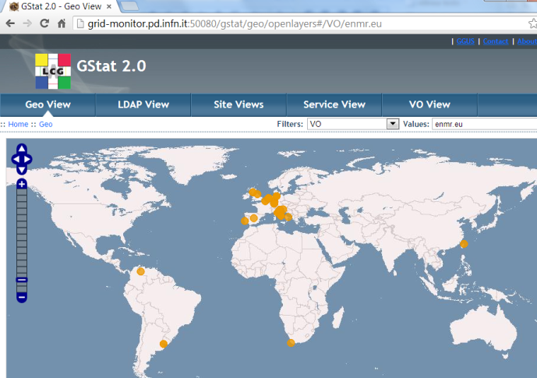
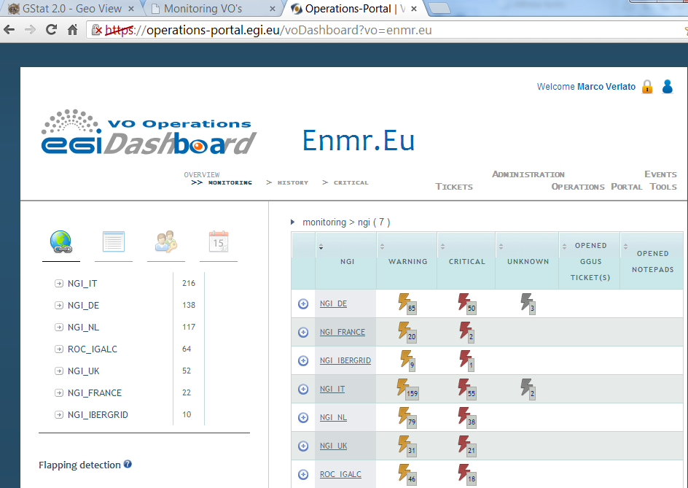
Grid operations monitoring
Wide use of the EGI/NGIs monitoring tools:
  Operating a dedicated instance of Gstat 2.0
  Operating a dedicated Nagios server with WeNMR specific Nagios probes
  Operating a dedicated WMSMonitor server
  Collaboration with EGI Operations team for integrating the dedicated services with:
    EGI VO Admin Dashboard
    EGI VO Operations Dashboard
Supported
by the
Italian
NGI

Slide 15










Worldwide grid extension
An activity explicitly foreseen in the WeNMR workplan
Building on Network Activities aimed at involving worldwide grids and e-Science projects
Worldwide grid extension outside Europe:
  Towards EMI/UMD based e-Infrastructures
    South Africa
    Latin America
    Asia-Pacific
    DEISA/PRACE (via EMI-ES)
  Towards e-Infrastructures based on other middlewares
    SBGrid in USA (OSG)
    Asian grids (Garuda, CNgrid)
Notes:
15
15
15
15

Slide 16
Building on Network Activities
Collaborations (MoU) relevant for this activity already established with the following projects:
  CHAIN (Co-ordination and Harmonisation of Advanced e-Infrastructures)
  EUMEDGRID-Support (Sustainability of e-Infrastructures across the Mediterranean)
  GISELA (Grid Initiatives for e-Science virtual communities in Europe and Latin America)
  EU-IndiaGrid2 (Sustainable e-Infrastructures across Europe and India)
  EMI and EGI
  SBGrid (Software Consortium for Structural Biology) and OSG (Open Science Grid) in US
Attending several networking events:
  CHAIN KoM (Rome, December ‘10)
  EU-IndiaGrid2 Workshop (Delhi, December ‘10)
  OSG All Hands (Boston, March ‘11)
  ISGC 2011 / OGF31 (Taipei, March ‘11)
  GISELA & CHAIN Workshop (Vilnius in April ‘11, Lyon in September ‘11)
  SC11 Exposition (Seattle, November ‘11)
  ISGC 2012/CHAIN Workshop (Taipei, March ‘12)
  EGI Community Forum 2012 (Munich, March ‘12)
  GISELA & CHAIN Conference (Mexico City, June ‘12)
  EGI Technical Forum 2012 (Prague, September ‘12)
  ISGC 2013/CHAIN-REDS Workshop (Taipei, March ’13)
Notes:
16
16
16
16

Slide 17
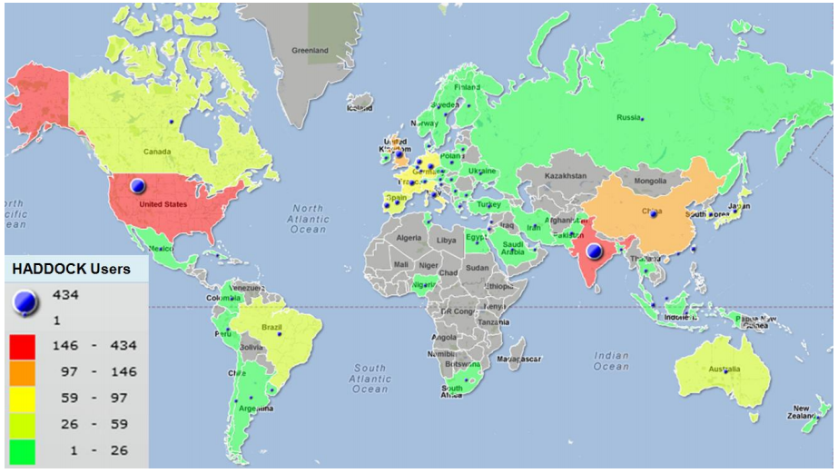
Why going worldwide?
Example: HADDOCK world map
> 2800 registered users
(150 with grid access)
~ 40000 served runs since June 2008
> 13% on the GRID
All potential users of the Grid!
Currently only if registered with the enmr.eu VO
Notes:
17

Slide 18

The SBGrid Consortium
SBGrid (www.sbgrid.org) is a global consortium of 220 structural biology groups and an Open Science Grid Virtual Organization
SBGrid laboratories share a common collection of approximately 350 scientific applications compiled and optimized for Linux and OSX operating systems
To support a subset of CPU-intensive workflows, SBGrid also runs a Science Portal, which interconnects with the computational resources of the Open Science Grid
SBGrid operates out of the Department of Biological Chemistry and Molecular Pharmacology at Harvard Medical School.
Notes:
18
18
18

Slide 19
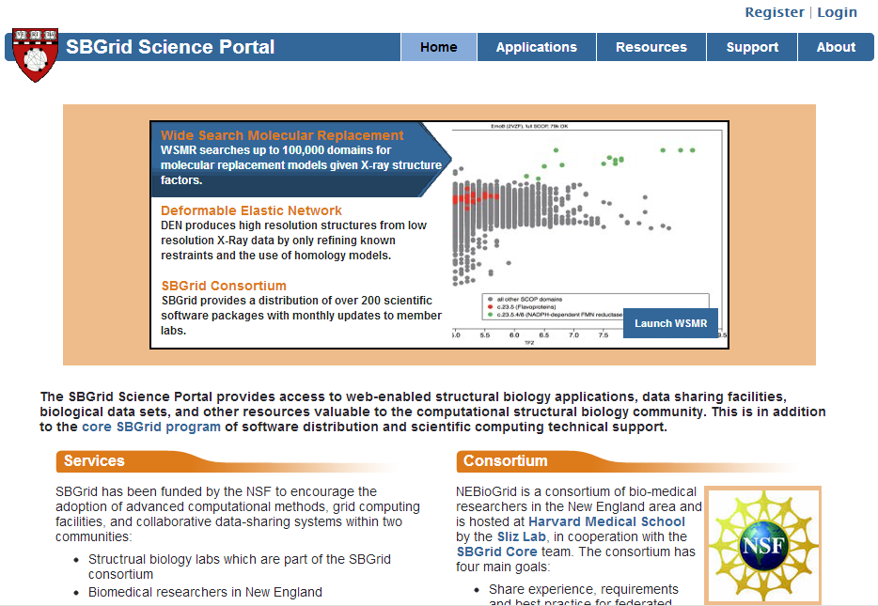
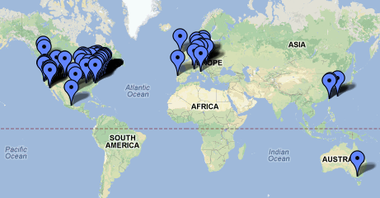
SBGrid Science Portal
The majority of users who access SBGrid
portals are from the US and Europe
A large fraction of SBGrid consortium
members are in European laboratories

Slide 20
WeNMR-SBGrid Collaboration
Scientific justification for the collaborative activity
  WeNMR and SBGrid developed two complementary grid portals that are used by structural biologists globally to perform specialized, compute intensive structure determination workflows
  The WeNMR portal supports a subset of services that are used for NMR structure determination as well as for molecular modeling
  SBGrid focuses on advanced X-ray crystallography structure determination workflows (e.g. wide search molecular replacement or low-resolution structure refinement)
Collaboration with SBGrid Consortium already well established
  WeNMR access provided as option to users registering with SBGrid Science Portal since two years
  76 US users (DOEGrids CA) currently registered with enmr.eu VO (15%)
SBGrid as VO of OSG
  supported by 22 OSG sites, ~40k CPU-cores opportunistic (according with GStat)
  5,000,000 CPU hours/yr on the OSG, with peak utilization of ~5,000 CPU-cores
Notes:
20
20
By coordinating the efforts of both projects, we aim to further expand the scope of services and continue to make them available to the structural biology community at large.
Justification for access to resources in both the US and Europe:
The two portal infrastructures developed by WeNMR and SBGrid are unique in their design and require a high level of computational and scientific support. These infrastructures need to be continuously updated to incorporate new versions of scientific applications and databases. It is, therefore, very appealing to extend access to those specialized resources to the global community rather than to redeploy or redevelop supported workflows in parallel in the USA and Europe. Sharing access to global resources would have the additional advantage of load balancing across a larger pool of computational resources and of sharing and promoting specialized local knowledge and technologies

Slide 21
WeNMR-SBGrid Interoperability Plan
A collaborative pilot project started in March 2011 to prototype an interoperability framework between WeNMR and SBGrid
  According to ISO/IEC 2382-01 (Information Technology Vocabulary, Fundamental Terms), interoperability is defined as follows: "The capability to communicate, execute programs, or transfer data among various functional units in a manner that requires the user to have little or no knowledge of the unique characteristics of those units"
Joint team with OSG-SBGrid-WeNMR-EGI personnel set up
WeNMR using SBGrid VO to access OSG/SBGrid resources
Two options for submitting WeNMR jobs to OSG:
  using gLite/EMI UI / WMS / SE / LFC enabled with SBGrid VO
  using the SBGrid glideinWMS submission system
GlideinWMS is the OSG recommended pilot-based job submission system
Notes:
21
21

Slide 22
Using gLite/EMI services
Existing gLite/EMI UI and WMS enabled with SBGrid VO, new LFC server set up for SBGrid VO at INFN-Padova centre
Data transfer from/to 10 OSG SEs with registration on LFC successful using lcg-utils from both gLite/EMI UI and OSG WNs
CS-Rosetta software installed from remote in 14 OSG CEs
CS-Rosetta test jobs successful submitted through gLite/EMI-WMS (with minimal changes of bash scripts) and run on OSG WNs
Notes:
22
22
22

Slide 23
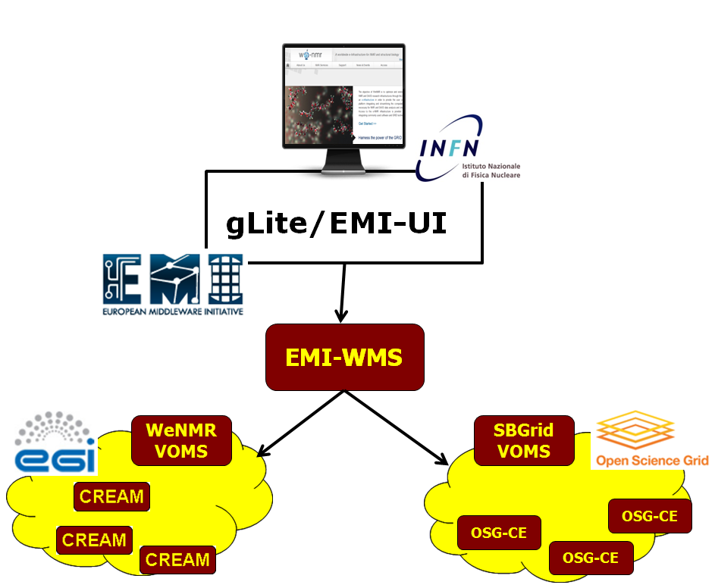
Using gLite/EMI services schema
Straightforward solution
Minimal changes to the current WeNMR portal setup
Just use the same robot proxy certificates with SBGrid VO attributes for submitting to OSG
Things would be even more easy by enabling enmr.eu VO over OSG resources
Notes:
23
23
23

Slide 24
Using SBGrid glideinWMS
Condor submit node installed on a gLite UI at INFN
Configured to work with SBGrid VO Frontend at HMS
WeNMR sw installed from remote on $OSG_APP area
  via condor job or globus-job-run on the CE head node
CS-Rosetta test jobs successfully submitted in two ways:
  direct condor_submit (JDL→condor submit file translation needed)
  via SAGA Python API implemented by LSU (www.saga-project.org)
Glideins are submitted by the OSG Factory with the SBGrid VO proxy
WeNMR jobs can be submitted with the enmr.eu VO proxy
  allows interaction with WeNMR existing LFC and SEs services
  allows jobs to be accounted in Gratia system under enmr.eu VO (and its VO groups/roles)
Notes:
24
24

Slide 25
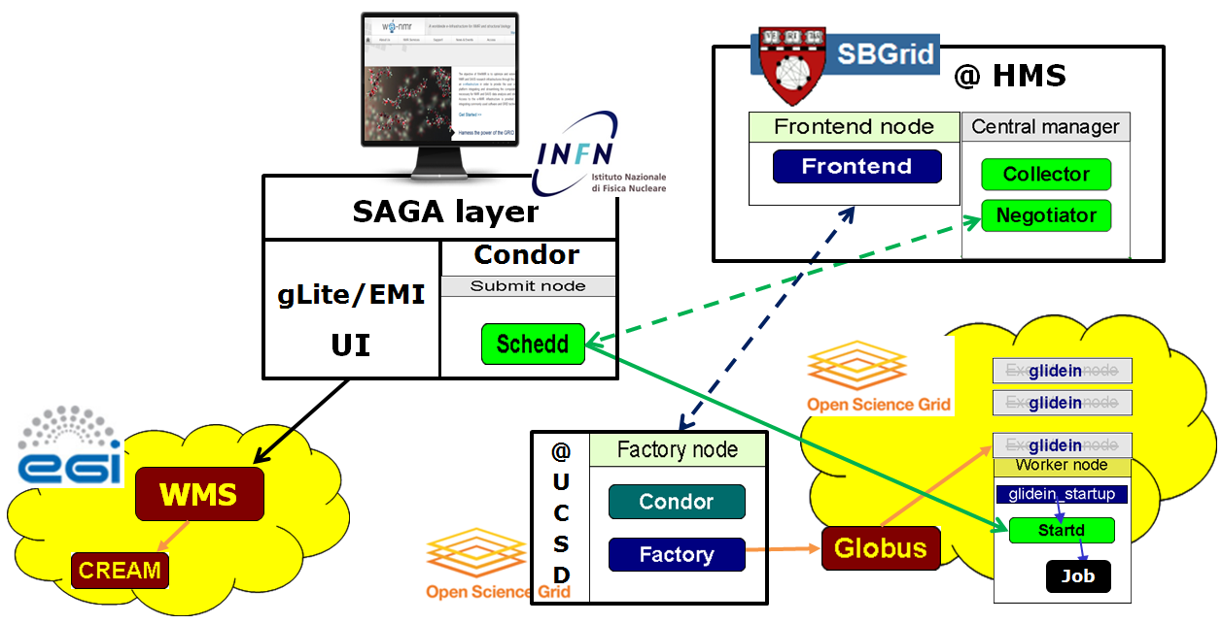
Using SBGrid glideinWMS/Architecture
Notes:
25
25

Slide 26


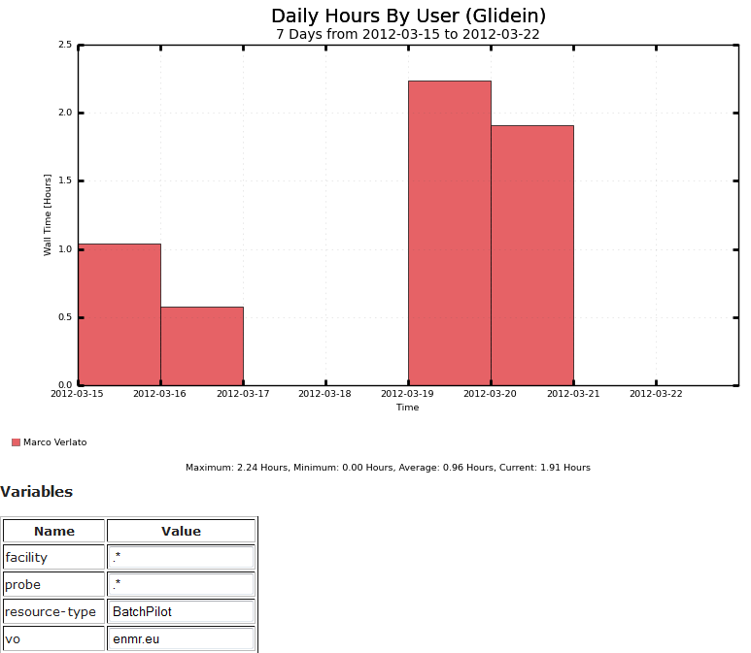
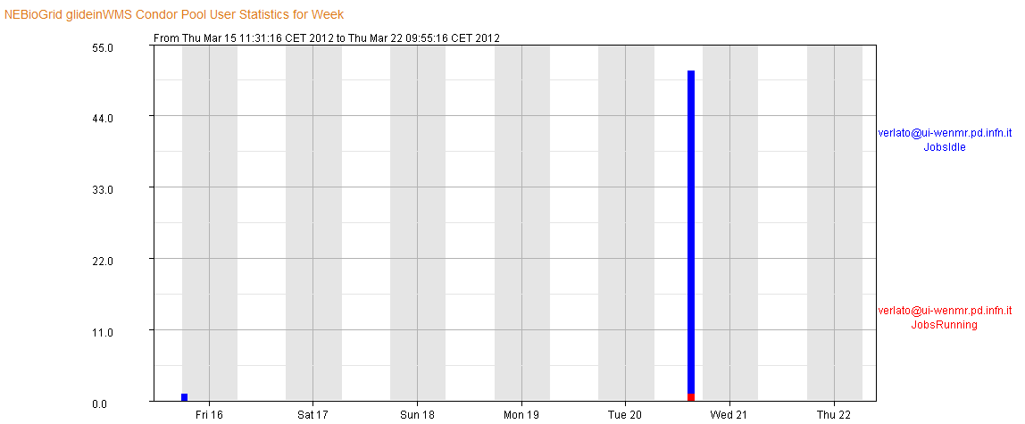
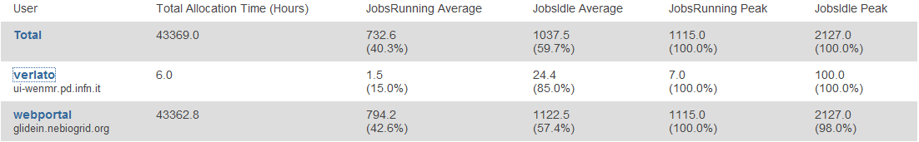
Using SBGrid glideinWMS/Accounting
Job statistics provided by:
Gratia
Condor view
Notes:
26
26

Slide 27
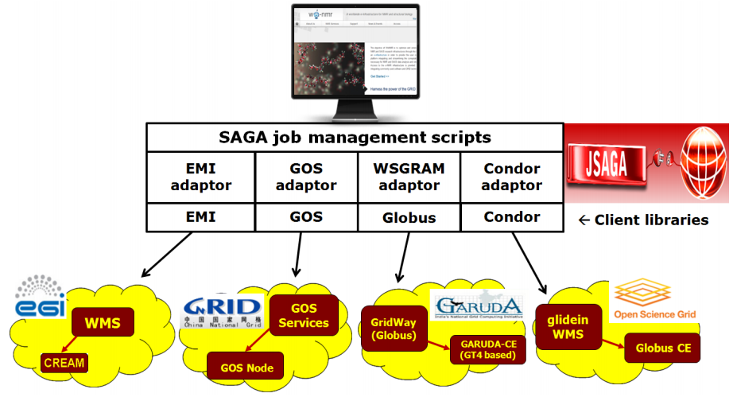
Looking at the wider context...
WeNMR collaborated with EU PF7 CHAIN Project (and now its follow-up CHAIN-REDS) to deliver an Interoperability Demo at the EGI TF 2012 of September
Science Gateway approach adopting worldwide standards as OGF (Open Grid Forum) SAGA (Simple API for Grid Applications) and its JSAGA implementation
The same JSAGA components developed by CHAIN can be re-used
JSAGA Condor adaptor under development by our team
Notes:
27
27
27
A few words about the SAGA layer…

Slide 28
Next steps
The pilot project to submit jobs from WeNMR to SBGrid/OSG needs to be transitioned to production
  significant work required to adapt the job management scripts lying behind the WeNMR portals
    from the gLite/EMI environment to the Condor environment
    or alternatively, to implement a SAGA layer to decouple the application level from the underlying middleware stack
A reciprocal system allowing submission of SBGrid jobs to EGI needs to be developed and implemented
A more flexible accounting system will need to be put in place
  it will provide a basis for load balancing between the two VOs based on cumulative usage rather than dispatching individual computations
Notes:
28
28
The current pilot system developed by WeNMR and SBGrid supports grid interoperability while allowing grid operators to control access and utilization. The developed system can provide US scientists who utilize the European portal infrastructure with opportunistic access to the NSF and DoE sponsored computational resources. Interoperability and collaboration will be crucial in the evolving e-Infrastructure landscape, in particular for the long-term sustainability of the services provided: for both sides, giving computational access to users outside their respective geographic/political locations (North America, EU) can only be justified provided that a proper mechanism for sharing of resources is in place.

Slide 29
Acknowledgments
The WeNMR/EGI/SBGrid/OSG team
Alexandre M.J.J. Bonvin
Christophe Schmitz
Marco Verlato
Eric Frizziero
Nuno Loureiro-Ferreira
Piotrek Slitz
Jan Stoke-Rees
Peter Doherty
Dan O’Donovan
Ruth Pordes
Gabriele Garzoglio
Igor Sfiligoi
Marco Mambelli
Chander Sehgal
Burt Holzman
Douglas Strain
Rob Quick

Slide 30
