Slide 1
Distributed Computing for Life-Sciences & Medical Research in the Genome-Age.
Distributed Computing Infrastructures for e-Science: Future Perspectives
EGI Technical Forum 2012
The Clarion Congress Hotel, Freyova 945/33, Prague
18 September 2012
Andrew Lyall PhD, ELIXIR Project Manager

Slide 2
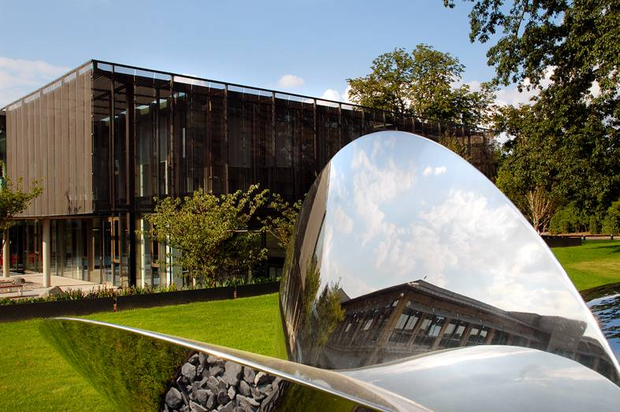
European Bioinformatics Institute
Outstation of the European Molecular Biology Laboratory
International organisation created by treaty (cf CERN, ESA)
20 year history of service provision and scientific excellence
EMBL-EBI has 500+ Staff, €50 Million Budget, at least a million users, 20 petabytes of data, 10,000 cpus
Data are doubling in less than a year
Bandwidth between disk and memory is at least as big an issue as obtaining sufficient CPU-cycles
Disk space
t

Slide 3
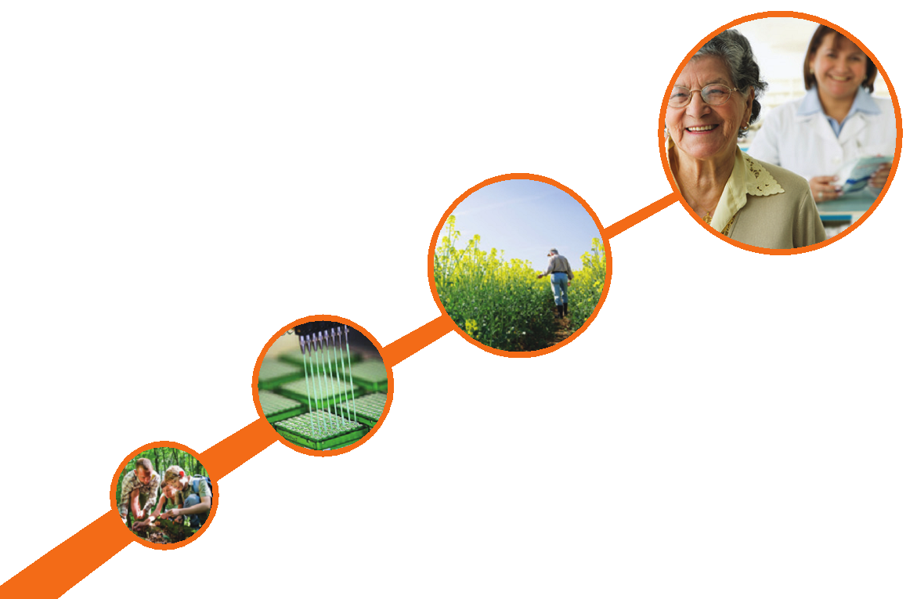

ELIXIR: A sustainable infrastructure for biological information in Europe…
ESFRI BMS RI & e-Infrastructure coordinated by EMBL-EBI
Entering construction phase
Interim board is meeting regularly
New data centres commissioned in London
Technical hub building construction is under way
Twelve countries have joined already
Many more have expressed interest
Over €100 Million already invested
More than 60 proposals for nodes
medicine
environment
bioindustries
society

Slide 4
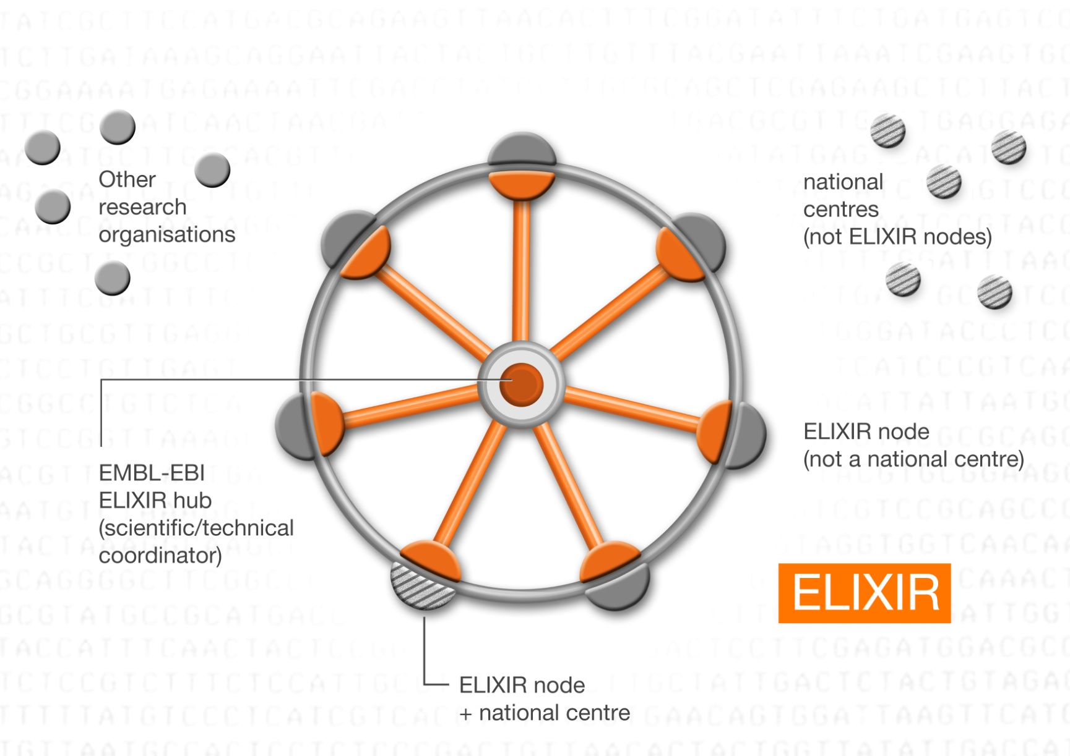
ELIXIR is a distributed infrastructure…

Slide 5

BioMedBridges
FP7-funded cluster project
  First European consortium coordinated by ELIXIR
  ﻿Includes the ESFRI BMS RI and European e-Infrastructure Providers
Award 10.6 M€, 4 years, 21 partners in 9 countries
  Austria, Denmark, Finland, France, Germany, Italy, Netherlands, Sweden, UK
e-Infrastructure Construction
  to allow interoperability between data and services in the biological, medical, translational and clinical domains: formats, standards, conventions, provenance, models, ontologies, etc
Provide computational ‘data and service’ bridges
  between the BMS RIs, linking basic biological research and data to clinical research and associated data

Slide 6
BioMedBridges Technology Watch
Representatives of GÉANT, DANTE, EGI.eu, PRACE & CERN & technical experts from the ESFRI BMS RIs
Monitor and report on developments and provide advice to the project
Facilitate the adoption of e-Infrastructure, technologies & standards by the BioMedBridges WP and the BMS RI
Communicates advice from the ICT Infrastructures and the e-Infrastructures to the BioMedBridges partners

Slide 7
Future perspectives…
What are the requirements of "big science" for Distributed Computing Infrastructures vs. the requirements of "everyday science"? Are they compatible?
Which science fields will drive the evolution of the future DCI?
What are the present DCI constraints hampering its take-up in science?
What do you expect from Cloud computing for the scientific community?

Slide 8
Biology is becoming “big science”…
The Human Genome Project was the archetype for large multinational big-science projects in biology
It has created new ways of doing biology and medical research where data generation and analysis are the main tasks
Hospitals and other health-research institutes will be generating and using huge amounts of data (cf. ELSI)
Storing, archiving and moving these data around are now significant challenges
I/O between primary and secondary storage is at least as big a bottle neck as CPU-cycles – this appears not to have been the case in other sciences

Slide 9
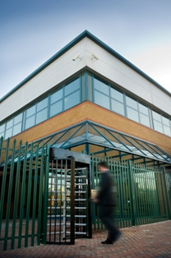








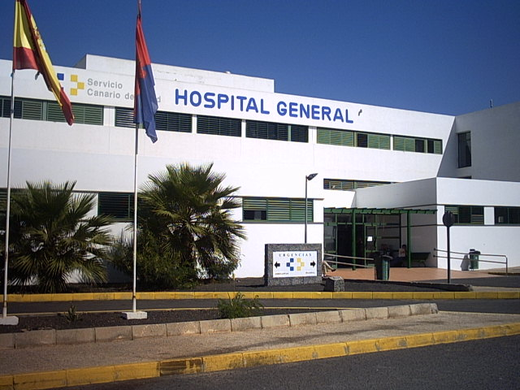
Many different modes of data & bandwidth utilisation
Thousands of small data producers
A few very large
data producers
gigabytes
petabytes
petabytes
A few international
collaborators
exabytes
terabytes
terabytes
Internet
terabytes
ELIXIR
terabytes
A significant number
of large data users
megabytes
petabytes
Many millions of small data users

Slide 10
History of Cloud Computing at EMBL-EBI
Since its inception, EBI has had the remit to provide services to a wide range of users using an “easy-as-possible” usage model
This led naturally to deployment via a web-browser interface on a thin-client – essentially equivalent to Software-as-a-Service
EBI has also been an early adopter of virtualisation as the optimum way to enable its service provision
More recently we have evaluated the Cloud market place in order to select products for the many diverse cloud projects that we are undertaking

Slide 11
Drivers for Cloud adoption at EMBL-EBI
Compute: Provision of compute to diverse users
Deployment: Provision of services at remote locations
Big Data: Moving compute to data
Security: Providing collaborators with secure access
Collaboration: Participation in international projects
Other: …
Notes: In additional to these EBI-specific drivers, there are also more generic ones including (i) the need to manage the rapid pace of change, (ii) unsustainable increases in cost and (iii) the need to manage increasing complexity.

Slide 12
Example projects
The EMBL-EBI Private & Public Clouds
The ENSEMBL Amazon Cloud
Cloud solutions for personalised medicine
Embassy Clouds
The Helix-Nebula Cloud

Slide 13
1. Compute Example: The EMBL-EBI Private Cloud
EMBL-EBI systems group provides compute and storage resources to a wide range of internal users.
Historically this was provided by assigning physical servers
Have acquired substantial experience of cloud enabling technologies such as virtualisation
Have just conducted a thorough analysis of the cloud market place
Selected VMware ESXi ™, vSphere™ & vCloud Director™to implement a hybrid cloud for internal and external users
Systems can now dynamically allocate resources and users can interact with their VMs through a web interface or via APIs

Slide 14
2. Deployment Example: The ENSEMBL Cloud
ENSEMBL is the most heavily used of EBIs services.
Users in the USA and Japan were reporting unacceptable response times: a solution was needed urgently
After an evaluation Amazon Web Serices (AWS) and Amazon Machine Instances (AMIs) running on Amazon Elastic Cloud (EC2) were selected
This provided a very rapid means to test a cloud solution
The project was extremely successful in that it removed the problem all together and now provides a substantial proportion of the ENSEMBL service at modest cost

Slide 15
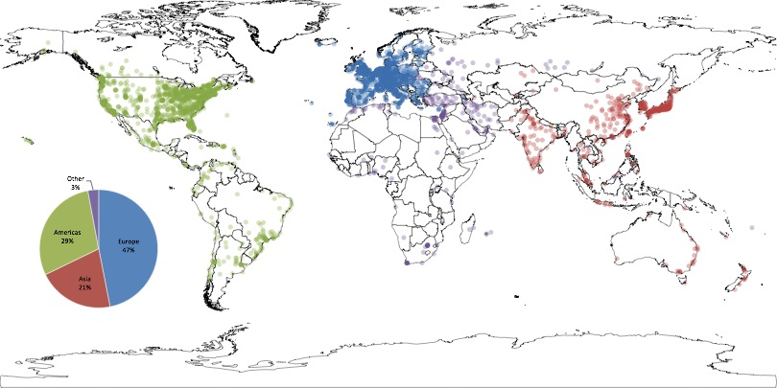
Global use of EMBL-EBI/Sanger ENSEMBL Service

Slide 16
ENSEMBL on AMAZON

Slide 17
3. Big Data Example: Personalised medicine
Personalised medicine will require sequencing of the genomes of large numbers of patients and volunteers
It will be necessary to compare at least some of these genomes with the reference data collections
Most hospitals and clinical research institutes will not wish to maintain up-to-date copies of the reference data collections
It will be therefore be necessary to send these genomes to the institutes that hold the reference data collections
It seems likely that this will be achieved using secure VMs and secure clouds holding the reference data collections
EMBL-EBI is engaging with stakeholders to evaluate opportunities in this area.

Slide 18
4. Collaborator “Embassy” Clouds
Pharmaceutical companies put significant effort into creating secure “EBI-like” services on their own infrastructure
Many other users with high computational requirement do not wish to recreate our infrastructure on their own site
A secure cloud environment providing “Cloud-Embassies” at EMBL-EBI would obviate this
Embassy owners would have complete control over their virtual infrastructure
Embassy owners could bring their own data and software to compute against EMBL-EBIs data and services
Such services would be managed with legally acceptable collaboration agreements.

Slide 19



5. The Helix-Nebula Science-Cloud
Three members of EIROforum (CERN, EMBL & ESA)
Thirteen European IT providers (more are joining)
A pan-European partnership of academia and industry to create cloud solutions and foster innovation in science
Stimulate the creation of a cloud computing market in Europe (cf USA)
Two year pilot phase after which it will be made more widely available to commercial and public domain
EMBL will use it for the analysis of large genomes

Slide 20
Conclusions
Data management is becoming a significance challenge in biology: size, complexity, ELSI…
Organising I/O from disk to memory is as big a challenge as obtaining sufficient CPU-cycles
High-throughput data-generators and users will be situated all round Europe
The environment will be very heterogeneous with complex data and many different modalities of use
Cloud solutions will be key in the approach to big-data challenges and complex international collaborations

