Slide 1
APEL Status and Plans
Cristina del Cano Novales, John Gordon

Slide 2
Current Status
General
APEL SAM tests replaced with NAGIOS
Still running both in parallel
APEL Parsers
No current issues
Still supporting PBS, LSF, SGE and Condor
Issue of who supports these batch systems is believed to have been addressed in WLCG

Slide 3
Current Status
APEL Publisher
glite-APEL released into production in June
glite-APEL to replace glite-MON
Transport of records based on ActiveMQ (replacing RGMA)
ActiveMQ broker currently installed at RAL
No changes to functionality
One update to glite-APEL released

Slide 4
Current Status
APEL Publisher (cont.)
Beta testing for glite-APEL node first half of year
IN2P3-LAPP, IN2P3-CPPM and GRIF in France
GR-04-FORTH-ICS in Greece
Australia-ATLAS
Currently 30 sites publishing via ActiveMQ
Still ~190 sites publishing with RGMA

Slide 5
Current Status
Migration to ActiveMQ
Need to test resilience of infrastructure in a controlled way
Migration in steps
Start with a few ROCs
So far contacted Spain, France, Serbia and UK
Very slow progress – summer?

Slide 6
Roll-out Plans
Tried targeting a few NGIs to migrate all their sites.
Failed – only a few sites in each
Plus a few sites we asked to migrate due to RGMA problems.
Continuing with a timeline of NGIs will take too long
Propose all NGIs start to migrate and manage their own sites
i.e. Learn from experience and help their own sites

Slide 7
RGMA
Propose to close central R-GMA registry at end of 2010
No risk to accounting. MON boxes will continue to collect data and store at sites until glite-APEL is installed and starts to publish.
Start planning now.

Slide 8
Future Plans
APEL Server
RGMA to be decommissioned – end of 2010
APEL to use the production network of brokers
Automation of processes – new topology database for Tier1 / Tier2
Internal work on database/processes
Increasing number of records

Slide 9
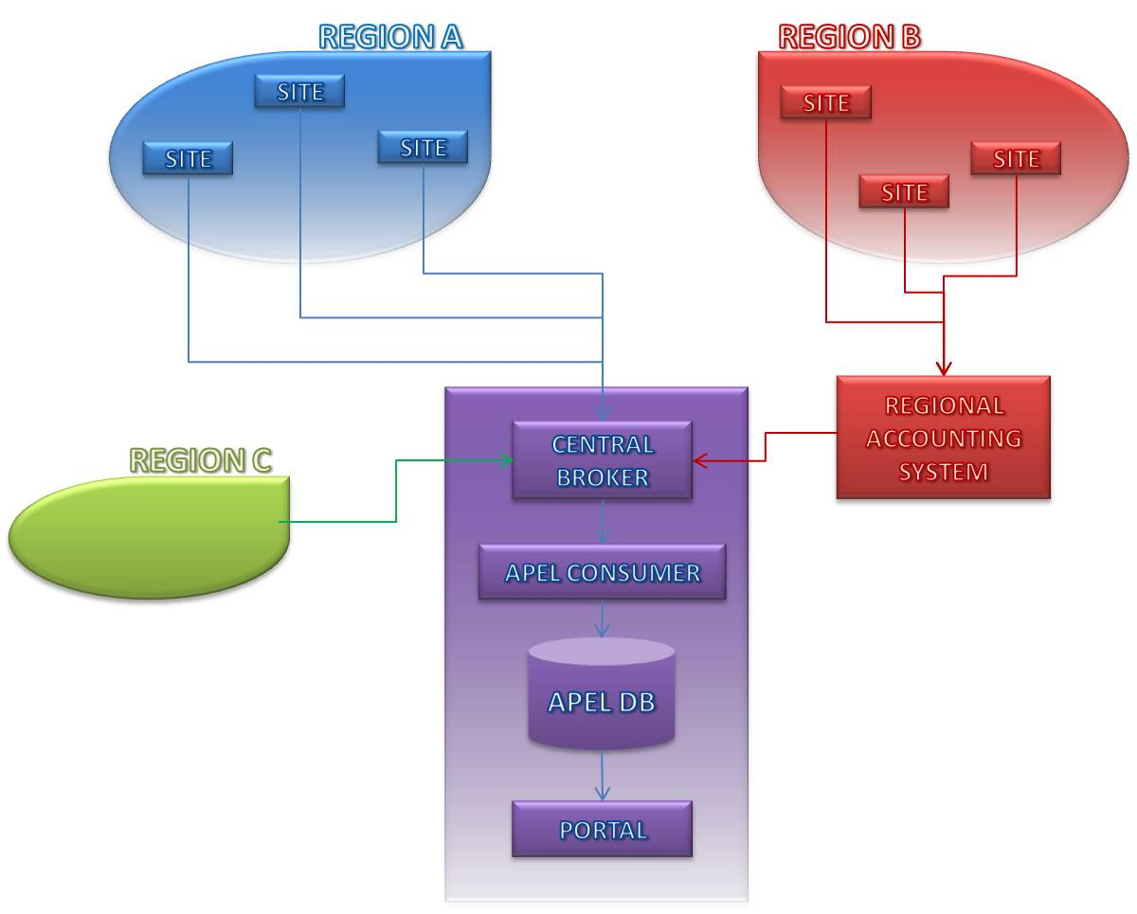
Regionalisation - Plan
All regions to publish via ActiveMQ
Provide regional accounting system
Allow regions to continue using central system
Collect records from other grids/tools via same interface

Slide 10
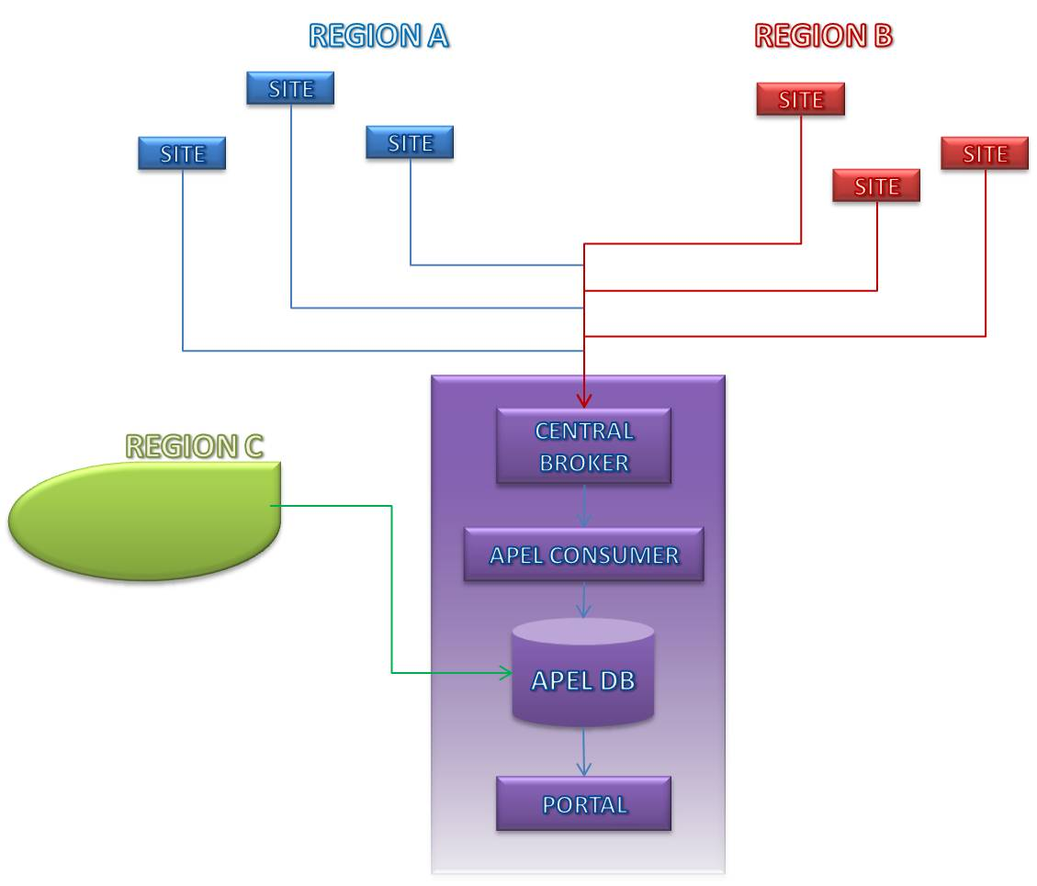
Regionalisation – Current Status
Currently no regional system ready
All sites using APEL publishing directly to central system
Other grids/subgrids using direct insertion into the APEL database
NDGF
OSG
INFN
IN2P3

Slide 11
Regionalisation – Next Step
First step moving other grids to use ActiveMQ client
Region C sites only publish summaries

Slide 12
Future Plans
Publisher
Implement summary publishing – regionalisation
Region C (other existing accounting systems)
Develop distributed repository
Parsers
Provide MPI support

Slide 13
Questions?
APEL-SUPPORT@JISCMAIL.AC.UK
http://goc.grid.sinica.edu.tw/gocwiki/ApelHome

