Slide 1
Cost Models for HPC and Supercomputing
Addison Snell, addison@Intersect360.com
Actionable Market Intelligence for High Performance Computing
January 2013

Slide 2
Intersect360 Research
HPC industry research reports: market sizing, forecasting, and technology trend analysis
Quarterly surveys of worldwide end users since 2007
Feature articles in partner publications
Custom research, consulting, special studies
Weekly podcast with HPCwire
“Analyst Crossfire” at HPC conferences
HPC500 user organization

Slide 3
Technical vs. Enterprise Computing
Technical Computing
Enterprise Computing
Top-line missions:
Find the oil
Design the minivan
Cure the disease
Driven by price/performance
Fast adoption of new technologies, algorithms, and approaches
Keeps business running
Communicate/collaborate
Market and sell the product
Accounting, HR, finance, …
Driven by RAS: reliability, availability, serviceability
Slow adoption of new technologies, algorithms, and approaches

Slide 4
Where We Find Technical Computing
High Performance Technical Computing (HPTC)
Applications in science and engineering
Top markets: academia, government labs, defense, manufacturing, bio/life science, oil/gas exploration
High Performance Business Computing (HPBC)
Applications include trading, pricing, risk management, logistics, fraud detection, online games, analytics, …
Top markets: financial services, ultrascale internet, online games, retail, entertainment

Slide 5
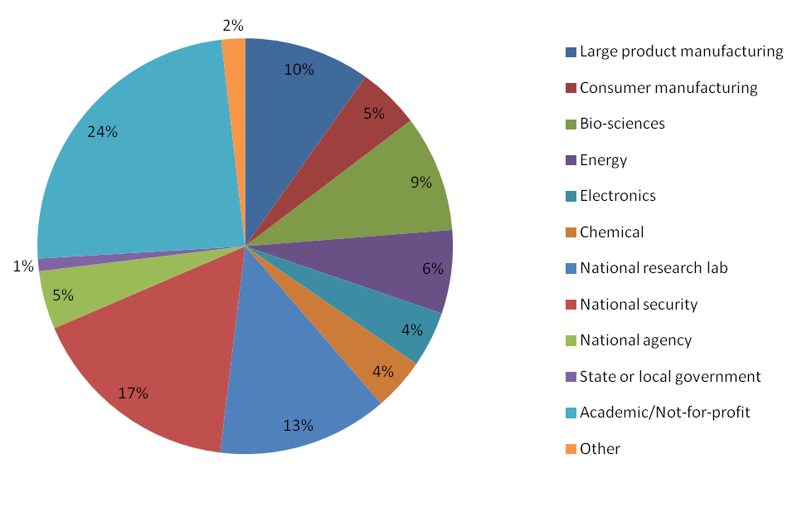
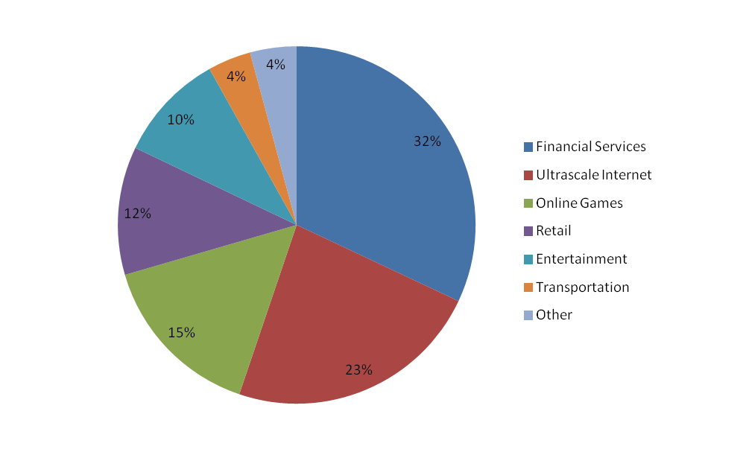
HPTC and HPBC Vertical Markets
HPTC Total Market (2011 rev., 68%) by Vertical
HPBC Total Market (2011 rev., 32%) by Vertical
24% Acad.
41% Comm.
35% Govt.
Financial services has overtaken manufacturing as largest commercial vertical
HPBC is >95% commercial (exceptions: Fannie Mae, Federal Reserve Bank, …)
Worldwide, private sector is growing faster than public sector

Slide 6
Growth in High Performance Computing
$27B worldwide in 2011, growing to $38B in 2016
Servers are the largest individual component, about $10B in 2012
Storage is fastest-growing component

Slide 7
HPC User Budget Map Survey
Users describe their HPC budgets
Size and projected growth of budget (in ranges)
Breakdown by category: hardware, software, staffing, facilities, services, cloud/utility, other
Breakdown within category – e.g., Software: operating systems, middleware, developer tools, storage software, application software, transfer costs, …
Respondents may or may not be in “acquisition years”; therefore budget distribution is a good model basis for total cost of ownership calculation

Slide 8
HPC User Budget Map Survey

Slide 9
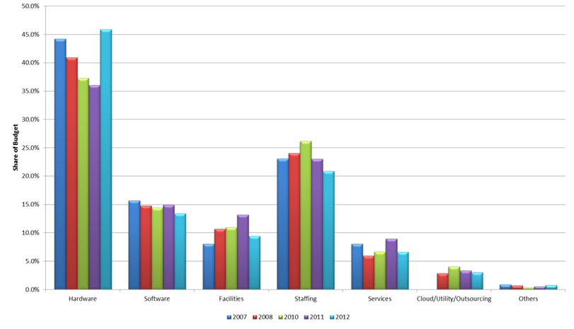
HPC Budget Distribution by Year
~$29B total market implies ~$44B total budget
Hardware declined every year until sudden rebound in 2012
Facilities increased every year until reversing in 2012
Public cloud is a small part of the market

Slide 10
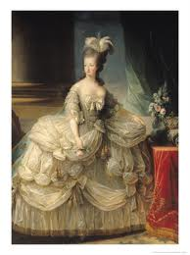
A Digression on HPC and Public Clouds
Cost Models
Barriers

Slide 11
Hardware Increases in All Sectors
Hardware increases across all segments indicate a market change, not likely to be sampling error
Public sector markets spend a higher proportion of budgets on hardware than commercial markets
Academic markets spend much less on software than commercial markets in general; commercial markets vary significantly depending on their usage of licensed software

Slide 12
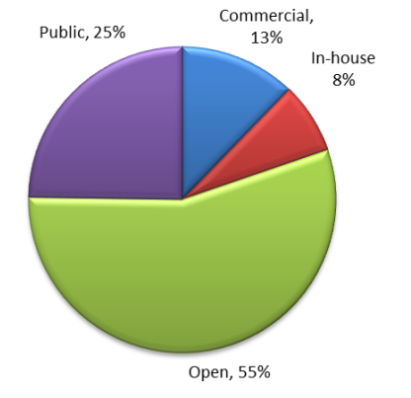
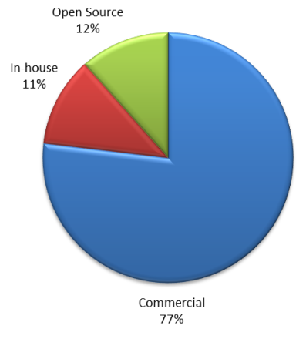
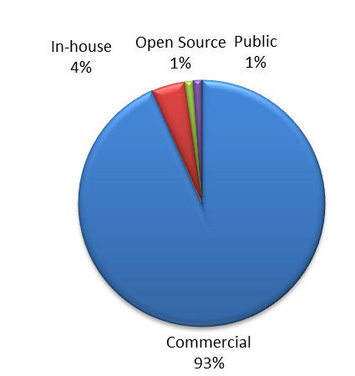
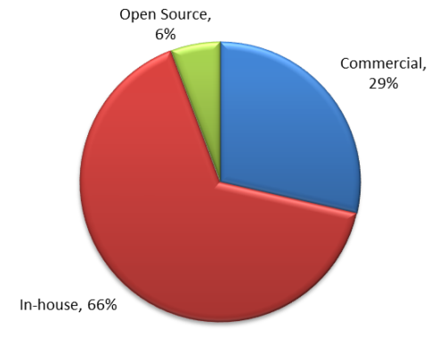
Different Software Approaches
Bio
CFD
Structures
(CAE)
Oil

Slide 13
Hardware Distribution
Half of hardware spending goes to the compute system
Half of the rest (one-fourth) is storage (on average)
Remainder split between networks, clients

Slide 14
Facilities Distribution
Building / floor space is often a “step function.” It doesn’t cost much (or anything) as long as I have it. Once I have to knock down a wall, or designate new lab space, or build a new building, it can cost a lot.

Slide 15
Supercomputing Budgets
Supercomputing sites spend less on hardware, software, cloud
Supercomputing sites spend more on facilities, staffing
These spending trends make intuitive sense. We can use the >$10M budget data as a proxy for petascale spending distributions.

Slide 16
Planning to Buy a 100M€ Computer?
Be prepared to also spend (over multiple years):
50M€ on storage
50M€ on other hardware
57M€ on software
46M€ on power consumption
26M€ on cooling
20M€ on a building
137M€ on people
47M€ on other stuff (services, other utilities, etc.)
Total cost of ownership: 533M€
All costs vary by site and by installation. These are averages for modeling TCO of a supercomputer. Your mileage may vary.

Slide 17
Future-Looking Trends (tomorrow a.m.)
Multi-core, and its implications for:
Memory usage
Power consumption
System utilization
Accelerators (e.g. GPU computing)
Programming models
System efficiency
Big Data
Adoption of HPC

Slide 18
Actionable Market Intelligence for High Productivity Computing

